Slide 1
Overview of the PS impedance model and its improvements
Acknowledgments: D. Amorim, N. Biancacci, A. Huschauer, B. Kosta Popovic, E. Koukovini Platia, E. Métral, M. Migliorati, N. Mounet, S. Persichelli, B. Salvant, G. Skripka, D. Ventura, C. Vollinger, C. Zannini
Sebastien Joly
23/03/2020

Slide 2
Table of contents
Context
Status of the impedance model
Ways of improving the study of long range wakefields instabilities
  Resonator fit of kickers
  N. Mounet fast Fourier transform
Wall impedance of elliptical beam pipe
Next steps

Slide 3
Context
In the context of the LIU project, it’s wanted to double the beam intensity and increase injection energy of the PS.
“Raise the injection energy in the PS to 2 GeV to allow for higher beam brightness at the same space charge tune spread.” ^{[1]}
Change of PS layout after LS2
Need to update PS impedance model and study possible beam instabilities
^{[1]} Shaposhnikova, Elena, et al. LHC Injectors Upgrade (LIU) Project at CERN. No. CERN-ACC-2016-288. 2016.

Slide 4
Impedance model
Optics from Madx input
CST impedance
β_{x,y}^{element} / β_{x,y}^{total} weight applied
Tsutsui impedance
Weighted total impedance
Sum of all the weighted elements
Resistive wall impedance

Slide 5
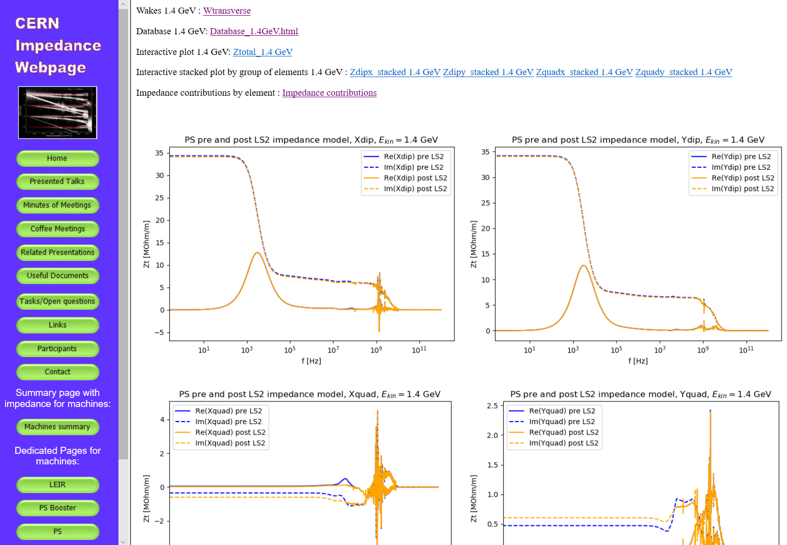
Status of the impedance model
Impedance website
Impedances, wakes, elements and interactive plots can be found on the CERN Impedance webpage
16/03/20

Slide 6
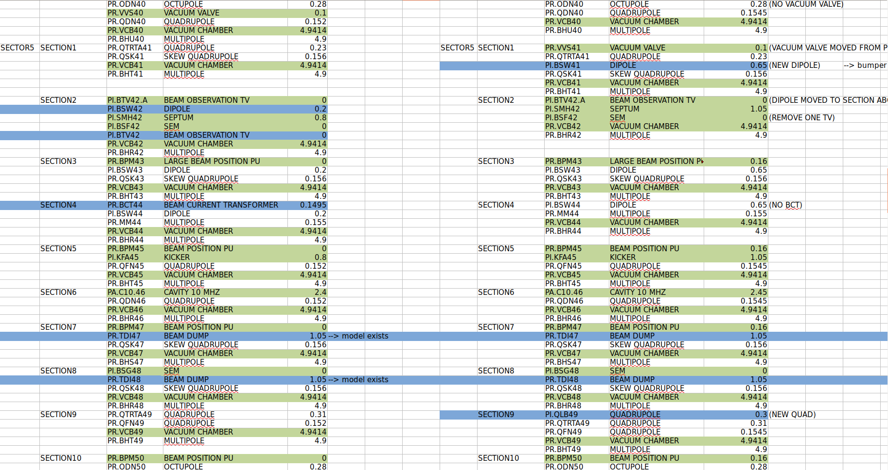
Comparisons pre and post LS2
PS Layouts for both pre and post LS2 including elements modifications
Source : Impedance website
Link impedance website

Slide 7
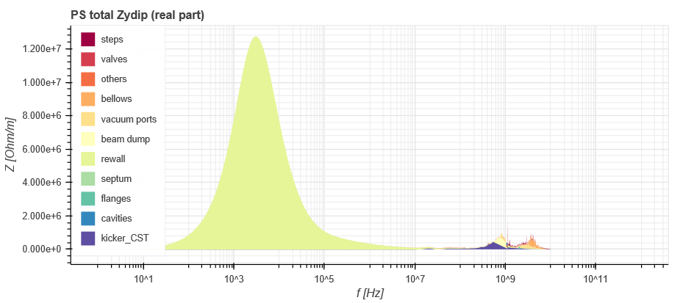
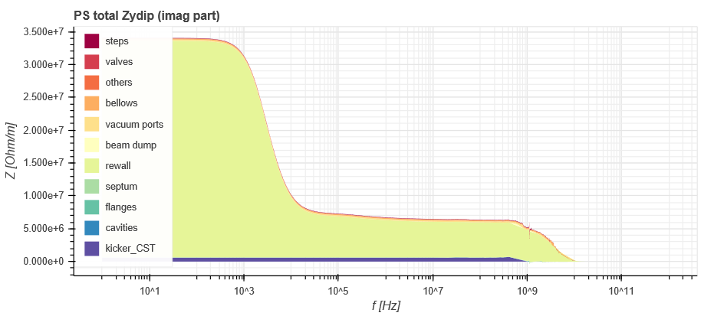
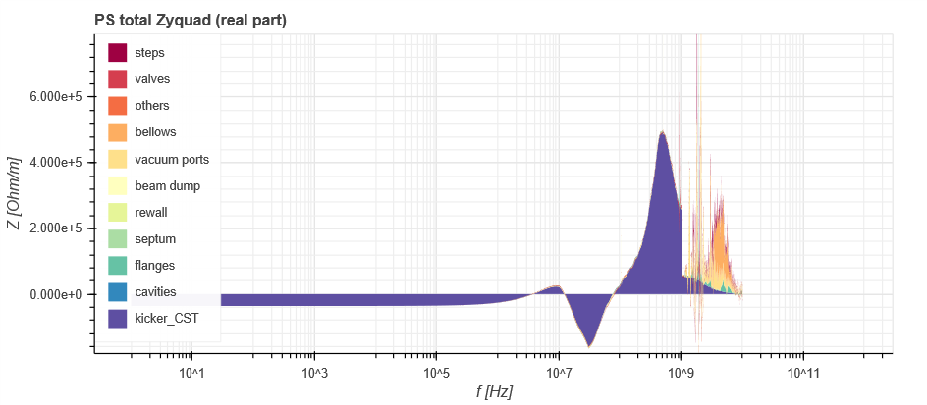
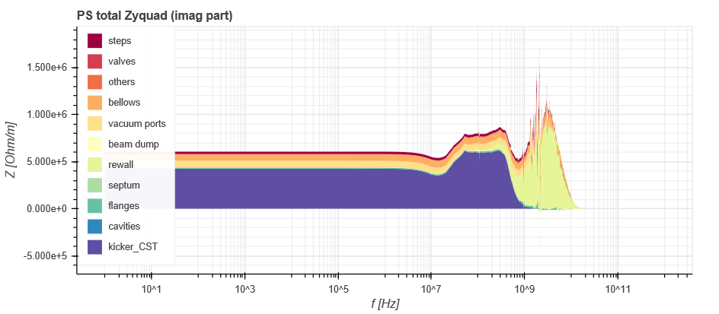
Impedances contributions by element
Main impedance contributions : resistive wall, kickers, vacuum ports, bellows

Slide 8
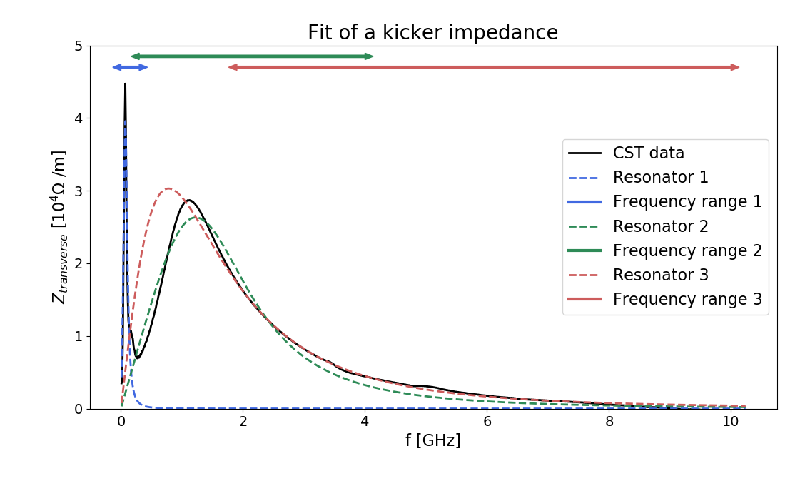
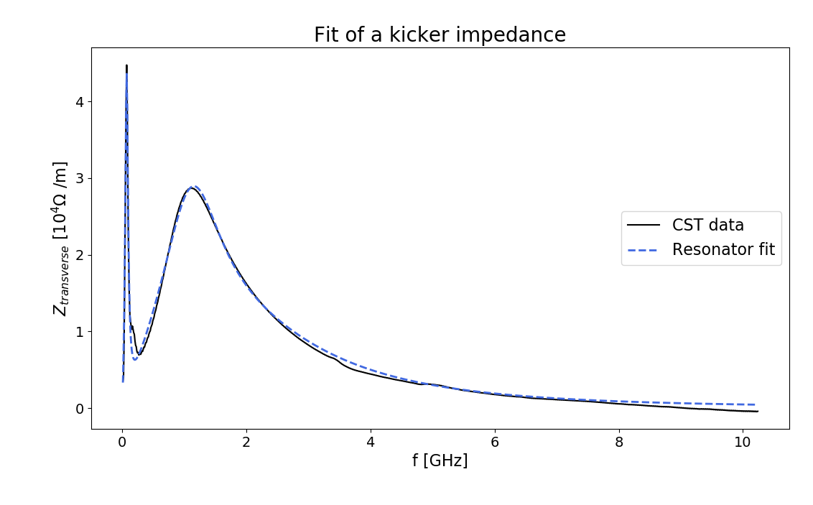
Resonator fit of kickers
Maximum number of resonators used : 3
Bounds on resonators parameters (Q >0, fres < 10 GHz, |Rt| < 70 MΩ/m)
Fit in two steps
Fit independently real and imaginary part of impedance then keep the fit with the smaller residual sum of squares
Reconstruct wake potential using broadband resonator formula to compare it with CST wake file
16/03/20

Slide 9
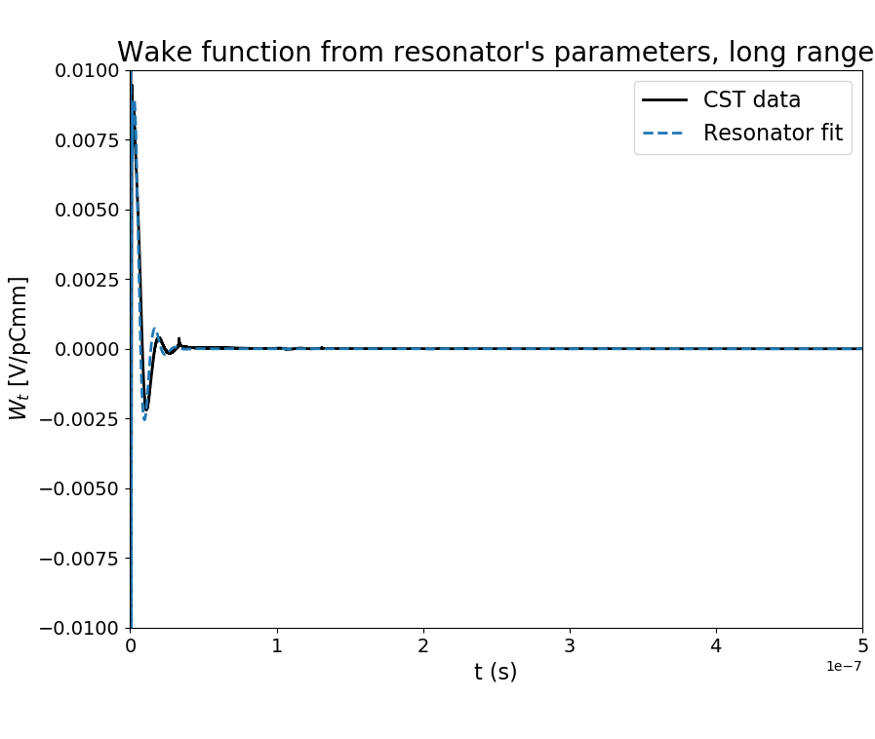
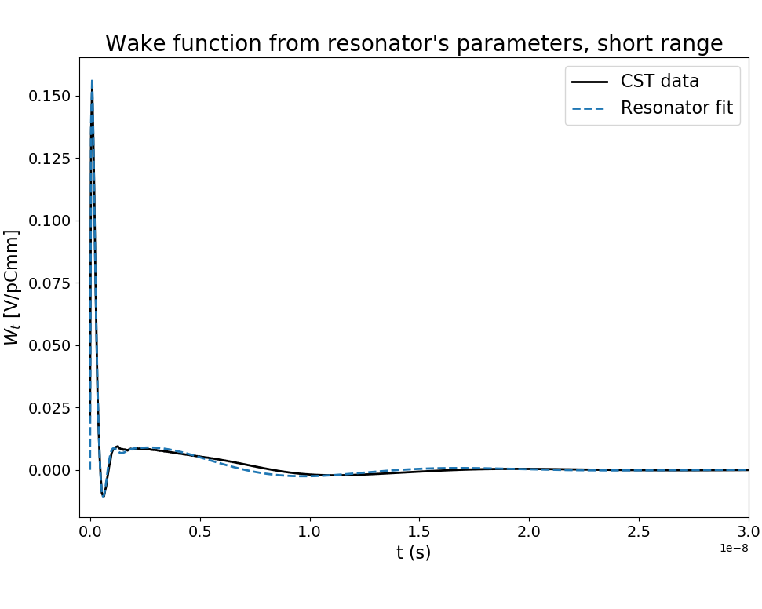
Resonator fit of kickers
16/03/20

Slide 10
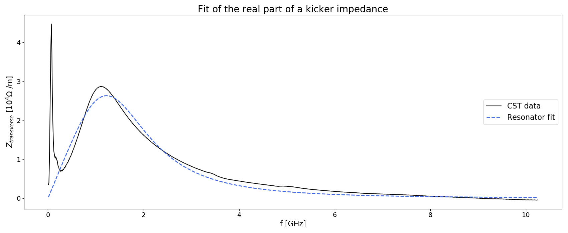
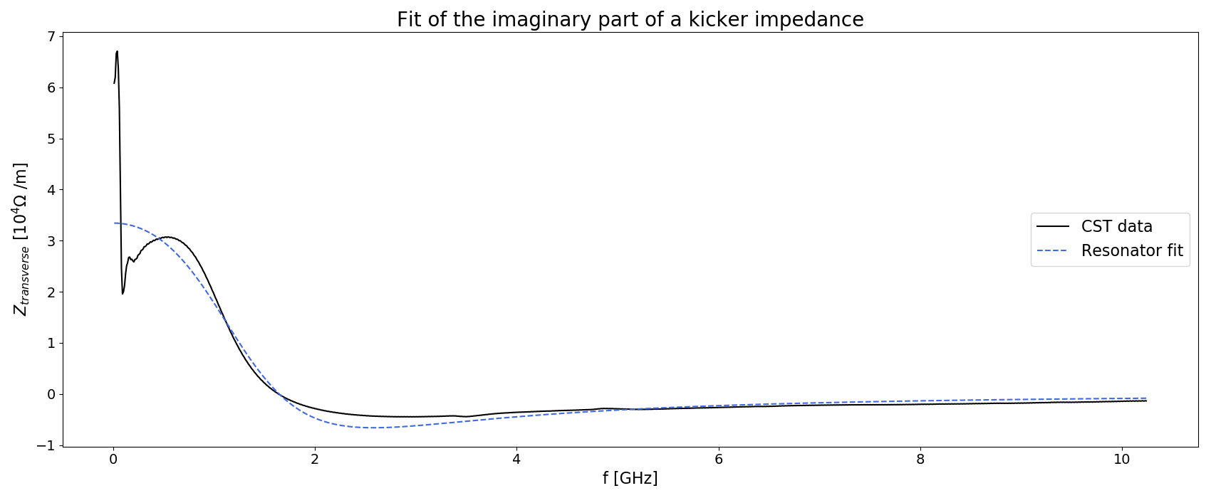
Resonator fit of kickers
1 resonator

Slide 11
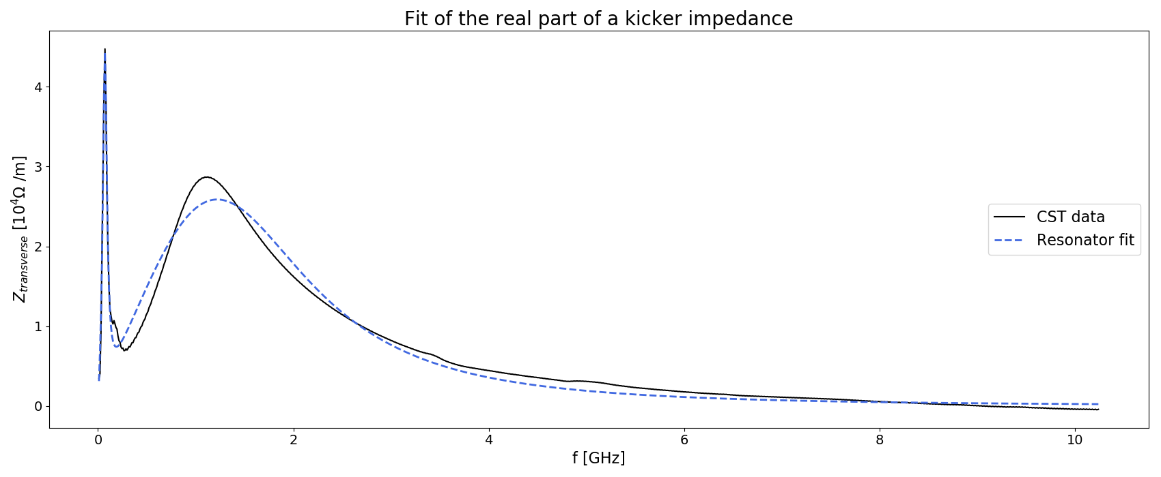
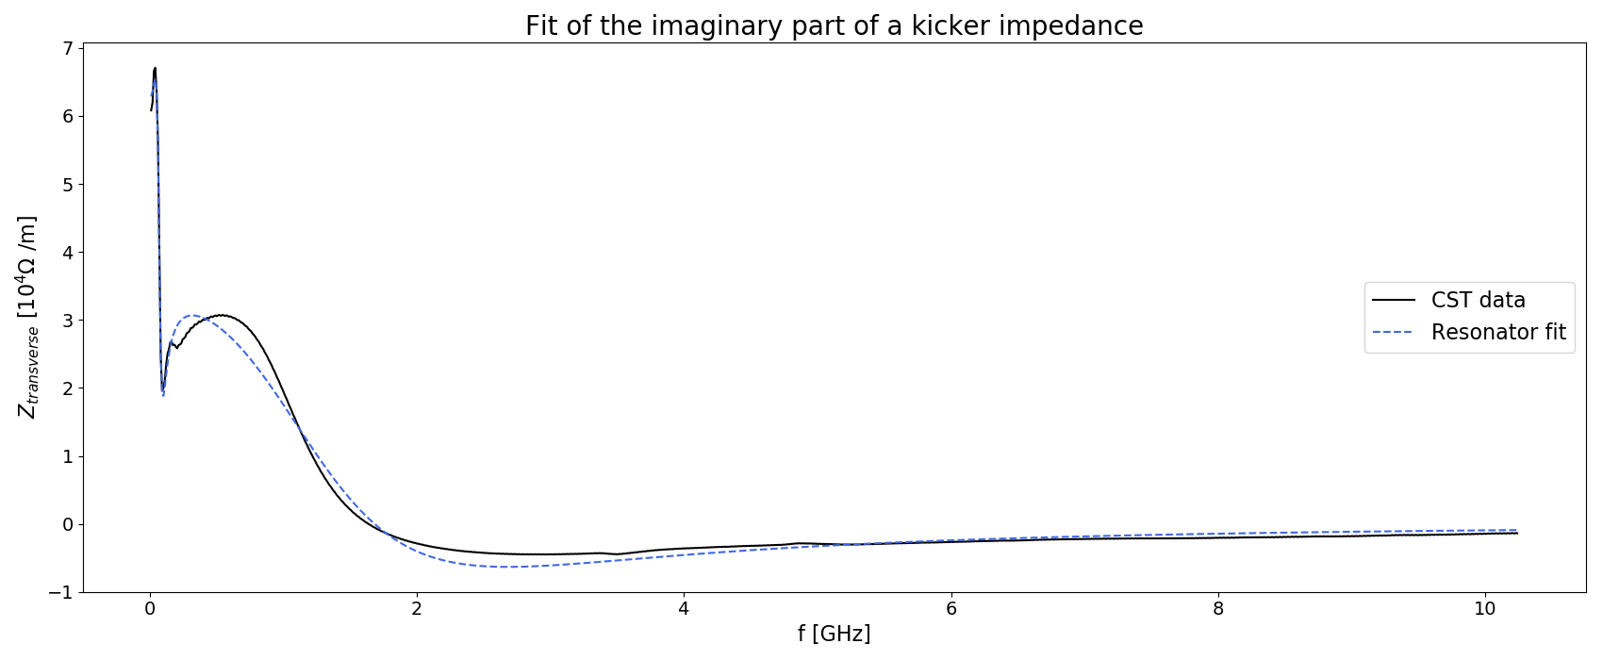
Resonator fit of kickers
2 resonators

Slide 12
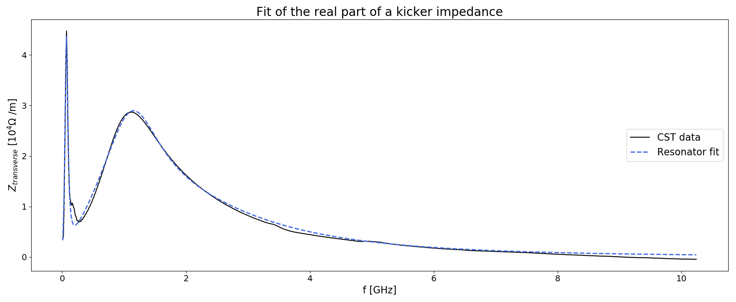
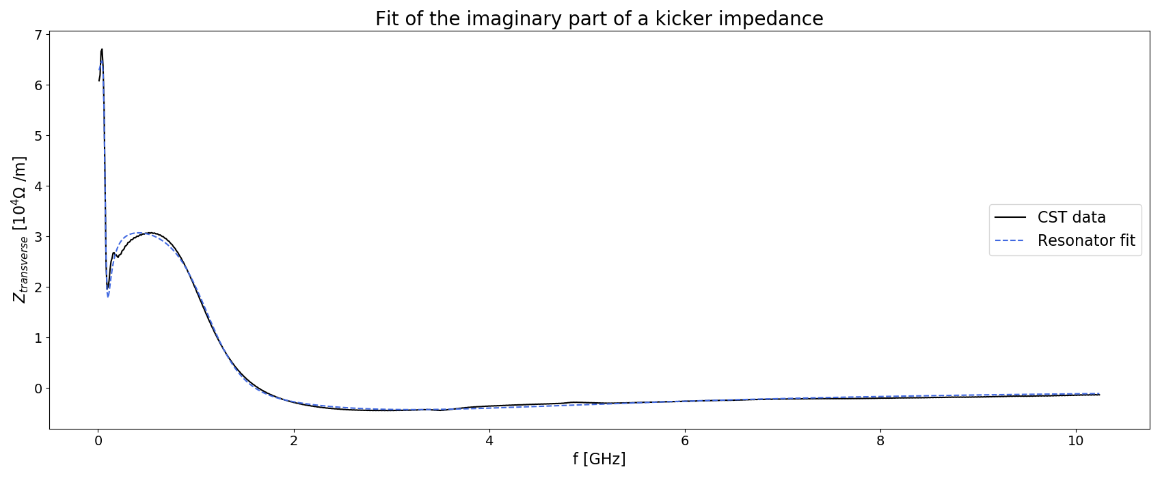
Resonator fit of kickers
3 resonators

Slide 13
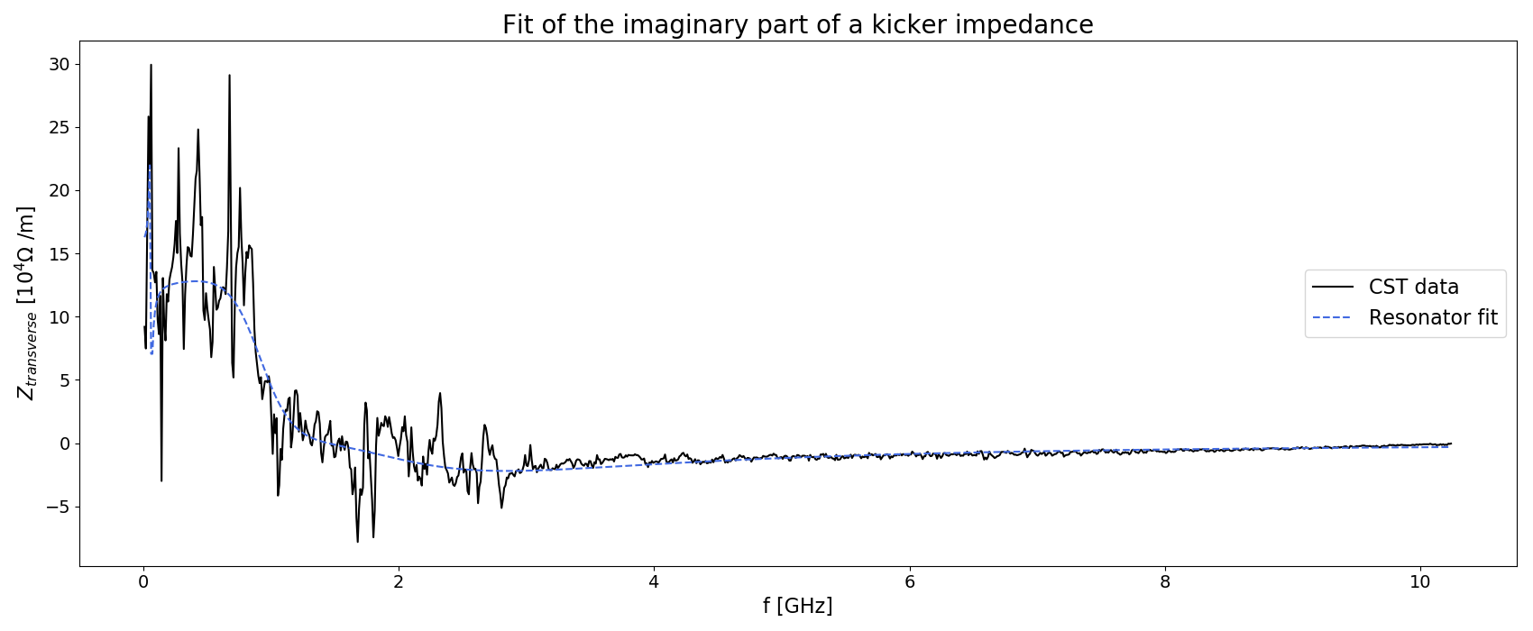
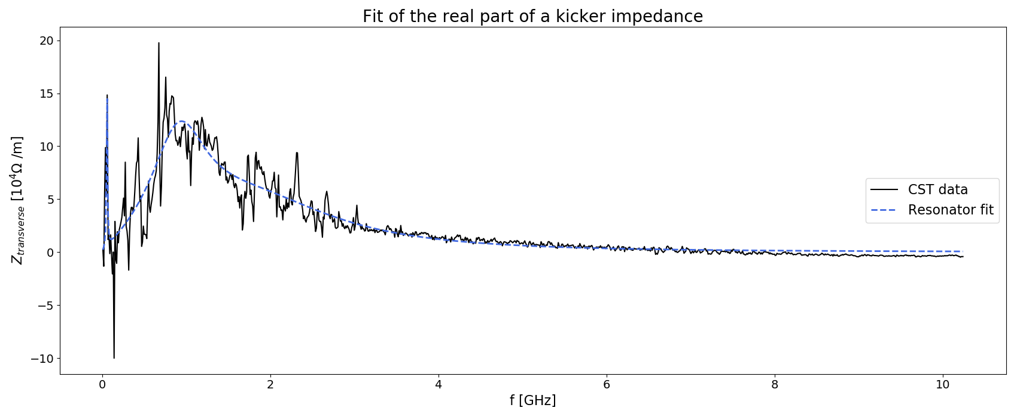
Resonator fit of kickers
Resonator fitting allows to greatly reduce noise at the expense of accuracy

Slide 14
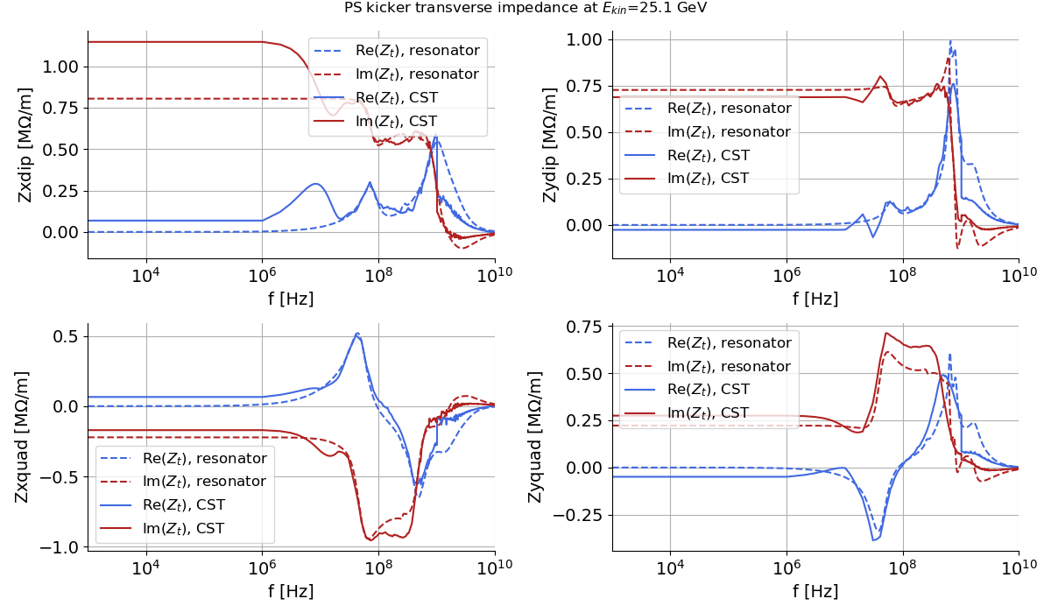
Resonator fit of kickers
Able to capture the main modes of the CST data and obtain a smoother impedance plot using a simple formalism
Still some fits to correct for a few kickers
16/03/20

Slide 15
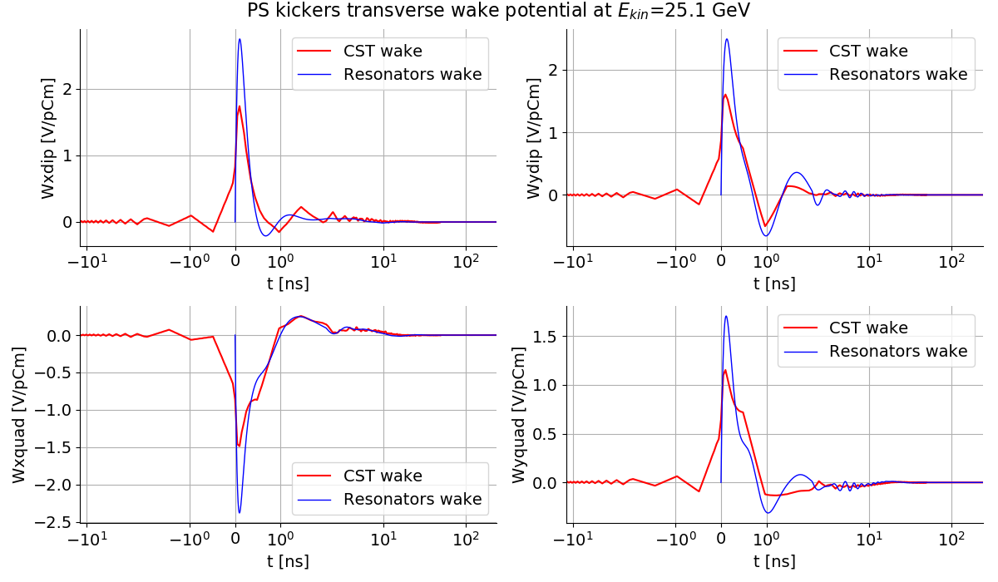
Resonator fit of kickers
Peak near t = 0 ns has a higher amplitude
CST data has very few points

Slide 16
N. Mounet fast Fourier transform
FFT with nonlinear sampling and polynomial interpolation^{[1]}
Allow FFT over several decades without needing unreasonably high number of points
Better accuracy compared to standard FFT
In our case, more accurate wake functions from inverse FFT of the impedance
^{[1]} N. Mounet PhD thesis
16/03/20

Slide 17
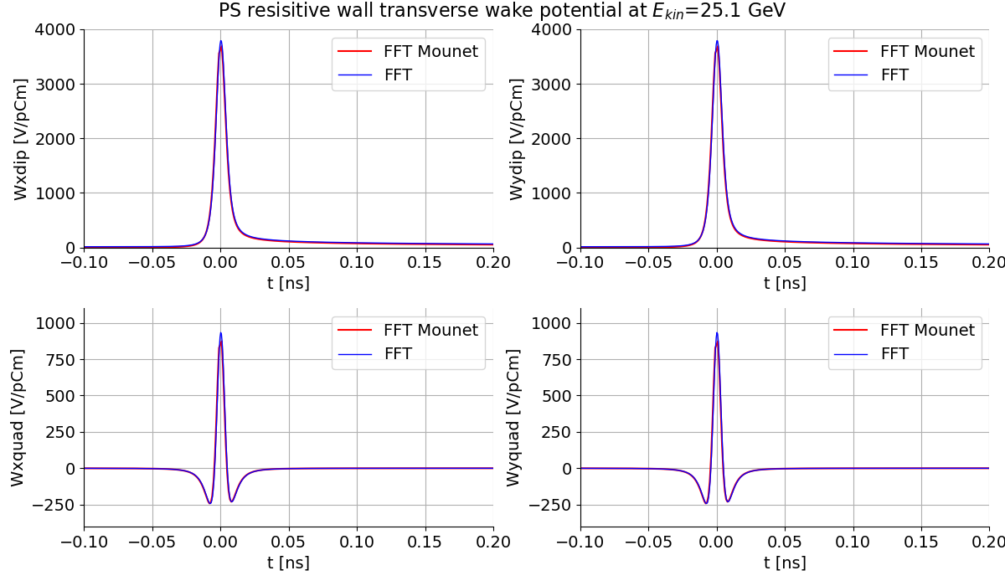
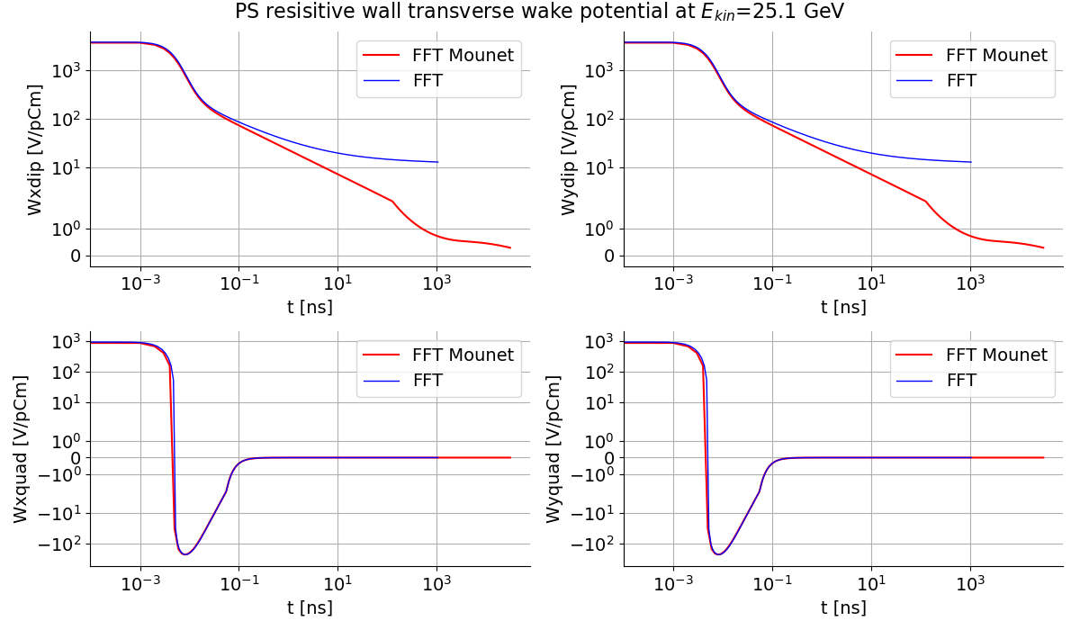
N. Mounet fast Fourier transform
16/03/20

Slide 18
Impedance of an elliptic beam pipe
Use of M. Migliorati et al. code ^{[1]} : https://gitlab.cern.ch/IRIS/ellipticchamber
Able to compute impedance for any beam pipe ellipticity using Mathieu's functions formalism and surface impedance thanks to TLwall
Goal is to benchmark Mauro's code with IW2D
^{[1]} Resistive wall impedance in elliptical multilayer vacuum chambers, M. Migliorati, L. Palumbo, C. Zannini, N. Biancacci, and V. G. Vaccaro
Phys. Rev. Accel. Beams 22, 121001 – Published 12 December 2019
16/03/20

Slide 19
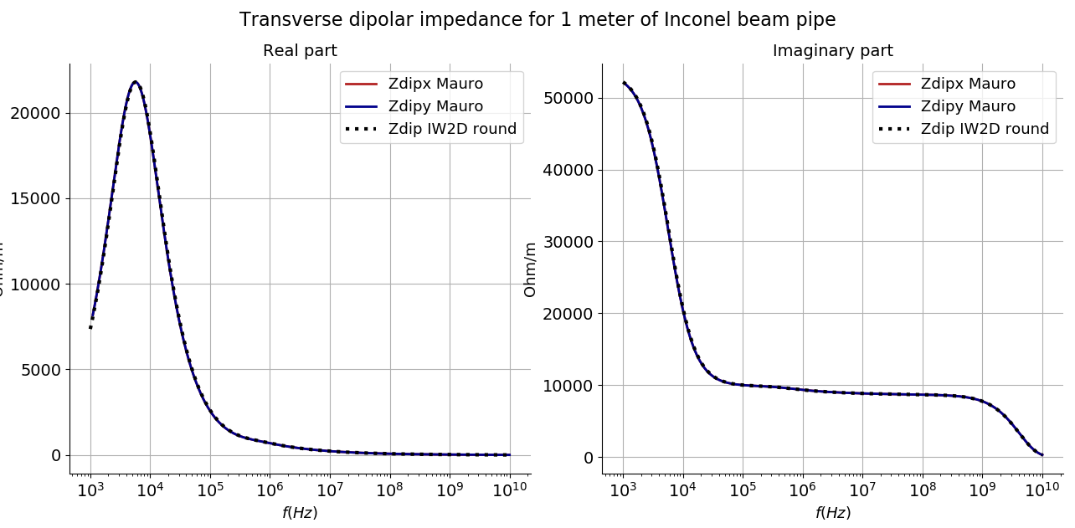
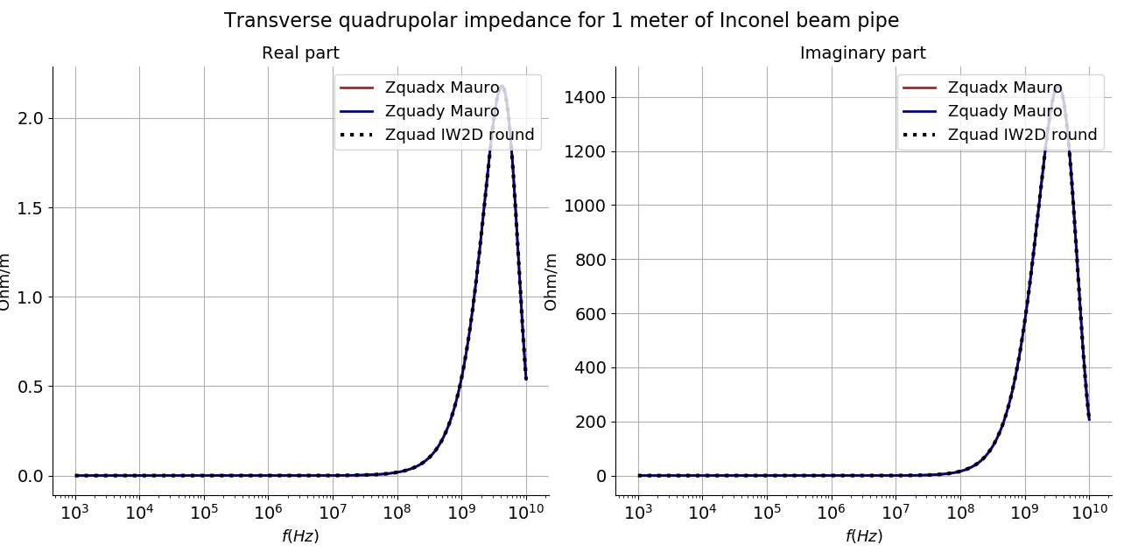

Round beam pipe
Round case ($qr = \frac{a−b}{a+b}={10}^{−12}$)
γ = 2.49
n_{terms} = 10
n_{matrix} = 15
e = 1.5 mm
b = 70 mm
a = 70 mm
16/03/20

Slide 20
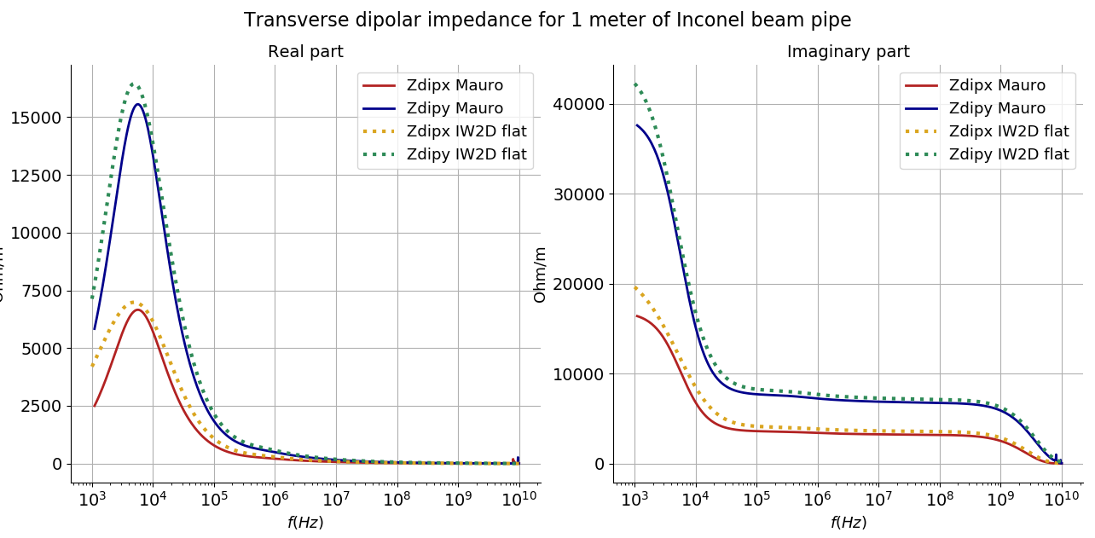
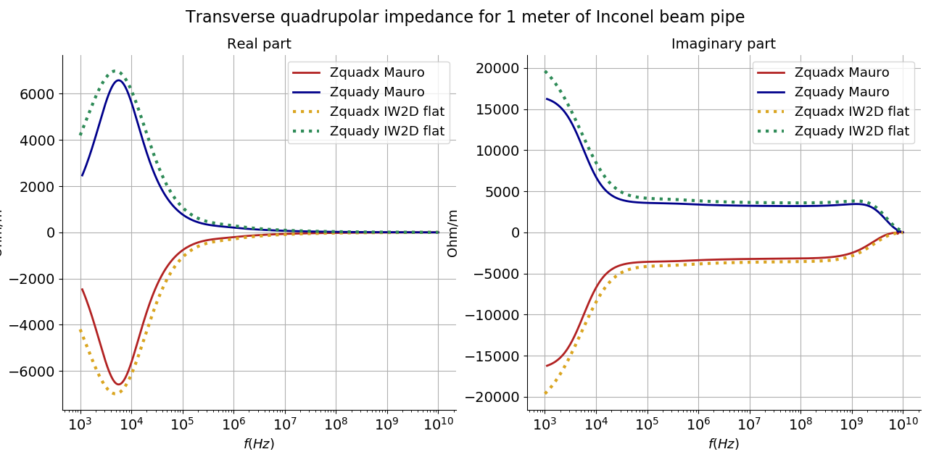

Flat beam pipe
Flat case ($qr = \frac{a−b}{a+b}=0.95$)
γ = 2.49
n_{terms} = 46
n_{matrix} = 58
e = 1.5 mm
b = 70 mm
a = 1.36 m
16/03/20

Slide 21
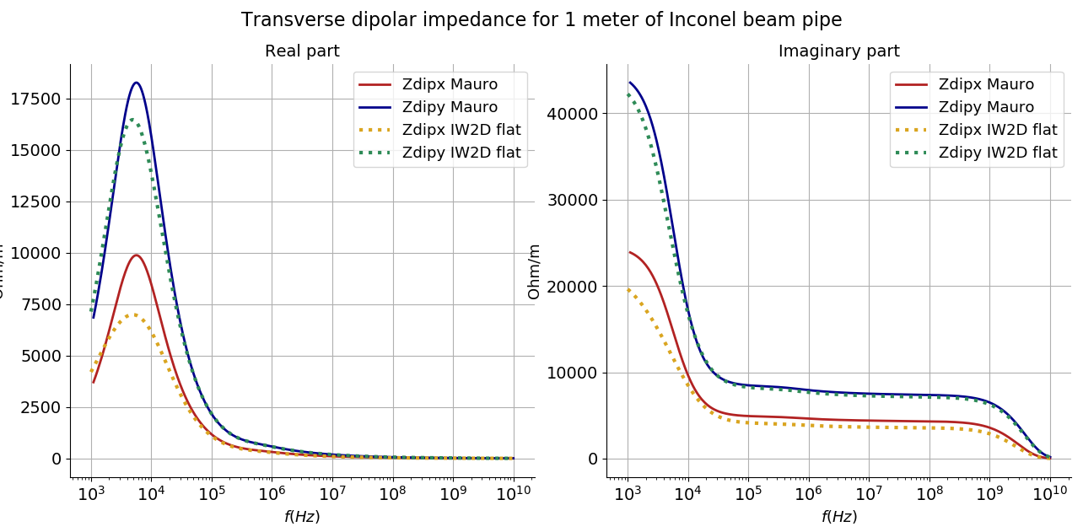
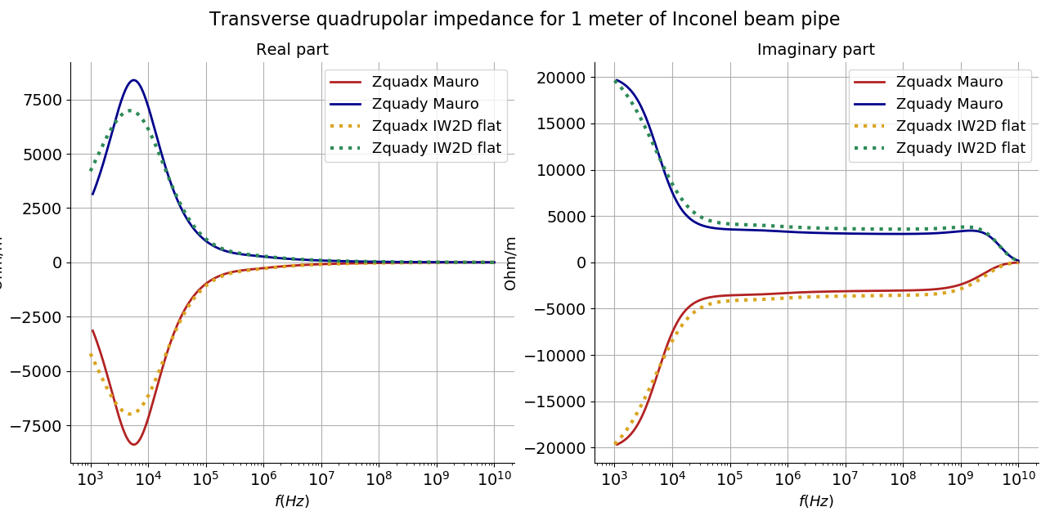

Elliptical beam pipe
Elliptic case ($qr = \frac{a−b}{a+b}=0.35$)
γ = 2.49
n_{terms} = 45
n_{matrix} = 60
e = 1.5 mm
b = 70 mm
a = 146 mm
16/03/20

Slide 22
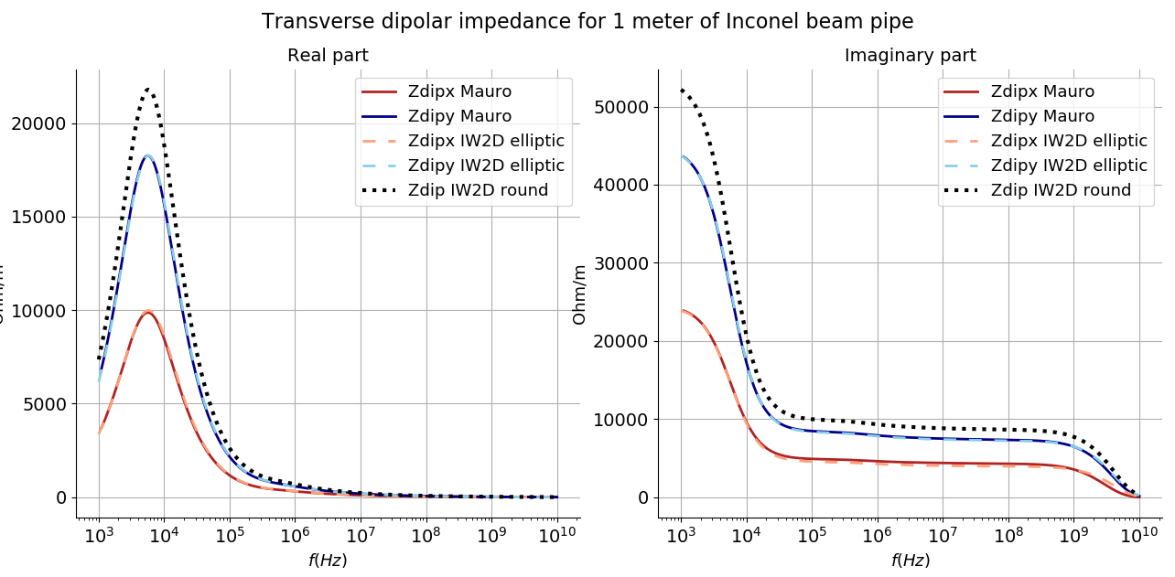
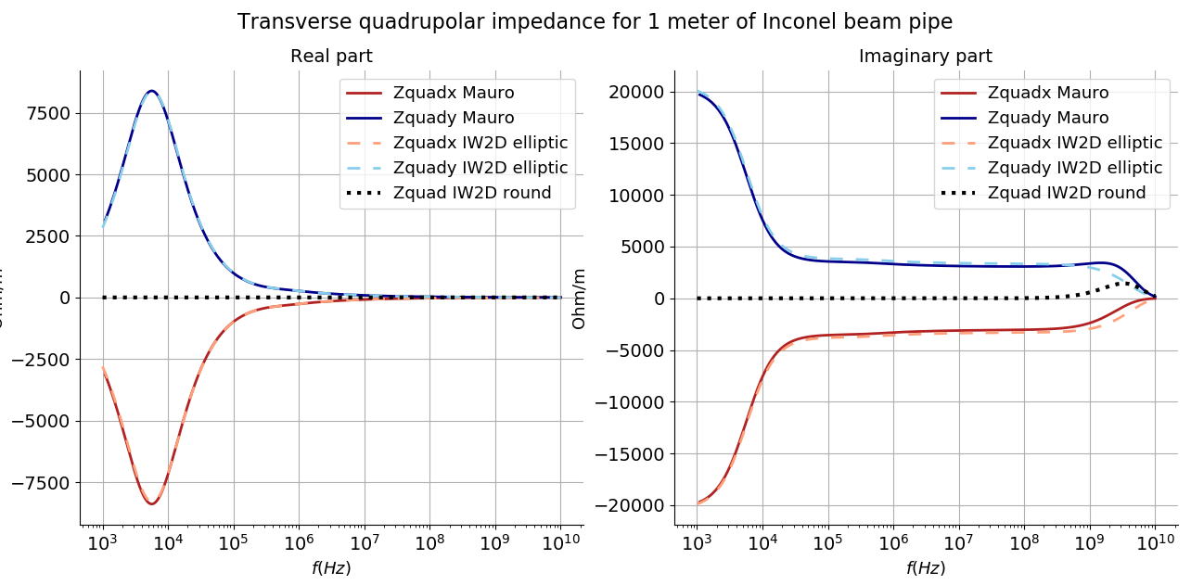
Elliptical beam pipe
Elliptic case ($qr = \frac{a−b}{a+b}=0.35$)
γ = 2.49
n_{terms} = 45
n_{matrix} = 60
e = 1.5 mm
b = 70 mm
a = 146 mm
16/03/20

Slide 23
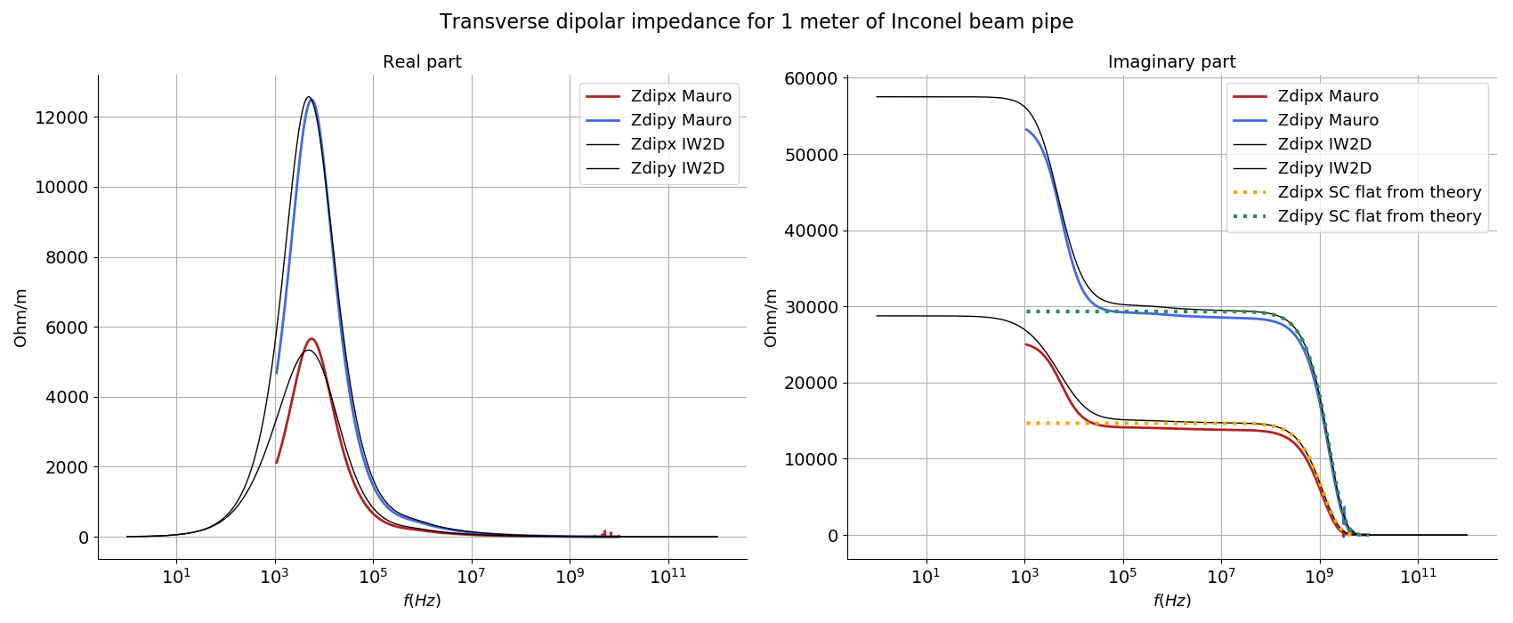
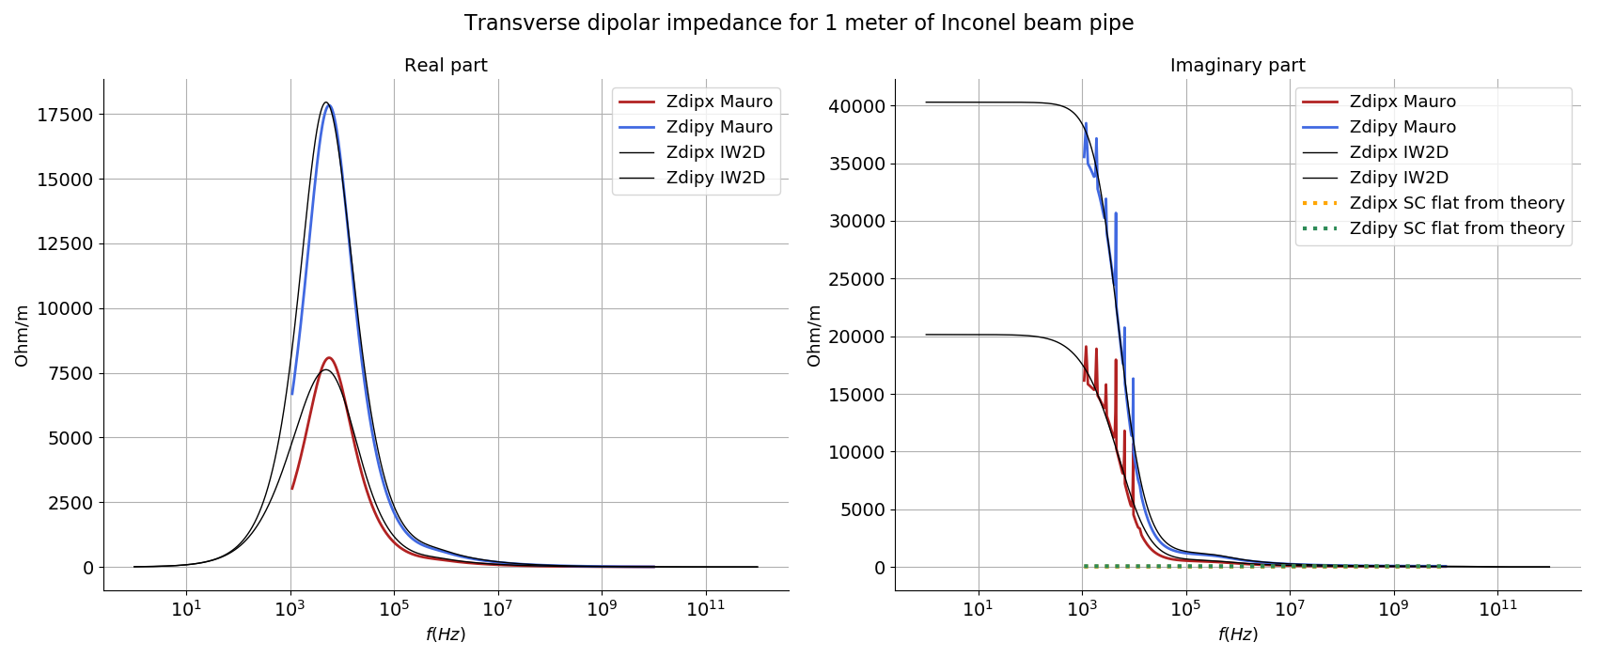
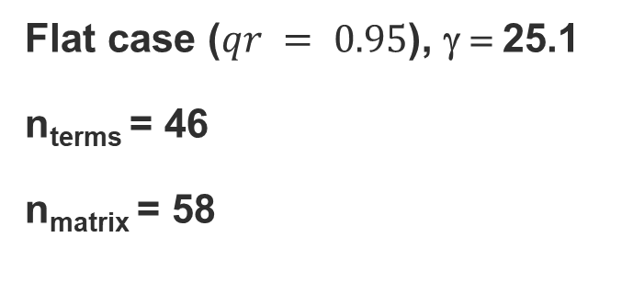
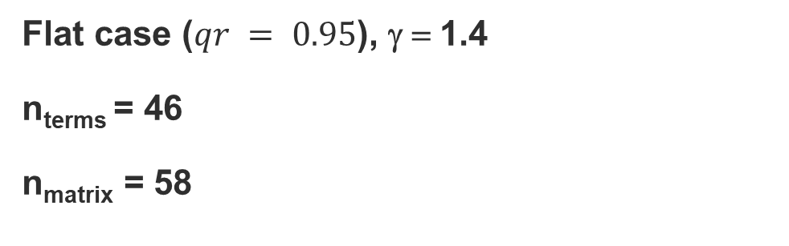
Limitations
Formalism is sensitive to n_{terms} and n_{matrix}, especially when approaching flat case
Need to adjust n_{terms} and n_{matrix} when energy changes for flat case
Flat case ($qr = 0.95$), γ = 1.4
n_{terms} = 46
n_{matrix} = 58
Flat case ($qr = 0.95$), γ = 25.1
n_{terms} = 46
n_{matrix} = 58
16/03/20

Slide 24
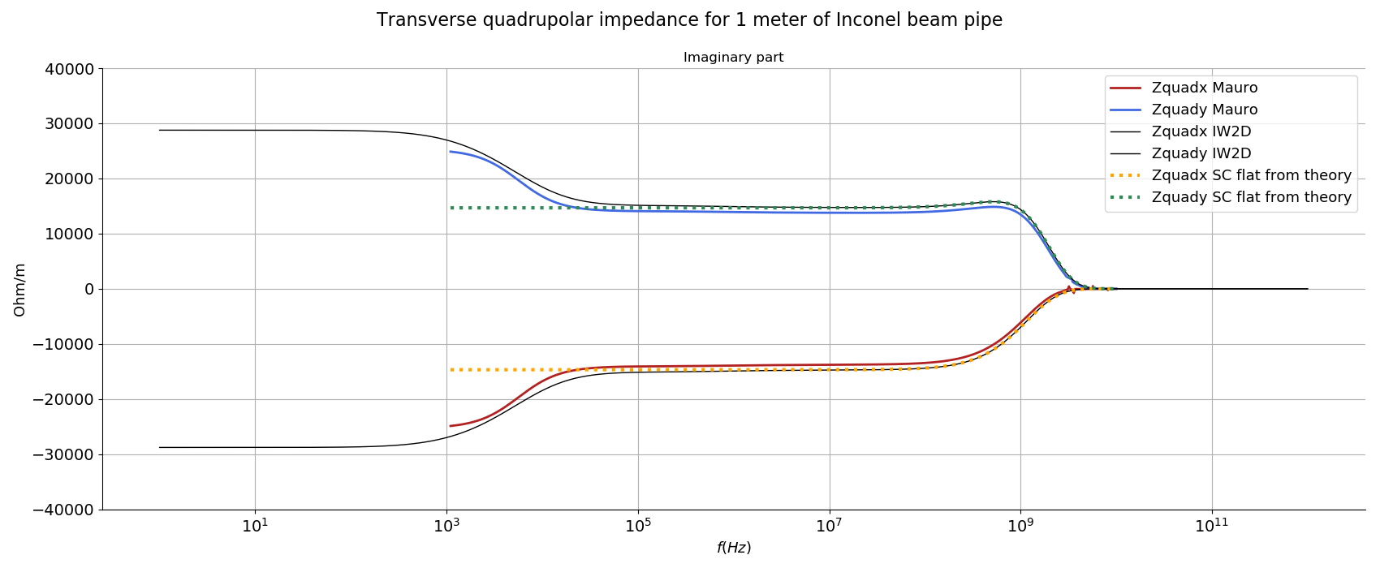
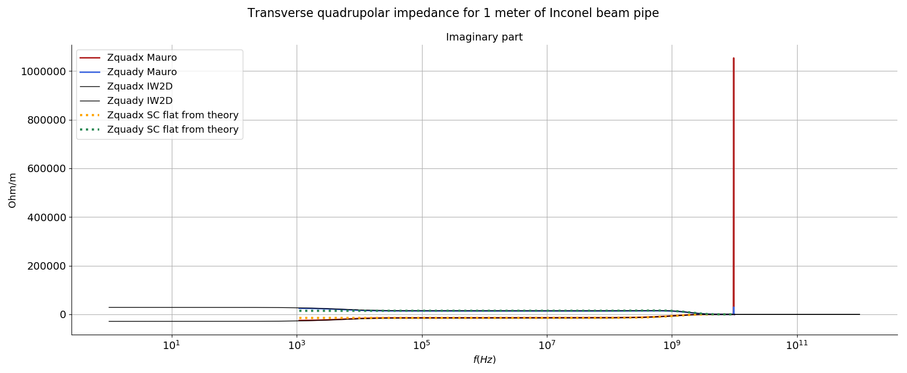
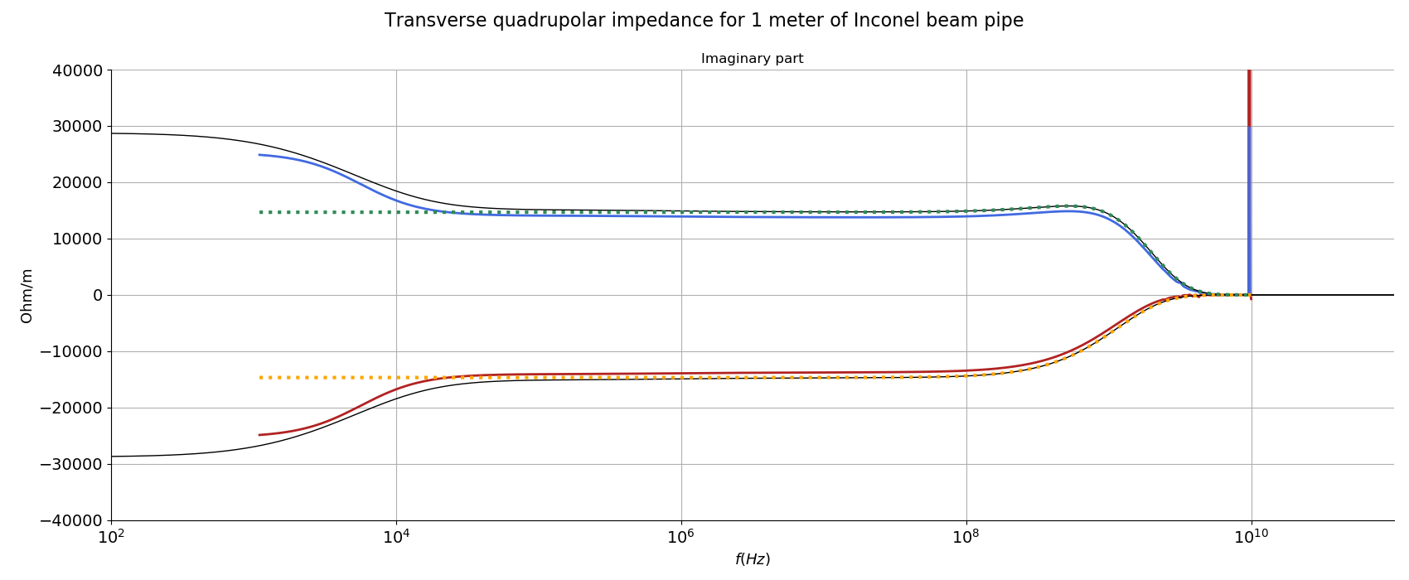
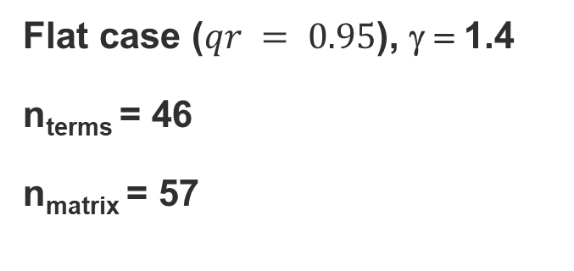
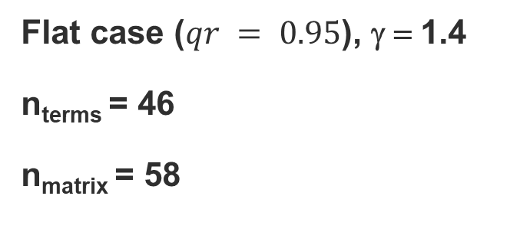
Limitations
Formalism is sensitive to n_{terms} and n_{matrix}, especially when approaching flat case
A small change in n_{matrix} can lead to non physical behaviours
Mauro is aware of these limitations, goal is to show their influence on results
Flat case ($qr = 0.95$), γ = 1.4
n_{terms} = 46
n_{matrix} = 58
Flat case ($qr = 0.95$), γ = 1.4
n_{terms} = 46
n_{matrix} = 57
16/03/20

Slide 25
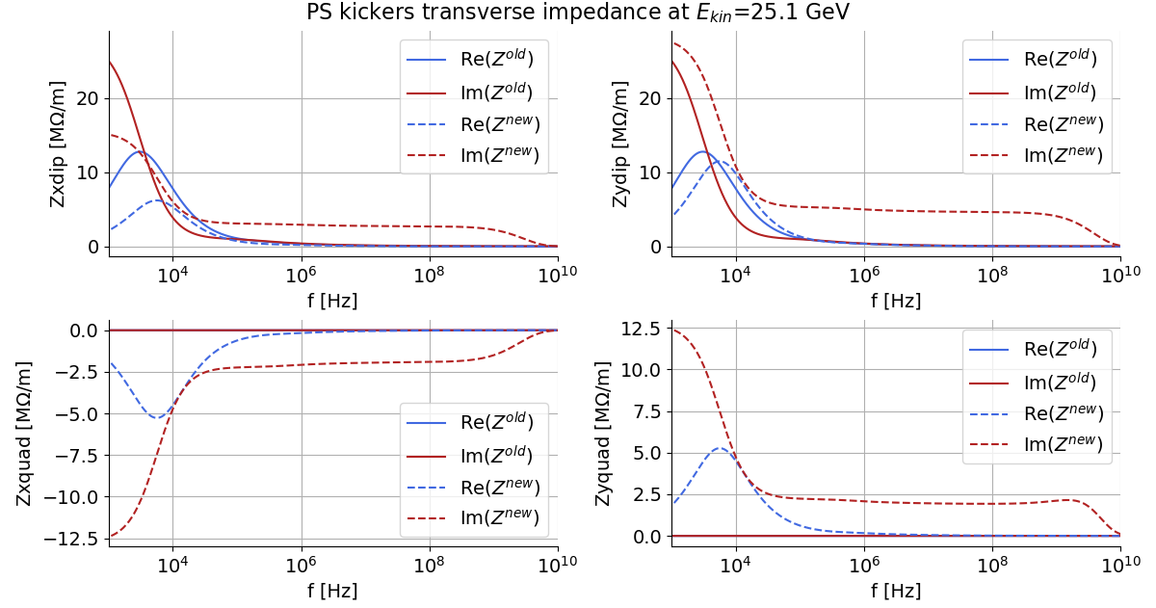
Application to the PS wall impedance
Old beam pipe geometry
PS transverse wall impedance at E_{kin} = 25.1 GeV
e = 1.5 mm
b = 70 mm
a = 70 mm
New beam pipe geometry
e = 1.5 mm
b = 70 mm
a = 146 mm

Slide 26
Next steps
Add new elements to both pre and post LS2 PS impedance models
Implementation of Tlwall to Mauro’s code with Carlo
Add effect of magnets surrounding the beam pipe to the wall impedance with Mauro’s code
Redo several elements CST simulations with longer wakes, smaller bunch length and different beta for injection energy
DELPHI and PyHeadtail simulations to assess beam stability
16/03/20

Slide 27

I NEED YOUR SUGGESTIONS
16/03/20

Slide 29
