Slide 1
CERN-IT Update
Ian Bird
On behalf of IT
Multi-core and Virtualisation Workshop,
21-22 June 2010

Slide 2
Multi-Core Update

Slide 3
Multi-core jobs at CERN
Multi-core jobs can be run on the CERN batch service:
  Dedicated queue “sftcms”
  dedicated resources
    2 nodes with 8 cores, one job slot each
  access restricted to pre-defined users
    Currently 12 registered users defined to use the queue
  Service is in production since February 2010
Usage statistics:
  Total number of jobs run ever in this queue: 92
    Last access: 19 May 2010
  Number of active users ever: 3, ~80% by one user:
    Gaudi Framework for LHCb simulation and reconstruction jobs. Ability to submit one job rather than several (as needed in the past). All parallelism happens within the 8 cores of a single worker node.

Slide 4
Multi-core jobs Grid-wide
EGEE-III MPI WG recommendations
  Current draft at http://grid.ie/mpi/wiki/WorkingGroup
  Final version to appear soon
Next steps
  Validate new attributes in the CREAM-CE:
    Using a temporary JDL attribute (CERequirements)
      E.g. CERequirements = “WholeNodes = \”True\””;
    Using direct job submission to CREAM
    Validation starting with some user communities
  Modify CREAM and BLAH so that the new attributes can be used as first-level JDL attributes:
    E.g. WholeNodes = True;
    Coming with CREAM 1.7, Q3 2010
  Support for the new attributes in WMS
    Coming with WMS 3.3, Q3 2010

Slide 5
Virtualisation: Directions in CERN-IT

Slide 6
Virtualisation Activities
In many areas – not all directly relevant for LHC computing
3 main areas:
  Service consolidation
    “VOBoxes”, VMs on demand, LCG certification testbed
  “LX” services
    Worker nodes, pilots, etc (issue of “bare” WN tba)
  Cloud interfaces
Rationale:
  Better use of resources – optimise cost, power, efficiency
  Reduce dependencies esp between OS and applications (e.g. SL4 → SL5 migration), and between grid software
  Long term sustainability/maintainability → can we move to something which is more “industry-standard” ?
don’t forget WLCG issues of how to expand to other sites
  which may have many other constraints (e.g. may require virtualised WN)
  Must address trust issue from the outset

Slide 7
Service consolidation
VO Boxes (in the general sense of all user-managed services)
  IT runs the OS and hypervisor; user runs the service and application
  Clarifies distinction in responsibilities
  Simplifies management for VOC – no need to understand system configuration tools
  Allows to optimise between heavily used and lightly used services
  (eventually) transparent migration between hardware: improve service availability
VMs “on demand” (like requesting a web server today)
  Request through a web interface
  General service for relatively long-lived needs
  The user can request a VM from among a set of standard images
  E.g.:
    ETICS multi-platform build and automated testing
    LCG certification test bed. Today uses a different technology, but will migrate once live checkpointing of images is provided.

Slide 8
CVI: CERN Virtualisation Infrastructure
Based on Microsoft’s Virtual Machine Manager
  Multiple interfaces available
    ‘Self-Service’ web interface at http://cern.ch/cvi
    SOAP interface
    Virtual Machine Manager console for Windows
    clients
Integrated with LANdb network database
100 hosts running Hyper-V hypervisor
  10 distinct host groups, with delegated administration privileges
  ‘Quick’ migration of VMs between hosts
    ~1 minute, session survives migration
Images for all supported Windows and Linux versions
  Plus PXE boot images

Slide 9
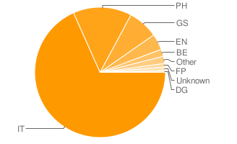
CVI: some usage statistics
Today, CVI provides 340 VMs…
  70% Windows, 30% Linux
… for different communities
  Self-service portal
    230 VMs from 99 distinct users
    Mixture of development
    and production machines
  Host groups for specific communities
    Engineering Services: 85 VMs
    Media streaming: 12 VMs
    6 Print servers, 8 Exchange servers
    … etc

Slide 10
CVI: work in progress - I
Microsoft Integration Components for Linux guests
  A.k.a. paravirtualized drivers
  Supported on RHEL5 (i386 and x86_64)
  Enhanced performance and functionality
    Boosts I/O performance for VMs on iSCSI storage
    Support for up to 4 virtual CPUs
    Better time keeping
    Support for synthetic mouse
  Required RPMs available in “slc5-testing” repositories
    “{kmod-,}mshvic” RPMs
    Based on v 2.1 Release Candidate

Slide 11
CVI: work in progress - II
Consolidation of physics servers (IT/PES/PS)
  ~300 Quattor managed Linux VM’s
    IT servers and VOBoxes
  3 enclosures of 16 blades
    Each with ISCSI shared storage
    Failover cluster setup
  Allows transparent live migration between hypervisors
  Need to gain operational experience
    Start with some IT services first (e.g. CAProxy, …)
    Verify that procedures work as planned
  Target date for first VOBoxes is ~July 2010
    gain experience with non-critical VOBox services first
  Next step: Virtual small diskservers (~ 5TB of storage)
    By accessing iSCSI targets from VM’s

Slide 12
“LX” Services
LXCloud
  See presentation of Sebastian Goasguen + Ulrich Schwickerath
  Management of a virtual infrastructure with cloud interfaces
  Includes the capability to run CernVM images
  Scalability test are ongoing
  Tests ongoing with both Open Nebula and Platform ISF as potential solutions
LXBatch
  Standard OS worker node: as VM addresses dependency problem
  WN with a full experiment software stack
    user could choose from among a standard/certified set. These images could e.g. Be built using the experiment build servers.
  As the previous case but with the pilot framework embedded
  CERNVM images
Eventually: LXBatch ➔ LXCloud

Slide 13
Batch and Cloud computing
HEPiX working group on virtualisation
  Establishing procedures for trusting VM images
    Helps the acceptance of sites to run VM images
  Details will be presented in a later talk

Slide 14
IP address space ...
Issue of IP address space:
  Sufficient addresses if allocated carefully, with a good understanding of the deployment plan of virtualised services

Slide 15
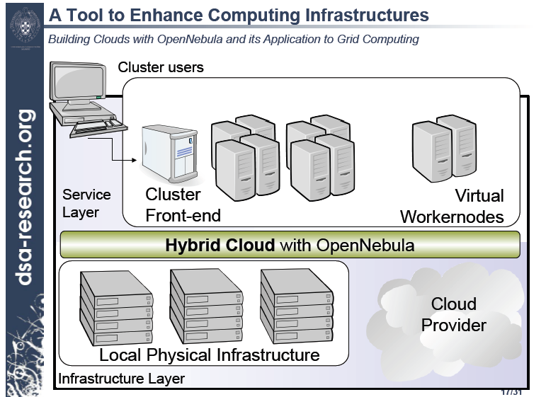
Longer term – connect to clouds

Slide 16
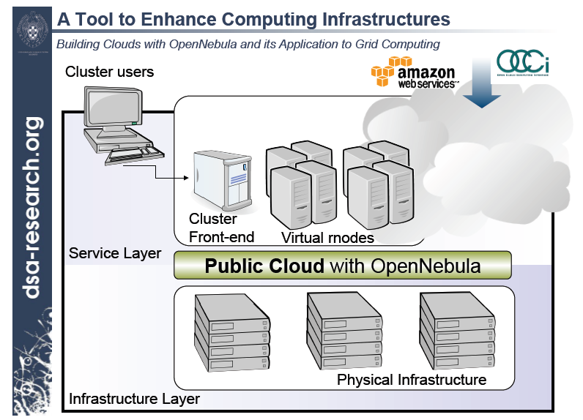
Appear as a cloud

Slide 17
Summary
Ongoing work in several areas
  Will see benefits immediately (e.g. VOBoxes)
  Will gain some experience in (e.g. LXCloud) test environment
    Should be able to satisfy a wide range of resource requests – no longer limited to the model of a single job/cpu
Broader scope of WLCG
  Address issues of trust, VM management; integration with AA framework etc
  Interoperability through cloud interfaces (in both directions) with other “grid” sites as well as public/commercial providers
  Can be implemented in parallel with existing grid interfaces

