Slide 1
IONS June 19-20-21, 2018
ESI, Archamps
High field NC magnets
Davide Tommasini, CERN

Slide 2
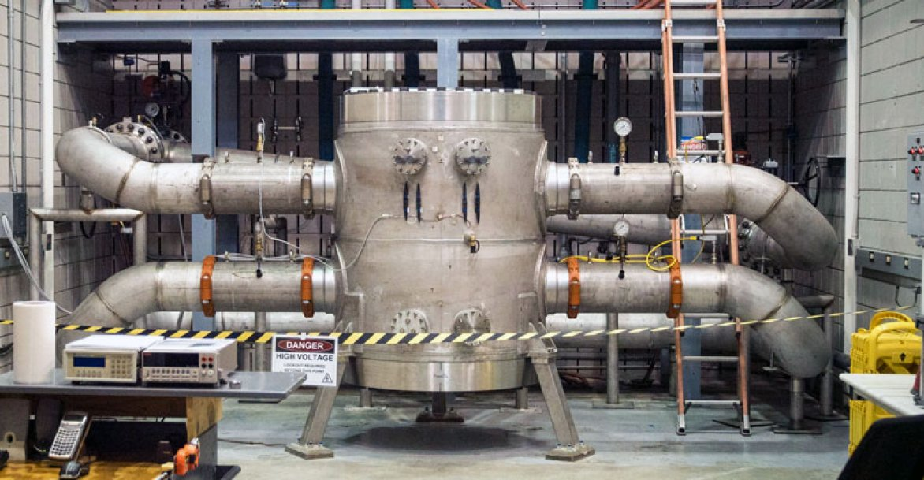
41.5 T normal conducting
NHMFL Tallahassee
Bore size 32 mm
Power 32 MW
Mass 6 tons
Coil height 730 mm
Coil diameter 1000 mm
J. Toth and S. Bole, “Design, Construction and First Testing of a 41.5 T All-Resistive Magnet at the NHMFL in Tallahassee”, IEEE Trans. On Appl. Supercond., vol. 28, no. 3, April 2018

Slide 3
Introduction
Every time I am consulted about magnets for medical application I am asked for the following characteristics:
Large aperture (>> 50 mm)
High field (> 1.5 T)
Fast response (ms range)
Compact size
Low consumption
Too easy to ask for this, we need to think out of the box

Slide 4
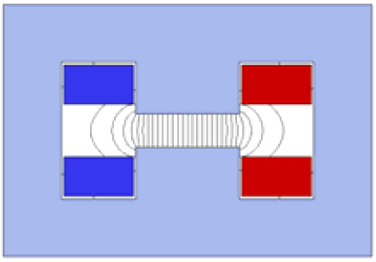
Keys for success: physical aperture
V [mm] | H [mm] | Mass/m | Power [kW/m]
10 | 20 | 70 | 2
 | 50 | 150
 | 100 | 350
 | 200 | 1000
20 | - | - | 4
 | 50 | 220
 | 100 | 450
 | 200 | 1200
50 | - | - | 10
 | - | -
 | 100 | 700
 | 200 | 1500
100 | - | - | 20
 | - | -
 | - | -
 | 200 | 2000
V
H
Field 1.2 T
Current density 5 A/mm²

Slide 5
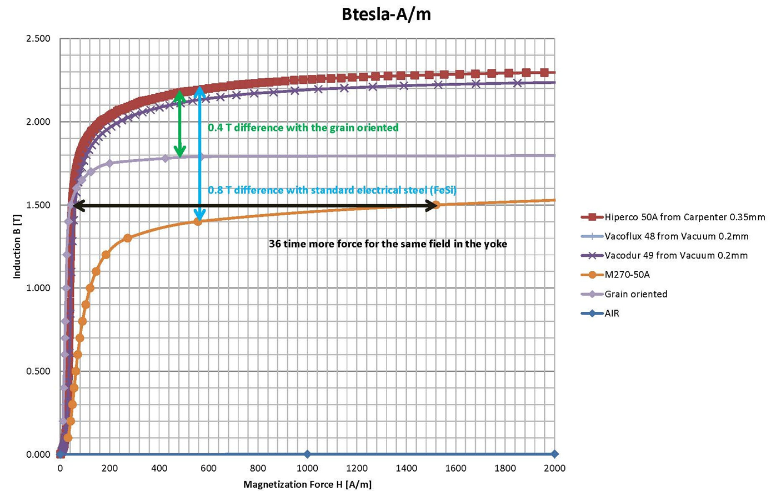
Keys for success: materials

Slide 6
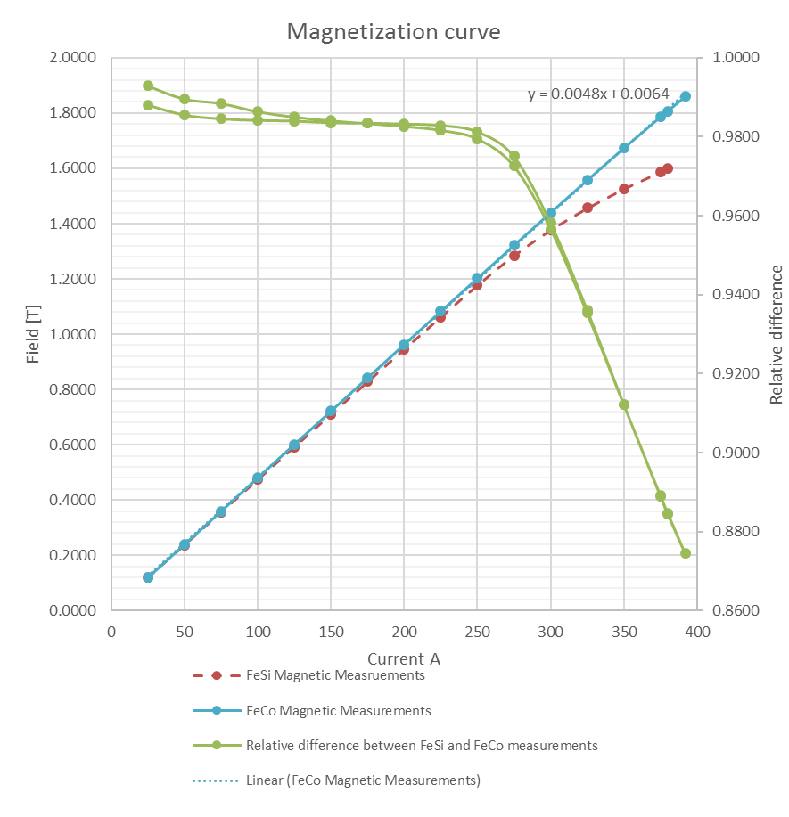
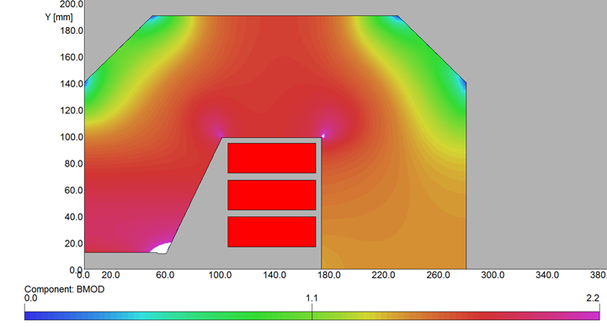
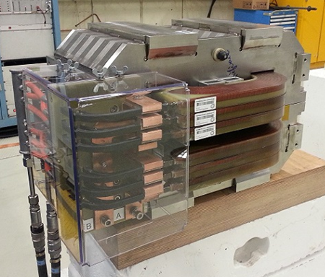
In a H-Type magnet FeCo allows full linear 1.8 T
FeCo enables higher fields for the same magnet size …
… or more compact magnets (30% in weight) for the same field … however it is expensive

Slide 7
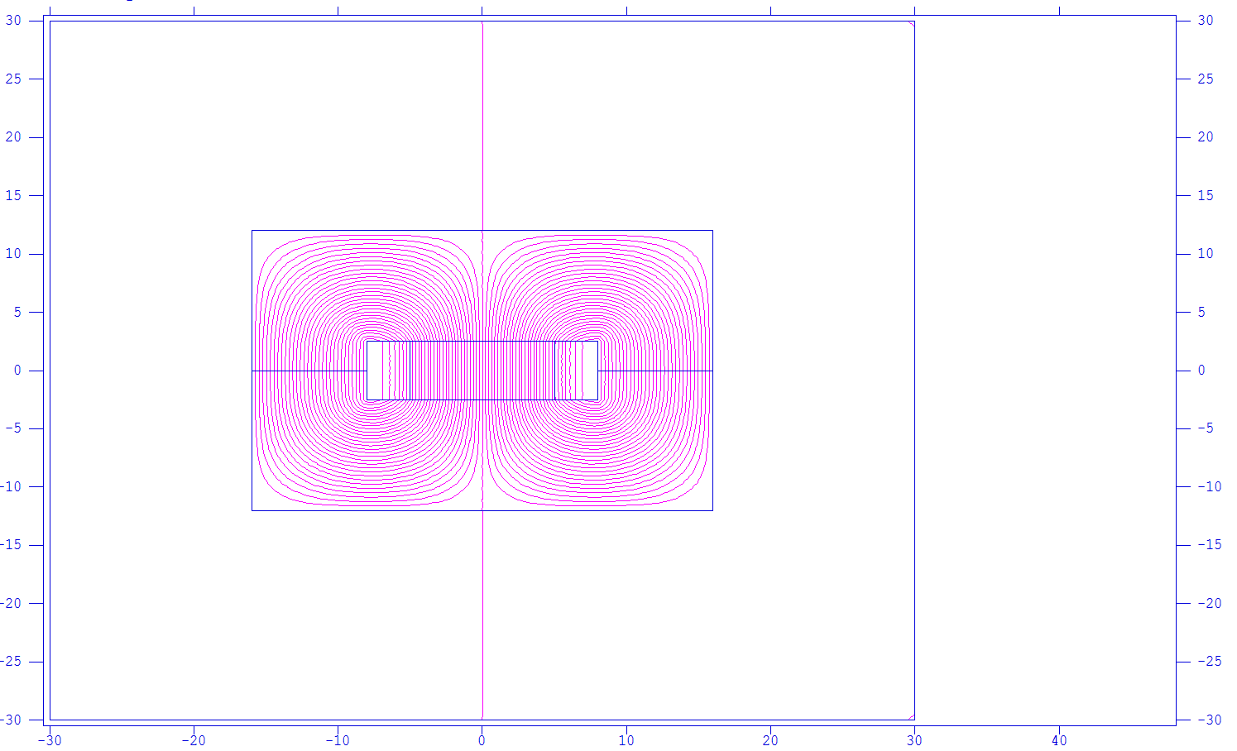
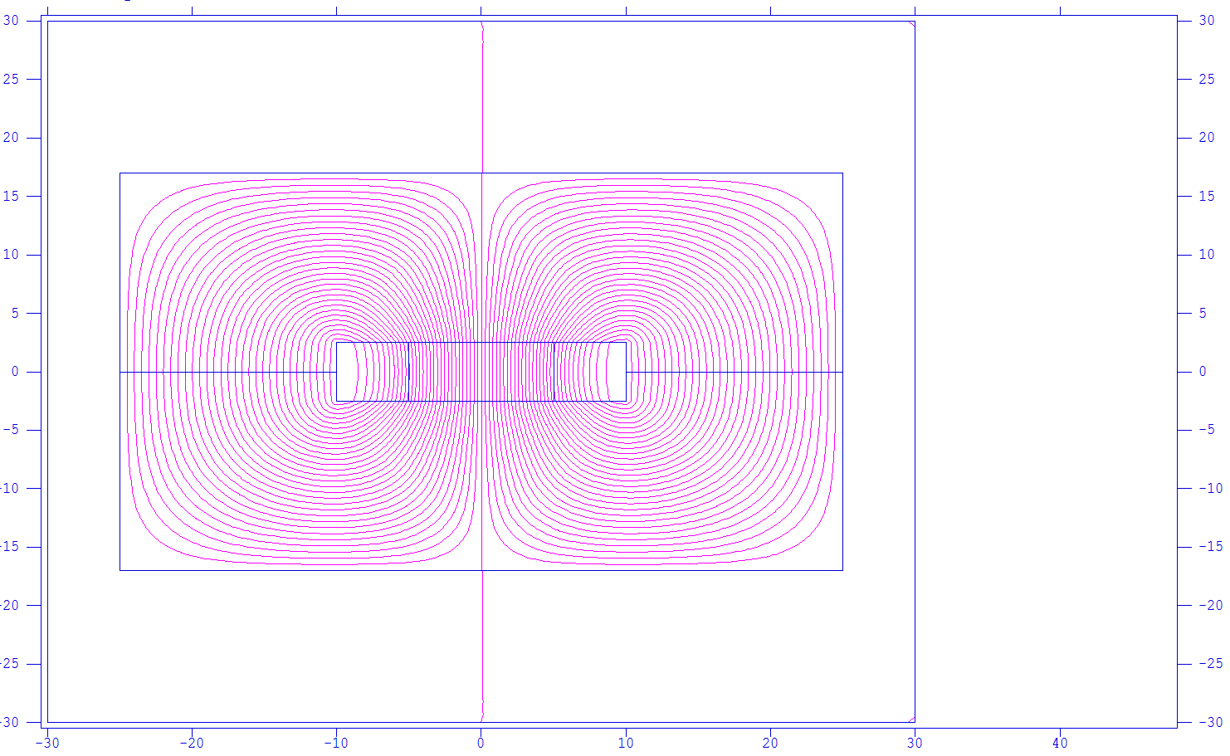
Beyond 2 T: operation mode
Pulsing with low repetition rate can considerably lower the I_{rms}
Ideally, this shall be such to allow using window-frame magnets instead than H-type or C-type magnets
To an extreme, we may even imagine costheta conventional magnets
2 T and 3 T window-frame magnet with I_{rms} ~ I_{max}/50 (one 10 ms cycle every 10 s)
H = 50 mm, W = 100 mm
320 mm
500 mm

Slide 8
Beyond 2 T: brute force H-Type
The ferromagnetic «pole» progressively disappears above 2 T.
Adding more ampereturns correspond to an increase of «gap», thus requiring even more ampereturns
Ideally, one would like adding the ampereturn in a concentrated way, to avoid increasing the pole height
This corresponds to increasing the current density: we are converging towards a superconducting magnet !
Beyond 2 T: brute force split solenoid
In principle high fields with resistive magnets become possible.
Power consumption becomes huge because of the long magnetic circuit in air.
Beyond 2 T: brute force window-frame
Fields of 3 T or even above can be produced.
Power consumption is large because of the small coil size which imposes a high current density.

Slide 9
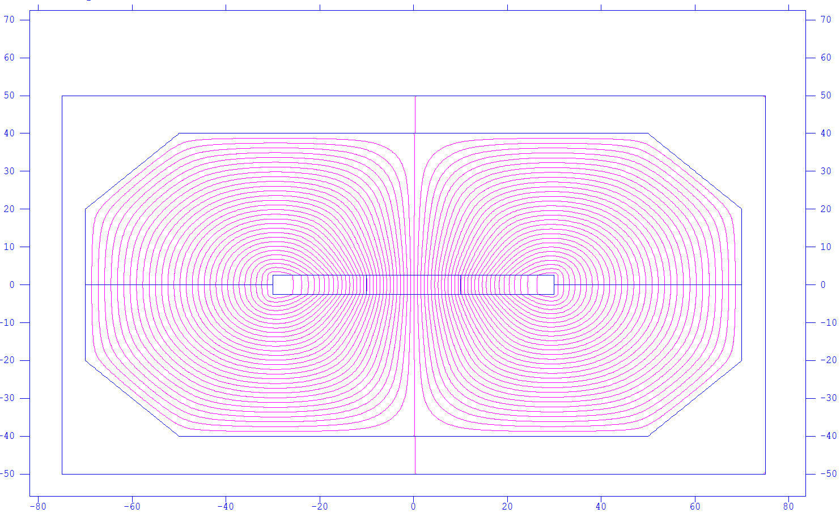
Beyond 2 T: brute force window-frame
B= 3 T
Gap= 50 mm
NI= 200 000 A
J=20 A/mm²
P=160 kW/m
Mass= 8 tons/m
1.5 meters

Slide 10
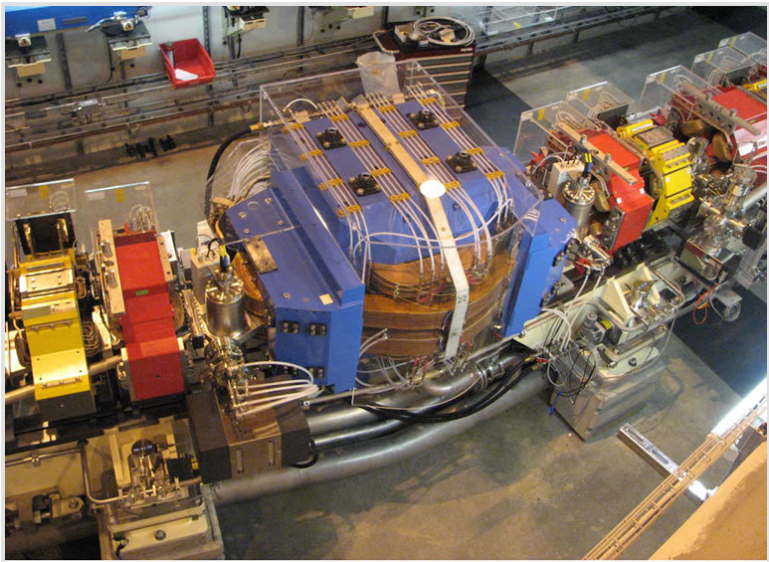
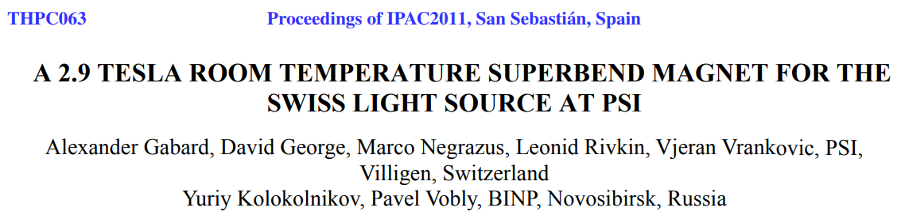
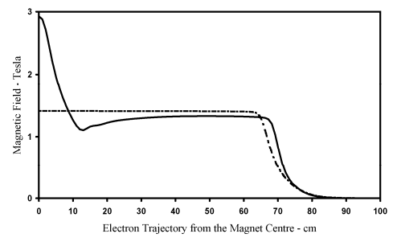
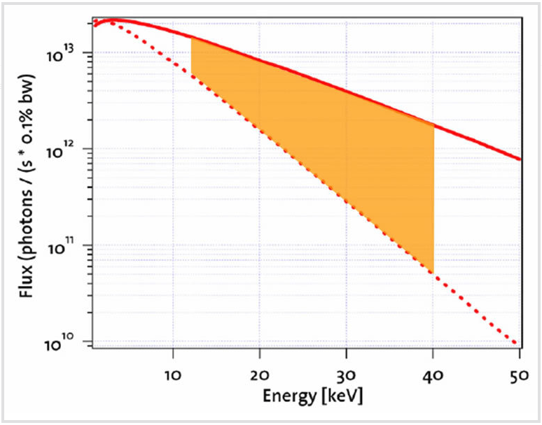
The 3 T superbend of the SLS (PSI)
Air gap 40 mm
Peak field 2.95 T
Power 40 kW
Coil mass (main/central) 570/500 kg
Total weight 6700 kg

Slide 11
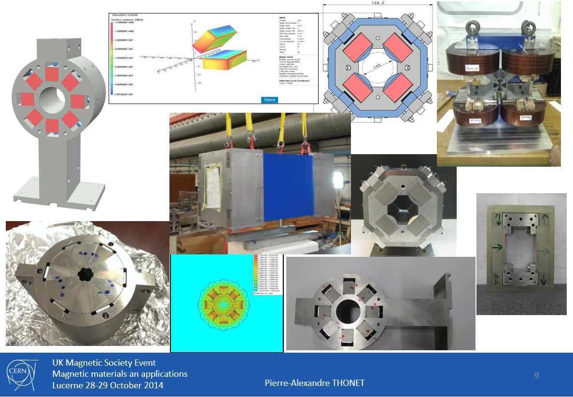
Permanent magnets at CERN

Slide 12
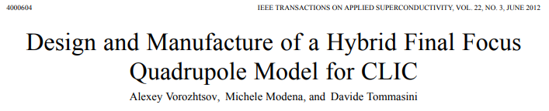
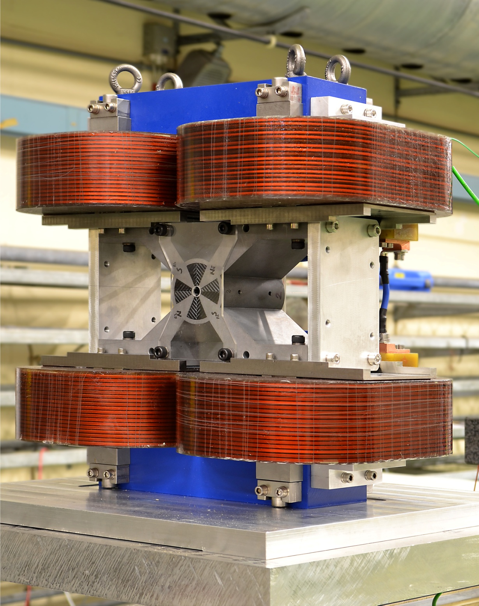
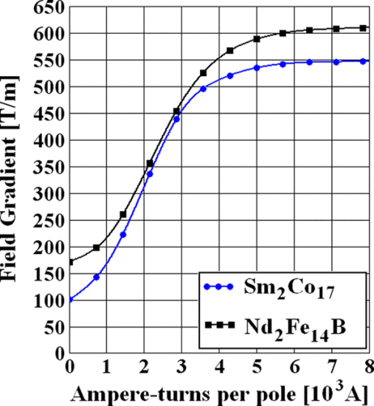
Hybrid Quadrupoles
Bore diameter : 8.25 mm

Slide 13
Conclusion
Size and power consumption of NC magnets are strongly dominated by the required aperture.
Above 1.2-1.5 T in the pole gap, magnetic efficient configurations are of window frame type, their drawback is power consumption to keep the coil size compatible with the window height (require high current densities).
Fast pulsing the magnets can mitigate the above limitations thanks to the reduction of the rms current.
The use of FeCo can either allow more compact magnets (30% less weight) or higher fields (approaching 2 T) without saturation (linear response). Above 2 T (in the aperture) the advantage of FeCo disappears.
For a NC dipole a field amplitude around 3 T, where the benefit of the iron is still moderately present, can still be achieved with a “reasonable” construction.
We should not forget permanent magnets, especially quadrupoles with small to moderate apertures.

