Slide 1
Superconducting magnets
and field control for
medical accelerators
Marco Buzio, Stephan Russenschuck
Magnet, Superconductors and Cryostats Group, Technology Department, CERN
1. Superconducting magnets
2. Field control issues and solutions
3. Power supply ripple
Notes:
Previous tutorial: Metrological basics, SI and CGS units, relationship to electrical quantities, standards, quantities of general interest for accelerator magnets (not repeated here)

Slide 2
Superconducting
magnets

Slide 3
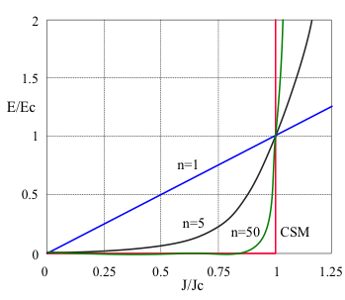
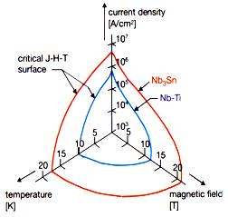
Hard superconductors – a recap
  Strong magnetic fields can penetrate by discrete flux quanta trapped by pinning sites
  Flux gradient → non-dissipative DC transport current at critical current density J_{C}
  De-pinning → electrical field E → strongly non-linear dependence J_{C}(E )
  Flux penetration creates persistent currents → magnetization with hysteresis →
  DC field distortion + AC losses
  Thermal stability + reduction of persistent currents → small filaments in a Cu matrix →
  local and long-range dynamic coupling → unique decay and snapback phenomena
  transition to resistive state (quench) triggered by local heat deposition or excess current/field
Critical State Model
Nb₃Sn
- brittle intermetallic compound
- higher performance but strain-dependent, difficult to produce
- many prototype, models and one-off projects (e.g. ITER TF coils)
- first large-scale accelerator magnet deployment planned for HiLumi LHC
(11 T bending in LS2, IR quads in LS3)
Normal conductor
(E_{c} = 1 µV/cm)
NbTi:
- ductile alloy
- industry standard
- many applications in accelerator and experimental magnets, MRI, electrical distribution and machines
Notes:
HTC still not viable for deployment in accelerator magnets
Nb3Sn for accelerator magnets: some wiggler, maybe magnets deployed at BNL/FNAL ?

Slide 4
Normal - vs superconducting magnets (1/2)
  SC magnets are used for regular operation in synchrotrons since the 70s, but no practical applications to hadronteraphy synchrotrons exist yet. Why ?
  For High Energy Physics, superconductivity is an enabling technology so high complexity
  and cost are more easily tolerated
  For medical applications, solutions already exist; the goal is lowering total costs
  → choice is less clear-cut
  Magnet total cost:
  Capital cost: direct: design, prototyping & testing
  manufacture
  indirect: special power supplies (e.g. purely inductive loads for SC)
  installation constraints (size, weight)
  Operation cost: direct: excitation power (only clear winning point for SC)
  cooling power
  maintenance
  indirect: downtime
  operational flexibility (cycling constraints)
Notes:
Superconducting synchrotrons: ESCAR (Berkeley), only testbed [Frontiers Of Accelerator Technology - Proceedings Of The Joint Us-cern-japan ]
Flex = freedom with cycling

Slide 5
Normal - vs superconducting magnets (2/2)
 | Normal conducting | Superconducting
Current density | 2~5 A/mm² (Cu, air-cooled) 5~10 A/mm² (Cu, water-cooled) | 9500~3000 A/mm² (NbTi @ 4.2K, 1~5 T) ~400 A/mm² (LHC NbTi cable @ 1.9 K, 9 T)
Field limitations | 1.5~2.3 T (linear range) ∞ (above saturation) | ~10 T (NbTi @ 1.9K) ~16 T (Nb₃Sn @ 1.9K)
Magnetic forces | Magnetic pressure σ_{[MPa]} ≈ 0.4 B_{[T]}² (practical limit 45~50 T)
Dissipation | Ohmic losses RI² (e.g. 140 kW/magnet in CERN SPS) | Heat influx + AC/beam losses Losses @ 4.5 K × 240 Losses @ 1.9 K × 900
Cooling power | Demineralized water flow + cooling plant (typically ~1 kW/magnet) | e.g. 40 MW LHC cryogenic system (~2.5 W/m @ 1.9K, 20 kW/cryomagnet)
Field quality | Geometry + iron effects (saturation, hysteresis, eddy currents) | Geometry + iron (if applicable) + persistent currents (magnetization, ramp rate, decay, snapback)
Interconnects (electrical / vacuum) | Easily accessible | Cold (inside cryostat)
Resistive (DC) voltage drop per magnet | Typically a few V (R ~ 10 mΩ) | << μV (R ~ nΩ) Interconnections, splices
Protection | Thermal switch interlock (T<60 deg) | Quench detection + Active/passive coil protection system
Notes:
Nonlinear phenomena are often mixed (some iron in all SC magnets)
Quench protection / diode MUST NOT fail in LHC
Passive protection: nothing to do with temperature margin, but rather with cooling efficiency (e.g. force flow) or energy dump

Slide 6
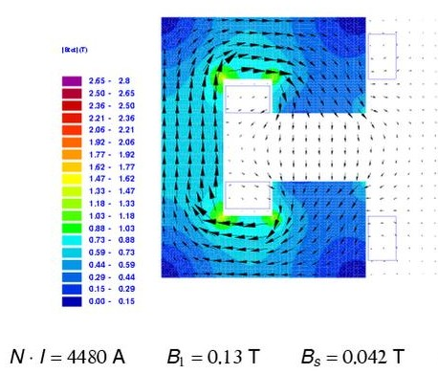
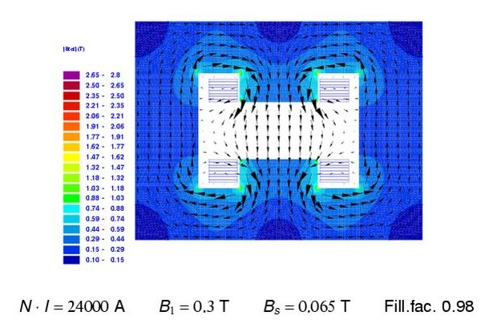
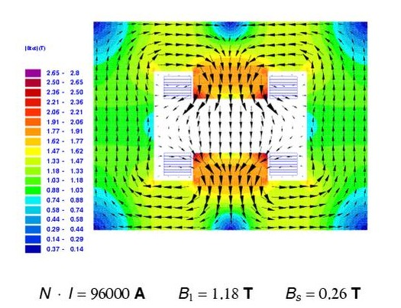
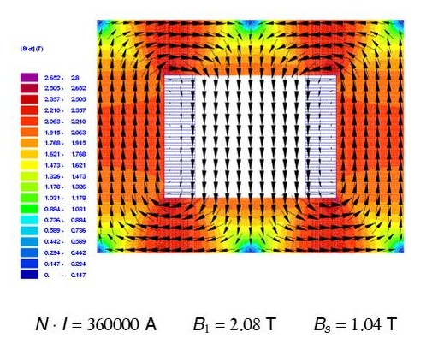
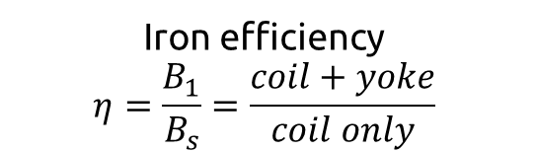
Iron-dominated dipole designs
  Dipoles = main driver
  for the ring size
  (and civil engineering costs)
  Field quality
  determined mainly by
  pole shape + saturation
  H-shape (η=4.6)
  improved field quality, less weight
  C-shape (η=3)
  Simple, easy access; odd harmonics
  Iron efficiency
  $$η=\frac{B_{1}}{B_{s}}=\frac{coil+yoke}{coil only}$$
  Window frame (η=2)
  best field quality, less/uniform saturation
  Superferric H-shape (η=4.5)
  corner saturation even at low field
Notes:
Consider dipoles as the main drivers for overall synchrotron size
LEP dipole
LHC warm TL

Slide 7
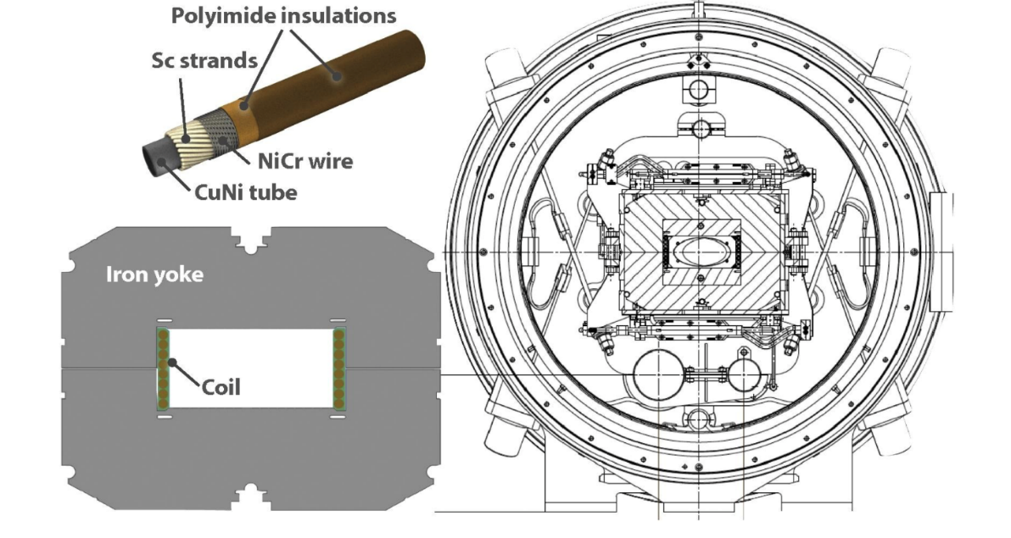
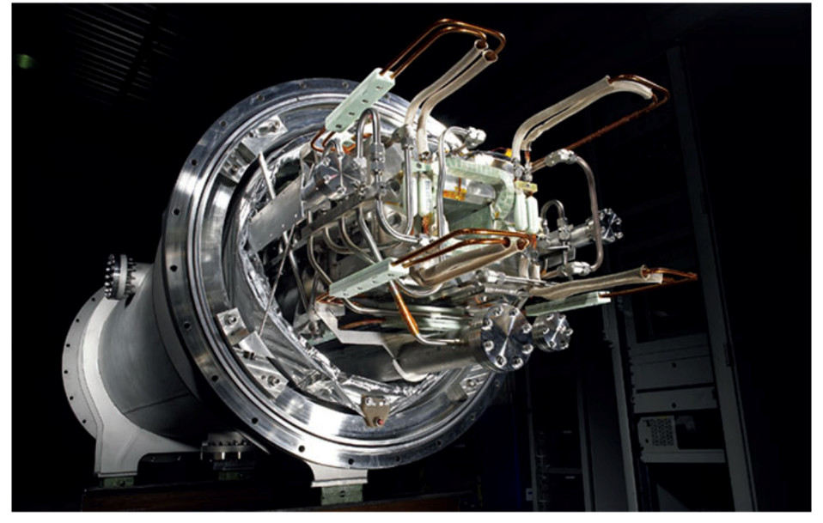
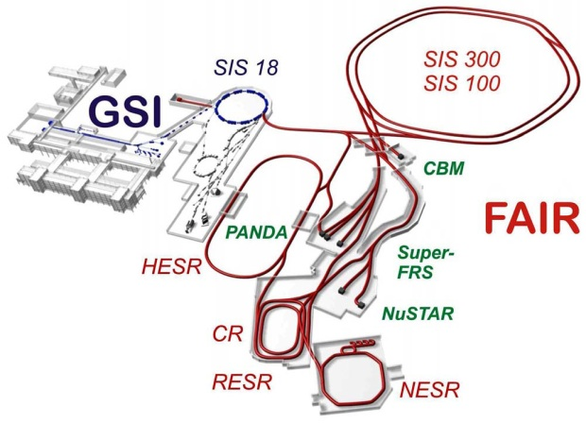
Superferric dipole example: SIS 100
  Largest superferric synchrotron project, currently in construction at GSI (FAIR)
  based on internally force-cooled JINR Nuclotron cable (AC losses)
  Efficient cold iron yoke: less magnetic leakage, coil closer to iron, but more complex, larger cold mass, limited access
  1.9 T @ 13.1 kA
  Fast-ramped at 4 T/s
  Bending radius 52.6 m
  Magnetic length 3 m
Notes:
5.7 Tm → 5 units could bend C12 @ 400 MeV/u, IF curvature would allow

Slide 8
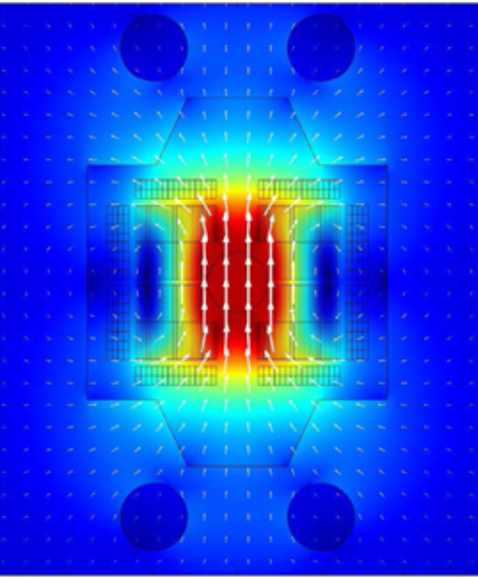
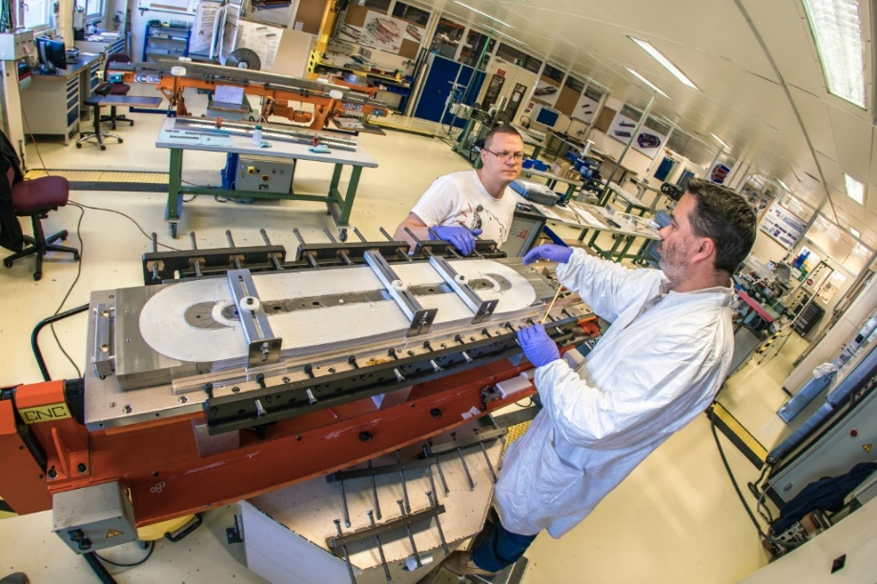
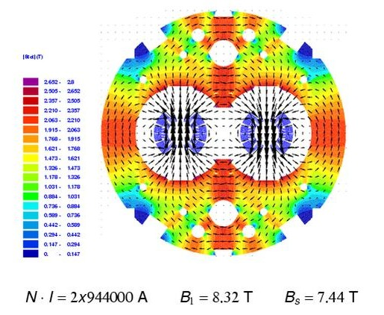
Coil-dominated dipole designs
  racetrack coils are comparatively easy to make (ideal for models and demonstrators)
  compatible with SC tapes
  Field quality hardly adequate for accelerator purposes
  Nb3Sn Racetrack Model Coil (16.2 T)
  Cos-θ design approximates 2D theoretical J distribution with no leakage
  Most efficient: peak field @ coil ≤ central field + 5%
  Best choice for high-quality, high-field large magnets; but long and costly optimization/prototyping
  Iron still gives non-negligible contribution (~1 T in LHC dipoles) + suppression from leakage and cross-talk; also gives measurable saturation
  LHC (η=1.12)
  Best field quality
Notes:
Notice the lower field in the iron yoke compared to the window frame

Slide 9
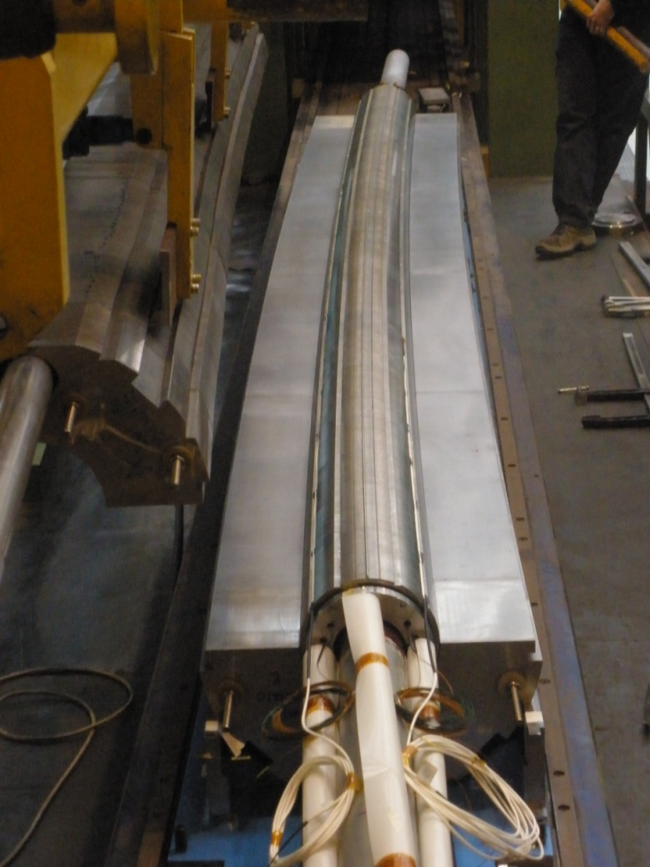
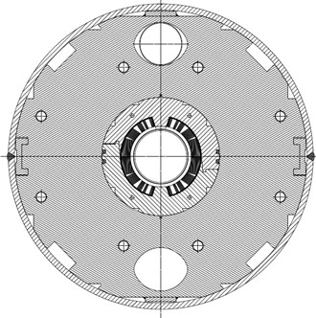
Example: SIS 300 bent cos-θ dipoles
  FAIR SIS300 prototype dipoles
  4.5 m long, 4.5 T
  Fast-ramping at 1 T/s → filament ∅ 3.5 μm
  Max curvature ever achieved in Cos-θ design:
  66 m bending radius
  Single-layer coil wound directly on a bent mandrel, supported by the collars only
  Difficult construction, design seems hardly extrapolable to stronger curvature …
Notes:
Superconducting synchrotrons: ESCAR (Berkeley), only testbed [Frontiers Of Accelerator Technology - Proceedings Of The Joint Us-cern-japan ]
Flex = freedom with cycling

Slide 10
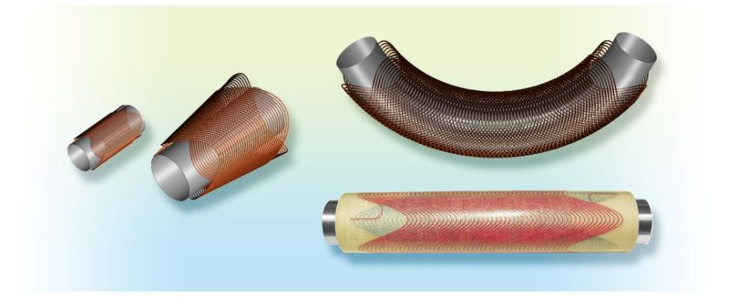
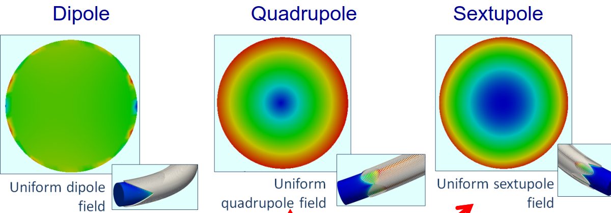
Canted Cos-θ design
  Proposed by Meyer in 1970∗ , commercialized as Double HelixTM by AML Superconductivity
  Not used as yet in accelerators, but for posible applications see e.g. L. Bottura’s talk (gantry) and E. Benedetto’s talk (synchrotron ring)
  Design based on cancellation of longitudinal field components → intrinsically inefficient, possibly sensitive to mechanical errors
  Pros: multipolar field possible with nominally ideal geometry up to several Tesla, even on a strongly curved former; magnets can be nested; distributed mechanical support
  Major drawback: magnetically inefficient, peak field at conductor ≈ central field + 25%
* Meyer, Flasck, Nucl. Instr. and Methods, 80, 1970
Notes:
Simple and clean design made possible by very precise numeric CNC
Projected azimuthal current distribution is of cos-theta type

Slide 11
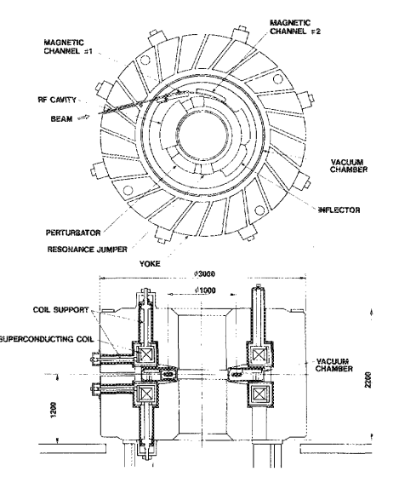
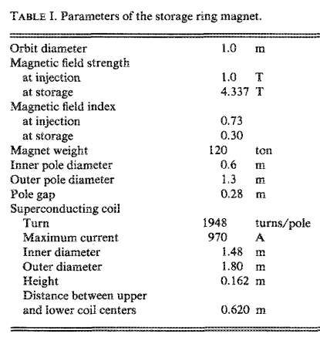
Example of compact SC synchrotron: Aurora
  Compact SC electron SR for X-ray lithography made at Sumitomo (1989),
  at Ritsumeikan university since 1995
  150 MeV to 650 MeV, 1 T to 4.3 T
  (Bρ=0.5 to 2.2 Tm)
  Solenoid design, no quad (field index changed via saturation of the iron poles
  and yoke)
Notes:
Demand for X-ray lithoonvegraphy suprceded since thanks to improvements in conventional optics

Slide 12
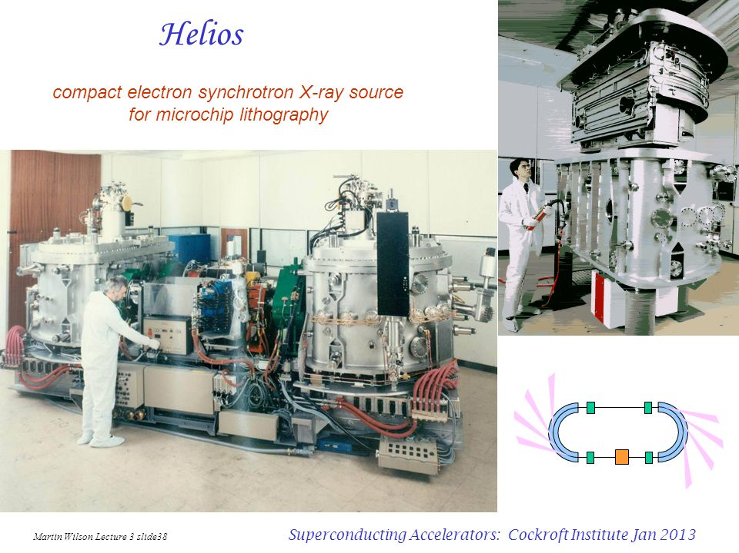
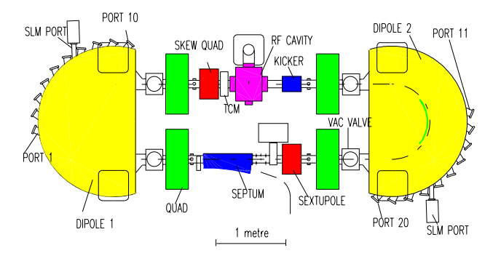
Example of compact SC synchrotron: Helios
  Two compact electron synchrotron X-ray sources for microchip lithography built at Daresbury in 1992 and 1998
  Max energy 700 MeV (Bρ=2.3 Tm)
  Two-sector racetrack with two 180°, 4.5 T air-core, cold-bore bending dipoles
  97% beam availability observed at IBM
  25 tons including girder.
  Transports on a single lorry
Notes:
Very little is said in the literature about the magnet (M Wilson’s baby)

Slide 13
Magnetic field
control: issues

Slide 14
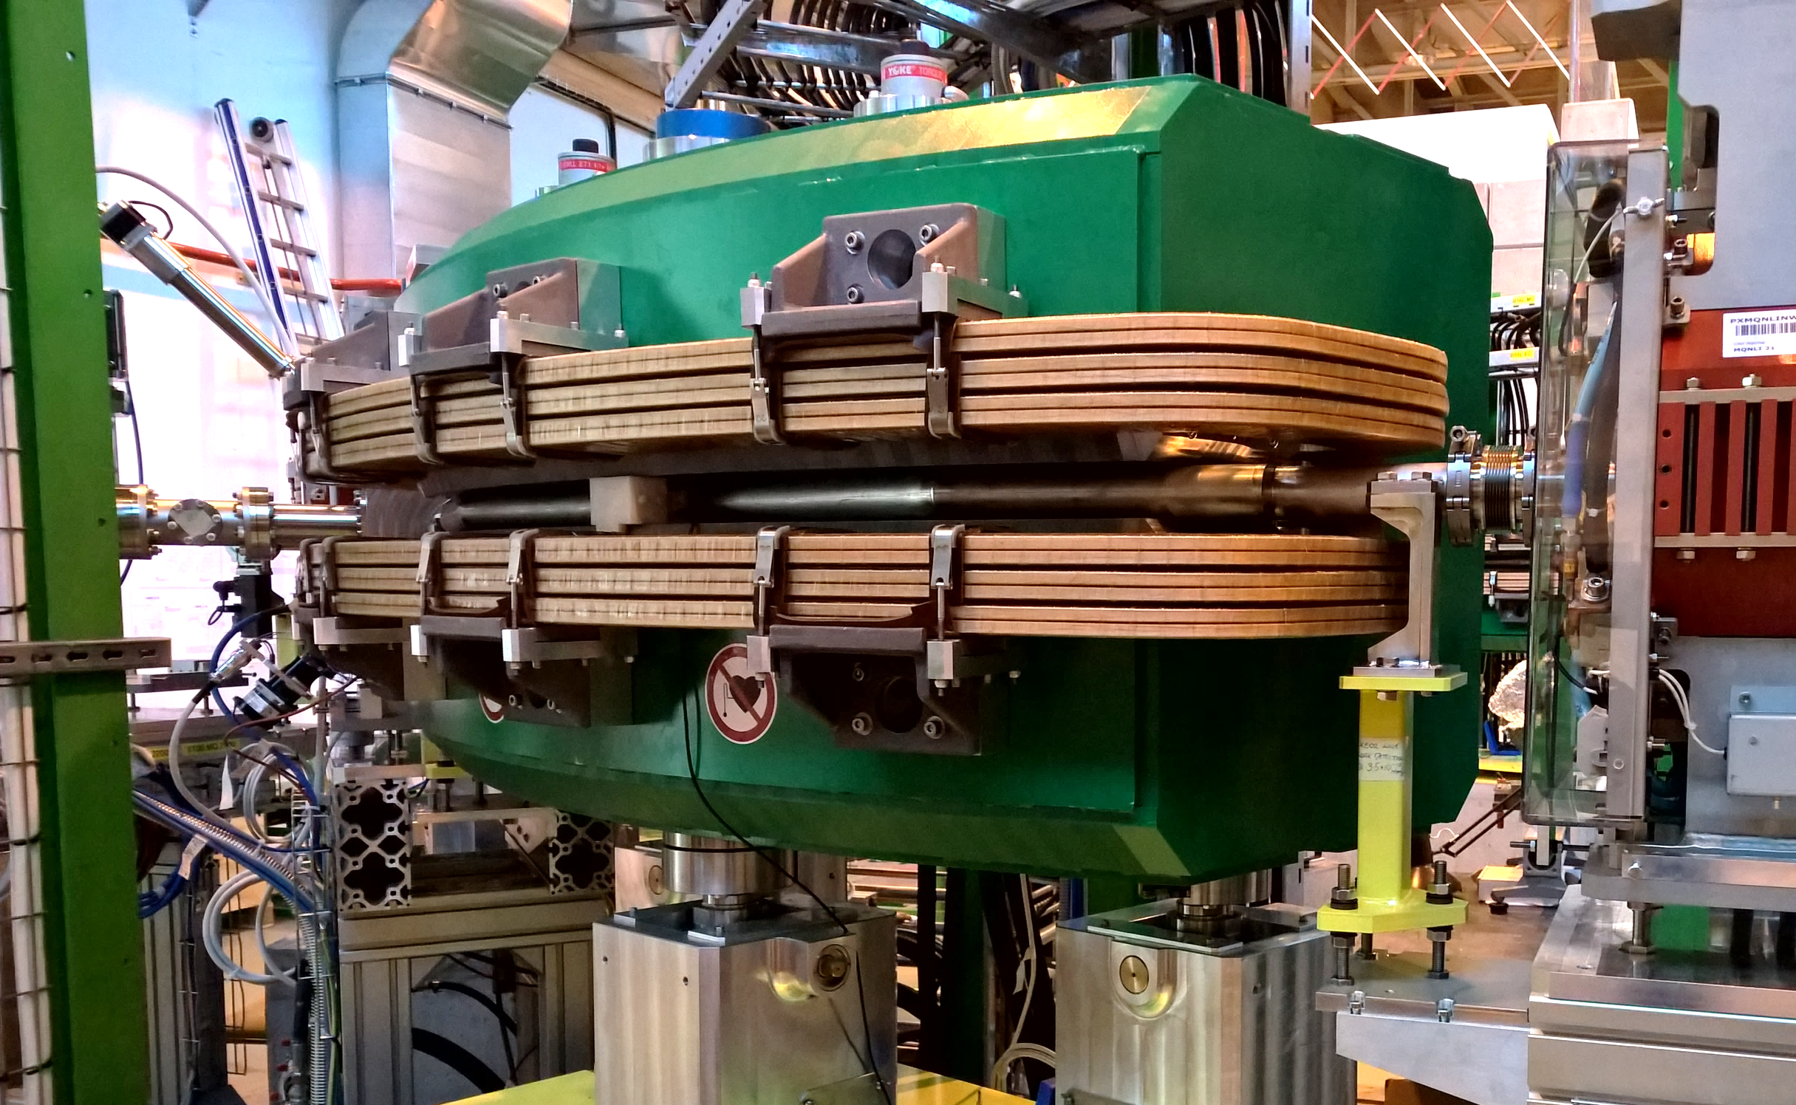
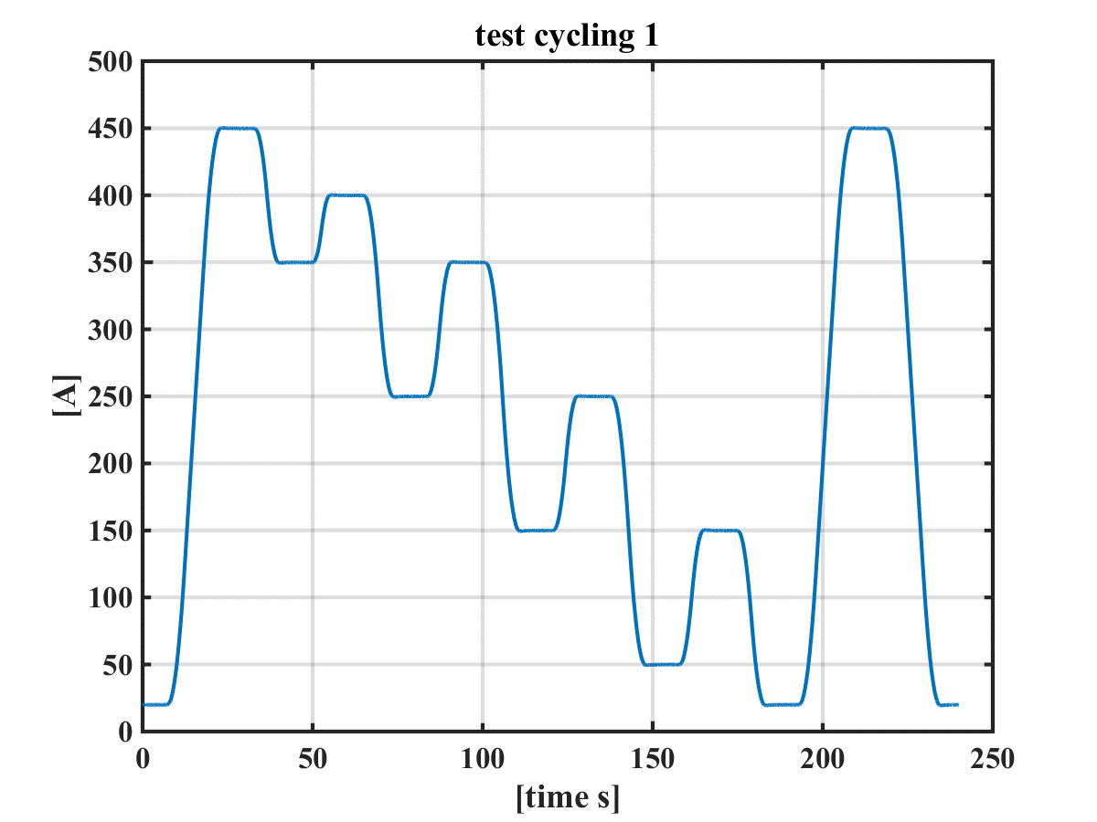
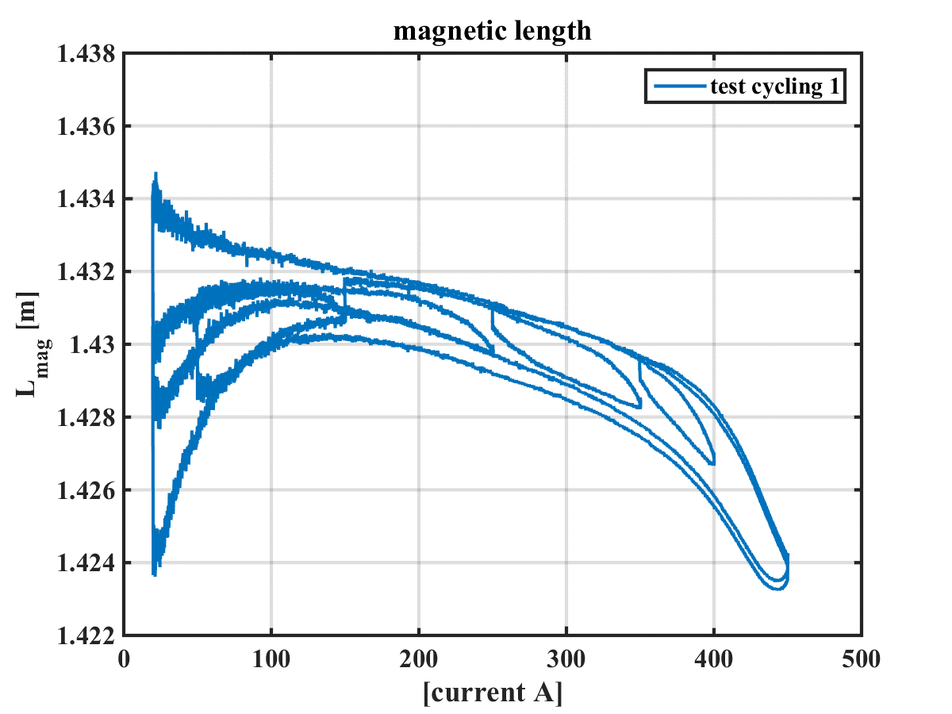
Issues in magnetic field control: iron hysteresis
Example: ISOLDE HIE TL bending
Arbitrary minor loops tend to wander inside the limit (major) hysteresis loop
As a rule, prediction using established methods (FEM/BEM, Jiles-Atherton, Preisach …) is currently not possible to the precision usually required
Notes:
Superconducting synchrotrons: ESCAR (Berkeley), only testbed [Frontiers Of Accelerator Technology - Proceedings Of The Joint Us-cern-japan ]
Flex = freedom with cycling

Slide 15
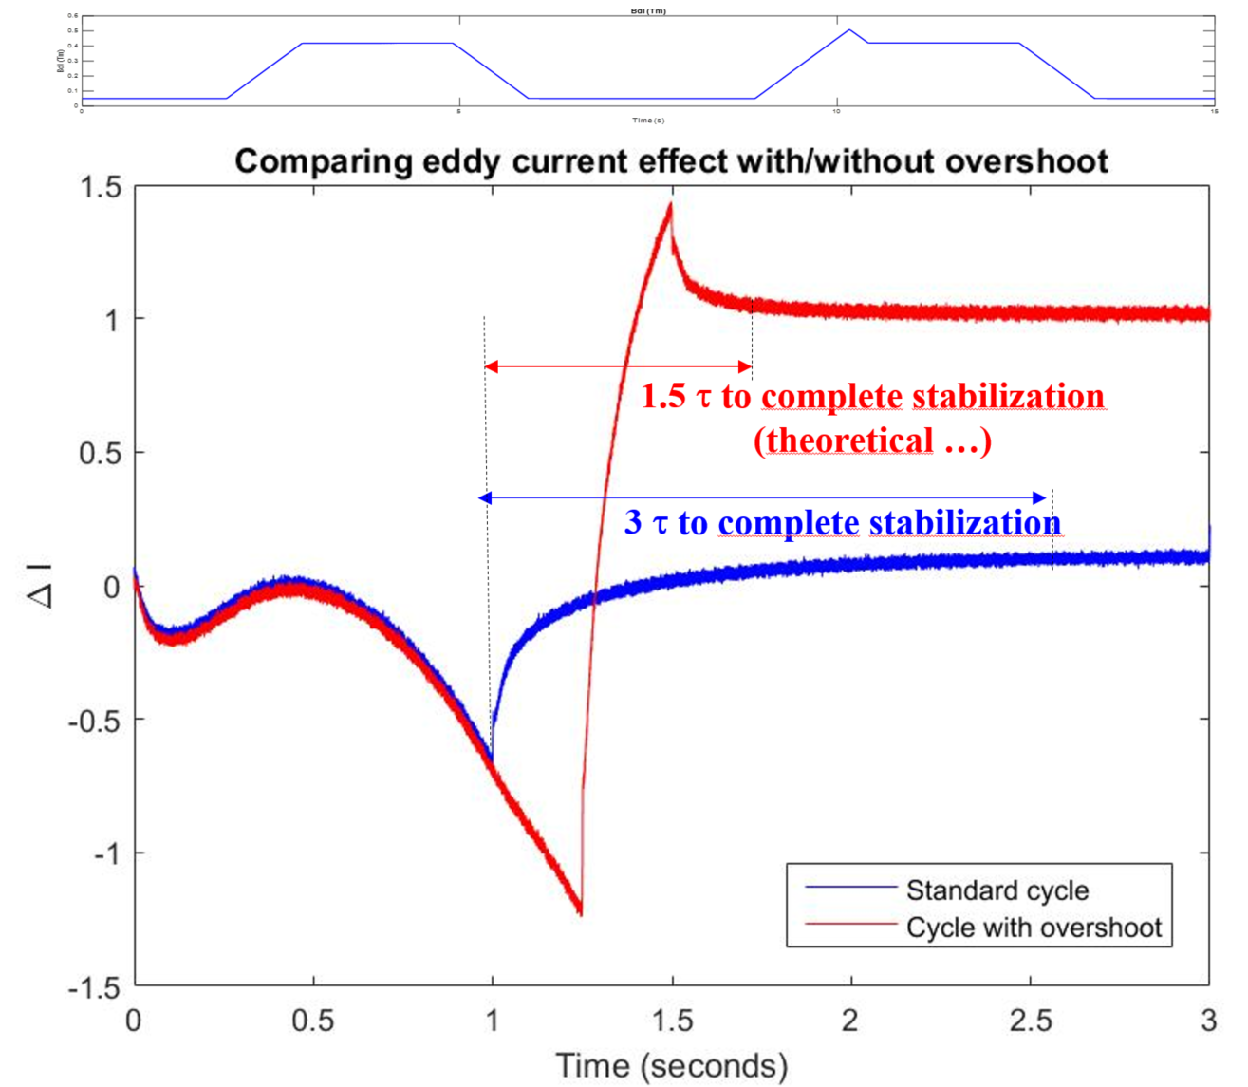
Issues in magnetic field control: eddy currents
  Classical solution to reduce impact of eddy currents at the end of ramp-up: current overshoot
  Easily saving 1.5τ
  Moves response onto new limit hysteresis loop
  Impact of eddy currents on ramps: dissipation increases the are of the hysteresis loop
  Linear extrapolation of measurements to quasi-static condition is possible but not always precise
Notes:
Superconducting synchrotrons: ESCAR (Berkeley), only testbed [Frontiers Of Accelerator Technology - Proceedings Of The Joint Us-cern-japan ]
Flex = freedom with cycling

Slide 16
Issues in magnetic field control: superconductor hysteresis
Superconducting filament magnetization (persistent eddy currents)
large hysteresis with relative errors of the order of 10⁻³ at low field (injection)
hysteresis depends on temperature, current and current history
main field and multipoles affected in different ways
Linear regime (geometric contribution)
field is proportional to the current
(can be computed with Biot-Savart’s law)
the T.F. depends only on the coil geometry
injection
Iron saturation
affects only small area in the collar (B>2T)
relative errors ∼ 10⁻² at high field
additional multipoles generated
Similar issues for superconducting magnets: different orders of magnitude may make
feed-forward prediction possible (e.g. LHC’s FIDEL semi-empirical model)
Notes:
Superconducting synchrotrons: ESCAR (Berkeley), only testbed [Frontiers Of Accelerator Technology - Proceedings Of The Joint Us-cern-japan ]
Flex = freedom with cycling

Slide 17
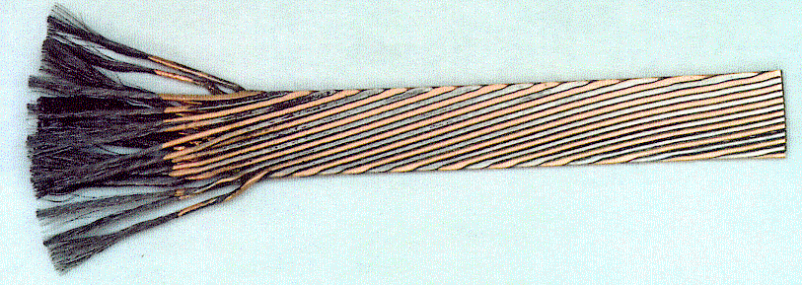
Dynamic effects in type 2 superconductors
Coupling currents
finite inter-filament and inter-strand resistance (R_{C}) gives rise to loops linked with changing flux
multipole errors ∝ Ḃ, R_{C}⁻¹
hysteresis depends upon field level, temperature and excitation history
Decay and snap-back
superconductor magnetization and coupling currents interact in a complex way → long-term logarithmic time dependence effects (field decay)
hysteresis branch switching at the end of decay → sudden current redistribution and additional multipole errors (snap-back)

Slide 18
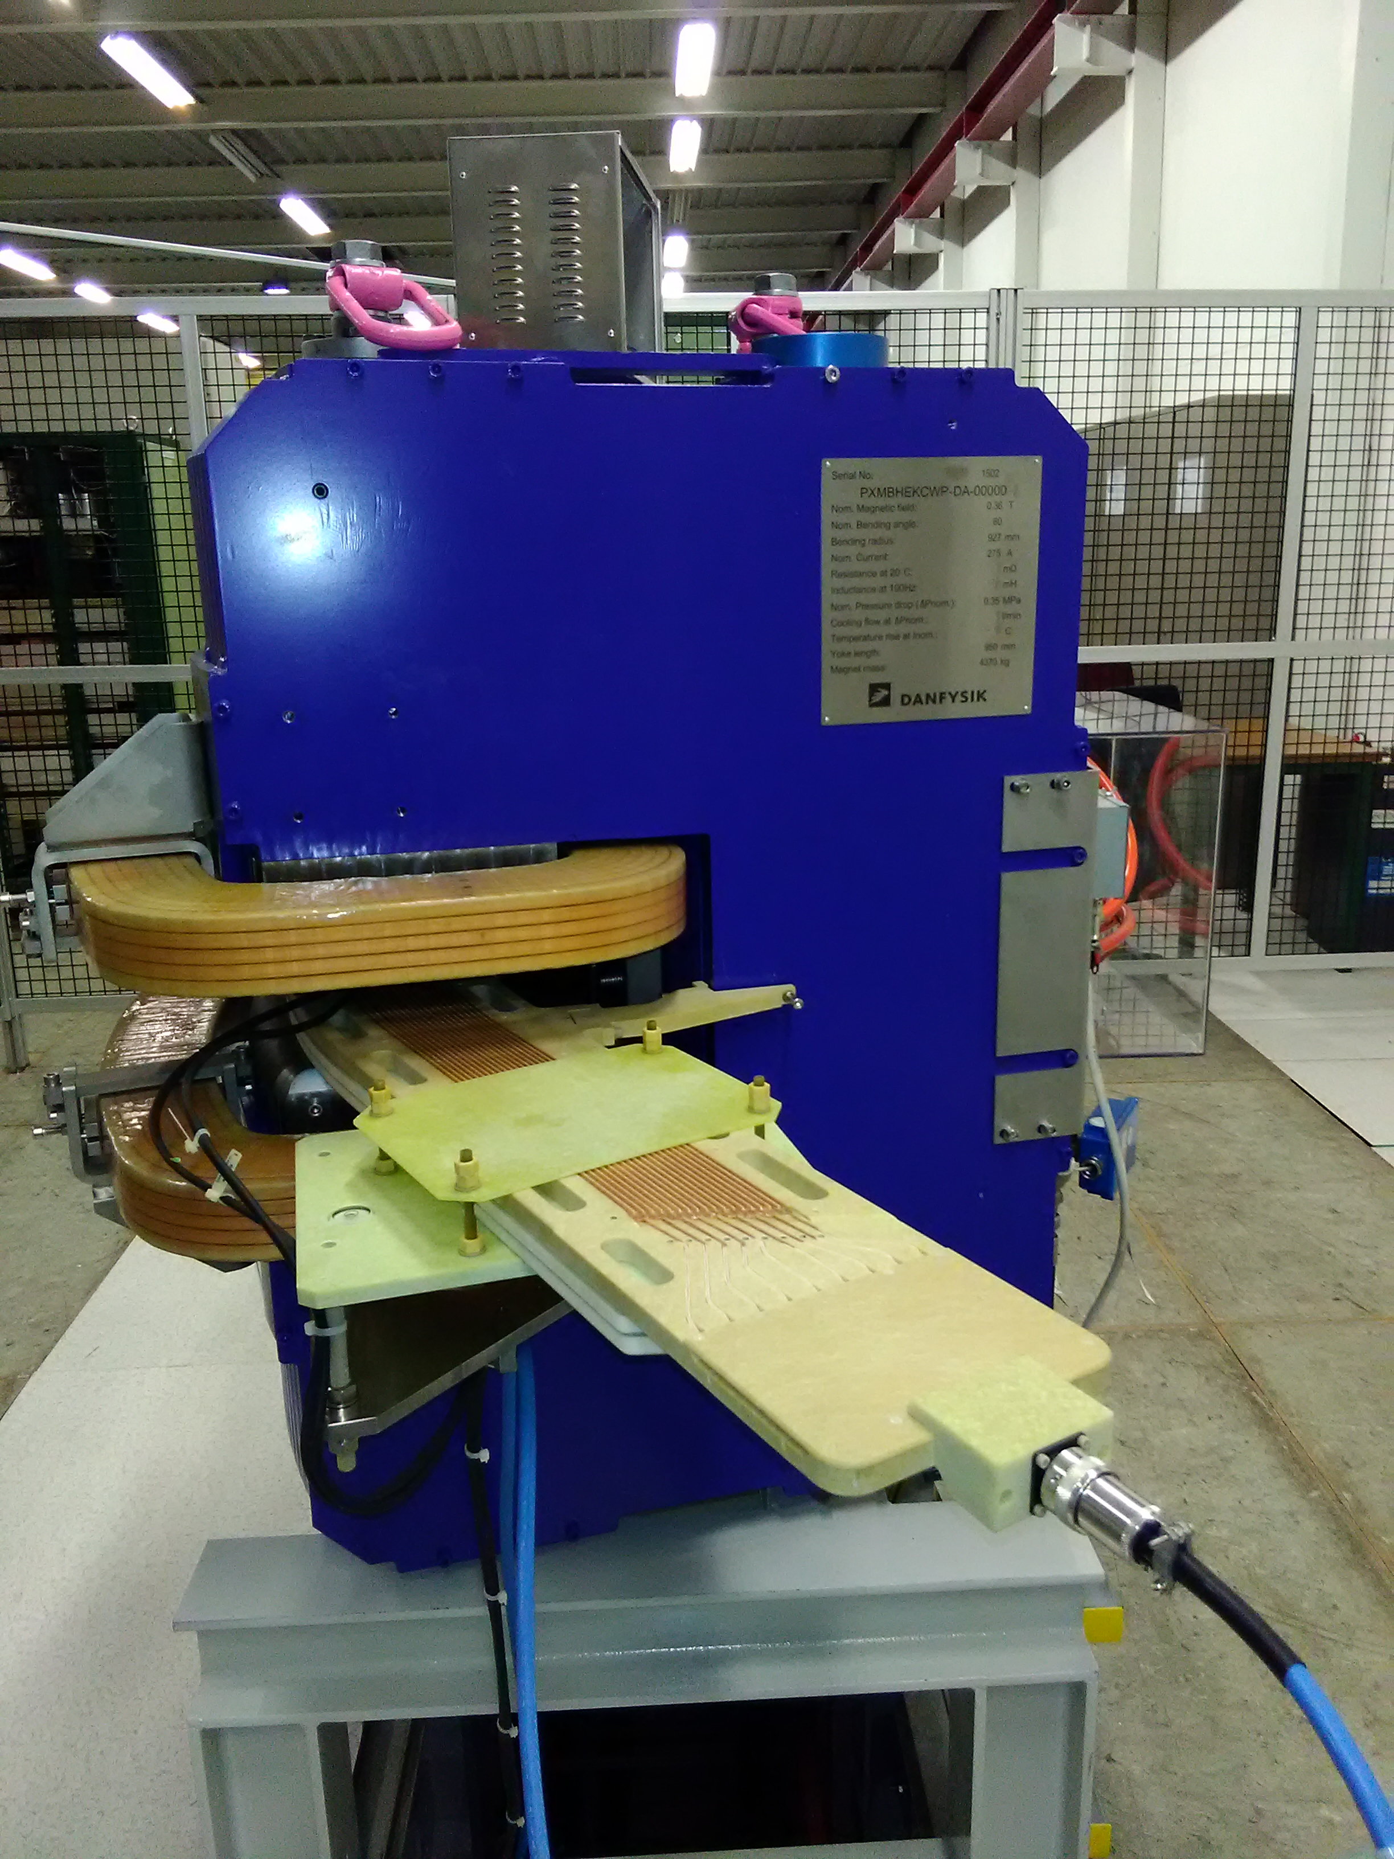
Issues in magnetic field control: pre-cycling
  Blah blah
  Blah blah …
return to previous hysteresis loop
branch when cycle resumes
ELENA
reference dipole
eddy currents decay
on current plateaux
Stable hysteresis loop achieved at the third repeated cycle
(result well in line with broader experience on similar dipoles)
Notes:
Superconducting synchrotrons: ESCAR (Berkeley), only testbed [Frontiers Of Accelerator Technology - Proceedings Of The Joint Us-cern-japan ]
Flex = freedom with cycling

Slide 19
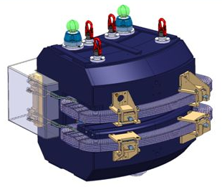
Issues in magnetic field control: remanent field
Measurement on the pole surface
of an ELENA MB
NMR marker triggers
reference
state
transient
stable cycles
degaussing
(Nov 2016) I_{max}= 400 A: 0.45 → 0.02 mTm (~25:1)
(Oct 2017) I_{max}= 326 A: 0.86 → 0.03 mTm (~29:1)
In both cases: (Bd)_{r} ≈ 5-8·10⁻⁵ of full range (needs to be taken into account)
Notes:
Superconducting synchrotrons: ESCAR (Berkeley), only testbed [Frontiers Of Accelerator Technology - Proceedings Of The Joint Us-cern-japan ]
Flex = freedom with cycling

Slide 20
Magnetic field
control: solutions

Slide 21






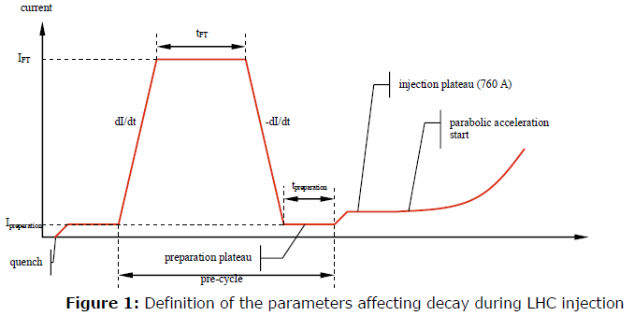




LHC field model: FIDEL
Options for real-time magnetic measurements
SC magnetization ∝ to critical current density Jc and ∅ filament
SC snap-back (at restart of ramp-up)
Iron saturation
(includes also Lorentz force displacement effects ∝ I²
linear component generated
by excitation coils
SC AC coupling currents
∝ ramp-rate
ideal magnet
(1st approx.)
Residual field
(constant)
$$C_{n}=C_{n}^{res}+C_{n}^{geo}+C_{n}^{MDC}+C_{n}^{def}+C_{n}^{sat}+C_{n}^{decay}+C_{n}^{snap}+C_{n}^{MAC}$$
parametric model (all magnets): DC components AC components
SC field decay during plateaux
Source: N. Sammut, FIDEL - The Field Description for the LHC, LHC-C-ES-0012
Notes:
Superconducting synchrotrons: ESCAR (Berkeley), only testbed [Frontiers Of Accelerator Technology - Proceedings Of The Joint Us-cern-japan ]
Flex = freedom with cycling

Slide 22
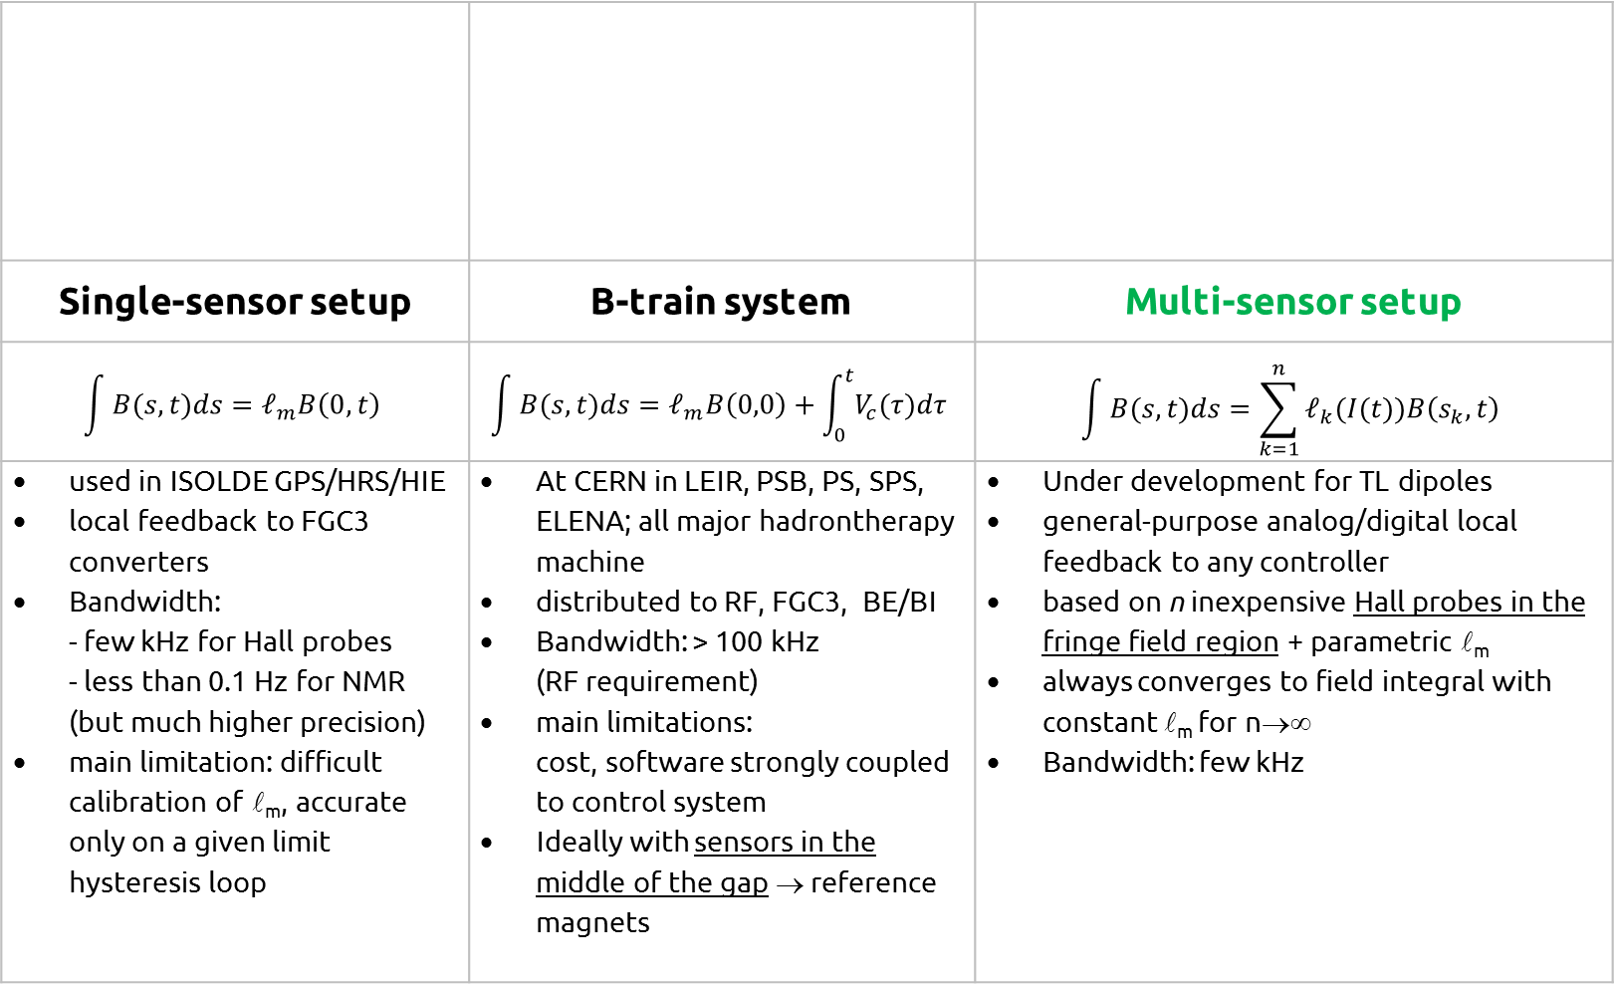
Options for real-time magnetic measurements
Single-sensor setup | B-train system | Multi-sensor setup
$$\int{B(s,t)ds}=𝓁_{m}B\left(0,t\right)$$ | $$\int{B(s,t)ds}=𝓁_{m}B\left(0,0\right)+\int_{0}^{t}{V_{c}(τ)dτ}$$ | $$\int{B(s,t)ds}=\sum_{k=1}^{n}{𝓁_{k}(I(t))B\left(s_{k},t\right)}$$
used in ISOLDE GPS/HRS/HIE local feedback to FGC3 converters Bandwidth: - few kHz for Hall probes - less than 0.1 Hz for NMR (but much higher precision) main limitation: difficult calibration of _{m}, accurate only on a given limit hysteresis loop | At CERN in LEIR, PSB, PS, SPS, ELENA; all major hadrontherapy machine distributed to RF, FGC3, BE/BI Bandwidth: > 100 kHz (RF requirement) main limitations: cost, software strongly coupled to control system Ideally with sensors in the middle of the gap → reference magnets | Under development for TL dipoles general-purpose analog/digital local feedback to any controller based on n inexpensive Hall probes in the fringe field region + parametric _{m} always converges to field integral with constant _{m} for n→∞ Bandwidth: few kHz
Notes:
Superconducting synchrotrons: ESCAR (Berkeley), only testbed [Frontiers Of Accelerator Technology - Proceedings Of The Joint Us-cern-japan ]
Flex = freedom with cycling

Slide 23
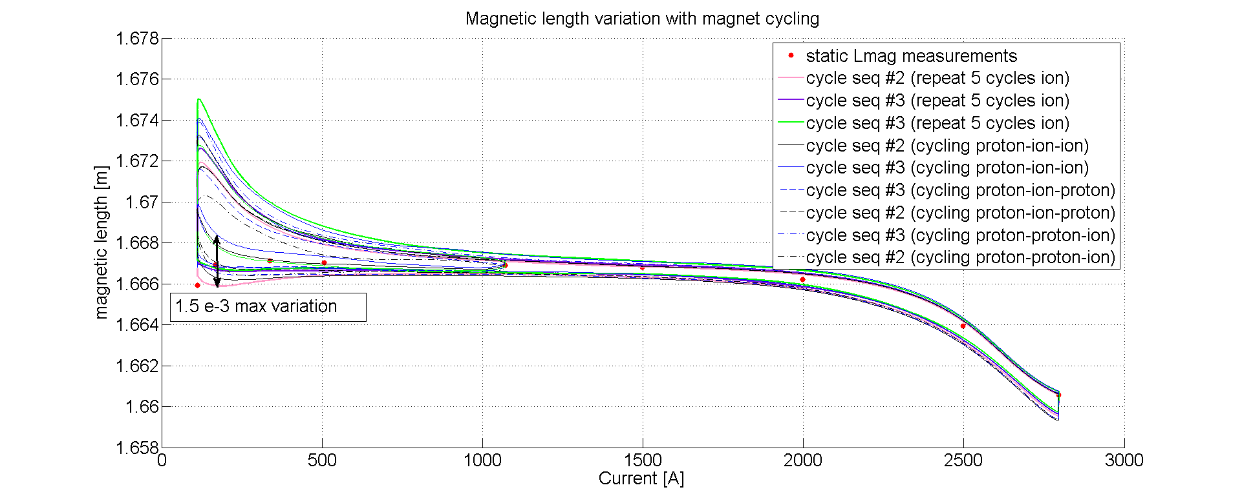
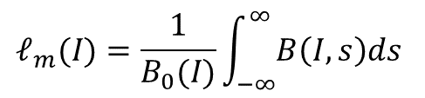
Single sensor setup limitation: magnetic length reproducibility
large fluctuations due to history-dependent residual field
reproducibility degrades at low field
$$𝓁_{m}(I)=\frac{1}{B_{0}(I)}\int_{−∞}^{∞}{B\left(I,s\right)ds}$$
 _{m} drops due to
saturation in the ends
eddy current
decay (τ=0.2 s)
central coil replaced
by NMR (DC cross-check)
saturation tends to erase previous magnetic history
→ better reproducibility at high field
Courtesy G. Golluccio
Notes:
Superconducting synchrotrons: ESCAR (Berkeley), only testbed [Frontiers Of Accelerator Technology - Proceedings Of The Joint Us-cern-japan ]
Flex = freedom with cycling

Slide 24
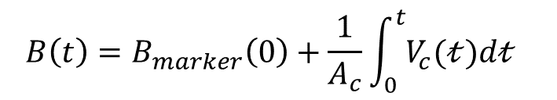
B-train systems
Real-time knowledge of the magnetic field in the main bending magnets
is essential for longitudinal and transversal beam control
Mathematical modelling is an option … (e.g. FIDEL, synthetic B-trains …)
… but precise predictions in iron-dominated magnets are hard → today we must measure !
(hysteresis, eddy currents, steel ageing, temperature drifts, I(t) measurement errors …)
B-train systems at CERN: LEIR, PSB, PS, SPS, AD, ELENA; BNL: AGS; hadrontherapy: HIT, CNAO, MedAustron
$$B\left(t\right)=B_{marker}\left(0\right)+\frac{1}{A_{c}}\int_{0}^{t}{V_{c}(𝓉)d𝓉}$$
$$A=πr^{2}$$
Notes:
Superconducting synchrotrons: ESCAR (Berkeley), only testbed [Frontiers Of Accelerator Technology - Proceedings Of The Joint Us-cern-japan ]
Flex = freedom with cycling

Slide 25

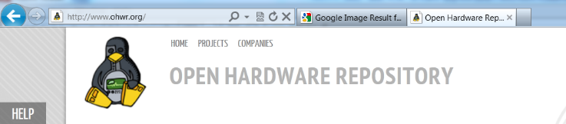

B-train consolidation at CERN
  Blah blah
  Blah blah …
Industrial PICMG1.3 PC (SLC3)
64 bit GNU/Linux Bmeas FESA3 class
for remote configuration and diagnostics
SPEC PCIe carrier card + FMC mezzanine
VHDL can be updated remotely quickly
The CERN-wide B-train consolidation project FIRESTORM
(Field In REal-time STreaming from Online Reference Magnets)
Optical fiber serial transmission of absolute field values (non-incremental)
via CERN’s White Rabbit protocol (≈ Ethernet + nanosecond synchronization)
(now an IEEE standard adopted by National Instruments et al.)

Slide 26
New PS B-train commissioning
Short-term repeatability ~ 0.02 G
Δ w.r.t legacy: < 0.2 G @ injection, < 2 G @ extraction
with FIRESTORM: 27 Hz ripple disappears, effective field resolution from 0.1 to < 0.02 G, frequency resolution from 8 to 1 Hz
0.2 G ripple
0.02 G resolution
feedback from legacy system B_{up}/B_{down}
feedback from new FIRESTORM B(t)
http://elogbook.cern.ch/eLogbook/event_viewer.jsp?eventId=2371101, http://elogbook.cern.ch/eLogbook/event_viewer.jsp?eventId=2371081
Notes:
Superconducting synchrotrons: ESCAR (Berkeley), only testbed [Frontiers Of Accelerator Technology - Proceedings Of The Joint Us-cern-japan ]
Flex = freedom with cycling

Slide 27
Multi-sensor setup: motivation
PS BOOSTER switching dipole on the extraction line to ISOLDE/PS
Cycling conditions: essentially random switching between ±1.4 GeV and ±2.0 GeV,
0.5 s rise time, 0.5 s plateaux
±2·10⁻⁴ peak non-uniformity in a 38 × 42 mm² GFR center on the nominal beam path
“regular” B-train not easily feasible, sensors must be installed next to vacuum chamber
Similar requirements by dozens other magnets in CERN transfer lines
Notes:
Superconducting synchrotrons: ESCAR (Berkeley), only testbed [Frontiers Of Accelerator Technology - Proceedings Of The Joint Us-cern-japan ]
Flex = freedom with cycling

Slide 28
Multi-sensor setup
Intermediate alternative between single-sensor setups and full-fledged B-train
Meant mainly for individual beam-line magnet control → no integral coils, small sensors to be installed in the gap next to vacuum chamber
stand-alone instrument + optional add-on interface to control system
analog/serial output for flexible interface to converters
Off-the-shelf electronics and sensors (commercial Hall probes)
proof-of-principle testing under way
Final cost expected be one order of magnitude less than a B-train
Dynamically switching between
arrays for L/R bunches
(if L/R asymmetry important)
Hall probes and/or other sensors
(coil, NMR/FMR markers)
Notes:
Superconducting synchrotrons: ESCAR (Berkeley), only testbed [Frontiers Of Accelerator Technology - Proceedings Of The Joint Us-cern-japan ]
Flex = freedom with cycling

Slide 29
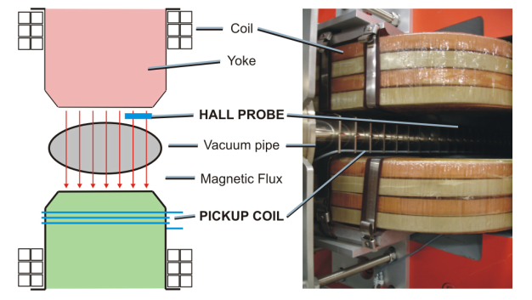
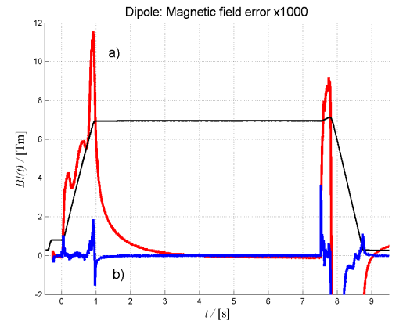
Magnetic sensors in the fringe field
  CERN LEIR B-train
  Coils and FMR markers in the fringe field of LEIR bending dipoles give results comparable with legacy B-train within ±5 G (sufficient to accelerate and extract beam)
HIT B-train
coil wound around the yoke + a single Hall probe market at flat top
field error reduced 6 ×
dead time by 30%
reproducibility 50 ppm
Notes:
Superconducting synchrotrons: ESCAR (Berkeley), only testbed [Frontiers Of Accelerator Technology - Proceedings Of The Joint Us-cern-japan ]
Flex = freedom with cycling

Slide 30
Power supply
ripple

Slide 31
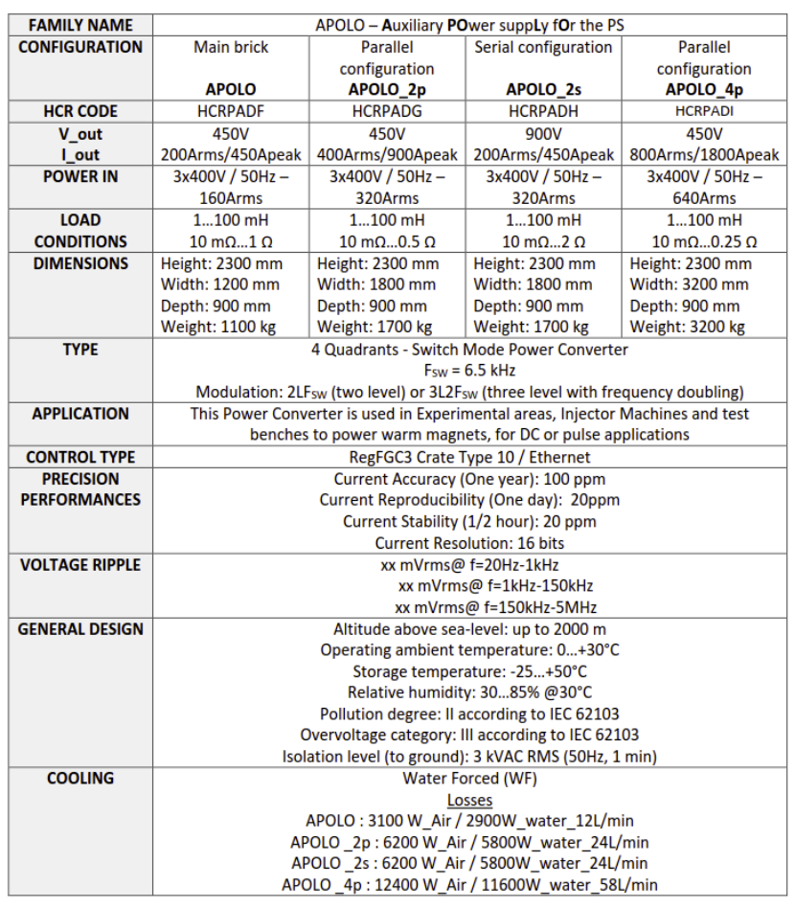
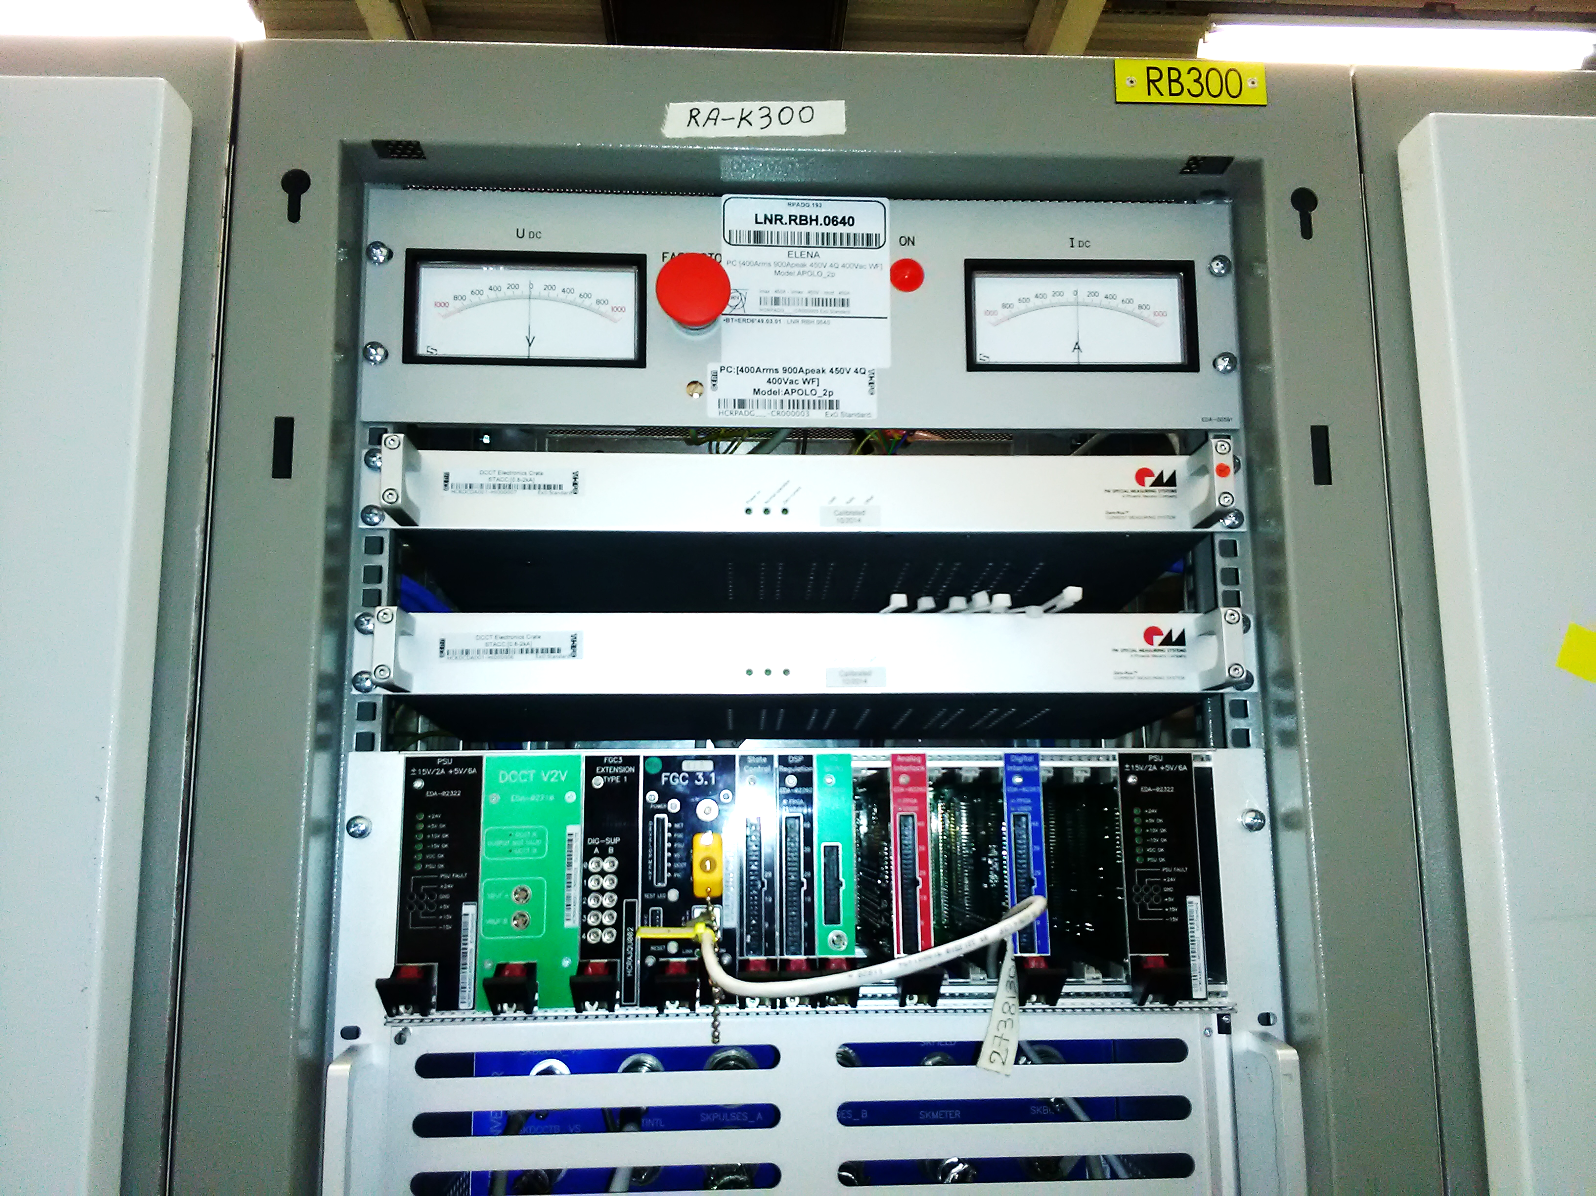
Example: APOLO on ELENA MB
  CERN-made APOLO_2p switched-mode power converter, ±450 V/ ± 450 A
  Two converters tested with different loads: 1×MB (bldg. 311), 7×MB in series (ELENA ring)
Notes:
Superconducting synchrotrons: ESCAR (Berkeley), only testbed [Frontiers Of Accelerator Technology - Proceedings Of The Joint Us-cern-japan ]
Flex = freedom with cycling

Slide 32
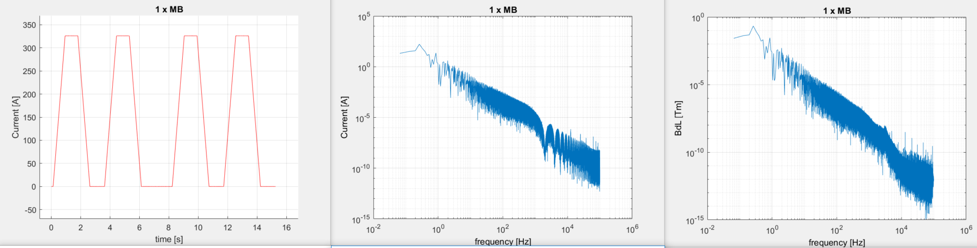
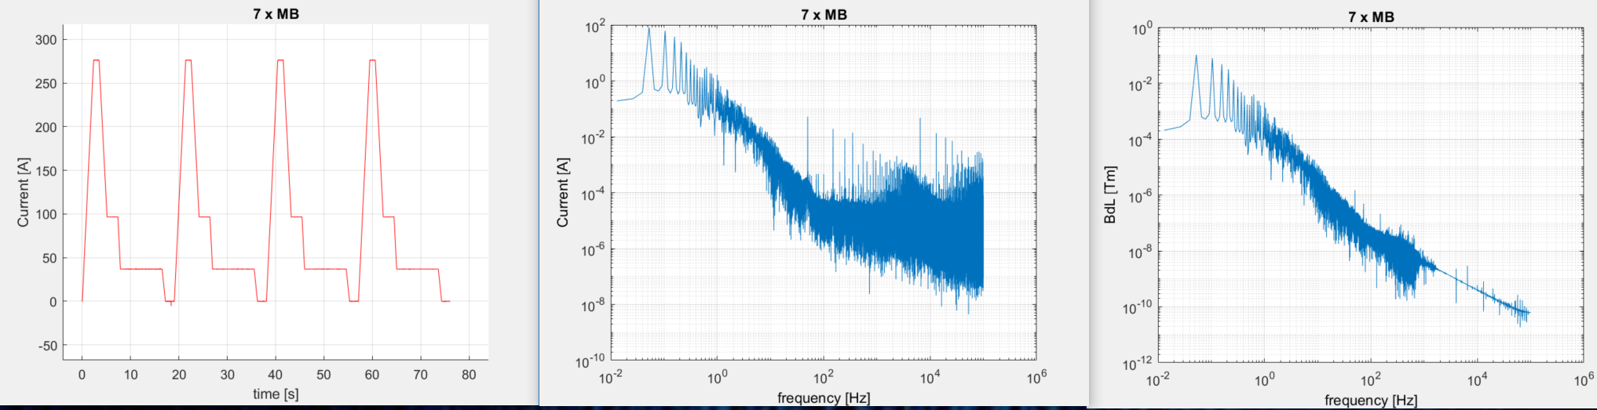
Spectral analysis
12.5 kHz + harmonics
< 1 μA
13, 21, 31 kHz ..
< 1 nTm
DCCT
filter side lobes
Test cycle (Hall 311)
6.5 kHz + harmonics
< 50 mA
6.5 kHz + harmonics
< 3 nTm
50 Hz + harmonics
+ spurious noise
(cable pickup)
Pbar machine cycle
additional
coil output filter
  Preliminary comparison between two slightly different configurations
  Switching frequency and harmonics visible in both I(t) and B(t), negligible amplitude
  7 × higher load → 10 × less current noise @ 100 Hz
Notes:
Magnet time constant = 1.4 s
Acquisition done with 16-bit NI ADC USB @ 200 kHz

Slide 33
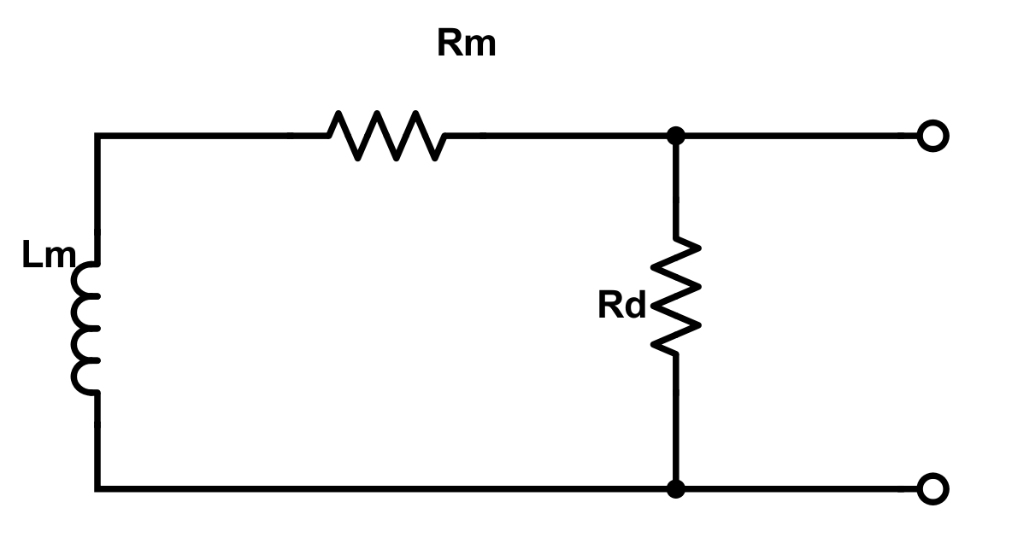
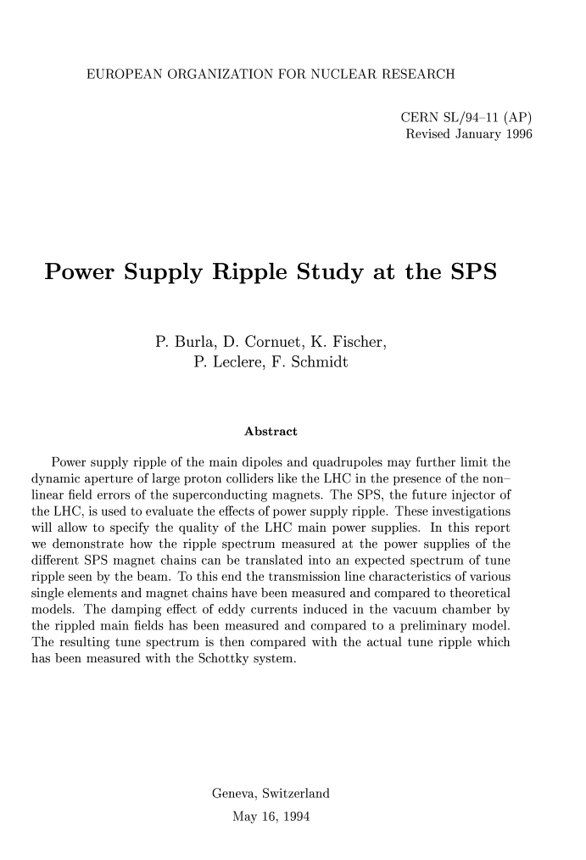

Damping resistor
  Classic technique to damp high current frequencies: resistor in parallel with excitation coil
  Works in addition to damping provided by eddy currents in the yoke and vacuum chamber
I
I_{m}
1000 Ω
$$\frac{Im}{I}=\frac{Rd}{Rd+Rm+ⅈ⁢2⁢π⁢f⁢Lm}$$
R_{d}
100 Ω
50 Ω
18 Ω
SPS MBB: Rm=3.2 mΩ, Lm=7.7 mH
10 Ω
Notes:
design time: fill in information missing in computer models:
- material properties, mechanical tolerances ()
complement models: provide hard-to-get information
- time constant of eddy currents (difficult)
- hysteresis effects (practically impossible)
magnet acceptance: go-no go decision
- accept/reject/do further tests
- spot checks (series tests)
fiducialization data for installation and alignment
magnetic axis (transversal), longitudinal center
characterization for beam physics
- input data for beam optics codes
- operating information for the control room
- one-off questions (e.g. measure a specific harmonic)
Examples: ELENA magnet model (dilution), magnet with refurbished coils, LHC series

Slide 34
Conclusions

Slide 35
Conclusions
compact synchrotrons with SC magnets in the range of 2~3 Tm beam rigidity have some historical precedents
strongly-curved extrapolations of well-established designs such as cos-θ look difficult; R&D needed to qualify new designs such as CCT
real-time dipole field feedback needed for high accuracy control; many applications to CERN and medical synchrotrons
new measurement solutions are being developed at CERN to decrease costs and fit beam line magnets
measurement of field harmonics for real-time correction
might allow to relax field quality constraints in future magnets
switched-mode power converters provide negligible ripple

