Slide 1
Ion therapy linacs: the TERA experience
Dr. Alberto Degiovanni
Workshop on Ions for Cancer Therapy, Space Research and Material Science
19-21 June 2018, ESI-Archamps (F)

Slide 2
Outline
The IDRA concept and CABOTO
    Design at 300-430 MeV/u
The CABOTO cyclinac study 2008-2012
    The cyclotron + linac system (230-430 MeV/u)
    High gradient tests - Frequency comparison
New developments:
    Source: Med-E gun
    Cyclotrons (70 MeV/u injection) / RFQ for ions + SCDTL injection
    RF design: bTW structures
    RF power: Multi Beam Klystrons
Conclusion

Slide 3
The IDRA concept and CABOTO

Slide 4
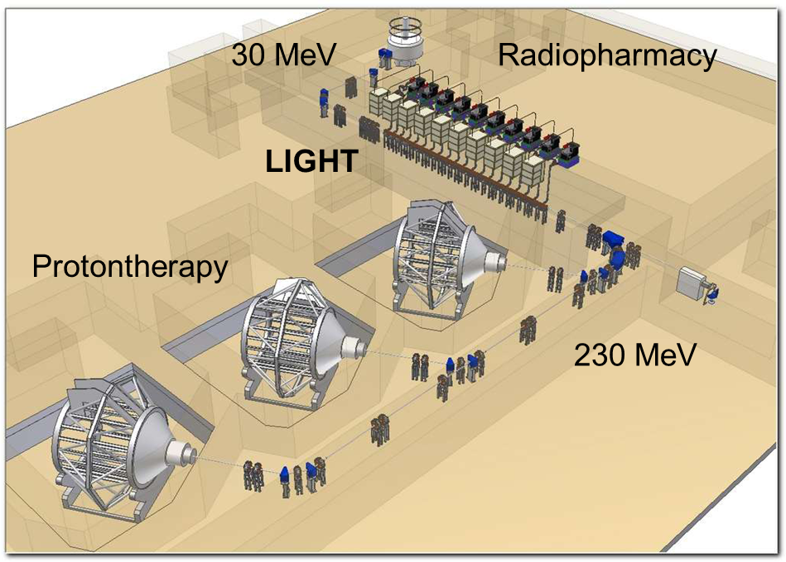
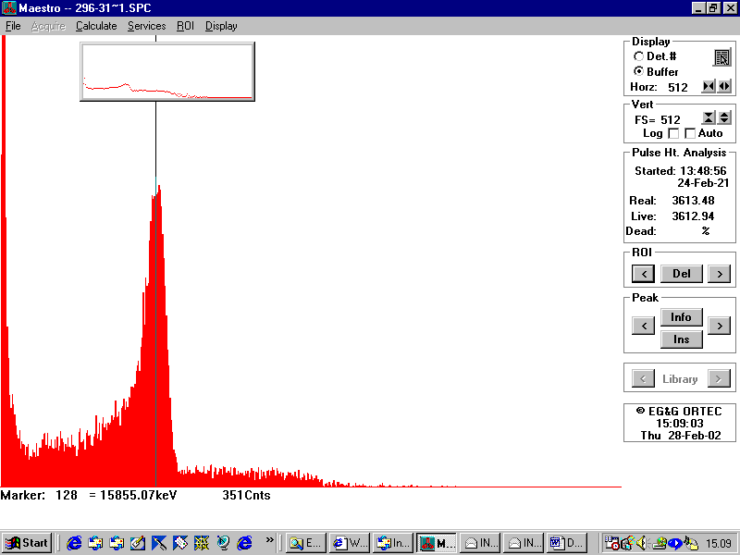
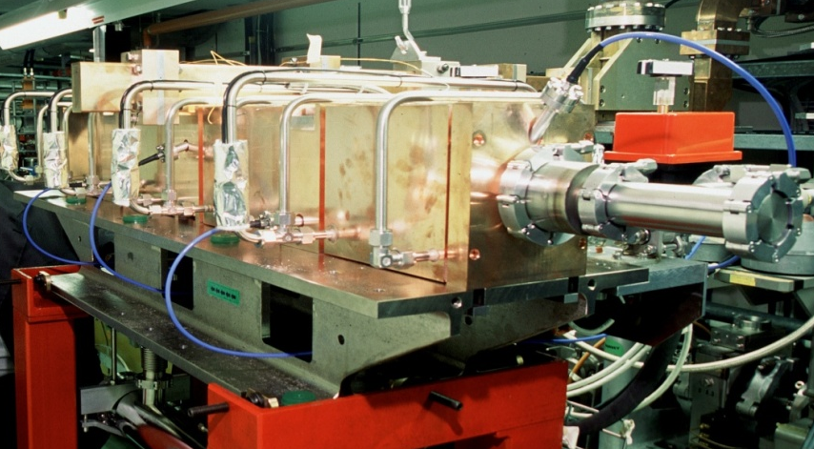
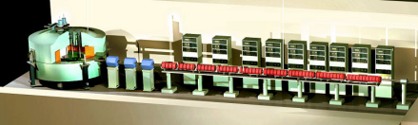
The cyclinac and IDRA timeline
1993: Cyclinac first proposal
2001: IDRA concept
2002: test of LIBO-62 MeV (CERN-TERA-INFN)

Slide 5
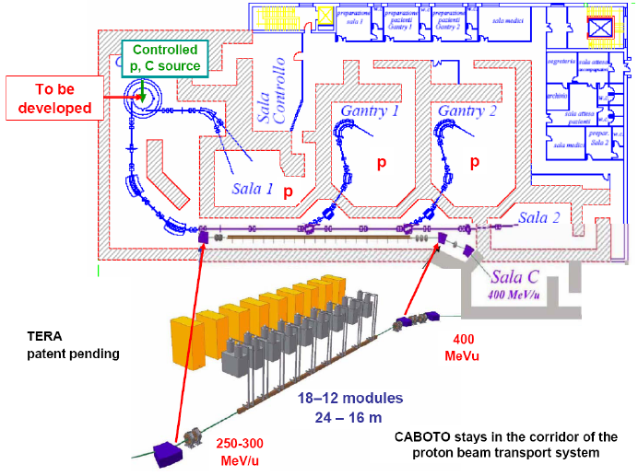
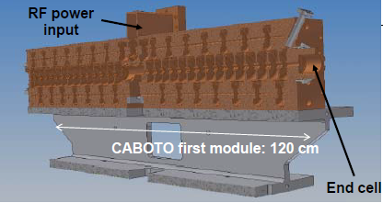
CABOTO: a CArbon BOoster for Therapy in Oncology
1993: Cyclinac
proposal
2001: IDRA concept
2002: test of LIBO-62 MeV (CERN-TERA-INFN)
2007: first CABOTO
proposal

Slide 6
The CABOTO cyclinac study 2008-2012

Slide 7
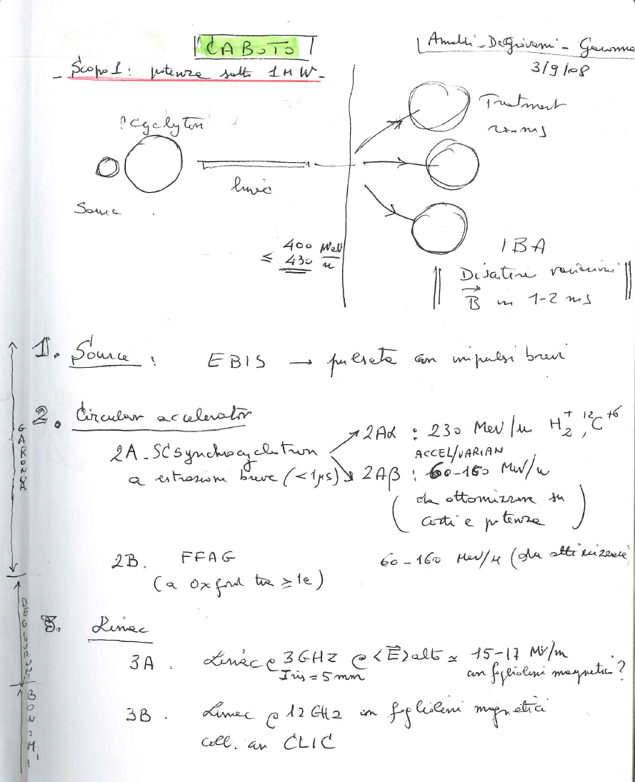
CABOTO Project – 03.09.2008

Slide 8
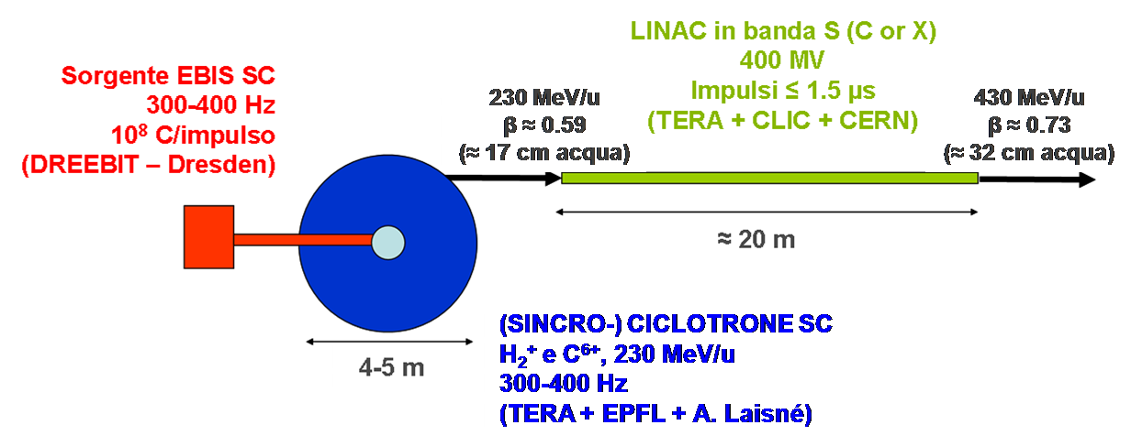
CABOTO Project 2008-2010
CABOTO-S (3.0 GHz)
CABOTO-C (5.7 GHz)
CABOTO-X (9.3 GHz)

Slide 9
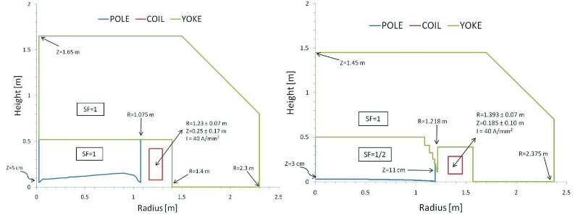
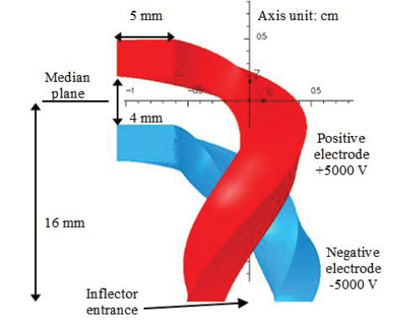
The CABOTO cyclotron injectors studied by TERA
Comparison between two possible solutions at 230 MeV/u
  Isochronous Cyclotron
  Synchro-cyclotron
Conceptual design of IC for intermediate energies at 70-120-170 and 230 MeV/u
A. Garonna et al., CYCLOTRON 13 Conference
A. Garonna, PhD Thesis EPFL 5156 (2011)

Slide 10
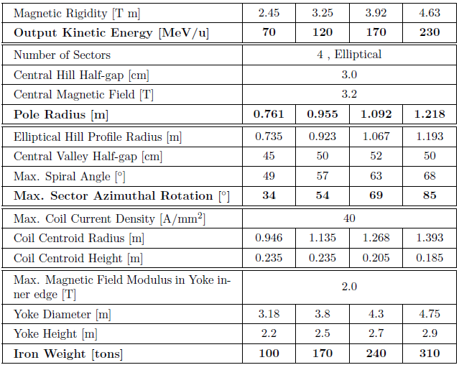
Isochronous Cyclotrons conceptual designs
A. Garonna, PhD Thesis EPFL 5156 (2011)

Slide 11
CABOTO-S first design
Cells per tank / tanks per module | 16 / 2
Number of accelerating modules and number of klystrons | 17
Peak power per module (with 15% losses) [MW] | 5.2
Total length of the linac [m] | 24
Synchronous phase | -16°
Effective shunt impedance ZT² (100% SF values) [MΩ/m] | 114-120
Average axial electric field E₀T [MV/m] | 23-22
Total peak RF power for all the klystrons [MW] | 88
Total peak klystron power [MW] | 210
Repetition rate [Hz] | 400
Duration of the accelerated hadron pulse [μs] | 1.5
Duration of the HV power pulse [μs] | 3.2
Duty cycle of the HV power pulses | 1.3 10⁻³
HV wall plug power for the RF system [kW] | 270
S-band design
230-430 MeV/u
17 RF units
24 meters
Avg. Field E₀ = 26 MV/m

Slide 12
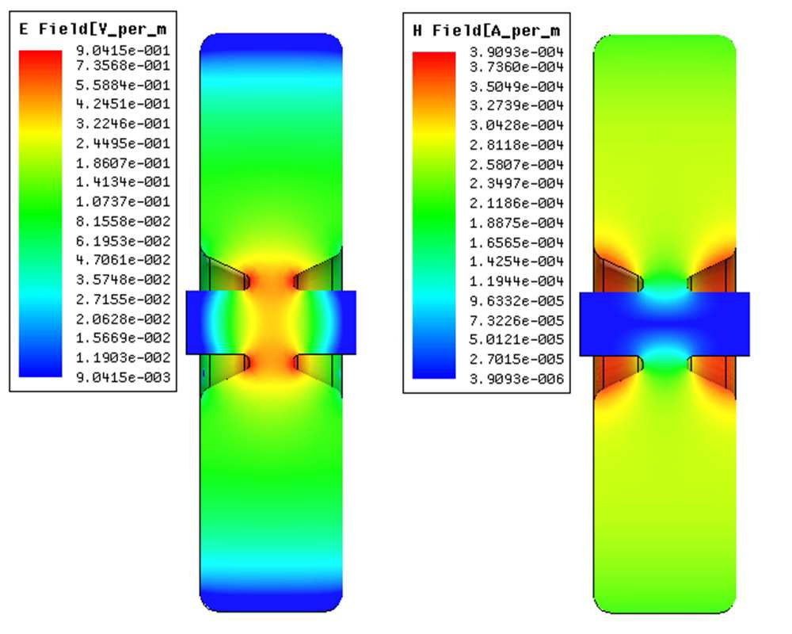
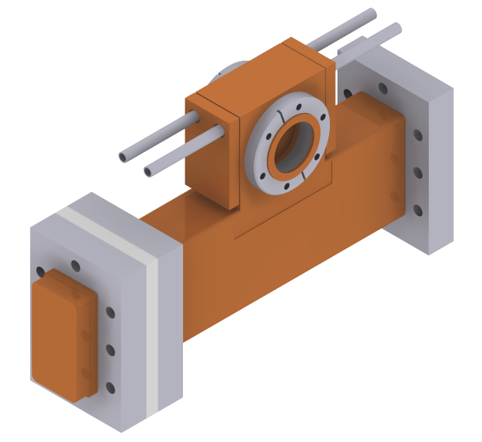
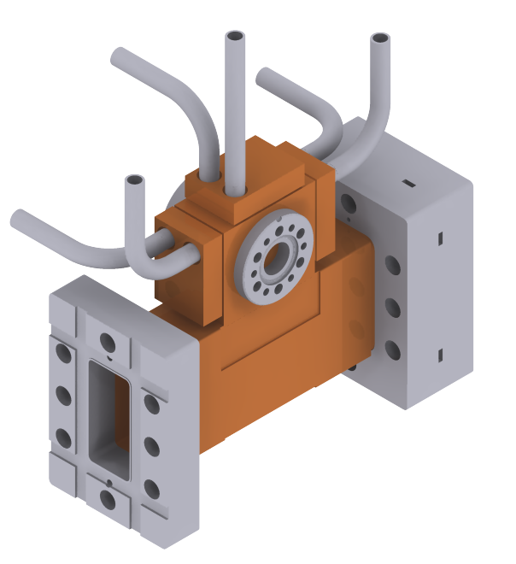
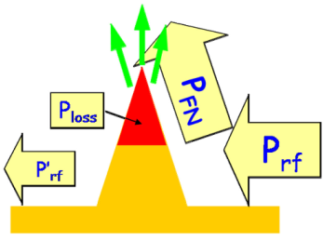
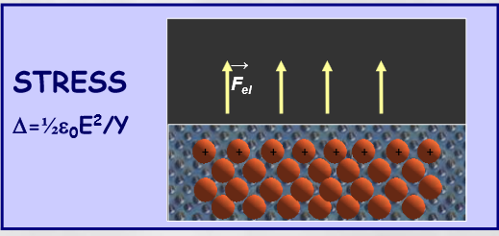
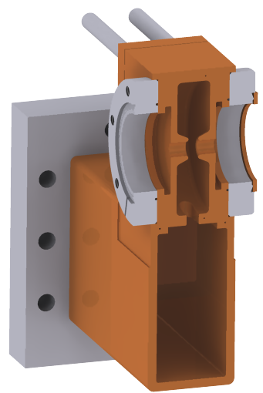
TERA high gradient test program
Find maximum achievable field at frequencies of interest for cyclinacs
Determine limiting quantities for high gradient performance and models for optimization of future cyclinacs
1x S-band
3x C-band
Probability of BD:
For protontherapy BDR < 2 10⁻⁶ bpp/m → <1 BD every treatment session
Validate BD scaling for new geometries:
  power flow:
  stress model:
Grudiev at al., Phys. Rev. ST Accel. Beams 12 (2009)
Djurabekova et al., Phys. Rev. ST Accel. Beams 15 (2012)
Notes:
The high gradient test program consisted in the design, fabrication and high power test of a set of single cell cavities in order to
1- find maximum achievable fields in the structures used for the linac designs
2- determine the limiting quantities and the scaling laws for the optimization of future cyclinacs
The performance of high gradient structures are limited by the phenomena of BD or vacuum arcs. To quantify the probability of BD the BDR is introduced which is defined as the N of BD divided by the number of Pulses and usually normalized to the structure active length. It is measured in bpp/m. The BDR for protontherapy application should be less than 10-6 bpp/m, that would correspond to a BD probability of less than a BD every treatment session for a 20 m long linac.
In this thesis the study of the BD probability with respect to the fields present on the cavity surface has been performed for the first time for the structures of interest for protontherapy linacs and is compared with the results obtained by the CLIC study.
In particular two models are used: the power flow model that relates the BD probability to the power flow heating small tips present on the copper surface, and for which the modified Poynting vector Sc has been introduced to describe both the active and reactive power flow. The second model is the «stress model» for which the BD are initiated by the local stress induced by the high electric fields and for which the BDR is proportional to the concentration of defect in the copper cristalline structure.

Slide 13
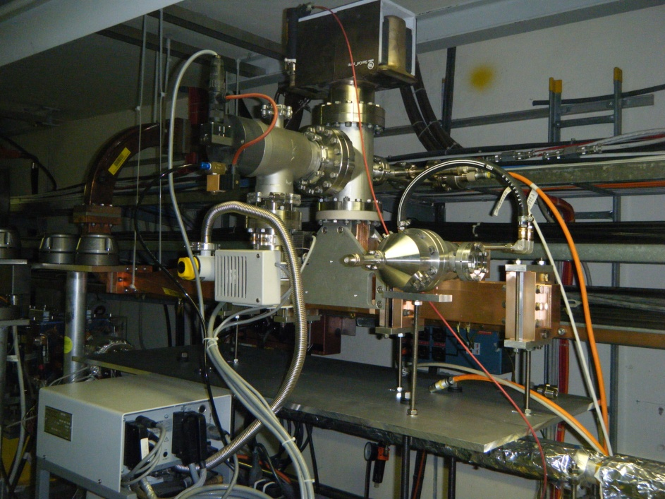
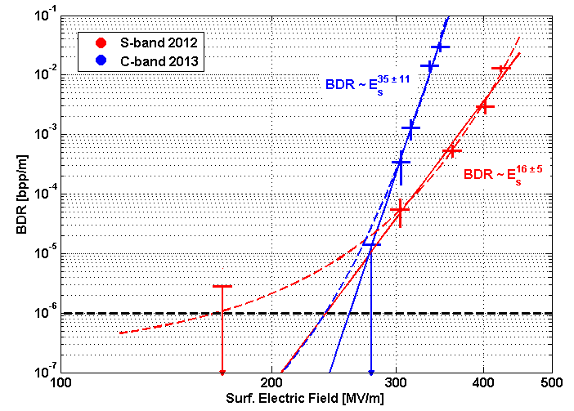
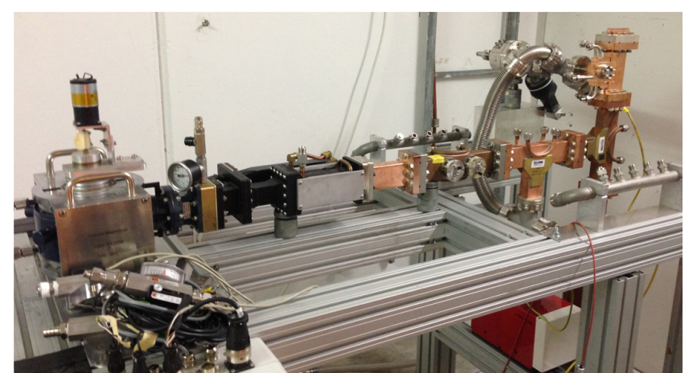
A TERA project: understanding the limits on gradients
High gradients are needed to reduce the linac size
Accelerating gradients for CABOTO ~ 30 MV/m
Collaboration with CLIC for understanding the limits on gradients…
S-band cavity under test
S. Verdú-Andrés et al, arXiv:1206.1930v2
A. Degiovanni et al, NIM A 657
C-band cavity under test

Slide 14
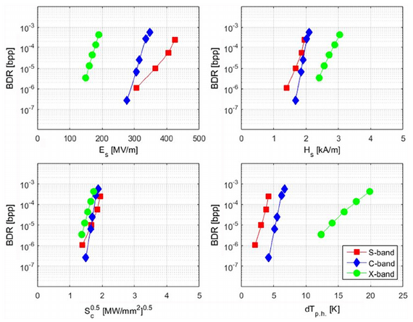
High gradient test comparison
BDR results for different field quantities and at different frequencies
A. Degiovanni et al., NIM A (2018)
Notes:
Un resultat très interessant des tests est representé dans ce graphique. De la comparaison de notre resultats avec les mesures effectué sur une structure à plus haute freq. Pour le projet CLIC on peut conclur que entre ces quatres quantité qui peuvent representer une limite pour les performences des structures à haut gradient, celles du vectueur de Poynting introduite il y a quelques années par Walter et collegues semble etre la mieux adapté, car elle donne un mineur ecart de donnés ùà differente frequences.

Slide 15
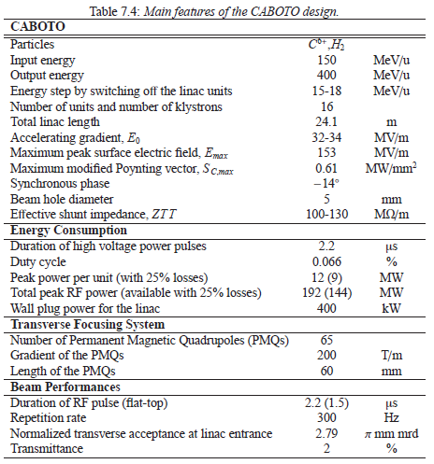
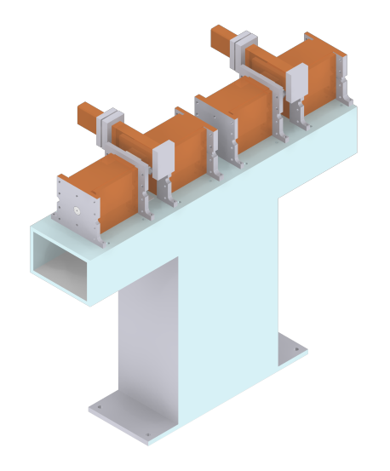
CABOTO-C first design
C-band design (5.7 GHz)
150-400 MeV/u
16 RF units
24 meters
Avg. field E₀ = 33 MV/m
S. Verdú-Andrés, J. of Rad. Res., 2013 (54)

Slide 16
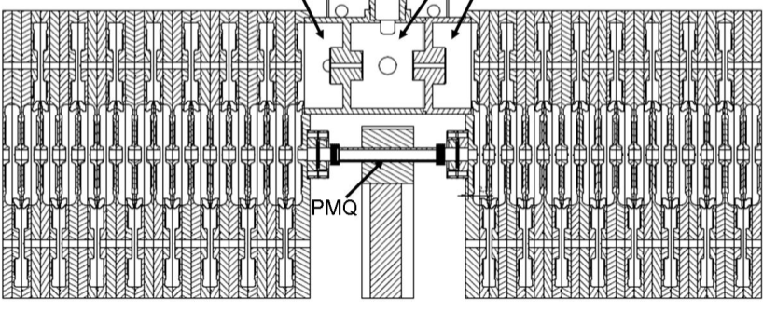


Accelerating gradient and real estate gradient
Presence of electric field free spaces (for PMQ and flanges!) reduces real estate gradient!
Typical filling factor is ~ 70-75%
    Minimum space for PMQ (small aperture, high gradient)
    Reduced space for diagnostics!

Slide 17
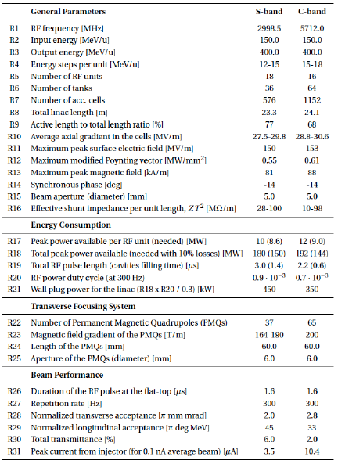
Design philosophy
Power consumption "Injector" + linac < 1 MW
    → gradient vs power
    → use of PMQ
Controlled peak surface fields
→ low BDR
Power splitting scheme / energy modulation
Optimized transmission
    → choice of aperture
Dual acceleration
A. Degiovanni, PhD Thesis EPFL 6069 (2014)

Slide 18
New developments

Slide 19
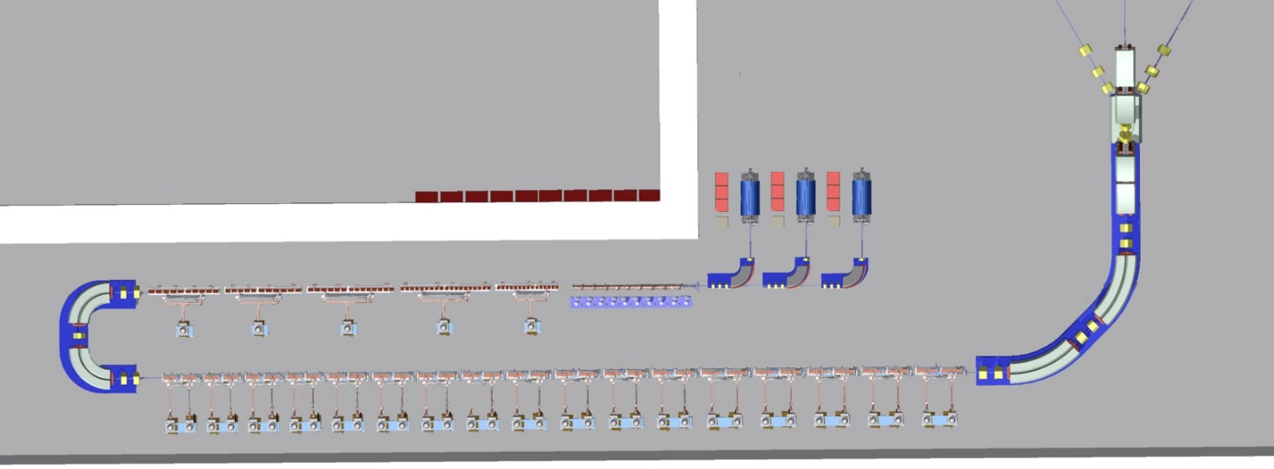
CABOTO cyclinac / all-linac
Cyclinac
(Cyclotron injection)
  Compact
  Power efficient
All-Linac
(RFQ+DTL “injector”)
  High transmission
  Low emittance
70 MeV/u
34m – 34 kl
≤ 430 MeV/u
70 MeV/u
34m – 34 kl
≤ 430 MeV/u

Slide 20
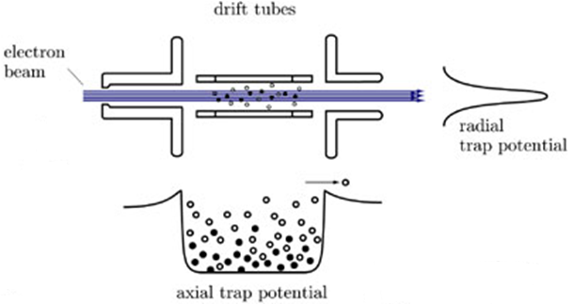
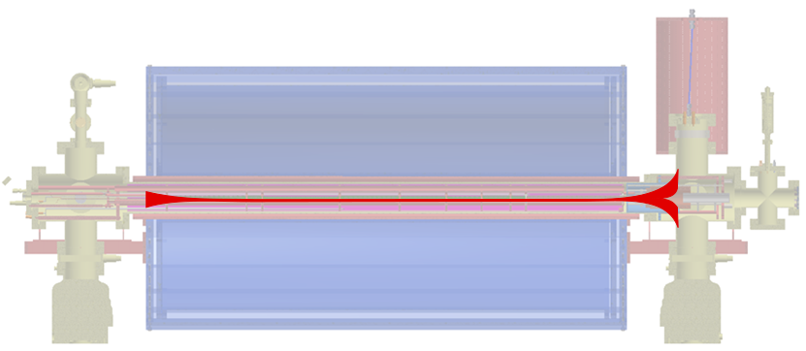
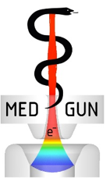

The ion source – Superconducting EBIS
Large magnetic fields and intense electron guns allow to produce fast ionization
Pulsed operation at high repetition rate is possible
Very small emittances are produced (< 0.1 µm rms normalized)
Others: Krion-2 from JINR and EBIS-SC from Dreebit Gmbh
(courtesy of Zschornack, Dreebit Gmbh)
CERN’s MEDeGUN
F. Wenander (CERN)

Slide 21
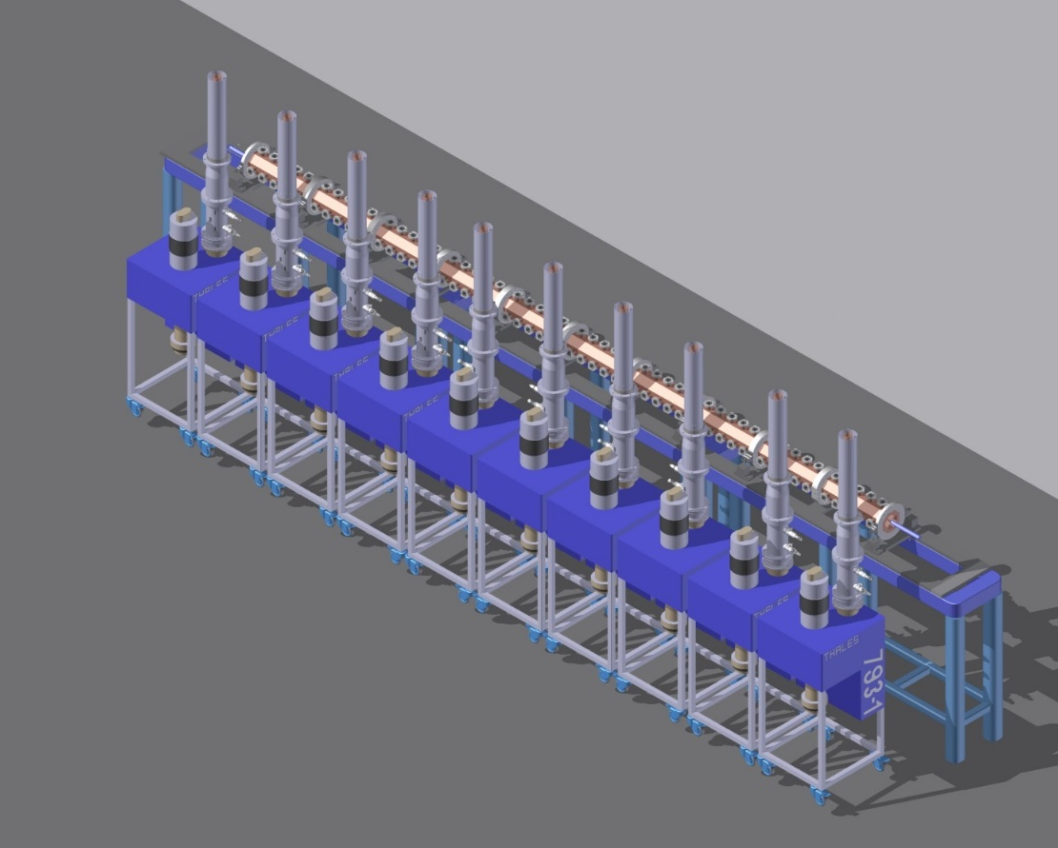
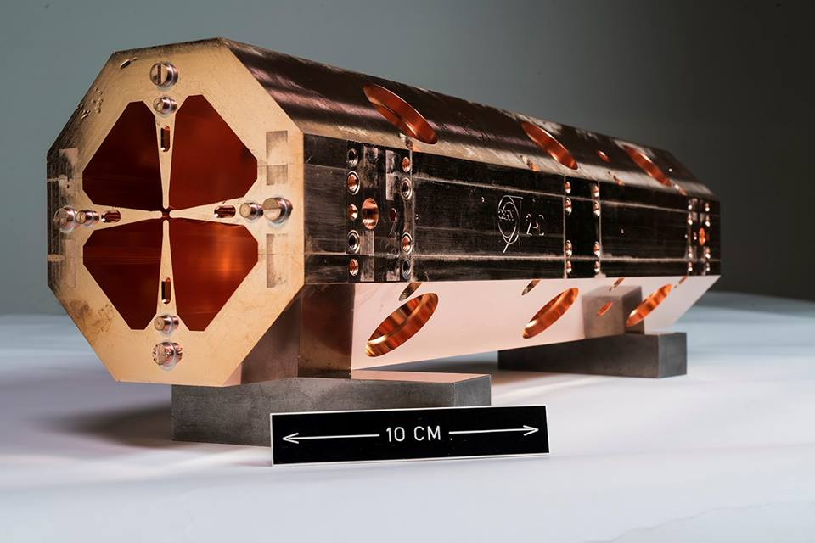

New HF-RFQ for Carbon ions
Proton RFQ built and presently in use for ADAM LIGHT project
Based on the same technology, a C⁶⁺ RFQ is being designed
bunching and acceleration of the beam up to 5 MeV/u
ε_{x}=ε_{y} [Norm. RMS] | 0.025 pi mm mrad
ε_{z} [Norm. RMS] | 0.125 pi deg MeV
Test stand at CERN
CERN 750 MHz proton RFQ module

Slide 22
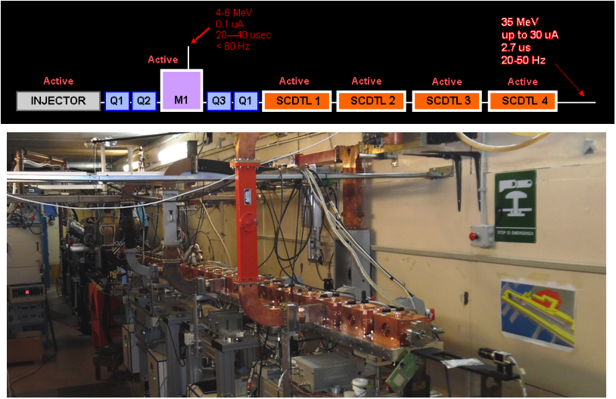
High-frequency low-beta acceleration - SCDTL
IMPLART (ENEA, Frascati – Italy)
http://www.frascati.enea.it/accelerators/Sito/TopImplartStatus&Schedules/index.htm

Slide 23
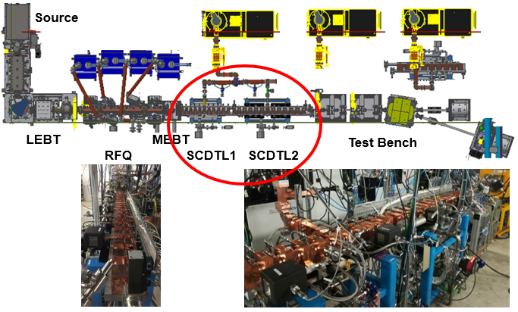
High-frequency low-beta acceleration - SCDTL
LIGHT (AVO-ADAM)
A. Degiovanni et al., MOPML014, IPAC18
V. Dimov et al., TUPAF002, IPAC18

Slide 24
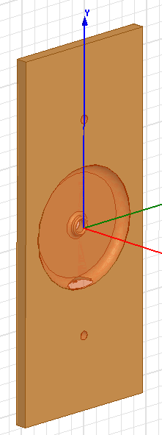
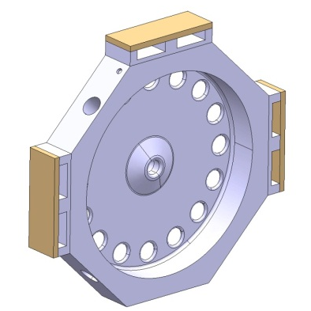
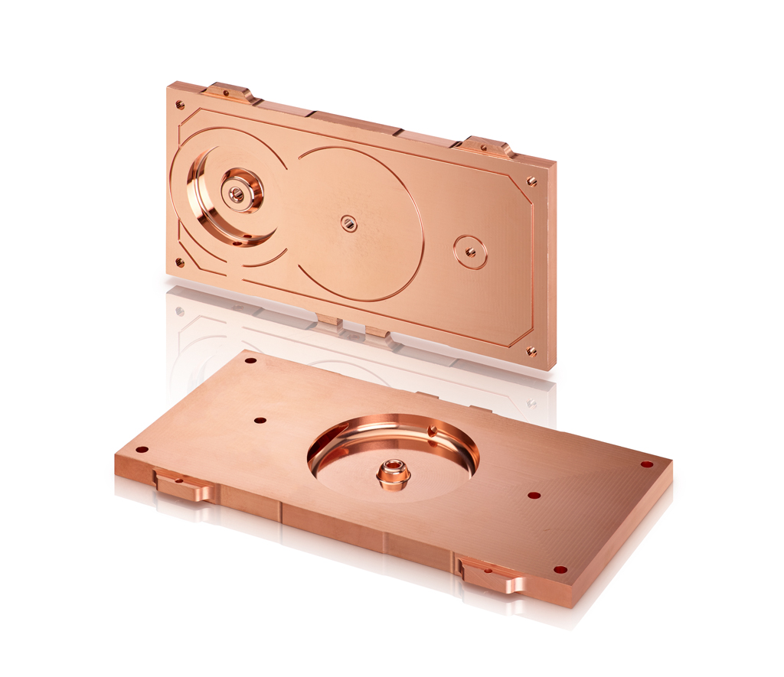
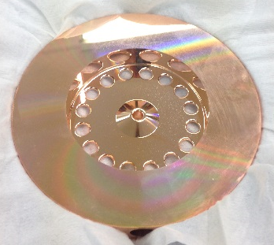
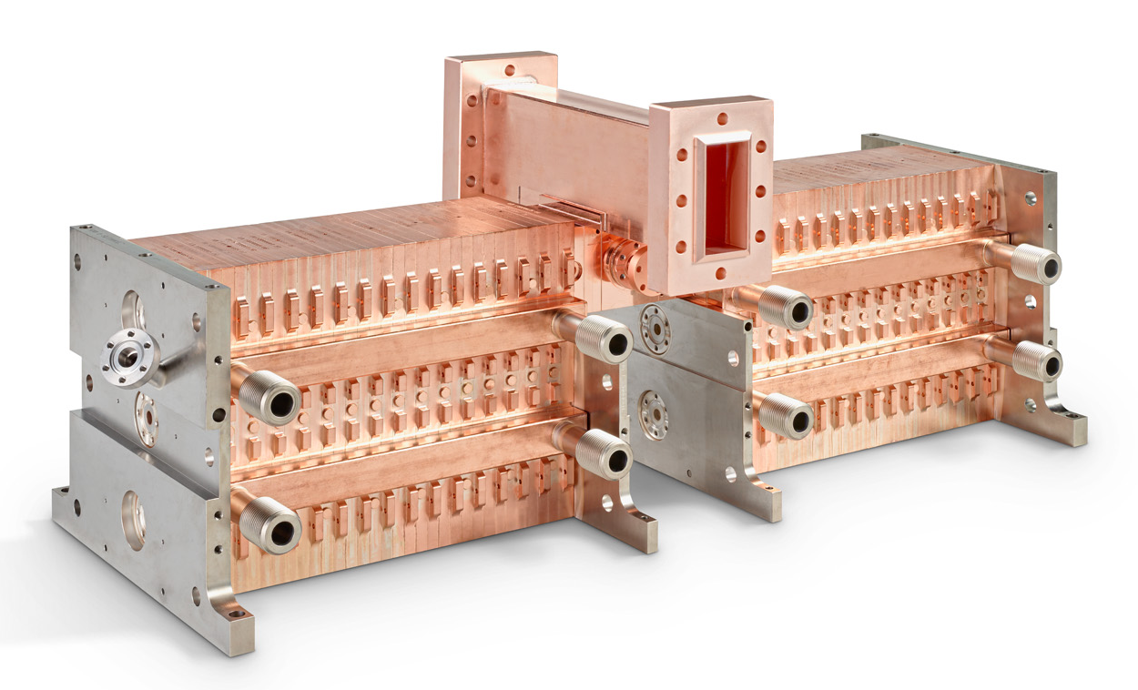
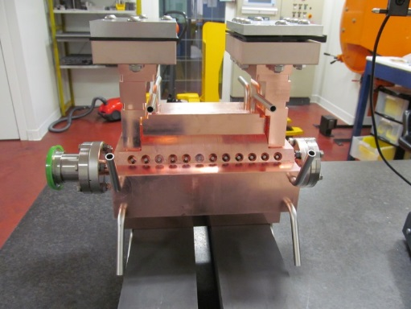
An alternative to CCLs → BTW structures development
A CLIC-TERA collaboration - funded by CERN-KT
20 cm long
Max gradient of more than 50 MV/m!
10 MeV energy gain from this structure (with peak power
~22 MW)
→ see talk by A. Grudiev
~ 70 cm
19 cm

Slide 25
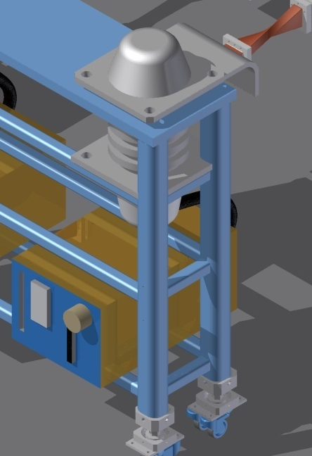
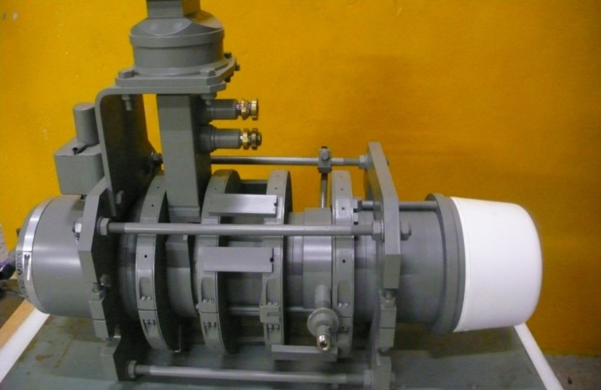
Efficient RF power source (Syratchev et al. CERN)
New Klystron design dramatically increases efficiency wrt current available technology
Assembly at VDBT (Russia) and tested at CERN
77% predicted Klystron efficiency, achieved 60 %
6.5 MW peak power, 90 kg, 0.9 m long
6 MW VDBT MBK
Test stand at CERN
7.5 MW VDBT MBK

Slide 26
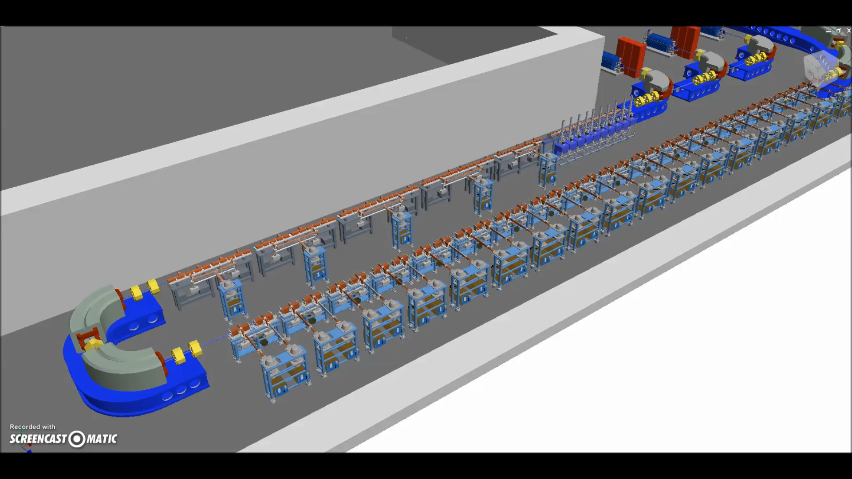
CABOTO all-linac solution
Folded linac
Power ~ 1.2 MW
High intensity possible (up to 10¹¹ C⁶⁺/s)
Test stand at CERN

Slide 27
Conclusion

Slide 28
Conclusion
Almost 25 years have passed from the proposal of using high-frequency linac for particle therapy.
High frequency proton linacs are now under commissioning by ENEA and AVO-ADAM. Based on the proton experience, light ions is natural extension!
TERA has studied in the past several schemes based on cyc-linac and all-linac solutions also at different frequencies.
Design of Carbon ion linac (CABOTO), patented and designed by TERA Foundation, has included new developments in:
    Ion source (F. Wenander et al.)
    High Frequency RFQ (A. Lombardi, V. Bencini)
    High gradient cavity design and testing (A. Grudiev, S. Benedetti, et al.)
    High efficiency klystrons (I. Syratchev)
Collaboration with several groups has been fundamental!
... A big THANK to all of them!

Slide 29

THANK YOU FOR YOUR ATTENTION

Slide 30
Back-up

Slide 31
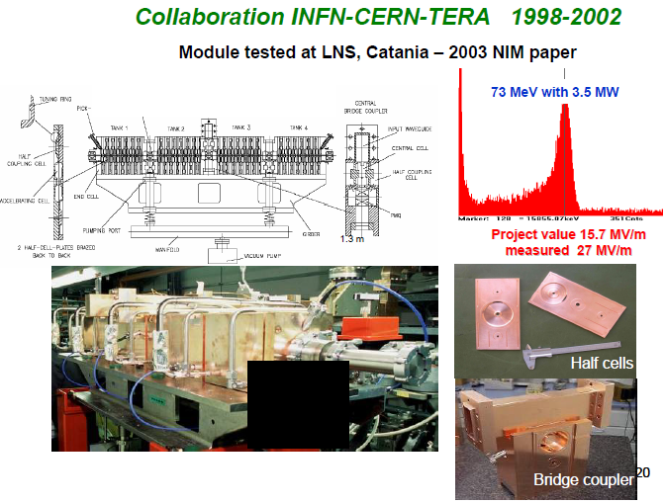
High-frequency booster

Slide 32
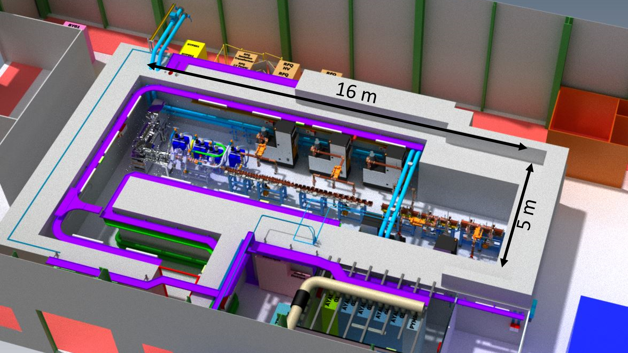
LIGHT (Linac for Image Guided Hadron Therapy) @point 2
A. Degiovanni et al., MOPML014, IPAC18
V. Dimov et al., TUPAF002, IPAC18

Slide 33

Cyclinac or all-linac ?
Cyclotron or RFQ+DTL
Compact
Power efficient
High transmission
Low emittance
E_{min}
E_{max}
3-5 μs
Klystron RF pulse
Active energy modulation
controlled in klystron
P
Rep rate 100-400 Hz
~ 2.5-10 ms
RF power into the tanks
time

Slide 34
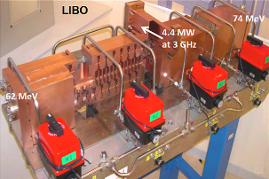
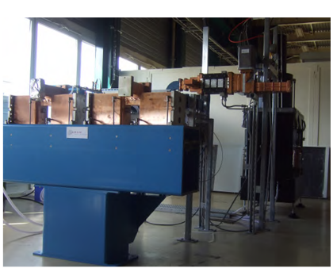
Technology transfer I: the LIBO and the first unit
LIBO (Linac Booster) prototype by TERA-CERN-INFN
  Built in 1999-2000
  First proof of principle
First Unit of ADAM
  first industrial 3 GHz linac
  unit for PT
  Optimized for industrial production
Amaldi et al., NIM A(521), 512-529, 2004

Slide 35
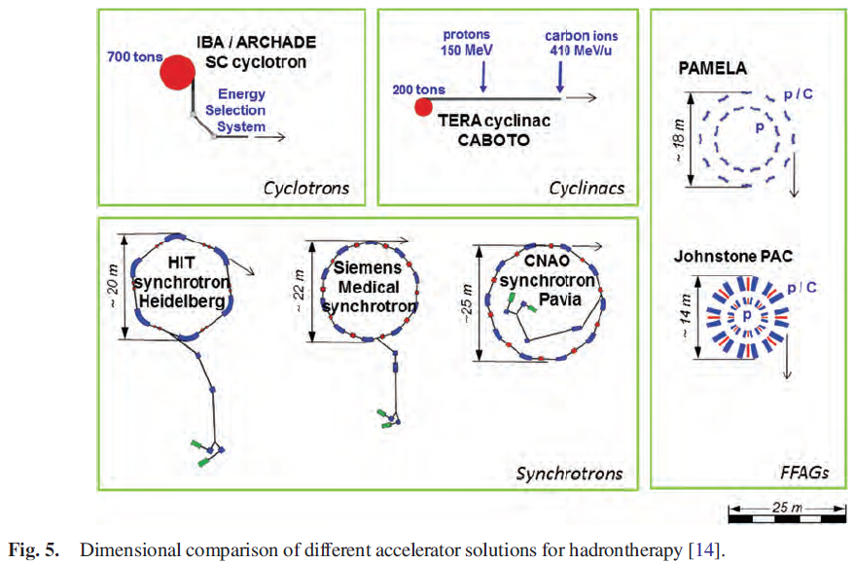
Dimensional comparison
S. Verdù-Andrès, Journal of Radiation Research, 2013, 54, i155–i161

Slide 36
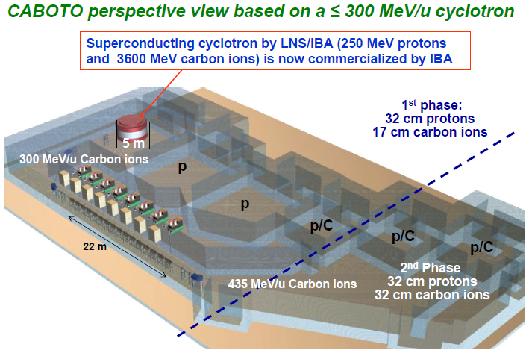

Slide 37
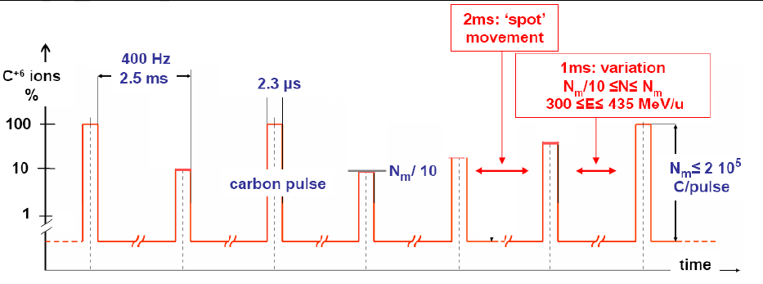
CABOTO - Time structure

Slide 38
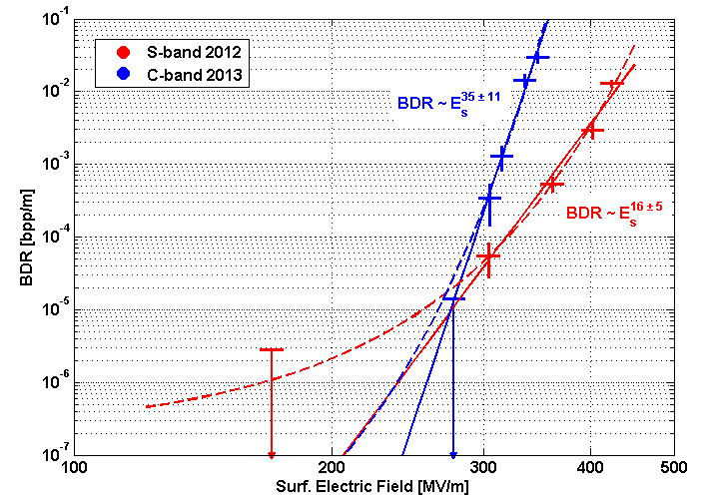
Results and discussion I
Pulse duration: 2 μs
stress model
BDR limit for therapy
power flow
Notes:
Coming now to the main results of the experiments, here is the summary of the TERA high gradient tests where the measured BDR is shown with respect to the electric surface field in the structures. This is the first time that these kind of measurements are performed on high frequency linacs for protons.
The surface field was calculated from the Power into the structure rescaled by the shunt impedance and the ratio between surface to axial field obtained in simulations. The error bars correspond to the uncertainty in power that was of about 10%. The errors on the BDR is inversely proportional to the square root of the measured number of BD, since the BD follows a Poisson distribution.
Two fits are applied and are shown in this double log plot.
With both fits, the high field limit is higher than what typically used for linac designs. According to these results surface fields up to 170 MV/m can be used for linac design.
Taking into account a surface field to axis ratio of about 5 due to the presence of nose cones this corresponds in practice to accelerating gradients of up to 30-35 MV/m, almost double than the one typical in use.

Slide 39


CABOTO cyclinac solution
Cyclotron output energy:
  Choice linked to facility’s clinical goals
  ( 70 MeV/u – 230 MeV/u)
Superconducting Cyclotron design in collaboration with INFN-LNS
External ion sources
  2 10¹⁰ H₂⁺
  in 1.5 μs pulse (100 Hz)
  1 10⁸ C⁶⁺
  in 1.5 μs pulse (300 Hz)
Source for Carbon Ion Therapy
Source for protontherapy
Cyclotron

Slide 40


New developments on cyclotrons
Iron-less Synchrocyclotron (Minervini et al., MIT)
  Design for 245 MeV protons
  Rextraction= 0.3 m, Ryoke=1.6 m, 7 tons
  8.8 T central field, 8.1 T at extraction radius

Slide 41



LIGHT (Linac for Image Guided Hadron Therapy) Overview
Proton Source
Modulator-klystron systems
Radio Frequency Quadrupole (RFQ)
Side Coupled Drift Tube Linac (SCDTL)
Coupled Cavity Linac (CCL)

Slide 42











The linac modular approach
Accelerating System
Accelerating System
Cooling System
Cooling System
Focusing System
Focusing System
RF Network System
RF Network System
RF Power System
RF Power System
Support System
Support System
Vacuum System
Vacuum System

Slide 43

The ion source – EBIS MEDeGUN
Design Parameter | MEDeGUN
Main magnet | 2 T
Trap length | 0.25 m
Electron current | 1 A
Current density | 1.5 kA/cm² (3.5 kA/cm², 5 T)
Electron energy | 7.5-10 keV
Capacity C⁶⁺ | up to 1·10⁹ ions per pulse
Repetition rate C⁶⁺ | 180 Hz (440 Hz, 5 T)
Dedicated EBIS source for CABOTO with high-compression Brillouin electron gun
Low electron beam energy optimized for C⁶⁺
Short pulse lengths <5 µs pulses
First electron beam has been propagated. (stable 1 A electron beam under 2T magnetic field - design goal)
Future stages include introduction of carbon and extraction of carbon ions
Courtesy of F. Wenander (CERN)
* R. Mertzig et al., ”A high-compression electron gun for C⁶⁺ production: concept, simulations and mechanical design”, NIM A 859 (2017)
* A. Shornikov and F. Wenander, "Advanced Electron Beam Ion Sources (EBIS) for 2-nd generation carbon radiotherapy facilities", http://dx.doi.org/10.1088/1748-0221/11/04/T04001
Test at CERN

Slide 44


CABOTO – CCL structures
The final accelerating section of CABOTO
Will bring the beam up to 430 MeV/u, and be able to vary this energy in the range 100 MeV/u – 430 MeV/u
34 Klystrons, 34 m long
28 MV/m average active gradient
No technical limits in increasing even further the final energy
ADAM CCL unit
Test stand at CERN

Slide 45



CABOTO - low beta structures for higher efficiency
DTL 3GHz
IH-750 MHz (opt)
CCL 3GHz
15 MeV/u
Energy
75 MeV/u
S. Benedetti, A. Grudiev, and A. Latina,
High gradient linac for proton therapy
Phys. Rev. Accel. Beams 20, 040101 – 2017

Slide 46








CABOTO - CCL structures optimization by TERA
Side Coupled Linac (RF cavities π/2 mode)
CCL-HG
0
CCL-BL
BTW150
0
0
waveguide
accelerating cavities
coupling cavities
S. Benedetti, A. Grudiev, and A. Latina,
High gradient linac for proton therapy
Phys. Rev. Accel. Beams 20, 040101 – 2017

