Slide 1
LGAD measurements from different producers
Alissa Howard, G. Kramberger, žan KljuN, Petja Skomina
Jožef STEFAN institute, ljubljana
A work performed in collaboration with CMs-ETL and ATLAS-hgtd groups:
INFN-Torino, USCS, IHEP-Bejing, CNM

Slide 2
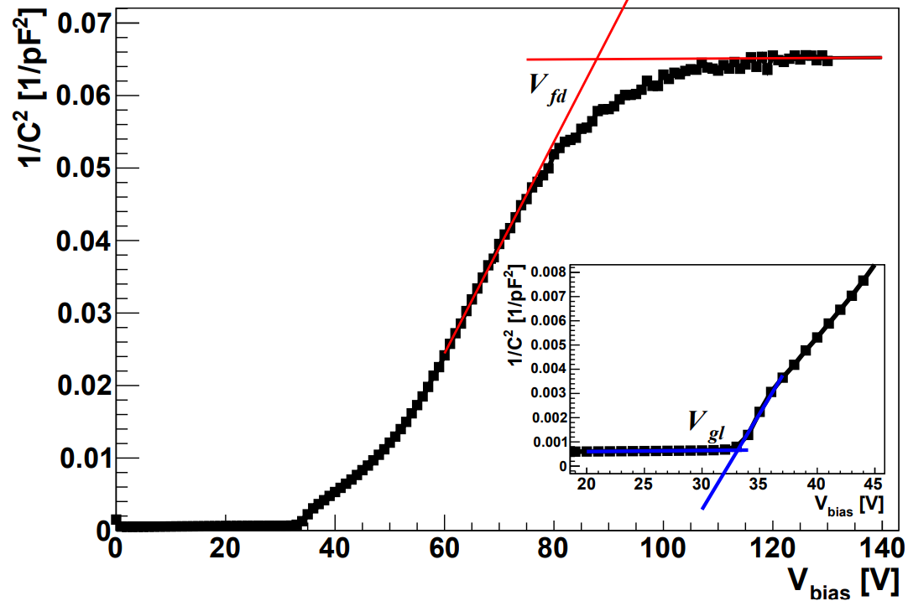

Motivation for the studies
iw
ATLAS and CMS upgrades require sensors to withstand φ_{eq}=2.5e15 cm⁻² and TID 200 Mrad -> significant decrease of gain
Gain decreases as boron substitutional atoms get deactivated (“acceptor removal”) –> reduction of the field
Ways to mitigate degradation of gain layer:
  Make the implant thinner (IW->”0”) and more doped N_{B} (~1e17 cm⁻³), reduces the acceptor removal constant (c~2-7∙10⁻¹⁶ cm²)
  Increase the bias voltage -> after depletion increase of electric field in the GL is ΔΕ ~ΔV_{bias}/thickness
  Make the implant deeper (increase of GL)
    Larger multiplication region
    Easier to recuperate the electric field ΔV_{gl}/GL compensated by ΔV_{bias}/thickness
  Replacement of gain layer implantation material or co-implantation of material that decreases the acceptor removal rate (carbon)
GL~1-2.5 μm
iw~1 μm
N_{B}~1-10∙10¹⁶ cm⁻³
thickness
GL
$$N_{eff}∝V_{fd}−V_{gl}$$
$$N_{B}∝V_{gl}$$
We want to compare the producers, which have choosen different approaches to achieve sufficient radiation hardness.

Slide 3
Experimental Procedure
Example of Vgl/Vfd determination:
Irradiated with neutrons (at JSI Triga II reactor)
Annealed for 80 mins @ 60˚C and kept cold
CVIV:
  20˚C/500mV/10kHz
  V_{gl}/V_{fd} determined from CV
Timing/CC :
  -30˚C/⁹⁰Sr source
  See Gregor’s talk for details

Slide 4
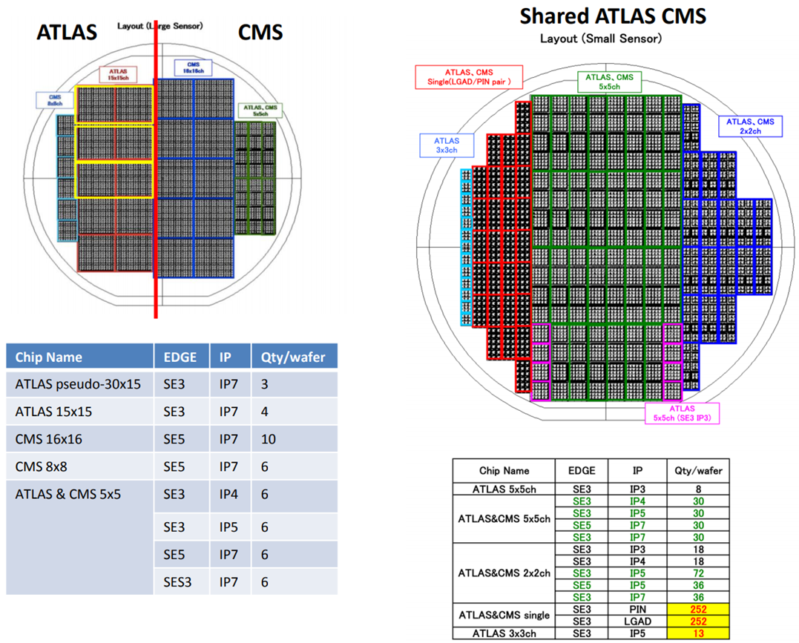
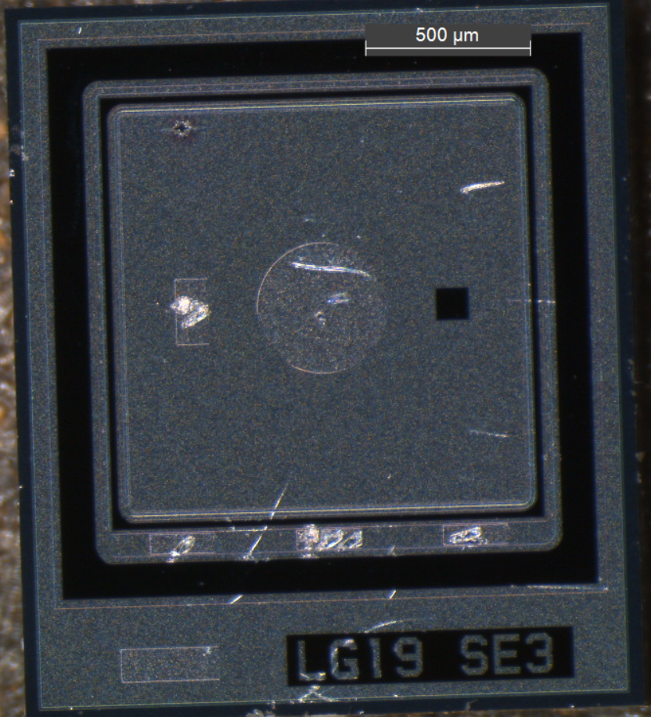
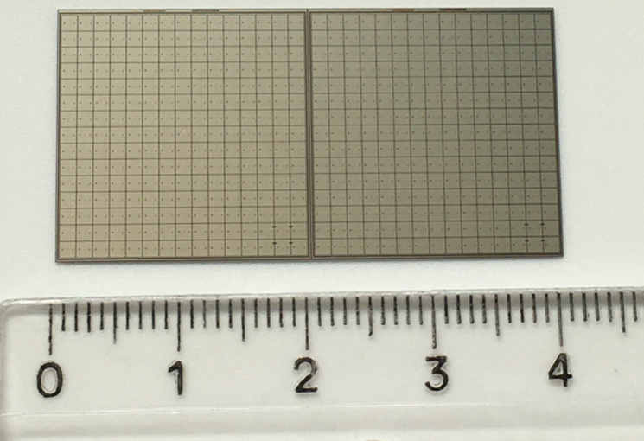

HPK-P2 – Samples
Wafer | Wafer Layout | Split | Vgl | Target Vbr | Measured Vbr
28 | Small | 1 | 50.5V | 160V | 85-155V
33 | Small | 2 | 51.0V | 180V | 85-170V
37 | Small | 3 | 53.7V | 220V | 155-205V
43 | Small | 4 | 54.5V | 240V | 170-235V
HPK-Prototype 2
  4 different doping profile (“Splits”)
  50µm
7 fluences [1e14, 4e14, 8e14, 15e14, 25e14, 30e14, 40e14]
Sensors were irradiated together (W28,33) and (W37,43) and were packed close together to minimise fluence uncertainty.
Difference in sensors V_{GL} was small and measured V_{BR} was close to targeted
PHOTO?

Slide 5
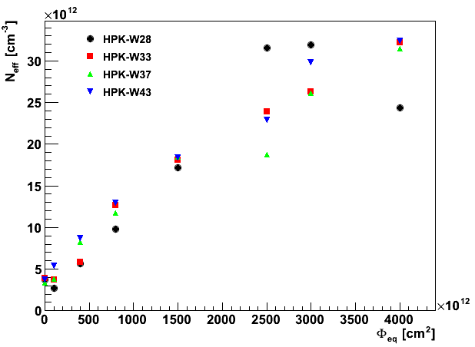
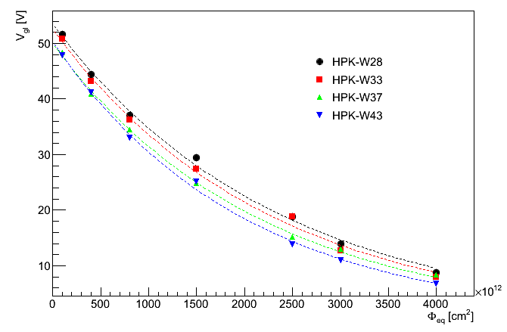
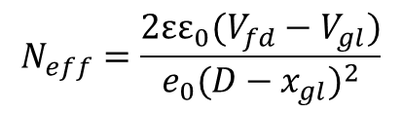
HPK-P2 – V_{gl} and Neff vs fluence
Dashed line is fit of V_{gl}(φ)=V_{gl}(t=0)exp(-c*φ)
g_{eff}~0.01-0.015 cm⁻¹
$$N_{eff}=\frac{2εε_{0}(V_{fd}−V_{gl})}{e_{0}{(D−x_{gl})}^{2}}$$
HPK-P2 | W28 | W33 | W37 | W43
c [ 10⁻¹⁶ cm⁻²] | 4.3 | 4.5 | 4.6 | 5.0
D=Sensor thickness
x_{gl}=gain layer thickness (assume 2 µm)

Slide 6
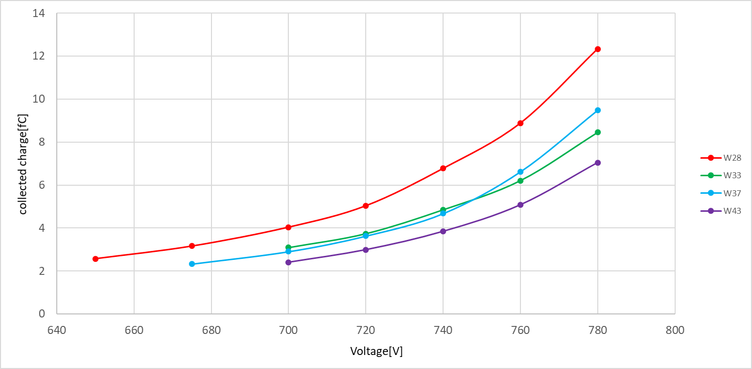
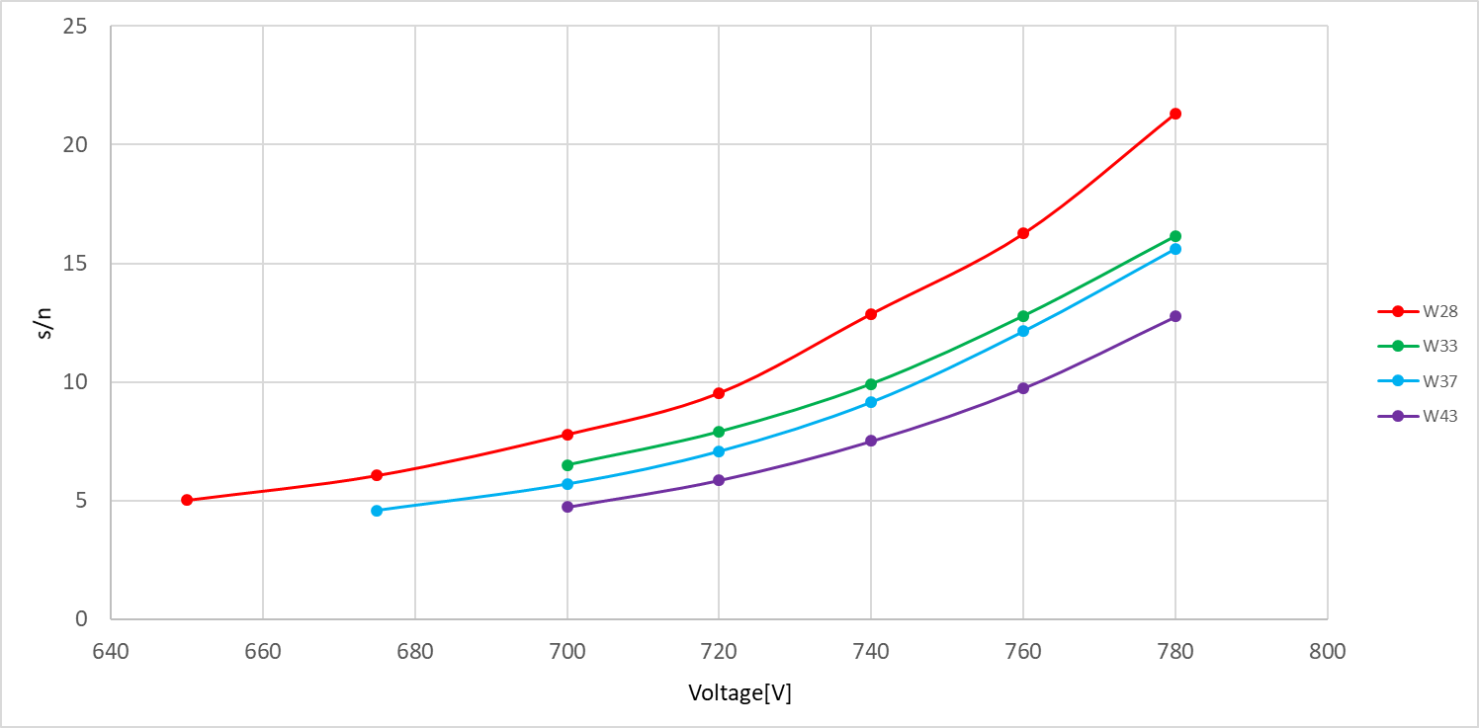
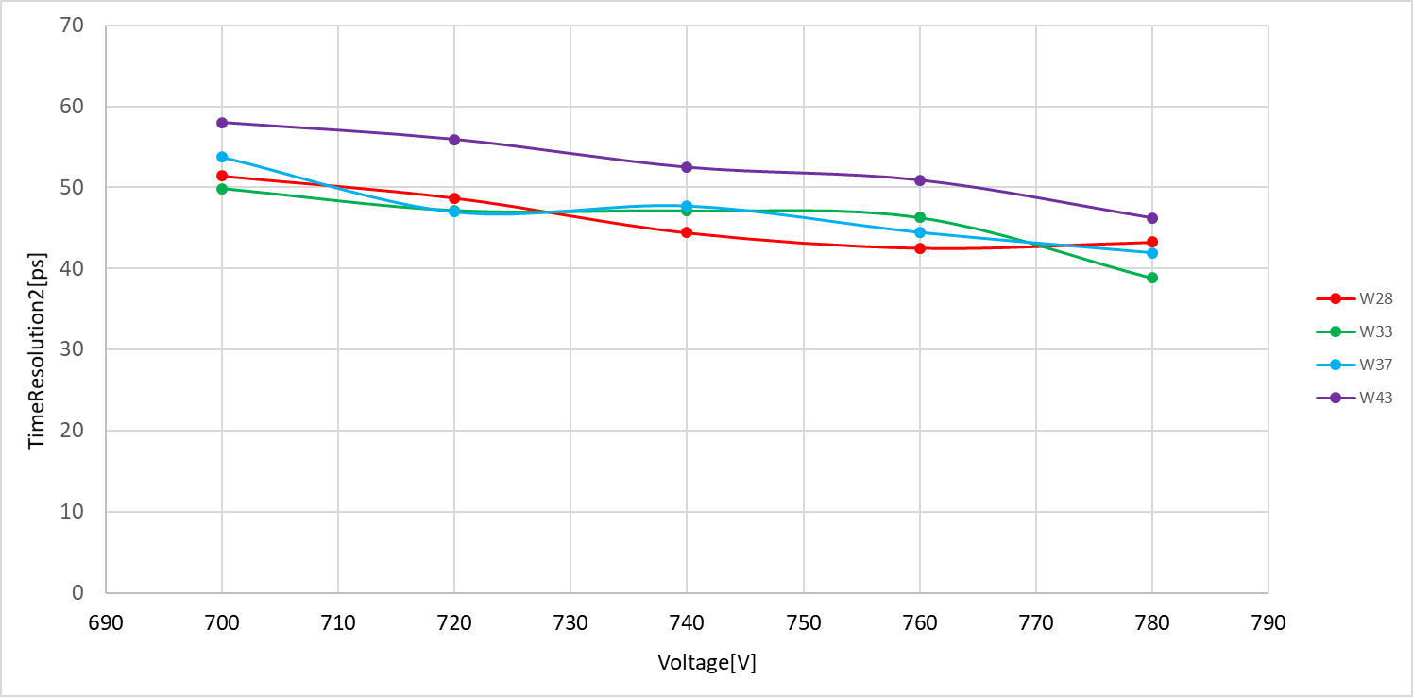
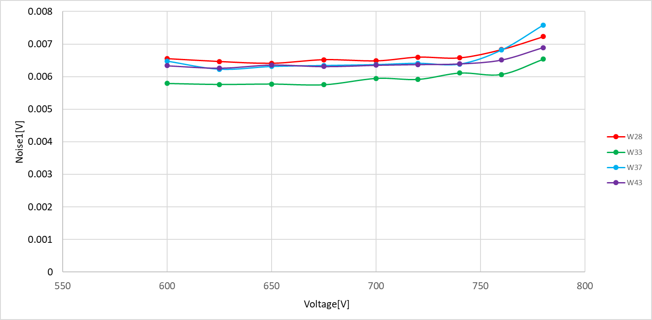
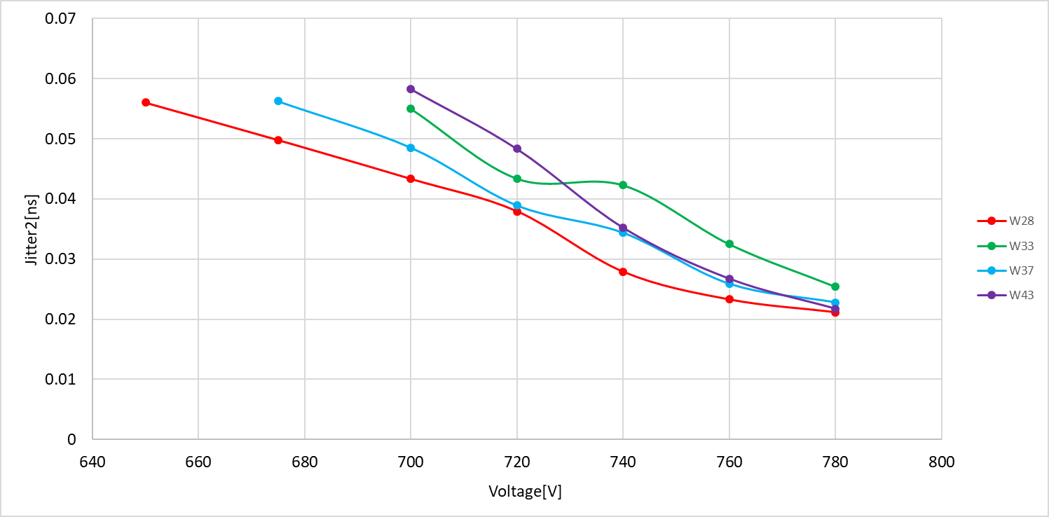
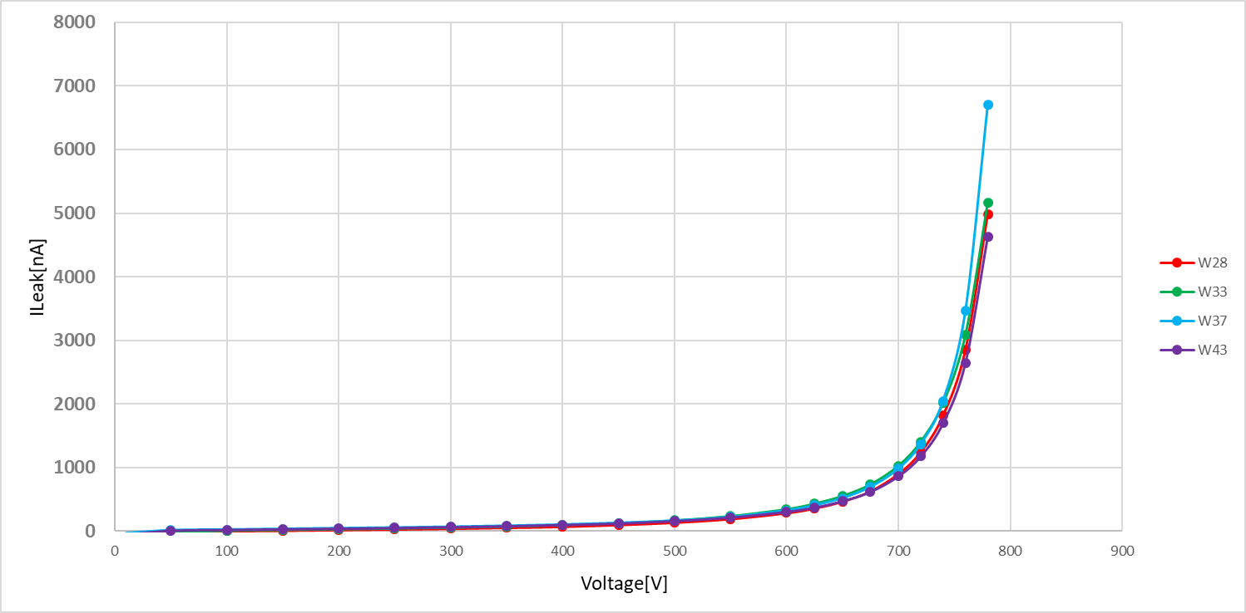
HPK-P2 – Timing/CC (at 2.5e15 cm-2)
Collected charge
S/N
Time resolution
W28 is slightly better in CC , but all sensors are very close in performance.
noise
Jitter
Leakage current

Slide 7
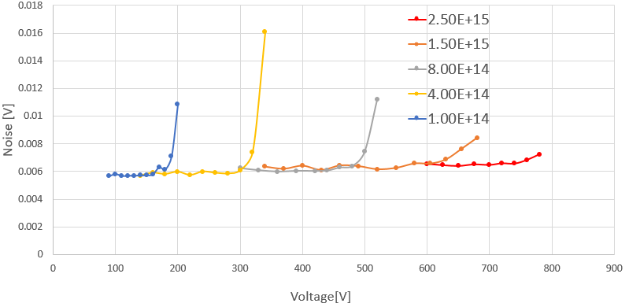
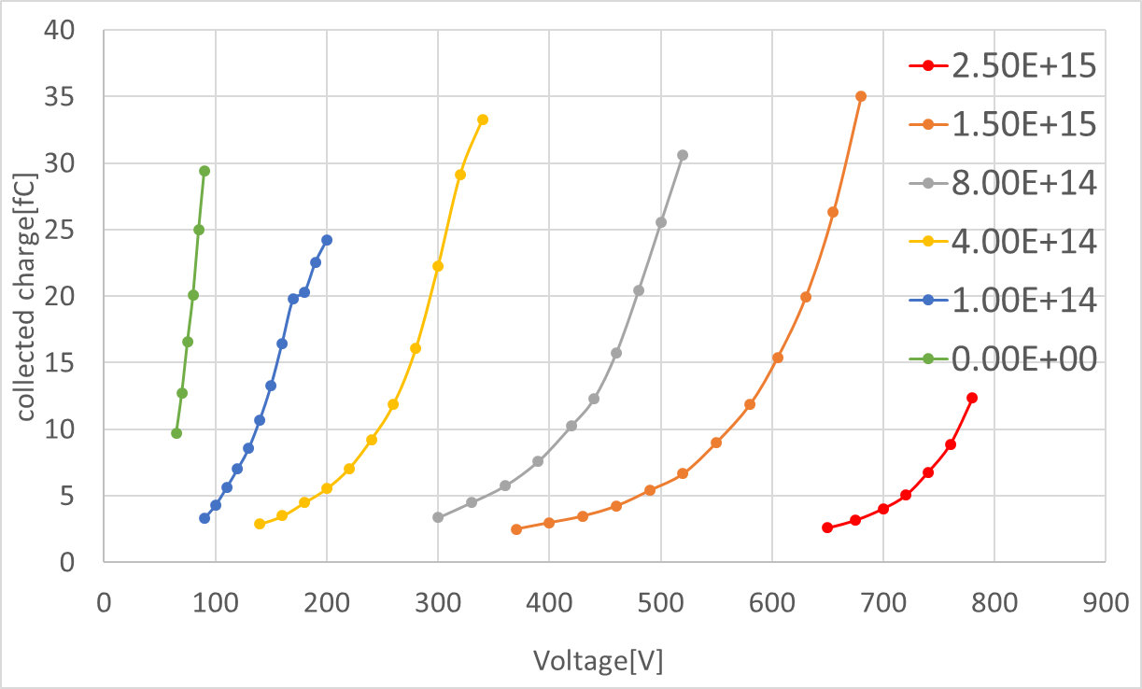
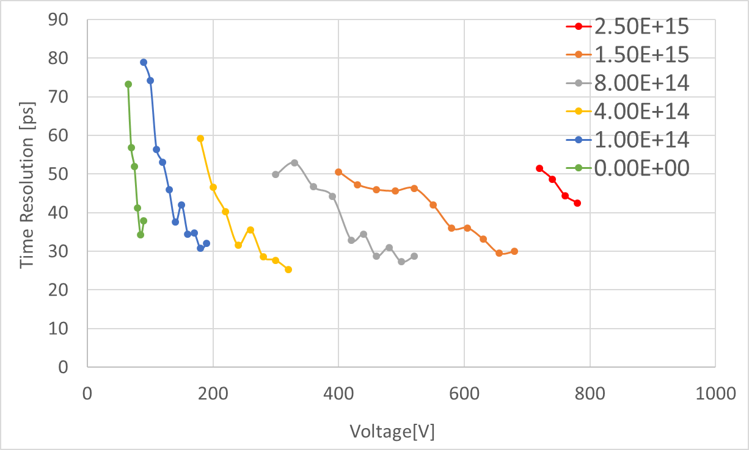
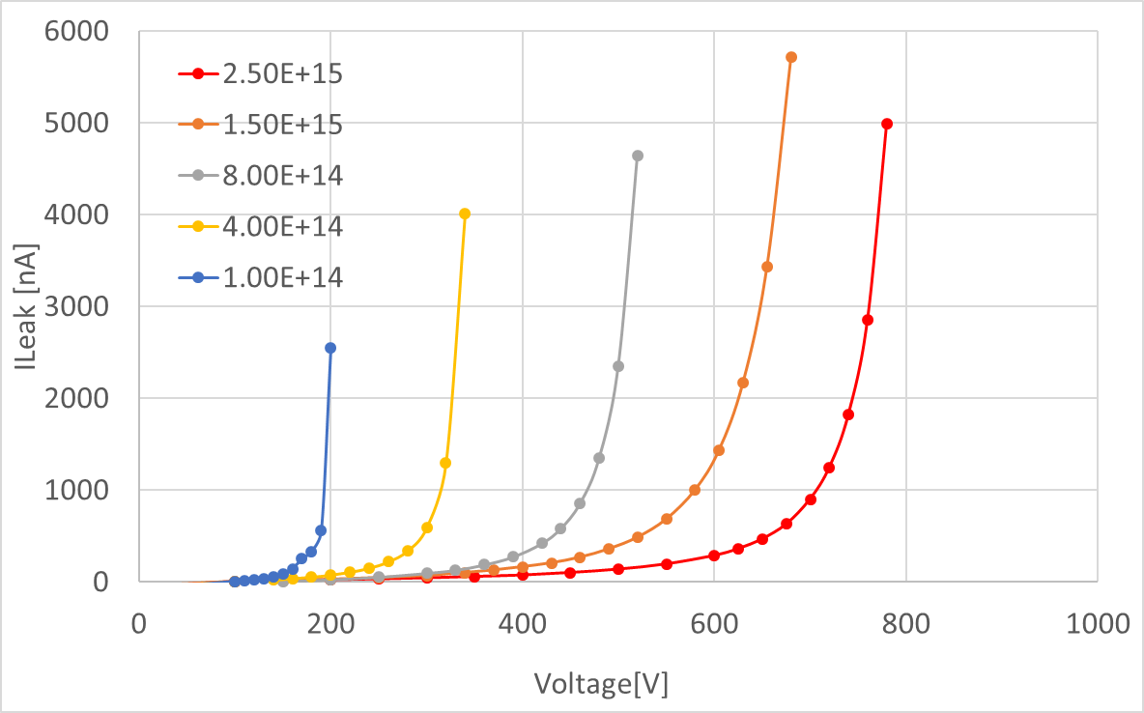
HPK-P2 – Timing/CC (W28)
Noise
W28 - highest gain layer doping
HPK-P2 run satisfies HGTD –TDR requirements (pre and post radiation!)
  4fC @ 720 V and σ_{t}<50 ps after 2.5e15 cm-2
  I_{leak}<5 μm, P_{dis}<100 mW cm² , S/N > 10
  safe operation voltage V_{op}~780 V for the highest fluence
Collected charge
Time Resolution
Leakage current

Slide 8
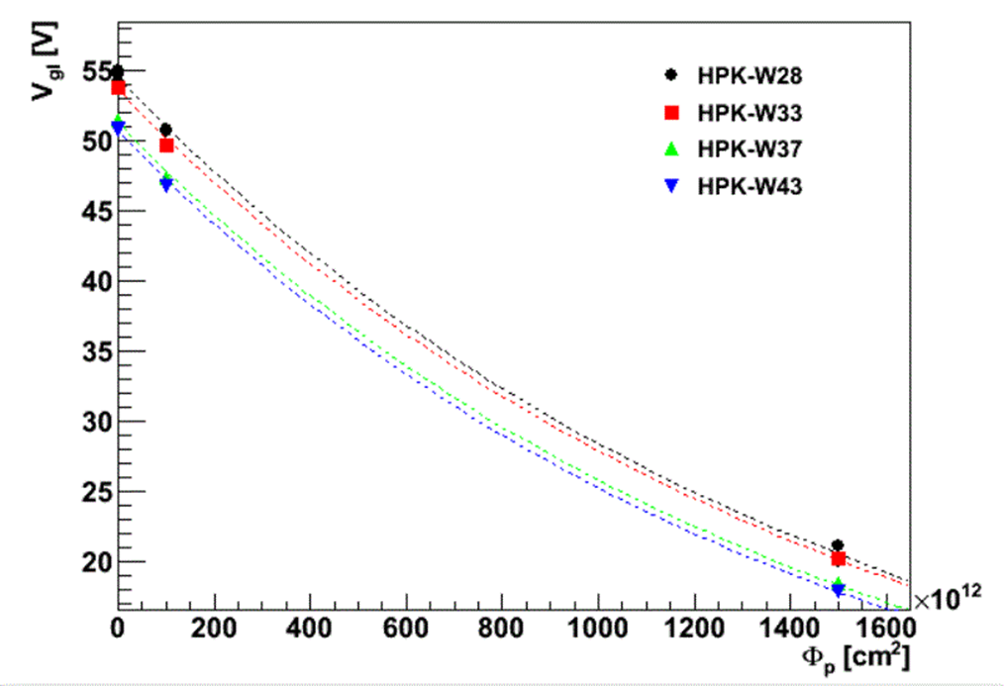
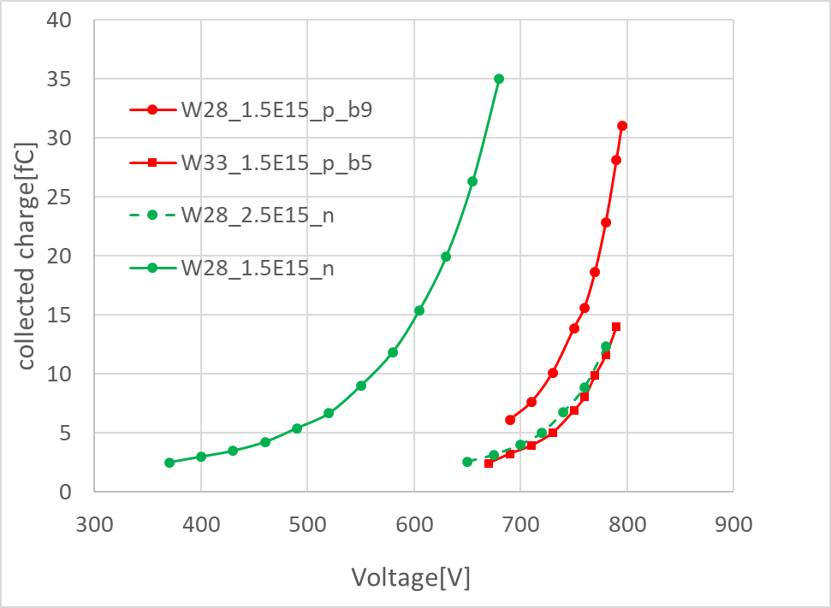
HPK-P2 – 70 MeV proton irradiated
Wafer | c [10⁻¹⁶ cm⁻²]
28 | 6.51
33 | 6.53
37 | 6.87
43 | 6.96
c_{p}/c_{n}~1.5-1.6
similar to previous measurements
2 fluences [1e14, 15e14]
Ratio between neutron and proton damage c_{p}/c_{n} is nicely reflected in CC measurements – similar charge vs. voltage plot for 1.5e15 p and 2.5e15 n.

Slide 9
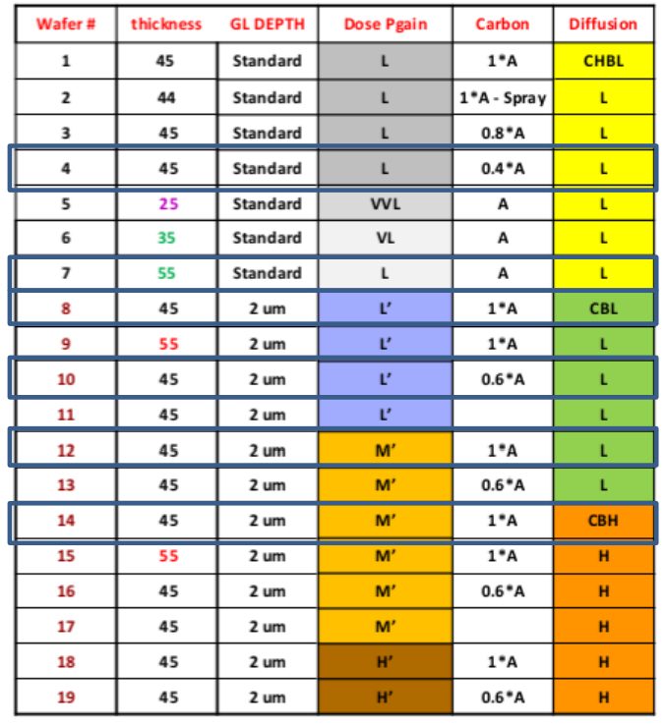
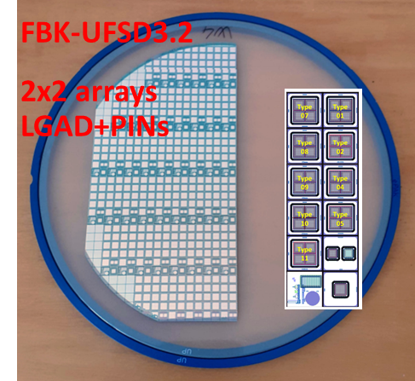
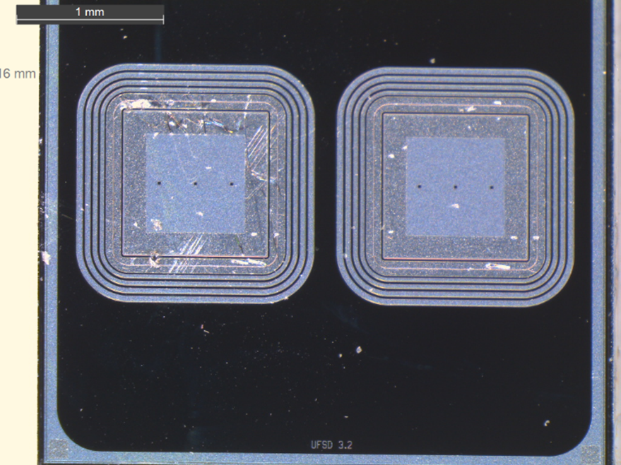
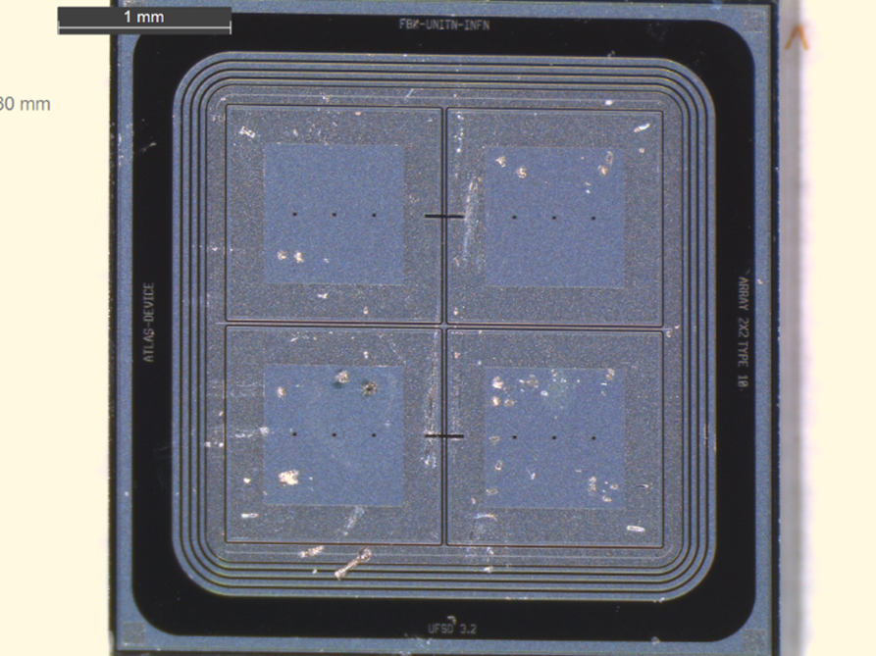
FBK UFSD3.2 run
Purpose of the run to find optimum gain layer doping layer parameters
    Carbon dose
    Boron dose
    Depth of implantation
    Thermal budget during activation
Irradiated in two batches:
  Batch 1: Wafers 4, 7, 8, 10, 12, 14
  Batch 2 : Wafers 13, 18, 19
5 fluences [1e13(batch1)/1e14(batch2), 4e14, 8e14, 15e14, 25e14]

Slide 10
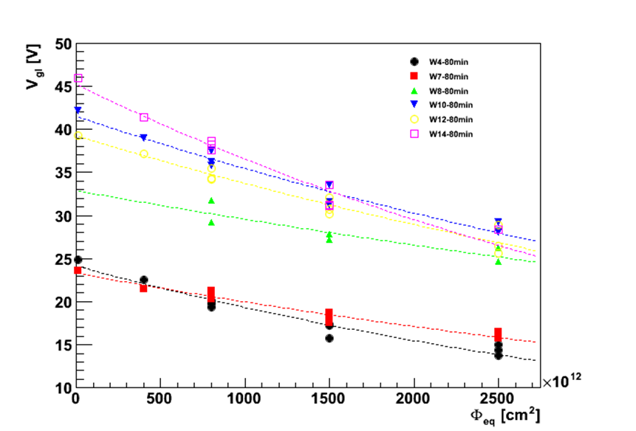
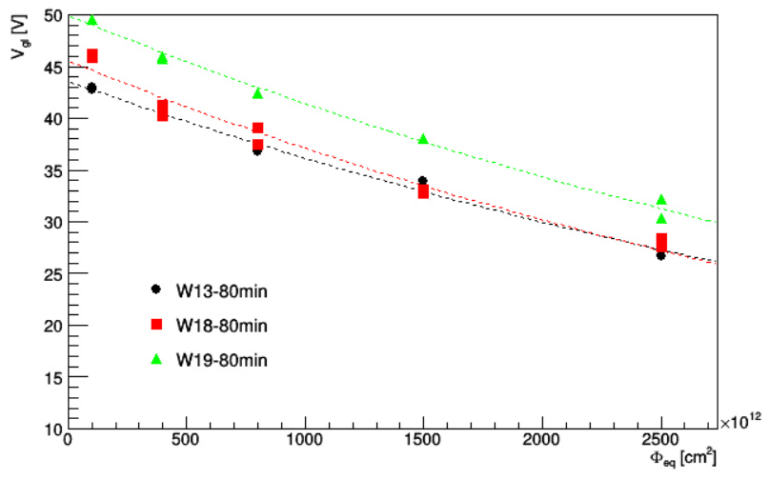
FBK UFSD3.2 – V_{gl} vs fluence
preliminary
1st batch
2nd batch
Wafer | c [10⁻¹⁶ cm⁻²]
4 | 2.23
7 | 1.55
8 | 1.07
10 | 1.58
12 | 1.52
14 | 2.13
Wafer | c [10⁻¹⁶ cm⁻²]
13 | 1.87
18 | 2.06
19 | 1.87
Large uncertainties in measured c – use them only as guidance!

Slide 11

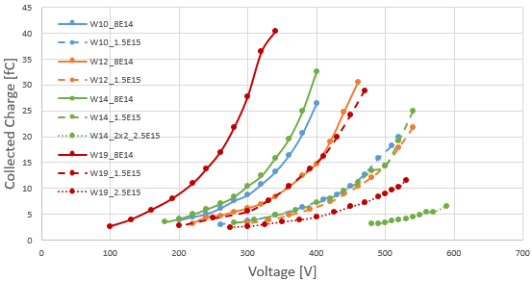
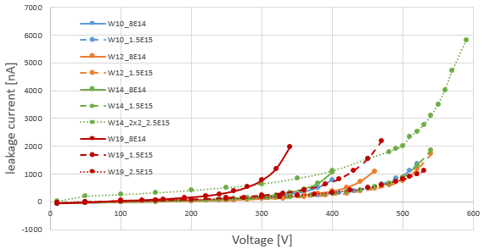
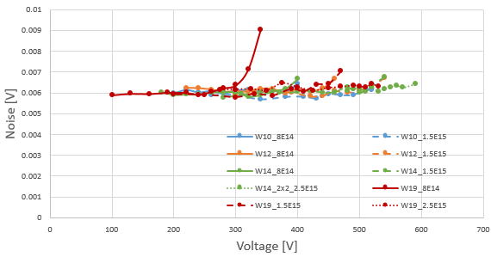
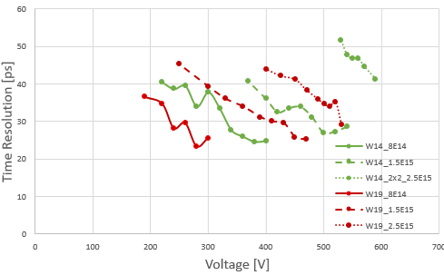
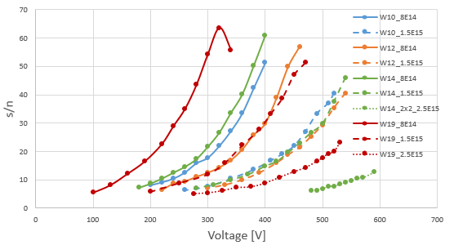
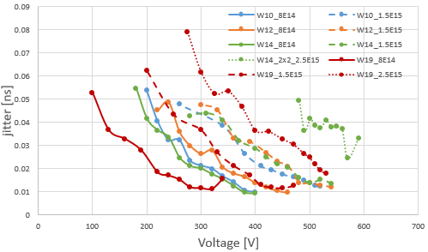
FBK UFSD3.2 – Timing/CC
2x2 device
W10/12/14:
  Good results for 1.5e15cm⁻²(all perform similarly), but early breakdown at < 600V doesn’t allow exploitation of beneficial gain layer properties at 2.5e15 cm⁻².
  ΔV(5fC)~200 V between 1.5&2.5e15, which corresponds roughly to ΔV_{GL} ~8 V for GL depth of ~2 μm. Measured ΔV_{GL}~6 V .
W19:
  much lower V_{op} – most radiation hard LGAD seen so far!
  ΔV(5fC)~130 V between W19 & W14(2.5e15), which corresponds roughly to ΔV_{GL} ~5 V for GL depth of ~2 μm. Measured ΔV_{GL}~4 V .

Slide 12
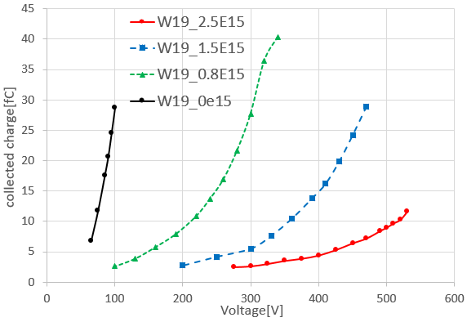
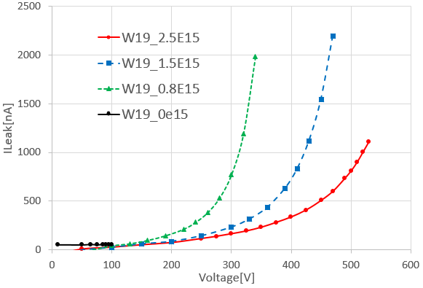
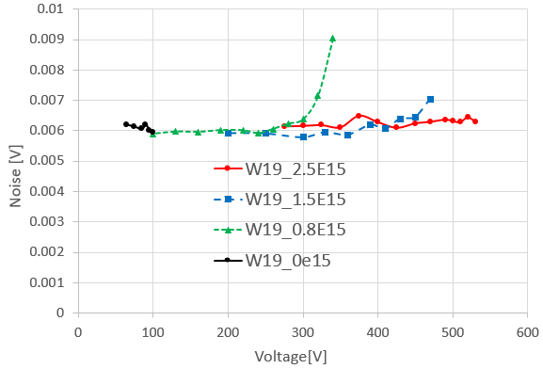
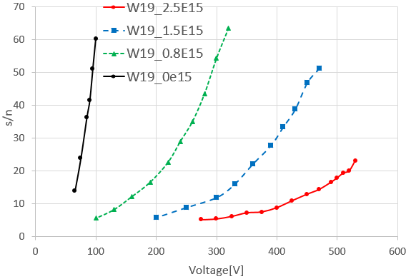
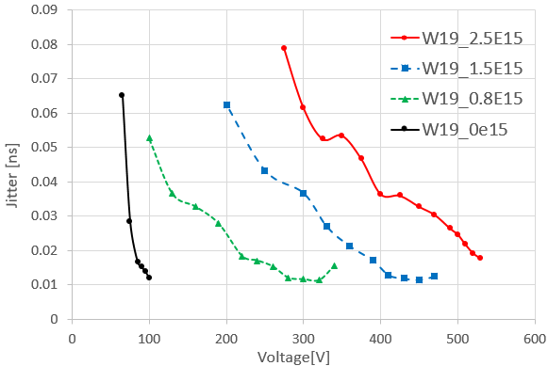
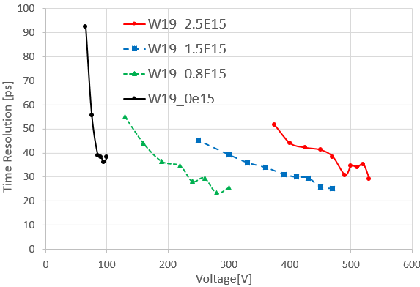
FBK UFSD3.2 – Timing/CC (W19)
Excellent CC and time resolution
Satisfies HGTD requirements and possibly extends the fluence range beyond required – no need for inner ring replacements

Slide 13
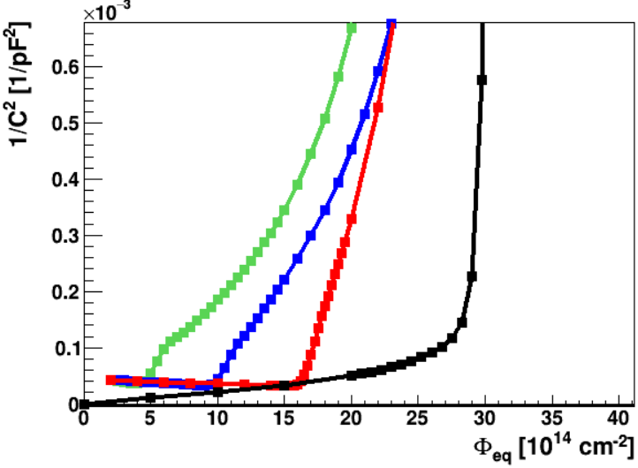
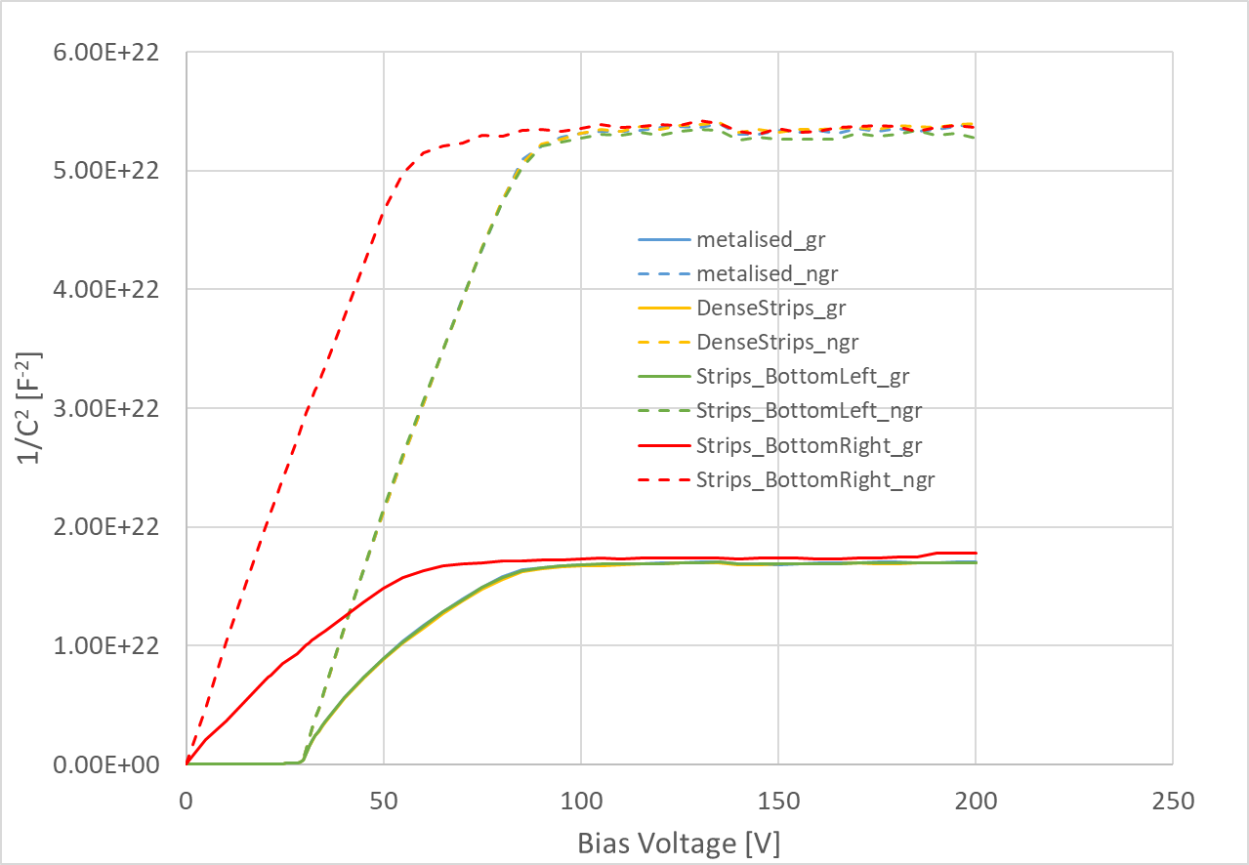
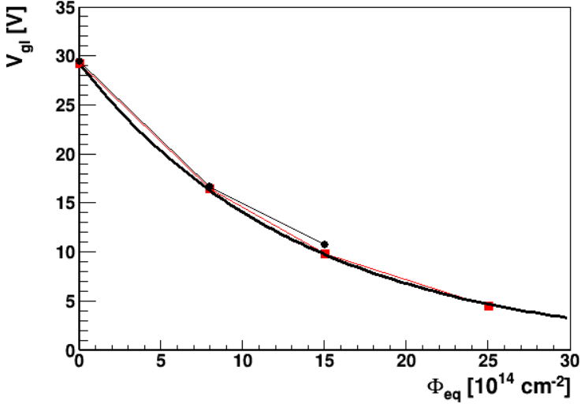
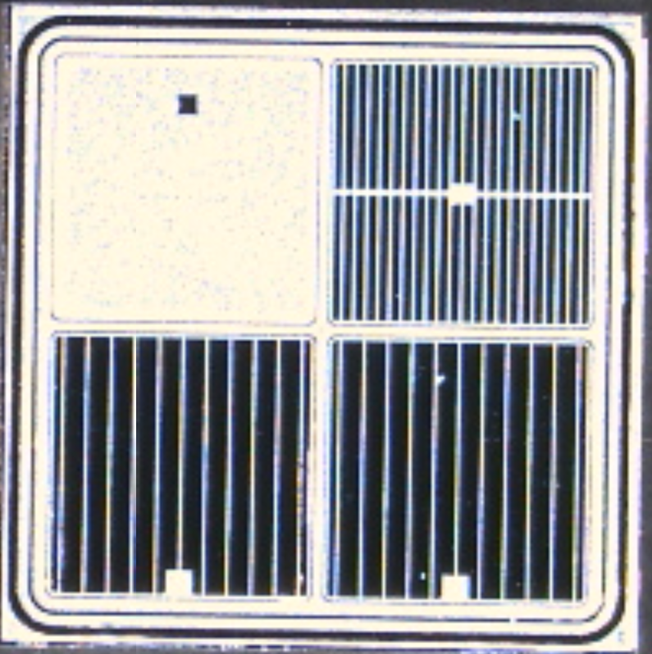
NDLv3 – CV
50 μm thick
CV PLOT
Non-irradiated
Vgl~29.4 V
Vfd~83 V
C~4.2 pF/pad
B14
B58
B14
B58
c=7.3∙10⁻¹⁶ cm²
Blue/yellow/green overlap
3 fluences [8e14, 15e14, 25e14]
Leakage current very small – on the level of hundreds of pA – no break down up to 200 V.
Small resistivity of the wafer – V_{fd} ~ 83 V

Slide 14
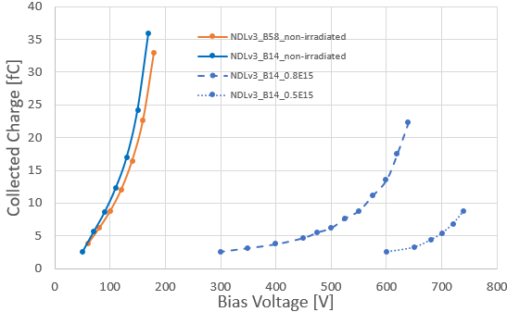
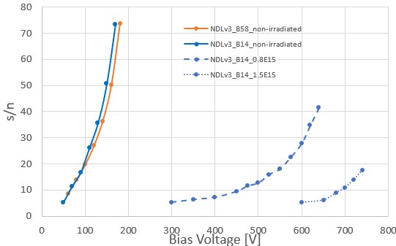
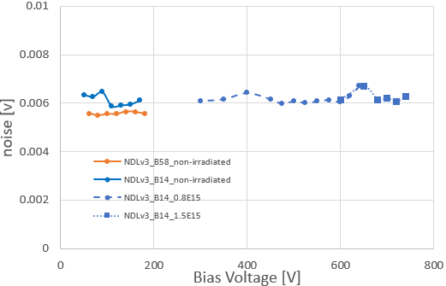
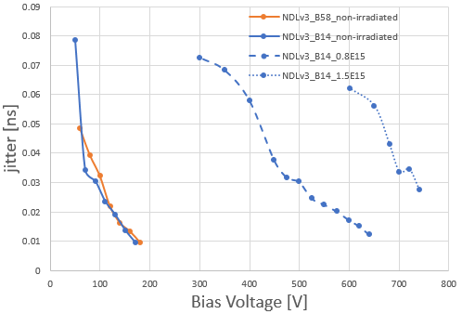
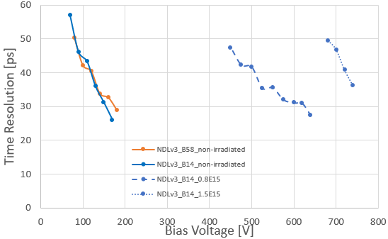
NDLv3 – CC & timing
Non-irradiated: Good charge collection, S/N and noise – similar for both device types
Devices are functional
Gain layer degradation is too large
  devices can not be operated at 2.5e15 cm⁻² , breakdown at 710 V

Slide 15
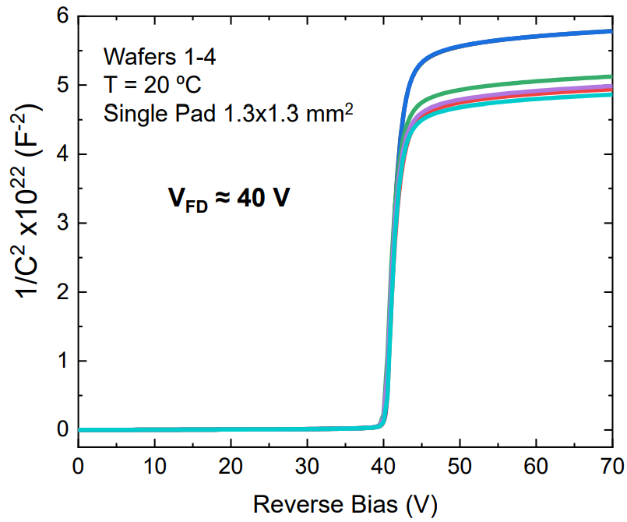
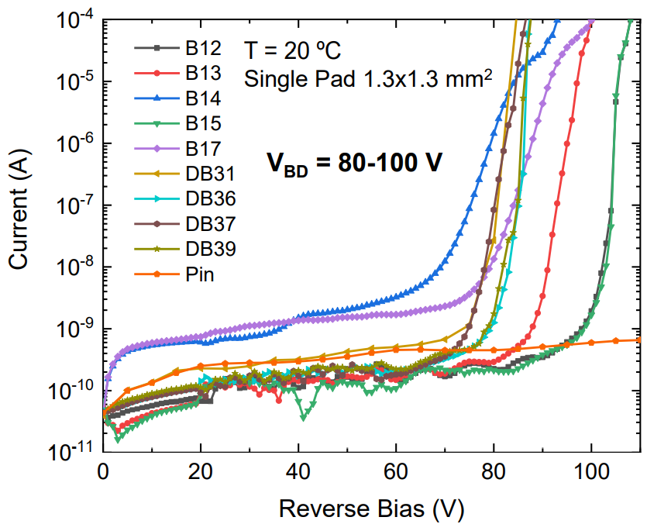
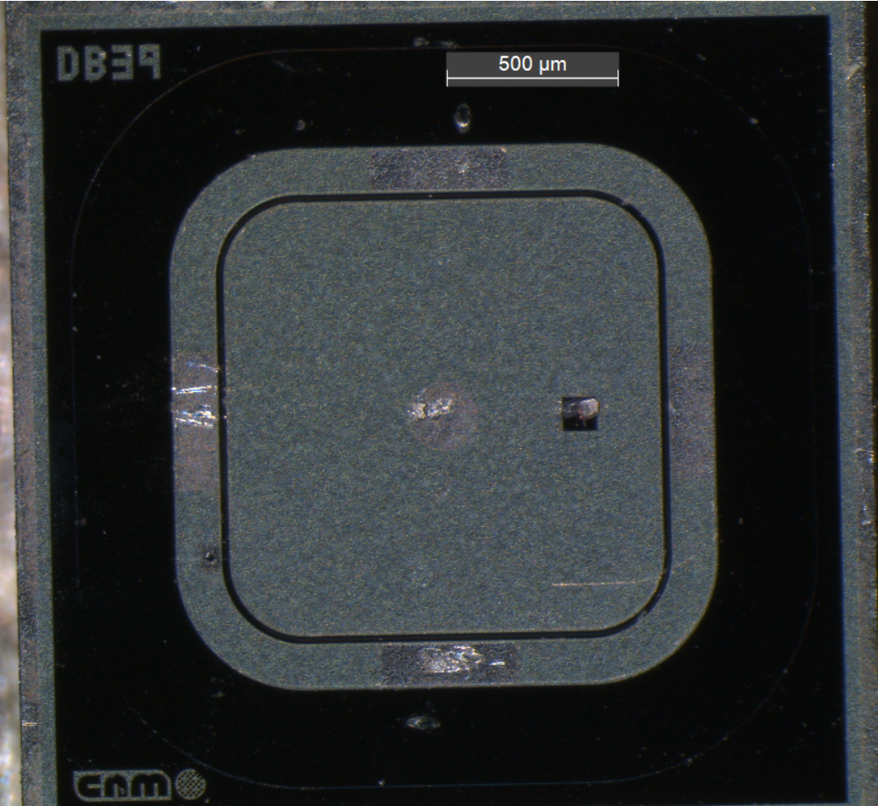


CNM – AIDA2020v2 (R12916)
these two used in tests: irradiated to 2.5e15 cm⁻²
Narrow and highly doped implant, but also shallow

Slide 16






CNM – Timing/CC
Both irradiated to 2.5e15

Slide 17



Comparison of V_{gl} vs Fluence
NLDv3
HPK-P2
FBK-UFSD3.2
B58
B14
Shallow & narrow highly doped implant
Deep & narrow highly doped implant
Deep & highly doped C enriched implant
Wafer | c [10⁻¹⁶ cm⁻²]
28 | 4.3
33 | 4.5
37 | 4.6
43 | 5
Wafer | c [10⁻¹⁶ cm⁻²]
13 | 1.9
18 | 2
19 | 1.9
Wafer | c [10⁻¹⁶ cm⁻²]
B58/14 | 7.3
Much lower c for FBK – carbon enrichment of gain layer significantly improves the radiation hardness.

Slide 18



Comparison at 2.5e15 cm⁻²
V_{gl}~20V
(1.5e15 cm⁻²)
(1.5e15 cm⁻²)
(1.5e15 cm⁻²)
V_{gl}~33V
The most radiation hard wafers (FBK/HPK) and both NDLv3 and CNM-AIDA2020v2 compared!
The performance of FBK seems to be comparable to HPK at voltages that are 300 V lower – significant improvement.
  ΔV_{bias}=300 V for 50 μm thick detector means ΔΕ=6 V/μm. Assuming 2 μm thick gain layer that results in ΔV_{gl}~12 V. Measured ΔV_{gl}~12V.
FBK UFSD3.2 is clearly most radiation hard, but we see some problems with sensors breaking down at >600V.

Slide 19
Conclusions and future work
HPK meets radiation hardness requirement needed for HGTD
  Behave well and have shown they can produce working full size sensors.
  This will be the best we get from HPK – they will not do any C implantation
FBK has also shown they can withstand high irradiation
  Excellent GL design; C implantation significantly improves radiation hardness
  V_{op} way below any other vendors
  But need to show can perform equally well with full size sensors
  Also need to fix breakdown problem
CNM just reaches required radiation hardness
  Future runs include C implantation
  Also need to show can maintain performance with full size sensors
NDL produced a sensor that works, but still in early phase of development
  Need to improve radiation hardness by modifying GL
All future runs will be qualified in the same way as those presented here

Slide 20

Backup: c_{p}/c_{n}
In HGTD inner ring, neutron/charge hadron mix is ~50/50, goes to ~75/25 in outer ring.
Can use the c_{p}/c_{n} ratio during neutron irradiations, irradiating to higher fluence to take into account extra damage charged hadrons would cause.

