Slide 1
Preliminary results from mortality studies conducted on the LGADs using the ELI fs-laser beam
37th RD50 Workshop,
November, 18-20 Zagreb, Croatia
Presented by Gordana Medin
Full list of authors/institutions on the next page

Slide 2
Collaboration/People & Institutions
ELI Beamline, CZ – RP4 group (Application in Molecular, Bio-medical and Material Science) and BIS group
    Mateusz Rebarz, Jakob Andreasson
    Tomáš Laštovička, Kamil Kropielniczki
Institute of Physics, Academy of Sciences, CZ
    Jiří Kroll, Michal Tomášek
University of Montenegro
    Gordana Medin
JSI
    Gregor Kramberger
INFN Torino
    Nicolo Cartiglia, Valentina Sola

Slide 3
Motivation
It was observed that LGADs seem to be destructively breaking down earlier (at lower bias voltage) at test-beam than in the lab. This is primarily observed for irradiated sensors irradiated to highest fluences operating at >600 V. This is so far not established why, but it is not excluded that single events with huge deposition of energy in the sensor can be the reason.
Tests have been tried with lasers and alphas, but the density of ionization and its time structure was not good enough. ELI fs-beam seems ideal to test that.
The same sensors from HPK runs that showed destructive breakdown were tested at ELI connected to the USCS timing boards
At ELI, pulses in Si are around 50-60 fs corresponding to 15 um; this means that the time of the charge deposition in the silicon is comparable with is the same order as it should be with high energetic particles; furthermore fs-laser of wavelength of 800 m has penetration of around 20 um that is ideal for mortality study on LGADs at ELI. In this way it is possible to simulate very dense charge deposition in a very short time in LGADs.
How to perform these tests: The possible tests are to simply connect the sensors to HV; to increase the bias and test different pulse energies at each bias until the sensor breaks down (breakdown is followed by huge increase of leakage current and often also visible damage of the sensor surface – burn marks).

Slide 4
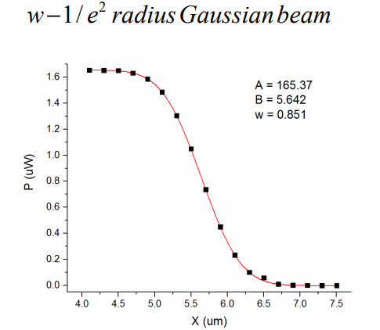
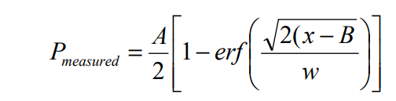
Reminder: Beam waist parameter
Rayleigh length is z₀=3.31 um.
The waist radius looks quite good w₀=0.85 um.
The beam diameter (1/e2) is 1.7 um and this is actually limit of our resolution (stations are more precise).
All these data are for 800 nm

Slide 5
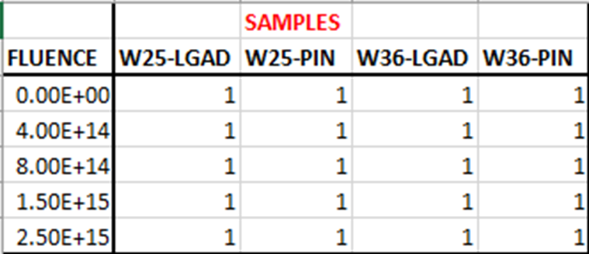
The Sample Preparation
The samples are from HPK-P2 run, the latest ATLAS/CMS LGAD fabrication with HPK
  deep B implant, high implantation dose – Vgl~50.5-54.5V for different dose splits
  the sensor are 200 um physically thick while active area is ATLAS/CMS baseline of 50 um.
  there are two different wafers W25 (Vgl~54.5 V, Vbd~145V) and W36 (Vgl~51.5 V, Vbd~220 V) which different in gain layer depletion voltage and break down voltage.
  fluences covered are the ones of interest for ATLAS and CMS: 4e14, 8e14, 1.5e15, 2.5e15 cm⁻²
Samples from HPK-P2 run sent to ELI in October. The samples are shipped cold – Styrofoam container with ice.
After annealing at 80min@60C they are wire bonded to the USCS timing board were kept cold at <-10C
W25 has the highest gain pre-irradiation (offering some advantage at large fluences), although at -30C it is possible only to reach 90 V before irradiation.
The reference PINs are sent for comparison on sensor properties with/without gain.

Slide 6
Measurement by Sr-90 in Ljubljaa

Slide 7
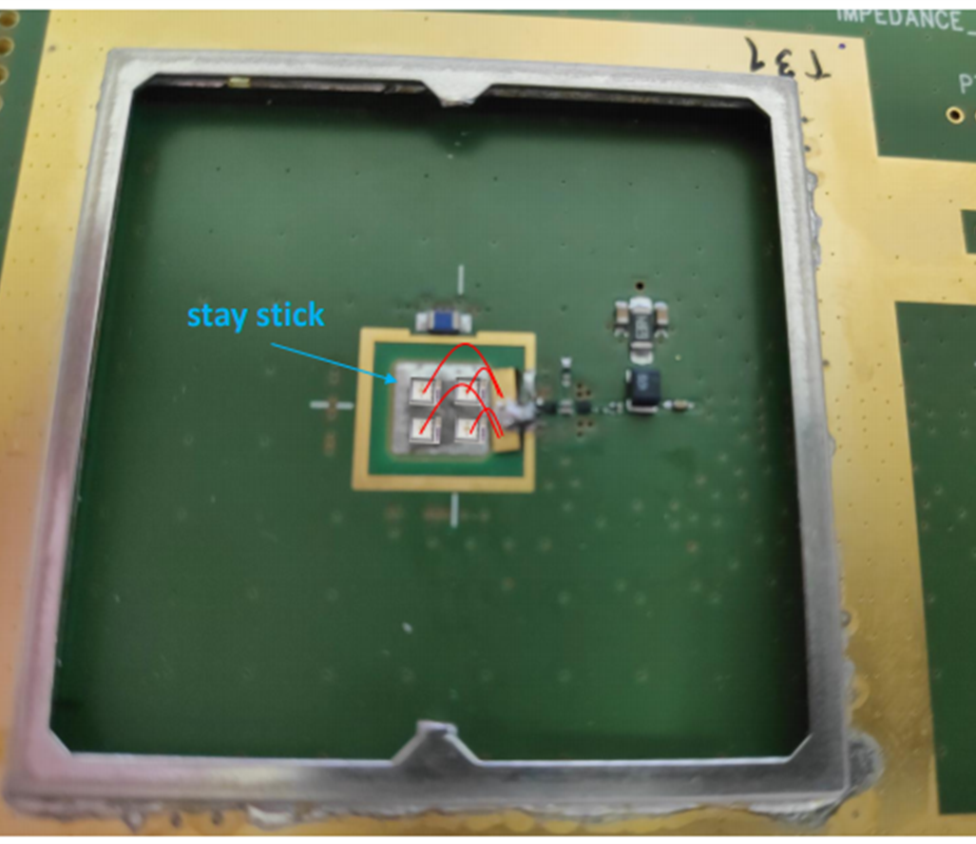
The mounting/dismounting
Initial problem: To use one LGAD per board would be the optimal choice. But we were limited in terms or available timing boards and the fact that Covid19 made life-commuting between the bonding lab (CAP) and ELI difficult.
Solution: The sensors are relatively small (hence capacitance) so four of them on one board; then to connect them to the same amplifier input. The capacitance may be large, but only for low bias voltages.
Use “stay stick” –self adhesive tape that is conductive. I have put a piece of in the sample box.
Bond all the samples (shown 4, but we could also include nonirradiated) from the same wafer to the same amplifier. The bonds must not be in the way of the light – so that the opening is free.
Start test with the sample that can stand lowest voltage, then you rip the bonds to that sensor and continue to the next, until finally you are left with the device that can stand the highest bias voltage.
Connect 4e14,8e14,1.5e15,2.5e15 cm-2 to the same input of the amp.
First measure 4e14 which can stand ~340V and remove the bond, then test 8e14 with ~520 V, remove the bond and test 1.5e15 that can stand 680V and finally 2.5e15 with ~780 V. since you have two boards you can use one for W25 and one for W36 or one for W25 and other for non-irradiated samples…

Slide 8
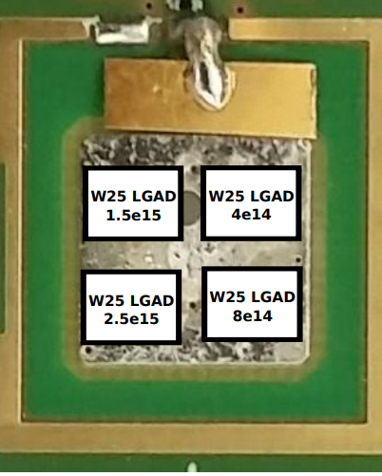
The arrangement of sensors on the board
(done at CAP)
It was expected that the capacitance will be higher of 4 pF x N depleted and connected samples and will affect the performance – rise/fall time of the signal; e.g. 16 pF x 50 Ohm will give ~900 ps.
The jitter measurements can be affected too, but the question was how much if at all.
The measurements followed the procedure
  Low fluence low bias first
  Rip the bonds and move to the next LGAD
  repeat the procedure

Slide 9
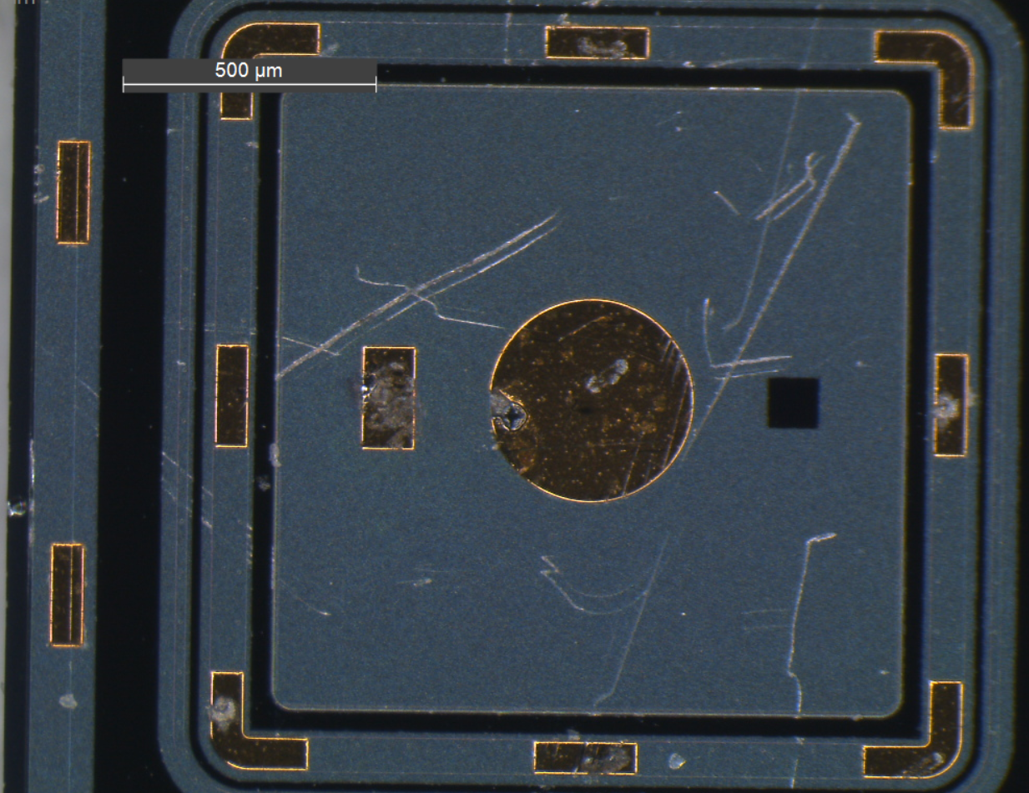
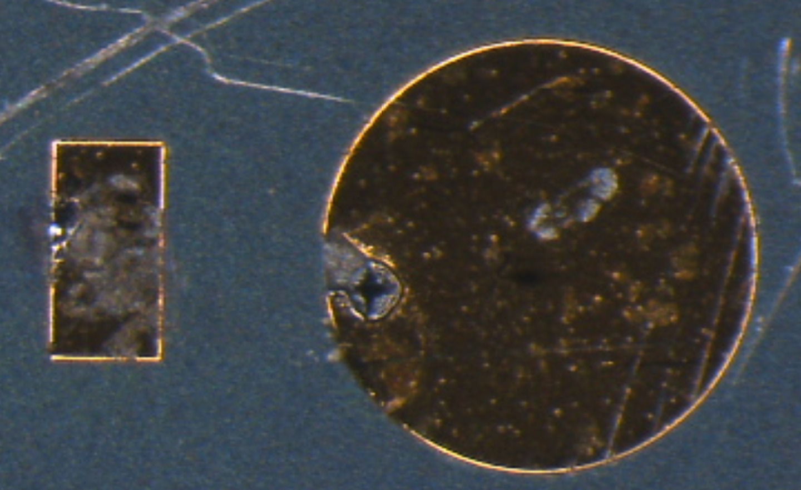
Mortality studies/Journey into unknown
Not known know if large charge injections will lead to destruction of the sensors.
We know that once the sensor breaks down – it is physically destroyed (see photo of HPK example)
Known: If sensor is connected to electronics – that usually dies too.
The “last” sensor at 2.5e15 is the most interesting for the mortality
Un uncharted territory so expect surprises

Slide 10
Measurement procedure
The number of triggers/events taken doesn’t have to be very large – 1 kHz
It would be interesting if possible to see what happens if we hit the GR area.
The reason for that is that at LHC there will be events that will deposit very large energy; As LGADs are close to breakdown the fear is that large amount of ionization in small space may lead to collapse of the field and destructive breakdown.
The fatalities of the sensors at test beam appear sooner than at the lab tests with ⁹⁰Sr electrons.
Strategy/Methodology to be applied:
The HV has to be applied to the timing board – all the sensors are at the same bias and the sum of the currents are measured
The intensity of the laser should have no effect to leakage unless we use very high repetition/pulse rate.
We decided to leave the electronics boards connected – exposing them to the risk of being destroyed (we measured also Q-V at each point)
At focused laser we looked for the breakdown of the detector by increasing the pulse energy alone.
The breakdown will be seen as sudden increase of the leakage current.
We could only cool the sensors to -3C and were not able to explore the entire bias range due to large currents.

Slide 11
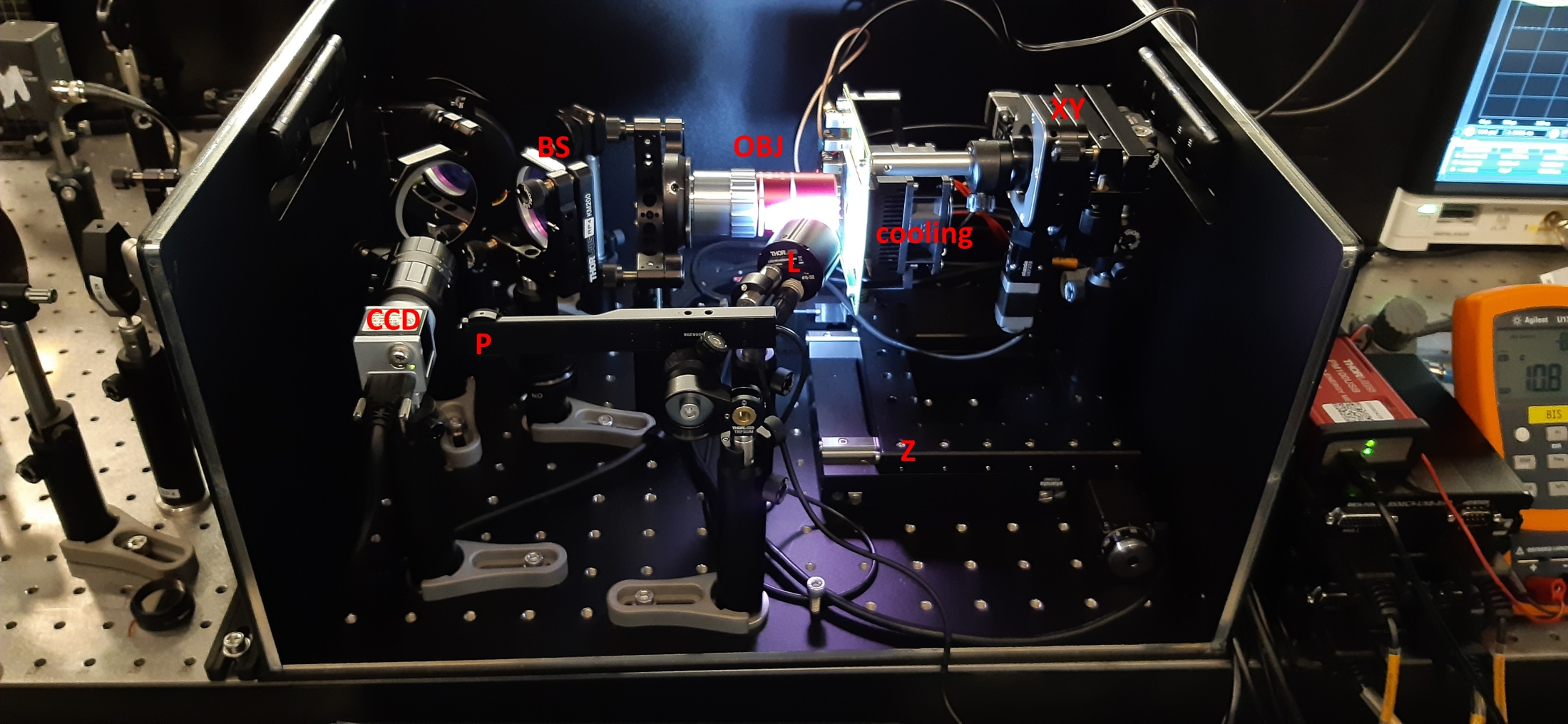
Reminder: Set-up

Slide 12
Results

Slide 13
Mortality study on irradiated W25 LGADs
Conditions:
λ = 800 nm (beam focused in the centre of pad)
Beam diameter: d = 1.7 μm
Temperature: not exactly known (probably a few degrees below 0 C) but kept constant for all measurements
Fluence (cm⁻²) | Max. achievable bias ª | Max. used laser power | Damage
4e+14 | 340 V | 1 μW | no
8e+14 | 300 V | 1 μW | no
1.5e+15 | 400 V ^{b} | 1 μW | partially ^{c}
2.5e+15 | 360 V | 10 μW | no
ª our HV power supply allows maximal current 0.5 mA so maximal achievable bias corresponds to situation when current does not exceed this value
^{b} 400 V was maximal achievable value but at this voltage there was no pulse (only noise detected). Clear pulse appeared when bias was reduced to 360 V
^{c} after illumination with 1 μW current jumped and the signal was gone. However it was possible to get signal again after reduction of bias. Maximal achievable value dropped to 320 V

Slide 14
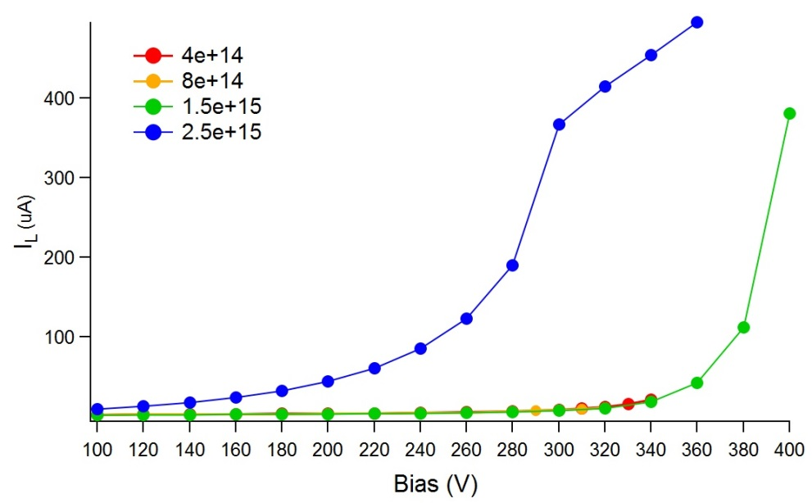
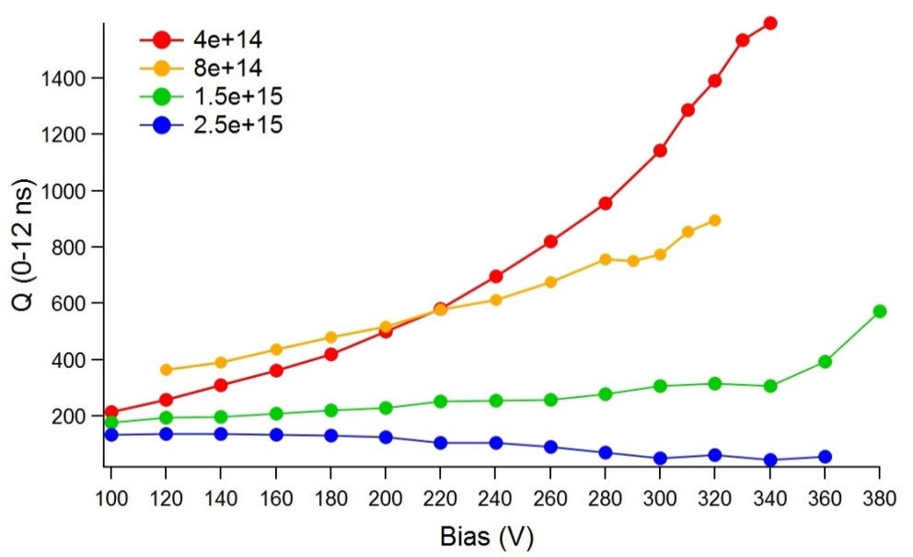
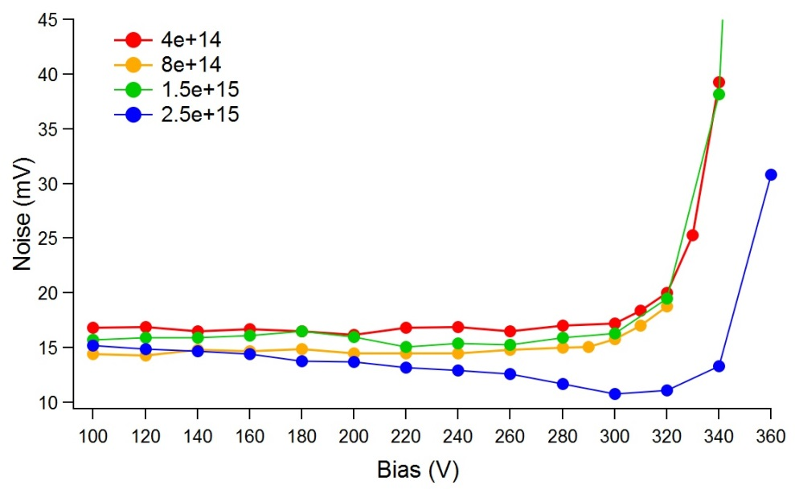
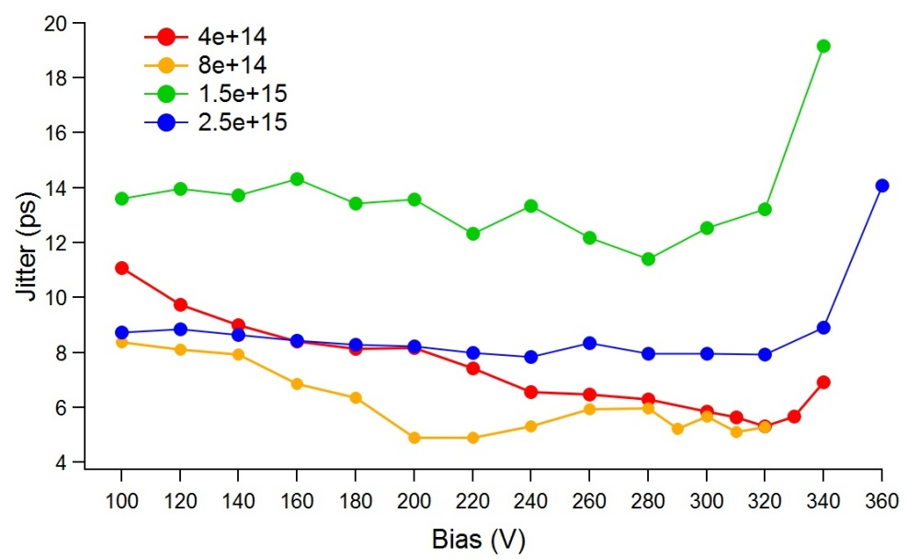
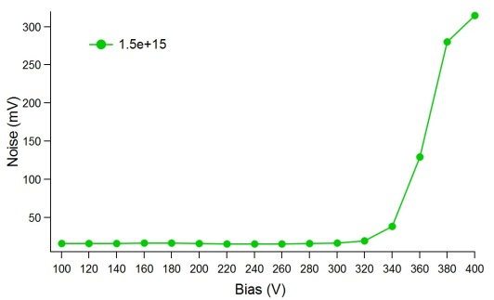
Leakage current, Collected charge, Noise and Jitter vs Bias

Slide 15
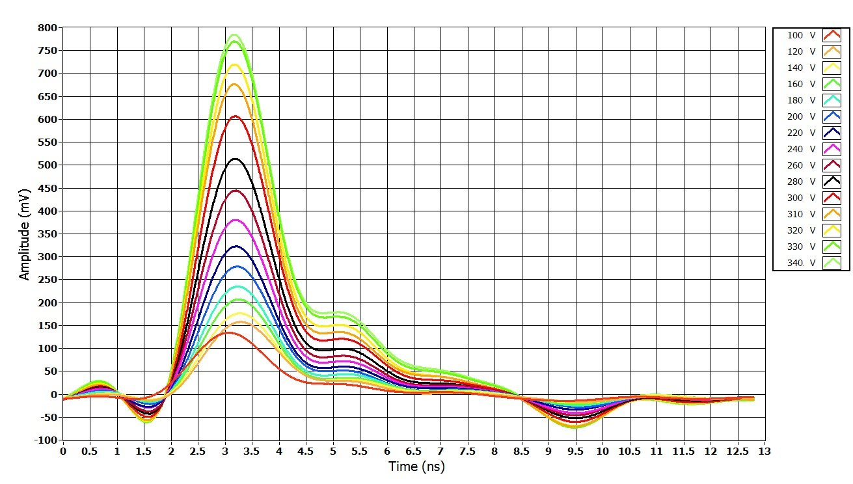
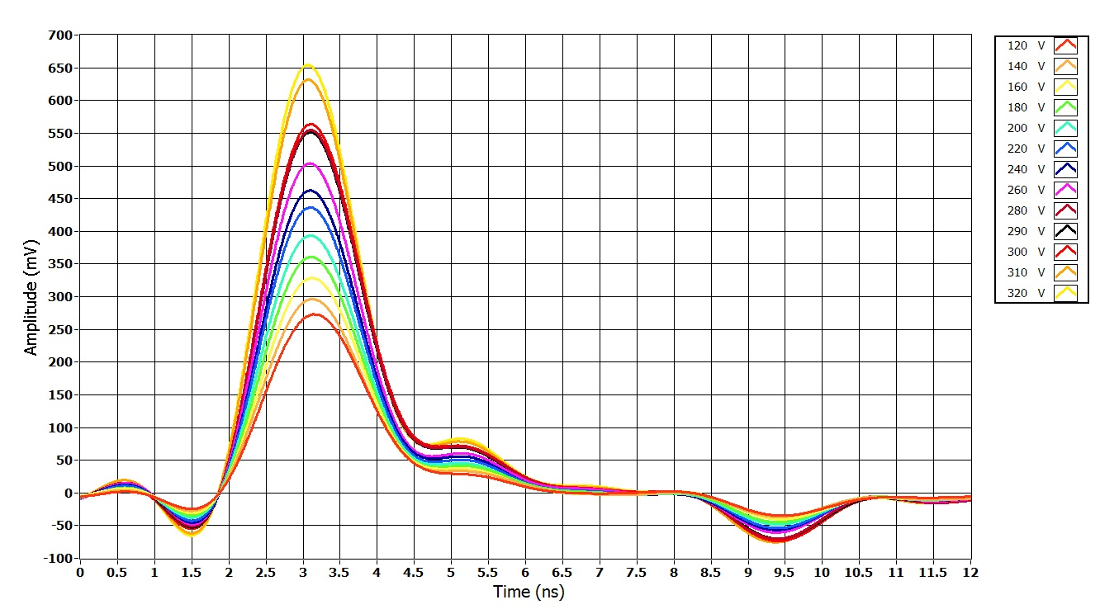
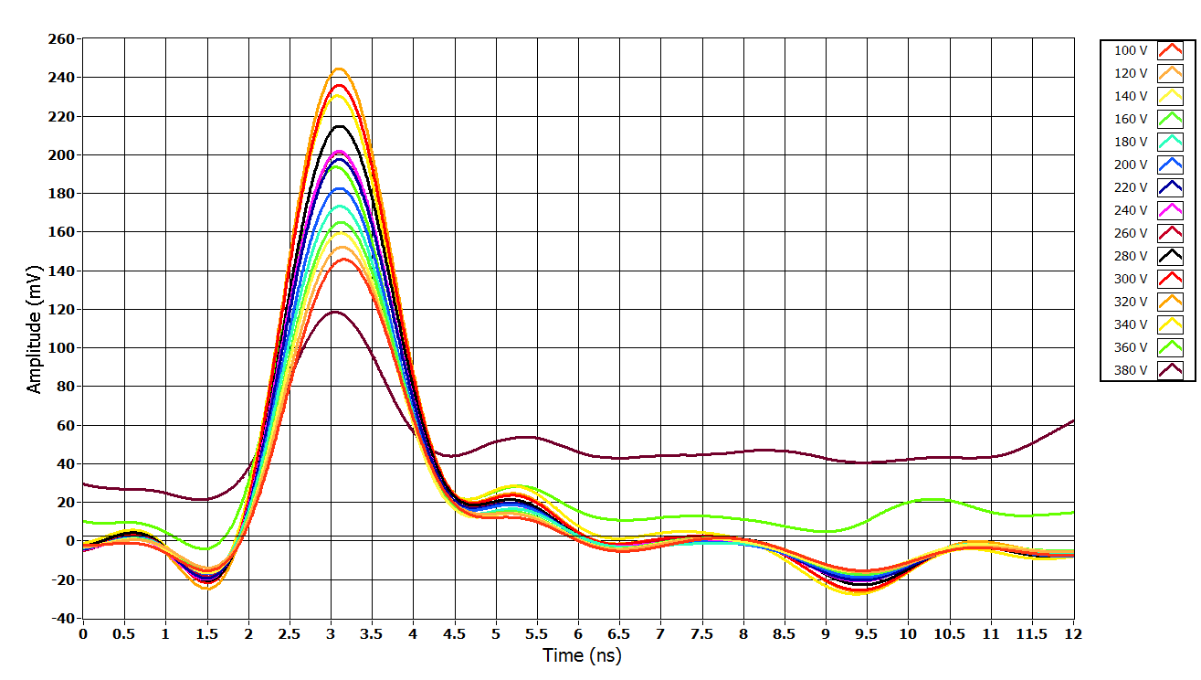
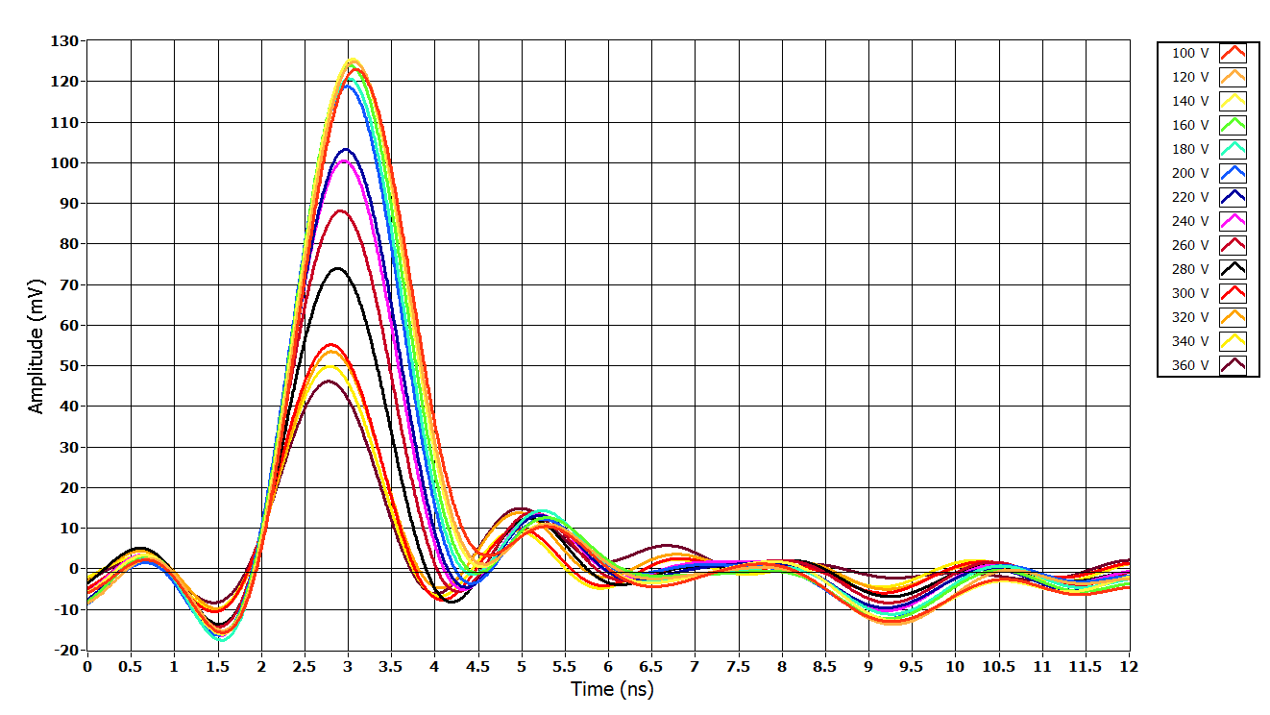
Sample: 4E+14
Sample: 8E+14
Signal vs bias at P=23 pW
Signal vs bias at P=40 pW
Sample: 1.5E+15
Sample: 2.5E+15
Signal vs bias at P=22 pW
Signal vs bias at P=40 pW

Slide 16
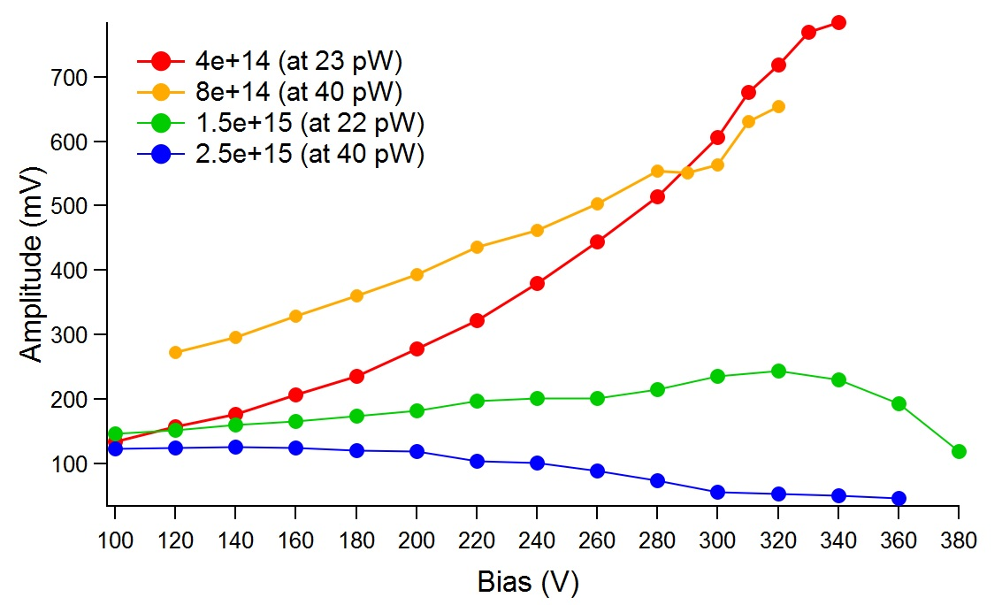
Amplitude vs Bias
20 pW (i.e. 0.02 pJ/pulse) was enough to generate amplitude about 100 mV at 100 V bias

Slide 17
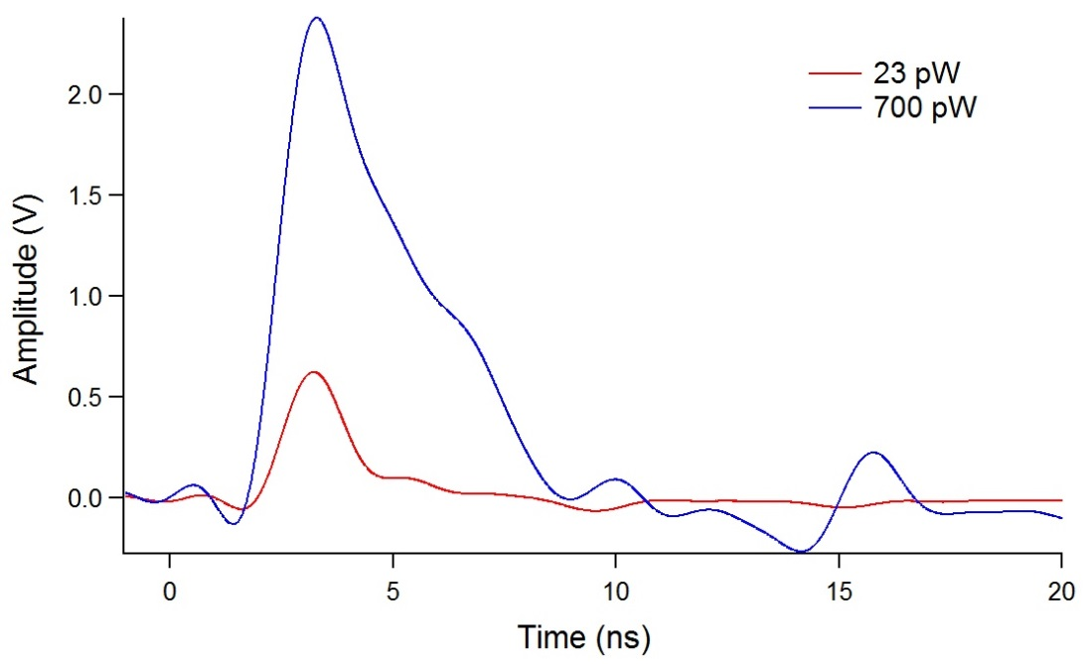
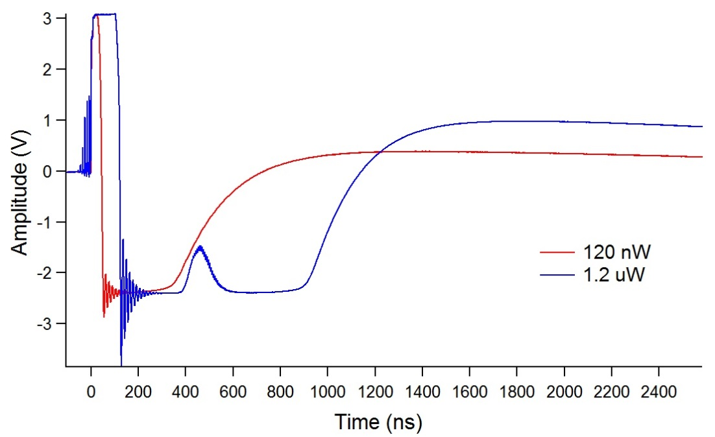
Sample: 4E+14 at bias 300 V
REMINDER
Signal for different power
Measurement by Sr-90 in Ljubljana
Signal vs bias at P=40 pW
300 V
Sensor not damaged

Slide 18
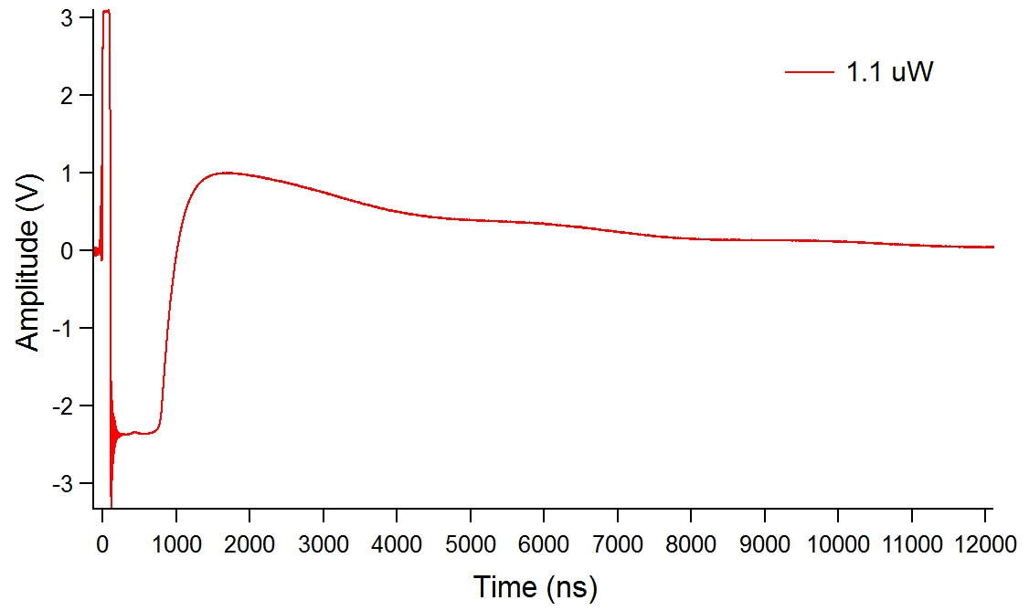
Sample: 8E+14 at bias 300 V
Signal for maximal used power
Sensor not damaged

Slide 19
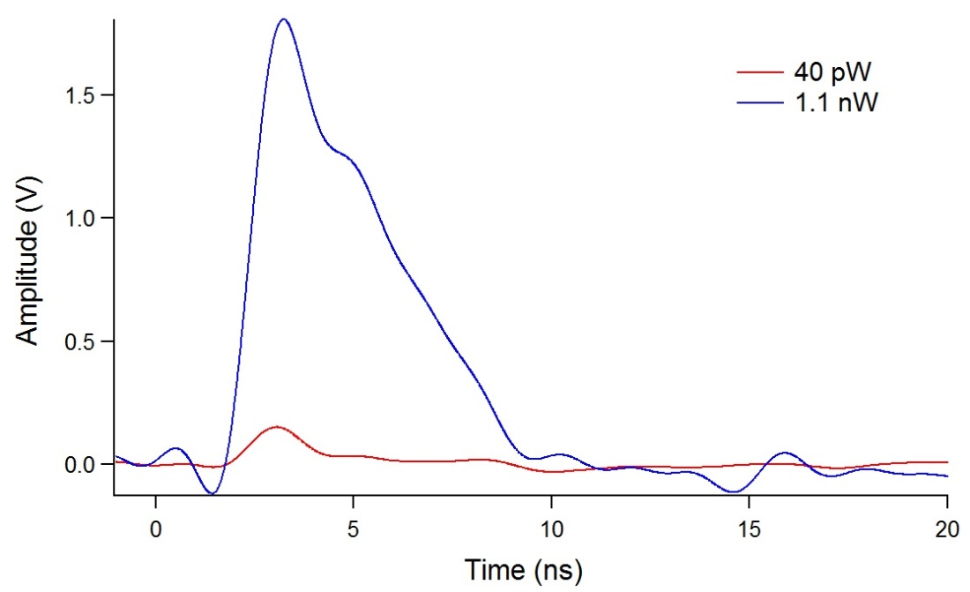
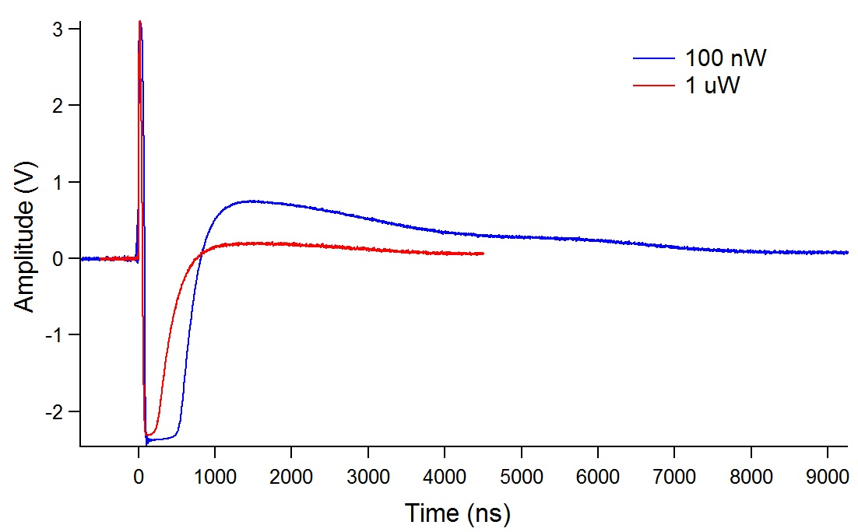
Sample: 1.5E+15 at bias 360 V
Signal for different power
Maximal achievable bias is 400 V but at this value there is no pulsed signal (just noise).
To see clear pulse we have to lower to 360 V.
Low power
Sensor probably slightly damaged at 1 uW.
It was still responsive but maximal achievable bias dropped to 320 V
High power

Slide 20
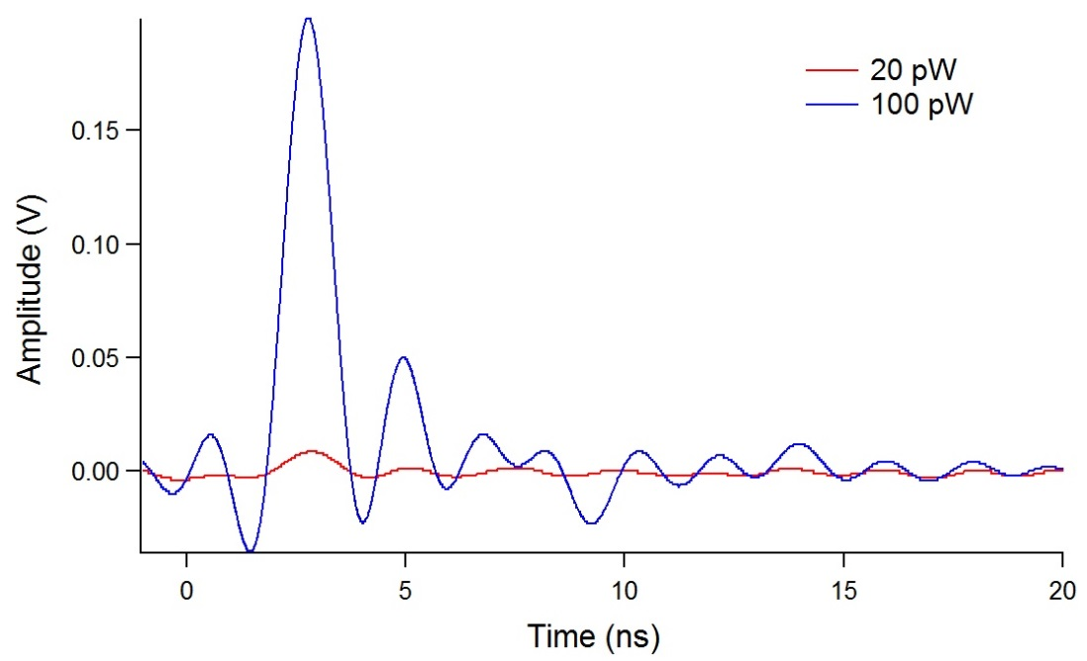
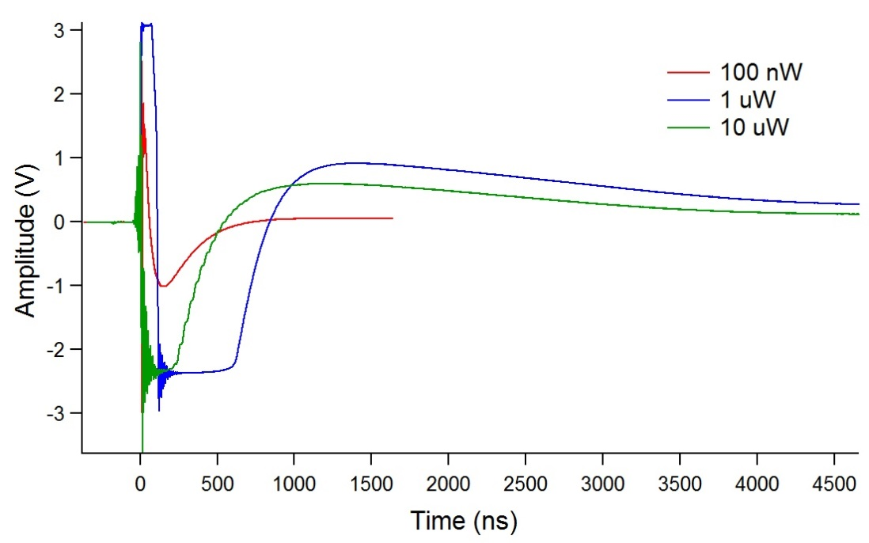
Sample: 2.5E+15 at bias 300 V
Signal for different power
Low power
Sensor survived even 10 uW however for this power the signal became narrower
300 V is too low HV to allow fully exploitation of sensor mortality;
Colling down to -39C has to be achieved in order to enable increase in HV bias up to 700 V.
High power

Slide 21
Conclusion
Future plan
Good progress made given the Covid19 times
Unfortunately, HV-PS current limit didn’t allow checking the full range of biases.
Going to lower temperatures and having single sensors mounted is extremely important for the future.
We know that Peltier works and cool the sensor below 0 C but we don’t know exact value. Temperature is stable and doesn’t induce condensation in dry condition.
For 4e14 cm-2 the bias where the break down occurs is around 340 V, but the rest have a higher “breakdown” bias (or better large gain bias voltage).
The signals are similar as expected for fully depleted detector.
We have to visually inspect the 1.5e15 to see if there is something visible in the sensors.
To ensure cooling down to -30C and low noise power supply
Tests on larger amount of sensors.
Single sensor per board – to use LGAD with 2nd amplifier or even without any amplifiers (to be further discussed)
Next Goal
Fully functional cooling system soon and fully complied mortality study on LGAD irradiated at 2.5e15

Slide 22
Backup Slides

Slide 23
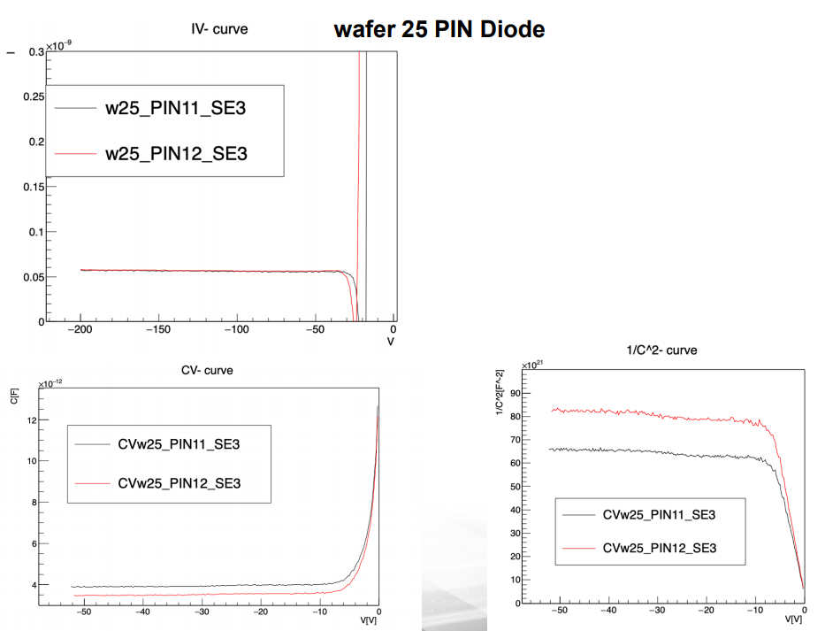
Properties of the samples

Slide 24
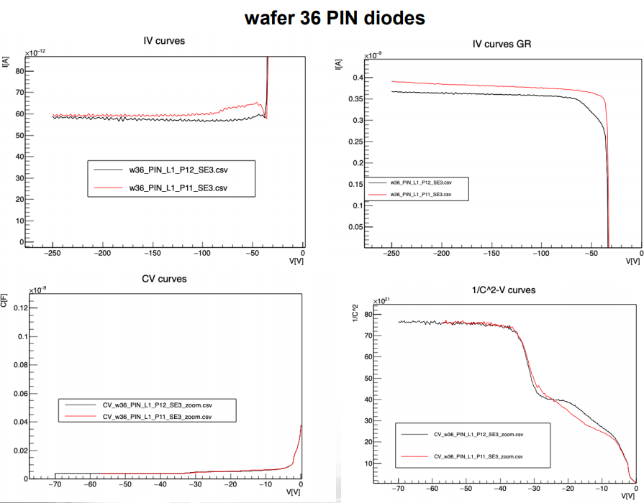
Properties of sensors

Slide 25
How to measure leakage current?
The leakage current is measured with the sensors on the timing board.
If the repetition frequency is not too large the impact of beam to leakage current should be small
One can easily calculate that and see when the intensity and frequency will be high enough to impact DC current measurement.
The full depletion of these devices will be max. around 100-150 V and the operation voltage at which we have to look for breaking down is around 700 V (2.5e15 cm-2)
The capacitance of these devices is 4.2 pF once fully depleted.
So, the only thing that needs to be closely monitored is the HV power supply leakage current.
ALTIROC (ATLAS ASIC for LGADs) can sink up to 5 uA/pad and this sets the operational limit for current.
The idea is to e.g. scan the operation voltage e.g for 2.5e15 up to 740 V with beam focused to the smallest spot (800 nm, no TPA) and simply do intensity scan and see what happens. If at some point we manage to collapse the field due to too much ionization the sensor may break down. We are looking at single event effect and the repetition rate should be small.
The max. pulse energy should correspond to large energy deposits e.g 100 MeV while the repetition frequency should be small. Since we have 50fs pulse with repletion rate of 1kHz, when power is tuned we can get up to 1G photons in the pulse. The aim is to leave it running for few s at each power step.

Slide 26
Can we protect amplifier in mortality studies?
A possible way (not checked) to protect the amp is to find the focus, see signals and moderate/small intensity (pulse energy) and switch off the electronics.
Only then to increase the pulse energy.
If the sensor permanently break down the leakage will go through the roof and we will know. Maybe that will save the amplifier.
The sensors have a gain layer doping profile that peaks at >2um – this is HPK standard as it leads to better performance after large fluences.
To force the 2.5e15 to higher currents (> 100 uA). Normally the current should be <5 uA at 700 V for 2.5e15 at -30C. If we assume the same gain (which is not true) and estimate generation current at -2C as 16 times larger than at -30C we can expect ~100 uA, but we may run into thermal runaway. At the same time it was requested to check that the leakage current doesn’t rise with time upon illumination with beams
Further request:

