Slide 1
11T & Mechanical Measurements
M. Guinchard
05/03/2020

Slide 2
Outline
      Goal & Lessons learned
      Mechanical measurements tools available at CERN
      11T Collaring mockup (End of 2017 – 2018)
      Conclusion

Slide 3
Goal
      To give an objective information about :
      - Techniques of mechanical measurements ;
      - Mechanical measurements related to 11T activities (2012 to 2019);
      Useful links for additional information :
      - EDMS#1064933 : Techniques of mechanical measurements for CERN applications and environment,
      M. Guinchard, I. Vanenkov, A. Kuzmin.
      - EDMS#1073153 : Caractérisation des mesures de déformation par jauges d'extensomètrie à température cryogénique, A. Bouchardy, M. Guinchard.
      - EDMS#1154650 : Analysis for the improvement of the capacitive gauges' performance, R. Morron Ballester, M. Guinchard.
      - EDMS#1936115 : Mechanical Strain Measurements Based on Fiber Bragg Grating Down to Cryogenic Temperature – Precision and Trueness Determination, L. Bianchi, M. Guinchard, and all…

Slide 4
Main tools for mechanical measurements?
 | Electrical strain gauges | Capacitive gauges | Optical fiber sensors | Non contact video systems
Principle | Resistive | Capacitive | Bragg | Image processing
Loading cases | All | Compression | All | All
Magnetic effects | Affected | Non affected | Non affected | -
Cryogenic temp. | Affected | Affected | Affected | Only RT
Resolution | 0,1 μm/m | 5 MPa | 0,5 μm/m | 5 μm (3)
Repeatability | 0,6 % | 3% (>10 MPa) | 0,3 % | -
Reproducibility | 0,7 % | 5 % | 0.9 % | -
Trueness | < 3,7 % (1) | 9 % | 5.2 % | -
Accuracy | < 5% (1) | 17 % (4) | 5.2 %(4) | 2 % (3)
EDMS1073153: Caractérisation des mesures de déformation par jauges d'extensomètrie à temp. cryogénique
EDMS#1936115 : Mechanical Strain Measurements Based on FBG Down to Cryogenic Temperature
http://www.imetrum.com
https://accelconf.web.cern.ch/accelconf/IPAC10/papers/mopeb043.pdf
EDMS#1154650 : Analysis for the improvement of the capacitive gauges' performance

Slide 5
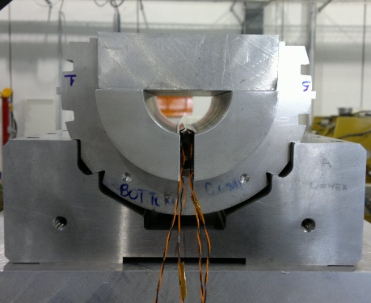
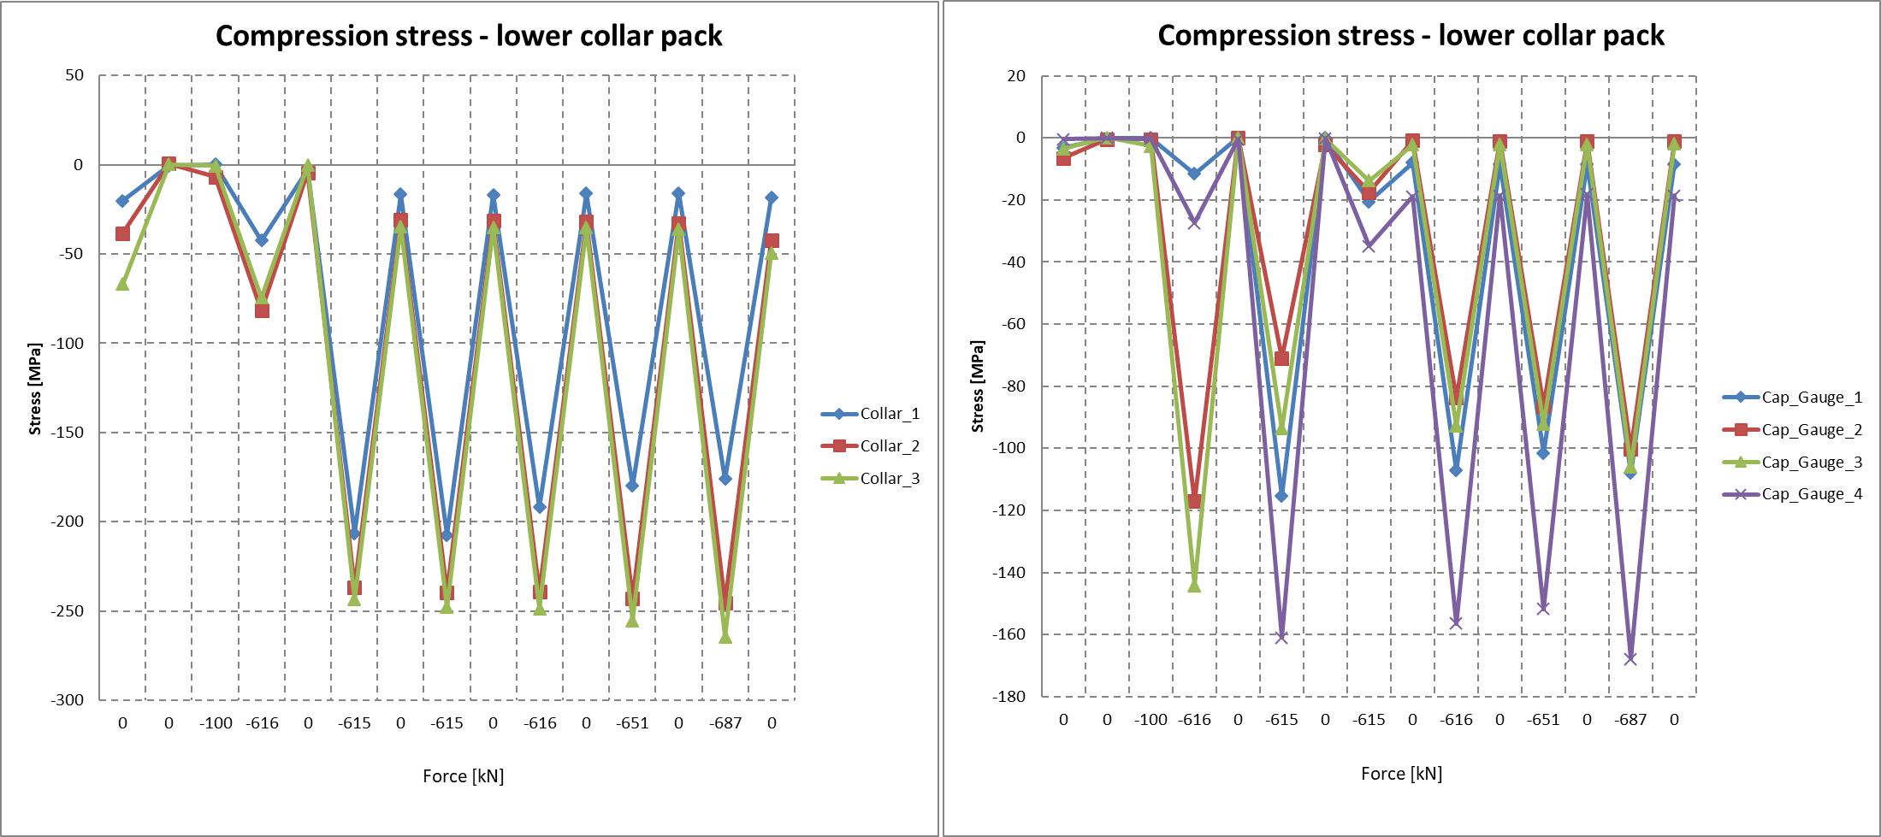
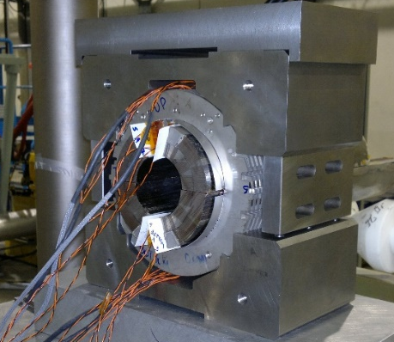
Lessons learned
      EDMS1221318
      2012 : 11T 150mm mockup
      Instrumentation : 6 instrumented collars based on strain gauges on the collar noses (without cuts next to the nose);
      8 Capacitive gauges on the pole wedges;
      Fuji Paper.
Main outcomes :
Calibration done with Al dummy coils;
No FEA values;
10% of bending effects on the collar noses;
Discrepancy between capacitive gauges;
50% of the capacitive gauges destroyed after tests.

Slide 6
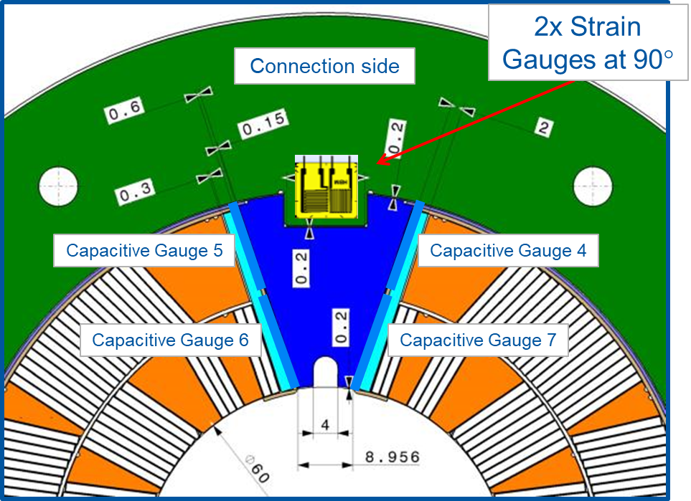
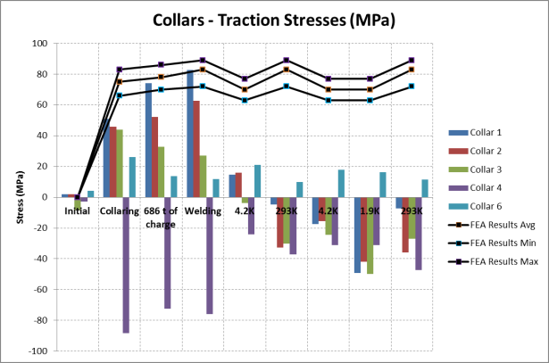
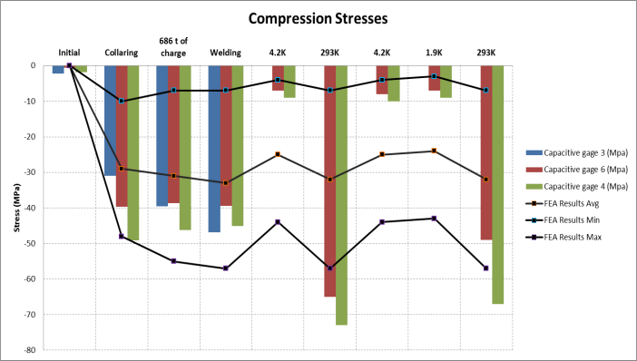
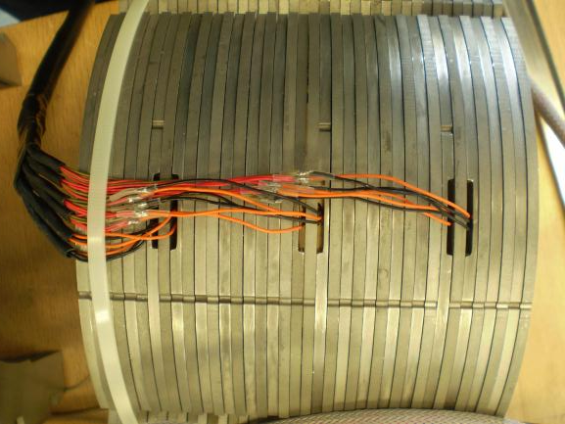
Lessons learned
      EDMS1352279
      2014 : 11T 2m model
      Instrumentation : 6 instrumented collars based on strain gauges on the collar noses (without cuts next to the nose);
      8 Capacitive gauges on the pole wedges;
      Fuji Paper.
Main outcomes :
Measurements done down to 4.2K;
30% to 50% of bending effects on the collar noses;
70% of the capacitive gauges destroyed during collaring.

Slide 7
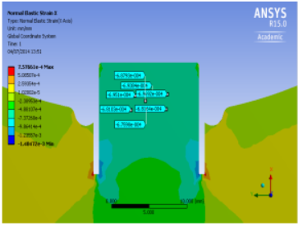
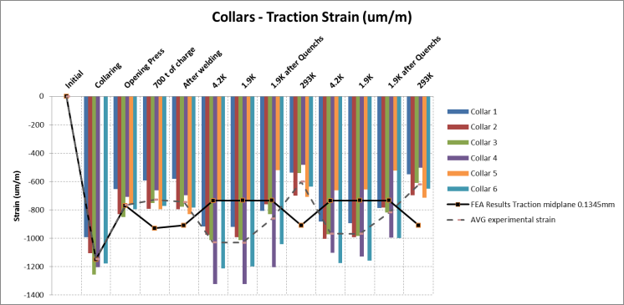
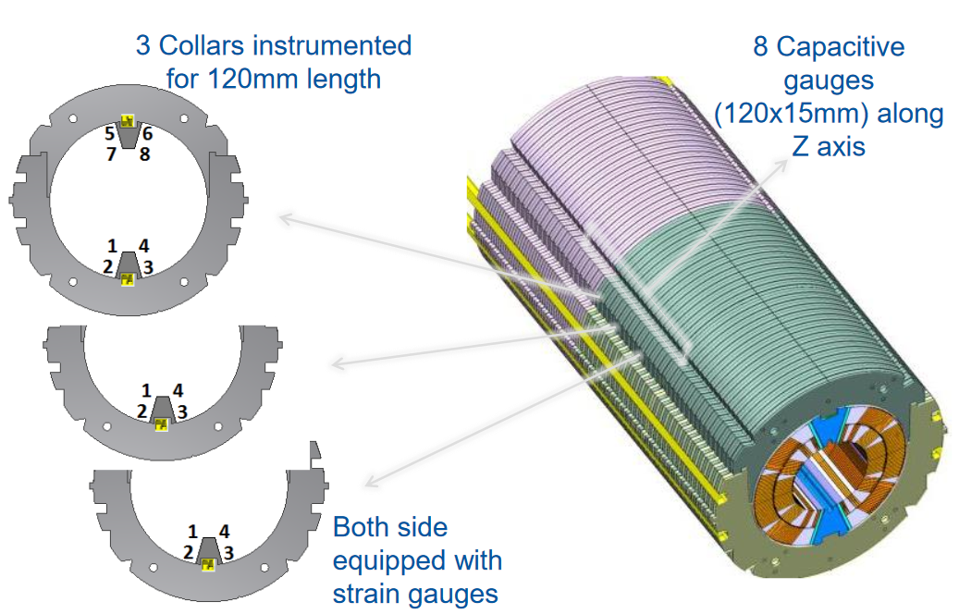
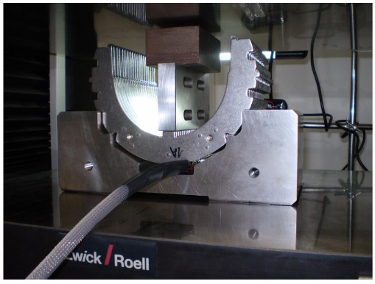
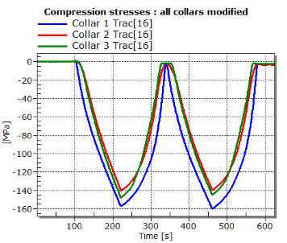
Lessons learned
      EDMS1387744
      2015 : 11T 2m model
      Instrumentation : 6 instrumented collars based on strain gauges on the collar noses (with cuts next to the nose);
      8 Capacitive gauges on the pole wedges.
Main outcomes :
Calibration of the collar noses, additional cuts added;
Measurements done down to 4.2K
30% to 50% of bending effects on the collar noses;
100% of the capacitive gauges destroyed during collaring.

Slide 8
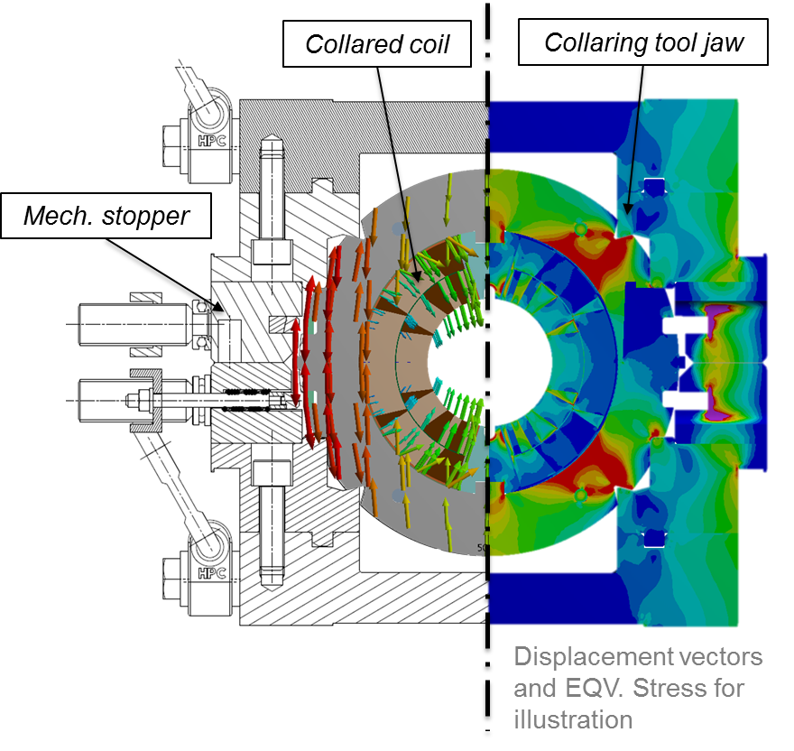
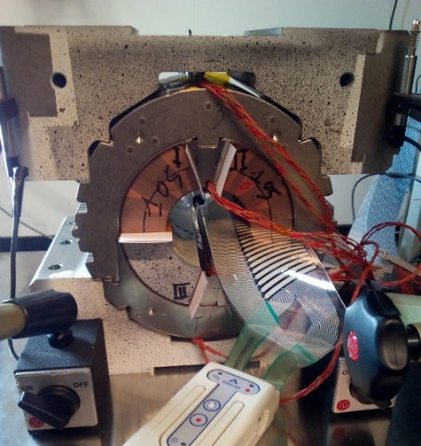
11T Collaring mockup (End of 2017)
GOAL :
By using a 150 mm long collaring mock-up :
    Study collaring kinematics and mechanics, in particular coil peak stress during collaring
    Define type and location of the instrumentation
    Define shimming and loading scenarios (algorithm) to reduce coil peak stress during collaring in the next models
      EDMS1886742

Slide 9
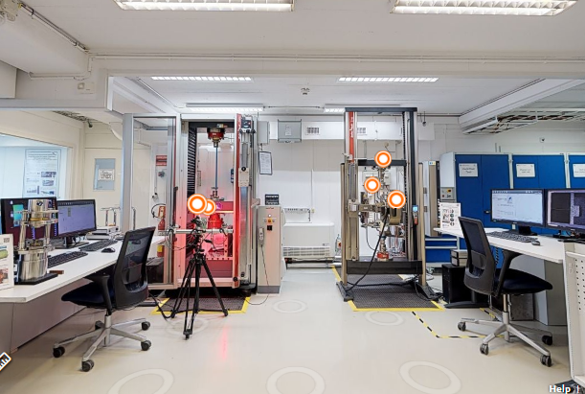
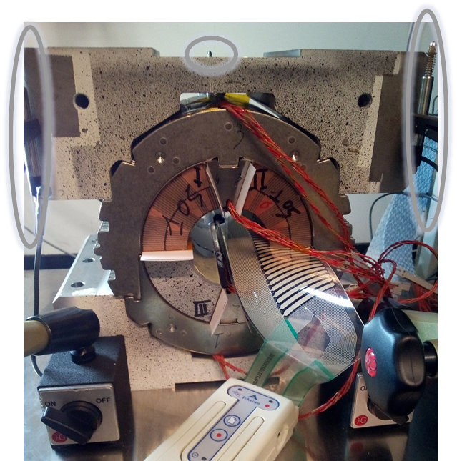
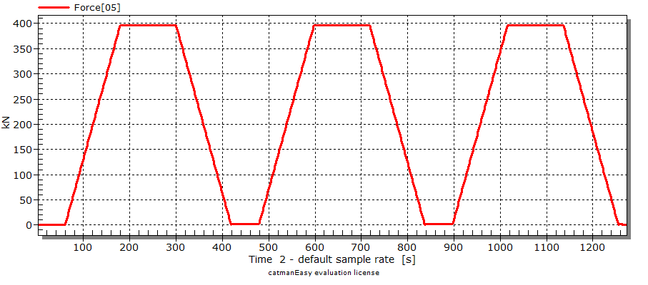
11T Collaring mockup (End of 2017)
Universal Testing Machine Z400
400 kN max load – ISO Calibration
Compression plates aligned
3 LVDT’s in vertical position’s
1 LVDT in Z position
Keys Insertion
Keys removal
Alignement cycle
Assembly
Disassembly

Slide 10
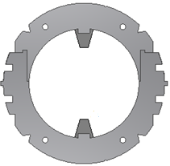

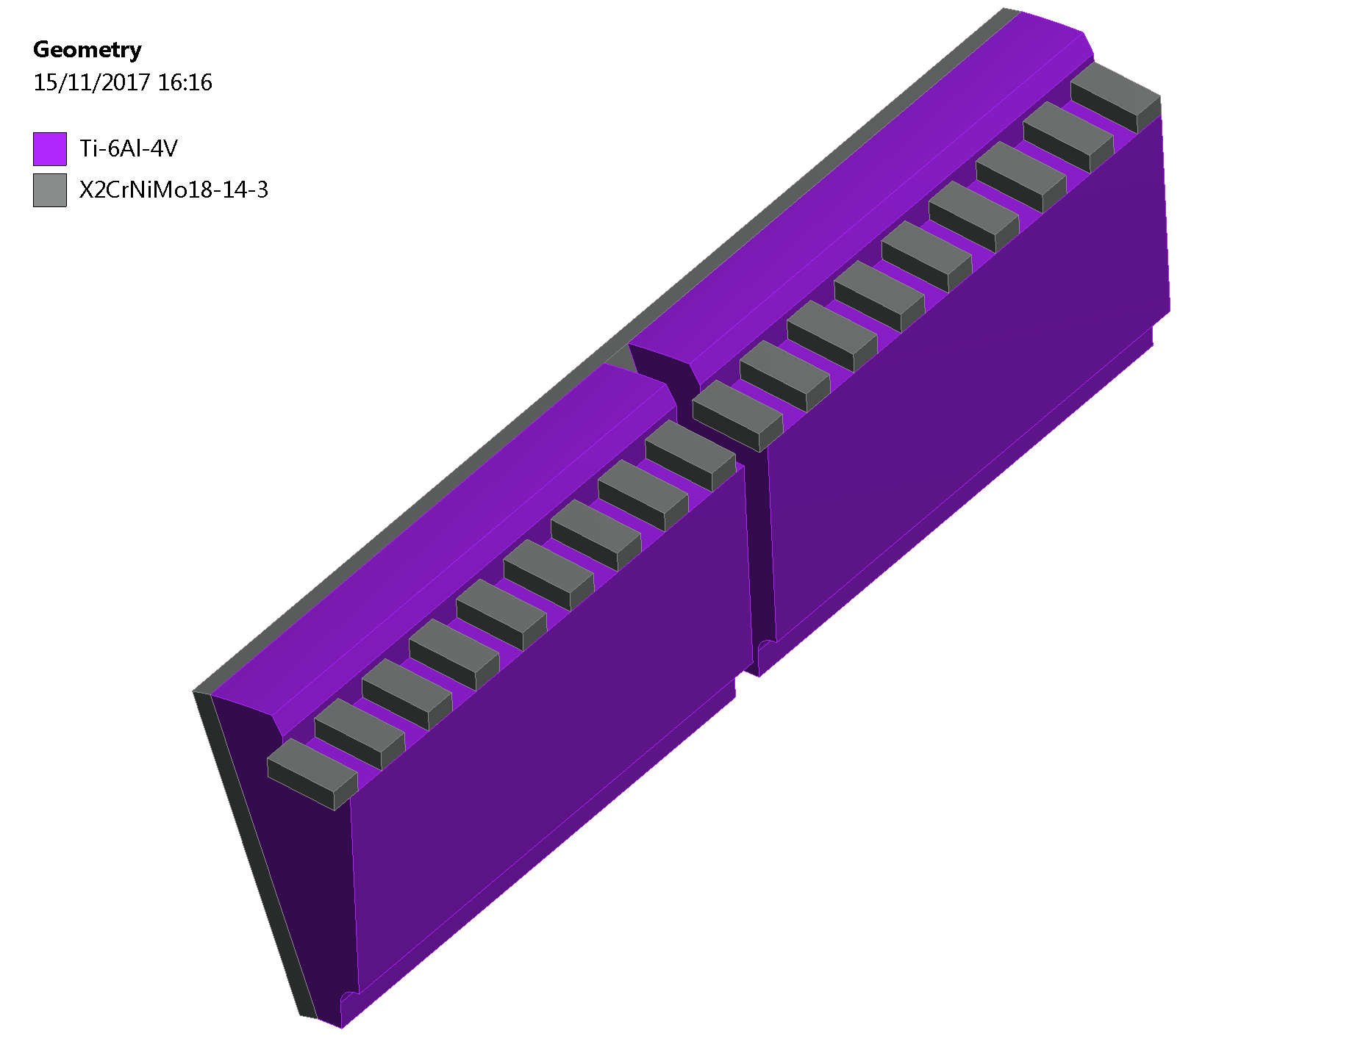
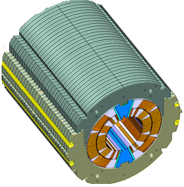
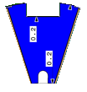
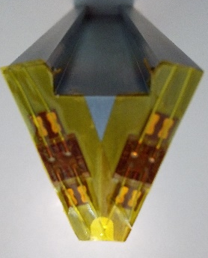
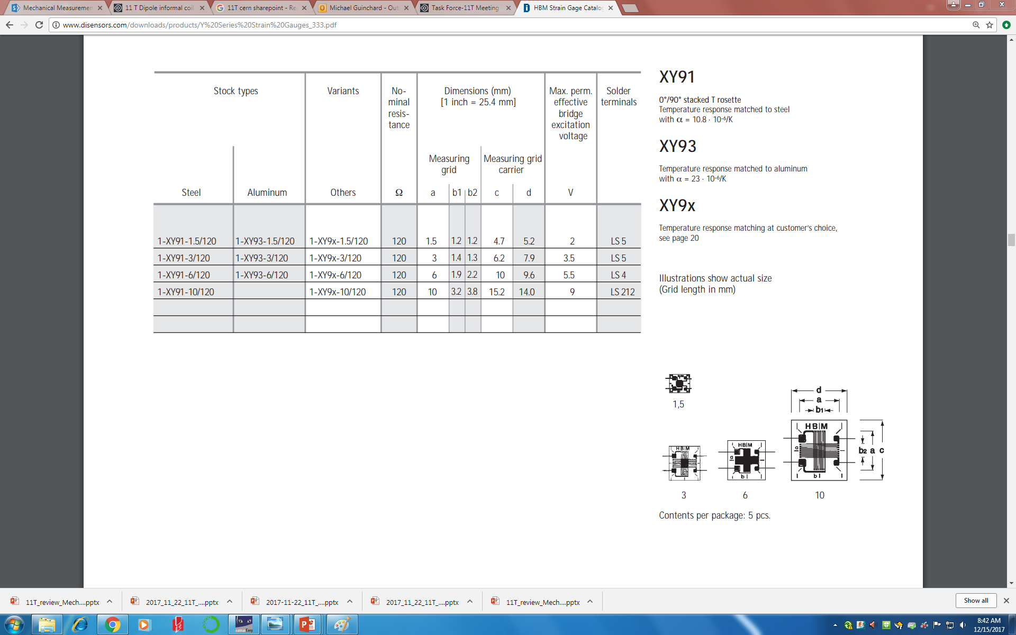
11T Collaring mockup (End of 2017)
Both side of the 6 collars equipped with strain gauges in half-bridge configuration (Production)
Bending and compression stress measurements for collars
Slits with a gap of 500 µm between nose and pole
Pole wedges equipped with biaxial strain gauges and angel wires
Pos. 1
Pos. 4
35mm
Pos. 2
Pos. 5
35mm
Pos. 3
Pos. 6
Pos. 3
Pos. 1
Pos. 4

Slide 11
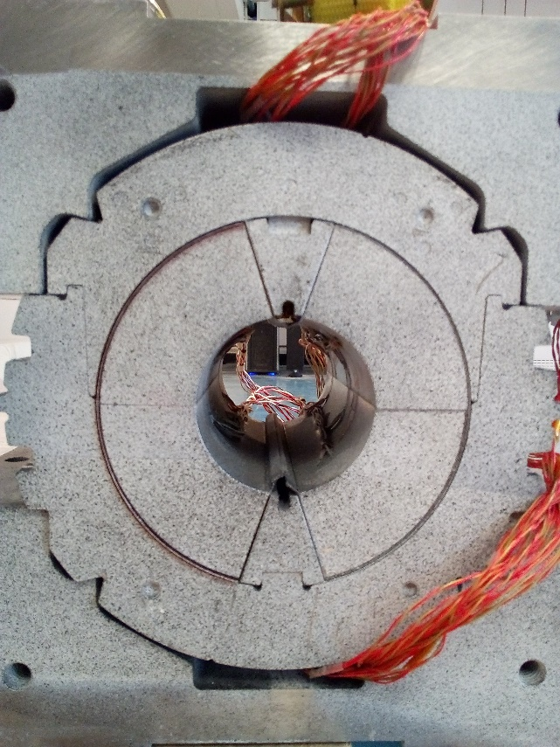
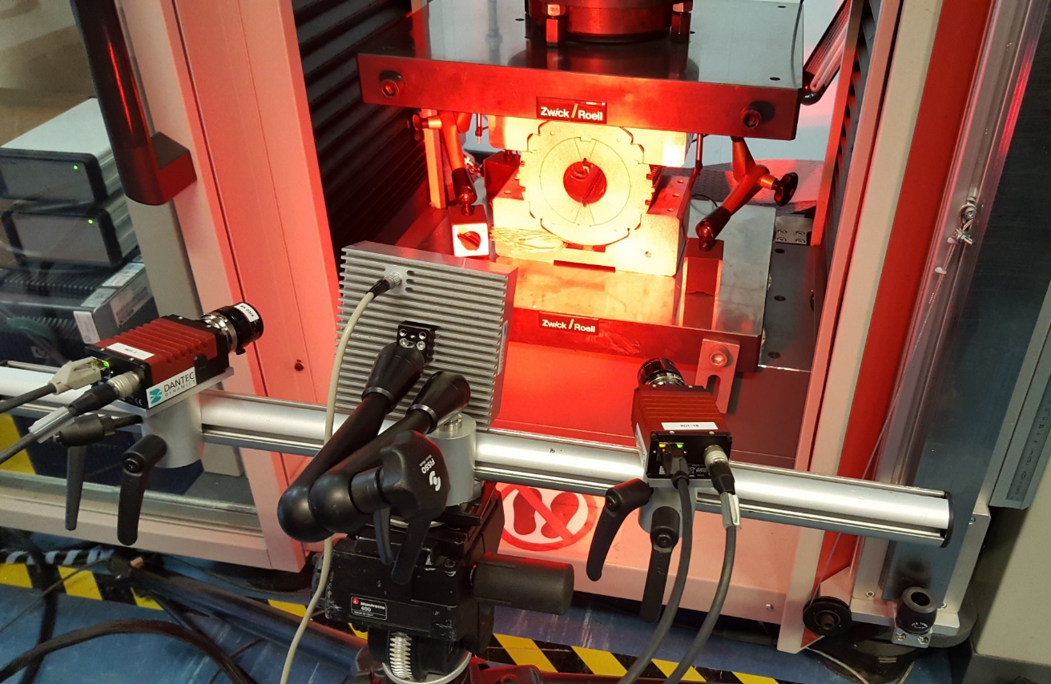
11T Collaring mockup (End of 2017)
Digital image correlation is an optical method that employs tracking and image registration techniques for accurate 2D and 3D strain measurements.
Camera#01
Lighting system
Camera#02
Pattern application
Aerosol cans
Airbrush
Pens / Sponge

Slide 12
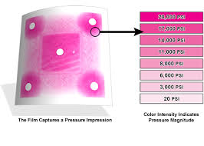
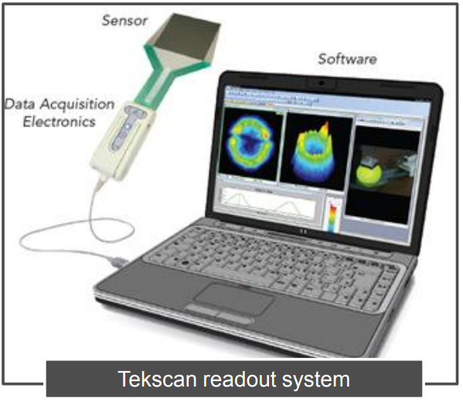
11T Collaring mockup (End of 2017)
FUJI Paper (Felix)
    Mid-plane
    Poles
Tekscan placed on the Mid-plane
    live read-outs of pressure throughout the collaring process.
    Range 0 to 150 MPa

Slide 13
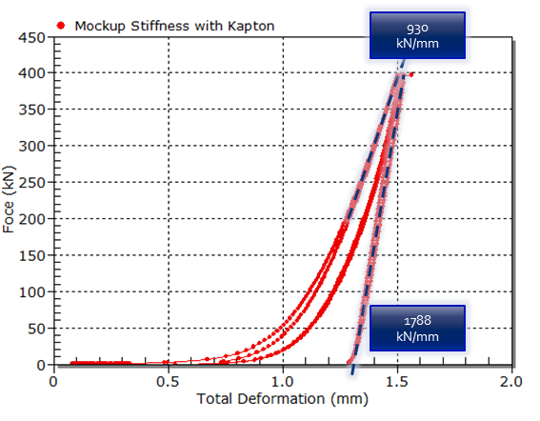
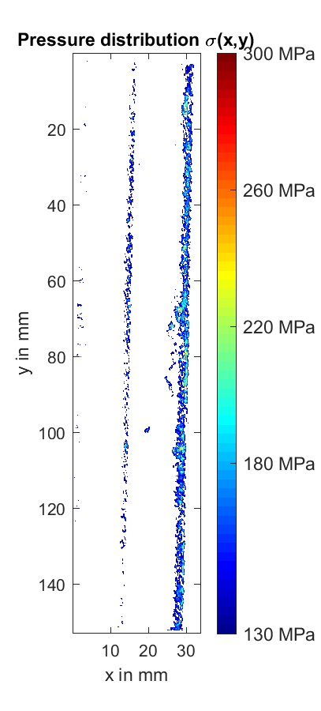
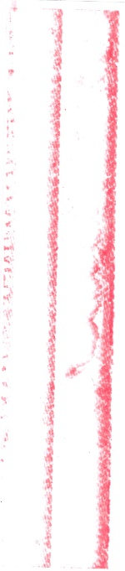
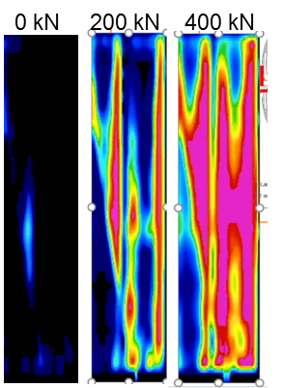
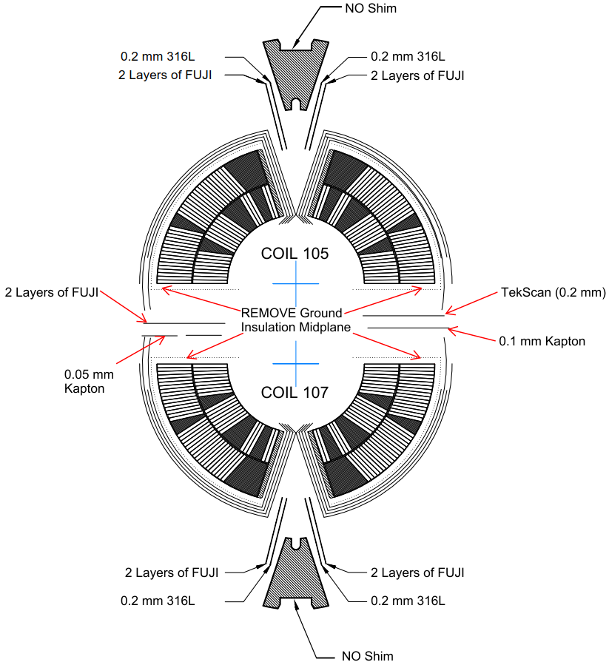
11T Collaring mockup (End of 2017)
      Validation results :
      Stiffness measurements
      FUJI Paper vs Tekscan
  At 400kN, average pressure of 42 MPa
  Pressure gradient from 130 Mpa down to 5 MPa on the mid-plane
  Good agreement
1
2
MP
Video 0 kN – 400 kN - 0 kN
3
4
HHS Paper

Slide 14
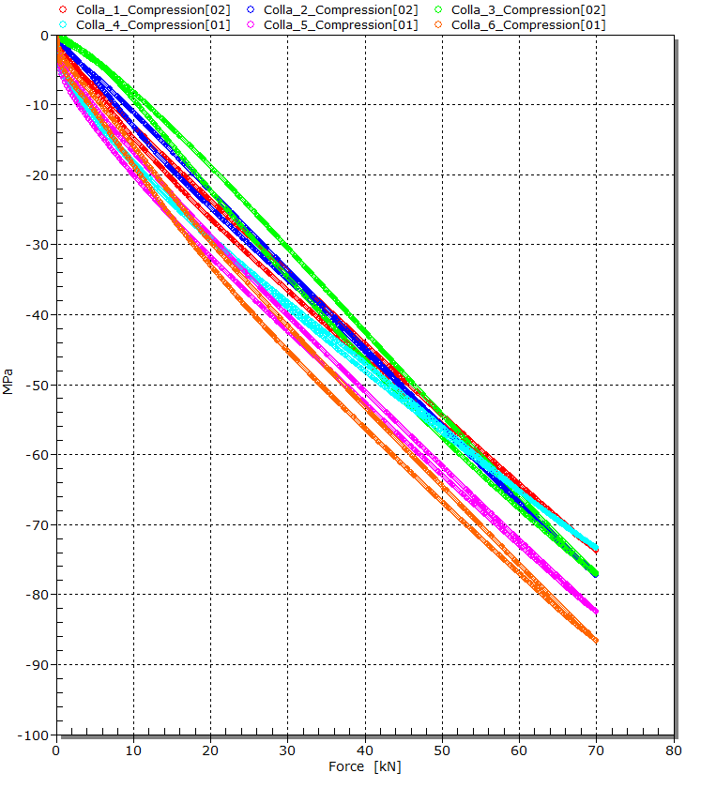
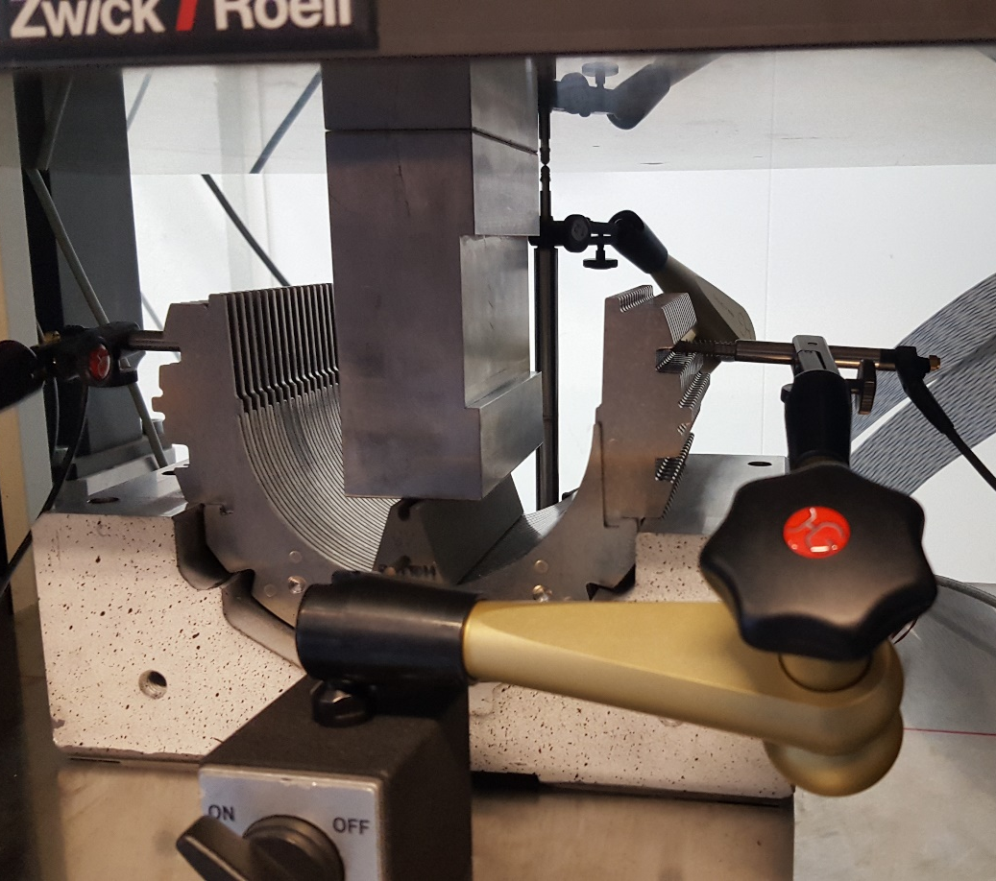
11T Collaring mockup (End of 2017)
      Validation results :
      3) Strain gauges response through the pole wedge

Slide 15
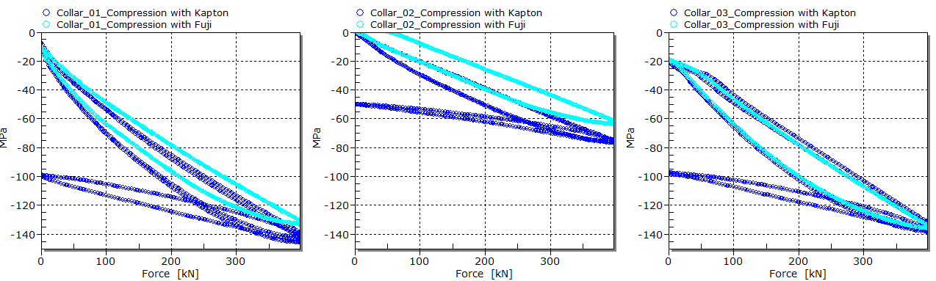
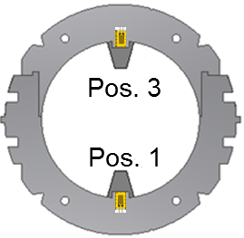
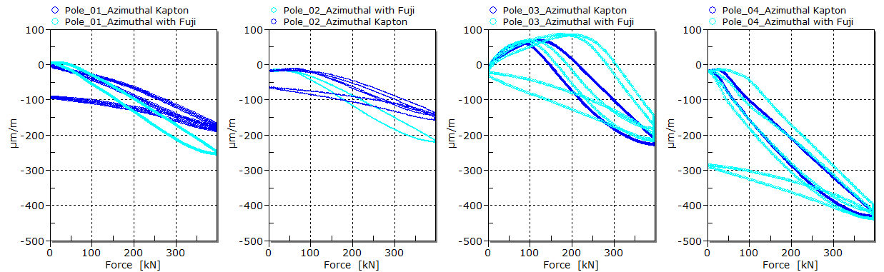
11T Collaring mockup (End of 2017)
      Validation results :
      4) FUJI Paper vs Kapton

Slide 16
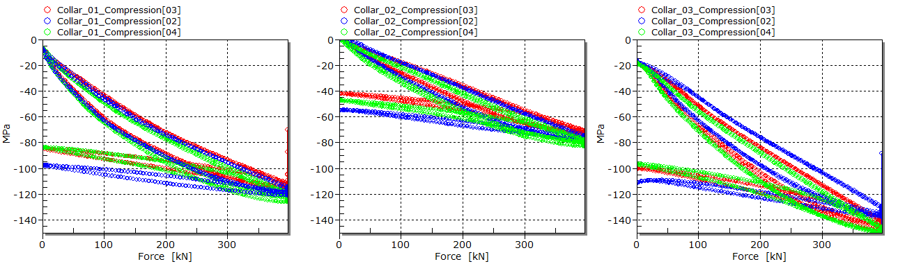
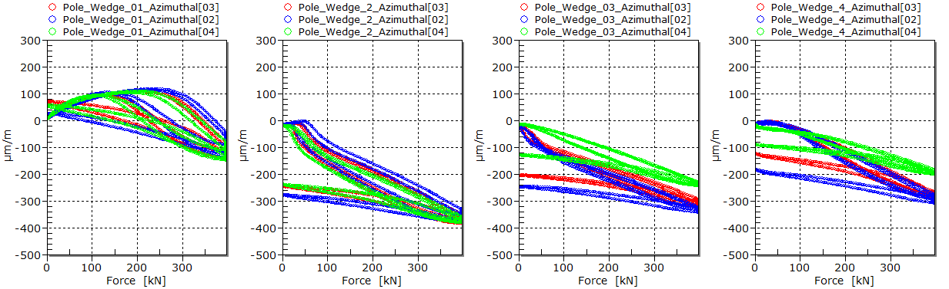
11T Collaring mockup (End of 2017)
      Validation results :
      5) Mounting repeatability
FEA
FEA
FEA

Slide 17
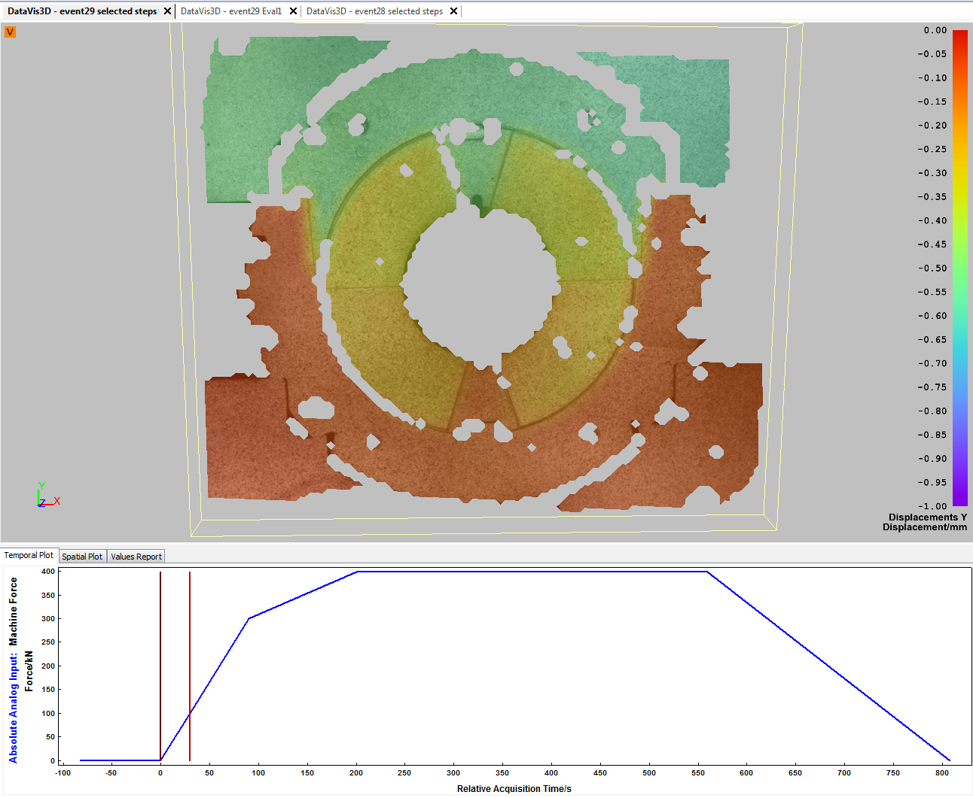
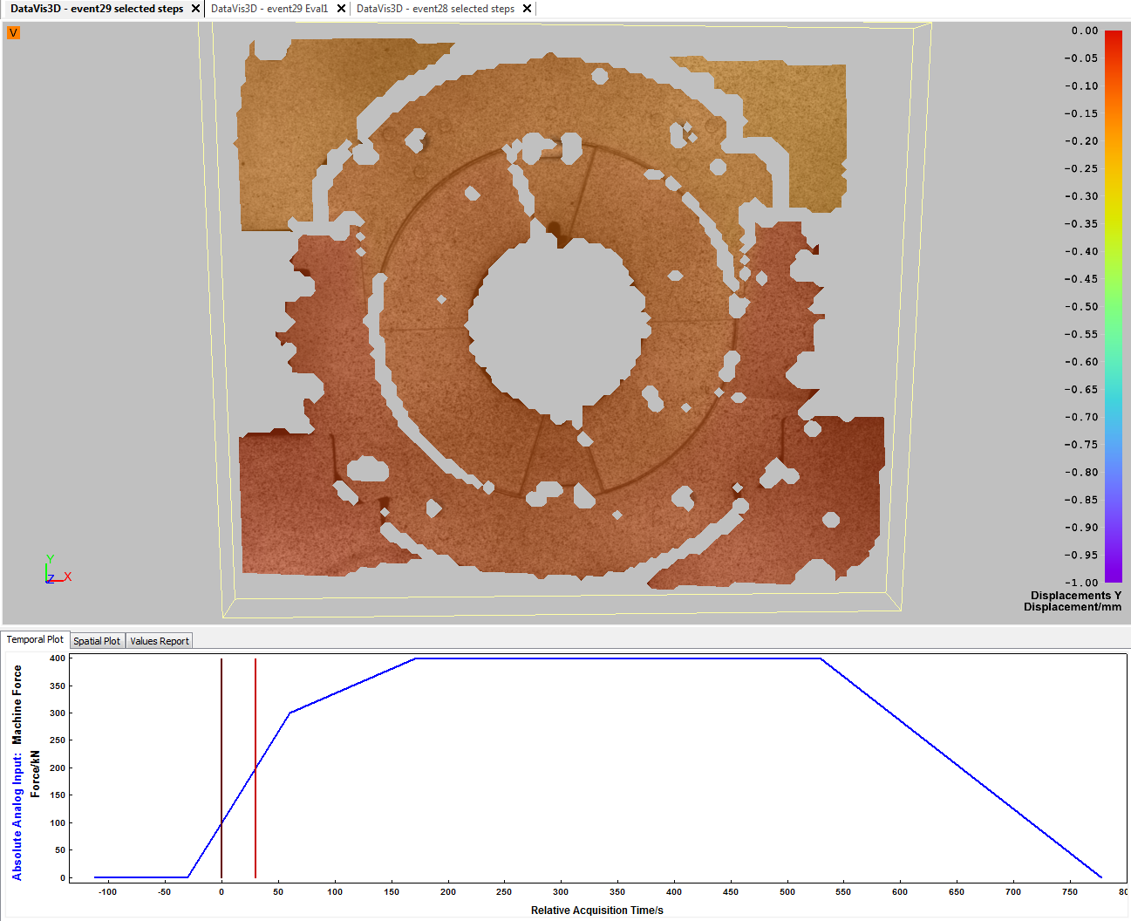
11T Collaring mockup (End of 2017)
Displacement results :
Relative vertical displacement : 0 to 100 kN
Relative vertical displacement : 100 to 200 kN

Slide 18
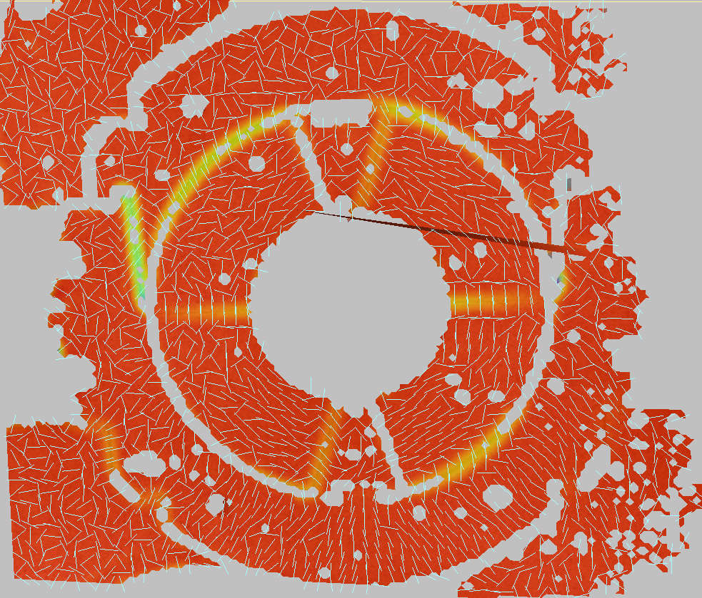
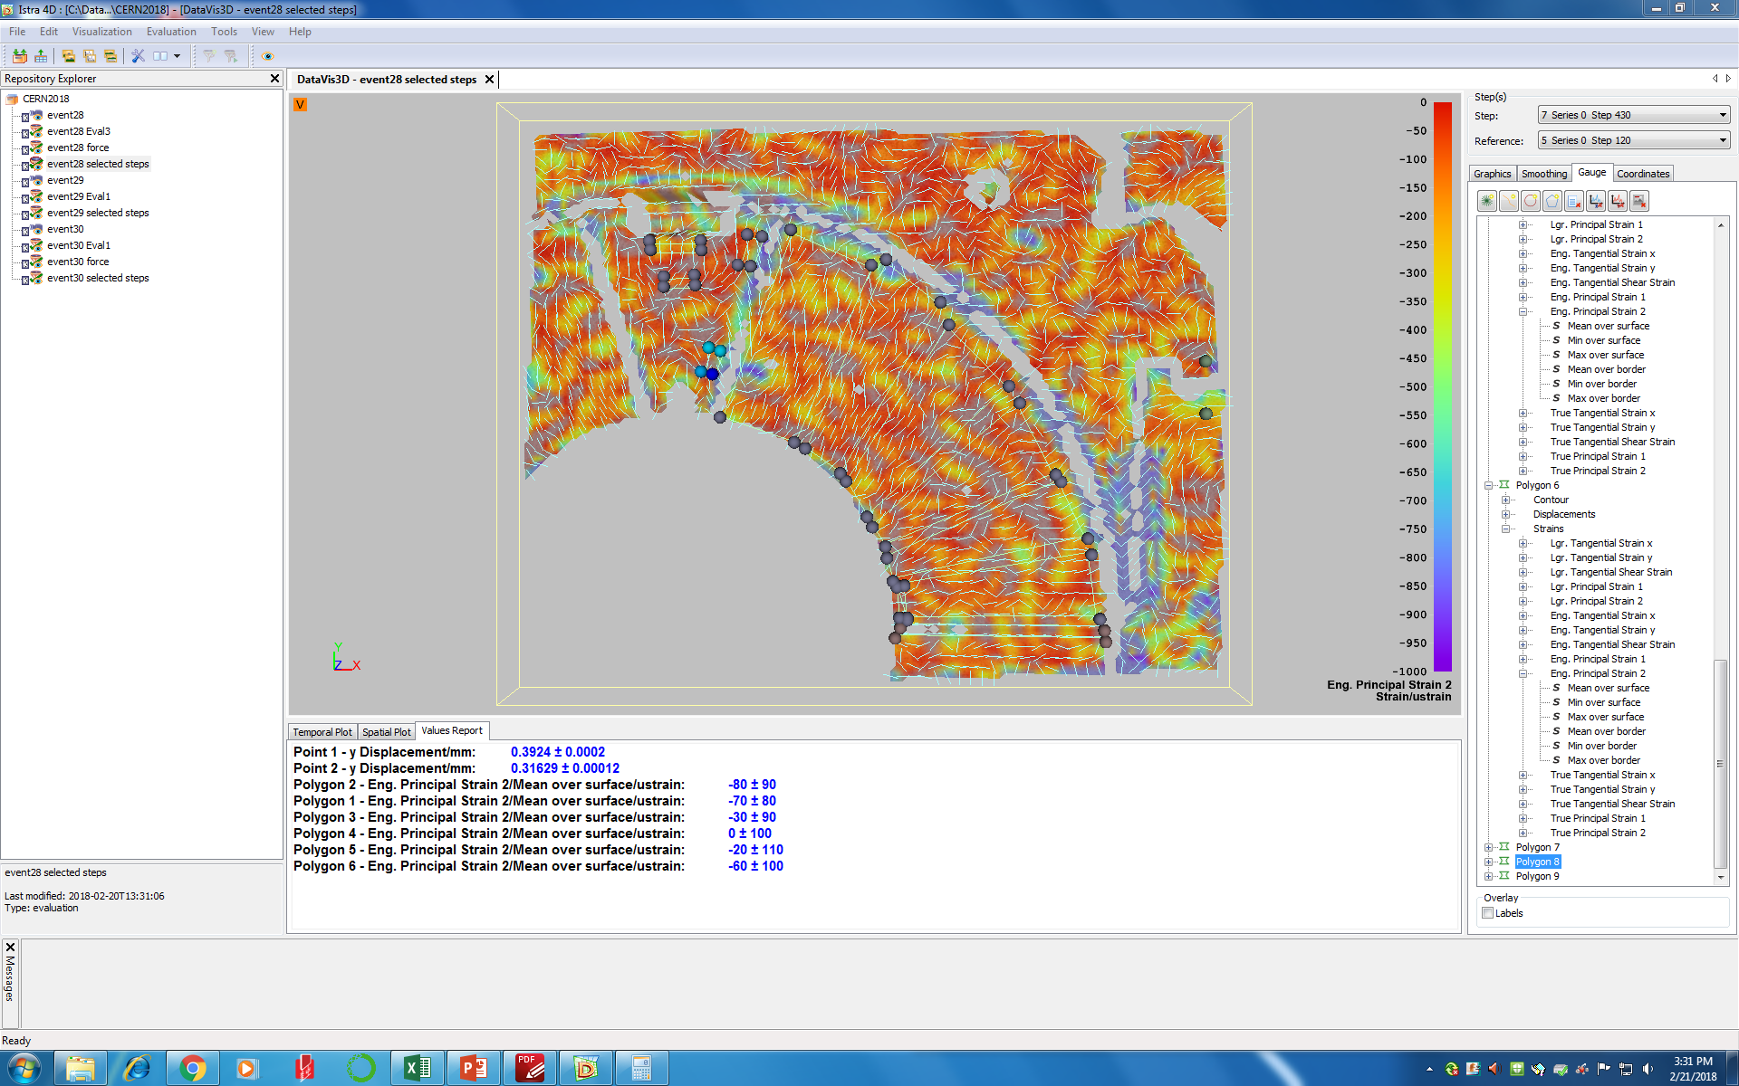
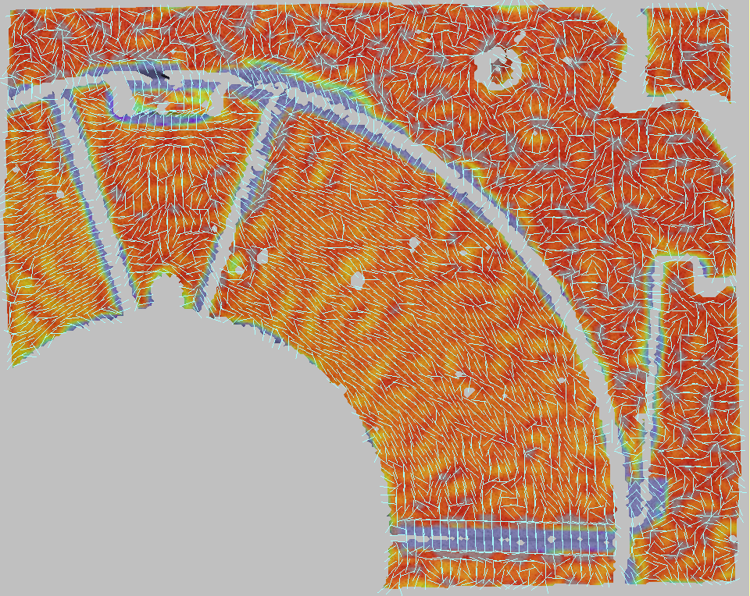
11T Collaring mockup (End of 2017)
Strain results :
Eng. Principal Strain 2 : 100 to 200 kN

Slide 19
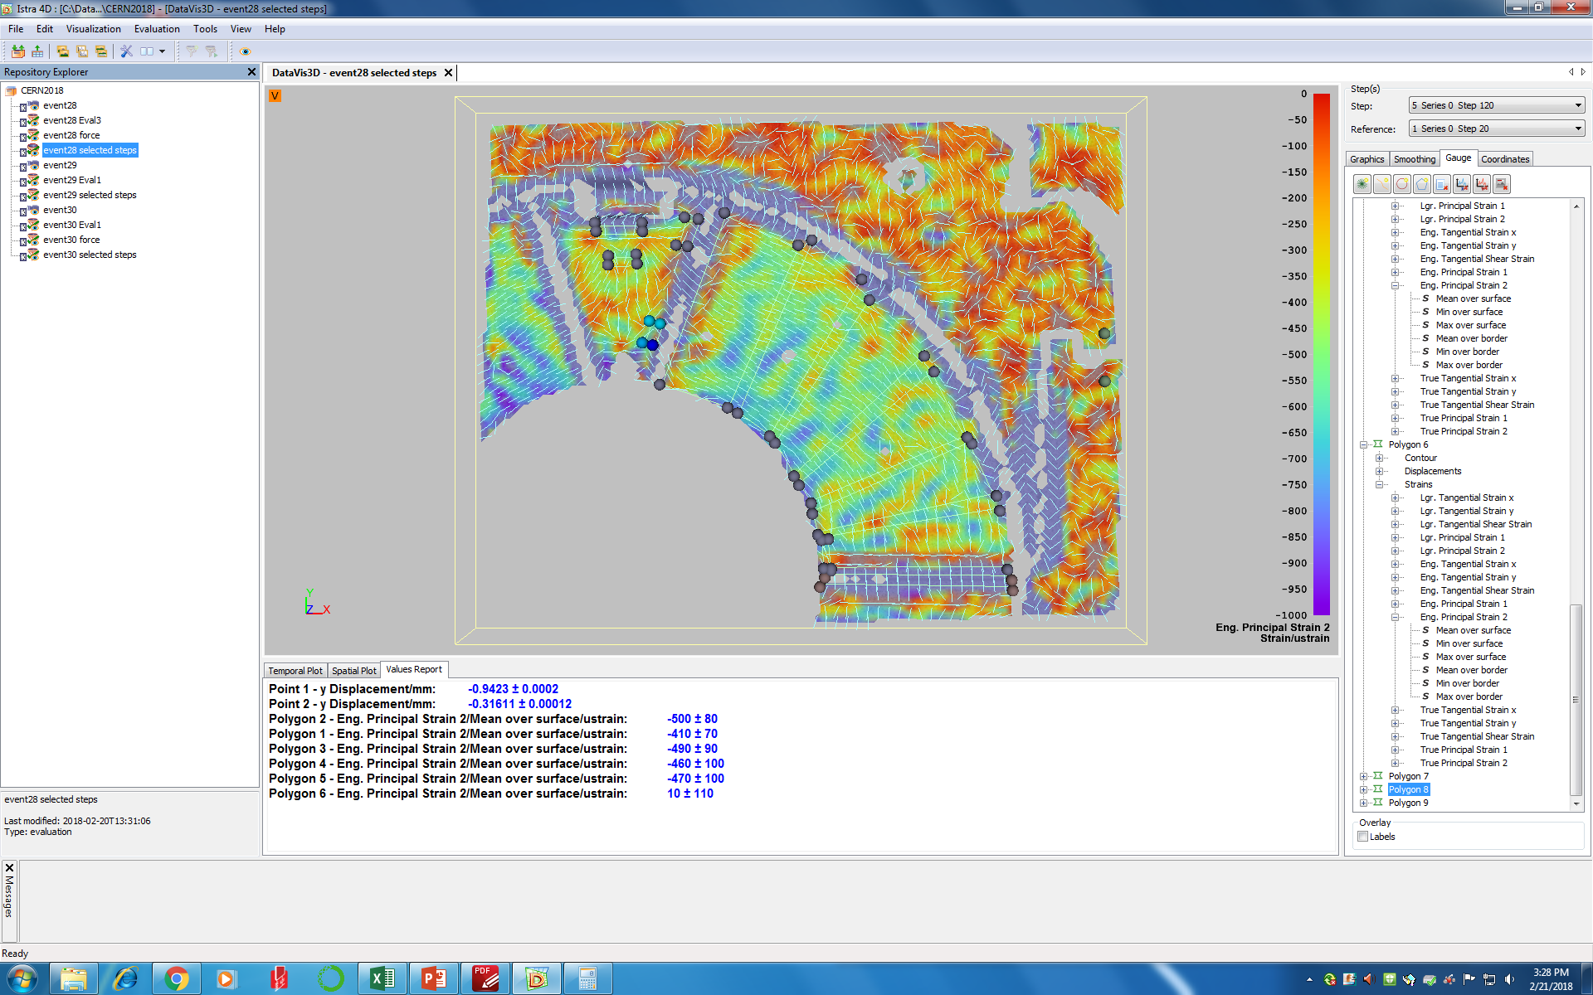
11T Collaring mockup (End of 2017)
Strain results :
Main outcomes:
Better understanding of the collaring process :
100kN is required to close radial gaps;
Shimming effects and load repartition.
Validation of the instrumentation by measuring the transfer function with the standard instrumentation;
Bending effects confirmed in Z direction;
Collaring process : Loading from 1kN up to 400kN
Collaring process : 400kN to keys in

Slide 20
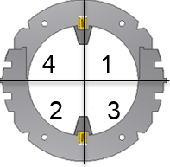
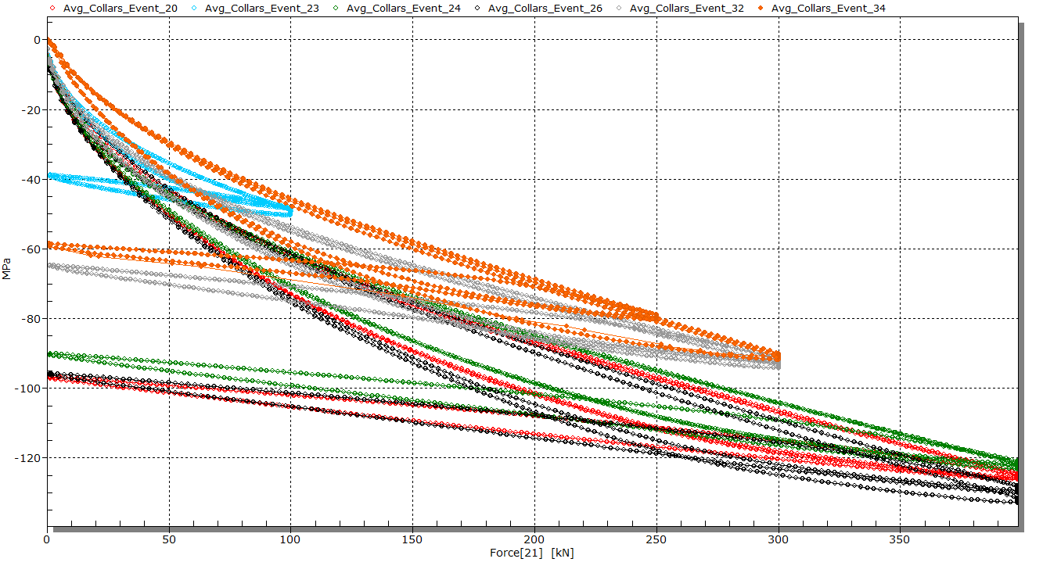
11T Collaring mockup (End of 2017)
Stress results :
Pole Shim
Lateral Shim

Slide 21
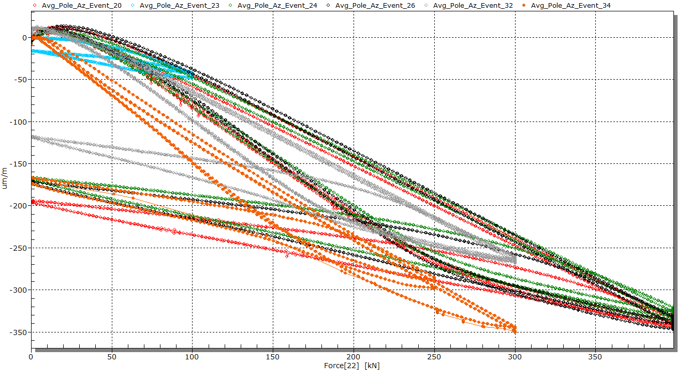
11T Collaring mockup (End of 2017)
Stress results :
Pole Shim
Lateral Shim

Slide 22
Conclusion
Several 11T 150mm Mockups were already measured and huge quantity of data is available, mainly for the last one in 2017/2018;
Several measurements devices were tested with the following outcomes :
  Electrical strain gauges (ESG) : Nice feedback with a minimum of mechanical effects but the coil azimuthal stress state needs to be extrapolated;
  Fuji paper / Tekscan systems gave coherent results but affect a bit the response of the system due to the friction;
  Capacitive gauges are not adapted due to the longitudinal motion during collaring steps observed by ESG and DIC. The 100kN to close the gap to access to the strain regime and the stress distribution doesn’t help also;
  DIC results have shown the overall behavior of the mockup during the collaring process – The transfer function with ESG was also determined and the bending effect measured by the collars was also confirmed.

Slide 23
Thank you !
Questions ?

Slide 24
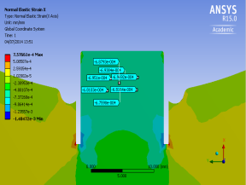
Strain gauges for 11T collars
Cuts next to the nose of the collars were done in order to get more axial stress
Half bridge configuration
Poison ratio compensation
Bending and traction measurements
ε1 = εB + εT
εTraction = (ε1 + ε2)/2
σT
ε2 = -εB + εT
εBending = (ε1 - ε2)/2
σB

Slide 25
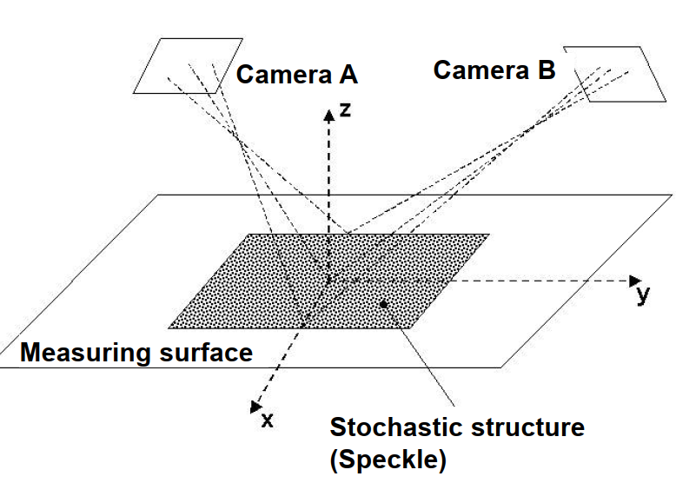


Measurement techniques
Goal :
3D Deformation Measurement based on the principle of perspective view (similar to our visual sense)
How does it work ?:
  Stochastic pattern on the object
  View with two cameras from different directions
  Identification of homologues points (correlation algorithm)
  Calculation of 3D coordinates

Slide 26

Measurement techniques
Equipment’s
  Two cameras of 5 mega pixels
  Fix lenses of x35 or x50
  Lighting system + support
  Electronic with 6 input/output channels
Boundary conditions :
  Zone of interest : Few cm2 up to one m2 with limited depth of field
  Strain accuracy : +/- 10 µm/m according to speckle size
  Temperature range : No limit if visible by human eyes
  Frequency range : Up to 15 frame/s with the standard camera
  Surface : Need to be paint (Study ongoing to improve this point)

