Slide 1

Collaring Status & Future work
J. L. Rudeiros Fernández*
D. Pulikowski
E. L. Gautheron
F. Savary
F. Lackner
11-03-2020

Slide 2
Content
Introduction
Research proposal

Slide 3
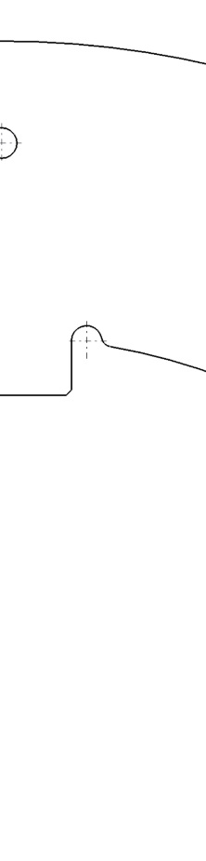
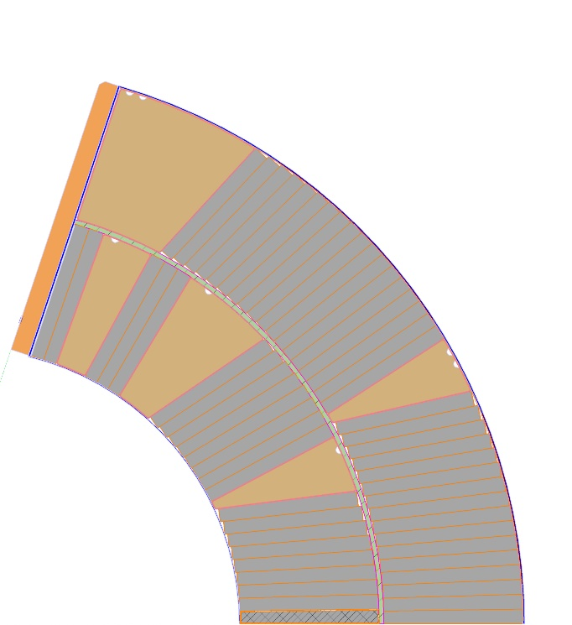
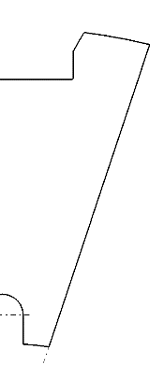






1. Introduction
Collar
$$lg$$
$$S_{0}$$
$$S_{Top}$$
Pole
$$α_{P}$$
Coil
$$d_{P}$$
$$cn$$
$$r_{o}$$
$$d_{C}$$
The assembly excess is created in the azimuthal direction in order to provide pre-stress to the coil, while not exceeding the maximum stress allowable. Given the geometrical variability of the coils’ cross sections along their length, a graded shim is used.

Slide 4
1. Introduction
Assuming a continuity of material properties along the length of the coil and between different coils, and no variation of quality within the geometry of involved parts (e.g. pole, collars) the simplified geometrical parameters used for the configuration of the assembly (i.e. coils’ azimuthal oversize) cannot explain the variability of dimensions observed for the collared coils assembly.

Slide 5
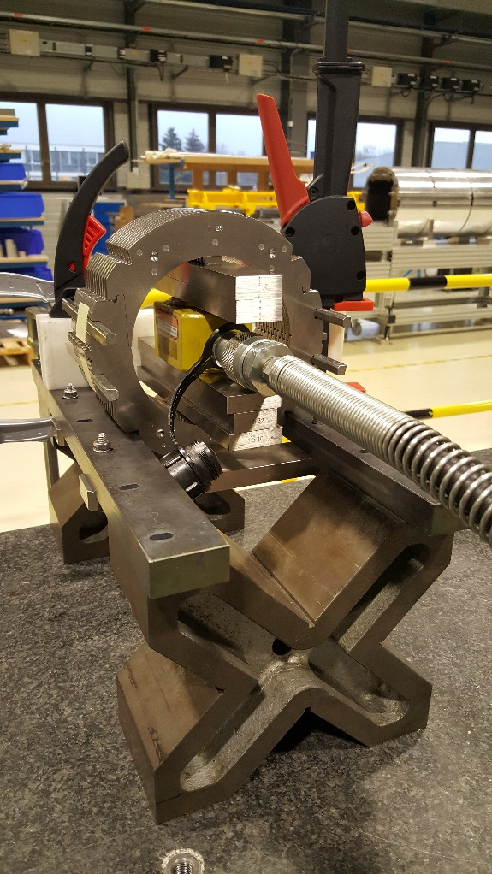
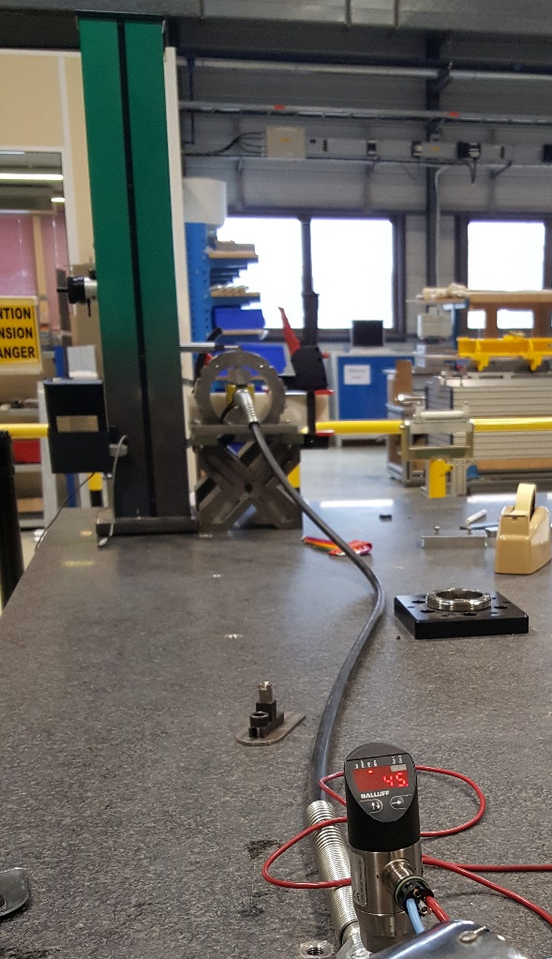




1. Introduction
5th
3rd
8th
1st
$$R_{e}$$
Top
$$F_{V}$$
$$R_{i}$$
$$F_{V}$$
Bottom
The developed analytical and FE models explain correctly the measured collar structure deformation. Further, the analytical model demonstrated that a variation of coil-collars interaction (e.g. non-even surface, or rotation of LP and MP) could induce a similar level of variability of overall deformation.

Slide 6
2. Research proposal
Research hypothesis
The deformation of the collared coils assembly, and therefore stress-strain state of the coils, is not only influenced by the material properties of the individual parts, and coils’ oversize, considering constant boundary conditions, but also by additional parameters such as:
Quality and continuity of the curvature of the coil’s outer radius surface.
Relative rotation of coils’ mid-planes along their length.
Relative rotation of coils’ loading plates along their length.
Variation of coils’ azimuthal size between inner and outer layers.
Rotation induced by non-even pole surfaces.
Small variations of the dimensions of collars and poles.
Ratio between shims’ thickness and coils’ azimuthal length.
Assembly asymmetries.

Slide 7
2. Research proposal
Materials and methods I
Material characterisation
Characterisation of new base isotropic material in compression following standards (ASTM E9 and ASTM E111).
Characterisation of new base isotropic material in a 10-stack configuration:
  Machining of new isotropic material with10-stack dimensions.
  Measurements of 10-stack new material elastic properties, based on strain gauge and\or clip gauges, and LVDTs, in EN-MME specially dedicated set-up.
  Comparison between compliance calibration versus direct strain measurements for this material.

Slide 8
2. Research proposal
Materials and methods II
Phase 1: 150 mm long 11T collaring mock up
Test of collaring mock up within EN-MME Zwick/Roell electromechanical material testing machine.
Analysis of parameters (initial):
  Coil block material (Steel, Aluminium, ~25 GPa material, Real coils).
  Geometrical parameters:
    Excess.
    Rotation of MP and LP angles.
    Ratio between shims’ thickness and coils’ azimuthal length.
  Asymmetries:
    Excess:
      Top-Bottom.
      Left-Right.
    Outer radius.

Slide 9
2. Research proposal
Materials and methods III
Phase 1: 150 mm long 11T collaring mock up
Measurements to be carried out during the experiments:
  Stress:
    Collar nose:
      SG
      FUJI
    Pole:
      SG
      Capacitive gauges
      FUJI
    Mid-plane:
      FUJI
      Continuous measurement (e.g. capacitive gauges…)
  Deformation/Displacement:
    DIC.
    Distance between top and bottom collaring tool.
    Deformation of the collared coils assembly.
    Determination of the degree of plastic deformation of the collars after de-collaring.

Slide 10
Thanks!

