Slide 1

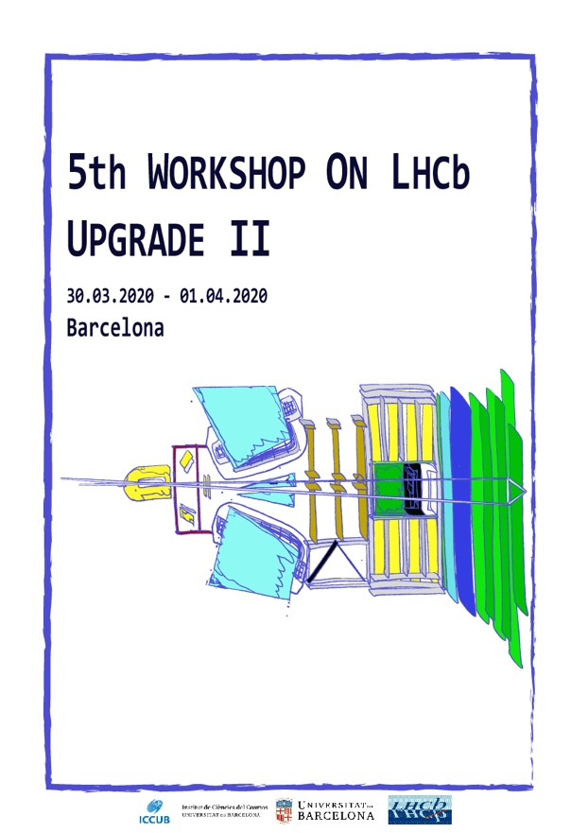
Upgrade II Workshop Introduction
Chris Parkes
Status
Timescales
Plans

Slide 2
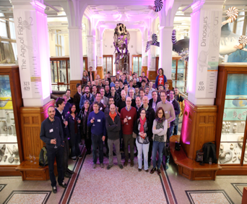
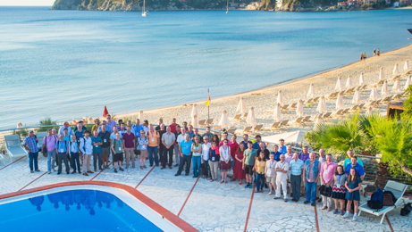


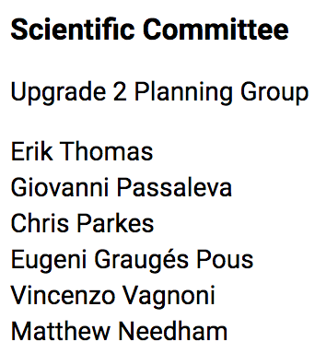
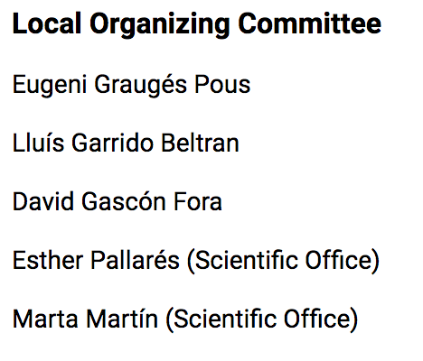
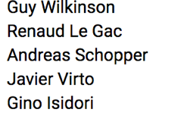
Workshop Series

Slide 3
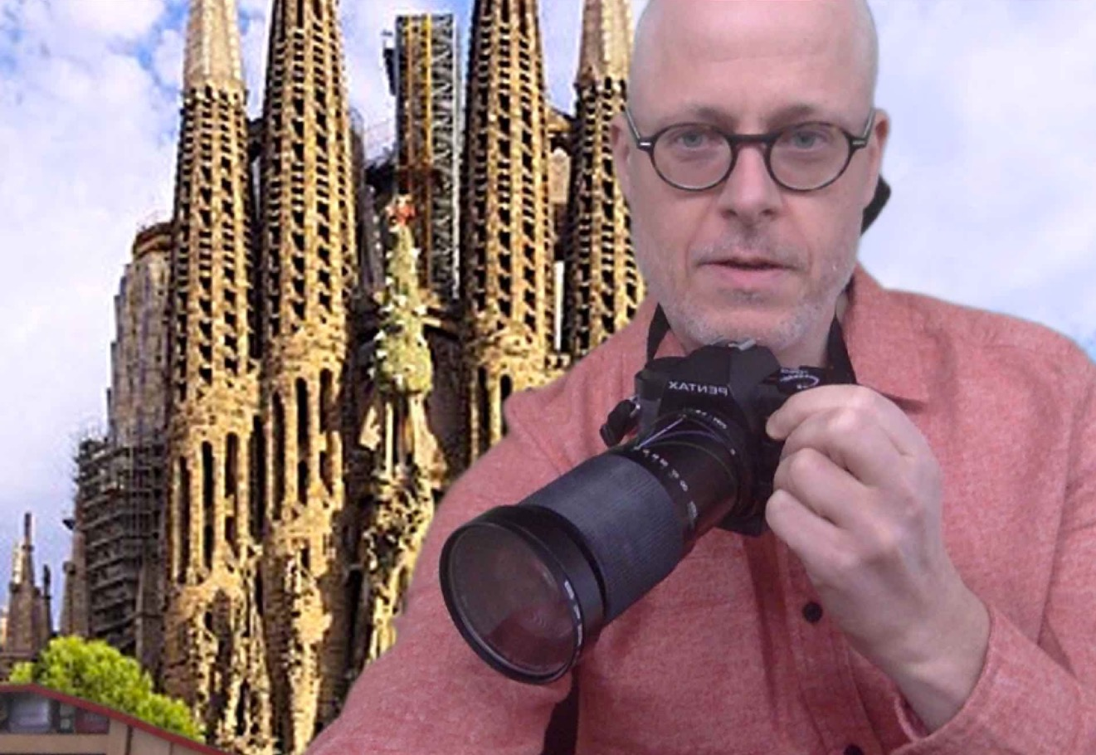
Some Gaudi Tourism ?

Slide 4
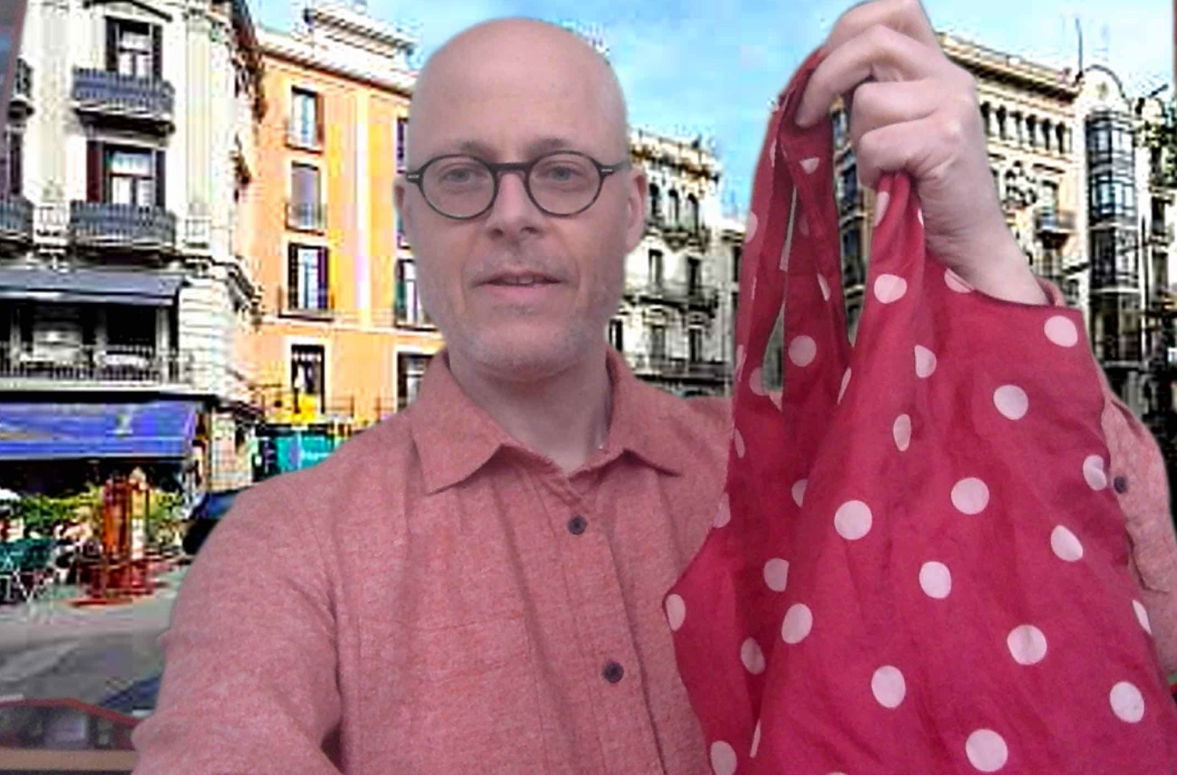
Shopping on La Rambla ?

Slide 5
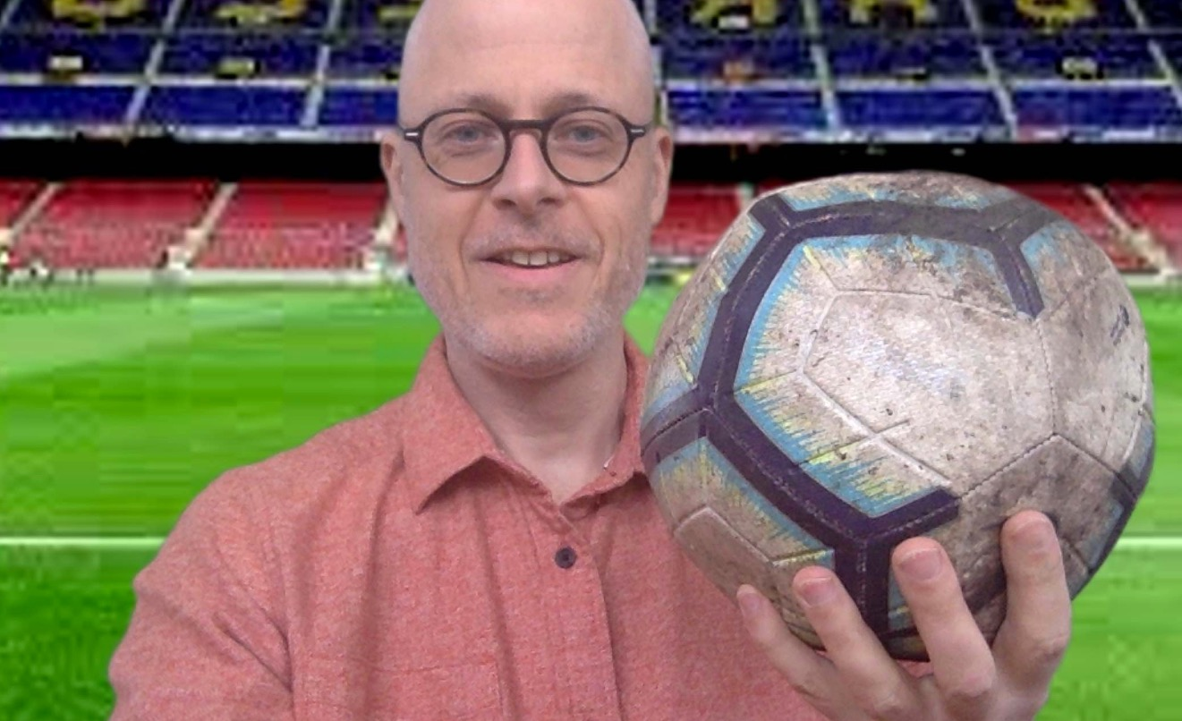
A quick game at the Nou Camp ?

Slide 6
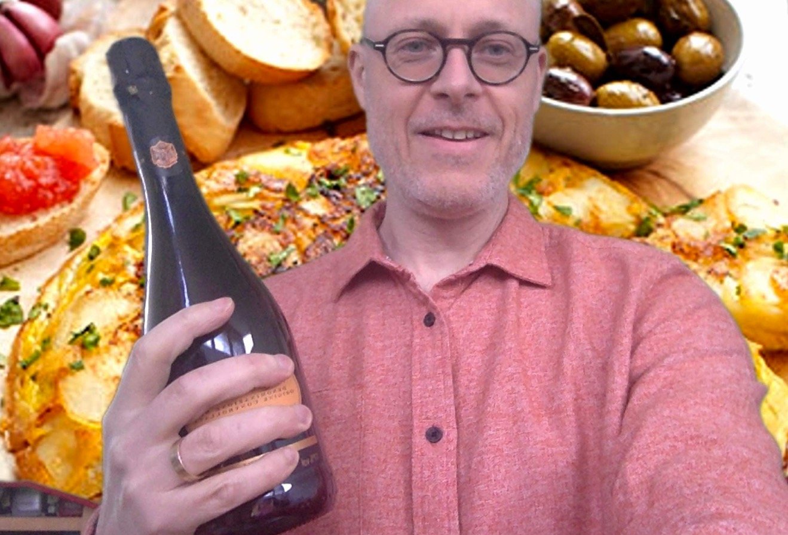
Tapas, BYO Cava ?

Slide 7
Workshop Series
Many Many thanks
to Barcelona local organisers
They had done a huge
amount of work before
we had to move to video conf.
LHCb will go to Barcelona for
an event at the next possible
occasion !
Vidyo
Zoom
Many Many thanks
to LHCb Secretariat:
Nathalie, Cindy, Amelie

Slide 8


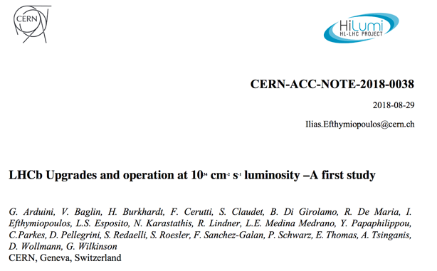
Documents
Expression of Interest (LHCC-2017-003) LHCC 2017
Physics Case (LHCC-2018-027) LHCC 2018
Accelerator Study (CERN-ACC-2018-038) LHCC 2018
  LHCb preferred scenarios (LHCb-PUB-2019-001)

Slide 9


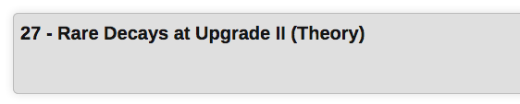
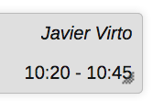
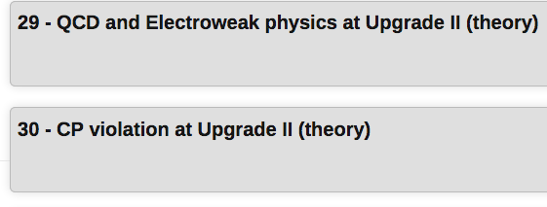
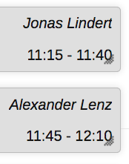
Physics Case
& European Strategy process
Theory
Monday
Wednesday

Slide 10
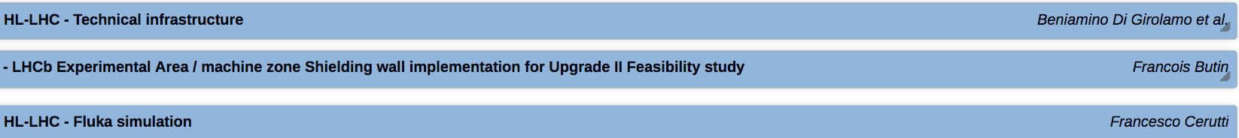
Machine Parameters
HL-LHC note [CERN-ACC-NOTE-2018-0038]
  Feasibility of running of LHCb Upgrade II
LHCb response [LHCb-PUB-2019-001]
  U2 Max. L (start of fill) 1.5 x 10³⁴ cm⁻² s⁻¹
  U2: Run 5&6: 250fb⁻¹ (physics studies)
  upto 350fb⁻¹ (detector)
Preferred scenario
  Max. mean Pile-up: 42
  rms z: 44.7mm
  rms t: 196ps
Monday

Slide 11
External Approval
LHCC September 2018
“The LHCC commends the LHCb collaboration for successfully preparing the physics case report for running beyond LS4 and supports the activities of the LHCb collaboration in planning for HL-LHC running through the preparation of TDRs”
Briefing book for the 2020 European Strategy Particle Physics (http://cds.cern.ch/record/2691414)
Many supportive comments including:
"The LHCb Upgrade II... will enable a wide range of flavour observables to be determined at HL-LHC with unprecedented precision"
CERN Research Board September 2019
"The recommendation to prepare a framework TDR for the LHCb Upgrade-II was endorsed, noting that LHCb is expected to run throughout the HL-LHC era.”

Slide 12
Next Stages
A number of R&D projects underway
  Some specific to LHCb, some related
Bids to national funding agencies in preparation
  Research Review Board kept up-to-date
Framework Technical Design Report
  Preparation for writing this is
  main aim of this meeting
Conceptual Design Report for accelerator
  Reports in this session

Slide 13
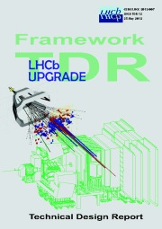
Upgrade II: Framework TDR Contents
Contents:
Document describing the detector and computing that demonstrates we have technological feasible options that will deliver our physics case.
Costing Options, Schedule, National Interests
Upgrade Resource Board
discusses funding
    One representative per country
Options not decisions for LS4
  For LS3 must be firmer
Cost of options
  (baseline / descoped)
  Start of 2021 (draft to LHCC)

Slide 14
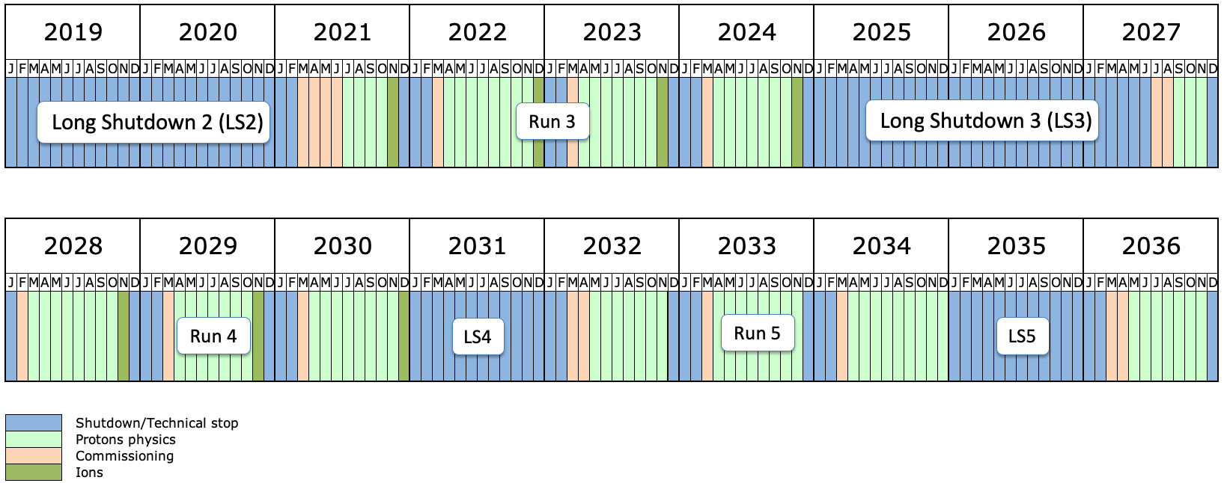
LHC Schedule
Run 6
Schedule changed in late 2019
  2024 operational year
Current covid-19 crisis could be expected to impact on 2021 schedule

Slide 15
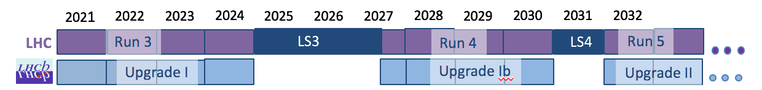
LHCb Upgrade / Installation Schedule
UII Framework TDR
UII Subdetector TDRs
Consolidation/enhancement phase in LS3
  First stage of Upgrade II “Upgrade Ib”
  No luminosity change (baseline)
Main installation phase in LS4
  Full Upgrade II (luminosity increase)
Framework Technical Design Report (FTDR)
Individual subdetector TDRs will follow FTDR
  LS3 consolidation/enhancements TDRs soon after
  LS4 Upgrade II subdetector TDRs later

Slide 16
Remarks
Schedule uncertainties
  LS3 already pushed back one year
  Profit from delay and long duration of LS3
Given current uncertainties decouple ask:
  What detector do we want for final LHCb luminosity ?
  What timescale could this be constructed on ?
    Plans for LS3 and LS4
LS3 modest changes
  Neither time nor finances would permit major upgrade for LS3 on current timescale

Slide 17
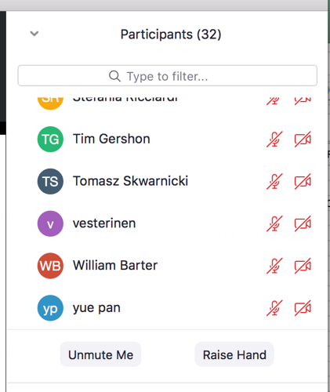
ZOOM etiquette
This is a public meeting
  Theory colleagues and potential new collaborators are attending
Session chair will share speaker’s slides
Slides containing initial costings will be shown
  but protected on indico for LHCb members only
Questions very much encouraged
  Use “raise hand” to ask to speak
  Chair will invite to speak
  Also good chat function
  Longer discussion sessions after several talk on same topic.
Thanks to Joel Closier for his advice & support

Slide 18

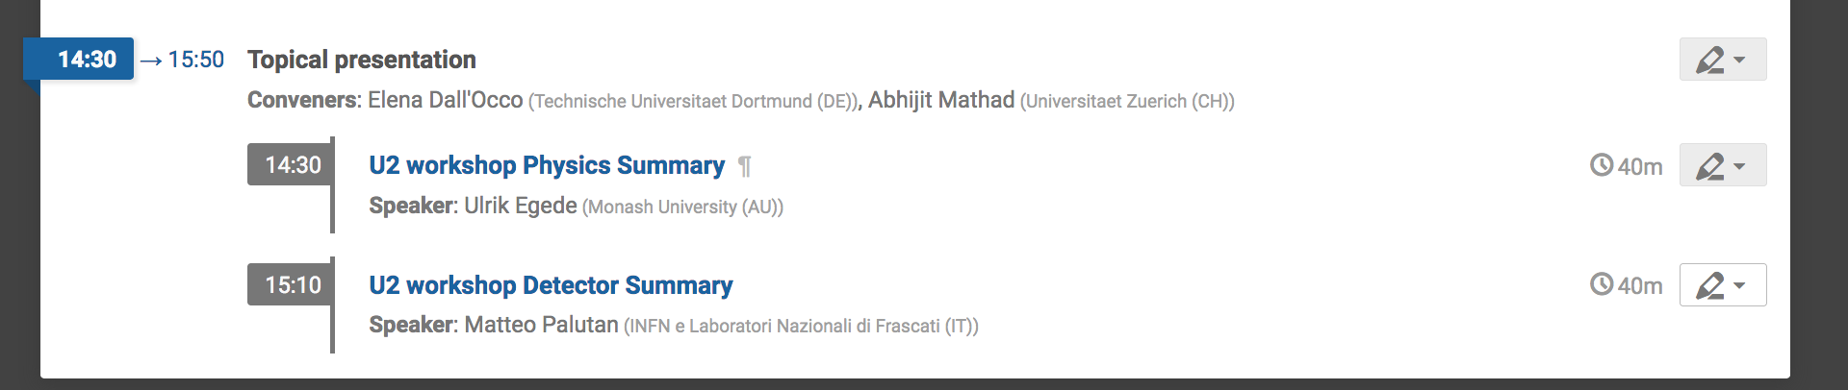


Programme
Workshop inside working hours (CET)
  Monday till Wednesday lunchtime
URB is being rescheduled
Summary Talks in Tuesday Meeting 7th April
Particular thanks to Ulrik for taking the night shift….

Slide 19
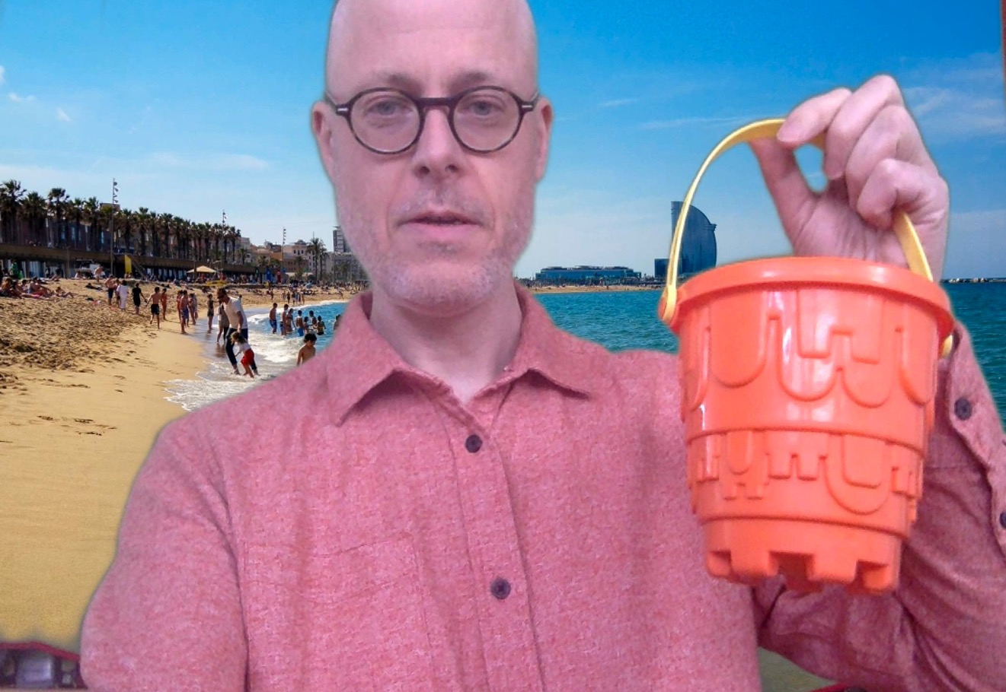
Come dive into our future !

Slide 20
Summary
Approved to proceed to Framework TDR
Machine CDR in tandem
FTDR: Layout the detector
    options, costs, interests
  Main aim of this meeting to discuss
  the potential projects to include
    Modest changes in LS3
    Major changes in LS4
FTDR Submission in early 2021

