Slide 1

LHCb Upgrade II: impact on Accelerator and Technology sector a.k.a. HL-LHC – Technical Infrastructure
Beniamino Di Girolamo (CERN ATS/DO)
5th Workshop on LHCb Upgrade II - 30/03/2020

Slide 2
Outline
Reminder of the HL-LHC Technical Infrastructure needs for LHCb Upgrade II
Scope of the studies
Organization to prepare a CDR/TDR for accelerator modifications
Conclusions

Slide 3
LHCb @ High Lumi: Impact on HL-LHC Layout
CERN-ACC-NOTE-2018-0038
TAS
Triplets
D1
TAN
D2
Q4-Q6
UX85
IP
TAS absorber to limit heat load and integrated to Q1-3
TAN absorber : to protect D2 recombination dipole against Neutrals. Maybe the one installed for Upgrade 1 will be sufficient
Collimation system: To shield Q5-6 against physics debris and limit the heat load
Also to be considered:
Impact on Cryo infrastructure in UX/US85
Impact on Cryo Lines
Impact on Life time / exchange scenario of warm corrector magnet
Impact General Infrastructure, Ventilation, Shieldings, R2E
…
For far more details please refer to my presentation at the 4th Workshop

Slide 4
LHCb Upgrade II – operation at high luminosity
Modifications to allow the experiment to collect 50 fb⁻¹ every year if able to work at
Major ingredients :
  adapting the beam optics, operation scenarios
  increasing the protections for both LHC machine elements and detectors experimental cavern to the new environment
Aim at exploiting Inner Triplets up to the 300 fb⁻¹ target
  however this has to be checked due to different optics conditions. We cannot assume that limits from ATLAS/CMS modus operandi apply to triplets around LHCb

Slide 5
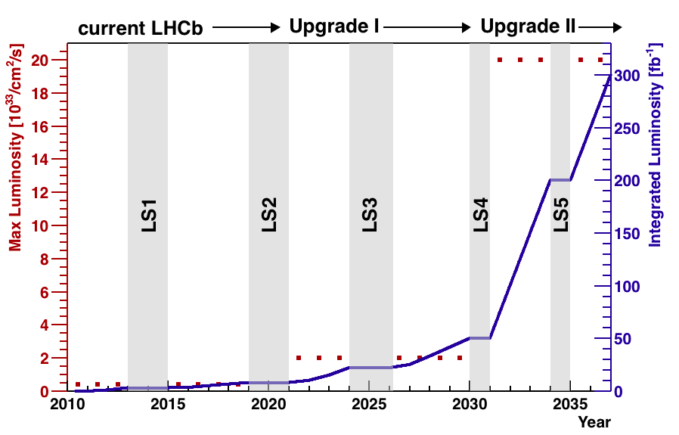
LHCb - Luminosity upgrade summary

Slide 6

LHCC session of Sept. 2018
LHCC minutes meeting:
“The LHCC commends the LHCb collaboration for successfully preparing the physics case report for running beyond LS4 and supports the activities of the LHCb collaboration in planning for HL-LHC running through the preparation of TDRs”
Timescale
FTDR DRAFT agreed to be submitted to LHCC in Feb 2021
FTDR PRINTED version: May-June 2021 LHCC session

Slide 7
Challenges
LHCb Upgrade II requires a number of modifications on the accelerator side
The upgrade has been announced via the HL-LHC coordination meetings, a forum of experiments-accelerator interaction
  A preliminary note has been prepared in 2018
  Need to proceed with a more detailed evaluation (CDR-like) to study feasibility and costs associated on the same time scale as FTDR

Slide 8
How to proceed in future
Timescale for LHCb Framework TDR production is from now to February 2021
  Work on accelerator studies started in 2019, now to start documenting asap
We need to ensure we follow the process and we interact and we aim at producing a CDR-like documenting feasibility and cost on the same timescale
We have a lightweight structure on the accelerator side and meetings with the participation of the experiment contact persons (more to come as soon as we will be a bit more free from the current emergency)
Avoid surprises on both sides
We need some budget for studies and we have a dedicated talk at the next Executive Committee meeting
  I expect support from you for my request

Slide 9
Lightweight structure started in 2019
Each group involved (in TE, EN and BE) appointed a contact person
  Extensive work done in TE with the help of V. Perez-Reale
  Extensive work with Francois Butin for R2E and experimental areas aspects
  Restarted discussion with F. Cerruti for more refined studies and extension beyond D2 to check Q4, Q5 and their correctors. In consultation with BE, beam dynamics, R. De Maria.

Slide 10
Organisation in progress
Project leadership: Beniamino Di Girolamo
Technical coordination: François Butin
Studies and simulations
  Beam dynamics: R. De Maria
  Energy deposition: F. Cerutti
  Radio-protection: S. Roessler
Cryogenics: L. Del Prat, G. Ferlin
Magnets: E. Todesco
Machine protection: A. Siemko
Power converters: J-P Burnet
Absorbers: F. Sanchez Galan
Shielding: M. Lazzeroni
R2E: R. Garcia Alia
Collimation: S. Redaelli
Vacuum: G. Bregliozzi

Slide 11
Work done in TE
Several iterations with TE/CRG, where the impact of the upgrade can result in high costs
  Now waiting more input from energy deposition and from e-cloud to better estimate the impact on cryogenics
Meetings with VSC, MSC, ABT, EPC, MPE
  VSC: nothing special
  MSC: studies to be done, being triggered in the coming weeks. Many items to be checked
  ABT: contacted to explore the lack of space for collimation and protection on the injection side
  MPE and EPC: clear plans of consolidation

Slide 12
Conclusions
Focusing now to studies to have a more precise costing
Template for CDR filling being prepared, distribution soon
This work comes in LS2 where a lot of key players have high load
  Light interactions to limit impact whilst producing suitable documentation
  COVID-19 doesn’t help
The cryogenics boxes shielding has to be seriously considered to limit costs
We will define costs in a conservative way to avoid later surprises
Scenario for anticipated installations will be considered in a more calm moment (LS2 has to restart and COVID-19 has to be a sad memory), but it is not forgotten

