Slide 1



RADIATION CHALLENGES
FOR THE MACHINE
Francesco Cerutti, on behalf of the
team
with contributions by L.S. Esposito, R. Garcia Alia, A. Lechner, G. Lerner, A. Tsinganis
acknowledging the input of many CERN colleagues
5th Workshop on LHCb Upgrade II zoom.us Mar 30th, 2020

Slide 2
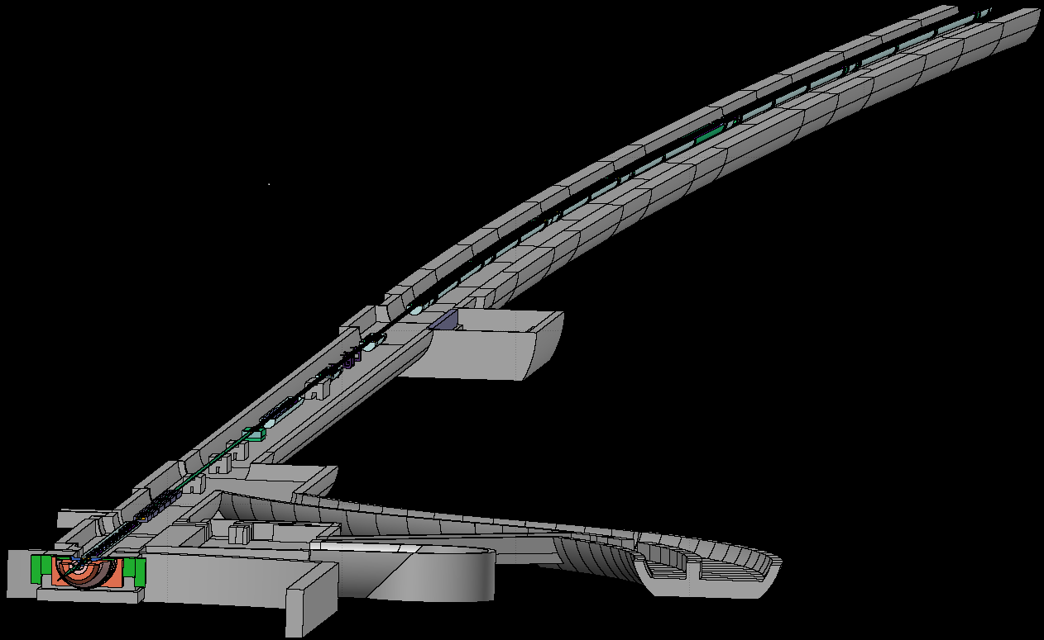
OUTLINE
Collision debris figures and features
Impact on superconducting magnets
of the triplet – D1 string
of the Matching Section
of the Dispersion Suppressor
and on electronics equipment

Slide 3
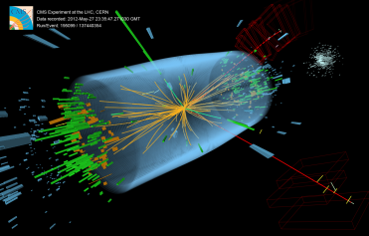

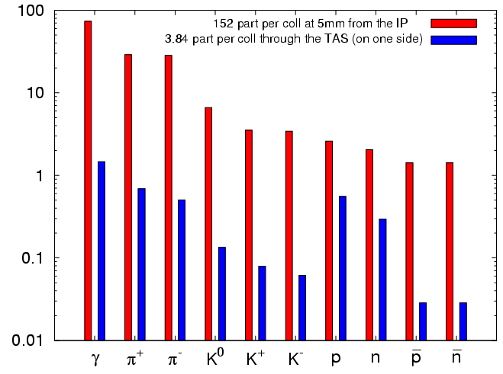
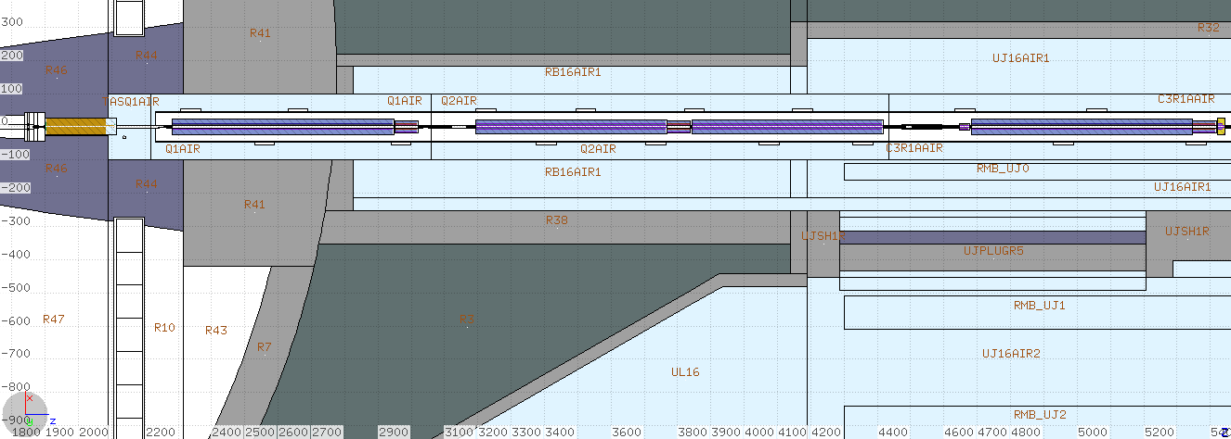
THE COLLISION DEBRIS
7 TeV p + 7 TeV p
with 7.5 10⁻¹⁰
Higgs bosons
proton-proton inelastic reaction
@ 10³⁴ cm⁻² s⁻¹ , i.e. 8.5 10⁸ s⁻¹ inelastic collision rate
950 W towards each (L&R) side
150 W absorbed in the TAS absorber
650 W going through the TAS
of which
150 W absorbed in the triplet
cold magnets
with 6.5 TeV beams (80mb) ~125 W (magnet end uncertainties) prediction at 10³⁴ cm⁻² s⁻¹
vs 115-135 W measurements (TE-CRG-OP) in the triplet cold mass

Slide 4
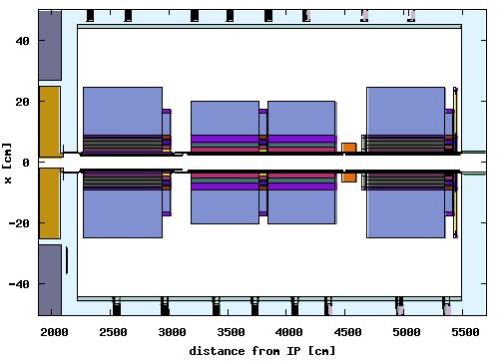
DEBRIS CAPTURE IN THE TRIPLET
right of ATLAS
high energy spectra are depopulated by charge particle (especially pion) interception in the successive quadrupoles
due to magnetic field bending
lost in Q1
end of the
TAS shadow

Slide 5
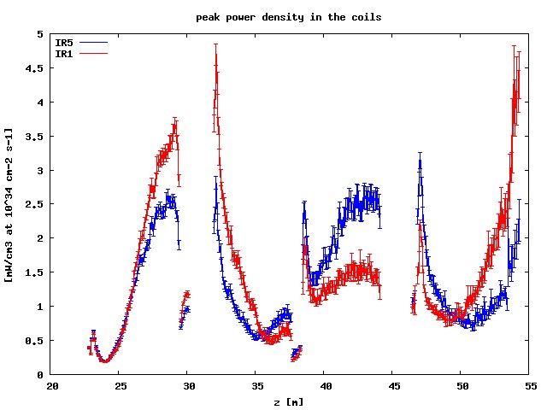
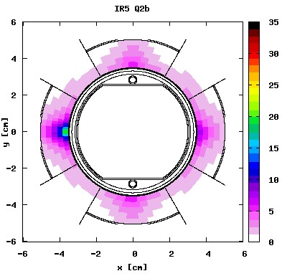
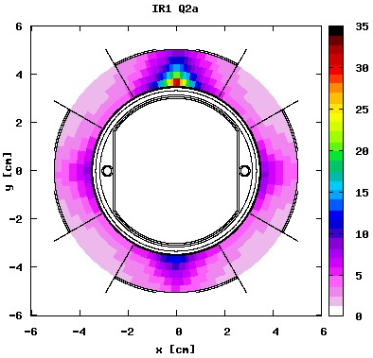
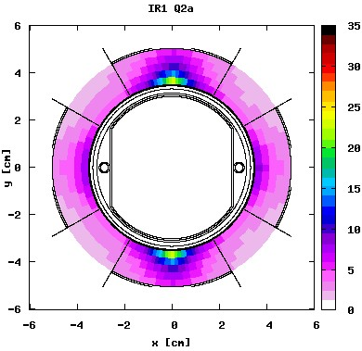
MARGIN TO QUENCH AND LIFETIME
round optics
142.5 μrad
≤20 MGy
x
peak dose [MGy] after 300 fb⁻¹, relevant for triplet (i.e. coil insulator) lifetime
V crossing in ATLAS (IR1)
H crossing in CMS (IR5)
≤30 MGy
~20 MGy
x
x
x
- different behavior reflecting the crossing plane variation for the same
magnetic configuration of the triplet (FDF in the horizontal plane for
positively charged particles coming from the IP)
- IR1 triplet (Q2a) approaches the design limit at nominal luminosity
50% +V & 50% -V crossing in ATLAS (IR1)

Slide 6
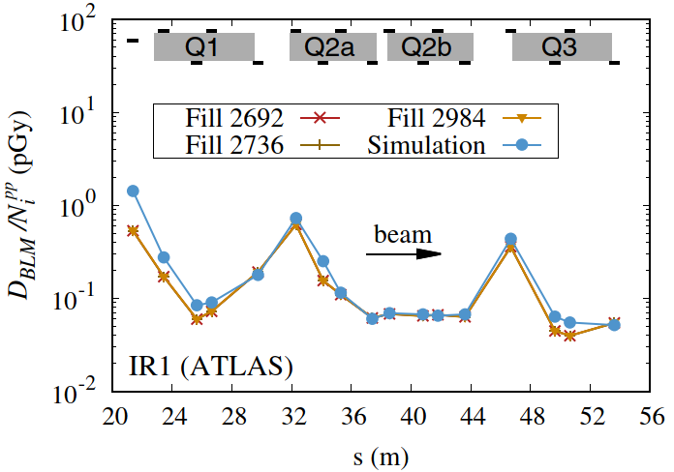
TRIPLET: BLM BENCHMARKING
2012
4 TeV beams

Slide 7
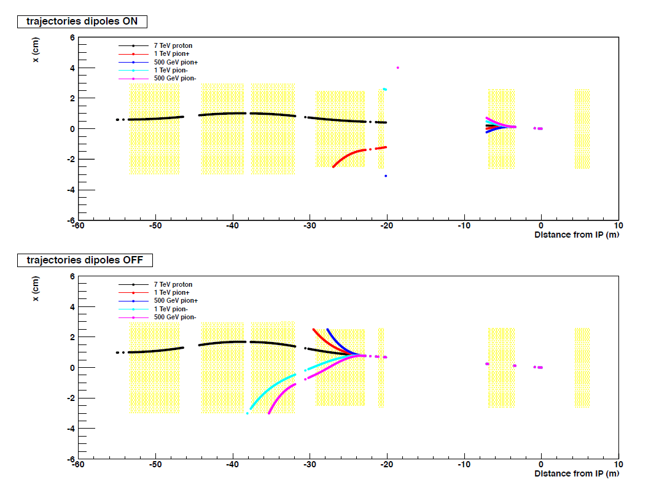
SPECTROMETER EFFECT
ON
OFF

Slide 8
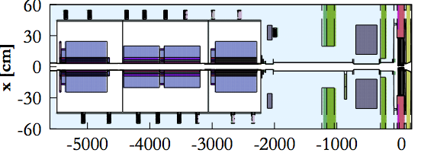
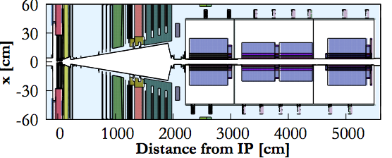
IR8: TRIPLETS
outside
the ring
D
F
F
D
[on the horizontal plane for the outgoing beam]
compensator dipoles
LHCb spectrometer

Slide 9
IR8: MARGIN TO QUENCH & CRYOLOAD
@ 10³⁴ cm⁻² s⁻¹
385 urad half horizontal crossing angle
145
45
45
35
total
power [W]
70
45
45
35
D1
design limit
LIFETIME
peak dose after 400 fb⁻¹ to be evaluated vs. 30 MGy design

Slide 10
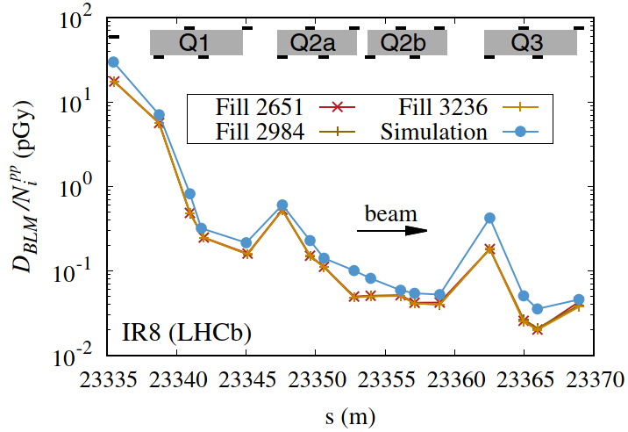
TRIPLET: BLM BENCHMARKING
2012
4 TeV beams

Slide 11
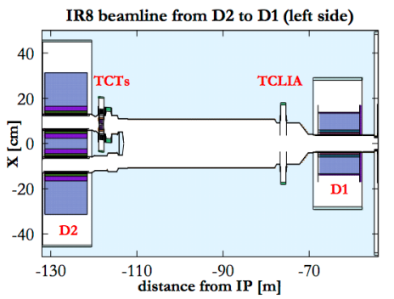
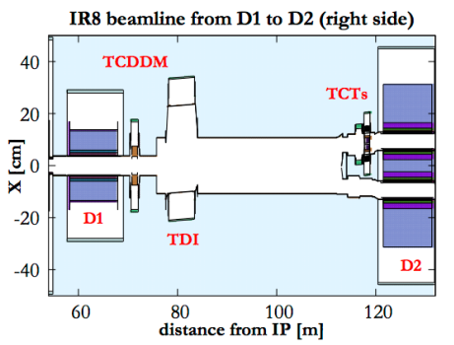
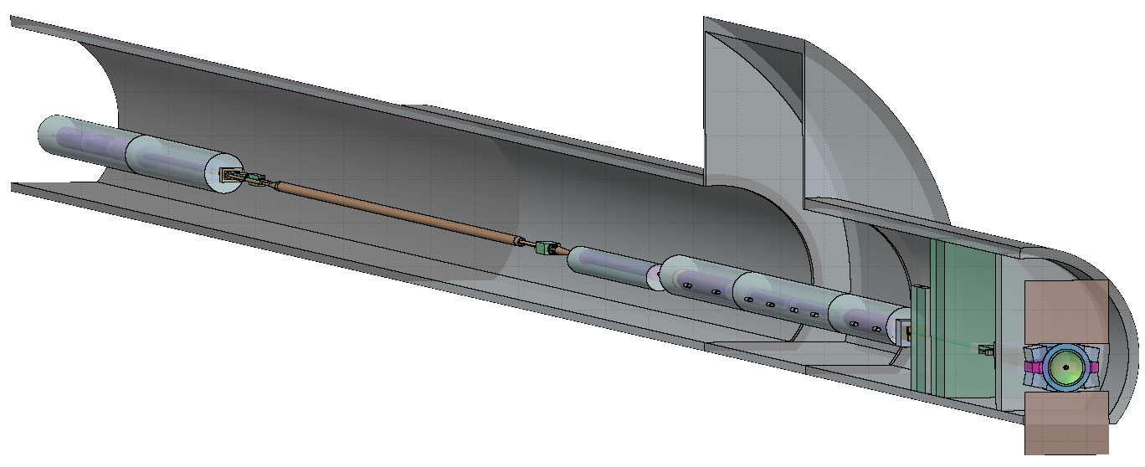
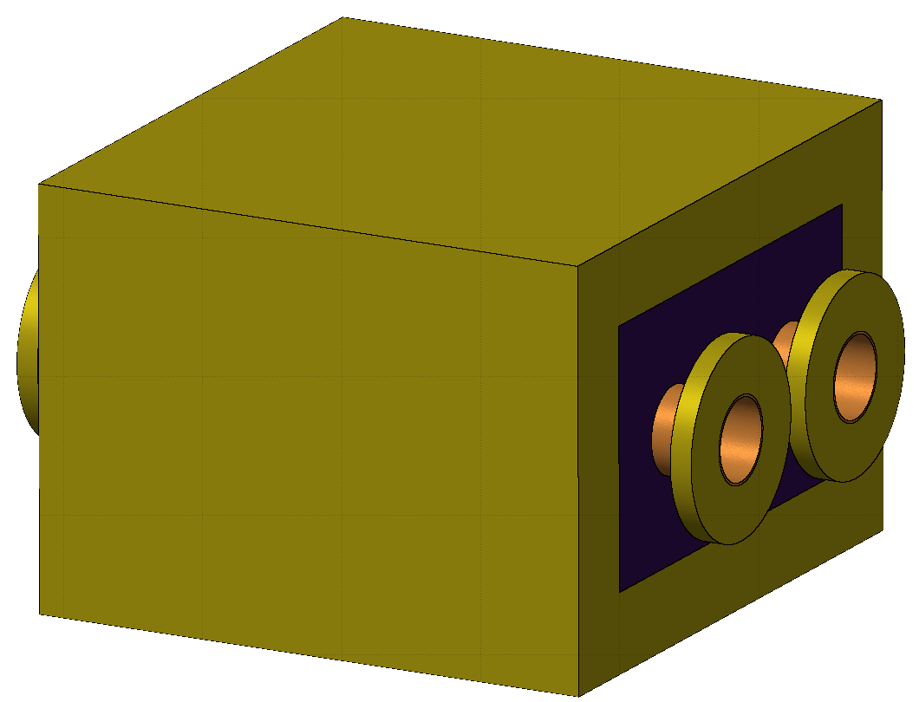
IR8: RECOMBINATION DIPOLE (D2)
outside
the ring
TANB
Q4 D2 D1 Q3 Q2 Q1

Slide 12
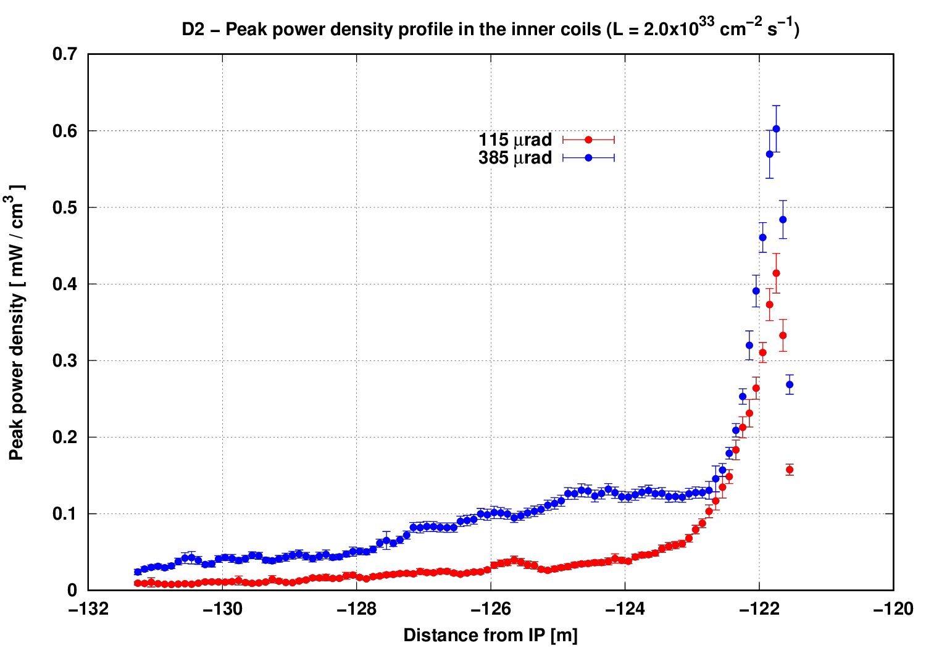
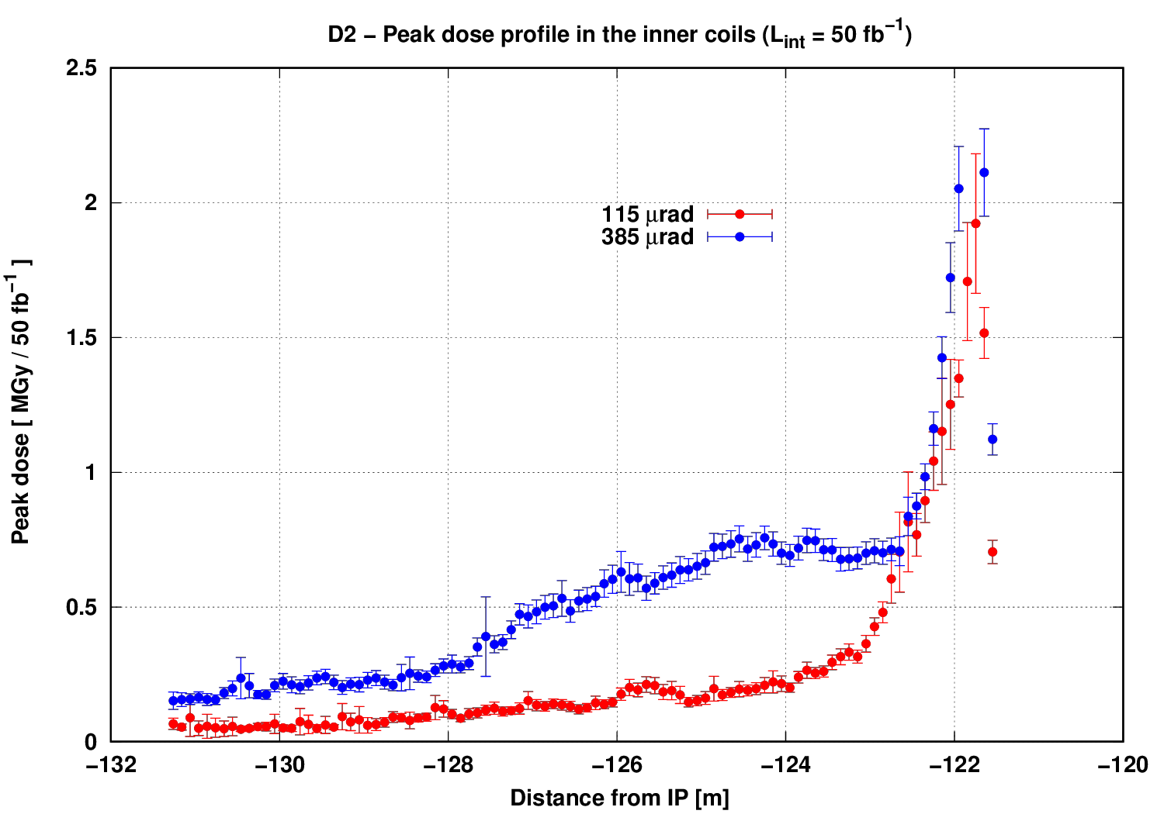
D2 QUENCH MARGIN, CRYOLOAD, LIFETIME
@ 1.5 10³⁴ cm⁻² s⁻¹ 5 mW/cm³
with a total load of 35 W in the cold mass
after 400 fb⁻¹ ≤20 MGy

Slide 13
MATCHING SECTION
need for designing a collimator (TCL) protection system
Looking for reference at Point 1&5 @ 10³⁴ cm⁻² s⁻¹
R5 (CMS)
major role played by TCL4/TCL5
Point 8 specificities: different optics, different crossing angle, different TAN,
injection kickers and septa around Q5R

Slide 14
MATCHING SECTION: BLM BENCHMARKING
6.5 TeV beams
IR1

Slide 15
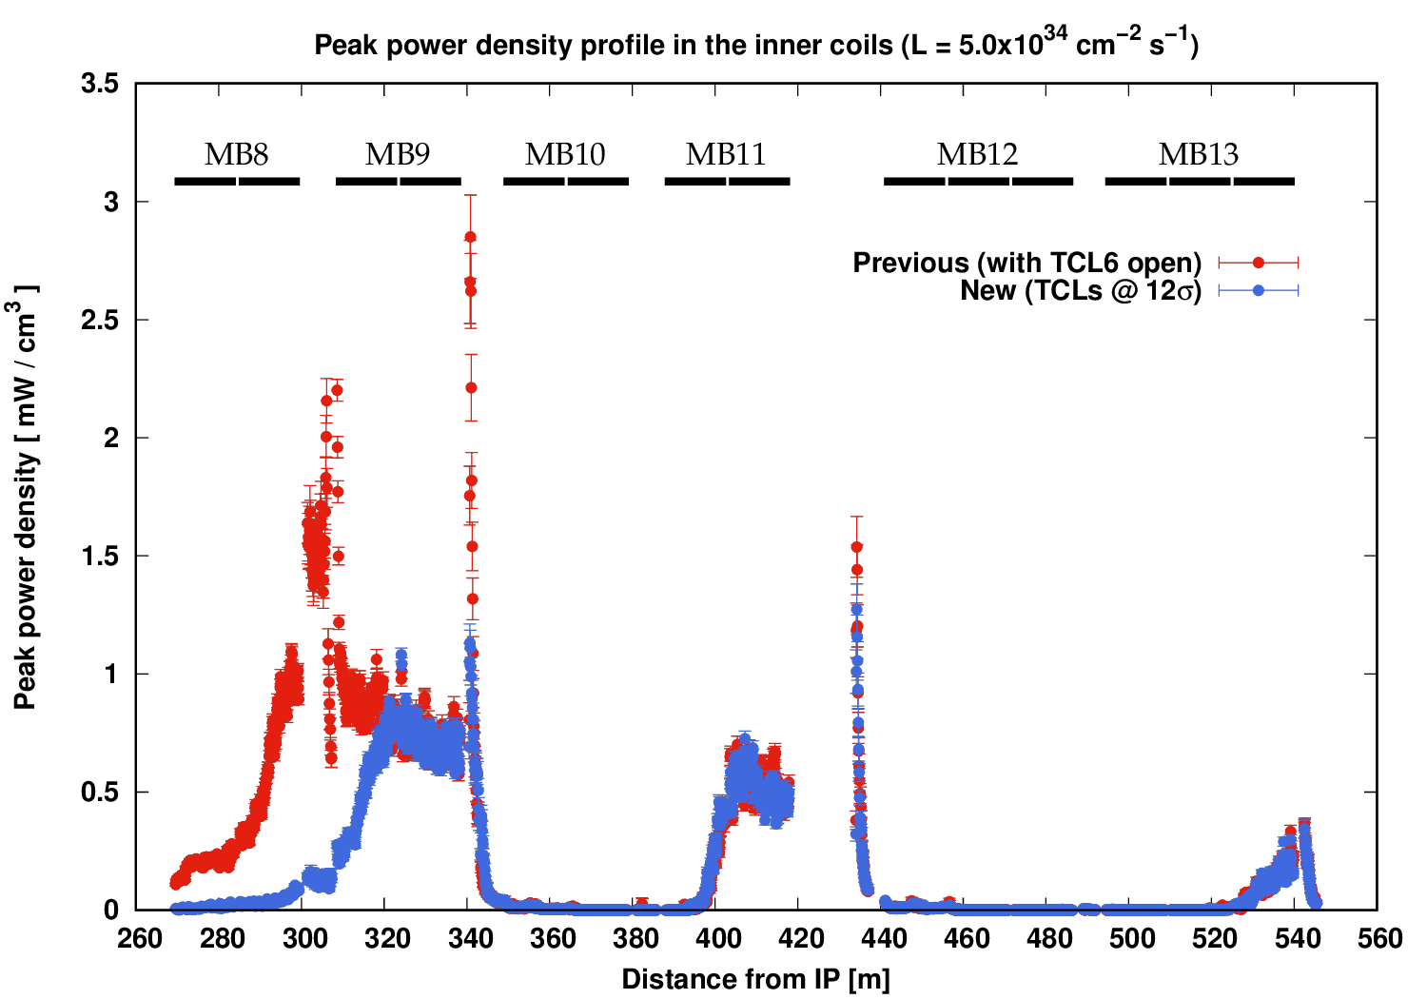
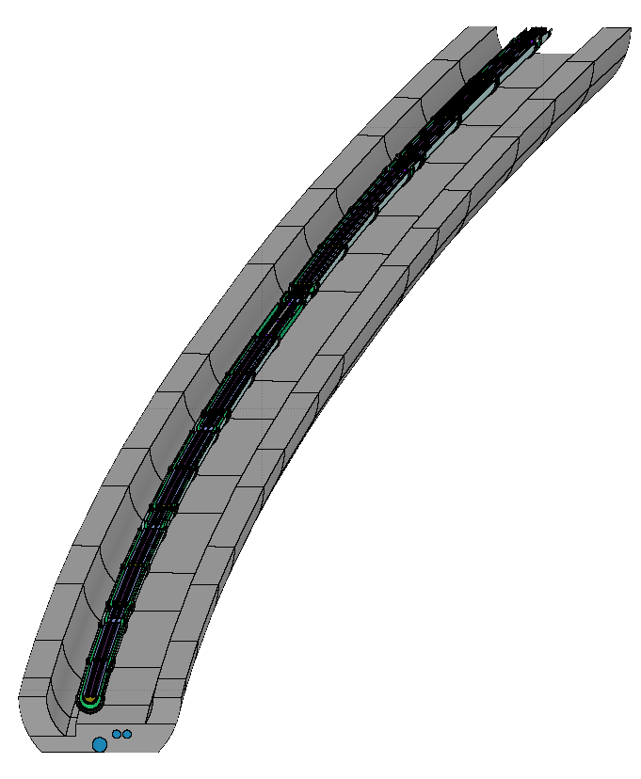
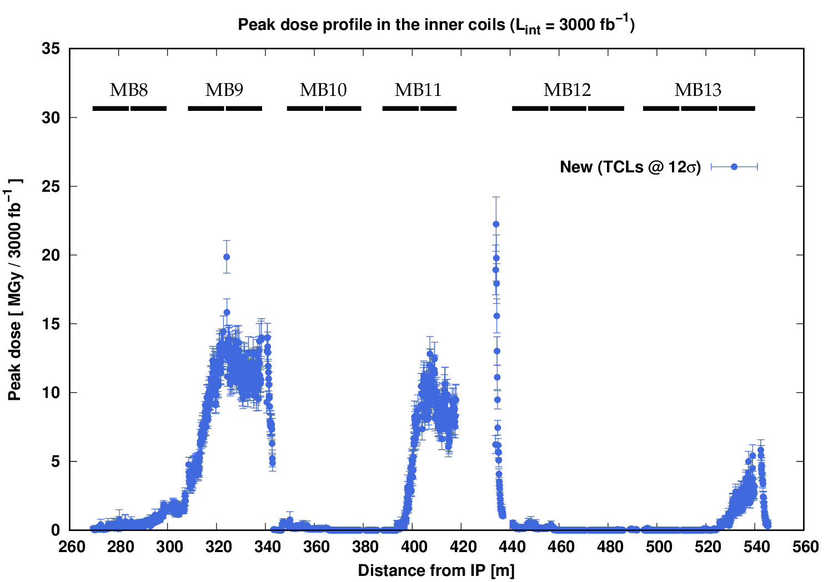
DISPERSION SUPPRESSOR
noticeable impact by TCL6 up to half-cell 9
pronounced sensitivity to aperture imperfections
14 σ
≤1 mW/cm³ @ 1.5L₀
≤3 MGy after 400 fb⁻¹
14 σ
Point 8 specificities: different dispersion function, TCL6 lack

Slide 16
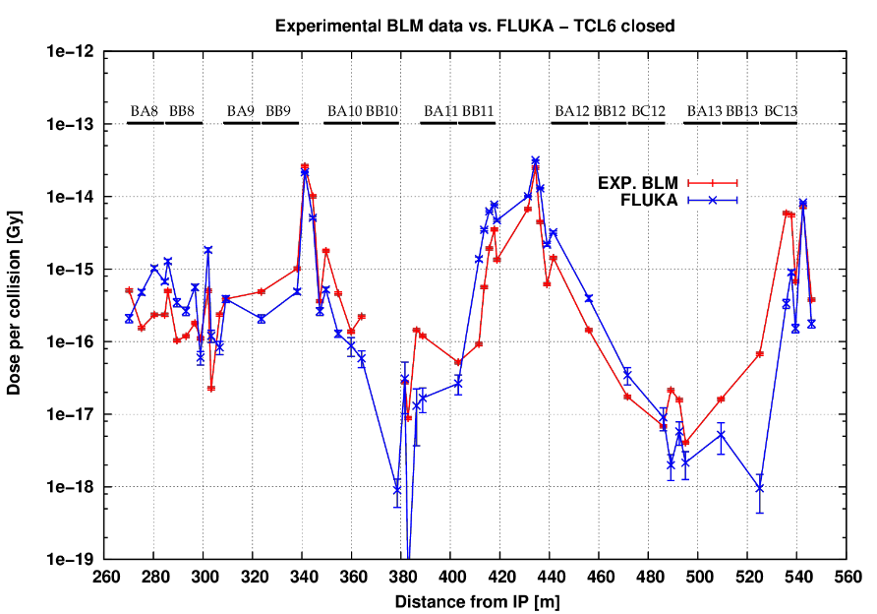
DISPERSION SUPPRESSOR:
BLM BENCHMARKING
Fill #5401 (October 2016)
TCLs @ 15-35-20 sigma
6.5 TeV beams
IR5

Slide 17
RADIATION TO ELECTRONICS
Annual High Energy Hadron fluence
determining the Single Event Effect rate
[cm⁻²]
scaling up to 50 fb⁻¹/y, i.e. 25 times more
UL86
US85
with a reference limit
(R2E-safe) of 3 10⁶ cm⁻²/y
At higher HEH fluences
a RHA procedure is needed
for equipment qualification
UW85
UL84
vertically averaged from -1.1m to 2.4m
(0 is the beam height)
x [cm]
Relocations of sensitive equipment have already been foreseen (see plans for cryo racks)
New FLUKA simulations are going to be carried on with updated geometry, aiming at an improved benchmarking against RadMon data and to study new shielding options

Slide 18
CONCLUSIONS
The LHCb upgrade to an instantaneous luminosity of 1.5 10³⁴ cm⁻² s⁻¹ and an integrated luminosity of 400 fb⁻¹ implies a TAS-like protection of Q1 and calls for the study of a physics debris collimator (TCL) system for Q5-Q7 as well as shielding solutions for the electronics equipment in the detector cavern proximity.
A systematic FLUKA study of both IP8 sides, implementing the updated detector model and crossing schemes, is being launched as the subject of a starting PhD.
An intentional triplet misalignment is known to offer on paper some potentiality, to be possibly assessed in this specific case.
The recently installed TANB, required by the Upgrade I, appears to offer an adequate D2 protection also in the long term.
The limited dose resistance of certain corrector magnets has to be reviewed in the IR8 context.

