Slide 1
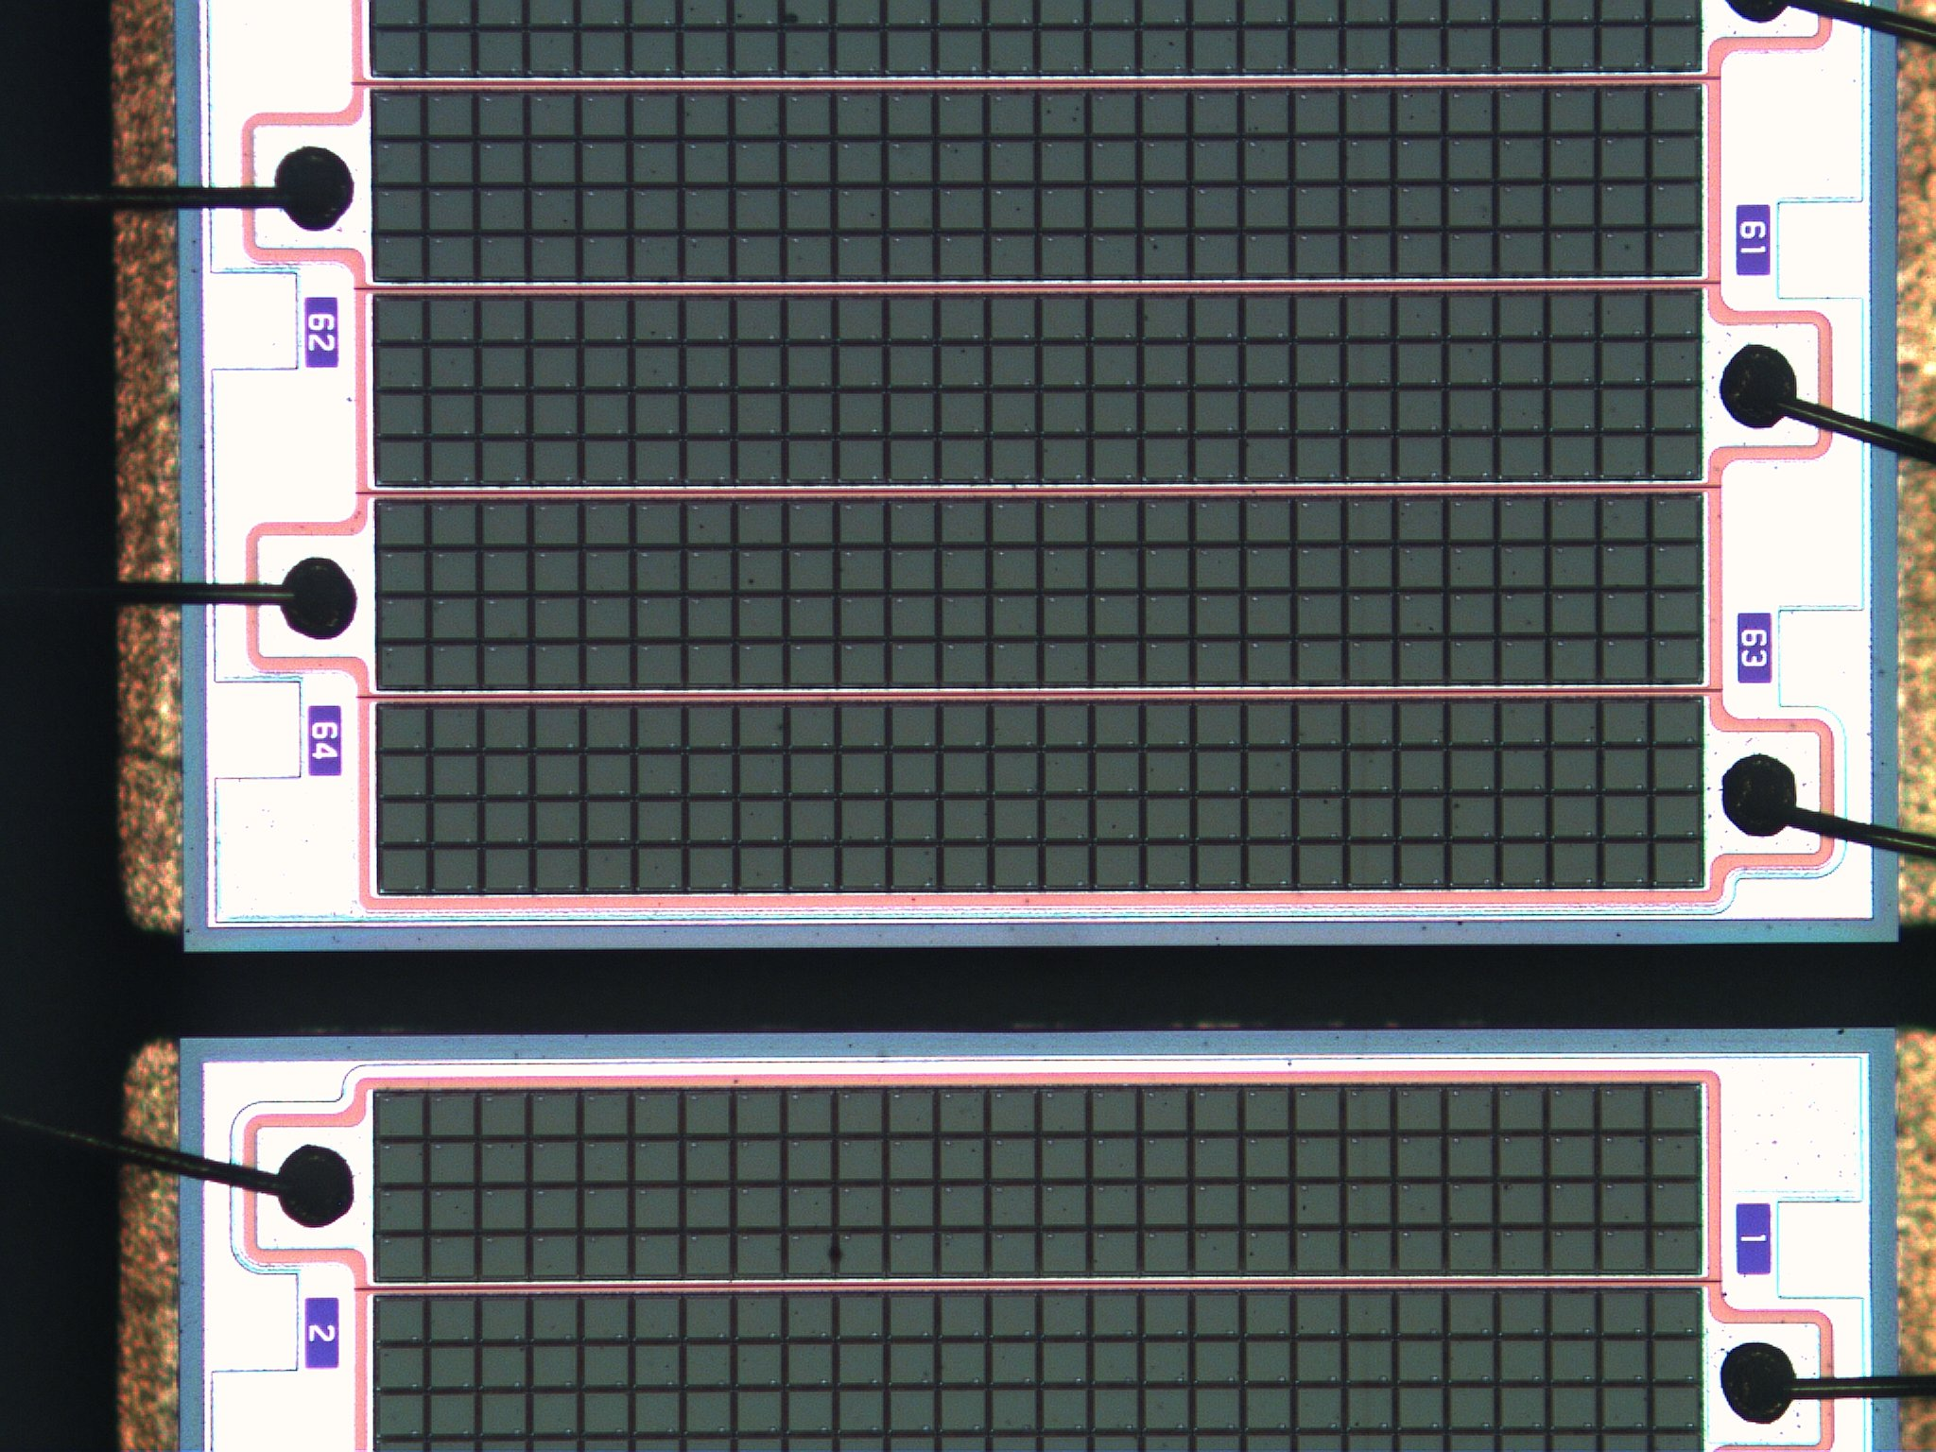
SciFi Tracker Upgrades
Prepared: Guido Haefeli, 30.March 2020

Slide 2


Outline
Expected aging of the SciFi after Run 3 & 4
Replacement and upgrade
Upgrade the performance of the SciFi
  Micro-lens enhancement of SiPMs
  Thinner SciFi
  Cryo-cooling
Conclusion for Upgrade 1b, Upgrade II

Slide 3
SiPM aging
SiPM nominal design:
Design luminosity 50fb⁻¹
  Neutron radiation: 6*10¹¹ n_{eq}/cm²
  Charged: 50Gy, responsible for 15-20% of SiPM DCR increase after neutron shielding
Fluka simulation with neutron shield yields the values for the most exposed regions in T1 and T3:
  T1: 8.1*10¹¹ n_{eq}/cm² ➔ 3.3*10¹¹ n_{eq}/cm² (reduction of 2.5 after shielding )
  T3: 14*10¹¹ n_{eq}/cm² ➔ 4.2*10¹¹ n_{eq}/cm² (reduction of 3.4 after shielding )
Fluka simulation uncertainty for the absolute values of the neutron fluence is a factor 2

Slide 4
SiPM aging
SiPM after Run 3 of 40fb⁻¹ :
  T1: 2.6*10¹¹ n_{eq}/cm² (worst case 5.2*10¹¹ n_{eq}/cm² )
  T3: 3.3*10¹¹ n_{eq}/cm² (worst case 6.6*10¹¹ n_{eq}/cm² )
SiPM after Run 3&4 of 80fb⁻¹ :
  T1: 5.2*10¹¹ n_{eq}/cm² (worst case 10.4*10¹¹ n_{eq}/cm² )
  T3: 6.6*10¹¹ n_{eq}/cm² (worst case 13.2*10¹¹ n_{eq}/cm² )
In red, values beyond the design fluence which is the limit of acceptable dark count rate (DCR) and has a consequence the noise cluster rate (NCR).
To maintain NCR<10MHz, the noise threshold cut has to be increased and the efficiency is dropping rapidly.

Slide 5
Neutron fluence is responsible for 80-85% of DCR increase of the SiPM after shielding
Neutron fluence with neutron shield.
3.3*10¹¹ n_{eq}/cm²
4.2*10¹¹ n_{eq}/cm²

Slide 6
Dose due to charged tracks, makes up 15-20% of the DCR increase for the SiPMs
Decrease to the edge is slow
Radiation dose profile in the x-y plane

Slide 7
Irradiated detector with 6*10¹¹ n_{eq}/cm²
DCR as a function of temperature at 3 different possible operation points
Reducing ΔV by 1V reduces DCR by a factor 1.58!

Slide 8
PDE as a function of over-voltage
Light emitted by the SciFi is centered around 475nm
Reducing ΔV by 1V reduces PDE by a factor 1.12!

Slide 9
Noise cluster rate (NCR) expected for the current SciFi
For “high” DCR only increasing the threshold can reduce NCR.
Integration window (Pacific 25ns)

Slide 10
Noise cluster rate for different seed thresholds
Integration window (Pacific 25ns)
~50x

Slide 11
Noise cluster rate expected for the current SciFi
Pacific integration time 25ns
Exponential behaviour of NCR
Irradiated detector to 3*10¹¹ n_{eq}/cm²

Slide 12
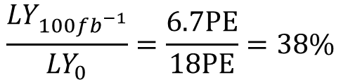
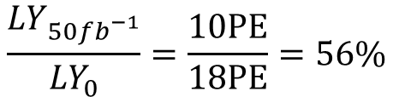
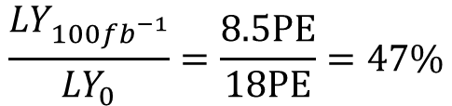
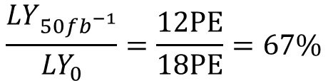
Radiation damage of the fibre results in lower photon survival probability
Linear law model ratios:
$$\frac{{LY}_{50{fb}_{}^{−1}}}{{LY}_{0}}=\frac{12PE}{18PE}=67\%$$
$$\frac{{LY}_{100{fb}_{}^{−1}}}{{LY}_{0}}=\frac{8.5PE}{18PE}=47\%$$
Power law model ratios:
$$\frac{{LY}_{50{fb}_{}^{−1}}}{{LY}_{0}}=\frac{10PE}{18PE}=56\%$$
$$\frac{{LY}_{100{fb}_{}^{−1}}}{{LY}_{0}}=\frac{6.7PE}{18PE}=38\%$$

Slide 13
Radiation damage reduces the LY
The selection at the production allows to obtain LY>18PE before irradiation
18PE
Reduceing ΔV by 1V reduces DCR by a factor 1.58!
12PE

Slide 14
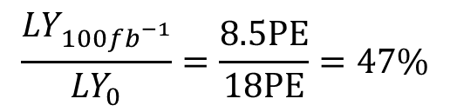
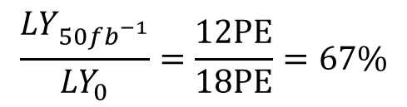
Cutting or “not using” 30cm of the inner-most part of the module
30cm from beampipe
$$\frac{{LY}_{50{fb}_{}^{−1}}}{{LY}_{0}}=\frac{12PE}{18PE}=67\%$$
$$\frac{{LY}_{100{fb}_{}^{−1}}}{{LY}_{0}}=\frac{8.5PE}{18PE}=47\%$$
12PE
8.7PE

Slide 15
Inefficiency as a function of noise cut and LY
End of Run4, >20%
End of Run 3, 2-3%

Slide 16
Micro-lens enhanced SiPMs
Goal 1: Reduce pixel size without loosing light to reduce:
optical x-talk
gain and therefore bias current and self heating
recovery time (dead time) and after-pulsing
DCR for irradiated devices
Goal 2: Improve sensitivity (PDE)
use micro-lenses to focus light in the center of the pixel avoiding dead and low-field region
Pro:
Expected improvement of the LY is larger than 20%
Same detector geometry and package size as current SiPM array
Cons:
High cost for micro-lenses and through silicon via (TSV) package
No cleaning possible anymore

Slide 17
Higher GFF technology between 2017 and now
Implementation example from FBK: High geometrical fill factor (GFF) due to thin trenches, NUV-HD has 20% higher GFF than the previous NUV design.
GFF
Comparison with H2017:
GFF=70% for H2017 62x57.5μm² vs GFF>80% for FBK 40x40μm²

Slide 18
Reducing occupancy
Typical cluster for an orthogonal track has a size of 3 channels.
Maximum occupancy depends not only on the number of tracks per linear distance but also on the cluster size.

Slide 19
Reducing occupancy
3 ch
5 ch

Slide 20
Reducing occupancy with thinner SciFi mats (less layers = less signal)
2 ch
4 ch
Less light, this can work with cryogenic cooling!

Slide 21
Reducing occupancy with thinner SciFi mats and or segmenting channels in height
2 ch
2 ch
2 ch
3 ch
Requires 2x the number of channels, this will be simulated for evaluation.

Slide 22
Reducing noise drastically with cryogenic cooling (LN2) in a vacuum chamber
Vacuum insulated cold box for LN2 cooling
SciFi mat
Vacuum
vessel
SciFi mat
Electronics
mirror
SciFi mat
SciFi mat
Note:
Flexible interface with clear fibre, expected light loss <15%
Total width of vacuum vessel allows space between modules. Sufficient space for services for the Si-pixel detector is available
Vacuum feedthrough with clear fibres

Slide 23
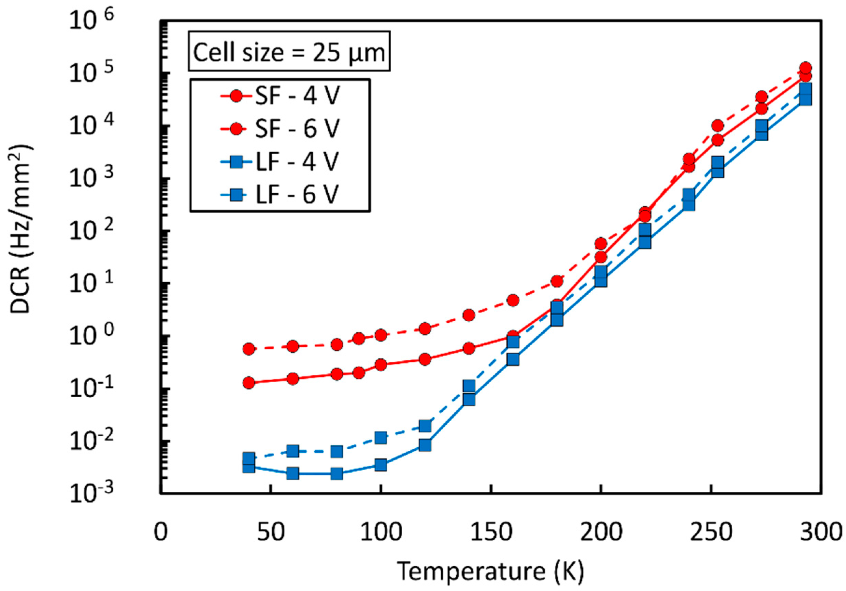
Reducing noise drastically with cryogenic cooling (LN2) in a vacuum chamber
FBK cryo version of SiPMs
-40°C
120K -> 1/4000 DCR of the current level
2017

Slide 24
Reducing noise drastically with cryogenic cooling (LN2) in a vacuum chamber
Noise reduction for FBK SiPMs optimized for cryogenic operation:
pessimistic assumption for noise reduction slope (10K instead of 8K for a factor 2)
Limited range of valid slope
Upgrade II conditions, 10 x radiation level 6*10¹² n_{eq}/cm² of current Upgrade
5x higher DCR than Hamamatsu for the same neutron fluence
Cryocooling allows to reduce DCR to a level of 5*10⁷ Hz per SiPM array
Noise cut is as low as 1.5PE producing less NCR than for the current detector
Cryogenic cooling is currently the only solution to operate the SciFi tracker beyond Run 4! It can compensate for the reduction of LY due to the fibre irradiation.

Slide 25
Conclusion
Large uncertainties for radiation level simulated by Fluka (Factor 2), neutron shield and neutron fluence.
Uncertainties for efficiency are large when the LY is close to 10 photons, steep rise
Uncertainties in LY from the fibre module at large irradiation level, annealing and aging of scintillator
We need to operate the detector to gain detailed knowledge
Upgrade 1b:
Optimistic scenario:
Replace the 12 0° central modules (6 layers) with Si-pixel + SciFi modules.
Keep fibre modules with 5° angles without exchange of fibres
Replace SiPMs for all 24 central modules after Run 3 (avoid 80fb⁻¹ of radiation for central SiPMs)
Develop and produce advanced micro-lens enhanced SiPMs for this replacement
Pessimistic scenario:
All replacements needed for the optimistic case plus replacing also the 5° central fibre modules
Upgrade 2:
Replace all modules and SiPMs
Replace cooling with cryogenic LN2 cooling and develop a clear fibre interface

Slide 26
EPFL and Upgrade 1b,2
Development of radiation optimized SiPMs
  Study optical focusing system on pixels with micro-lens to increase overall PDE.
  Study more radiation hard SiPM implementations (silicon structures) and the use of smaller pixels (Hamamatsu, Ketek, FBK, SensL, …).
Development of a clear fibre interface required for cryogenic cooling (vacuum feedthrough) and to reduce SciFi length for segmented readout.
Development of fast, high light yield, green fibres to reduce light transport loss (radiation) with possible application in LHCb SciFi Upgrade 1b or II.

Slide 27
Backup S/N
Reduced hit detection efficiency is the “aging” effect of the SciFi and is directly coupled to the S/N ratio.
For 50 fb⁻¹ a reduction of efficiency of 1-2% is expected. Precise numbers are difficult to obtain before a few years of operation.
Increase luminosity increases noise
Light loss of fibres decreases signal, green fibres help.
Reduce pixel size to improve x-talk, AP DCR, current induced self-heating
S / N
Decrease active surface of SiPM reduces noise
Increase PDE of SiPM increases signal
Decrease the number of fibre layers in mat to reduce occupancy!
27

