Slide 1
ECAL Simulation
Patrick Robbe, IJCLab Orsay + LNF Frascati, for the LHCb Calo Group,31 Mar 2020

Slide 2
Introduction
Need to have a simulation setup to test the various options for the ECAL modules and optimize their parameters (granularity, time resolution, Moliere radius, ...) in order to recover Run 1/2 ECAL performances to reconstruct the physics channels of interest.
Full simulation based on Geant4 for example is too CPU intensive to scan efficiently the various parameters.
Strategy:
  Develop fast simulation for signal only
  Increase realism by adding inputs from full simulation or test beams:
    Sizes of showers
    Measurement of time
    Backgrounds from particles coming from pile-up and from interactions with material in front of ECAL
    ...

Slide 3
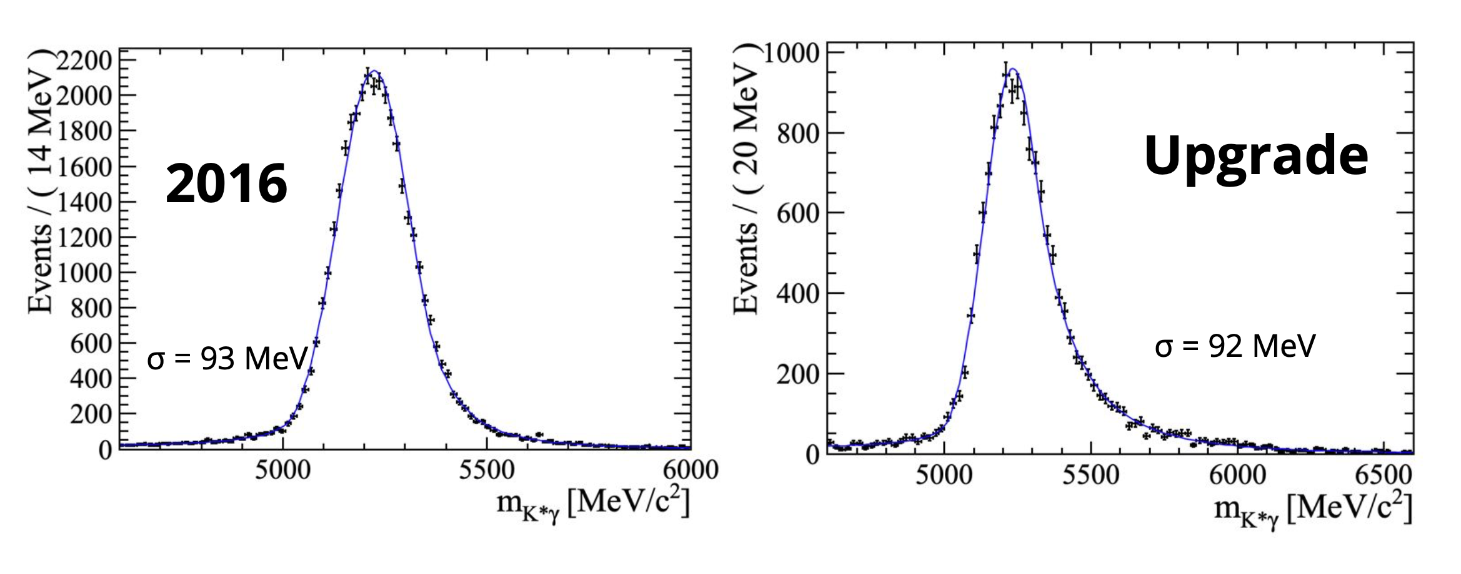
Conditions
Run 1/2: 4x10³² cm⁻².s⁻¹, Upgrade I: 2x10³³ cm⁻².s⁻¹, Upgrade II: 1.5x10³⁴ cm⁻².s⁻¹
Effect of increase of pile-up:
  Background increase
  Candidate photon clusters are rejected when charged tracks point to them: efficiency decreases in reconstruction of photons due to more frequent random track-cluster mis-associations
  Energies of particles overestimated: efficiency loss when applying mass cuts.
  These effects are increasing when moving closer to the beam axis
1
Full simulation,
Signal B⁰ ➝ K* γ
Carla Marin, Yasmine Amhis

Slide 4
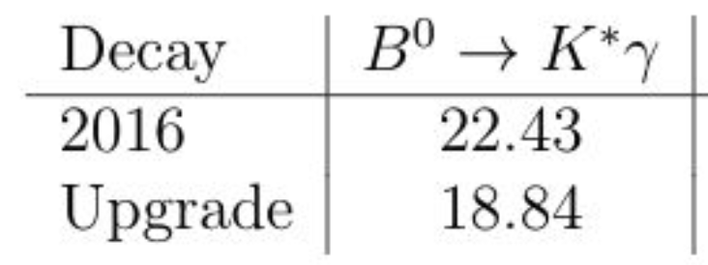
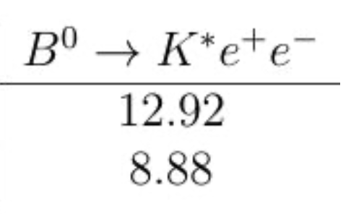
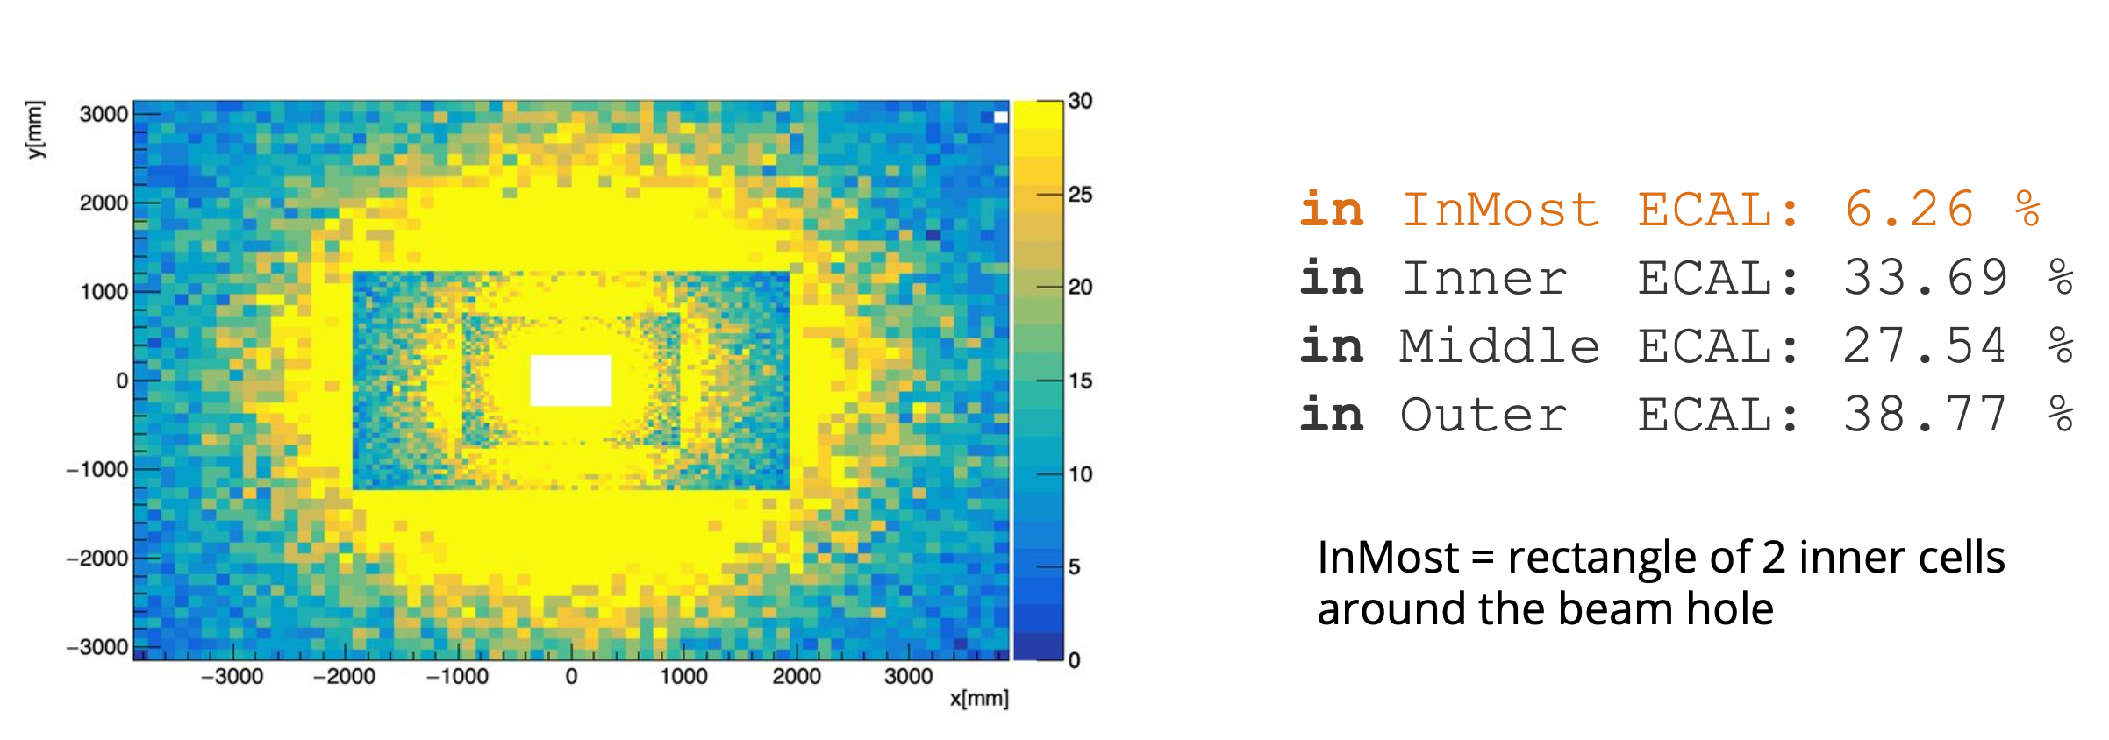
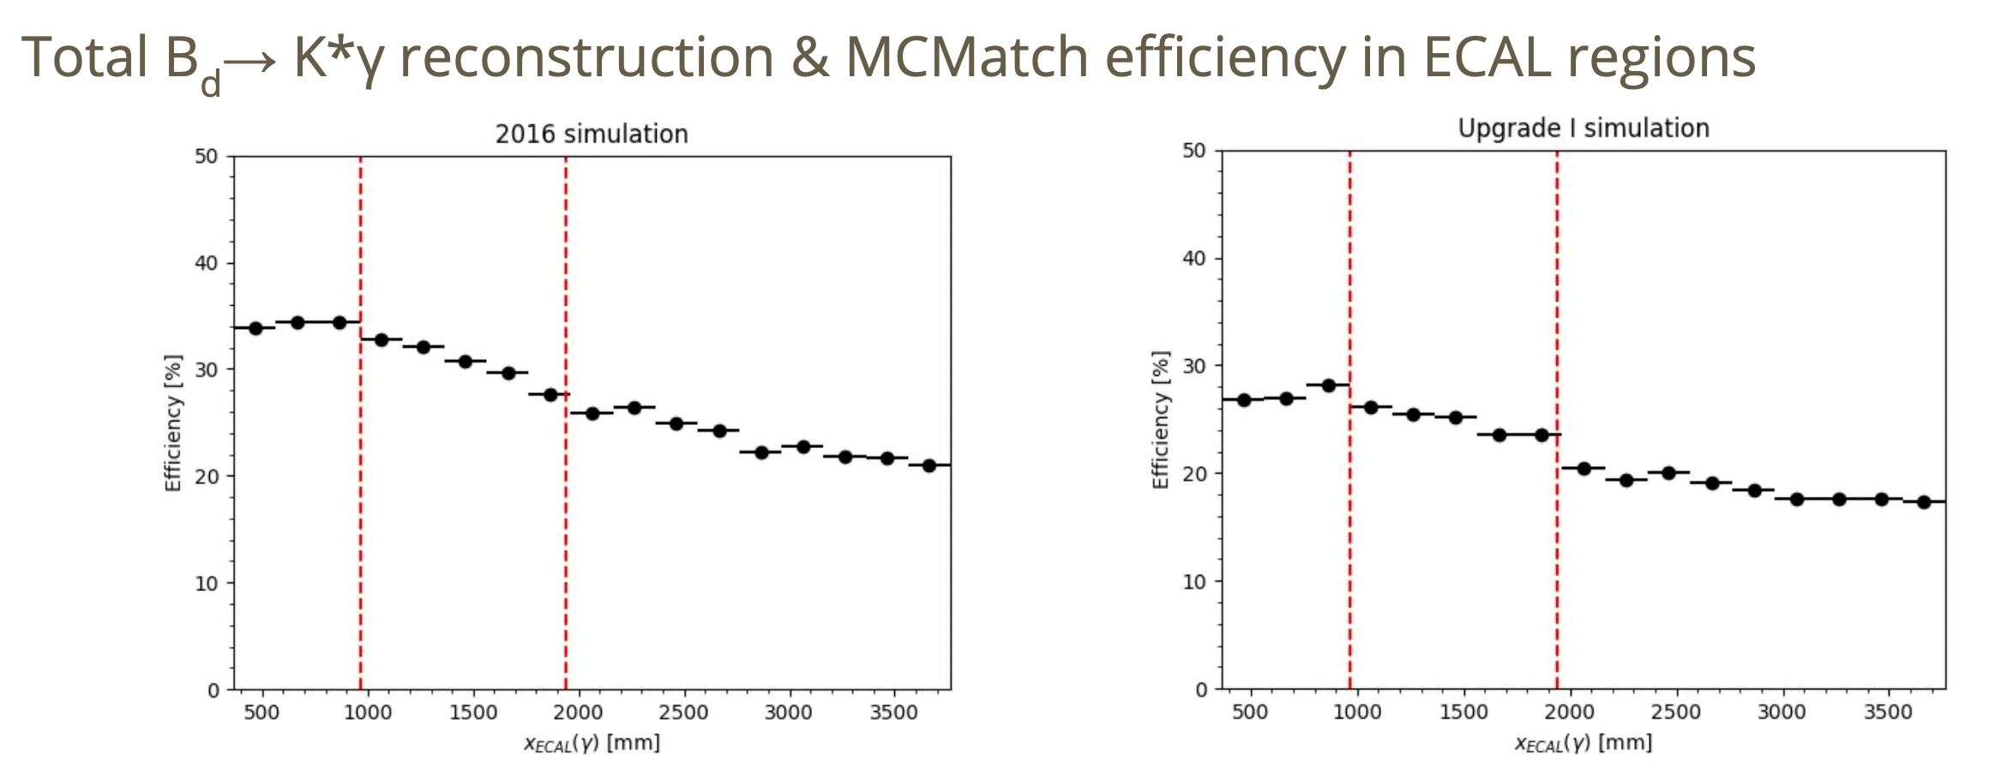
Upgrade I
Carla Marin, Yasmine Amhis
ECAL in upgrade I is identical to Run1/2 (same granularity and no timing measurement): expect degradation of performances for Upgrade I compared to Run1/2 because of occupancy.
Generator level
Signal B⁰ ➝ K* γ
Full simulation,
Signal B⁰ ➝ K* γ
All regions contribute equally to signal, inner part most affected by efficiency loss (for B decays)

Slide 5
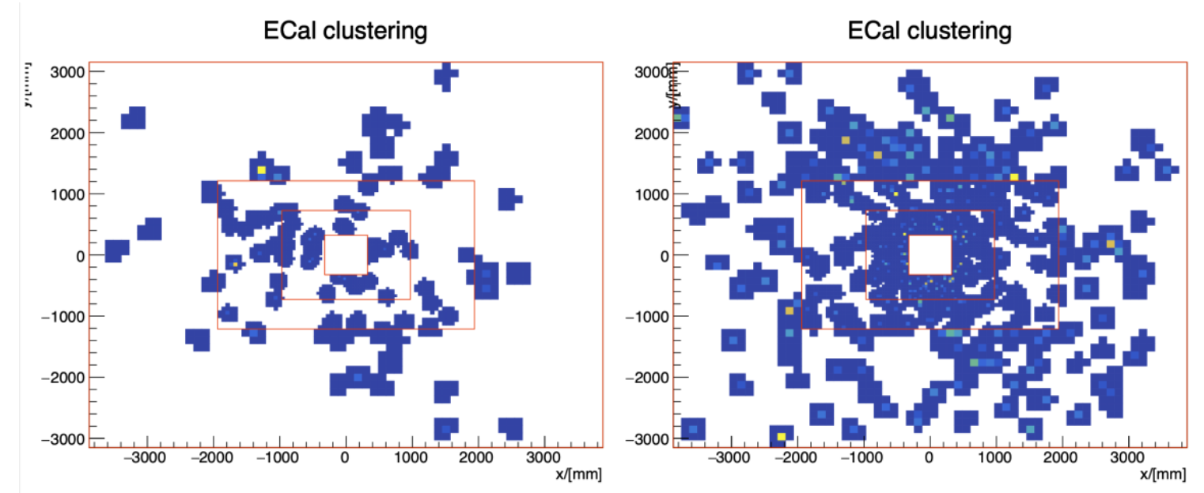
Upgrade II
Fighting against pile-up effects:
  Increase granularity
  Add timing measurement
One event display
Upgrade I
Upgrade II

Slide 6
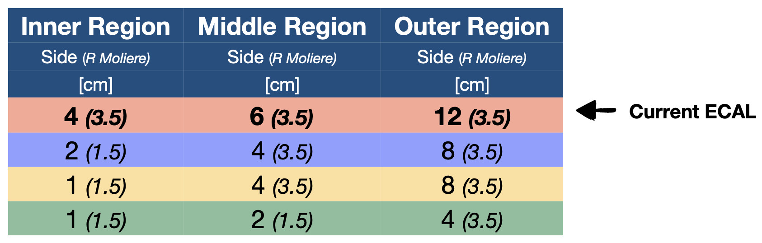
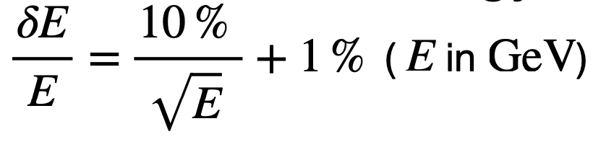
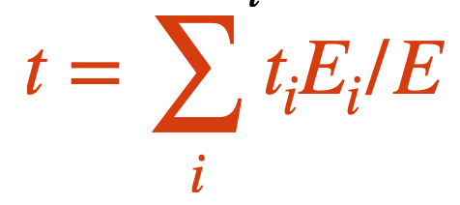
Upgrade II – Signal fast simulation
Daniele Manuzzi, Stefano Perrazini
Signal B⁰➝π⁺π⁻π⁰ events (generated with Pythia)
Only interaction of photons (signal and pile-up) considered in ECAL, using true π⁺ and π⁻.
Energy deposited according to Moliere radius considering various cell sizes and energy resolution of
Assume single time measurement (see next slide) per cell with resolutions of 0, 10 or 50 ps. Estimated as
Photon reconstruct as 3x3 clusters, including recovery of merged π⁰

Slide 7
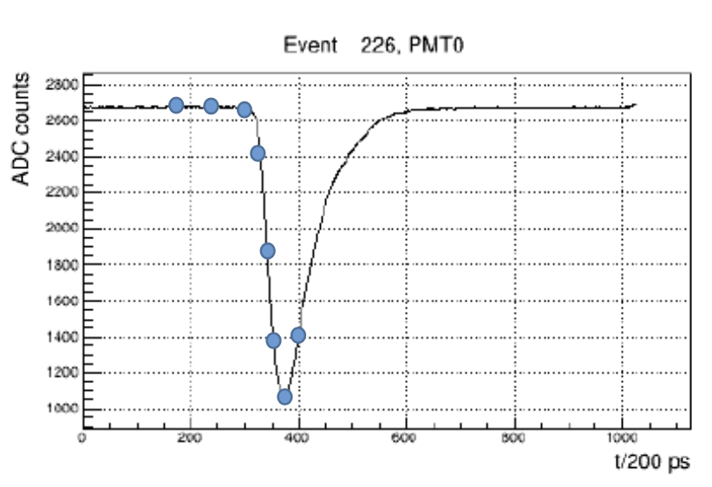
Timing measurement
David Gascon, Dominique Breton
Impossible to send offline full time waveform: 1 GHz sampling would require, for 15000 channels
  15000 x 40 MHz x 25 x 12 bits (energy) = 180000 Gb/s
Dedicated (very) Front-End ASIC to sample waveform with required resolution: precise time and energy measurements possible with 8 sampled points. But still too high rate.
Only send values for hit cells: requiring occupancy less than ~10% will give more manageable rate (in that case, it is necessary to send also the BCId and address to recognize the hit cells):
  15000 x 4 MHz x [8 x 12 bits (energy) + 16 bits (BCId) + 4 bits (address)] = 6960 Gb/s
Process information (in a FPGA, in the Front-End board or at the latest in the back-end) can reduce further to 1 energy value (12 bits) and 1 time value (11 bits for 12.5 ps precision)
  15000 x 4 MHz x [12 bits (energy) + 16 bits (BCId) + 4 bits (address) + 11 bits (time)] = 2580 Gb/s

Slide 8


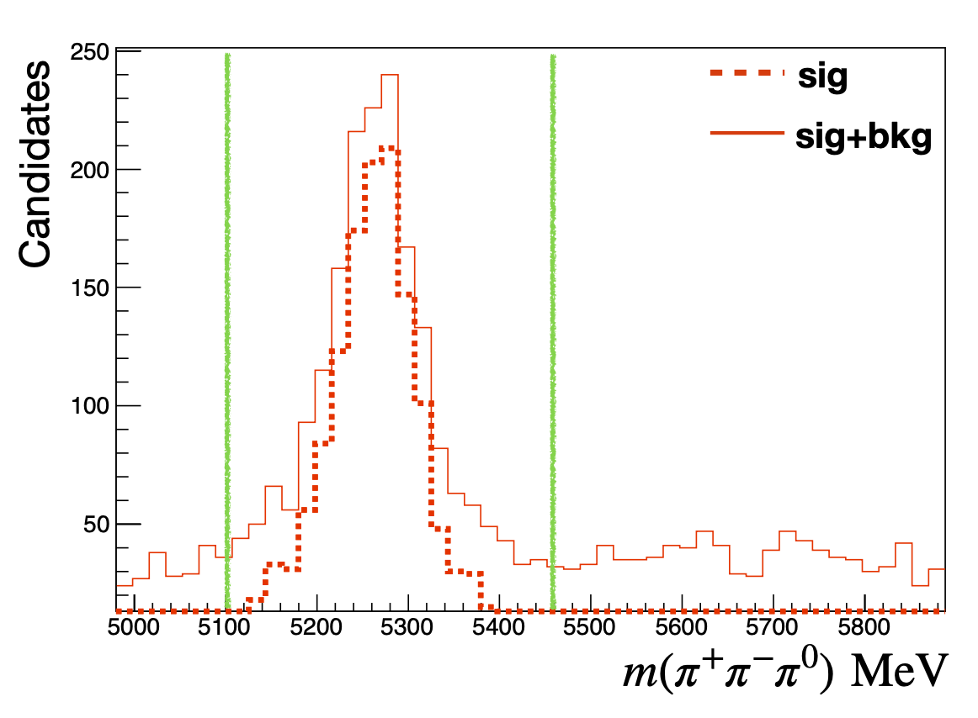
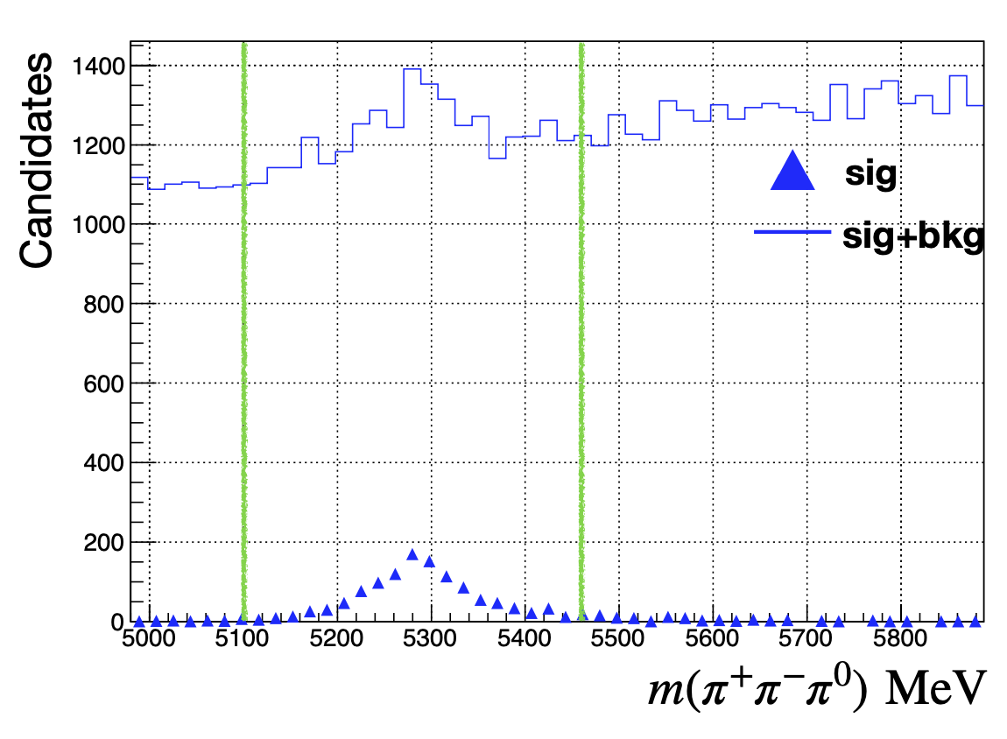
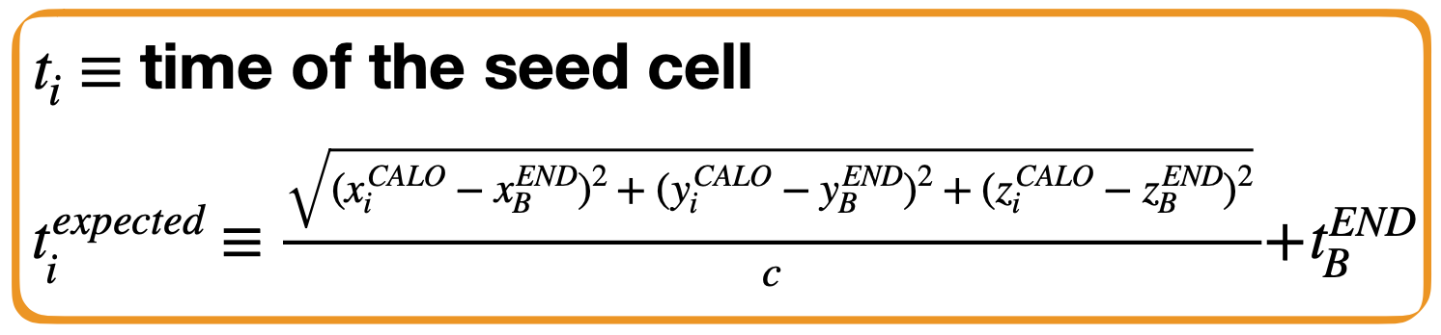
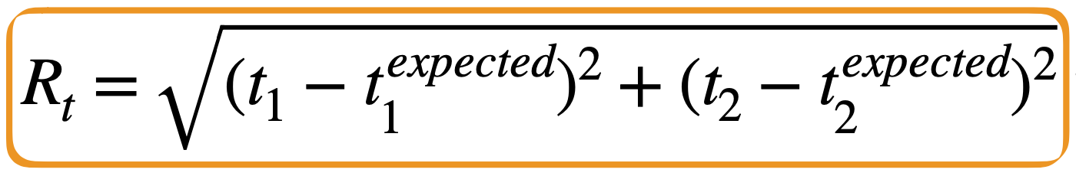
Upgrade II – Signal fast simulation
Daniele Manuzzi, Stefano Perrazini
Increase of granularity
(same cuts as Run1)
Clear indication that increase of granularity is not enough to fight against large increase of pile-up background.
Use time information
And cut on R_{t} (timing of the two photons from the π⁰ decay) NB: this can only decrease signal efficiency

Slide 9
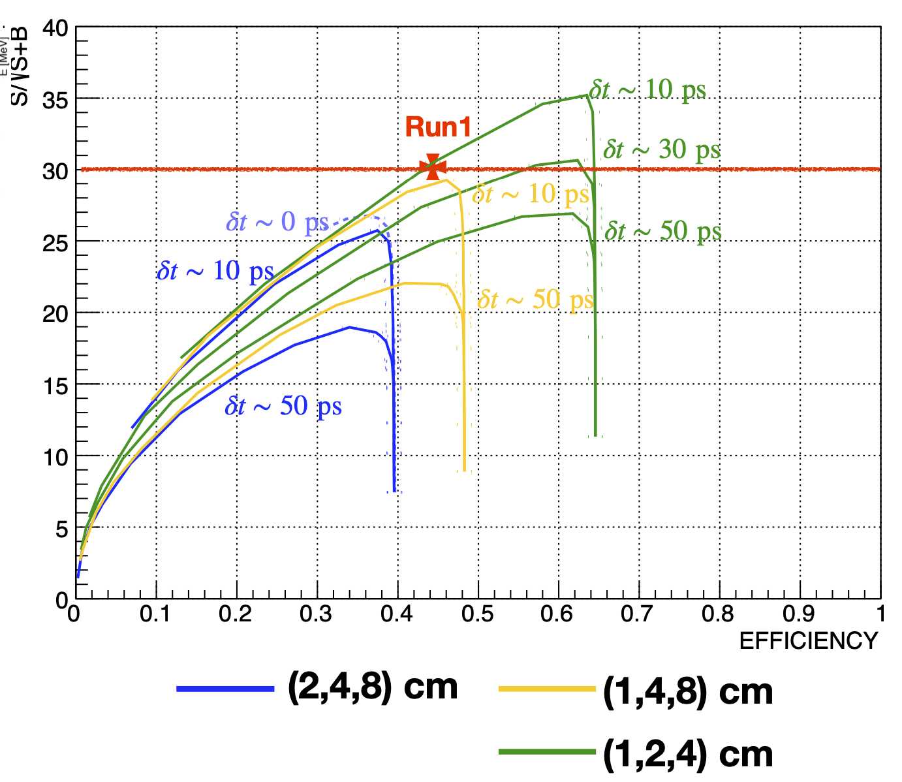
Upgrade II – Signal fast simulation
Daniele Manuzzi, Stefano Perrazini
~upgrade 1
Increase of granularity in inner section to 1 cm cells and timing resolution of 10 ps to recover Run1 performances.
All regions are contributing with the decrease of cell size, not only inner section
Tighter timing cuts

Slide 10
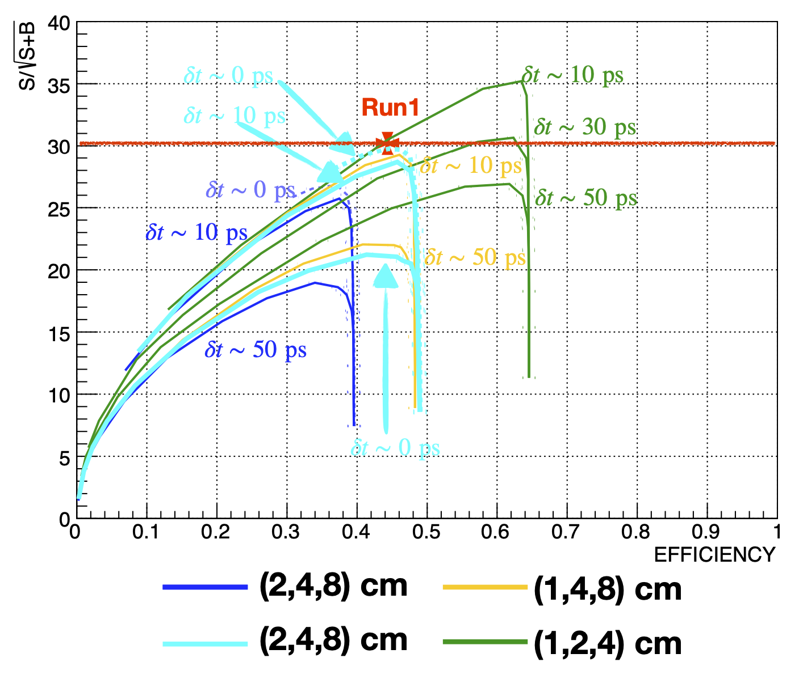
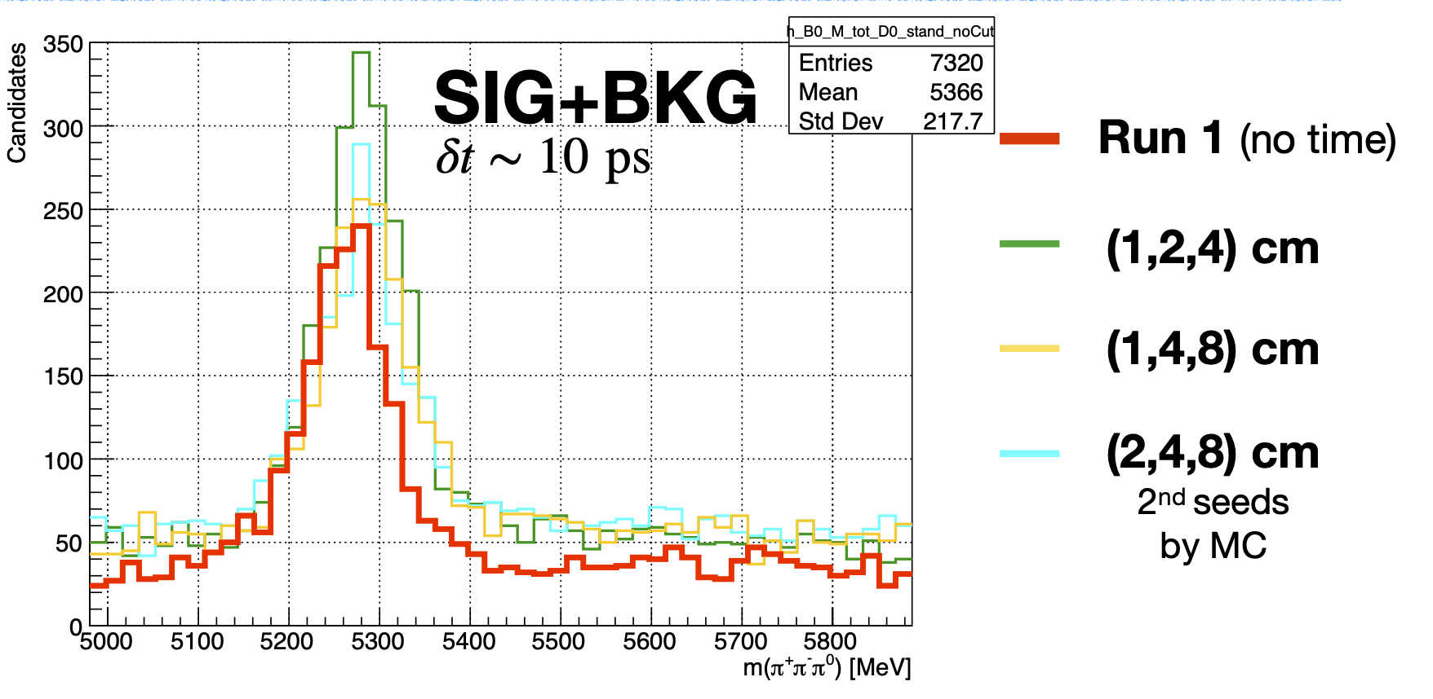

Upgrade II – Use of timing
Daniele Manuzzi, Stefano Perrazini
Timing information could be used in a better way than just to remove clusters with large pile-up contamination.
For example to disentangle energies of two overlapping cluster. Test this idea using true information to find a seed with the second largest energy deposit in a cluster (to give an estimate of the maximum gain of a better use of timing): large extra gain to be expected.
Segmentation in z is also not exploited yet and can help the clustering algorithm.

Slide 11
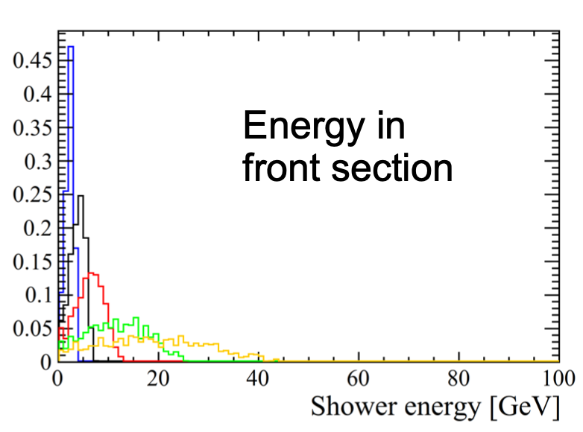
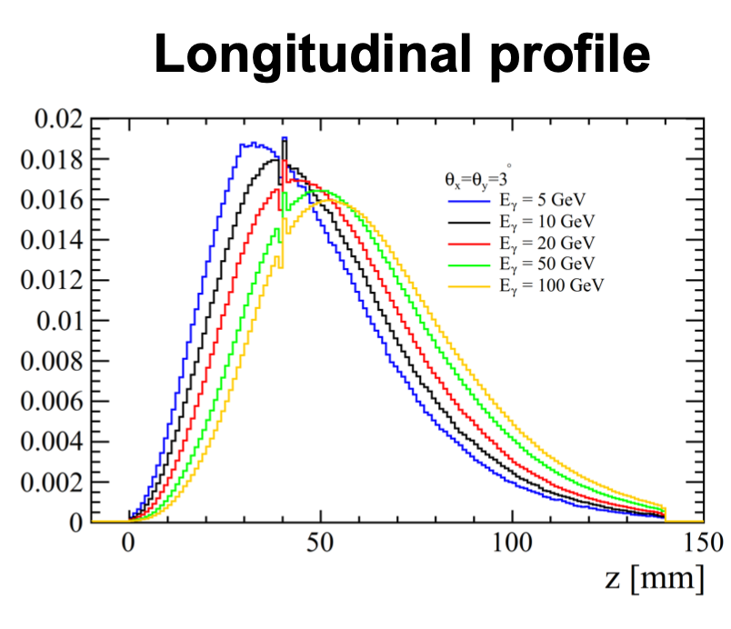
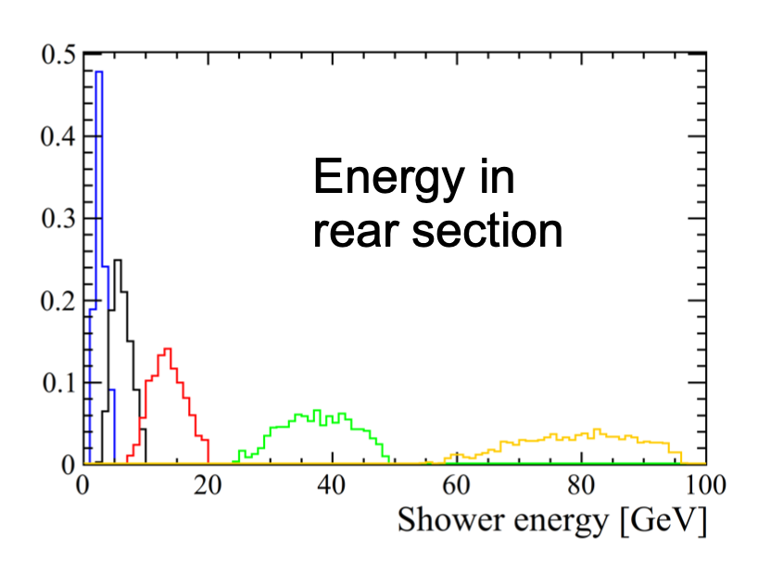
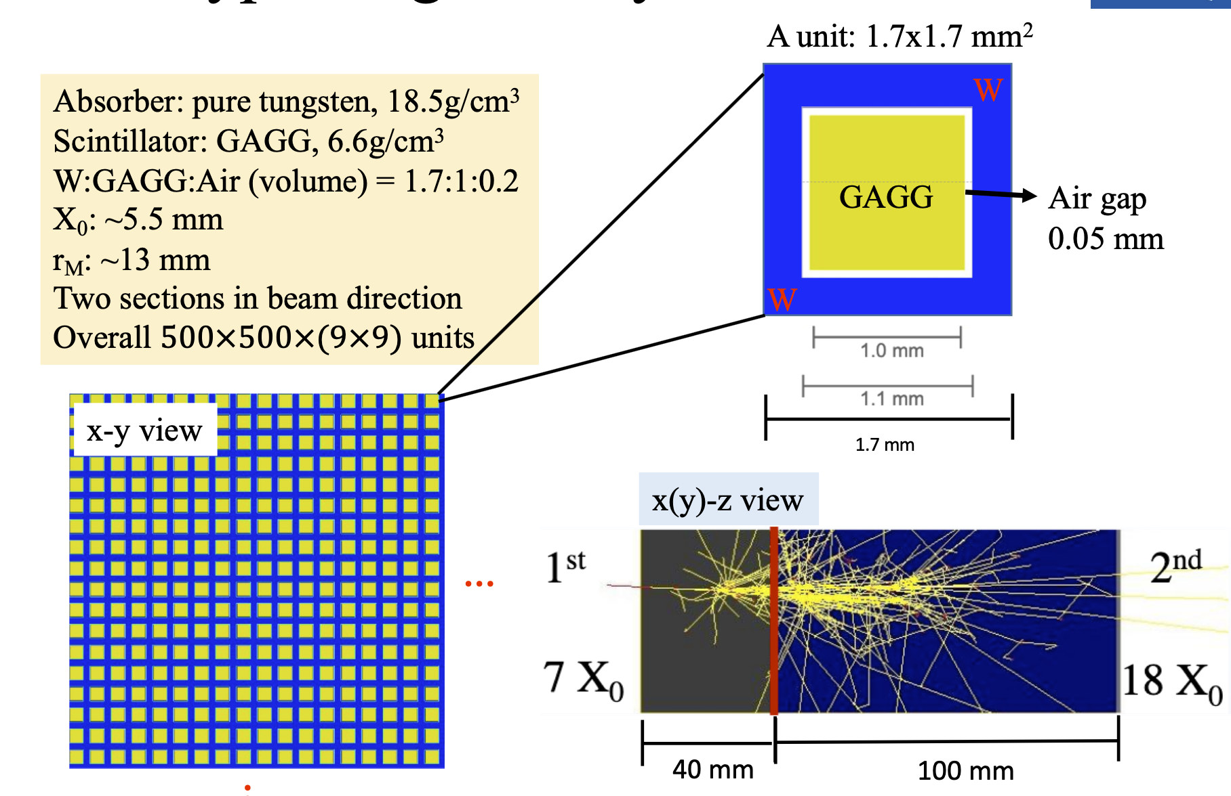
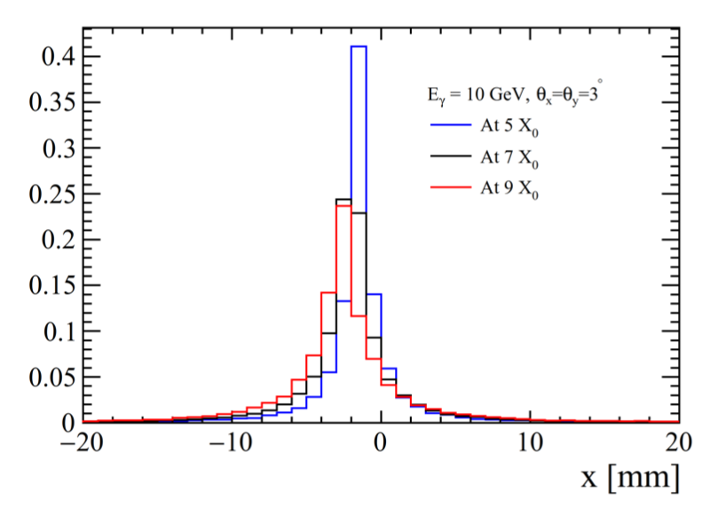
z segmentation
Philipp Roloff, Yanxi Zhang
Full simulation of SPACAL modules in Geant4 exist, with z segmentation, that can be used in the future as input to the full simulation to use it in the reconstruction
Energy profiles (longitudinal, transverse)

Slide 12
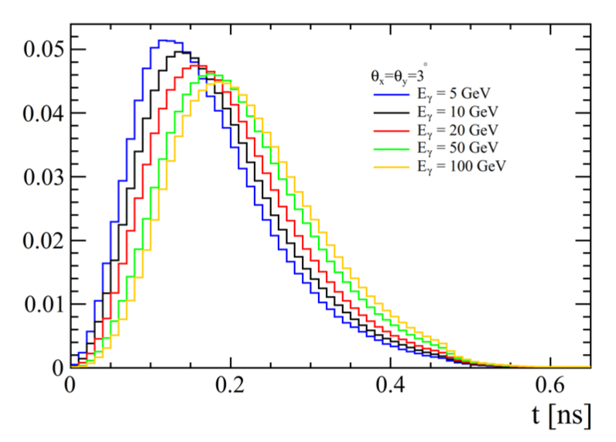
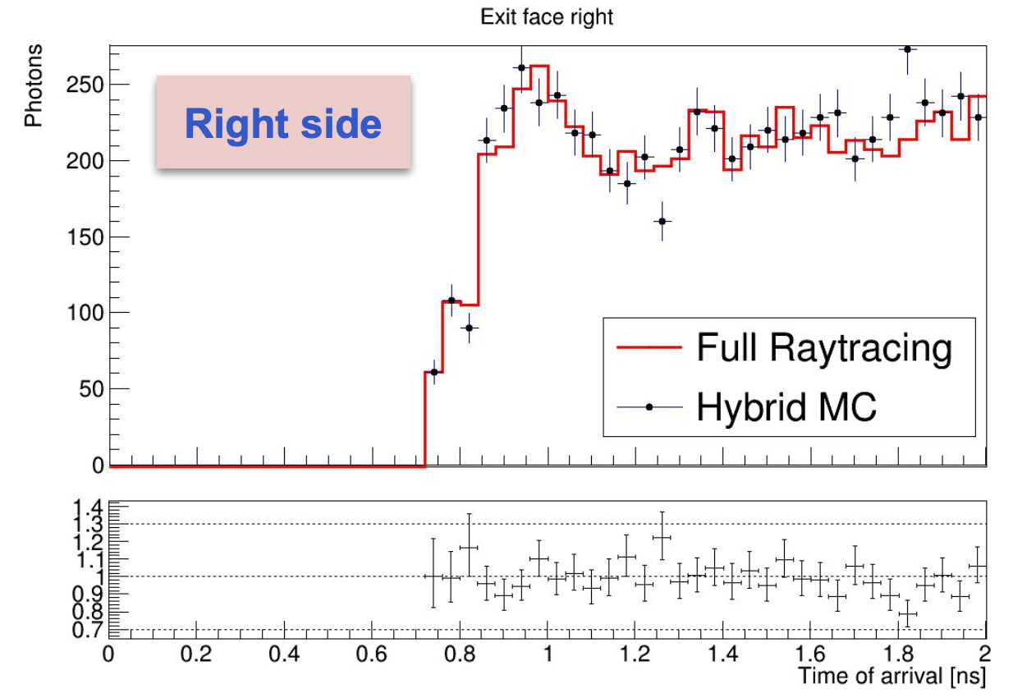
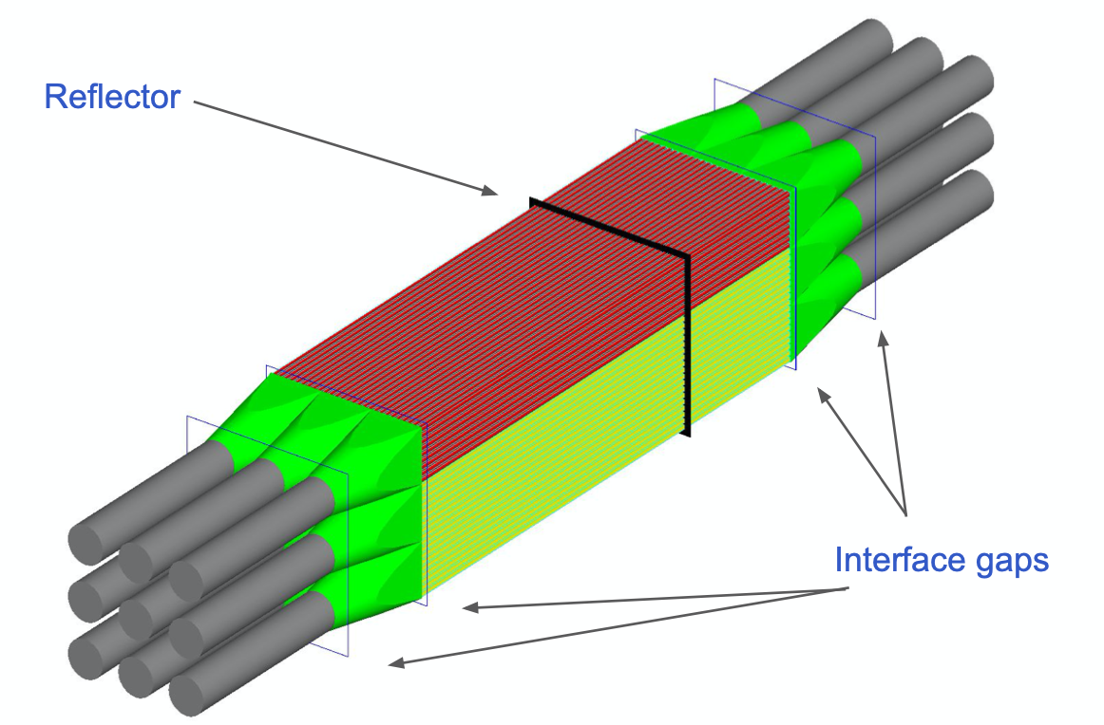
Time properties
Philipp Roloff, Yanxi Zhang, Yuri Guz, Loris Martinazzoli, Marco Pizzichemi
Time (only transport for the moment)
Timing also simulated, in particular dependence with energy which is not considered in the fast simulation
Hybrid Monte Carlo ray tracing to simulate precisely timing properties of modules to be added to full simulation in the future

Slide 13
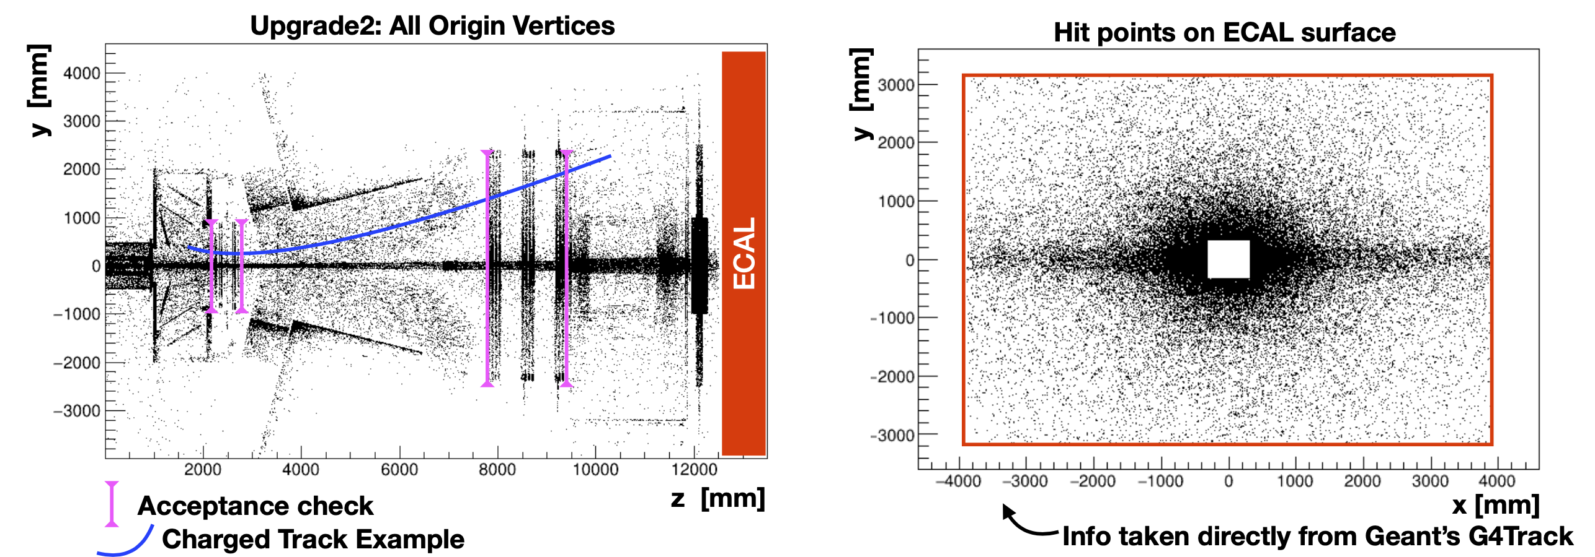
Backgrounds
Daniele Manuzzi, Stefano Perrazini
For more realism, it is necessary to add the contributions from primary π, e, K, p, μ, ... and from secondaries from material interactions
This is taken from full Gauss/Geant4 simulation with Upgrade 1 detector geometry
Neutron shield
For e and π charged tracks

Slide 14
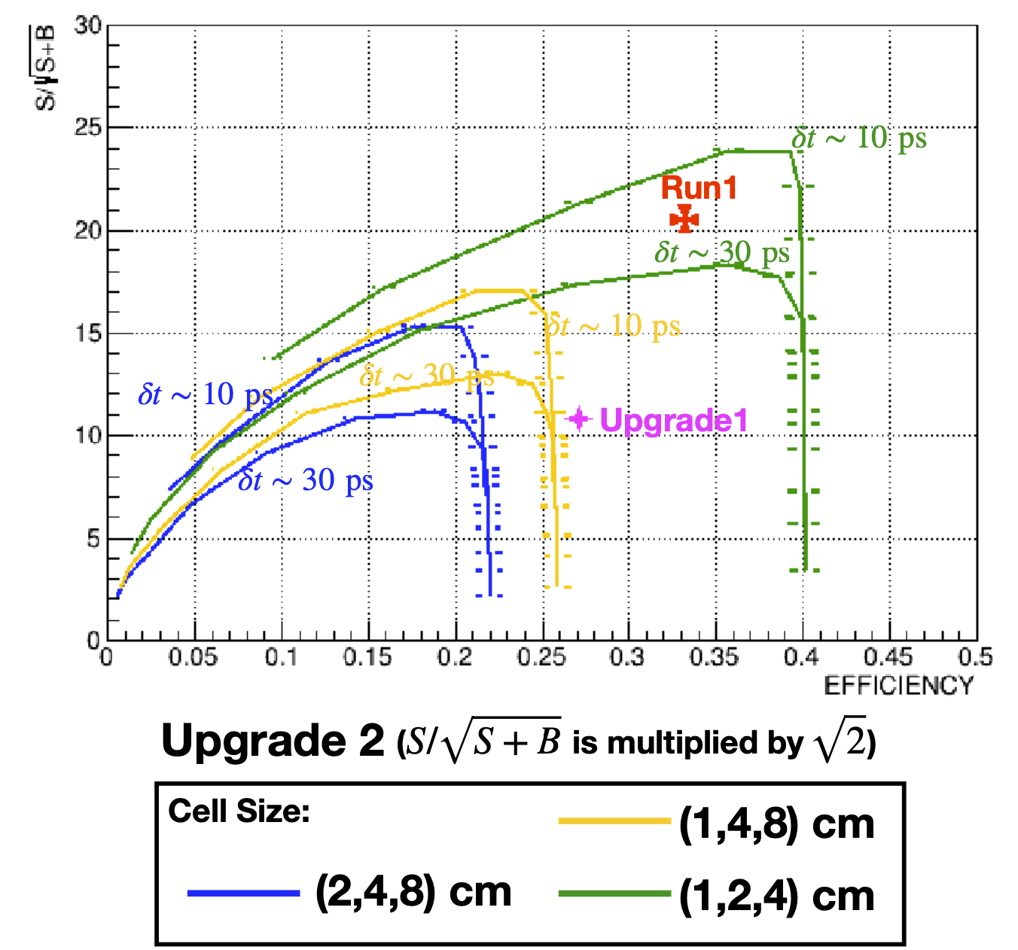
Contributions from e±
Daniele Manuzzi, Stefano Perrazini
Add to fast simulation the ECAL response to electrons (on top of photons).
  Adds a new source of background
  Allows to simulate the effect of the neutral cluster selection (reject clusters where a charged track points to)
Large degradation of performances when adding 1 source of background: crucial in the future to consider all others (π, ... )
In the future:
  add time information also in the neutral cluster selection
  Maybe z segmentation for further background rejection

Slide 15
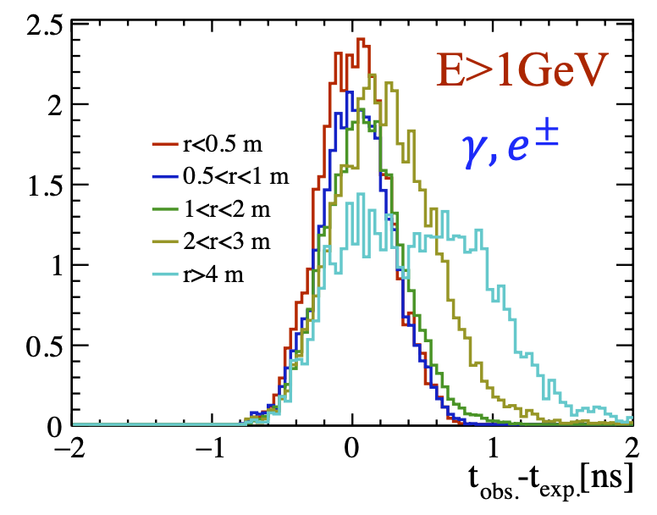
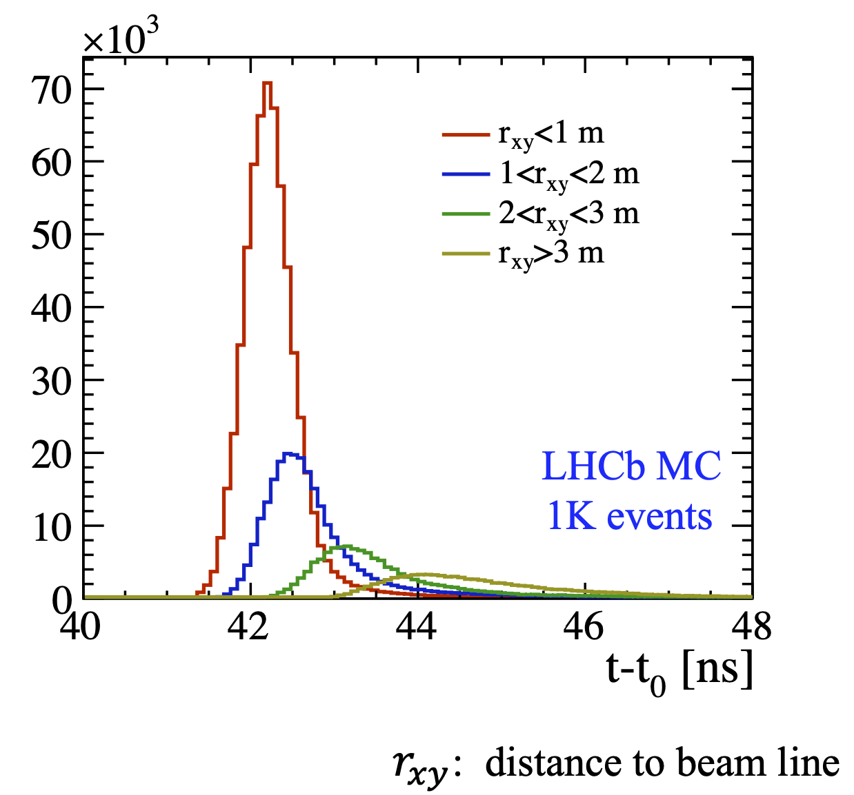
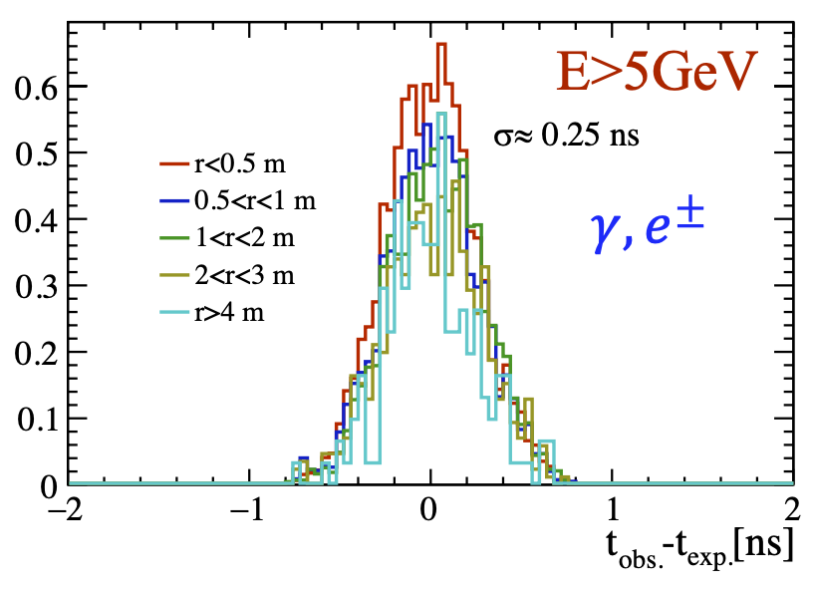
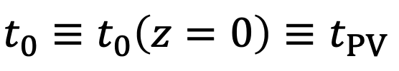
Other effects
Philipp Roloff, Yanxi Zhang
Other effects from the background must be considered in future studies for more realism, which have been simulated with full simulation
Timing spread of secondary particles
Evolution as a function of energy (all categories normalized)

Slide 16
Parametrisation of background
Alexey Boldyrev, Denis Derkach, Pavel Fakanov,
Leonid Matyushin,
Fedor Ratnikov, Andrey Shevelev
Novel technique using pipelines based on Machine Learning.
Sum of all background energy contributions (primary and secondaries of all types) close to the signal (B➝J/ψ π⁰) in time and space.
Sum of background energy compared to signal
ECAL region

Slide 17
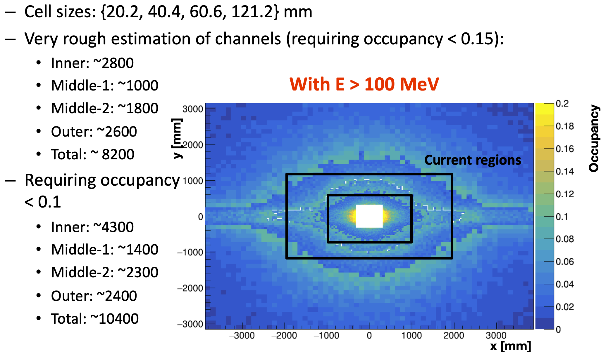
Occupancies – Upgrade I
Daniele Manuzzi, Stefano Perrazini
One of the requirement from the electronics read-out to be able to process realistically timing information is to limit the occupancy per cell to ~10%.
Optimize ECAL geometry (shapes of different regions) with this requirement
Inner, middle-1, middle-2, outer
Upgrade I (e and γ from full simulation)
Current geometry is more or less OK apart in the horizontal band which would benefit from being equipped with smaller size cells.

Slide 18
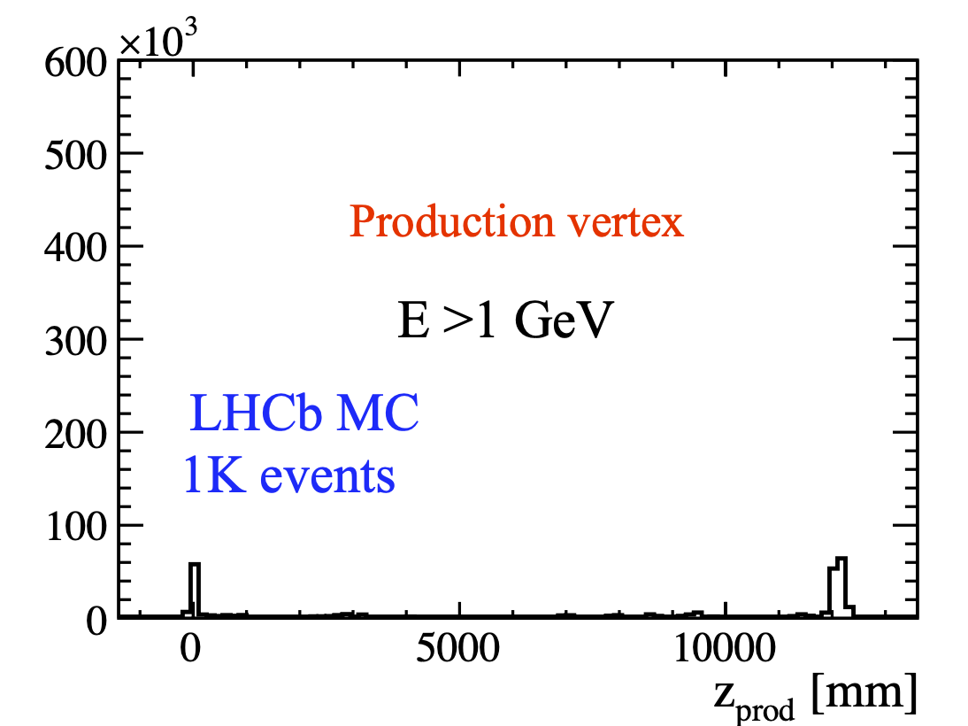
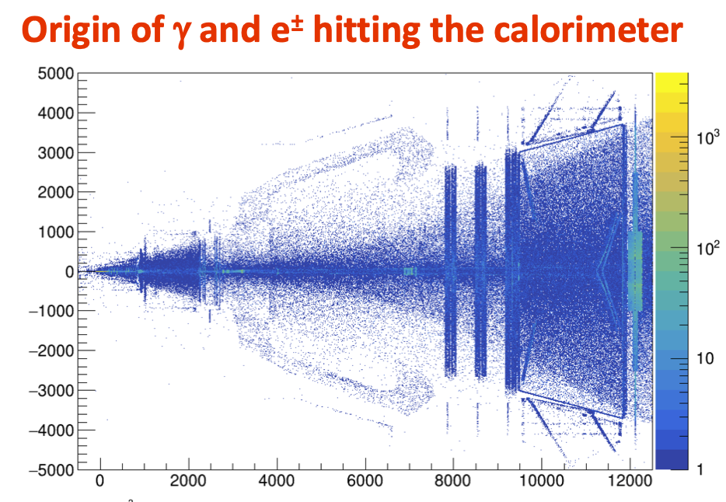
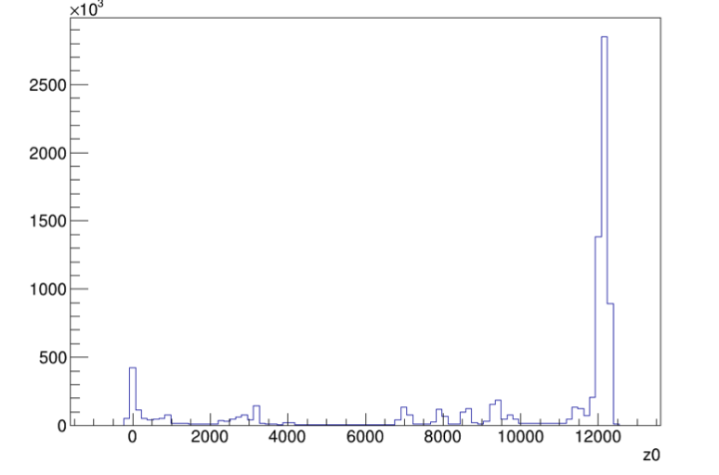
Occupancies
It is also seen that a large fraction of particles hitting the ECAL are (mostly low energy) secondaries produced in the neutron shield in front of ECAL
All E

Slide 19
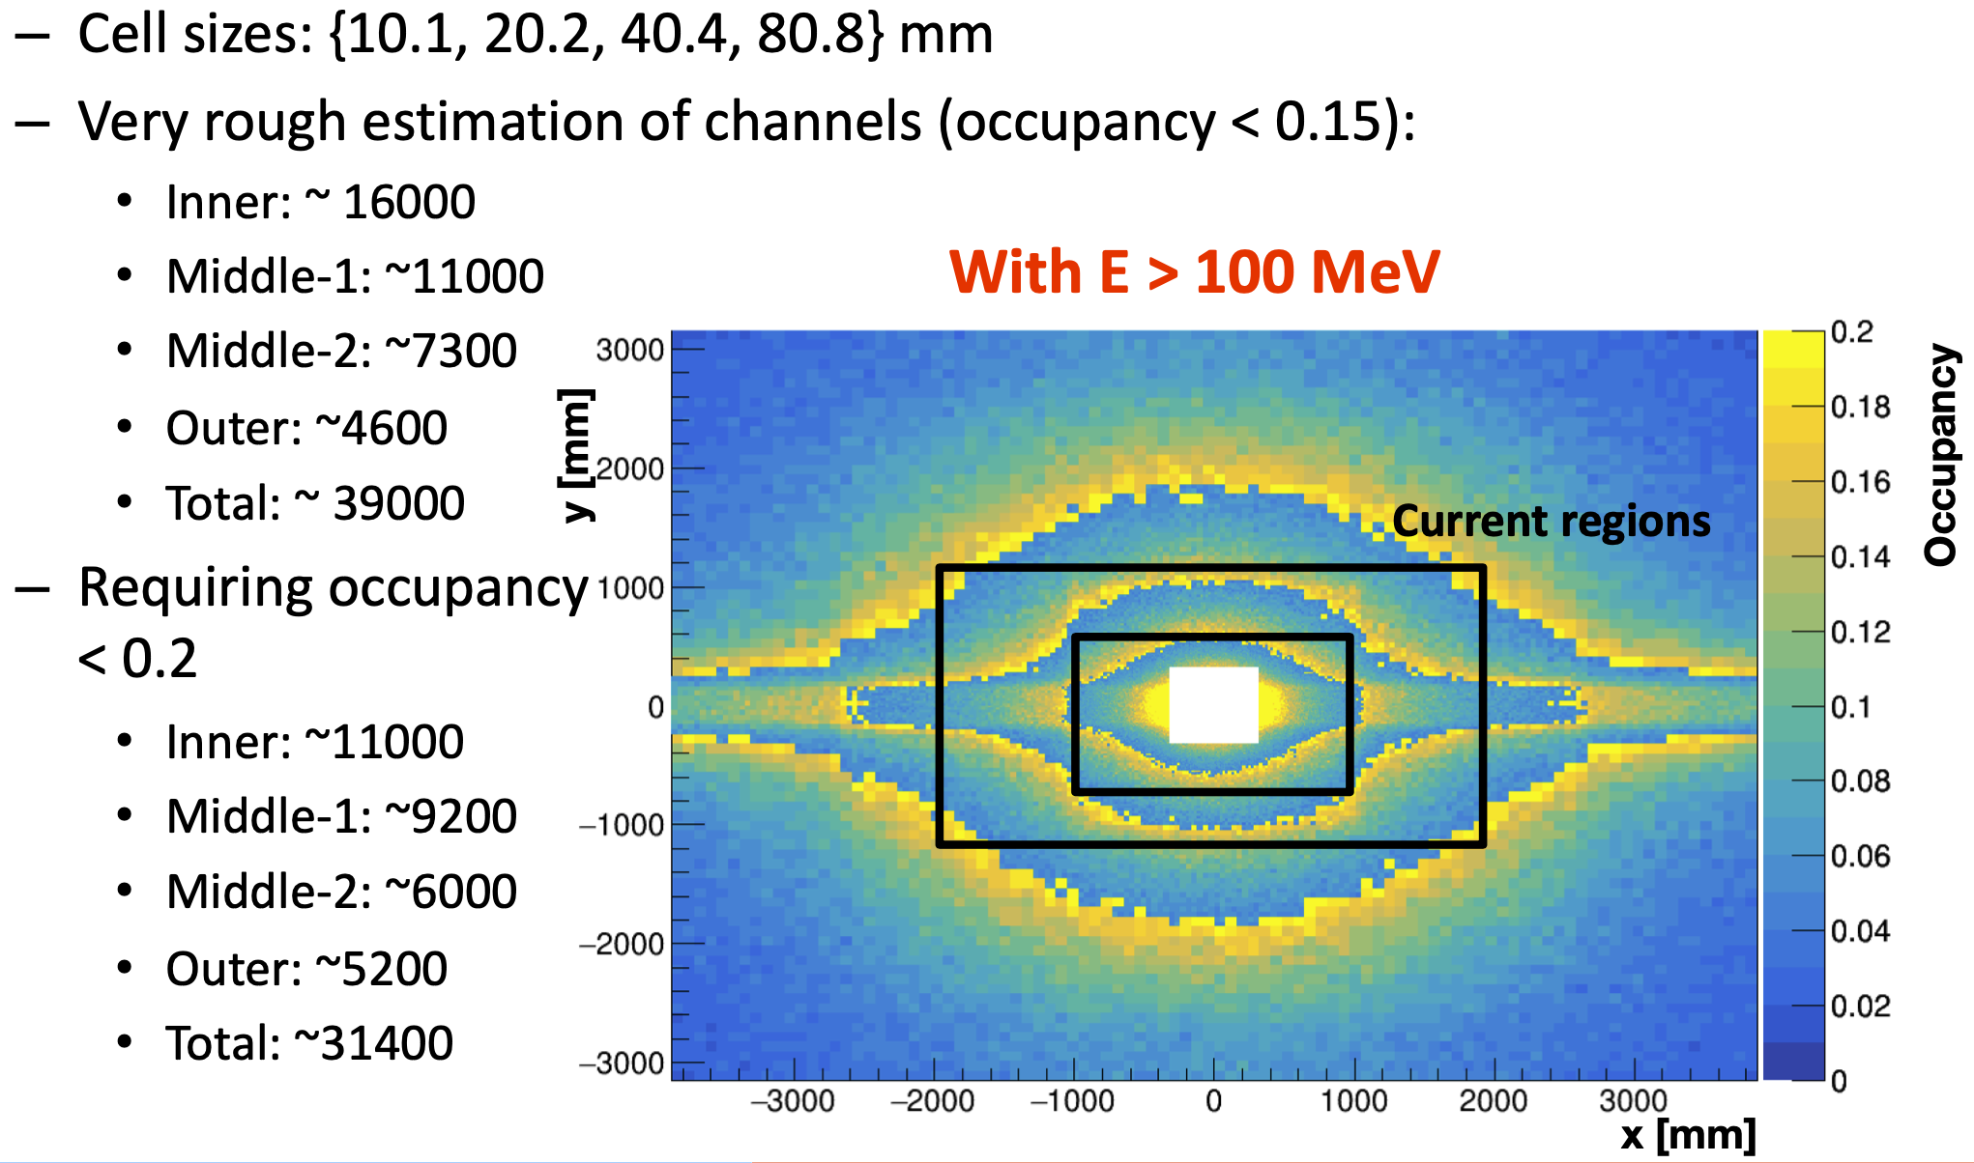
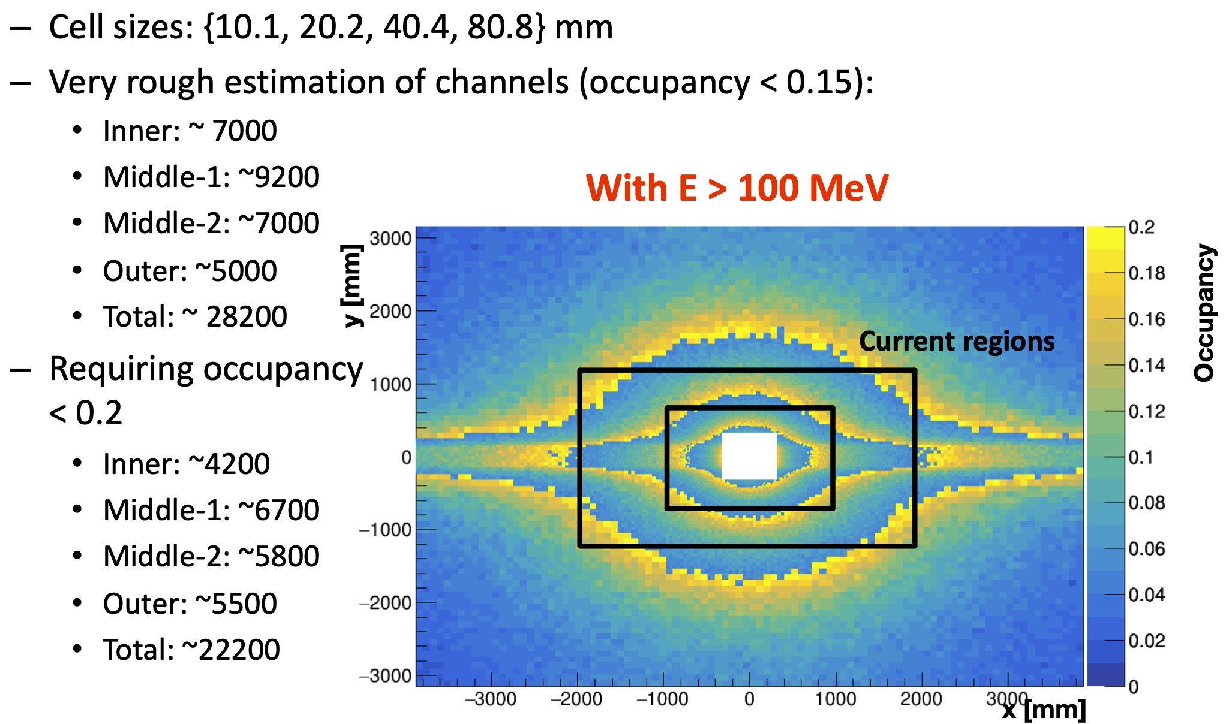
Occupancies – Upgrade II
Daniele Manuzzi, Stefano Perrazini
Upgrade II, number of e or γ per event (full simulation with upgrade I detector geometry)
With neutron shield
Without neutron shield
Preliminary studies but indication that a new geometry, not rectangular anymore, would be better suited.
Neutron shield has a non negligible impact on occupancy in ECAL which is a crucial parameter for its performance.

Slide 20
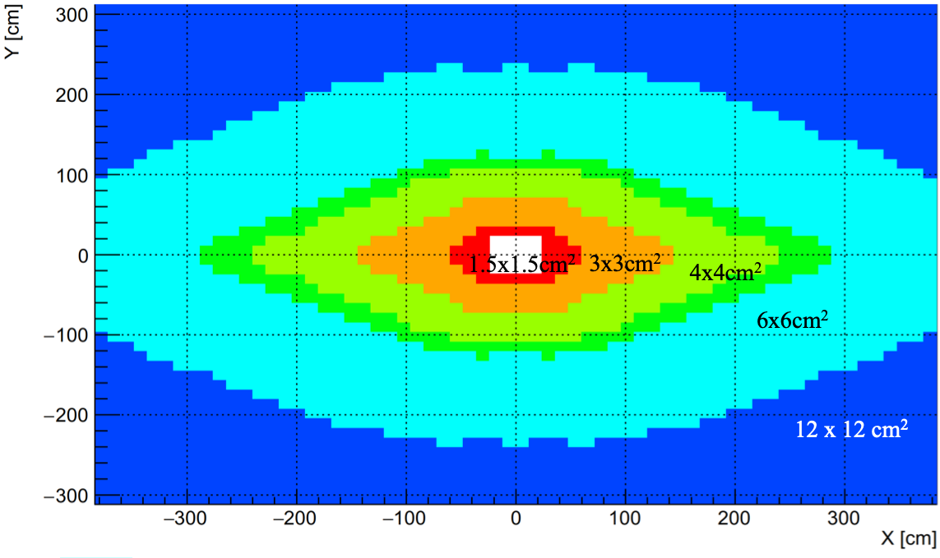
New ECAL layout – Upgrade II
Philipp Roloff
Definition of a new layout taking occupancy into account, and also reusing a maximum of already existing (current ECAL, 4x4, 6x6 and 12x12 cm²) modules.
Used now in the simulation and optimization of the characteristics of the electronics readout chain.

Slide 21
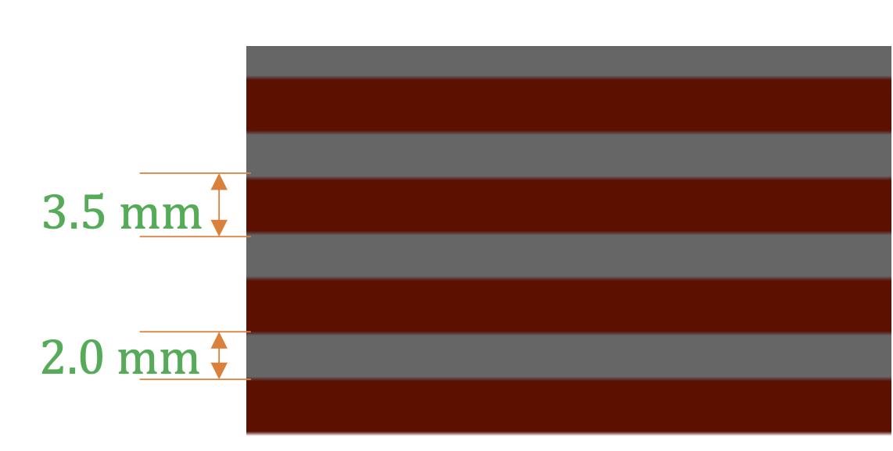
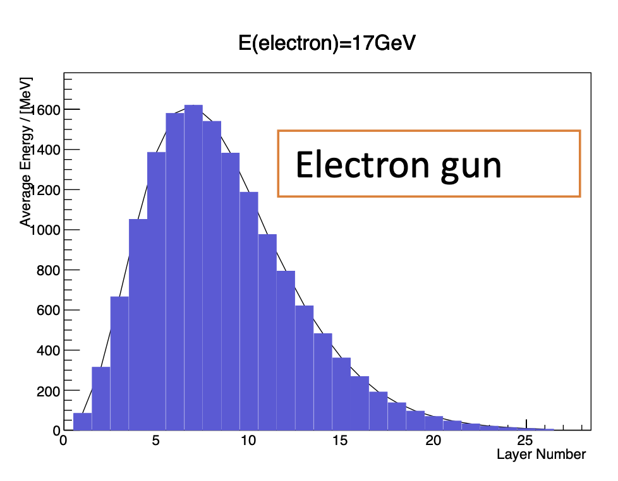
Other technologies
Zehua Xu, Zhihong Shen
Study performances of Si-W ECAL
Hypothetical detector with 1 cm cell sizes, with 26 layers of (3.5 mm W, 200 μm Si and 2 mm vacuum gap)
Simulated with particle guns and full simulation in Gauss/Geant4 (with Upgrade I detector geometry)
Goal is to parametrize it for a fast simulation and check performances for physics channels
Work in progress

Slide 22
Conclusions
Fast simulation framework put in place progressively to optimize ECAL parameters for Upgrade II:
  With optimistic considerations, confirms that timing with 10ps resolution and smaller cell sizes are mandatory in all ECAL regions to reproduce Run 1/2 performances in Upgrade II conditions
Several features to add for more realistic estimates and to study new reconstruction techniques:
  Background from primary and material interactions: first indications that it affects the performances
  Realistic timing and z segmentation: study new reconstruction techniques to mitigate these difficulties
  Input from full simulation exist, to be included in the fast simulation studies
Constraints from occupancy for readout lead to a new arrangement of ECAL modules
Only B decays studies so far: requirements from other channels should also be taken into account.
  Bremsstrahlung recovery is an important item not yet covered
  Work is starting with Z➝e⁺e⁻ (Alessio Gianelle, Donatella Lucchesi, Lorenzo Sestini, Davide Zuliani), which is sensitive to the range of the ECAL energy measurement and to the fact that HCAL will be absent in Upgrade II.

