Slide 1
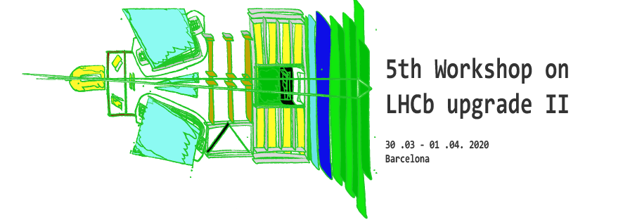
Closing remarks
G. Passaleva
(INFN – Florence and CERN)
Barcelona U2 Workshop – 30 March – 1 April , 2020

Slide 2

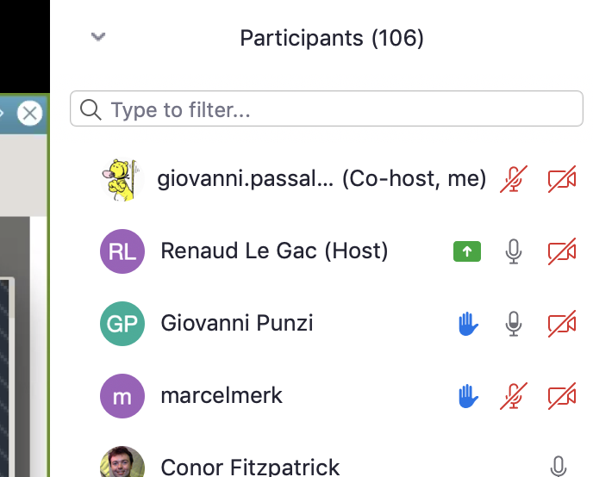
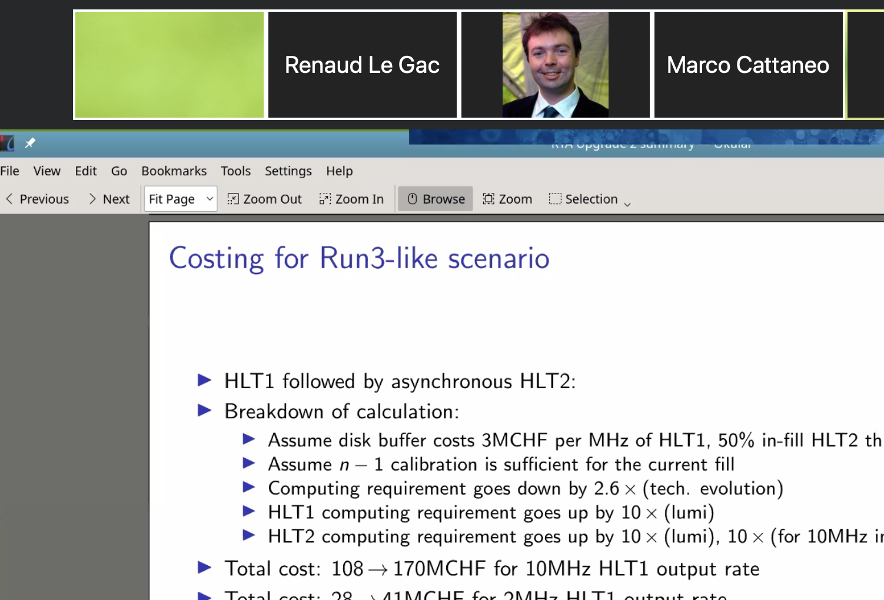
Zoom forever…
Extremely positive experiment!
  Very stable
  Easy to use
  Great handling of discussions and questions
  Very nice look&feel
  a lot of very useful “gadgets”
  It lacks a “timer” function afaik, but that’s a detail
Notice: in these days
  LHCb (~100) + CMS (~300) + ATLAS (peak of 500) all on zoom!

Slide 3
An excellent workshop!
All in all, despite the difficulties, it has been a fantastic workshop
  Great attendance: 100 < people < 200 all days !
Excellent presentations by all the speakers
  A huge amount of work by all the projects, despite the busy and difficult times
Great physics talks
  The more we think about opportunities at U2 the more exciting it becomes!
Excellent starting point for the preparation of FTDR
  Both on technology and costing sides
  Still a lot of work ahead of us but a great step forward!
Follow-ups
  Summary talks by Ulrik and Matteo next Tuesday April 7 at the Tuesday Meeting
  URB meeting on April 22 at 14:00 CET

Slide 4

Thanks…
… to Eugeni and the Barcelona group:
  This will be “The Barcelona workshop” although virtual…
  …but hopefully soon we will be delighted to meet again in person in Barcelona!
… to the secretariat and the team in Barcelona for the double work:
  Preparation for the meeting in person
  “post-processing” to move to the virtual meeting and to recover from the cancellations etc.
To the LHCb secretariat for setting up and assisting in the virtual meeting
…and to Joel for setting up for us Zoom and for guiding us through this new excellent tool!!!

Slide 5
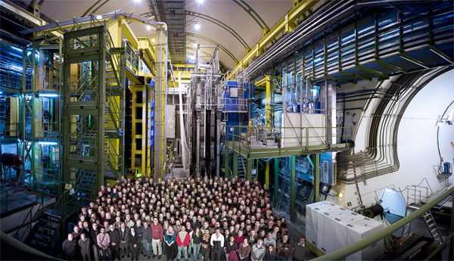
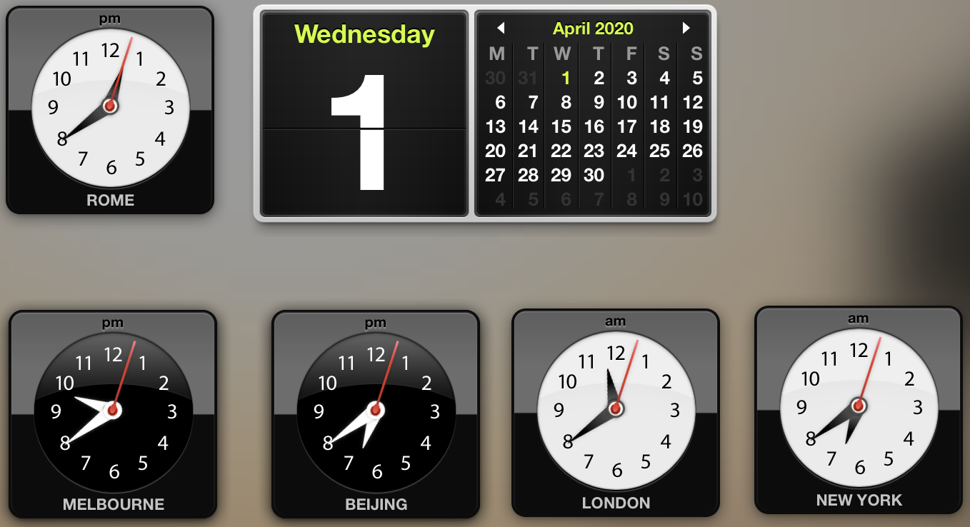
Thanks…
To all of you that from your houses followed patiently and so numerous the workshop and made it very interesting and exciting!
Stay safe at home with your families!
Everything will be all right!
Have a nice day or…night depending where you are!

