Slide 1

Fourier Analysis: Phonons in hBN
Alexandre Silva
João Henriques
Tiago Rodrigues
Laboratórios Avançados de Física
Braga, Março de 2020.

Slide 2
Objectives
Introduce the basics of Fourier analysis and the case of study (probing phonons in hBN using EELS);
Apply Fourier analysis to the experimental and theoretical data;
Understand what processes might have caused the differences between the experimental and simulated data;
Ultimate goal: Understand how Fourier analysis is used to validate theoretical models with experimental data;

Slide 3
Introduction…

Slide 4
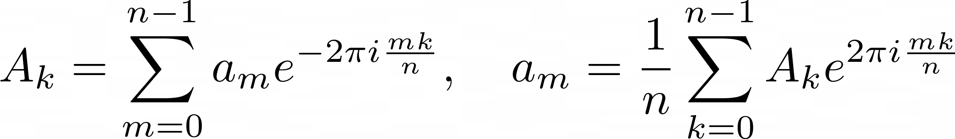
Fourier Analysis
The Fourier transforms are defined as:
Direct
Inverse

Slide 5
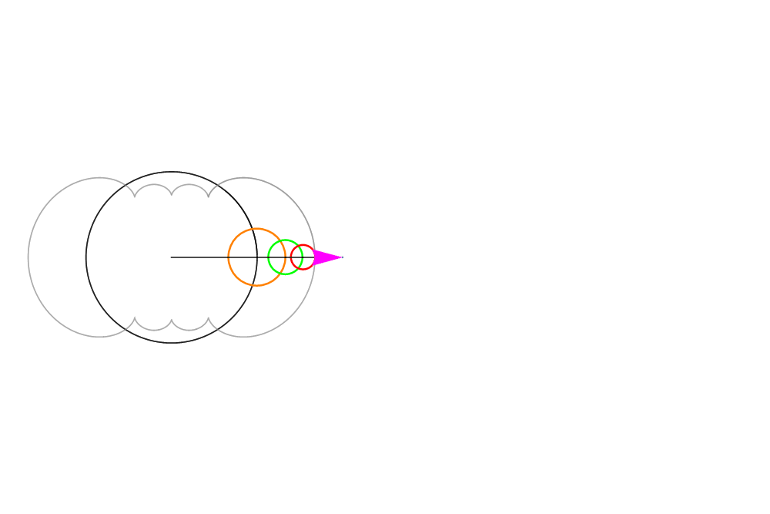
Fourier Analysis
The Fourier transforms are defined as:
Direct
Inverse

Slide 6
Case of Study: What & Why?
Case of study: Probing phonons in hexagonal boron nitride (hBN) using electron energy loss spectroscopy (EELS) - R. J. Nicholls et. al. PRB 99 2019.
  Phonons: Crystal lattice excitations. Why? To understand lattice Dynamics.
  hBN: Most stable form of BN polymorphs, widely used in its 2D configuration.
  EELS: Beam of electrons impinges on a sample and the transmitted electrons’ energy is measured. Why? Allows us to study momentum depedence and nanometer spatial resolution.
  DFT: Density functional theory is a powerful, widely spread method at the heart of today’s computational physics research… and it is like a black box to us.

Slide 7
Case of Study: Details
Theory:
Scattering formalism is used to compute cross sections;
To simplify the problem some approximations are introduced;
Density functional perturbation theory was used to compute the phonon eigenvalues.
Notes:
STEM to accurately control the range, magnitude, and direction of momentum transfers accepted by the circular spectrometer entrance aperture

Slide 8
Case of Study: Details
Theory:
Scattering formalism is used to compute cross sections;
To simplify the problem some approximations are introduced;
Density functional perturbation theory was used to compute the phonon eigenvalues.
Experiment:
A transmission electron microscope (STEM) was used to perform EELS;
The apparatus was callibrated no minimize electron damage;
No denoising or deconvolution routines were used.
Notes:
STEM to accurately control the range, magnitude, and direction of momentum transfers accepted by the circular spectrometer entrance aperture

Slide 9
Validation…

Slide 10
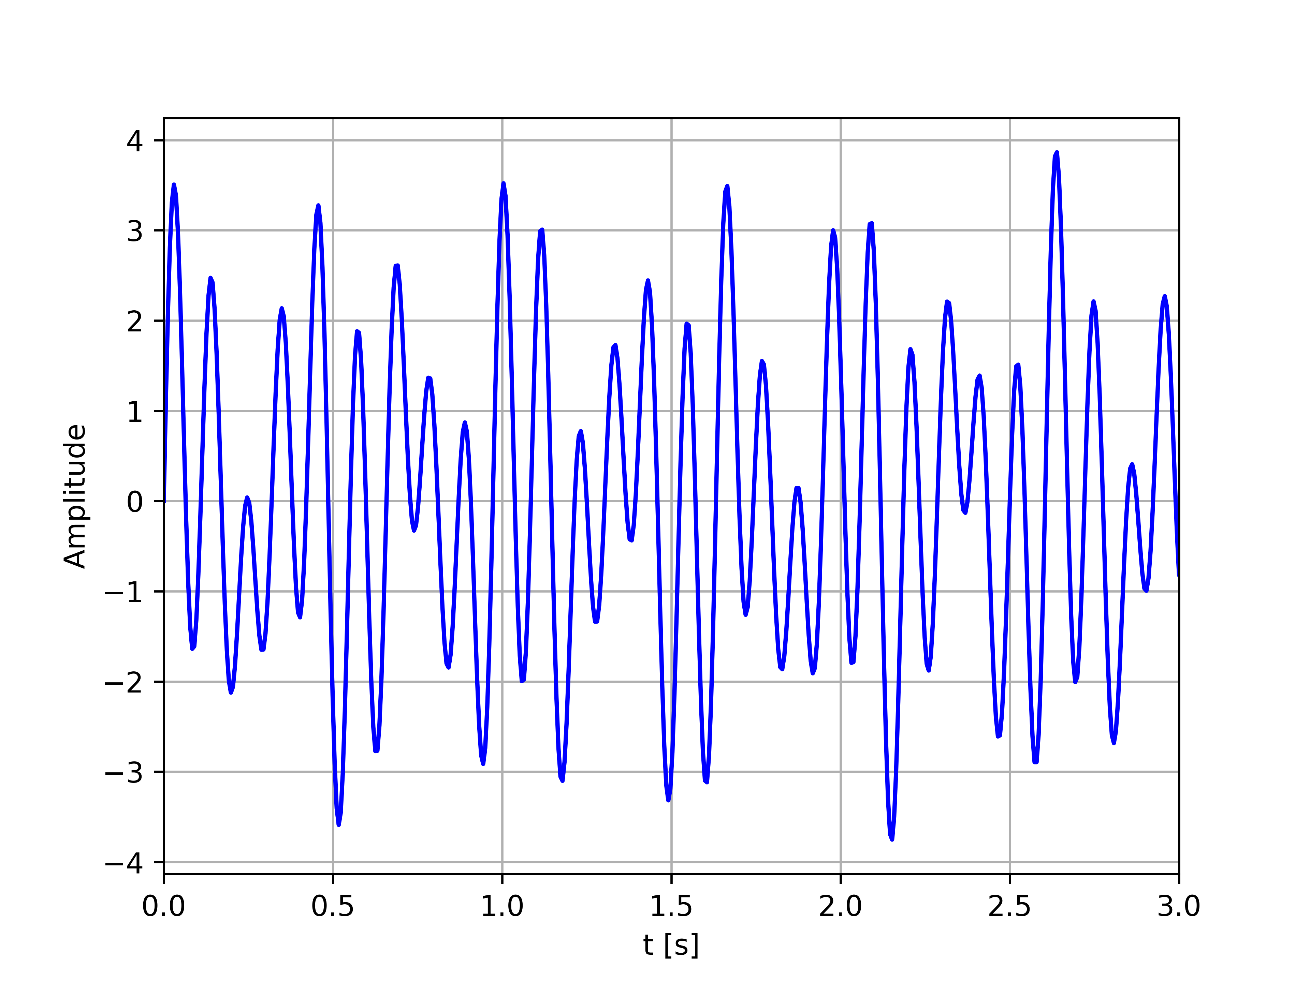
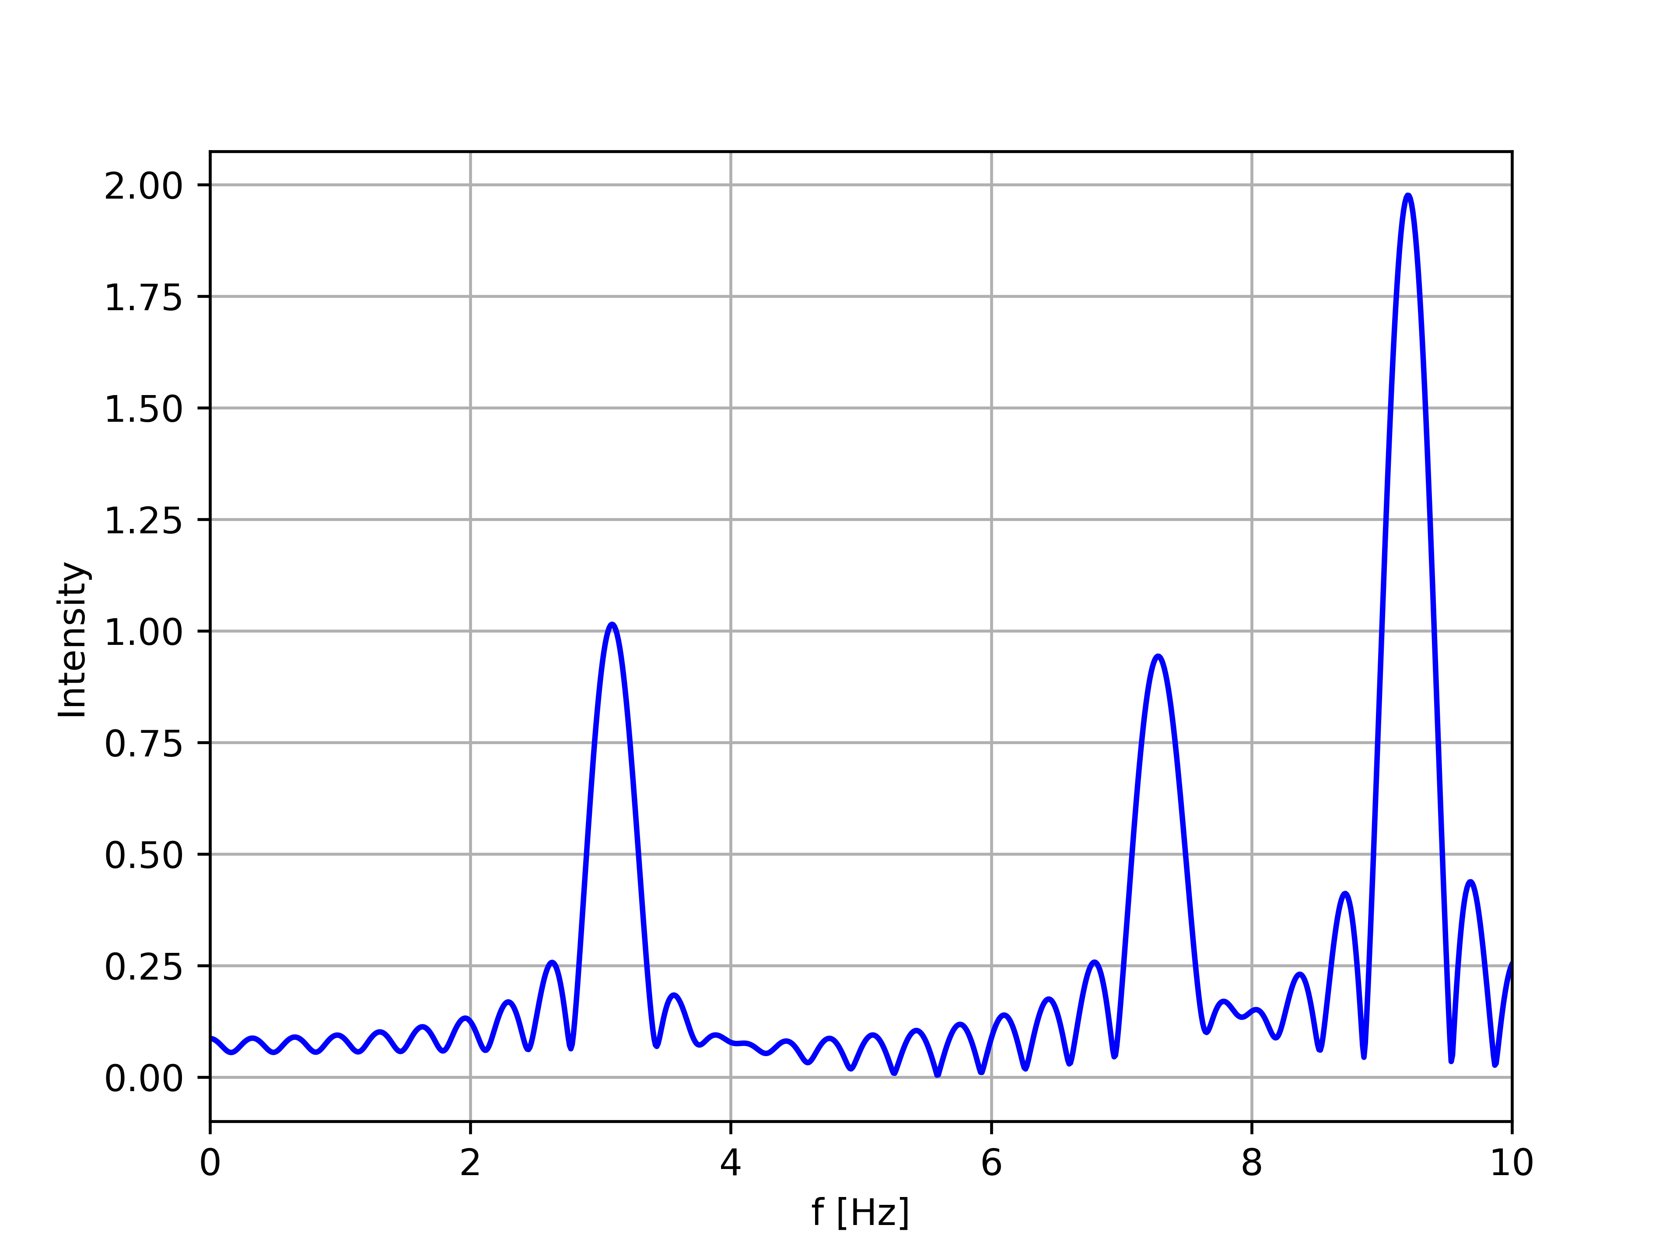
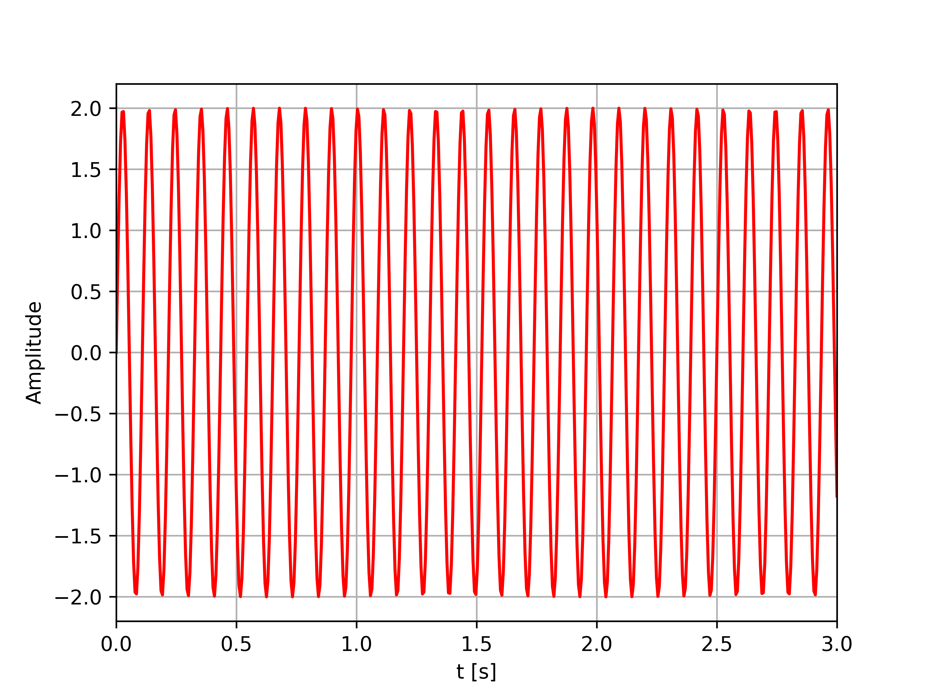
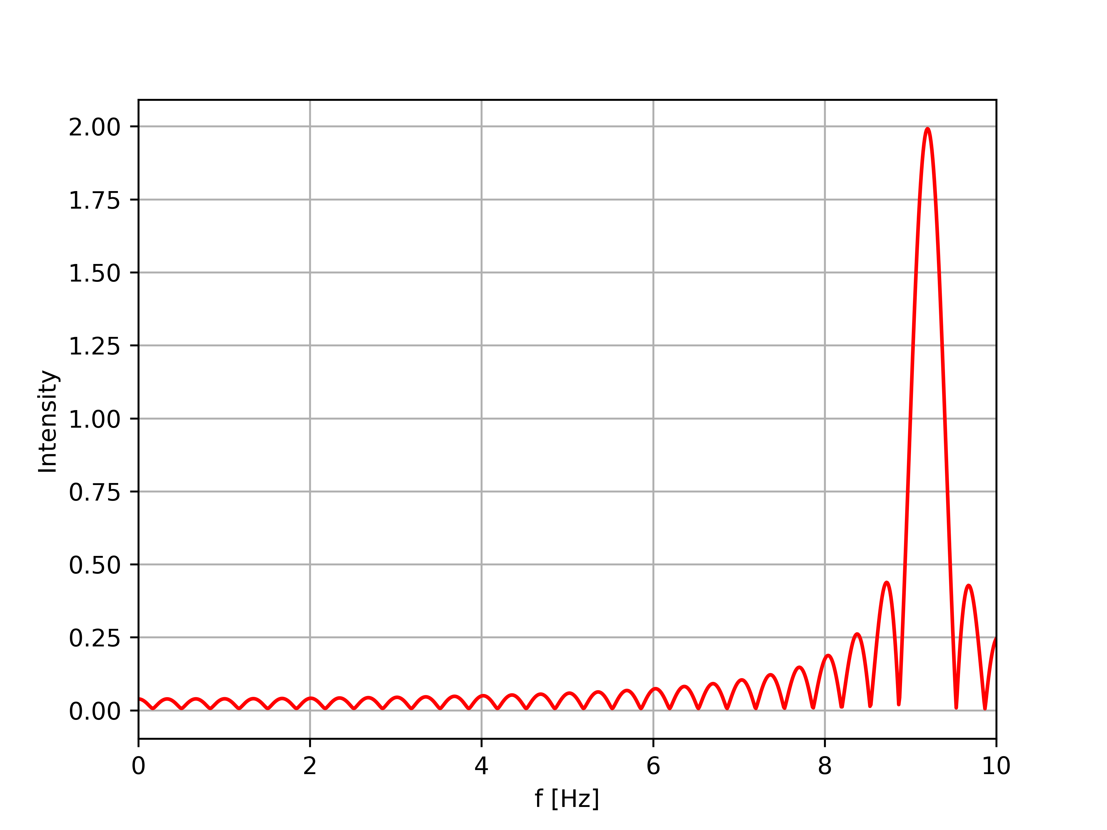
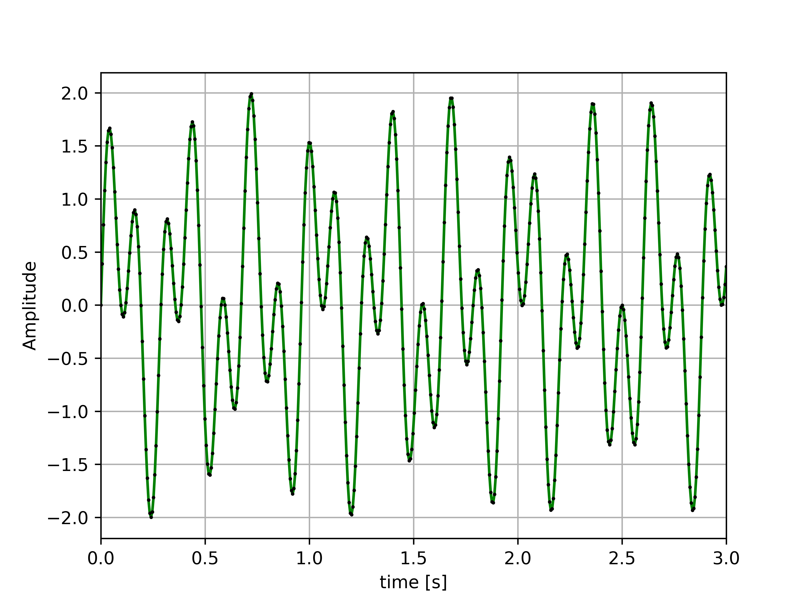
Learning The Tools
FT
FT
Subtraction
Subtraction
+ IFT

Slide 11
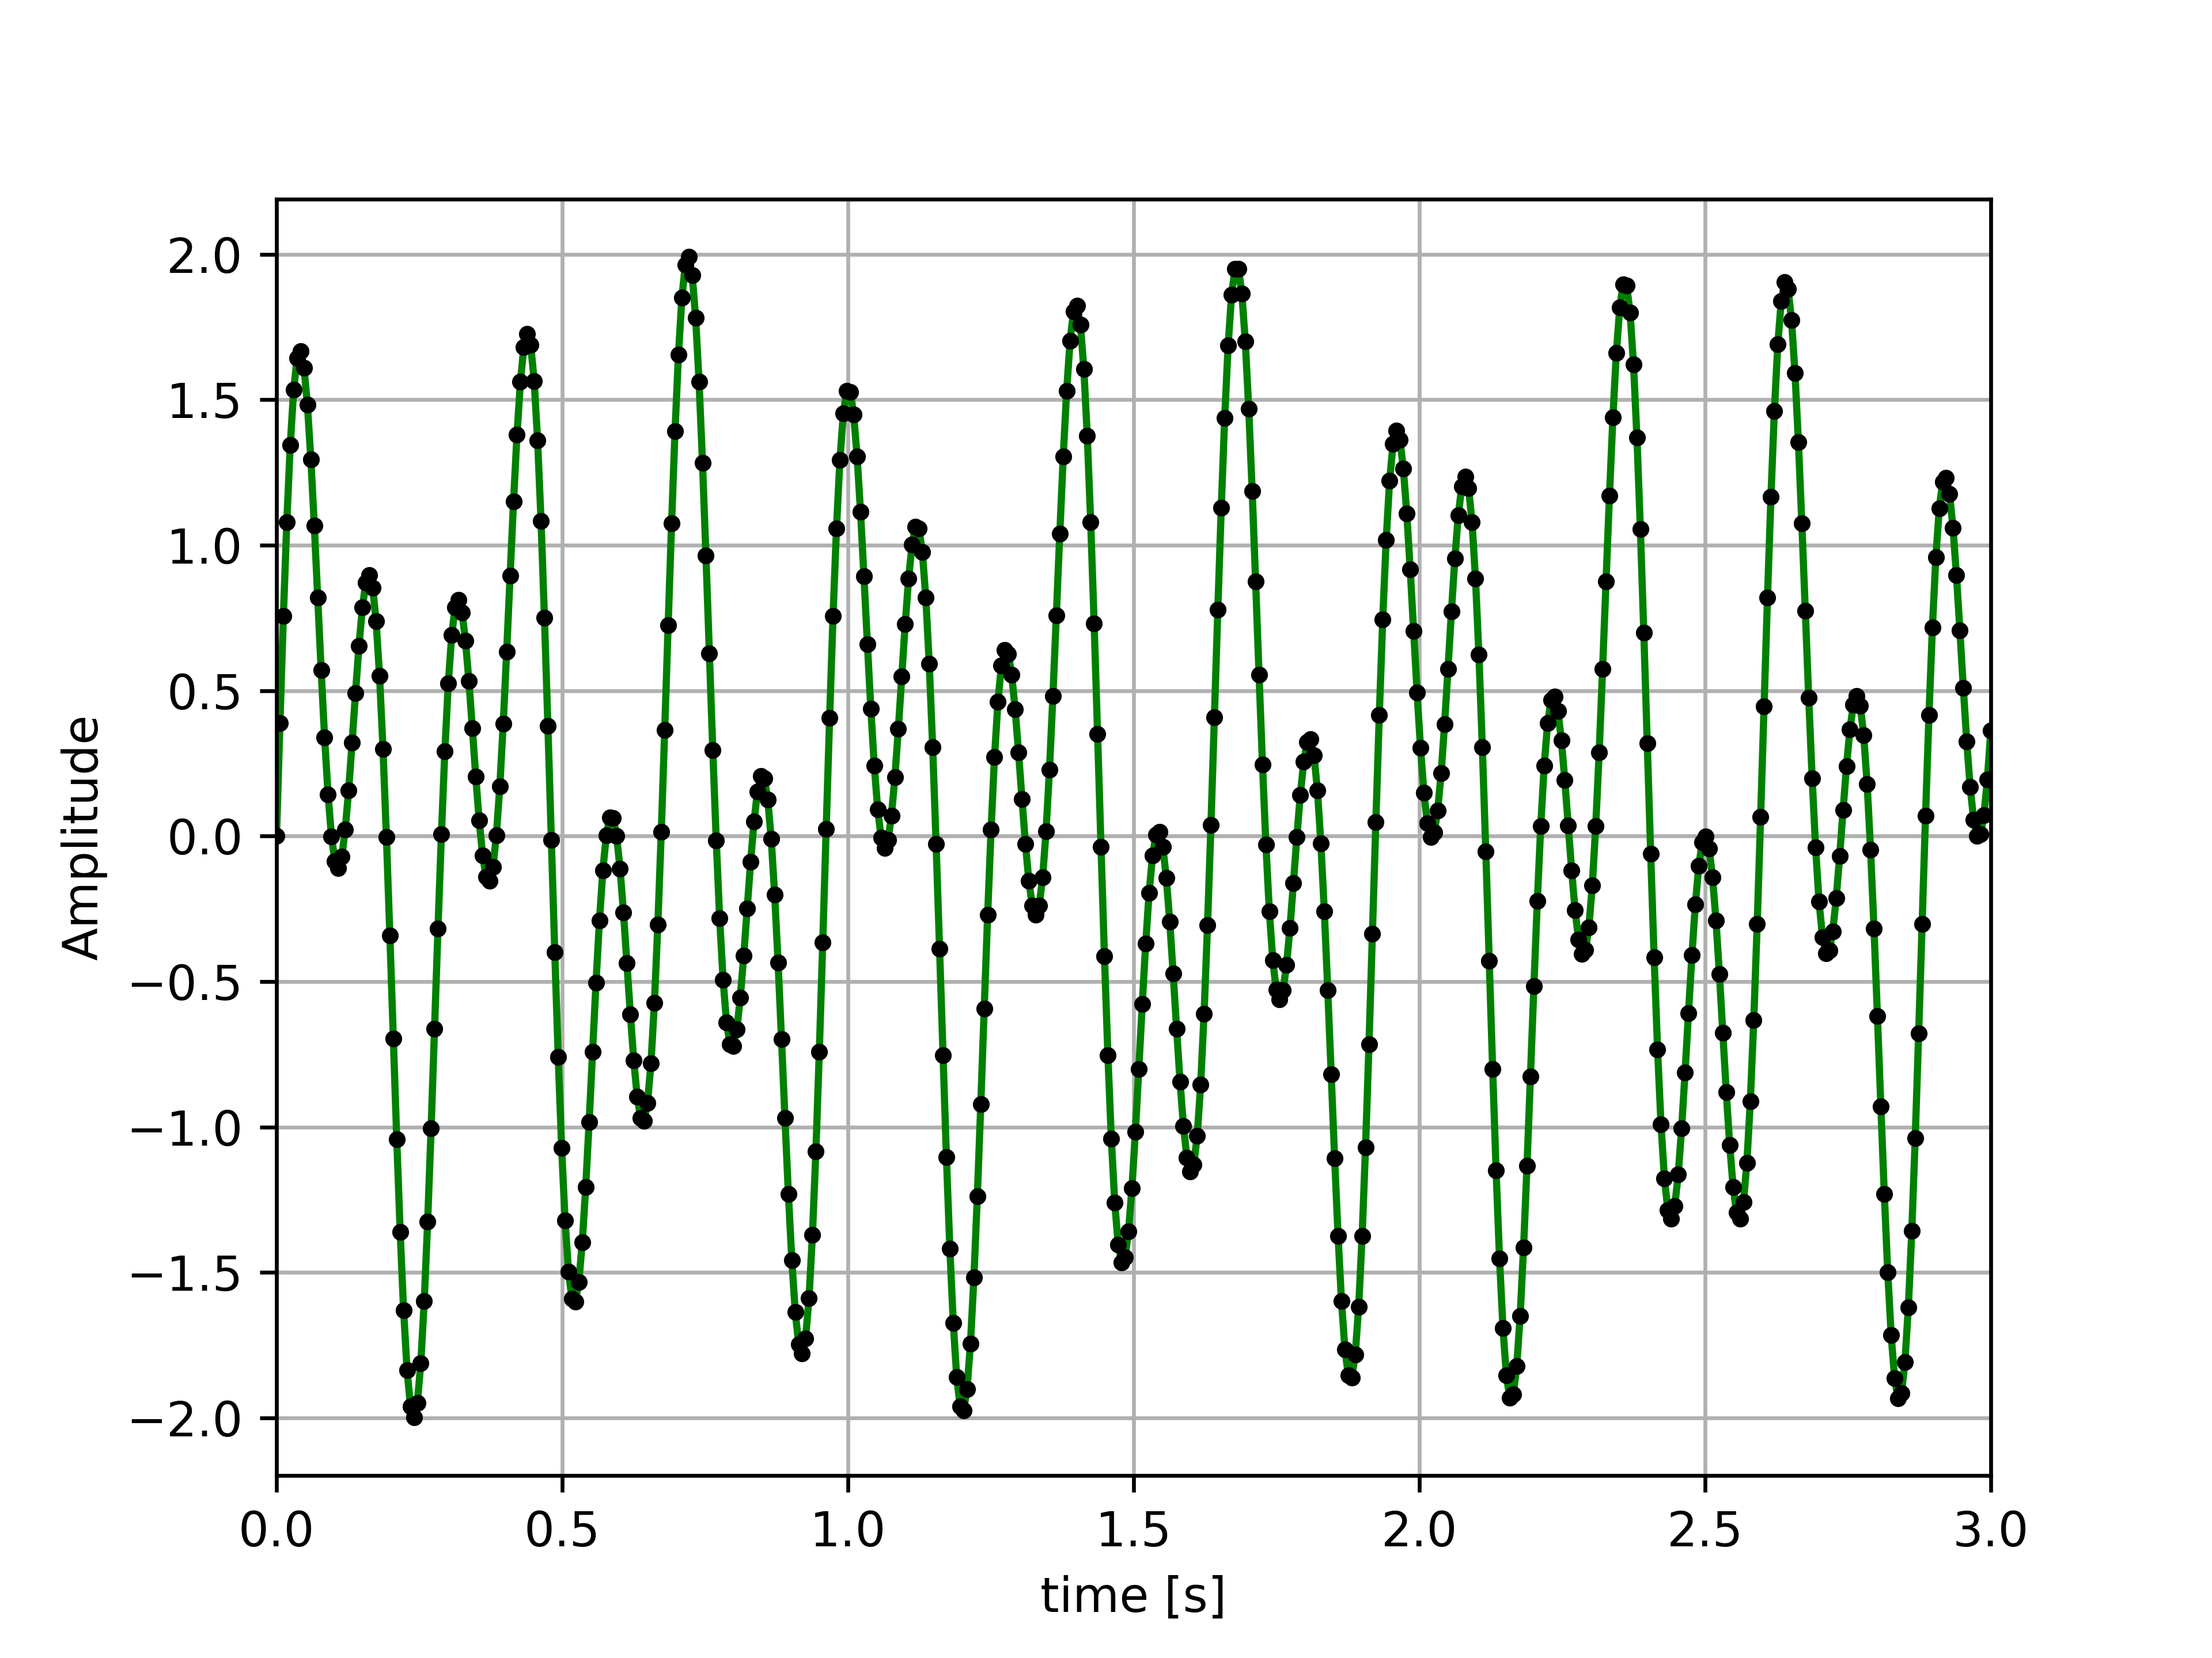
Learning The Tools
It Works!

Slide 12
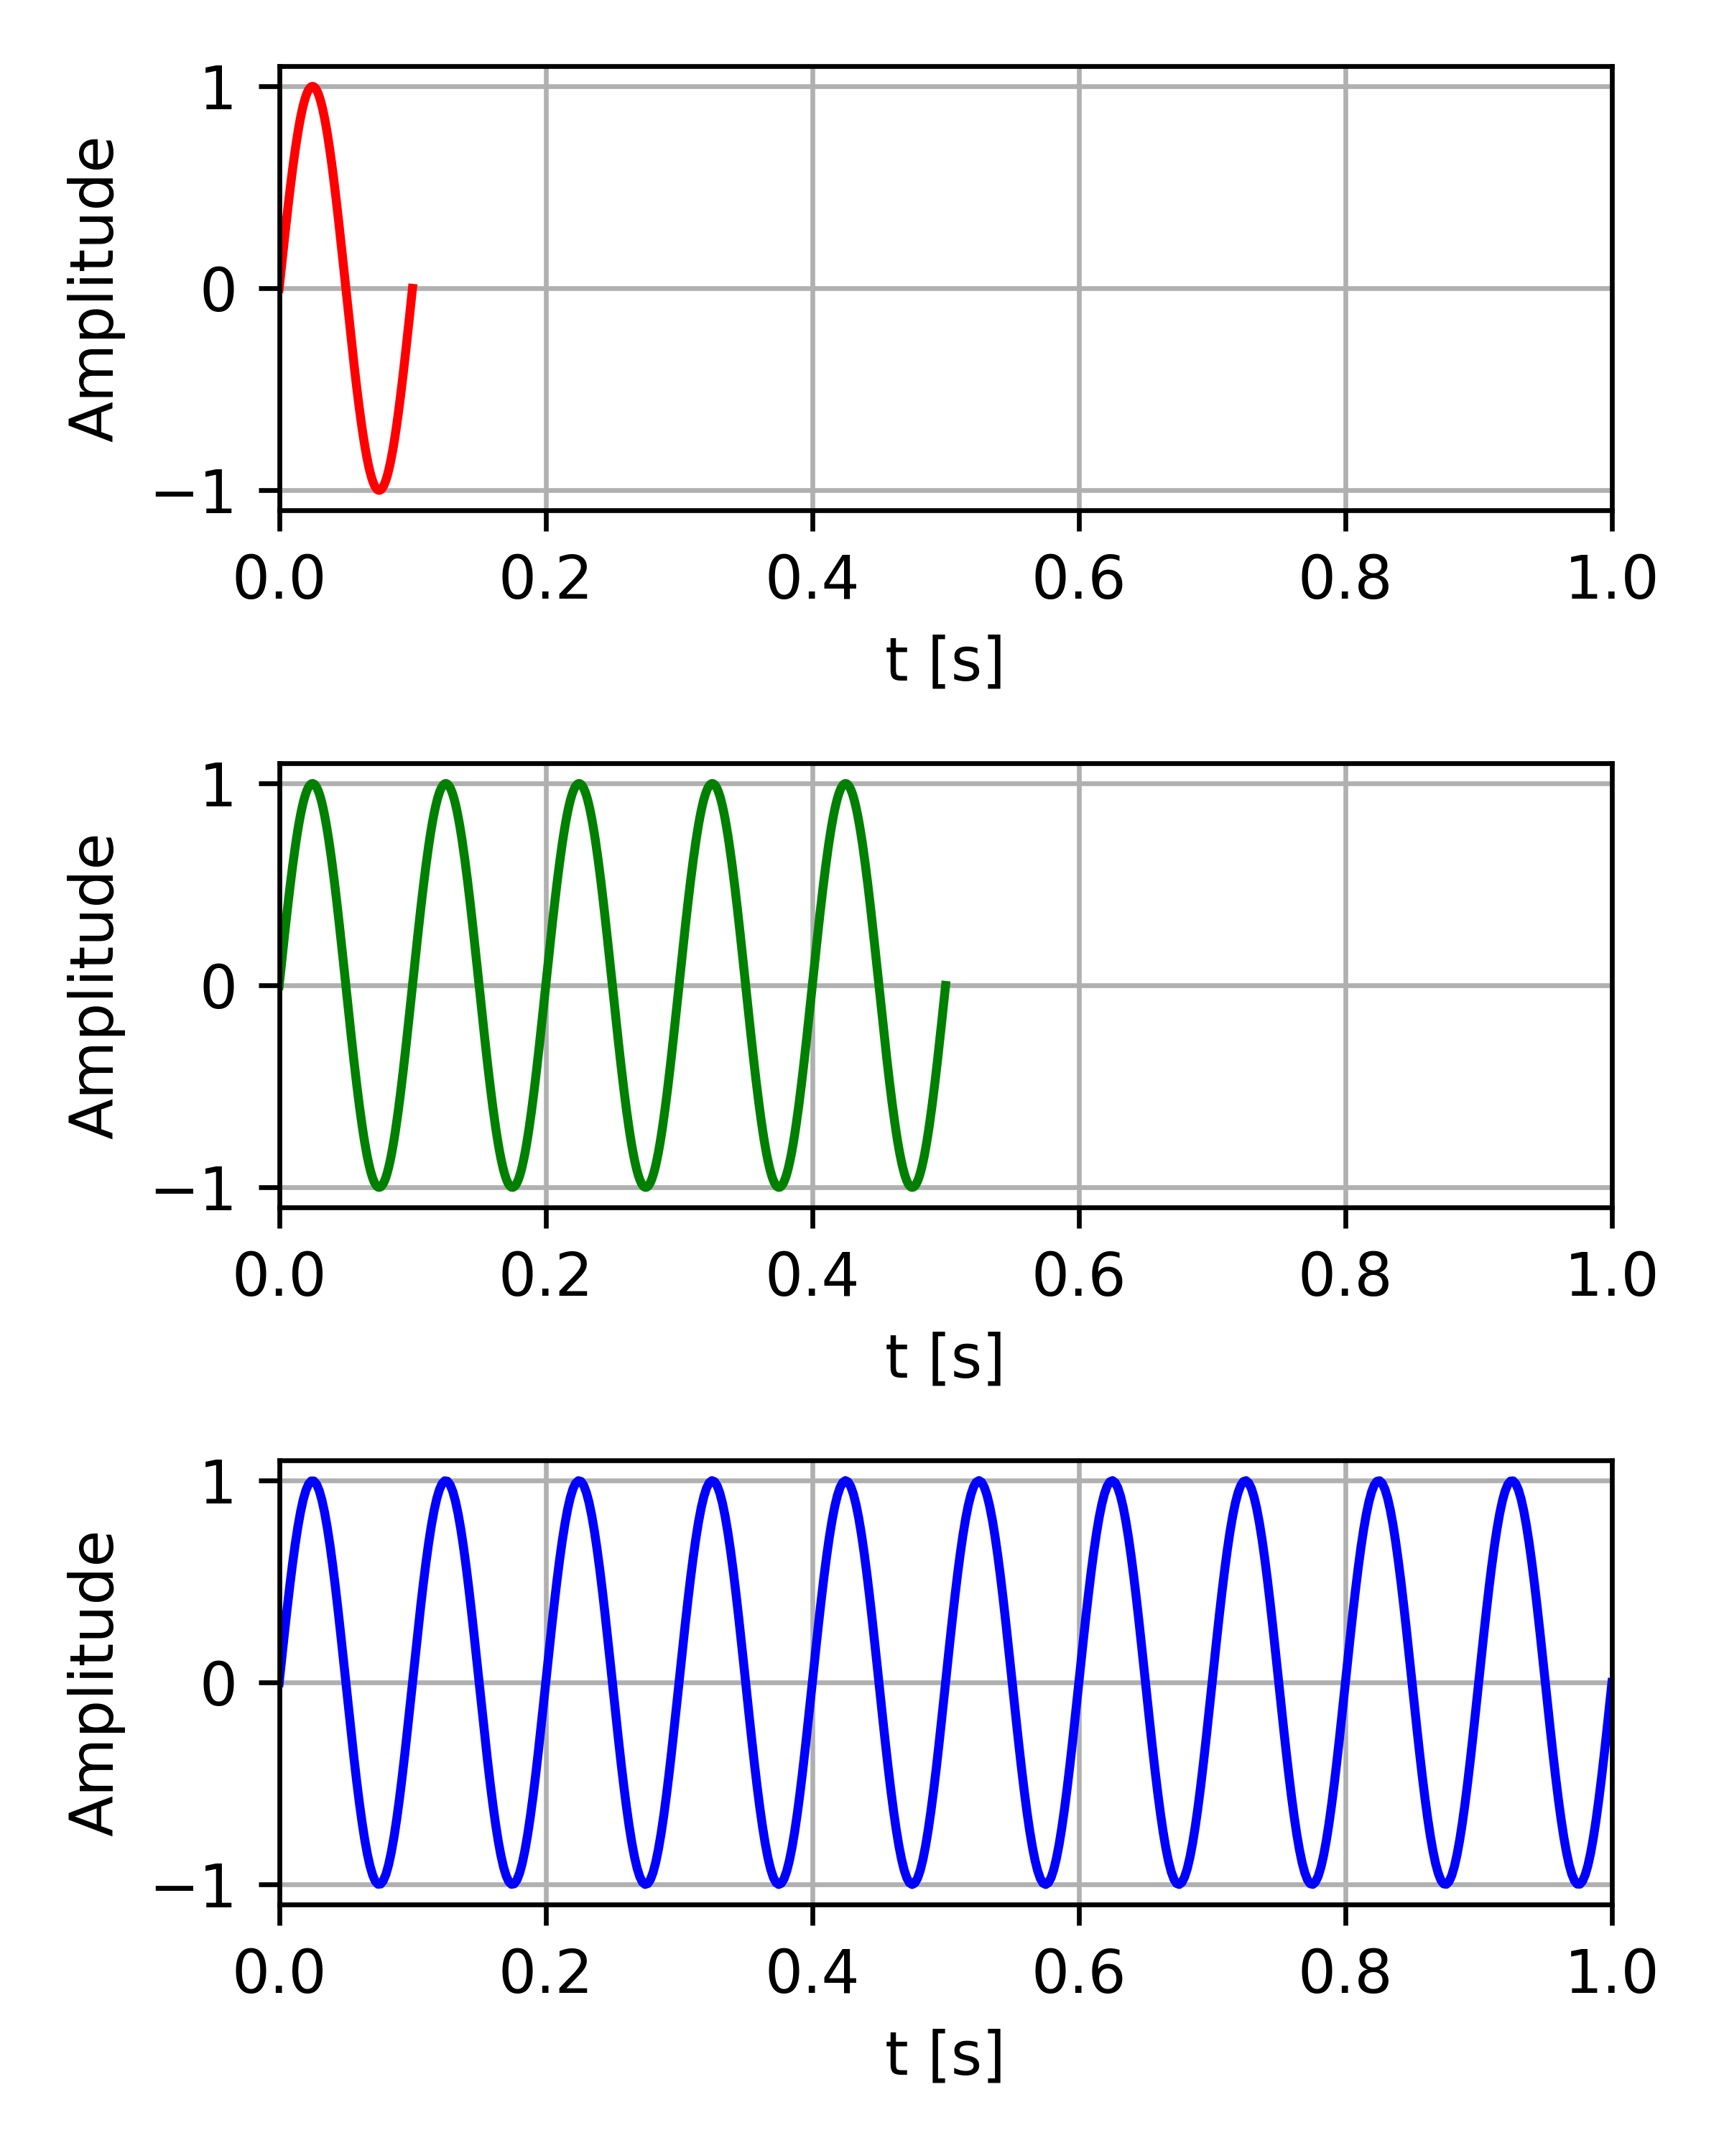
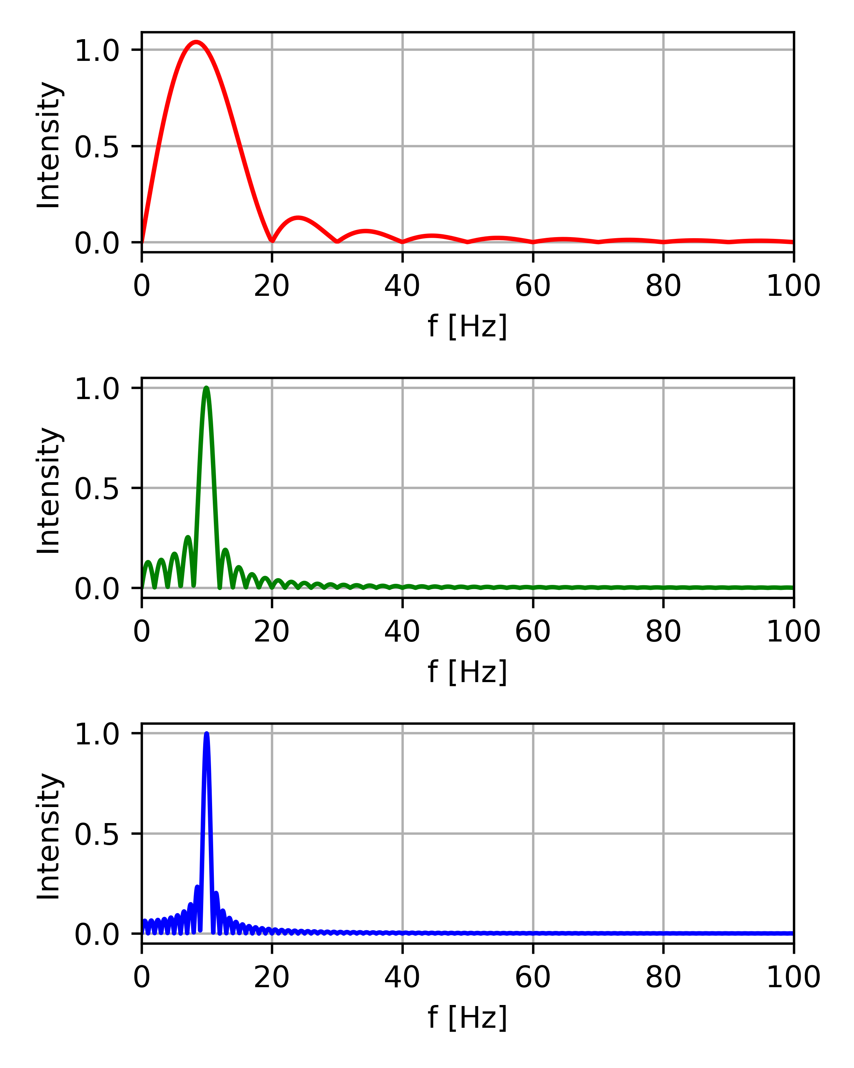
Uncertainty Principle
FT

Slide 13

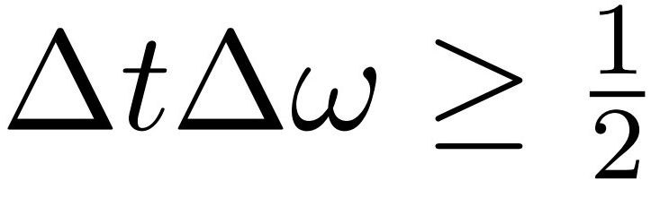
Uncertainty Principle
FT

Slide 14
Cleaning the Signal…

Slide 15
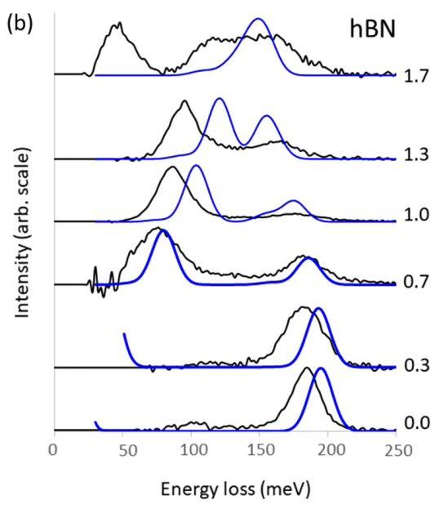
Raw Data
General features of the data
(R. J. Nicholls et. al. PRB 99 2019):
Two independent peaks;
Different broadening;
Initial noise.

Slide 16
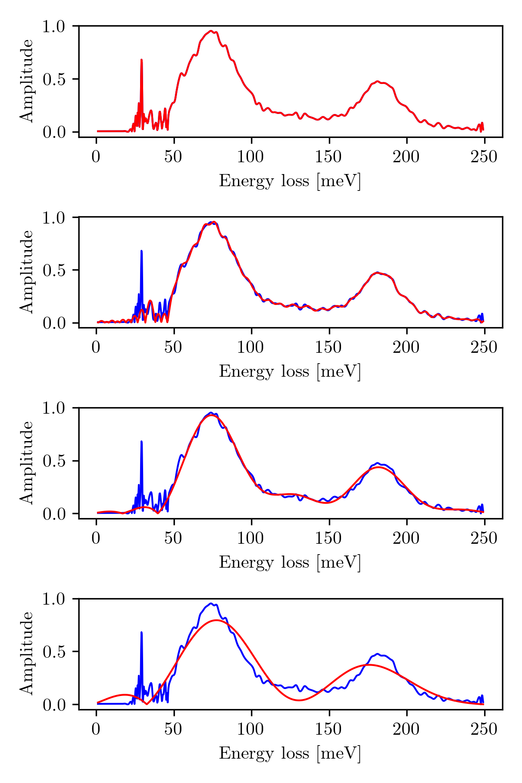
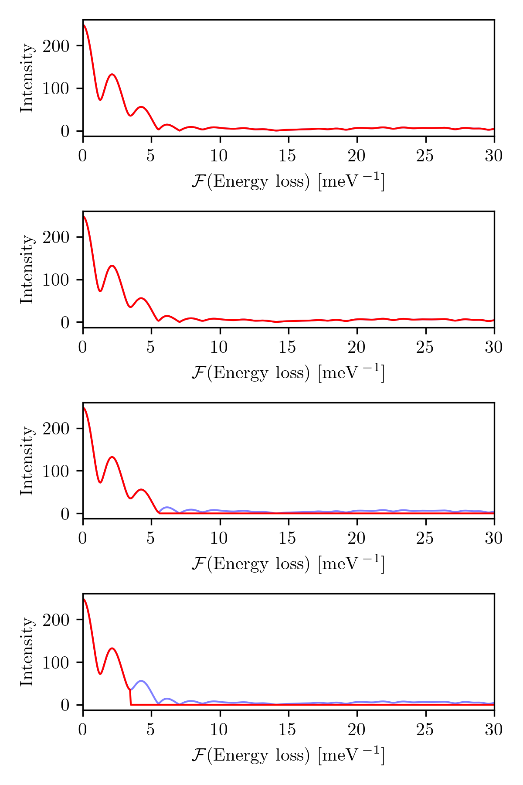
Cleaning the Experimental Data
FT

Slide 17

Cleaning the Experimental Data
FT

Slide 18
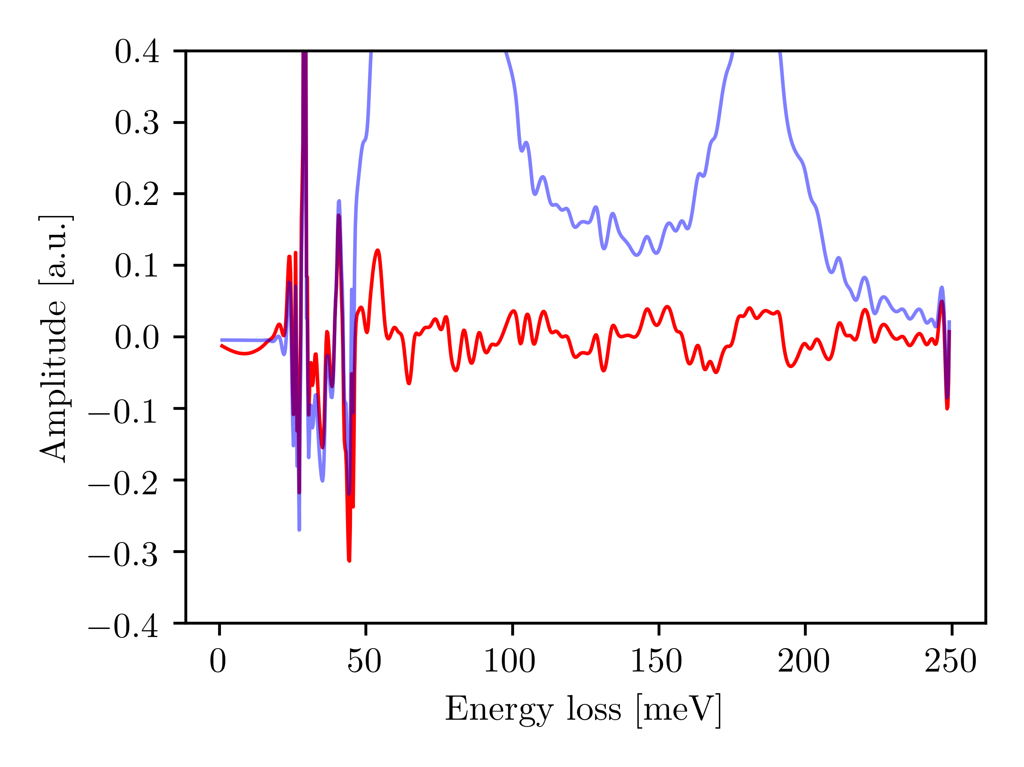
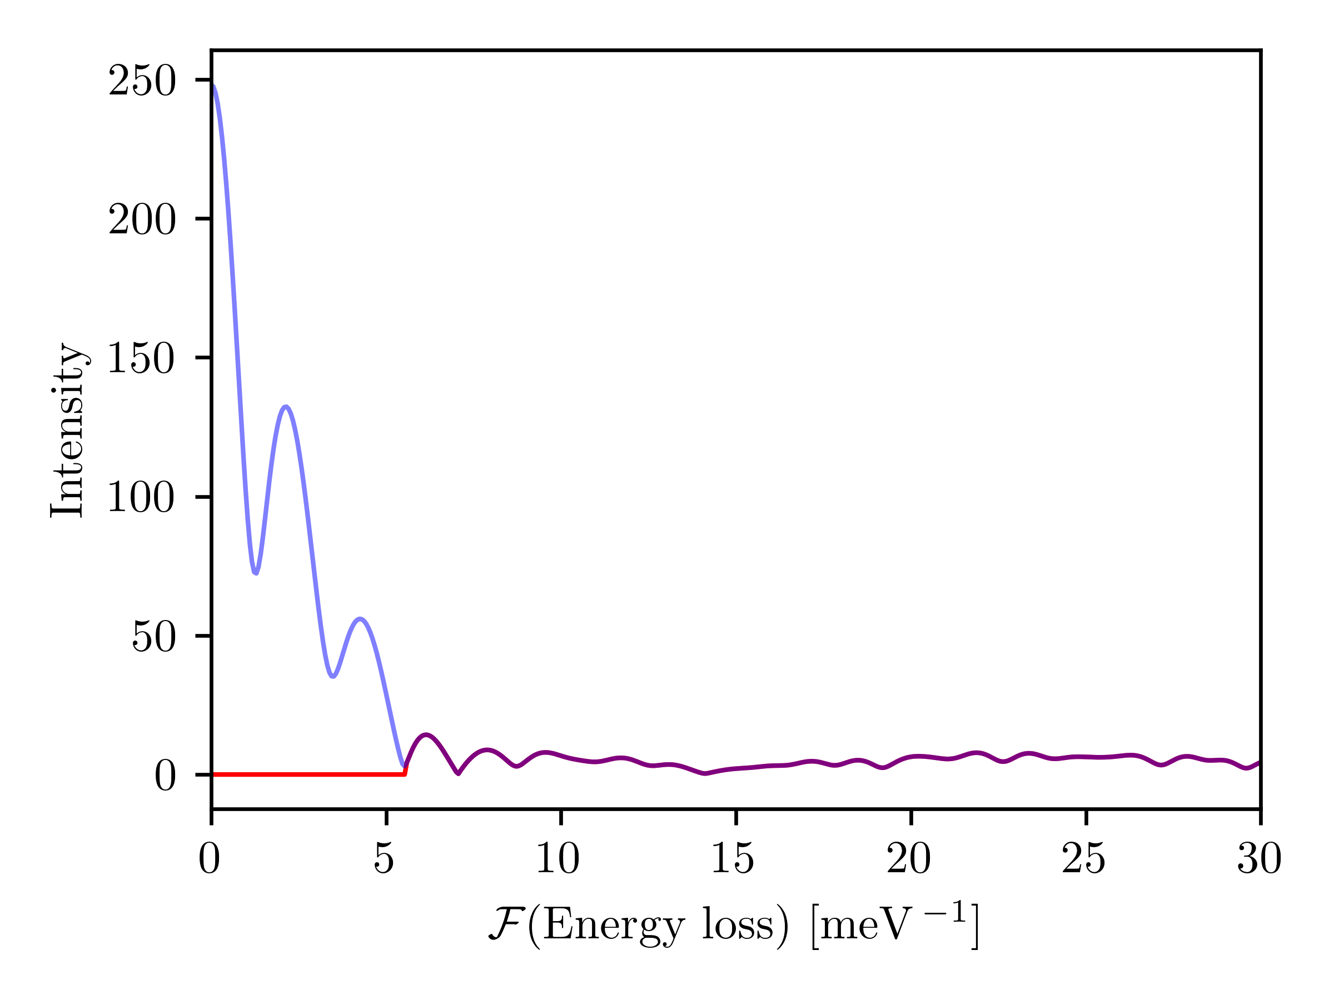
Cleaning the Experimental Data
Looking at the noise:
IFT

Slide 19
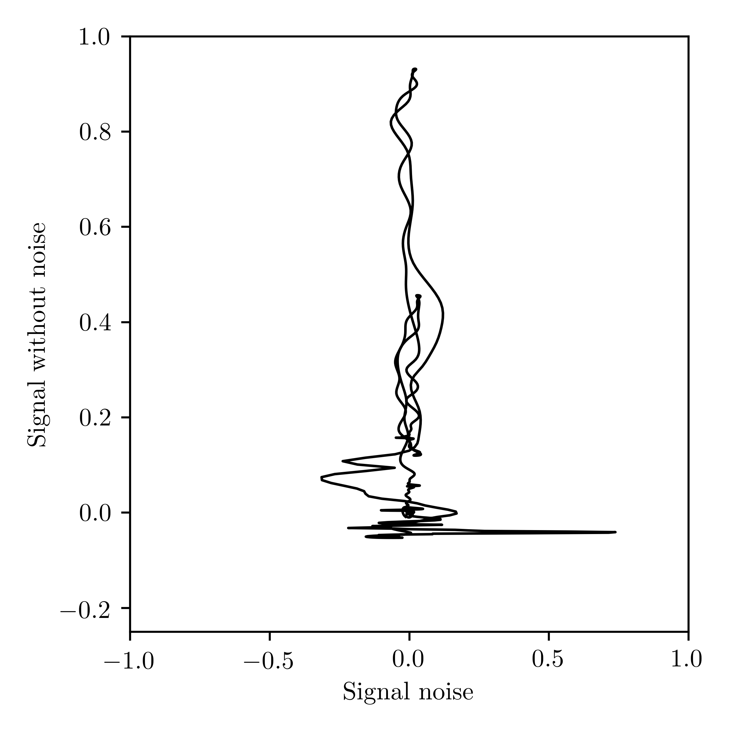
Cleaning the Experimental Data
It is noise…

Slide 20
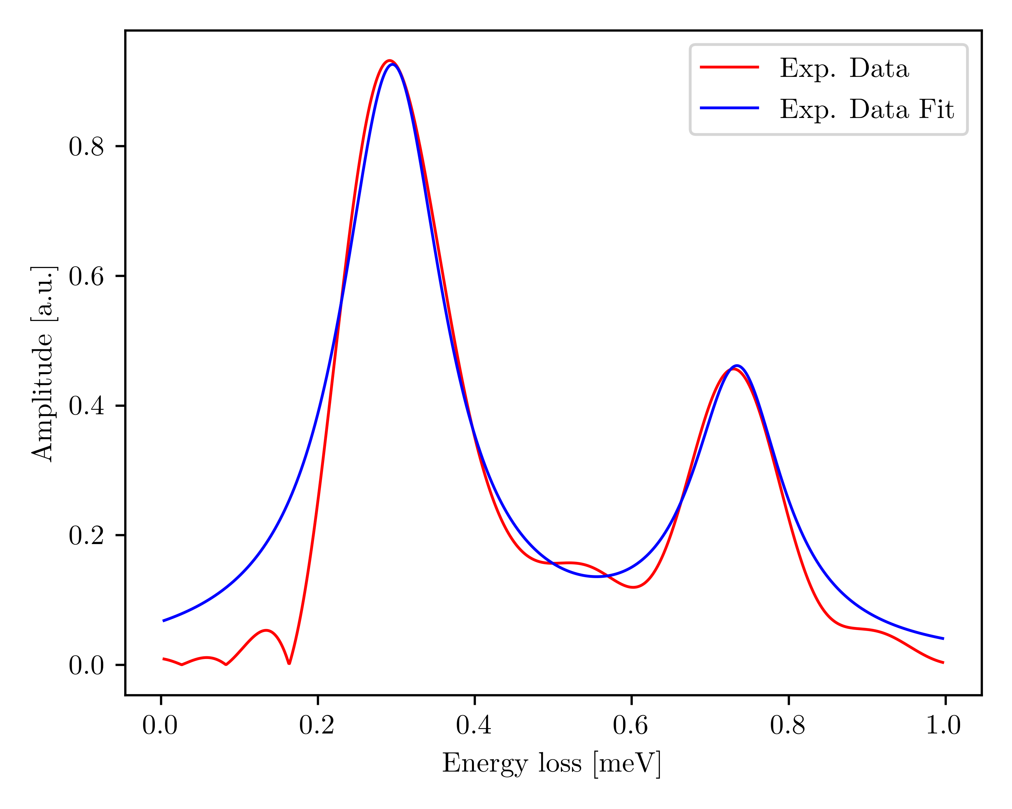
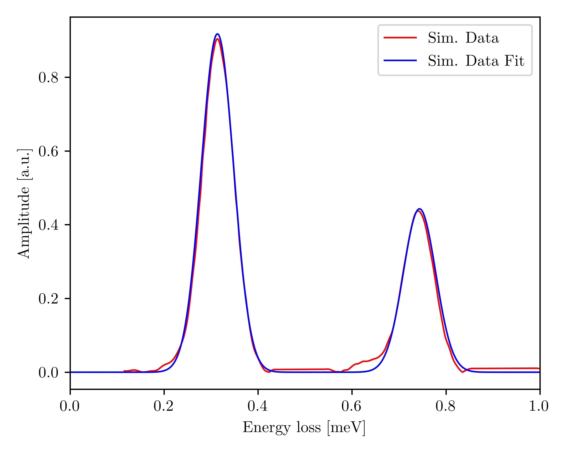
Data Fits
Experimental
Simulated
Lorentzian
Gaussian

Slide 21
Data Fits
Experimental
Simulated
Why the different fit?
Different couplings lead to different line widths.
Lorentzian
Gaussian

Slide 22
Smearing the Data…

Slide 23
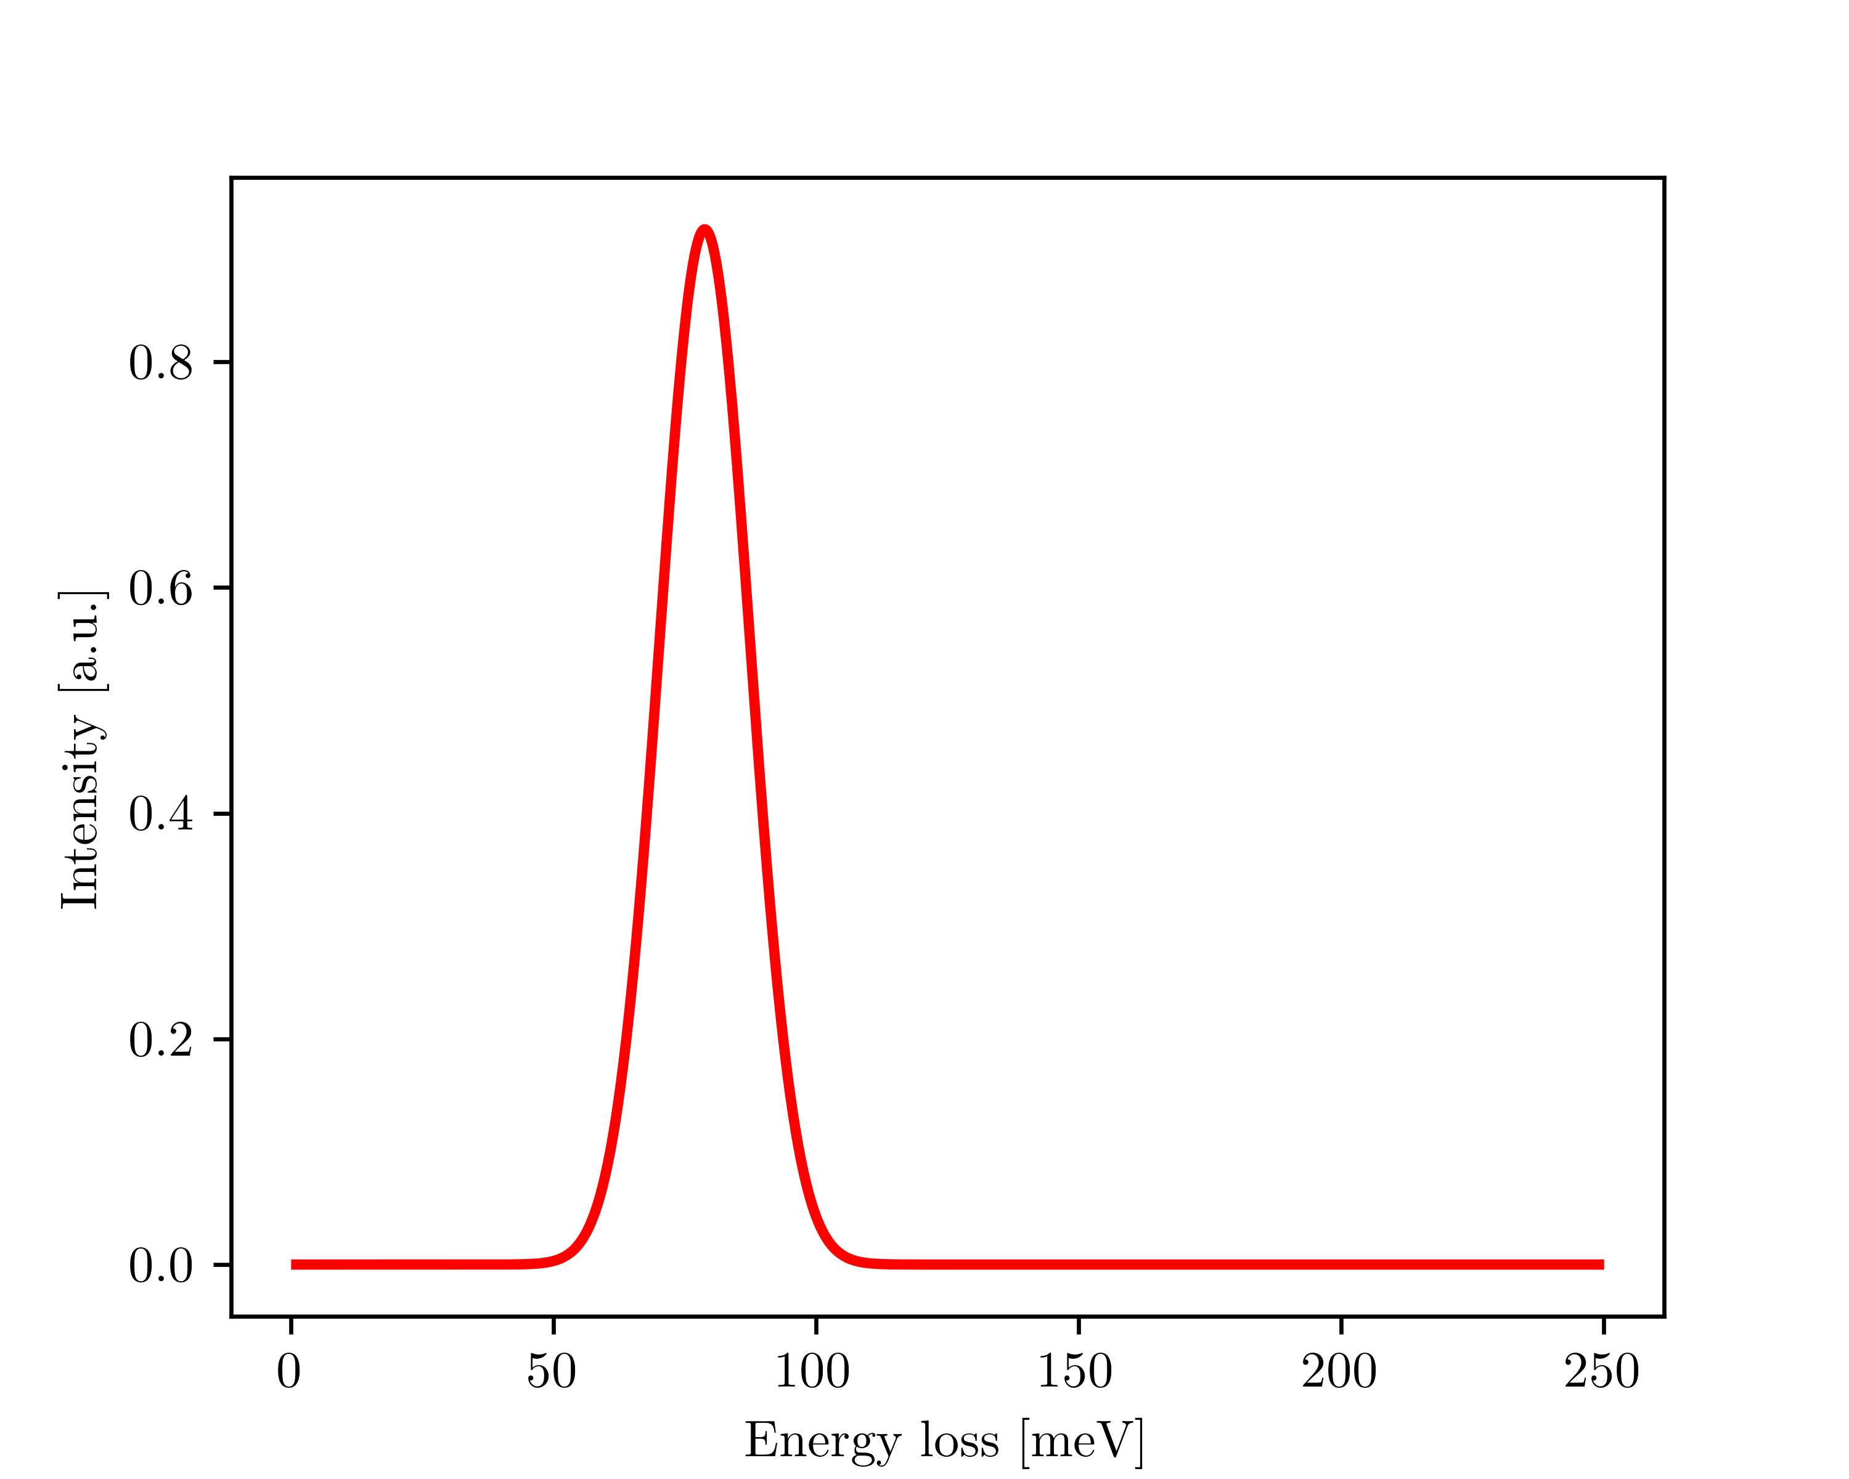
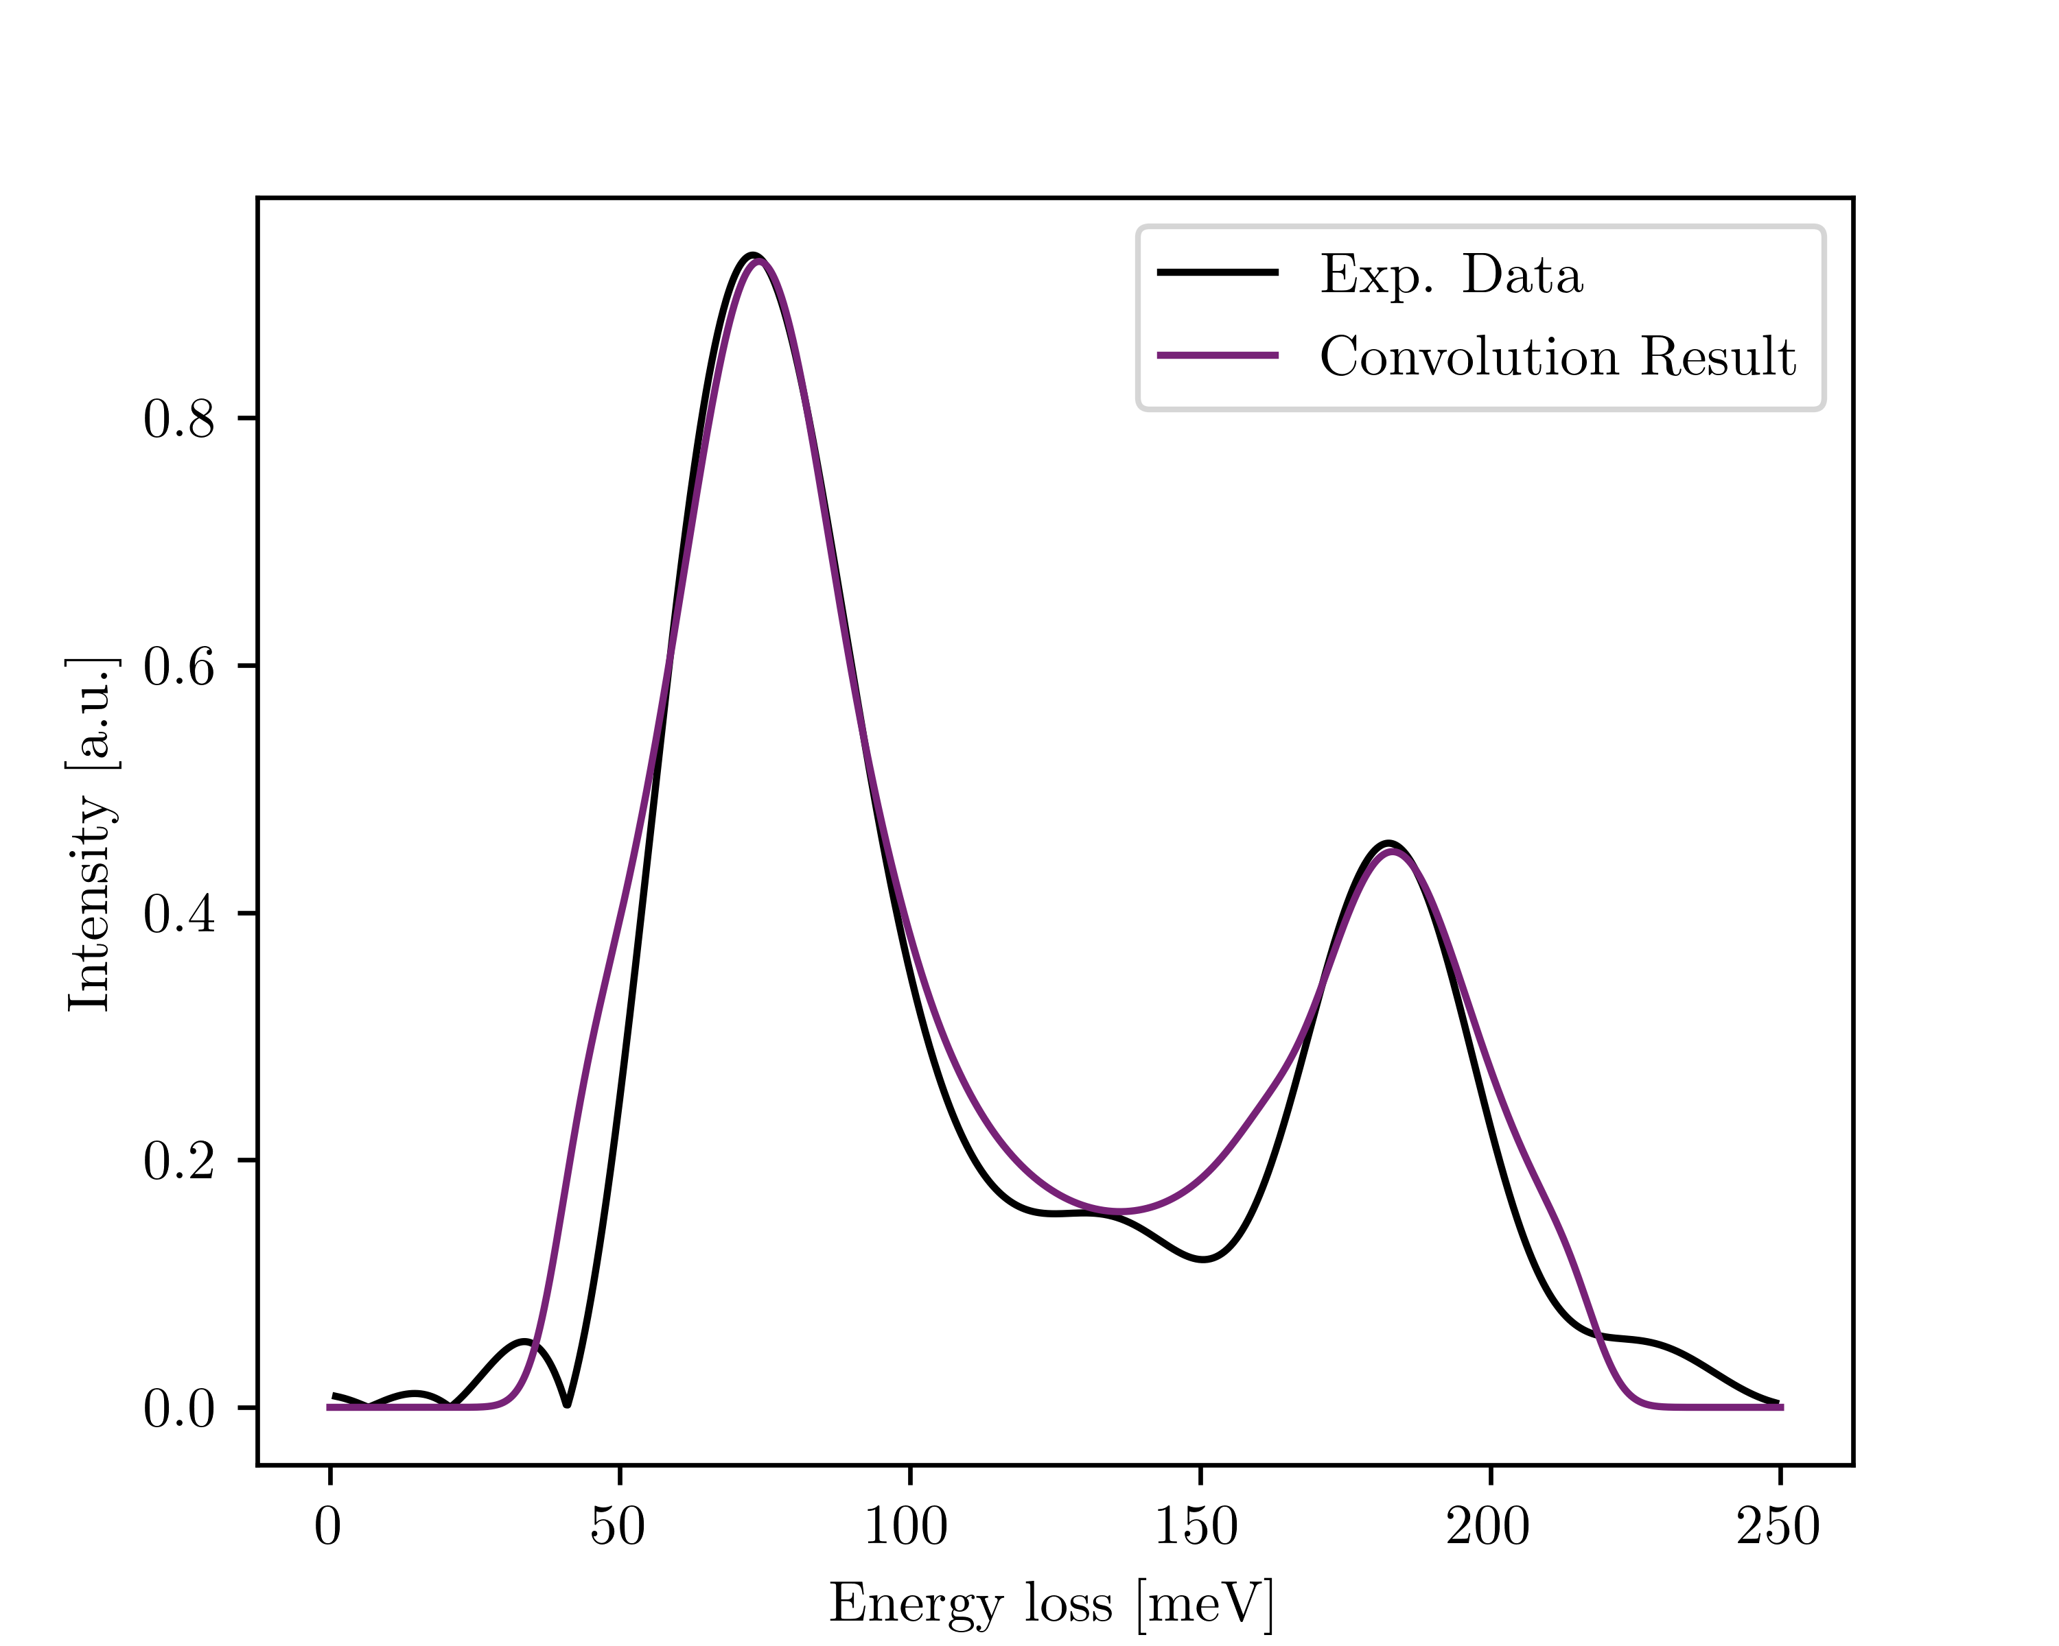
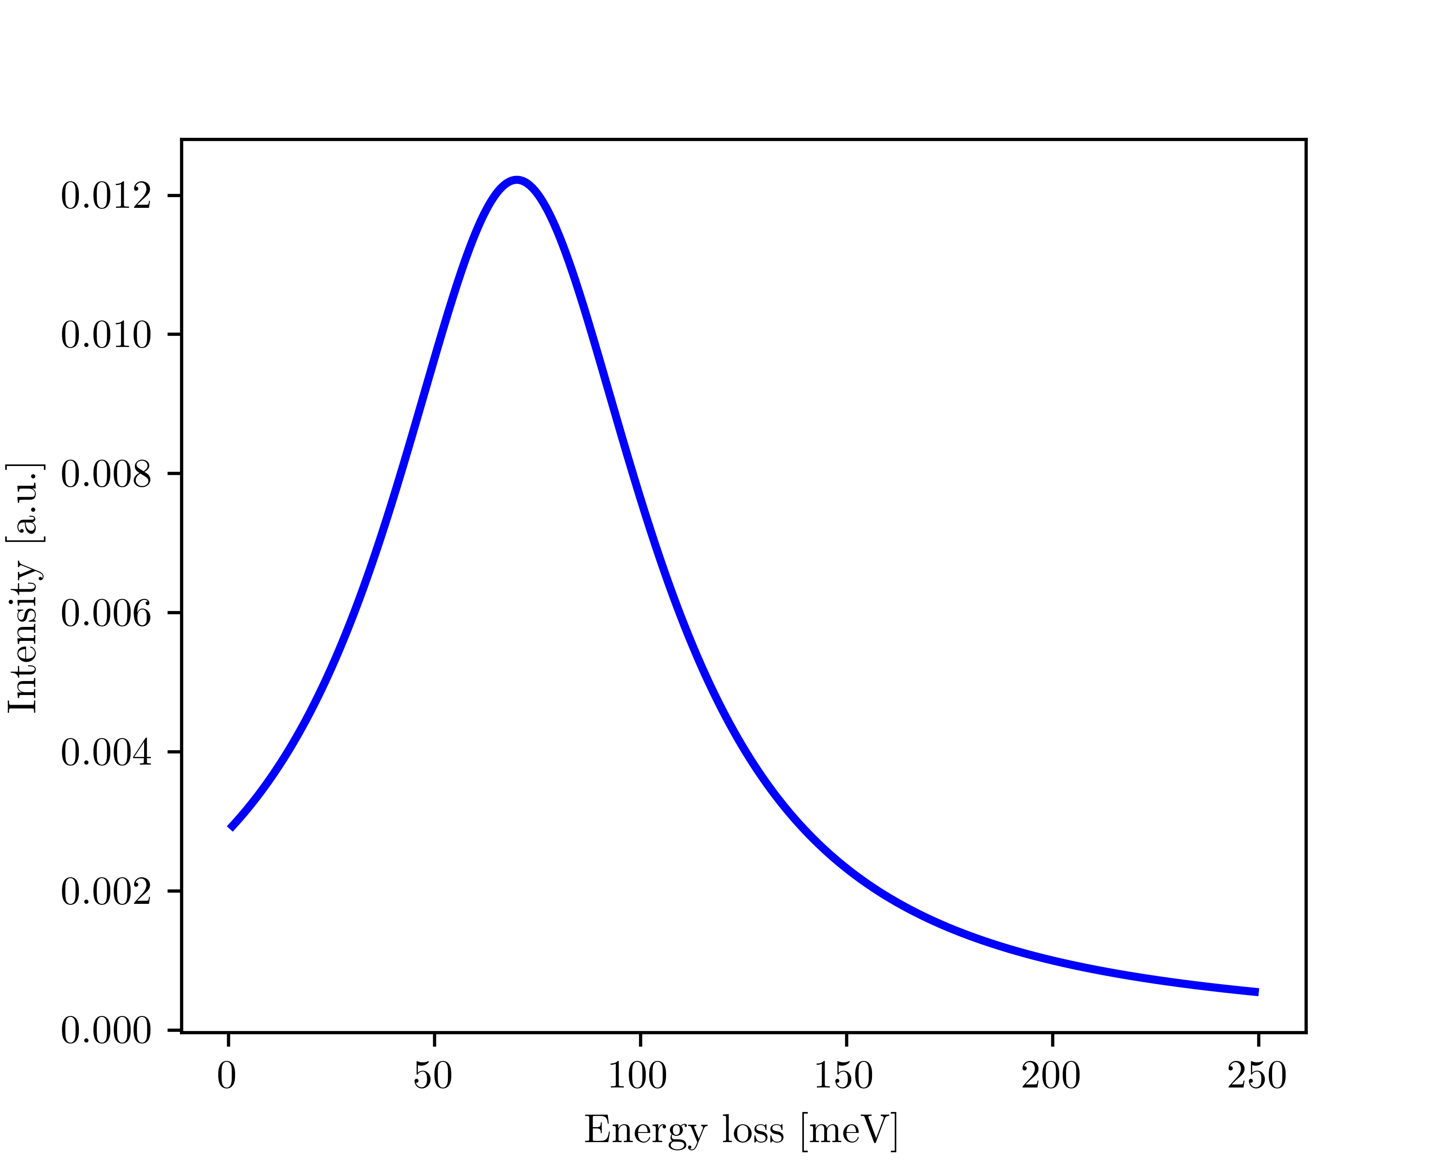
Convolution
We start by convoluting the first peak with a Lorentzian. Why?
To broaden the peak. Produce a better fit to experimental data.
*
9 x Larger

Slide 24
Overview
We started by validating the Fourier analysis method with controllable examples;
A frequency filter was applied to the experimental data, removing the noise and smoothing the results;
Experimental and simulated data were fitted with different distributions indicating different line width regimes;
The simulated data was broadened by means of a convolution with a Lorentzian presenting good agreement with experimental data.

Slide 25
Backup Slides…

Slide 26
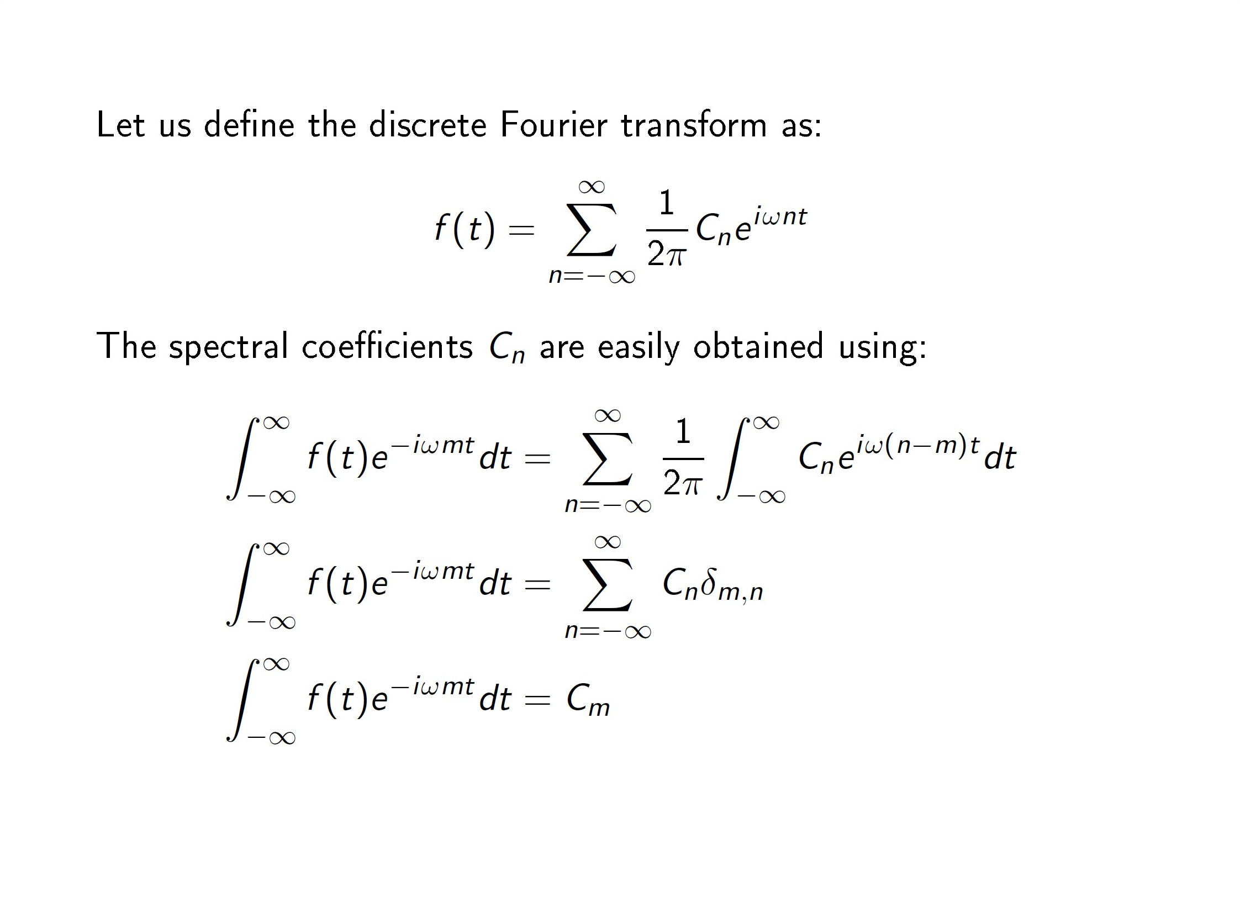

Slide 27
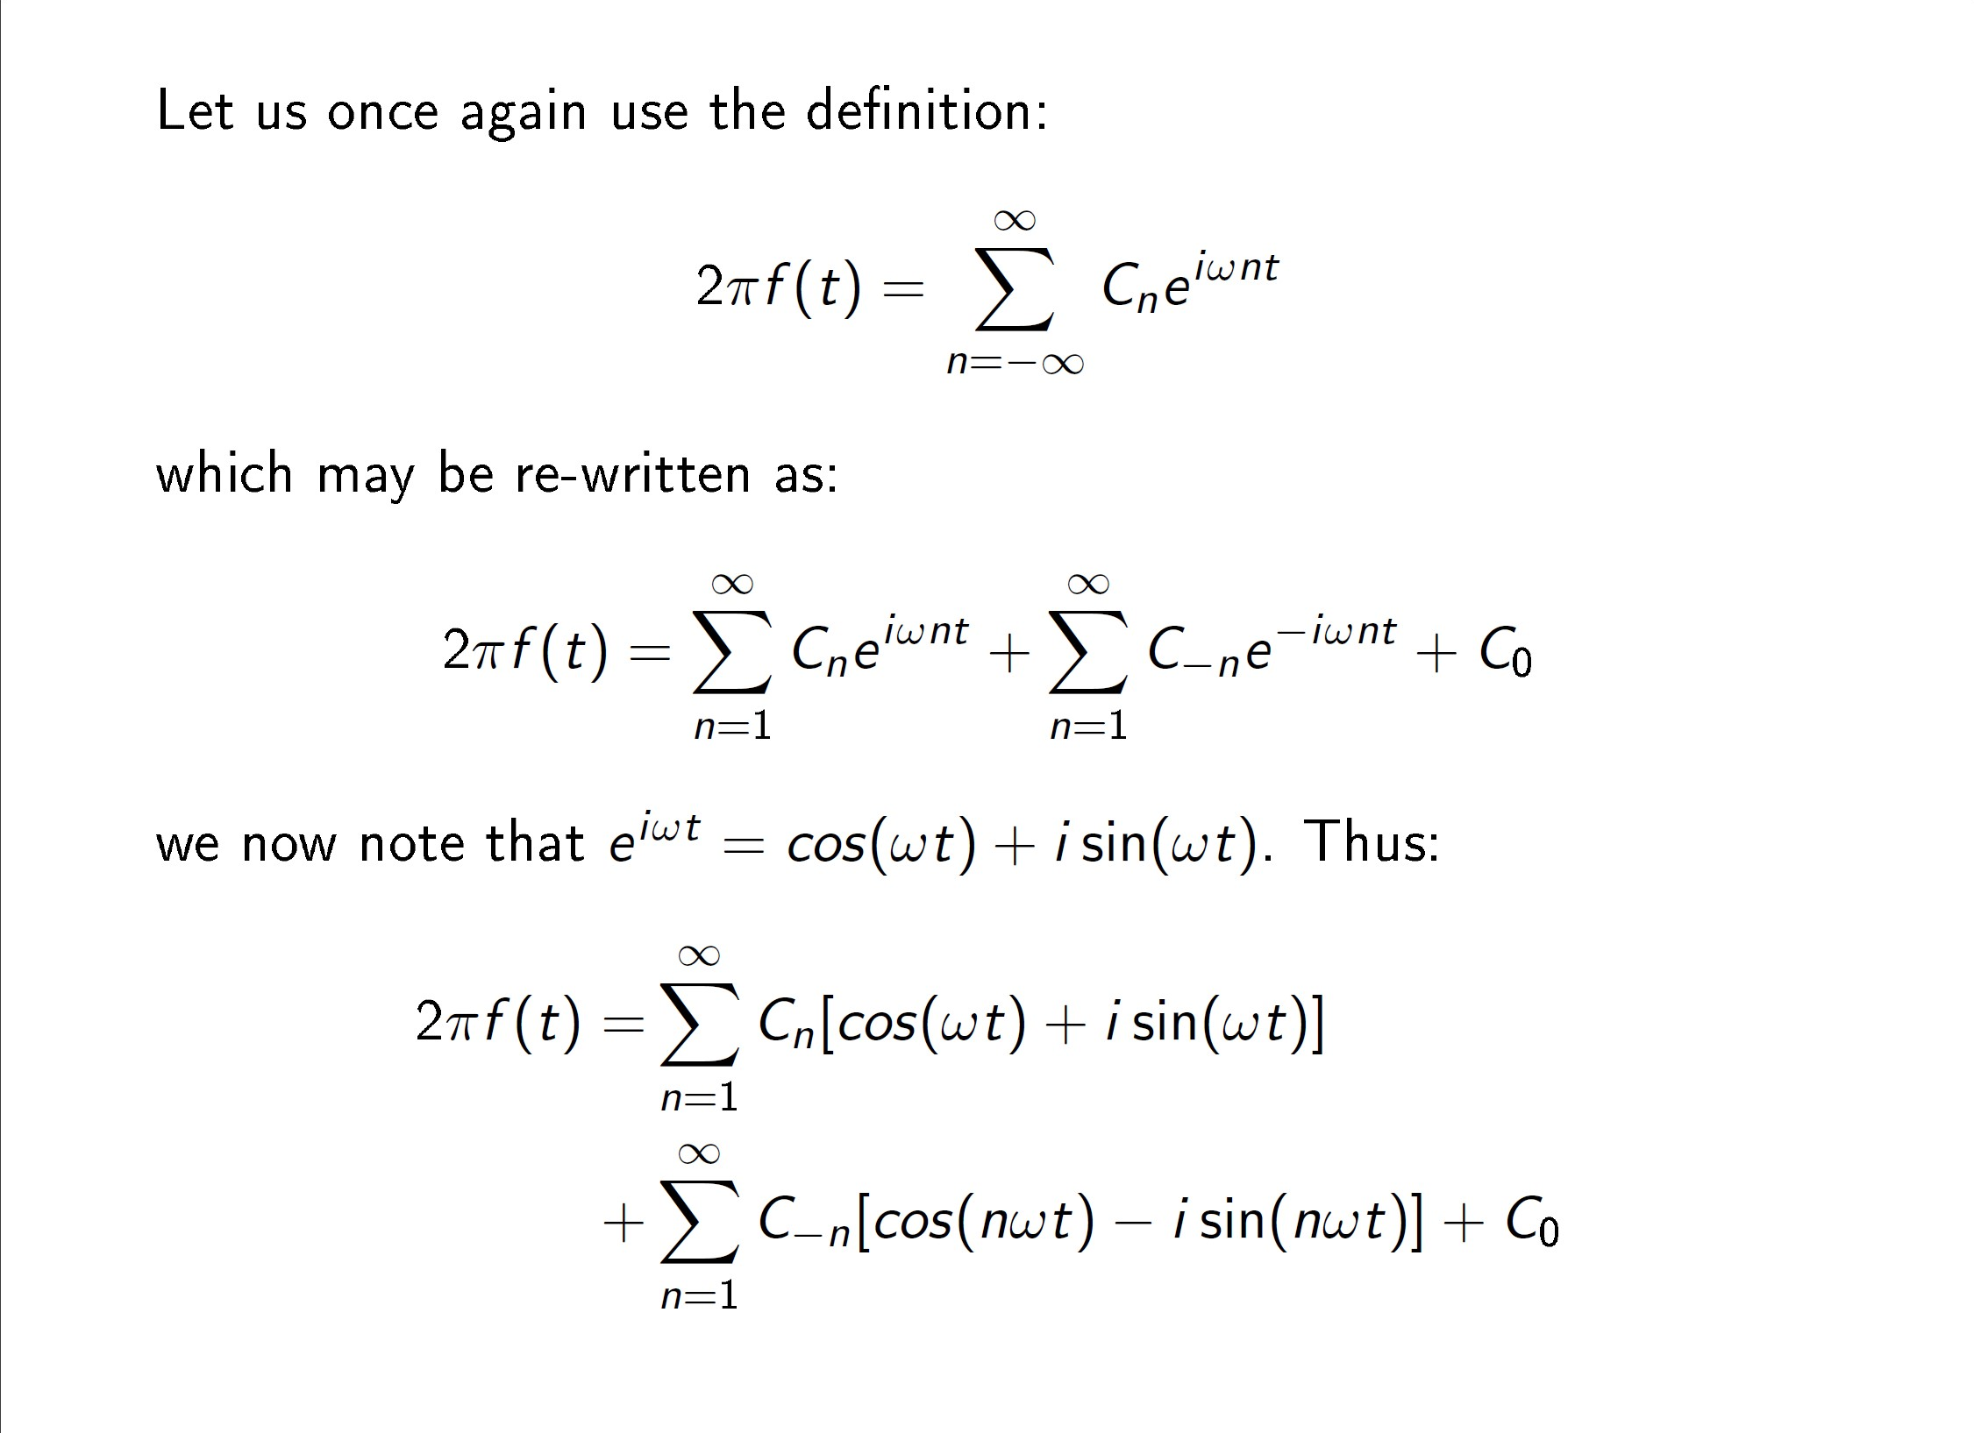

Slide 28
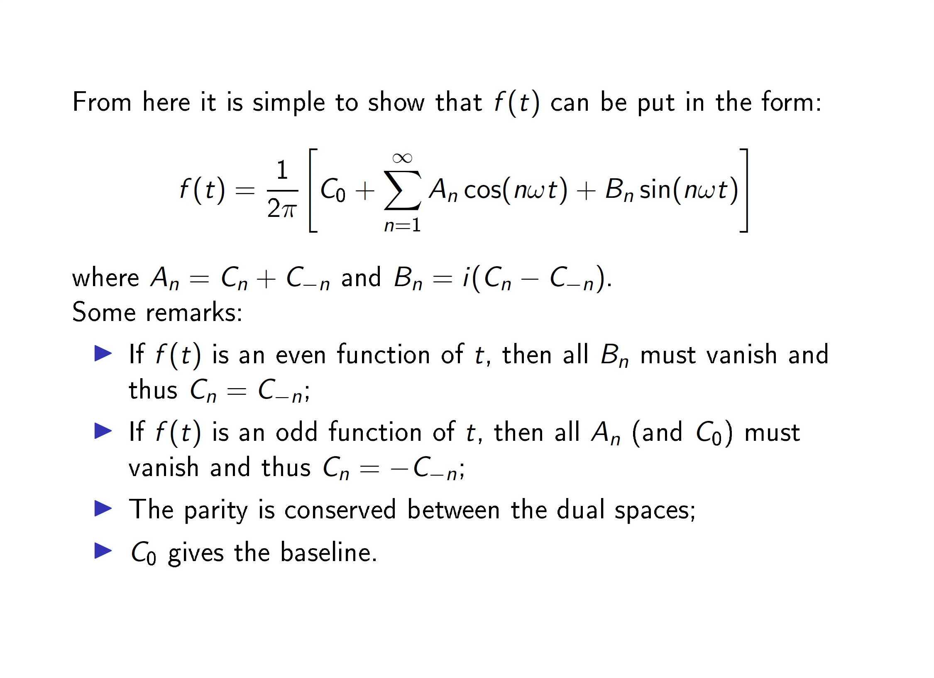

Slide 29
