Slide 1
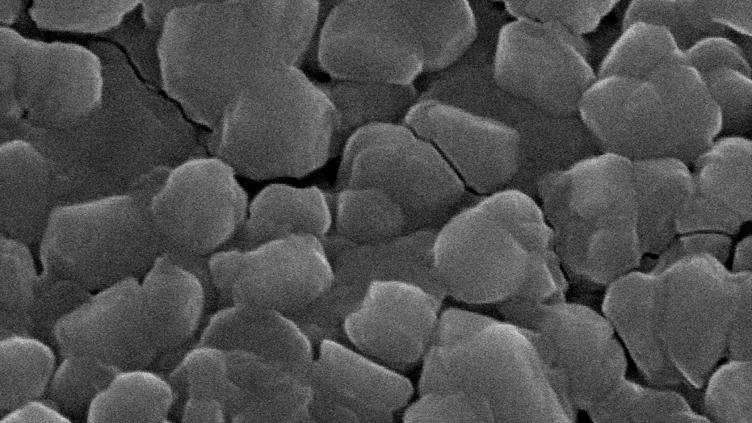
Dielectric Measurements on Thin Film (LiNbO3; SiPt)
Physics Advanced Labs by Professor António Onofre
Britta Dorn
Marco Brito
Rafael Cerqueira

Slide 2
Outline
Introduction- Know how to produce and study thin films
Mathematical details- What we need to know for dielectric data analysis
Data analysis- Learn to fit in Origin in physical analysis context
Discussion and conclusion

Slide 3
Introduction

Slide 4
Thin Films
In the past, present and in future we have used and will use thin films in our daily life from low to high tech devices.
What is a thin film? It is a set of atomic layers (in the order of nanometers) that are deposited on a substrate. Due to tensile or epitaxial strains we can change the different physical properties of the materials.
The positive aspect of this is, we can have the following:
  Small Size;
  Economic value;
  Functionality;

Slide 5
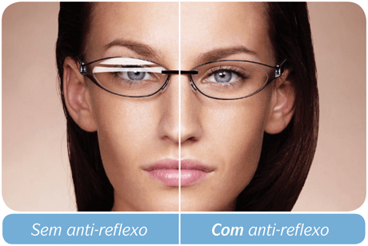
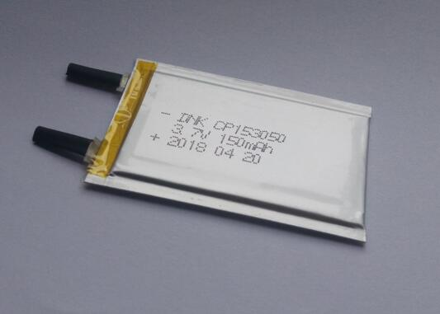
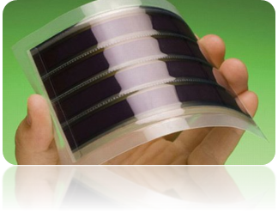
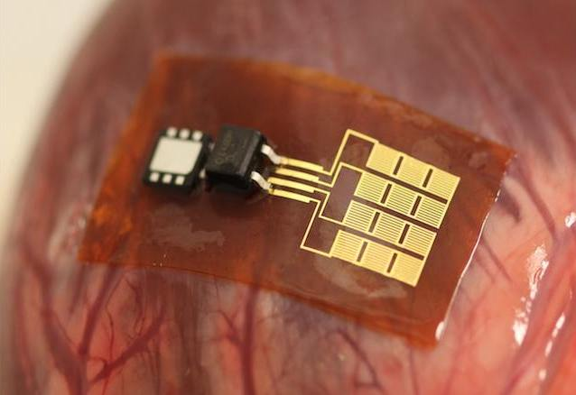
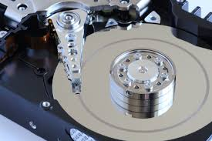
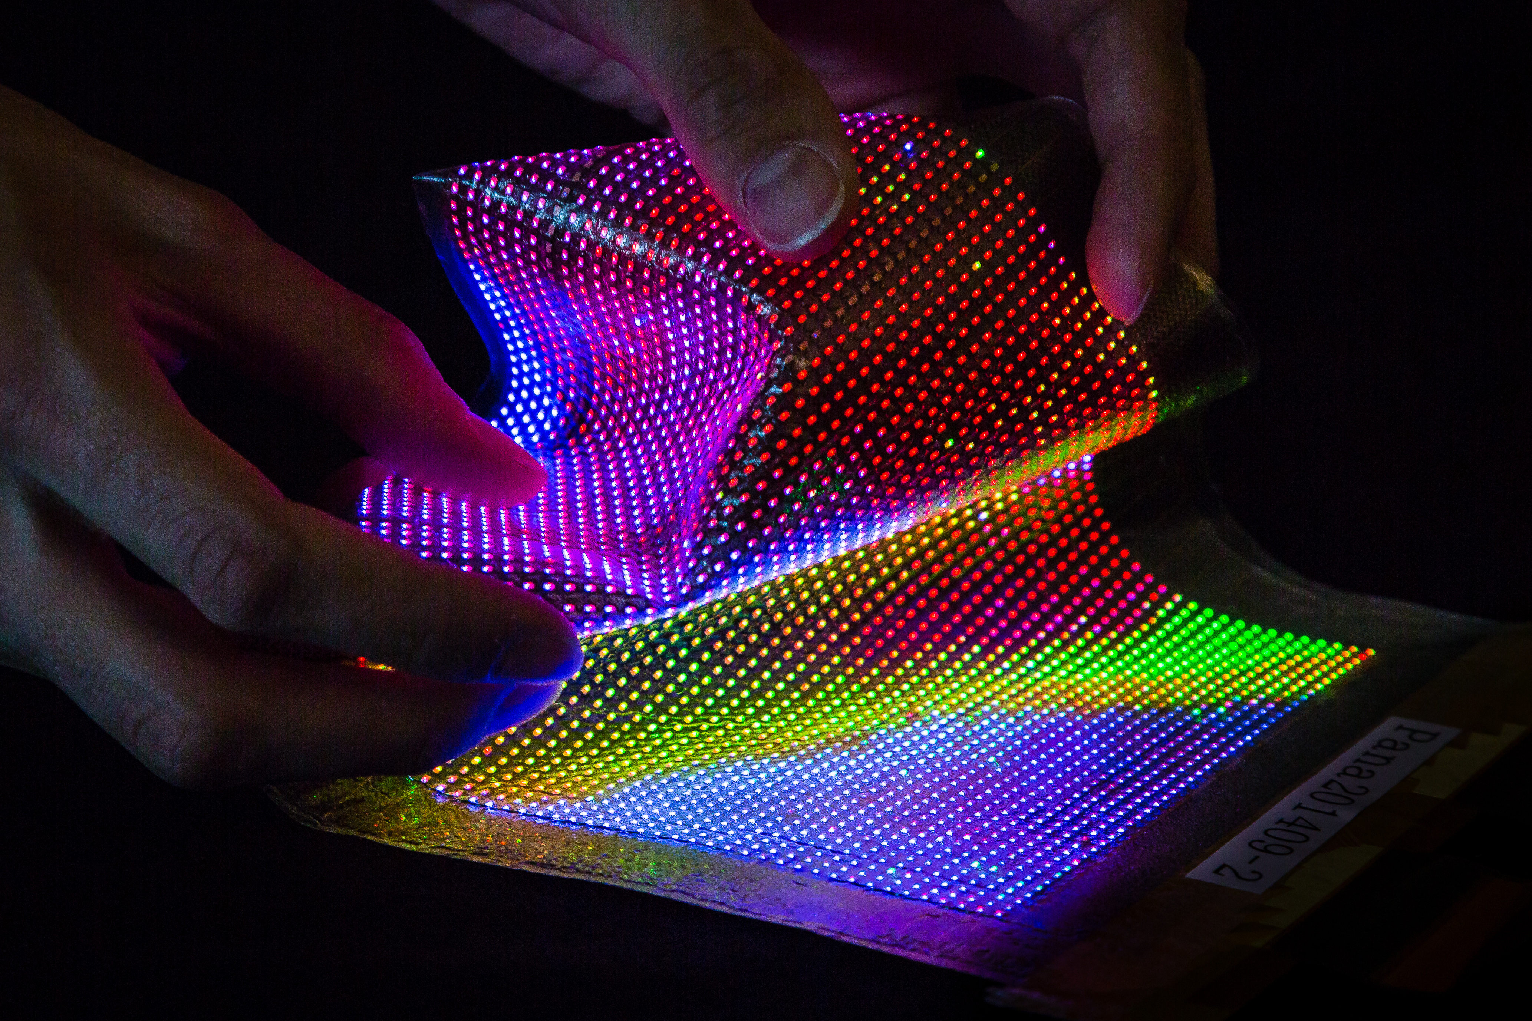
Utilities and applications
Glasses
Solar cells;
Batteries
Medical Devices
Hard disk
Screens

Slide 6
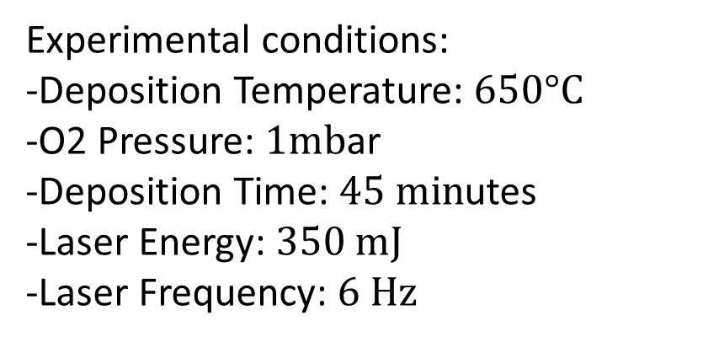
PLD- How to produce?
Experimental conditions:
-Deposition Temperature: $650°C$
-O2 Pressure: $1mb$ar
-Deposition Time: $45 min$utes
-Laser Energy: $350 mJ$
-Laser Frequency: $6 Hz$

Slide 7
LiNbO3
Professor Bernardo and his PhD students Bruna and João wanted to make thin films and study their physical properties.
They chose LiNbO3 as a film and PtSi(001) as substrate due to the wide range of physical properties exhibited by LiNbO3.

Slide 8
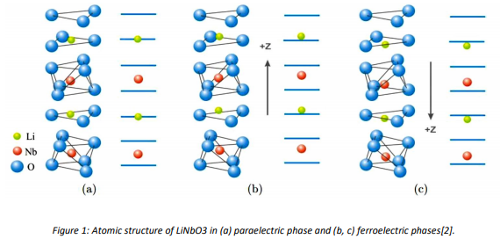
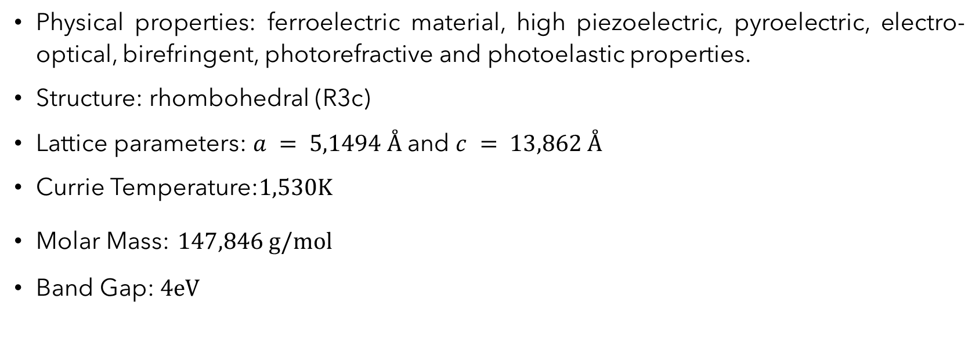
LiNbO3 ID Card
Physical properties: ferroelectric material, high piezoelectric, pyroelectric, electro-optical, birefringent, photorefractive and photoelastic properties.
Structure: rhombohedral (R3c)
Lattice parameters: $a = 5,1494 Å$and $c = 13,862 Å$
Currie Temperature:$1,530K$
Molar Mass: $147,846 g/mol$
Band Gap: $4eV$

Slide 9

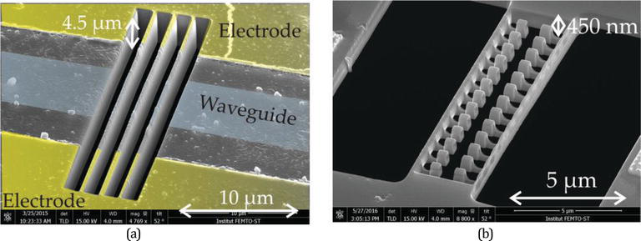
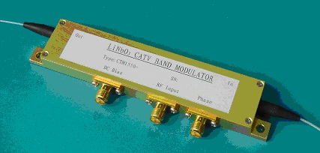
LiNbO3- Utilities and applications
Piezoeletric Devices
Waveguides
Optical Modulators

Slide 10
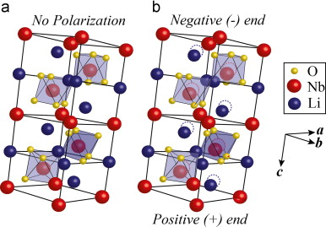
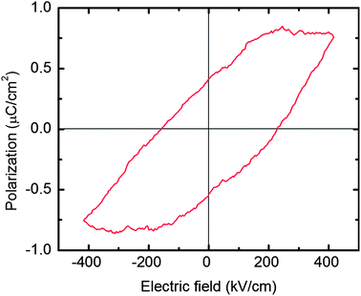
Ferroelectric Effect
Relaxion Time

Slide 11
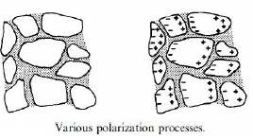
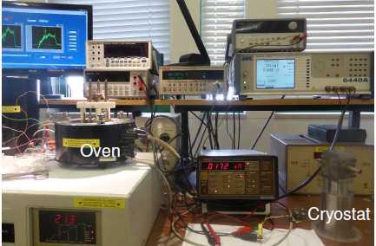

How to measure dielectric data?
To know better the electric properties we need to measure the dielectric data with an impedance analyser.
Impedance analyzer:
Waine Kerr 6440 A;
frequency range:10Hz - 3MHz;
Temperature controller and furnace:
Polymer Labs PL706 PID;
temperatures of $15−200°C$ ($50°C$ in our case);
2ºC/min temperature measurement;
Software:
Labview;

Slide 13
Mathematical details

Slide 14

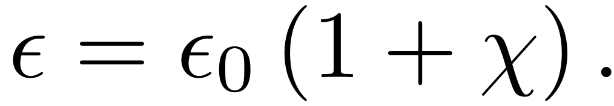
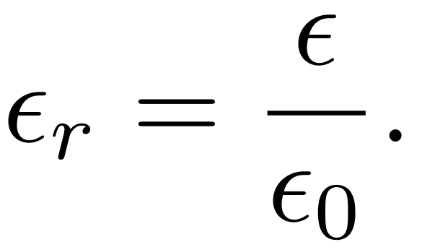
Dielectric function
The susceptibility of a material is a measure of the electrical polarizability of the said material. For example in linear dielectrics, the polarization is given by: .
The electric displacement field which describes the field produced by free charges is given by:
The permittivity of a material is then:
The dielectric function is defined as

Slide 15
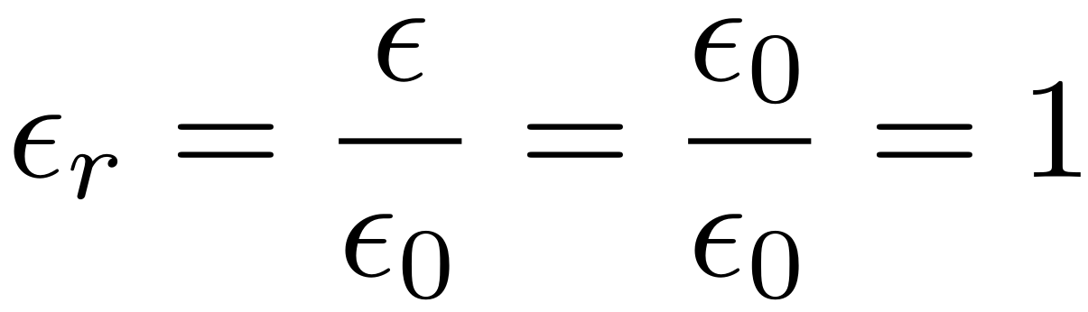
Dielectric function
For example in the vacuum the dielectric function is while for other materials is >1.
For nonlinear materials and anisotropic materials the dielectric function might be a highly nonlinear equation and dependent on the frequency of the electric field and might not be a scalar but a tensor.
There are several models for the dielectric functions of a material.

Slide 16
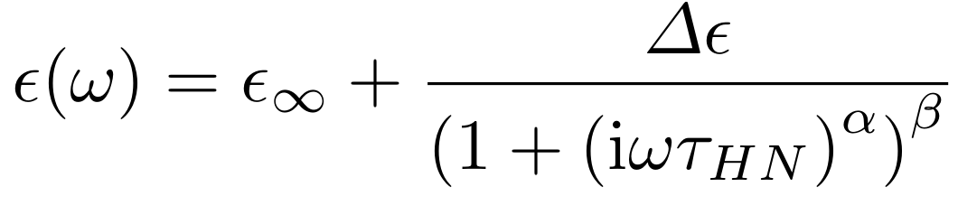
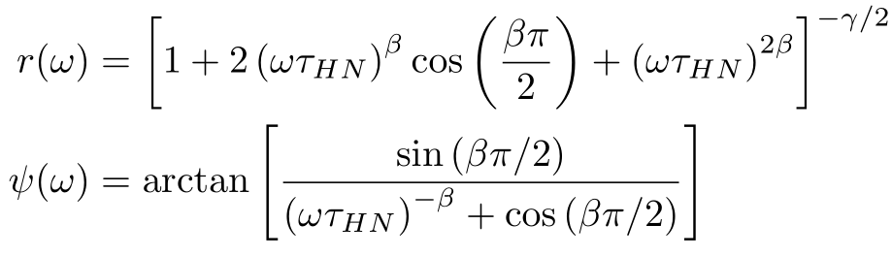
Havriliak-Negami model
In this model the dielectric function is given by
It can be divided in its real and imaginary parts given by
where

Slide 17
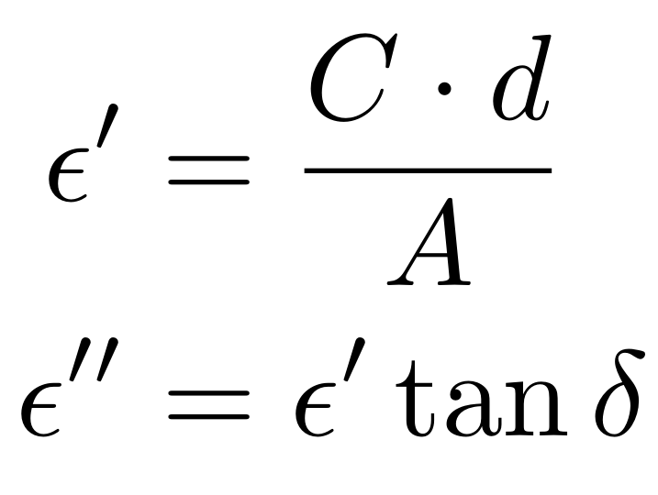
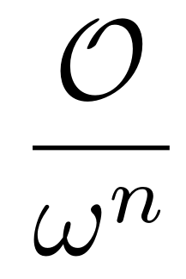
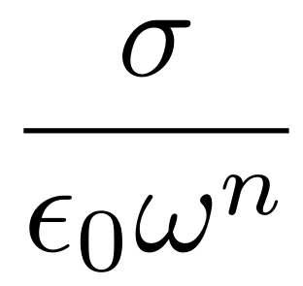
Havriliak-Negami model
Moreover it is known that the dielectric function is dependent of some experimental parameters
The model can also be modified by two extra terms to correct the behavior of the function at low frequencies.
For the real part we have the Maxwell-Wagner term and for the imaginary part we have a term depending on the conductivity

Slide 18
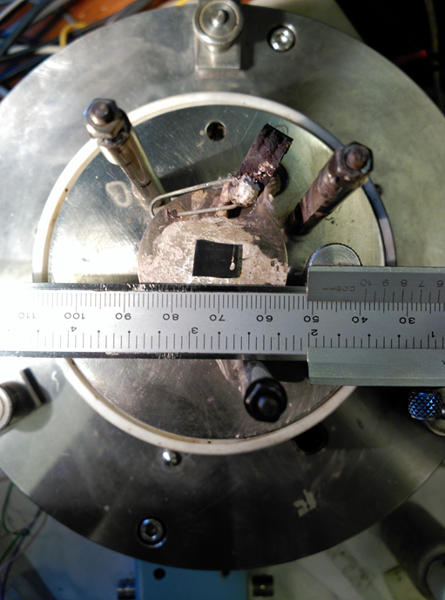
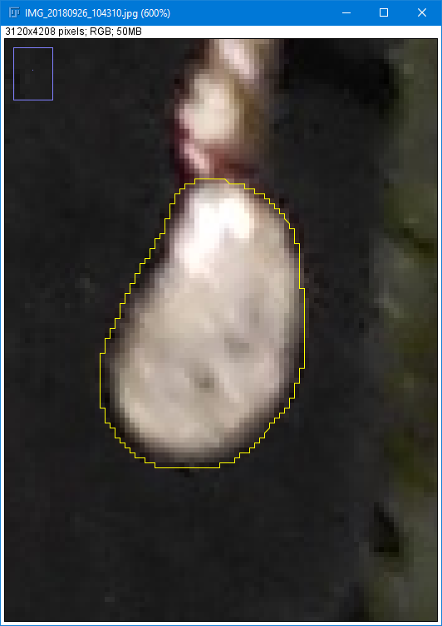
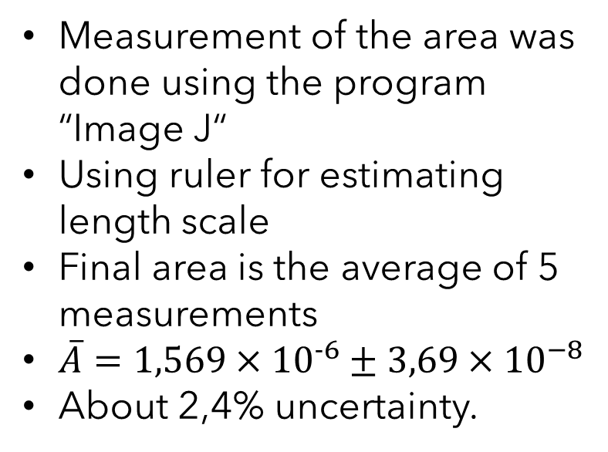
Area measurement
Measurement of the area was done using the program “Image J“
Using ruler for estimating length scale
Final area is the average of 5 measurements
$\overline{A}=1,569×{10}^{−6}±3,69×{10}^{−8}$
About 2,4% uncertainty.

Slide 19
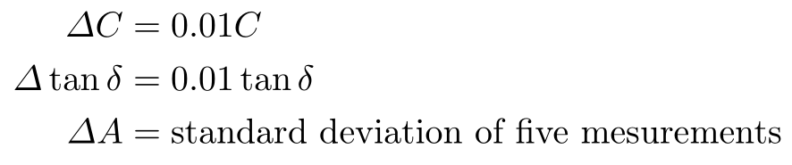
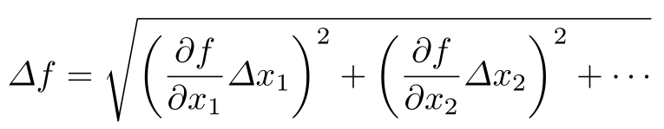
Uncertainties
As for the uncertainties in the dielectric function values they are calculated using the standard error propagation formula for a standard function f:

Slide 20
Data Treatment and analysis

Slide 21
Fitting
Our objective is to fit the experimental values of the dielectric function to the Havriliak-Negami model and if necessary, add extra corrective terms.

Slide 22
Fits without uncertainties

Slide 23
Imaginary and real part individual fit

Slide 24
Global fit – No corrections

Slide 25
Global fits with real and imaginary corrections

Slide 26
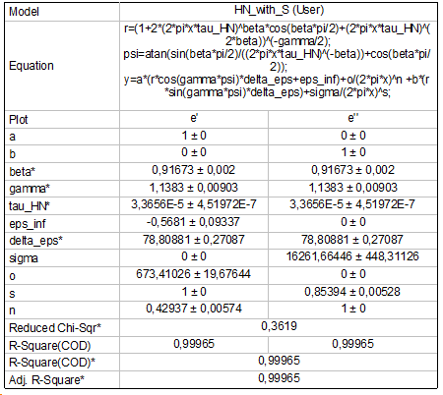
Global fit with corrections with exponents

Slide 28
Fits with uncertainties

Slide 29
Imaginary and real part individual fit

Slide 30
Global fit – No corrections

Slide 31
Global fits with real and imaginary corrections

Slide 32
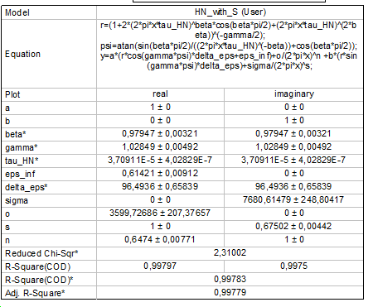
Global fit with corrections with exponents

Slide 34
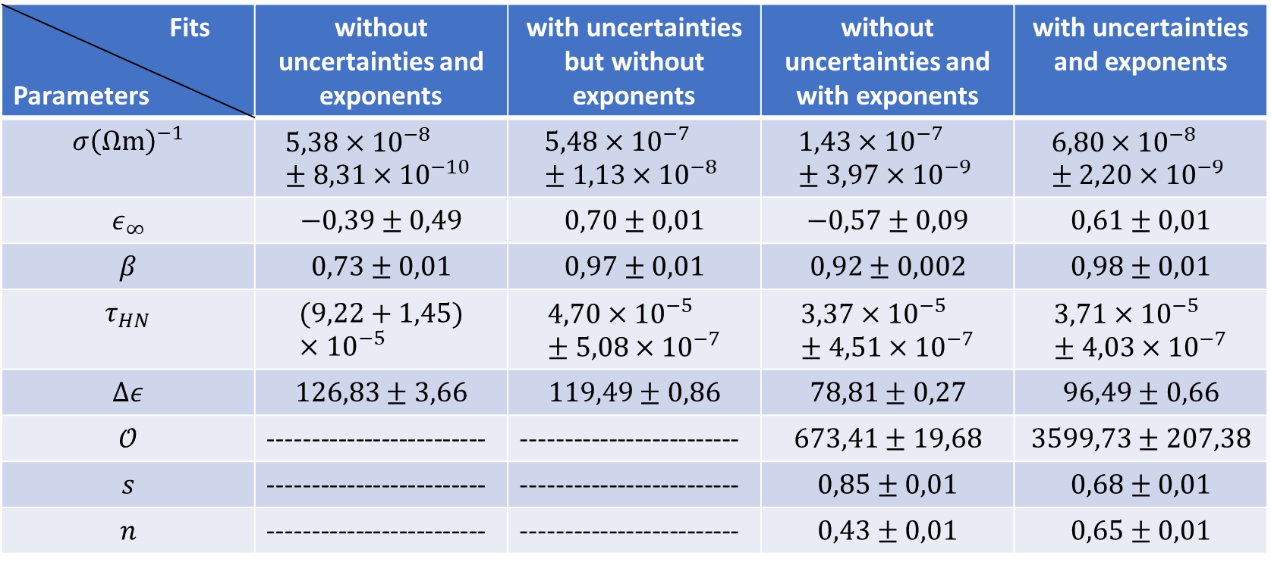
Parameter comparison
Fits Parameters | without uncertainties and exponents | with uncertainties but without exponents | without uncertainties and with exponents | with uncertainties and exponents
$$σ{\left(Ωm\right)}^{−1}$$ | $$5,38×{10}^{−8}±8,31×{10}^{−10}$$ | $$5,48×{10}^{−7}±1,13×{10}^{−8}$$ | $$1,43×{10}^{−7}±3,97×{10}^{−9}$$ | $$6,80×{10}^{−8}±2,20×{10}^{−9}$$
$$ε_{∞}$$ | $$−0,39±0,49$$ | $$0,70±0,01$$ | $$−0,57±0,09$$ | $$0,61±0,01$$
$$β$$ | $$0,73±0,01$$ | $$0,97±0,01$$ | $$0,92±0,002$$ | $$0,98±0,01$$
$$τ_{HN}$$ | $$(9,22+1,45)×{10}^{−5}$$ | $$4,70×{10}^{−5}±5,08×{10}^{−7}$$ | $$3,37×{10}^{−5}±4,51×{10}^{−7}$$ | $$3,71×{10}^{−5}±4,03×{10}^{−7}$$
$$Δε$$ | $$126,83±3,66$$ | $$119,49±0,86$$ | $$78,81±0,27$$ | $$96,49±0,66$$
$$𝒪$$ | ------------------------- | ------------------------- | $$673,41±19,68$$ | $$3599,73±207,38$$
$$s$$ | ------------------------- | ------------------------- | $$0,85±0,01$$ | $$0,68±0,01$$
$$n$$ | ------------------------- | ------------------------- | $$0,43±0,01$$ | $$0,65±0,01$$

Slide 35
Conclusions

Slide 36
Comparison of the fits
Adding the Maxwell-Wagner and conductivity terms improved the fit to the data in the lower frequencies range.
Comparing with the independent fit, the global fit has a better fit as indicated by the chi-squared.
The global fit real part vs. frequency approaches the experimental data without uncertainties better than the data with uncertainty.

Slide 37
Comparison of the fits
The global fit without uncertainties has a smaller chi-squared than with uncertainties, because in the latter the real part fit begins to diverge at lower frequencies.
It’s might be due to the different weights of the different points that make the fit converge to another solution.

Slide 38
Possible Improvements
Improvements in area measurements (higher resolution pictures for example)
C and tan δ error only estimated
→Check manufacturer information of measuring devices
Deviation of fit and data in the real part (low frequency range)
→ Add different terms to the equation? Would another model be more accurate for our sample?

