Slide 1
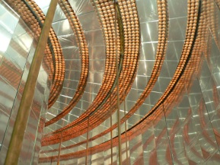

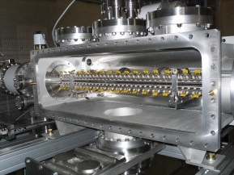
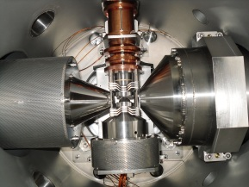
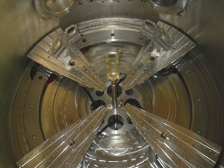
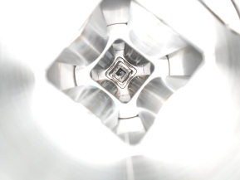
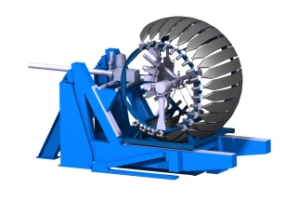



Design of the preamp board for the silicon detectors
Thursday 19 th March 2020
Laurent Leterrier, Xavier Fléchard

Slide 2

Main specifications for preamplifier
Si detector main characteristics:
6 channels (5 strips + main signal on n side)
Detector capacitor ≈ 120 pF for each strip
Leakage current ≤ 10 nA/strip (assumed, but no value yet)
Rise time ≈ 10 - 20 ns (not crucial)
Charge Sensitive Amplifier main requirements:
Resolution in energy < 5 keV FWHM
Energy max ~ 6-7 MeV_{Si}
Counting rate max ≤ 100 events/s
Integral Non Linearity < 0.1 %
Preamp boards requirements:
Total of 48 channels → Low power consumption & compact boards
Cooled environment → Low temperature compatibility
[WISArD, Visio conf meeting, Thursday 19 th March]

Slide 3
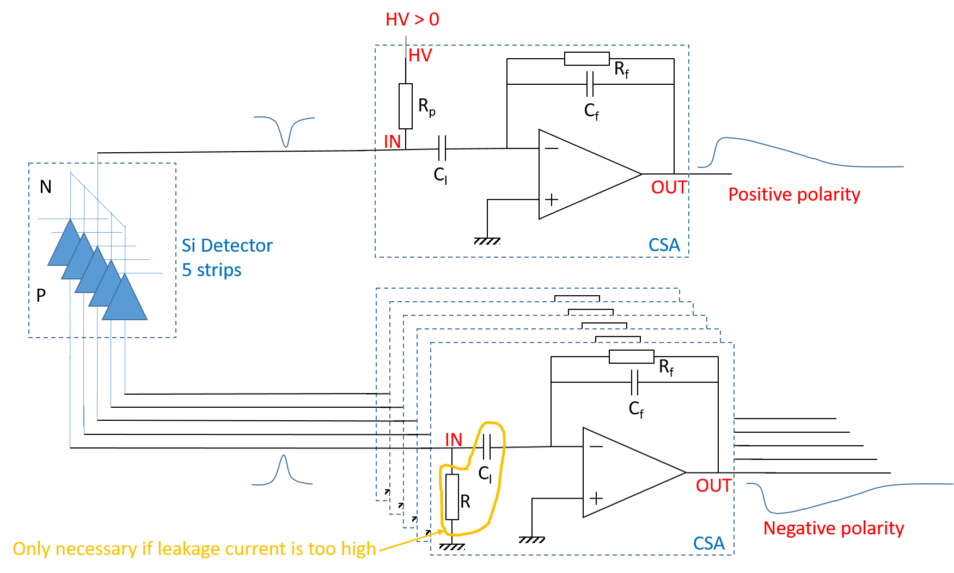
Overview for one detector
[WISArD, Visio conf meeting, Thursday 19 th March]

Slide 4
Choice of CSA : the state of the art
Main features of A250F (AMPTEK) :
Positive and negative signal processing
Noise : 5 keV_{Si} FHWM @ Cd = 130 pF and 25 °C
Integral Nonlinearity < 0.03 % cost ≈ 600 $ per unit
Power : 32 mW typical
Operating temperature min : -55 °C
Very small size
C_{f} = 0.25 pF
R_{f} = 1 GΩ
[WISArD, Visio conf meeting, Thursday 19 th March]

Slide 5
Noise Equivalent Charge with A250F
Estimation of NEC for 130 pF (Cd = 120 pF + Ccoax = 10 pF):
@ 25 °C
@ -50 °C
According to these graph of NEC, we can give the expected NEC for differents temperatures :
5 keV_{Si} FWHM @ 25°C 3.5 keV_{Si} FWHM @ -20°C 2.3 keV_{Si} FWHM @ -40°C
The front-end electronic must be cooled !
[WISArD, Visio conf meeting, Thursday 19 th March]

Slide 6
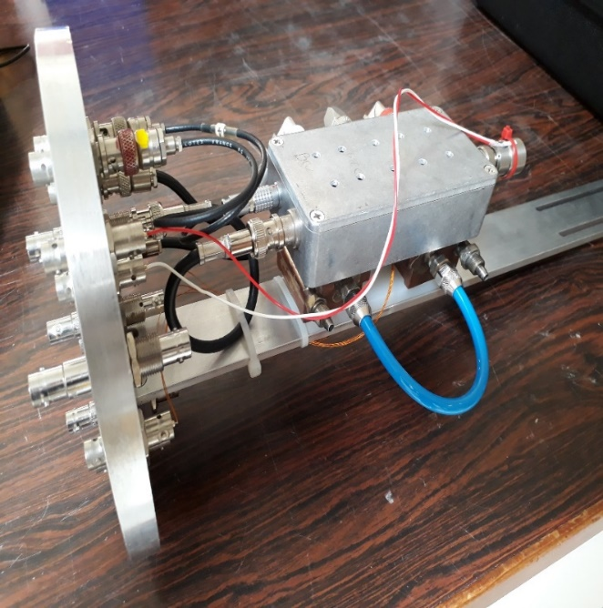
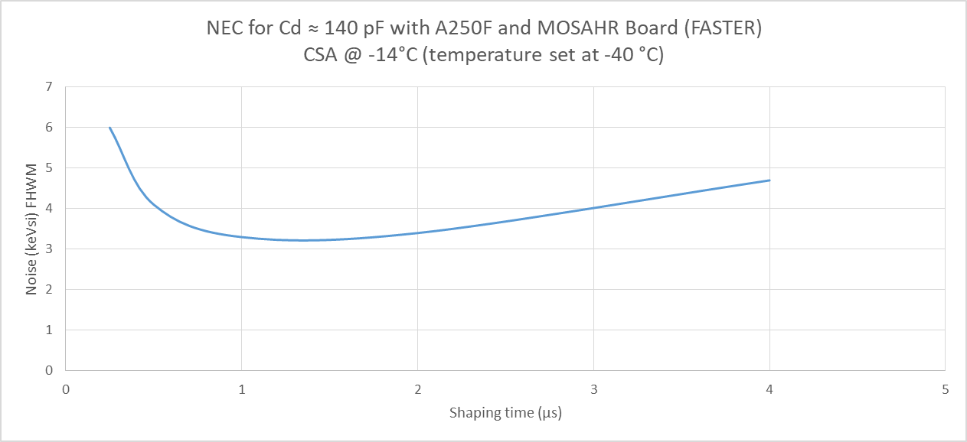
Measurement of
Noise Equivalent Charge for A250F (At LPC)
Testbench (cooling with alcool glycol under vacuum)
3.2 keV_{Si} FWHM
This measured value is in agreement with the previously theoretical estimated value (3.5 keV_{Si} FWHM @ -20°C ).
[WISArD, Visio conf meeting, Thursday 19 th March]

Slide 7
First prototype board :
AMPTEK Version
Main features :
6 channels with 6 charge sensitive amplifiers A250F
For each channel :
Cf ≈ 0.25 pF ⇨ 175 mV/MeV_{Si} ⇨ 1.05 V for 6 MeV_{Si} in CSA output
Rf ≈ 1 GΩ ⇨ Decay time ≈ 250 µs
2 amplifications stages allowing :
-to amplify the CSA output by a factor of 7.5 ⇨ 7.87 V for 6 MeV_{Si}
-to center the output signal to use input FASTER in ± 5 V
-to choose the polarity of output
Power consumption ≈ 550 mW / channel (additional amplification stages)
[WISArD, Visio conf meeting, Thursday 19 th March]

Slide 8
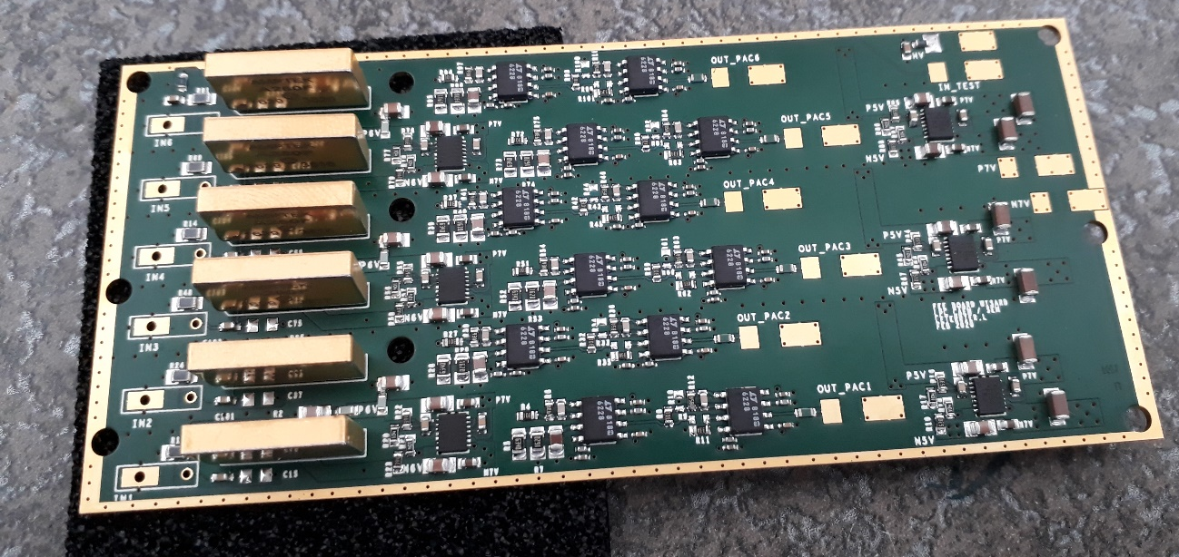
First prototype board :
AMPTEK Version
6 outputs
(suduring of coax
cables on board)
HV input (200 V max)
A250F preamplifiers
1 input for ohmic side
TEST input (50Ω)
5 inputs for jonction side
Power inputs
± 6.5 V
Amplification stages (x 7,5)
Board size: 54mm x 120mm
To be checked asap …
[WISArD, Visio conf meeting, Thursday 19 th March]

Slide 9

Another choice of CSA to test :
Main features of A1422H (CAEN) version F2 :
Positive and negative signal processing Power : 288 mW typical but more gain
Low noise ≈ 3 keV @ Cd =130pF & 25 °C Size : 39 x 20 x 3 mm
Integral Nonlinearity < 0.05 % Operating temperature min : ?
Cost ≈ 200 € per unit
20 mm
39 mm
[WISArD, Visio conf meeting, Thursday 19 th March]

