Slide 1
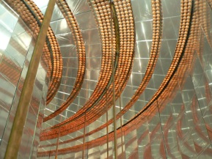

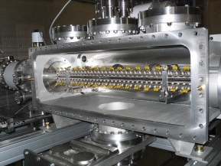
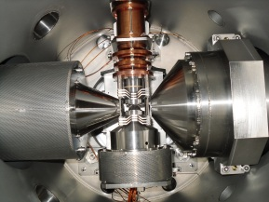
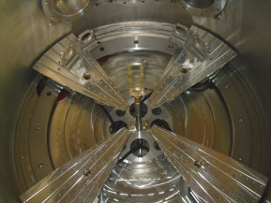
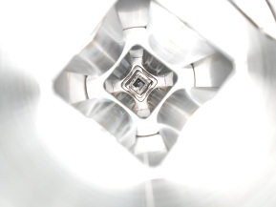
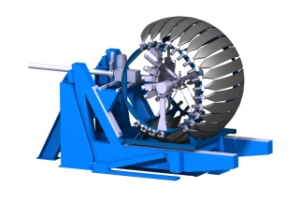



Quick discussion on systematics
Thursday 19 th March 2020
Xavier Fléchard

Slide 2

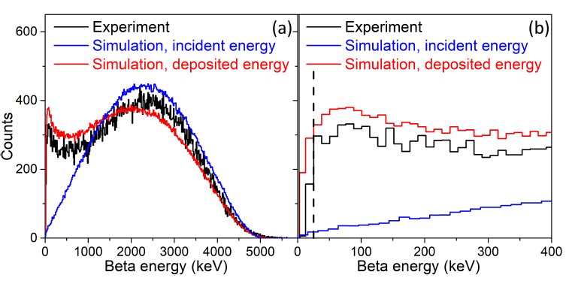
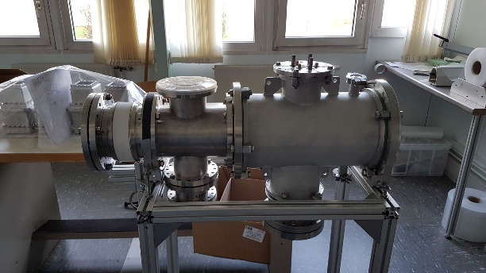
Main Systematics from positron
Backscattering on positron detector:
-Presently 0.2% with detection threshold at 25 keV & 15% error on G4 correction
-Reduced below 0.1% with 10 keV threshold, further reduced with progress on G4 error
→ lower det threshold
→ test G4 sim with backscat
measurements
Threshold uncertainty:
-Presently 0.8% for ΔE_{th}= 12keV
-low stat
-bad det knowledge
-Reduced by ~2 with 10keV threshold
-Reduced by ~6 with ΔE_{th}= 2keV
→ characterization of detector in the 0-30 keV range
-calibration sources (tests @ ISOLDE γ & e-)
-low intensity electron gun (under dev.)
→ use alpha source for normalization (between tests & experiment)
[WISArD, Visio conf meeting, Thursday 19 th March]

Slide 3
Main Systematics from positron
Backscattering on catcher:
-Presently 2.2% with ~6.7um mylar thickness & 15% error on G4 correction
-Gain of factor ~13 with 0.5 mylar thickness for G4 error but then uncertainty on thickness not negligible (+-20%)… Real gain only factor ~8 → ~ 0.3% error on ã
Not enough…
-To do better:
→ Measure precisely the thickness (proton E loss?)
→ Test G4 with e- source & several thickness
→ Alternate 2 thickness during experiment→ extrapolation @ 0 thickness
If linear effect: final error ~0.107%
[WISArD, Visio conf meeting, Thursday 19 th March]

Slide 4
Main Systematics from protons
Geometry:
-Need for ~0.5mm precision on detector & implant to reduce error at 0.05 % level
→ good mechanical design
→ detector to monitor implantation profile (MCP + Resistive anode)
to be ordered (but large) or designed…
Mylar thickness:
-Presently 0.2% for uncertainty of 0.15um → improved with statistics & new mylar
0.5+- 0.1um mylar → 0.15% error (not enough)
→ could be measured more precisely with proton shift
→ effect included in extrapolation with 2 thickness
Si dead layer thickness:
-Presently 0.5% for uncertainty of 0.3um → improved if dedicated measurements
→ Precise measurement possible with α source at different angles (Eshift vs angle)
(gain of factor ~10 seems possible)
→ Need for dedicated setup
Detector calibration slope:
-Presently 0.9% for relative uncertainty of 0.2% on slope
→ need for very precisely known proton energy peaks (33Ar?)
Several peaks with 1keV precision → 0.1-0.15% on ã , seems hard to do better…
[WISArD, Visio conf meeting, Thursday 19 th March]

