Slide 2

Powering tests on RB circuit/s equipped with 11T dipole
19.03.2020
M. Solfaroli
Slides from Z. Charifoulline, S. Yammine, J. Steckert

Slide 3
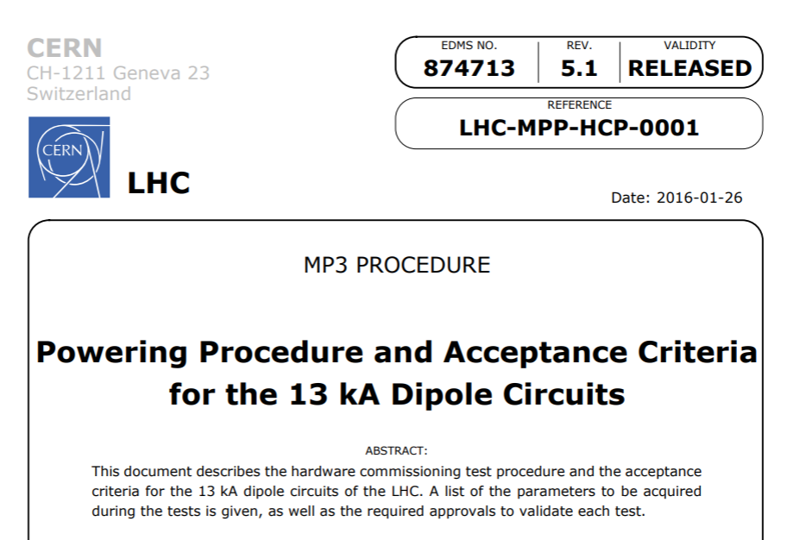
The RB powering tests procedure
The existing procedure:
https://edms.cern.ch/ui/file/874713/5.1
The existing procedure was successfully used in the campaigns:
Post LS1
2016
2017
2018
19.03.2020
Meeting on PT of 11 T

Slide 4
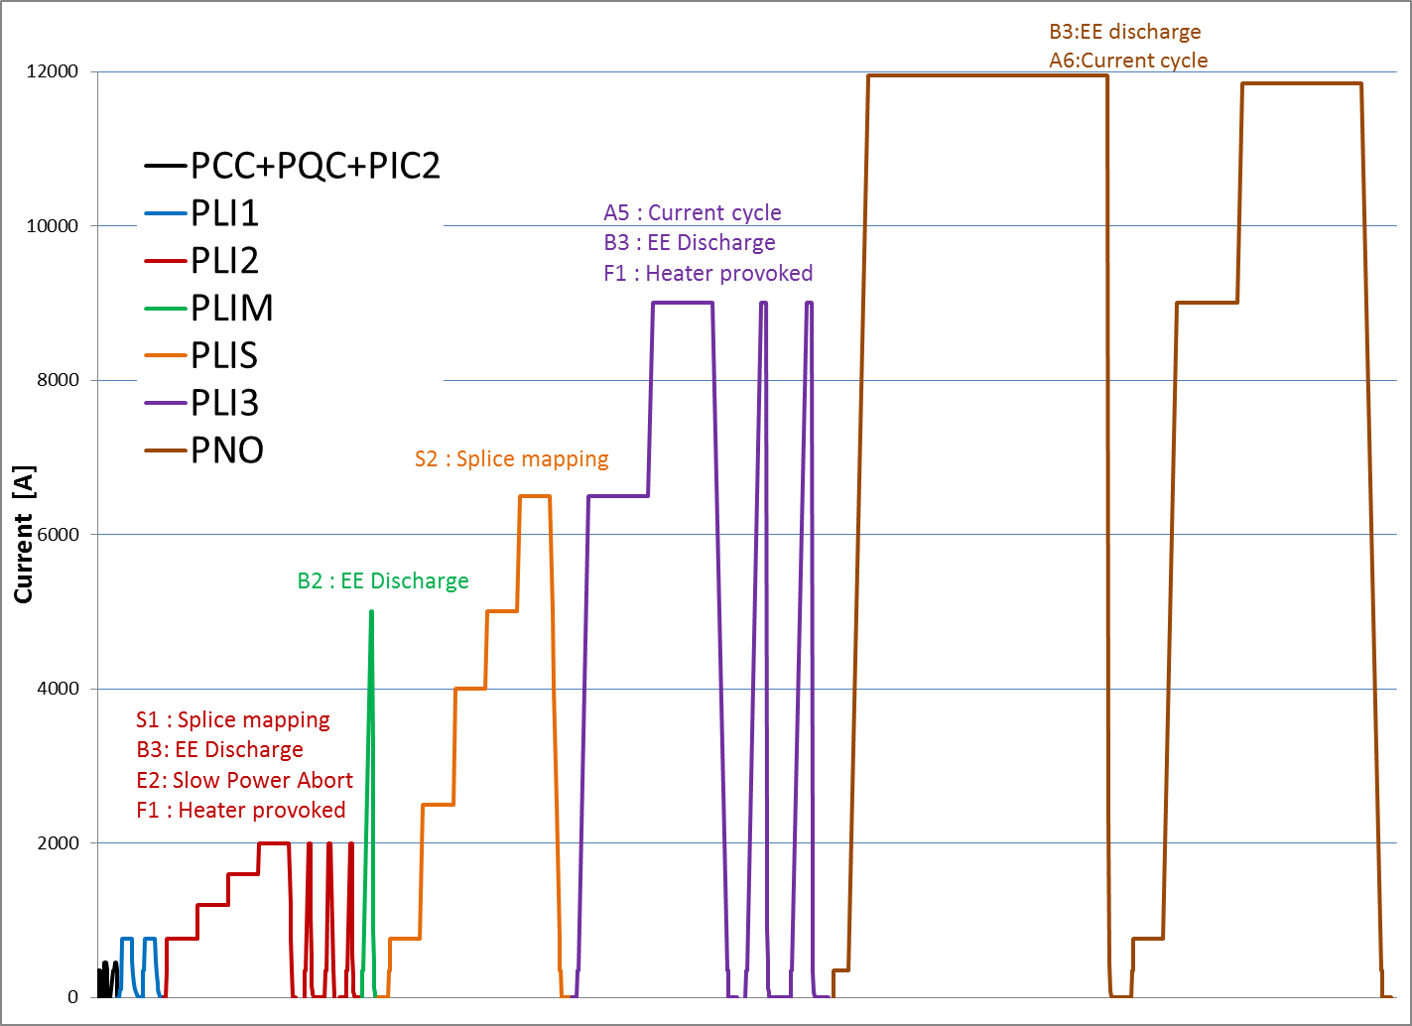
The test sequence
19.03.2020
Meeting on PT of 11 T

Slide 5
The test sequence
Step | Current level | Description
PCC.2 | 450 A | Power converter configuration
PQC | 450 A | Powering for QPS Preliminary Calibration
PIC2 | 100 A | Interlock tests with converters connected to the leads
PLI1.a2 | 760 A | Current cycle to I_INJECTION
PLI1.b2 | 760 A | Energy Extraction from QPS (Current Lead)
PLI1.d2 | 760 A | Unipolar Powering Failure
PLI2.s1 | 2000 A | Splice Mapping
PLI2.b2 | 2000 A | Energy Extraction from PIC during the ramp
PLI2.e2 | 2000 A | Slow Power Abort
PLI2.f1 | 2000 A | Quench heater provoked
PLIM.b2 | 5000 A | Energy Extraction from QPS (Current Lead)
PLIS.s2 | 6500 A | Splice Mapping
PLI3.a5 | 9000 A | Current cycle to I_INTERM_2
PLI3.d2 | 9000 A | Unipolar Powering Failure
PLI3.f1 | 9000 A | Quench heater provoked
PNO.b2 | 10980 A + 100 A | Energy Extraction from QPS (Current Lead)
PNO.a6 | 10980 A | Current cycle to I_PNO
19.03.2020
Meeting on PT of 11 T

Slide 6
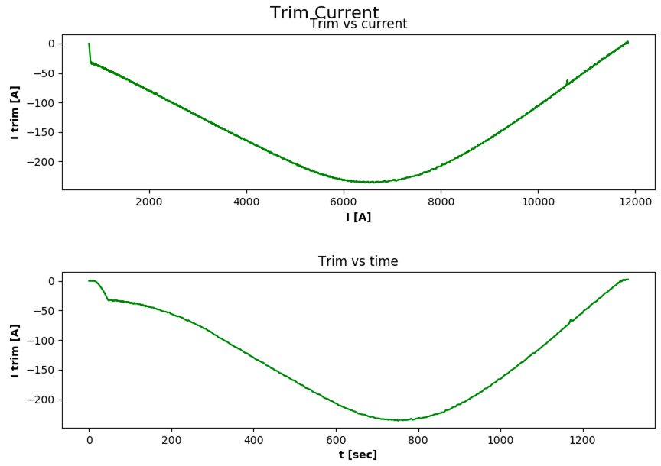
Circuit with 11 T
11 T
std dipoles
760 A
N.B. the low-current behavior is due to the fact that the TF presently available data starts @760 A
19.03.2020
Meeting on PT of 11 T

Slide 7
The current
6.5 TeV / I_{RB} = 11 kA / ΔI_{11T} = -67 A
I_{TRIMHWC}
19.03.2020
Meeting on PT of 11 T

Slide 8
Zinur’s approach
Zinur Charifoulline
Step | Current level | Description | Post LS1 | Post LS2
PCC.2 | I_PCC | Power converter configuration | 450 A | 450 A / ???
PQC | I_PCC | Powering for QPS Preliminary Calibration
PIC2 | I_MIN_OP | Interlock tests with converters connected to the leads | 100 A | 100 A / ???
PLI1.a2 | I_INJECTION | Current cycle to I_INJECTION | 760 A | 760 A / cycle
PLI1.b2 | I_INJECTION | Energy Extraction from QPS (Current Lead) | 760 A | 760 A / -50 A (x2)
PLI1.d2 | I_INJECTION | Unipolar Powering Failure | 760 A | 760 A / -50 A (x2)
PLI2.s1 | I_INTERM_1 | Splice Mapping | 2000 A | 2000 A / 0 A
PLI2.b2 | I_INTERM_1 | Energy Extraction from PIC during the ramp | 2000 A | 2000 A / -100 A
PLI2.e2 | I_INTERM_1 | Slow Power Abort | 2000 A | 2000 A / -100 A (x2)
PLI2.f1 | I_INTERM_1 | Quench heater provoked | 2000 A | 2000 A / -100 A (where?)
PLIM.b2 | I_SM_INT_4 | Energy Extraction from QPS (Current Lead) | 5000 A | 5000 A / -200 A (x2)
PLIS.s2 | I_SM | Splice Mapping | 6500 A | 6500 A / 0 A
PLI3.a5 | I_INTERM_2 | Current cycle to I_INTERM_2 | 9000 A | 6500A & 9000 A / cycle
PLI3.d2 | I_INTERM_2 | Unipolar Powering Failure | 9000 A | 9000 A / -150 A (x2)
PLI3.f1 | I_INTERM_2 | Quench heater provoked |  | Quench in 11T?
PNO.b2 | I_PNO+I_DELTA | Energy Extraction from QPS (Current Lead) | 11080 A | 11080 A / cycle
PNO.a6 | I_PNO | Current cycle to I_PNO | 10980 A | 10980 A /cycle
+ 6 TESTS
19.03.2020
Meeting on PT of 11 T

Slide 9
EPC’s approach
Commissioning of RB without 11 T Trim
After ElQA, perform commissioning of RB with 11T Trim disconnected
Commissioning at Injection Current (+3 tests)
Connect the 11 T trim converter, and ramp RB to Injection Current
[-250 A, 50A] current interval with steps of 50 A (verification of the dynamic and static control performance). (additional test)
11 T Trim PC Trip at -250 A (impact of cold diode) (additional test)
11 T Trim PC Trip at 50 A (additional test)
Commissioning 11 T Trim et RB at higher current (+4 tests)
Generate Trim Fault at 3.5 TeV (done on RB @2 and @9 kA)
Generate Energy Extraction of RB at 3.5 TeV
Generate Trim fault at nominal energy (additional test)
Generate Energy Extraction of RB at nominal energy
Samer Yammine
19.03.2020
Meeting on PT of 11 T

Slide 10
QPS considerations
Jens Steckert
I_MIN_OP
Verify I_mag and threshold/disc active → I_mag = 100A +/-5%
Verify that current reading of UQDS is correct
Verify that active detection settings are correct
I_PCC
Verify the same parameters
PIC2
Repeated twice more circuit quench via QPS (Box A and Box B) on 11 T
PLIs/PNO
Verify current reading of 11 T UQDS and active detection settings at different current steps
Take snapshot before triggering EE tests
MISC
We need to have a look on two nQPS crates which will have to get a modified firmware on DQQDS to compensate the missing voltage from A9
BS-boards will be connected to 11 T diode: special tests required for new splices ?
NO powering tests addition
19.03.2020
Meeting on PT of 11 T

Slide 11
PIC considerations
Alain Antoine
EVEN point
ODD point
PC_PERMIT
Global Protection Mechanism
PC
PIC
QPS
QPS
PIC
POW_FAIL
PC_FPA
QUENCH
QUENCH
PC_DIS_REQ
DIS_REQ
DIS_REQ
Use of an empty slot of the odd PIC:
Connect the trim power converter to the PIC interface
Don’t connect RB quench loop and use the Global Protection Mechanism to propagate the FPA of RB to the Trim.
Connect the new QDS for the current leads protection to the trim circuit via the quench loop
PLUS: Implementation of a SW link between RB and trim
QDS
PIC
PC_PERMIT
TRIM
PC
POW_FAIL
QUENCH
PC_FPA
AccTesting:
Addition of a new standard PIC2 test (B1 type) for the new trim circuits
During HWC, the GPM is masked during PIC2 tests and the Trim circuit will be unlinked from the RB circuit
19.03.2020
Meeting on PT of 11 T

Slide 12
Open questions
Step | Current | Description
PCC.2 | 450 A | PC configuration
PQC | 450 A | QPS Calibration
PIC2 | 100 A | Interlock tests
PLI1.a2 | 760 A | Current cycle
PLI1.b2 | 760 A | EE from QPS
PLI1.d2 | 760 A | Powering Failure
PLI2.s1 | 2000 A | Splice Mapping
PLI2.b2 | 2000 A | EE from QPS/PIC
PLI2.e2 | 2000 A | Slow Power Abort
PLI2.f1 | 2000 A | Quench heater firing
PLIM.b2 | 5000 A | EE from QPS
PLIS.s2 | 6500 A | Splice Mapping
PLI3.a5 | 9000 A | Current cycle
PLI3.d2 | 9000 A | Powering Failure
PLI3.f1 | 9000 A | Quench heater firing
PNO.b2 | 10980 A + 100 A | EE from QPS
PNO.a6 | 10980 A | Current cycle
PCC/PQC to be decided by EPC/QPS
PIC2 – circuit quench & FPA & discharge Request to be done by all sources (CL, PIC, PC, magnet) + 11 T + Trim
Current tests directly with (corresponding) trim current or not? +6/7 tests
Is splice mapping needed (more generic question valid for all RB circuits)?? If so without trim?!?!
Heater provoked quench (2 tests) on 8 T or 11 T?
How about training?
Shall we let the 11 T go to 7 TeV (no use of the trim?)? (final validation with PNO.a6 with trim)
…??
…??
19.03.2020
Meeting on PT of 11 T

