Slide 1




CLIC-Module Meeting
Week 20 – 2020
A. Castilla
a.castilla@cern.ch

Slide 2
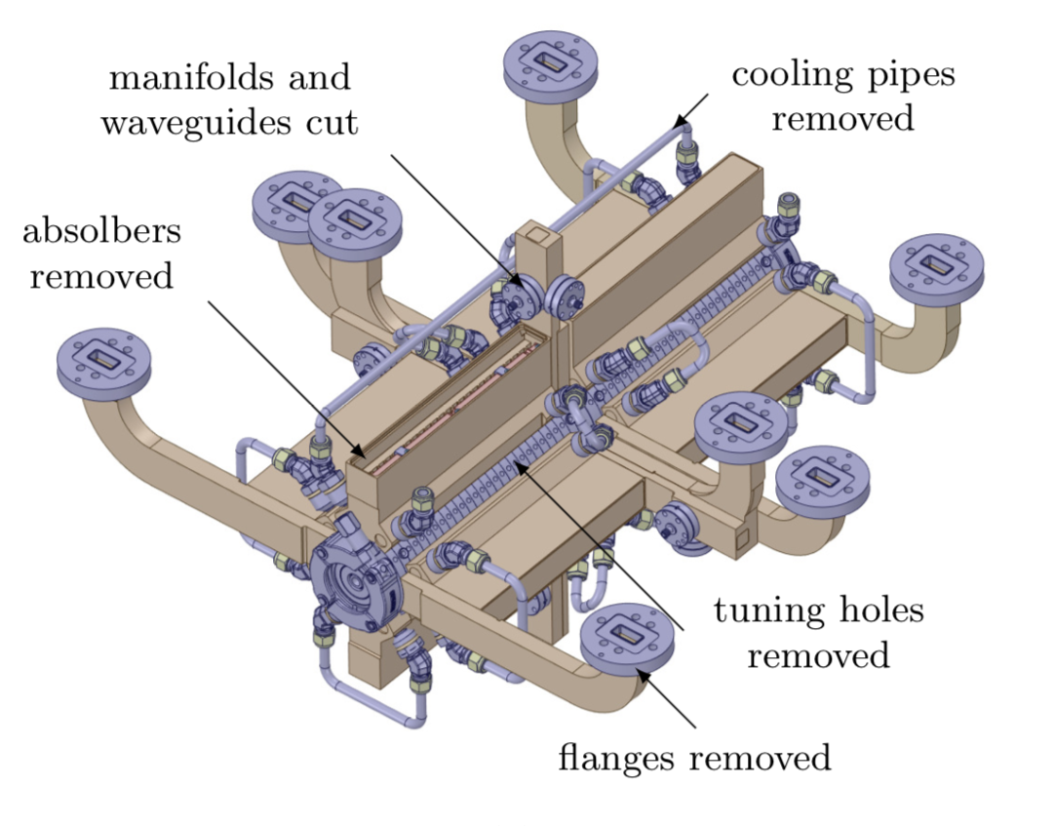
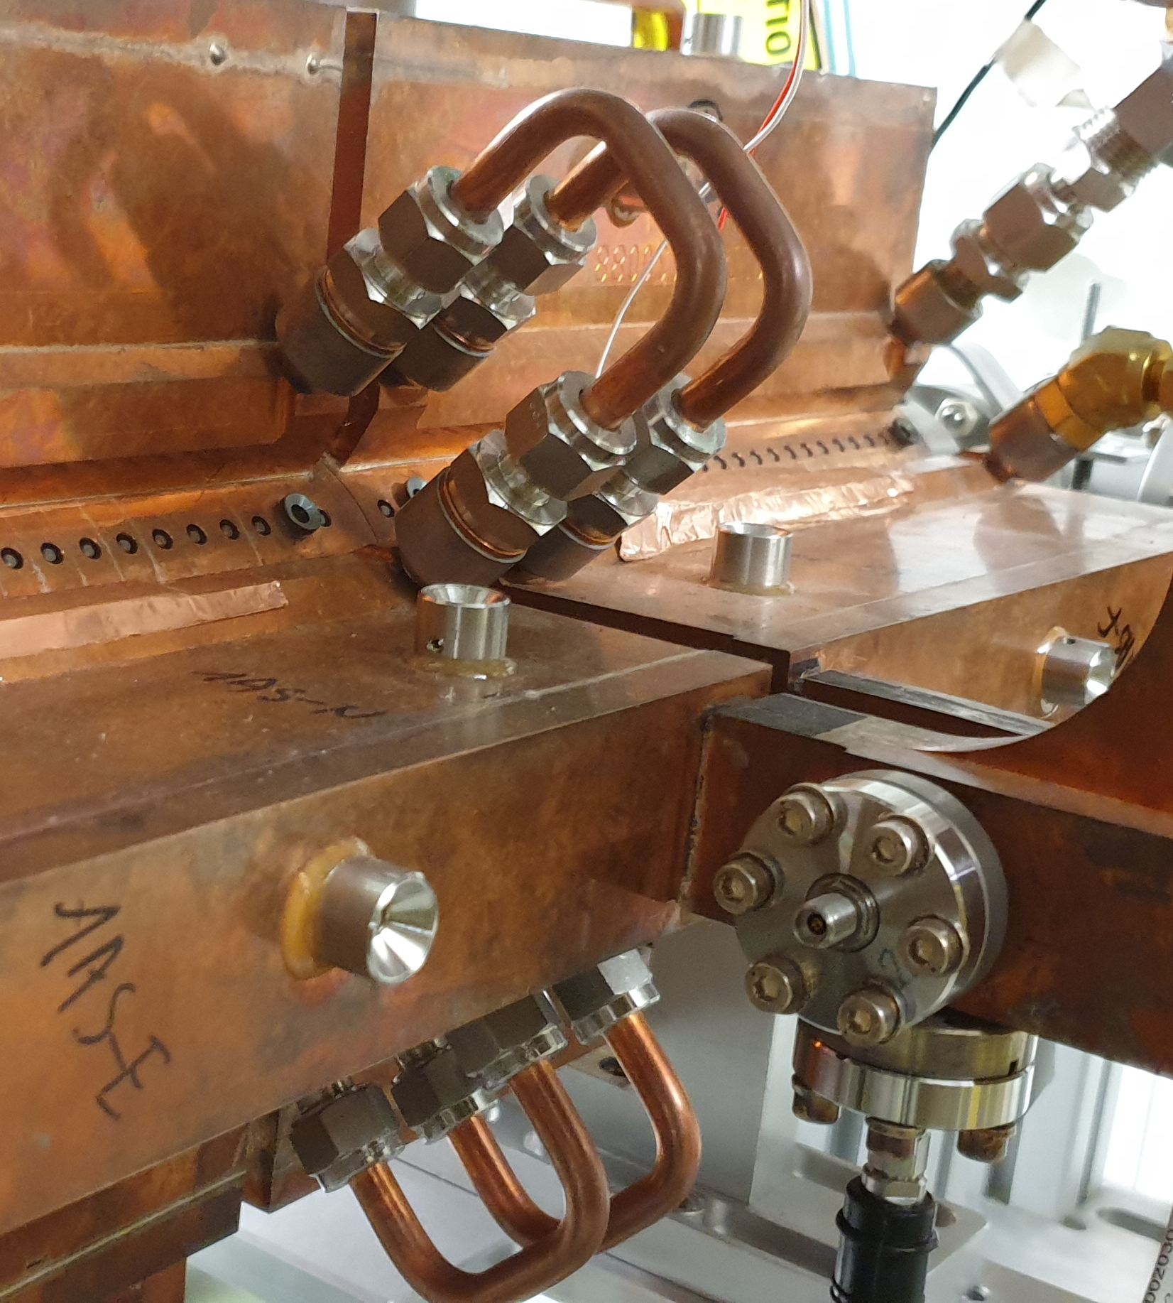
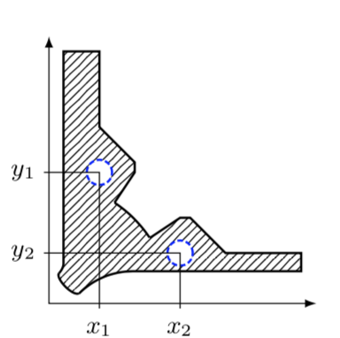
Following up Kai’s 4-5 l/min…
Flow limit and cavitation are given by bends or chiller’s capacity?
Can we simplify the cooling circuit and increase the flow?

Slide 3
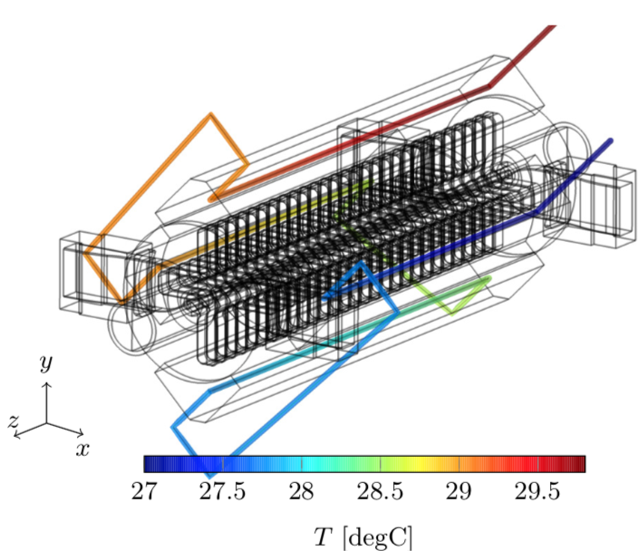
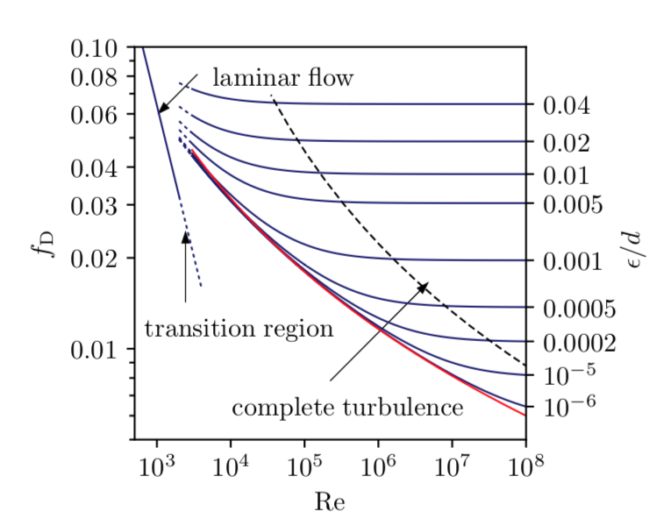
Following up Kai’s 4-5 l/min…
Flow limit and cavitation are given by bends or chiller’s capacity?
Can we simplify the cooling circuit and increase the flow?

Slide 4
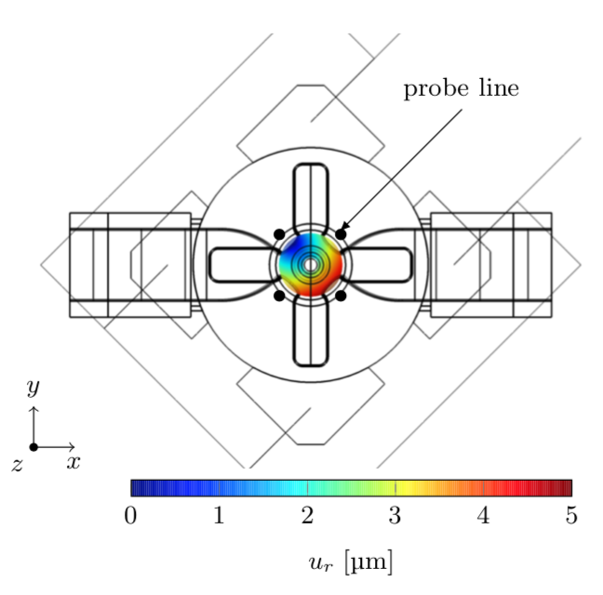
Questions Summary
The main question is: How much power is practically possible to handle in this structures?
What are the limitations to increase the power:
Physical?
Technical?
Can we have flow rates higher than 4-7 l/min?

