Slide 1
Update
Alice Petry
HIP Summer Trainee Sept-Nov 2020

Slide 2
Index
Mission
Geometry
FEA Model
Simulation Setup
Boundary Conditions
Parameters
Results
Pipe Losses
Conclusion

Slide 3
Mission
Define a cooling strategy for a Super-Acceleration Structure (SAS) of the two-beam module.
  Summarize design requirements and relevant insights from previous work
Design a cooling system for the two-beam module
  Design based on cooling philosophy
  CATIA used to create alternative designs
  ANSYS used to evaluate design

Slide 4
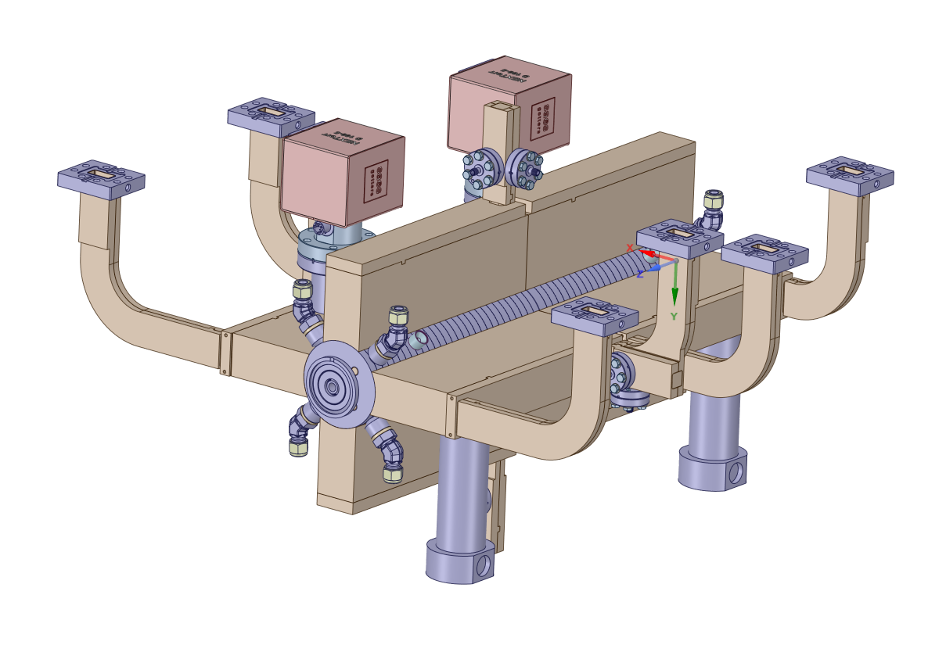
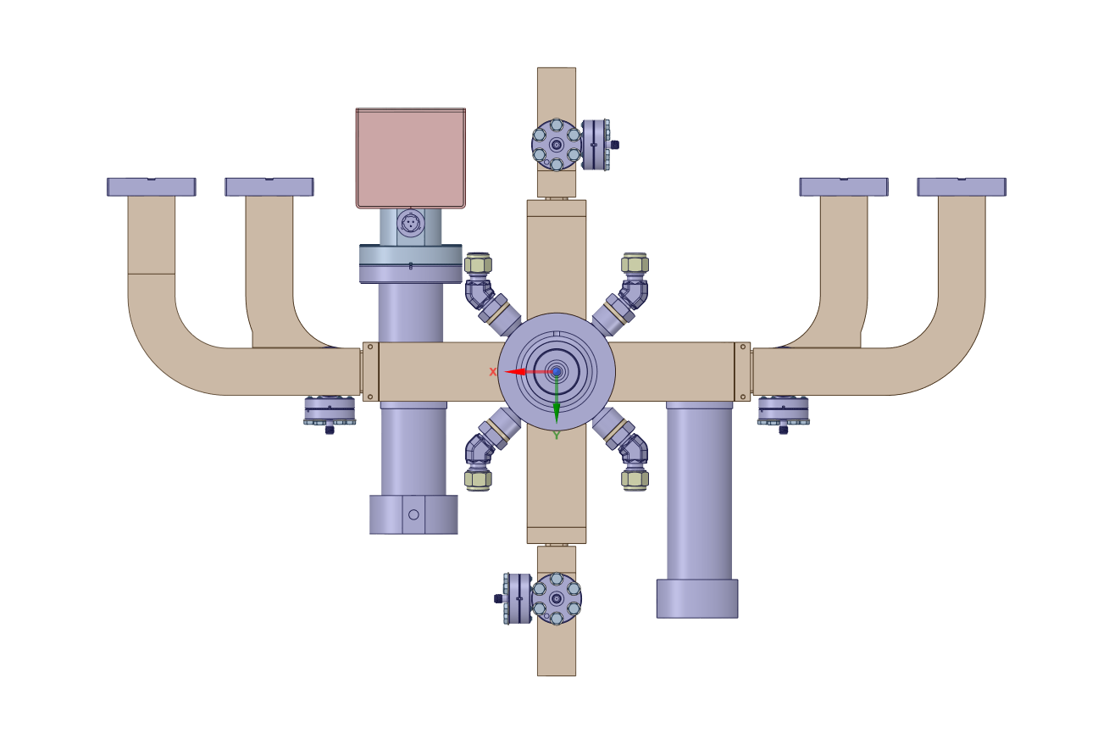
Geometry
ST1364474_01

Slide 5
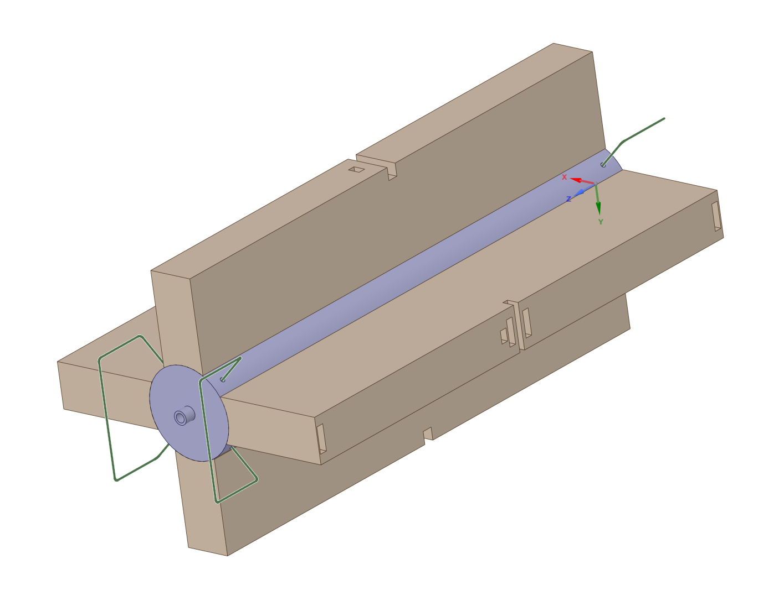
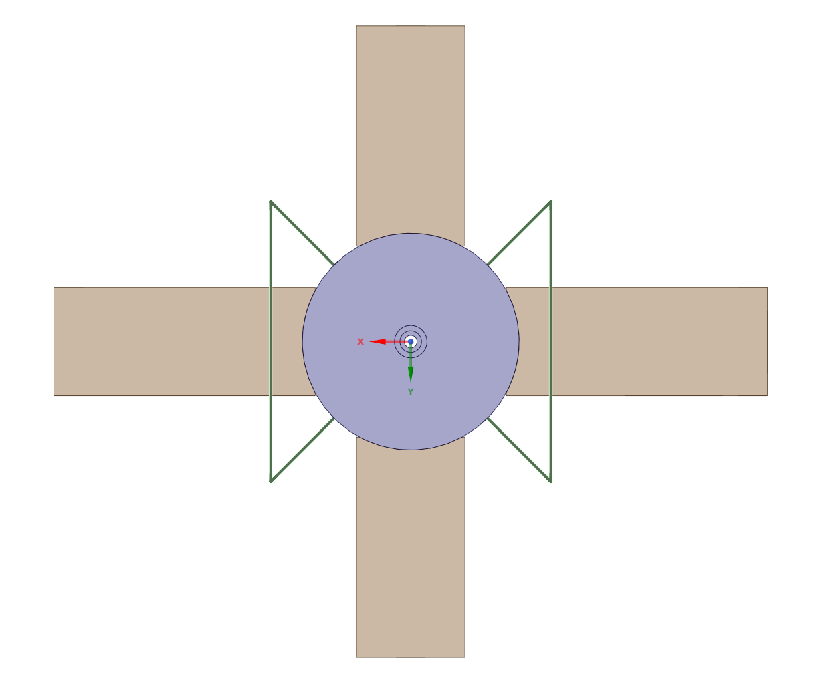
FEA Model
Removal of nuts, bolts, washers, flanges, connectors, wave guides, bellows, etc.
Removal of fillets, chamfers, small holes, and grooves.
Tuning holes are filled.
Individual cavity disks are combined into one large component.
Individual manifolds are combined into larger components.
Cooling channels are located inside the disk stack.

Slide 6
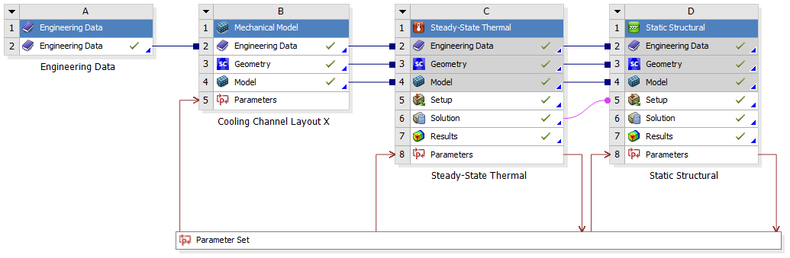
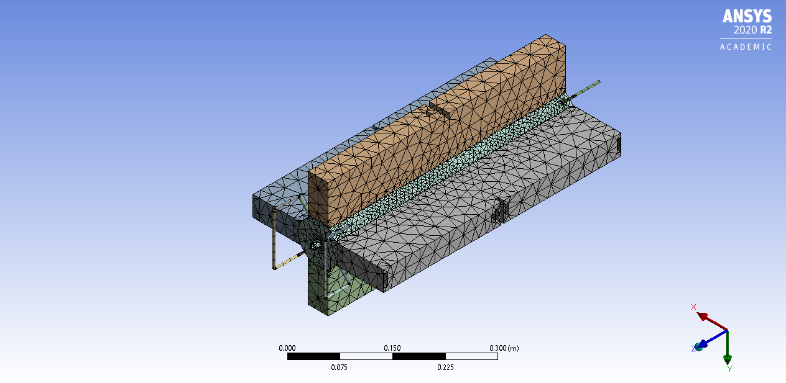
Simulation Setup
Example Setup for setup with two cooling channels
Mesh
Elements: 146446
Nodes: 272945
Notes:
Convergence study performed up to 1 $$μ$$m accuracy

Slide 7
Boundary Conditions - Thermal
Ambient temperature: 28 $$℃$$
Inlet coolant temperature: 27 $$℃$$
Convection to Air: 5 W/(m²$$℃$$) applied to all outer surfaces
Radiation to Ambient: emissivity = 0.05 applied to all outer surfaces
Convection between cooling fluid and cooling channels: calculated based on mass flow rate and cooling channel radius
Heat flux based on RF losses (calculated in HFSS) applied to surfaces inside the disk stack
Heat flow based on RF losses (values from the PIP) applied to the surfaces close to the irises inside the disk stack

Slide 8
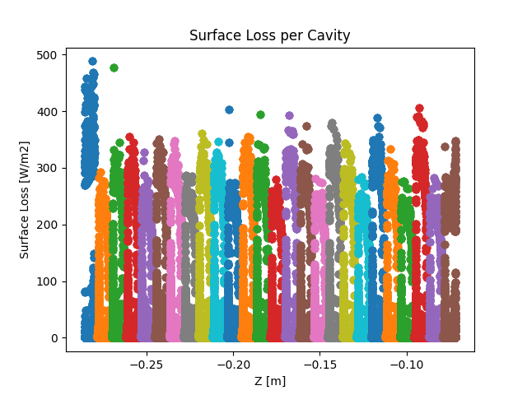
Boundary Conditions - Thermal
RF Losses based on thermo-mechanical simulations and measurements performed by Alex Vamvakas
  Benefits
    Determine the total RF losses (Input: 1 W; Loss: 0.76 W)
    Visualize the distribution of RF losses
  Disadvantage
    Simulation of a TD24 structure --> Current
    simulation contains 2x26 cells
    A scaling factor is needed to distribute the RF
    losses adequately over the SAS
    ANSYS extrapolates external data over
    different nodes, which can lead to inaccurate
    RF loss distributions

Slide 9
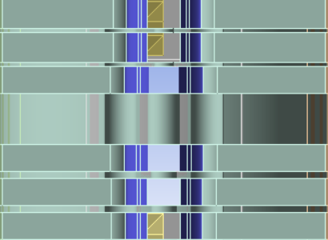
Boundary Conditions - Thermal
Total RF loss for the drive-beam based and klystron based design are reported in the PIP
  Based on the visualization from the HFSS simulation, these RF losses can be applied as heat flow on surfaces surrounding the irises
  Input values: 800 W and 1100 W

Slide 10
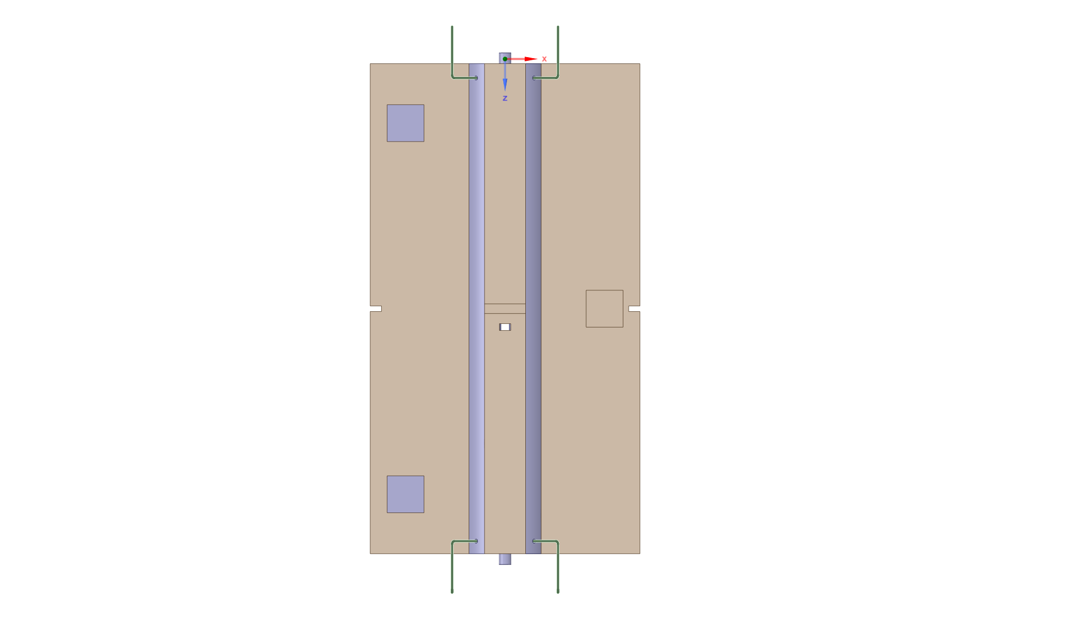
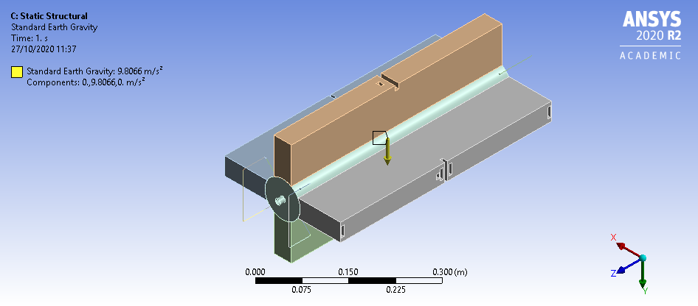
Boundary Conditions - Structural
Zero displacement in X and Y direction applied to the faces of the right-most cut (brown)
Zero displacement in Y and Z direction applied to the faces of the left-most cuts (grey)
Gravity pointing in the +Y-direction

Slide 11
Parameter Set
Position of cooling channel with respect to center axis of the disk stack: d = 15 mm - 30 mm
Cooling channel radius r
Cooling fluid mass flow rate: Q = 2 L/min - 2.5 L/min
Average cooling channel film coefficient h (convective heat transfer coefficient)
Cooling channel layouts

Slide 12
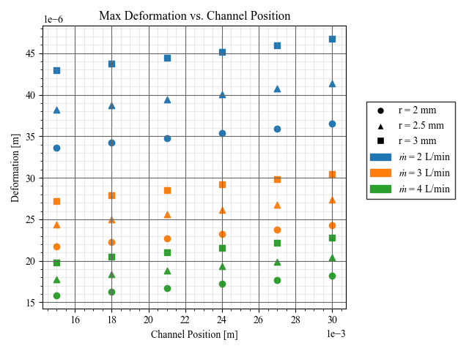
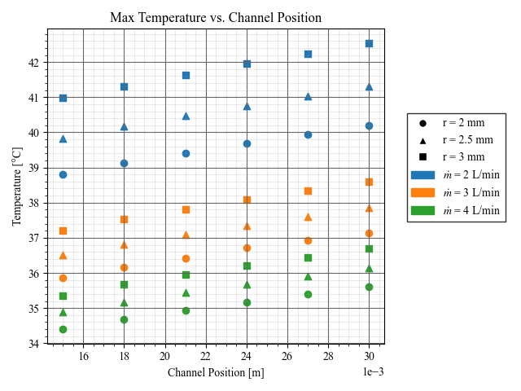
Preliminary Results for CLEX Structure
Max deformation and max temperature depend on the cooling channel placement

Slide 13
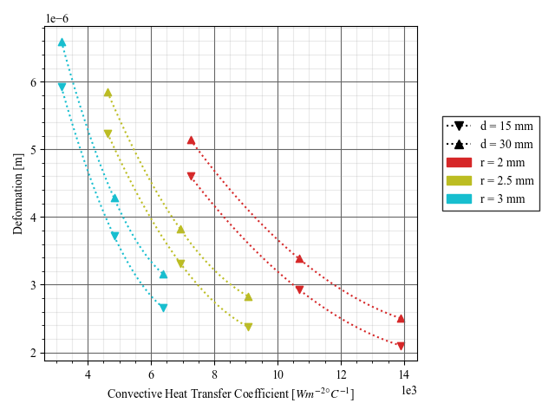
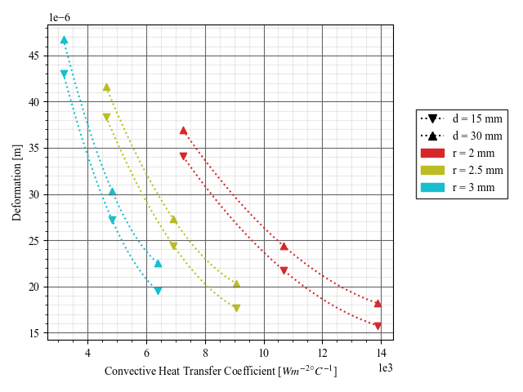
Preliminary Results for CLEX Structure
Min. Deformation (Left) vs Max. Deformation (Right)
Deformation is highly dependent on the convective heat transfer coefficient

Slide 14
Updated Simulation Boundaries
Base model: Layout with a single cooling path
  r = 4 mm, Q_{SAS} = 2 L/min, Re = 6212, f = 3.61e-2, h = 3613
Alternative design: Layout with two cooling paths
  r = 2 mm, Q_{SAS} = 2 L/min, Re = 6212, f = 3.61e-2, h = 7226
Alternative design: Layout with four cooling paths
  r = 1 mm --> unrealistically small
The designs are (to some extent) dynamically similar due to Re

Slide 15
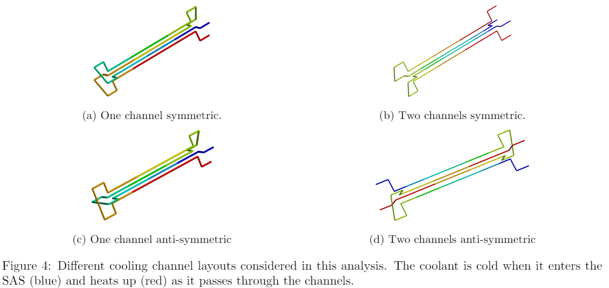
Considered Channel Layouts

Slide 16
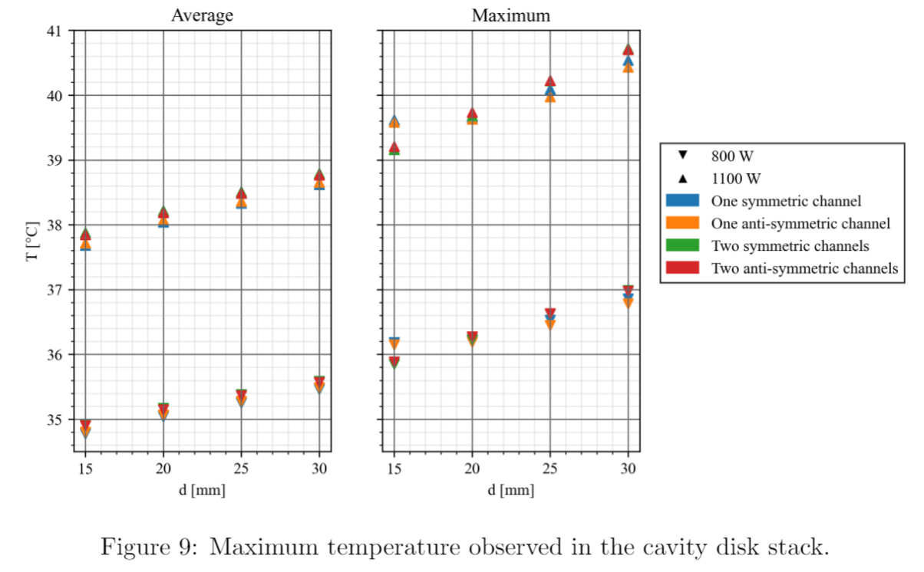
Results
Average and maximum temperature in cavity disk stack depends on cooling channel position.
  Temperature is minimized as distance between beam line and cooling channels is minimized.
Average and maximum temperature are higher when RF losses are higher.
The different cooling channel layouts result in approx. equal average and maximum temperatures.
  One channel layout performs slightly better expect when d = 15 mm.

Slide 17
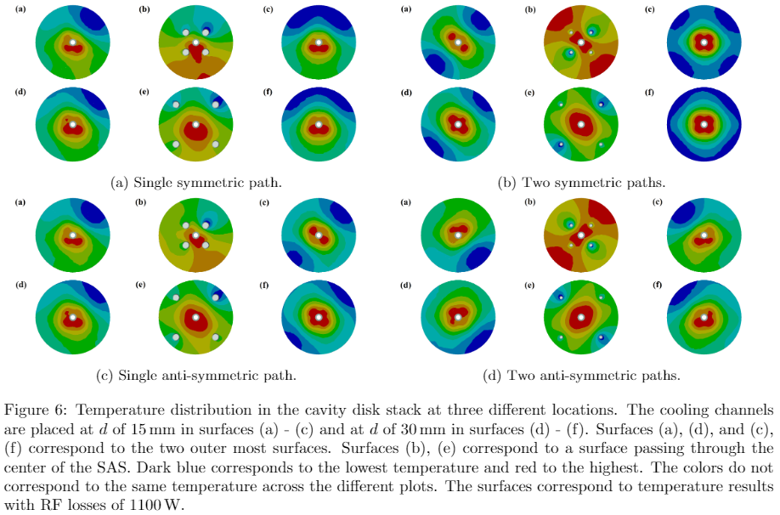
Results
An even temperature distribution results in an even deformation due to thermal expansion.
Two symmetric paths results in an even temperature distribution throughout the SAS.
Temperature distribution not centered for other layouts.
  Potential irregular thermal expansion along beam line.

Slide 18
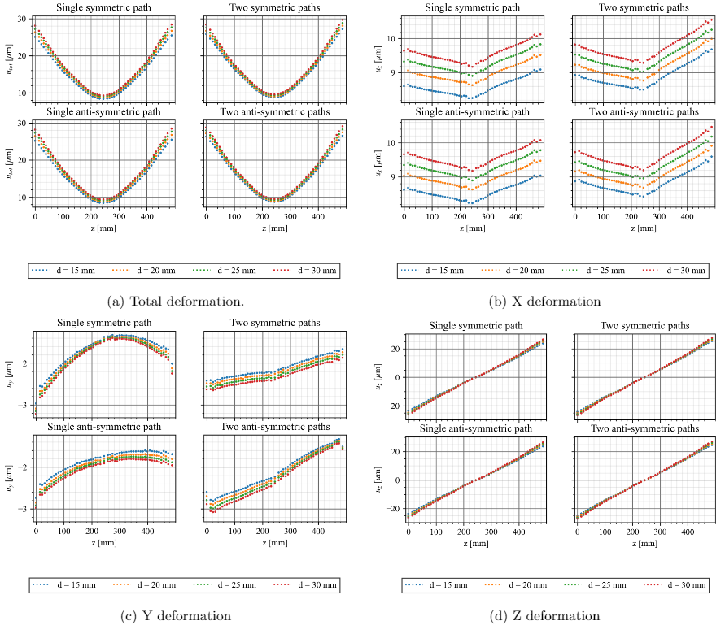
Results
Horizontal (X) and longitudinal deformation (Z) are similar for each layout and have the largest magnitude.
Vertical deformation (Y) differs for different layouts:
  One channel: deformation shaped in parabola, minimum deformation at the center
  Two channels: deformation linear across cavity disk stack.
  Two symmetric paths performs best since the difference between min and max deformation is smallest and deformation is linear
RF Loss: 800 W

Slide 19
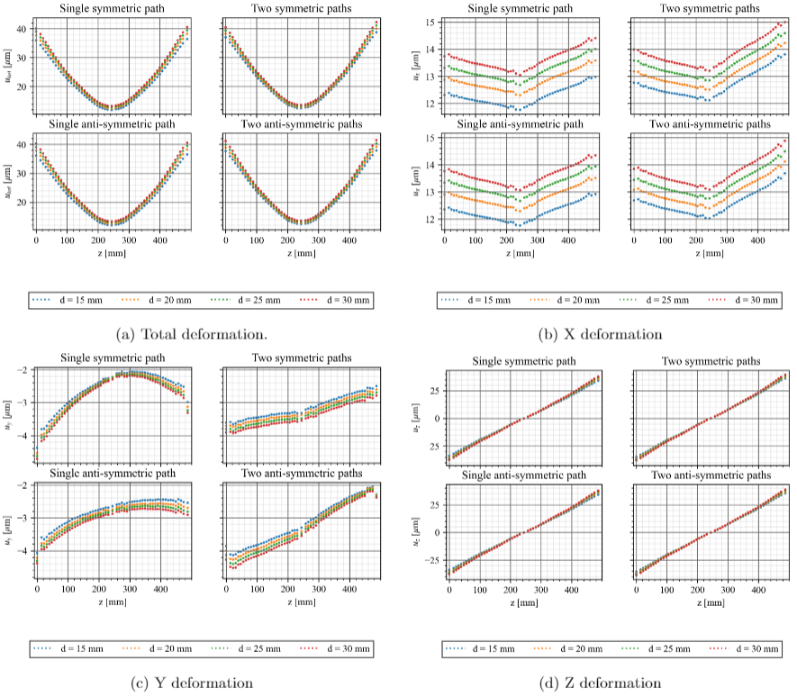
Results
800 W
1100 W

Slide 20
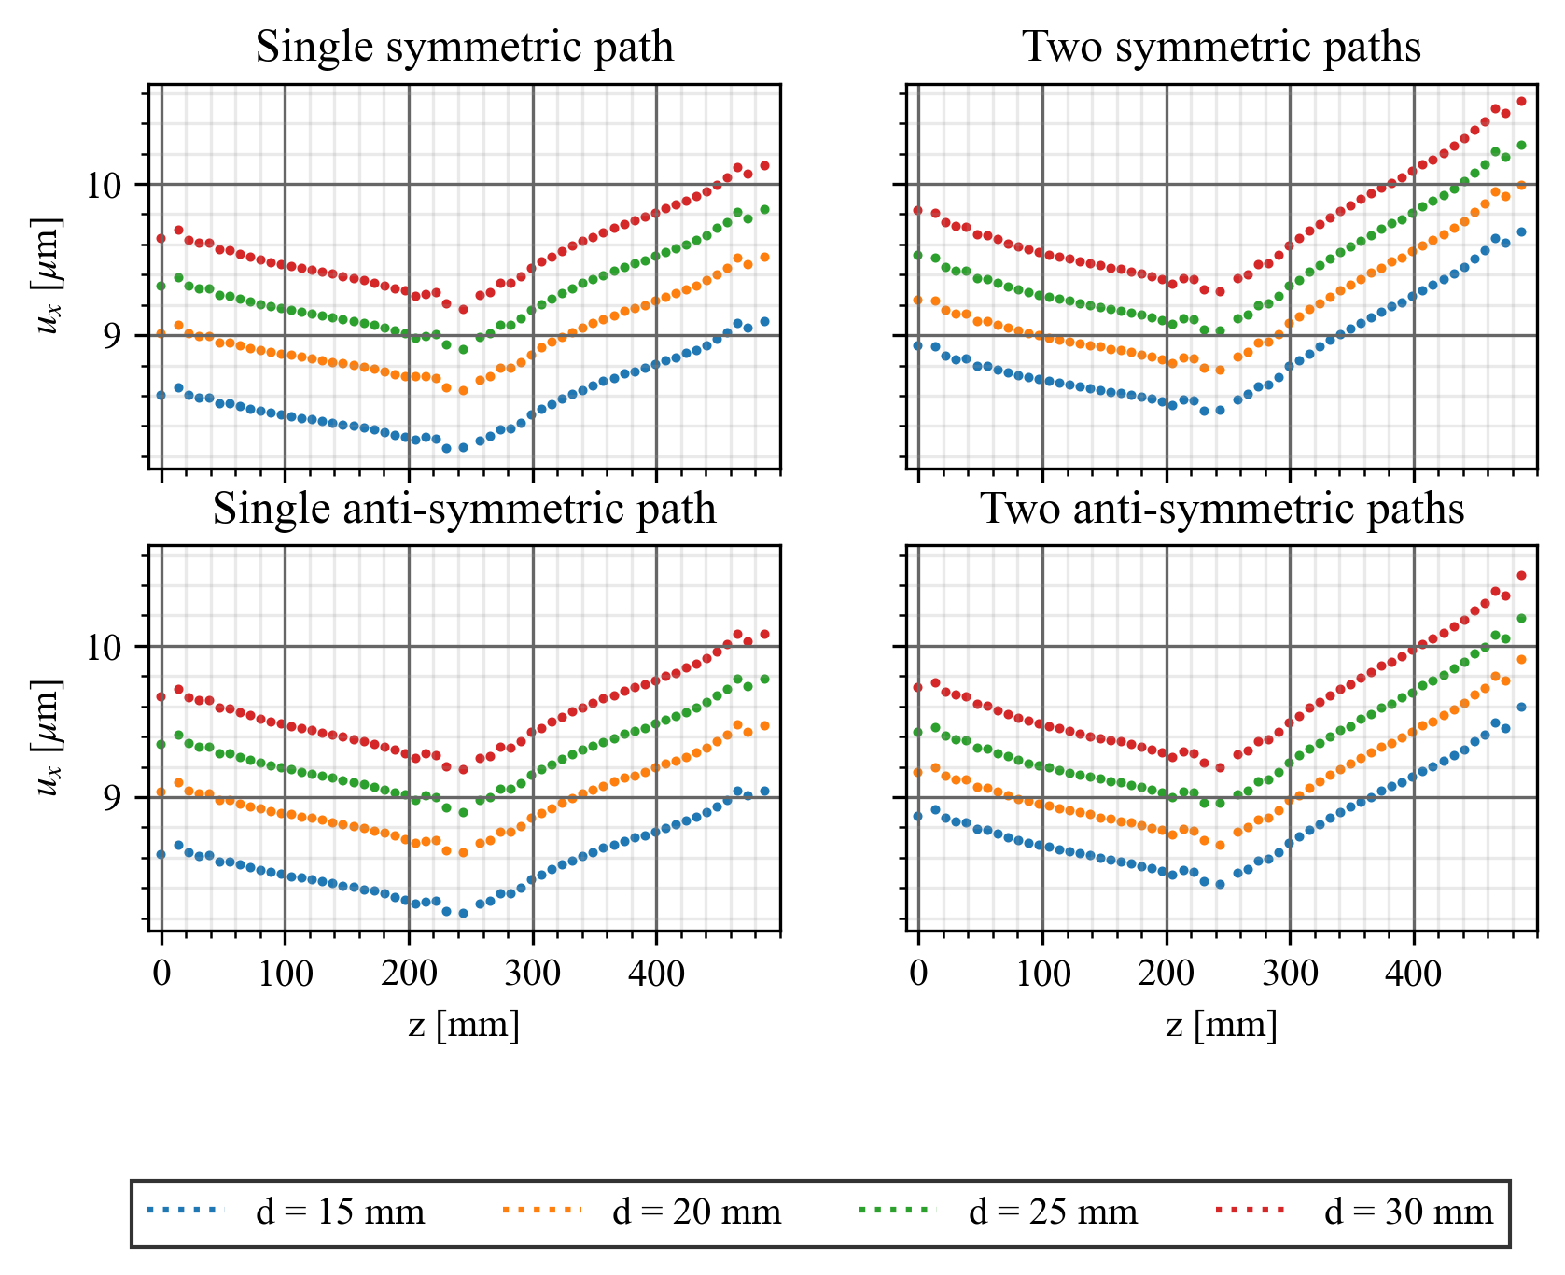
Results
Shape of the x-deformation most likely caused by the position of the supports
  Cavity disk stack expands thermally
  Side with two supports stiffer than side with single
  support
  Structure
  "bends"
  around the
  single
  support

Slide 21
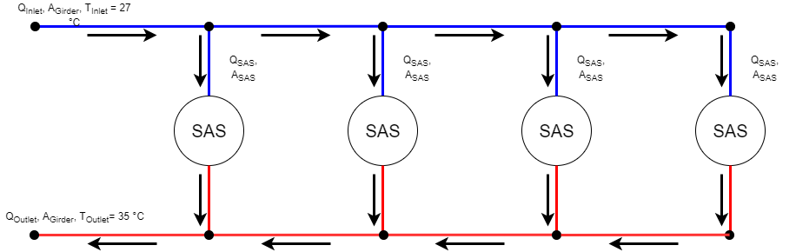
Pipe Pressure Losses and Cavitation
Pipe pressure losses are relevant to design the coolant distribution system (choose pumps, pipes, fittings, etc.)
Cavitation occurs when the local pressure in the cooling channels is lower or equal to the vapor pressure
Vapor pressure of water
  At 30 °C: 4.25 kPa (4.25e-2 bar)
  At 35 °C: 5.63 kPa (5.63e-2 bar)

Slide 22
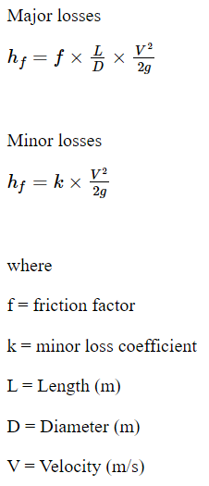
Pipe Losses (Head Loss)
Major losses (friction losses)
  Caused by friction between the moving fluid and the pipe surface.
Minor losses
  Caused by a change of section, valve, bend or other interruption.
  Can be larger than the major losses.
(Equations taken from https://lo.unisa.edu.au/mod/book/tool/print/index.php?id=466227)

Slide 23
Pipe Losses (Head Loss)
Single cooling path
Two cooling paths
Path length L
Channel diameter D
Volume flow rate Q
Velocity V=$$\frac{4Q}{πD^{2}}$$
$$h_{f}=f\frac{L}{D}\frac{V^{2}}{2g}$$
Path length $$≅$$ L/2
Channel diameter D/2
Volume flow rate Q/2
Velocity $$\frac{8Q}{πD^{2}}$$=2V
$$h_{f}=4f\frac{L}{D}\frac{V^{2}}{2g}$$

Slide 24
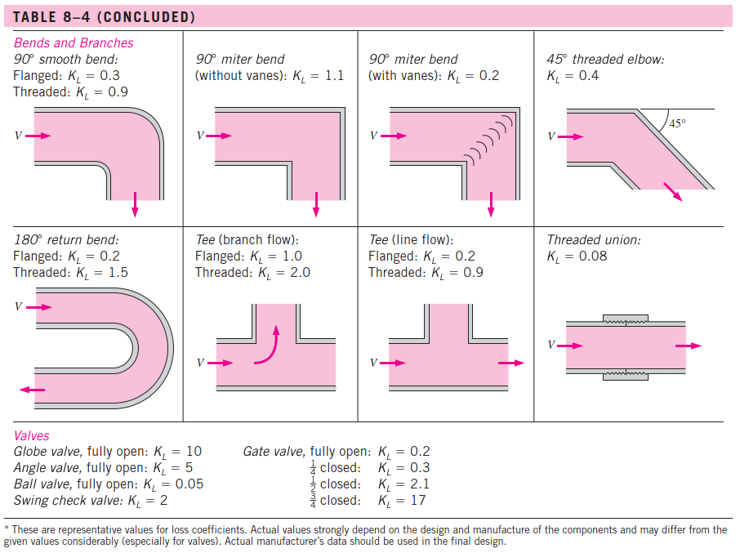
Pipe Losses (Head Loss)
Single cooling path
  Miter bend: 8
  90° bend: 12
  K_{tot} = 8x1.1+12x0.3 = 12.4
  $$h_{f}=k$$$$\frac{V^{2}}{2g}$$
Two cooling paths
  Miter bend: 4
  90° bend: 4
  (Tee bend: 2)
  K_{tot} = 4x1.1+4x0.3 = 5.6
  $$h_{f}=0.9k$$$$\frac{V^{2}}{2g}$$

Slide 25
Pipe Losses (Pressure Loss)
Pressure drop can be calculated from the head loss as $$Δp$$=$$ρgh_{f}$$
Single cooling path
  h_{tot} = $$(f\frac{L}{D}+$$$$k$$$$)\frac{V^{2}}{2g}$$
Two cooling paths
  h_{tot} =$$(4f\frac{L}{D}+$$$$0.9k)$$$$\frac{V^{2}}{2g}$$
The head loss and pressure drop are larger in the two cooling channel layout BUT there are less bends per channel
  There are less places where the flow can detach
  There should be a lower risk for the pressure to drop below the vapor pressure

Slide 26
Pipe Losses (Pressure Loss)
Head loss and pressure loss calculations are subjected to significant uncertainty
  Turbulent flow, smooth pipes, friction coefficient: 5% (3$$σ$$ Uncertainty)
  Loss coefficient miter bend: 15% (3$$σ$$ Uncertainty)
  Loss coefficient 90° bend: 10% (3$$σ$$ Uncertainty)
  Loss coefficient Tee bend: 10% - 20% (3$$σ$$ Uncertainty)
  (from Rennels, D.C. and Hudson, H.M., 2012. Pipe flow: A practical and comprehensive guide. John Wiley & Sons.)
Pressure loss can be reduced through a smart channel layout e.g., by using a large bend radius or a smaller bend angle
CFD analysis and/or experimental setup of the cooling circuit is required to gain a better understanding of the performance of different layouts

Slide 27
Conclusion
The convective heat transfer coefficient has the largest influence on the cooling channel performance (according to the simulations).
The four channel layout is not suitable due to the limited available water flow rates.
The cooling channels should be placed closer to the location of RF losses (inside the cavity disks).
The two symmetric channel layout results in the most even deformation due to thermal expansion.
The surface roughness of the cooling channels should not be too high since this negatively affects the pipe pressure losses and elevates the risk of cavitation.
The number of (sharp) bends in the cooling layout should be reduced to reduce pressure losses and the risk of cavitation.

Slide 28
Context
Activities performed in this internship
  Thermo-mechanical simulation of CLEX based SAS
    Updated (and simplified) boundary conditions to model RF losses in a SAS
    Limited water flow rate compared to previous analysis
    Model validation based on previous work
  Pipe loss calculations
  Cooling channel layout for a CLIC module in CATIA
    Idea for channel layout worked out on paper and simple pipe loss calculations
    Note: updated Cooling and Ventilation Studies for the CLIC required to take into account pressure losses per SAS

