Slide 1
GPU Code integration in FairRoot
1
MOHAMMAD AL-TURANY
FLORIAN UHLIG
GSI Darmstadt

Slide 2
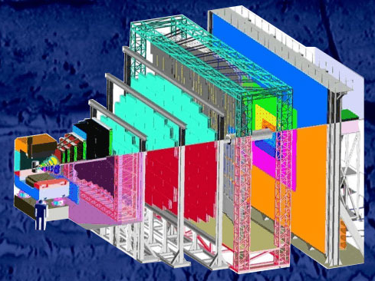
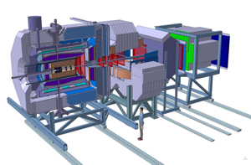
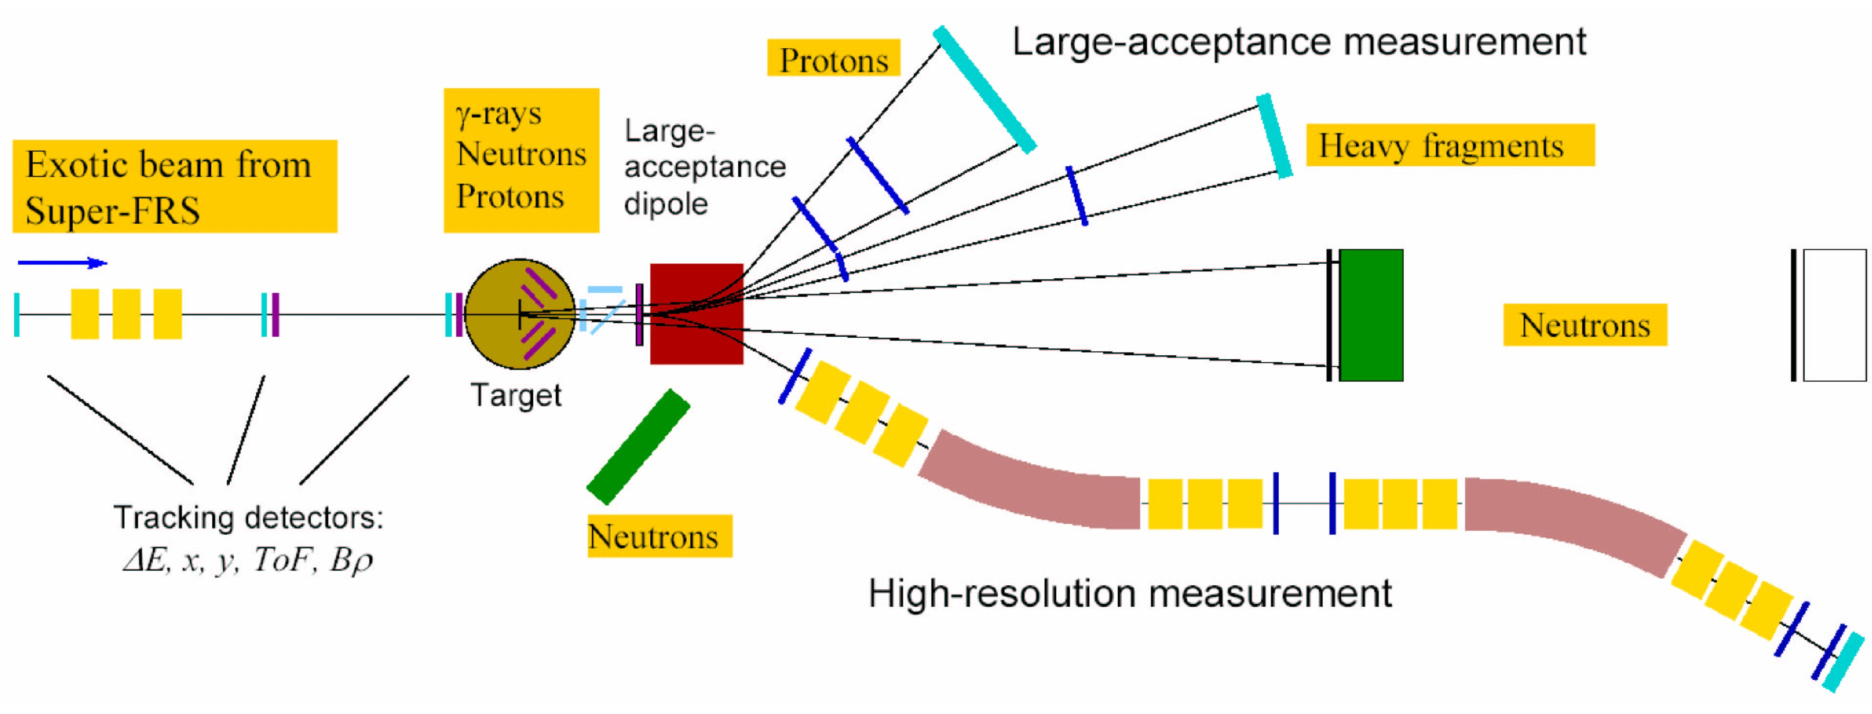
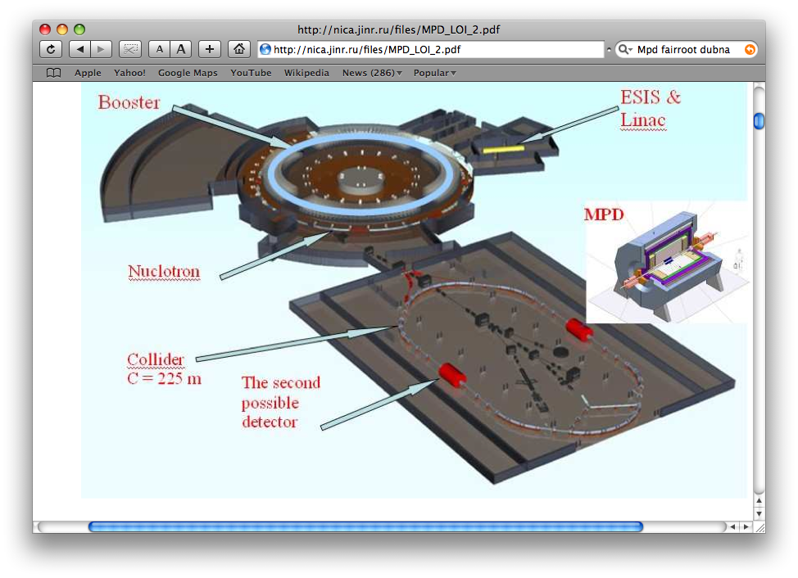
FairRoot
2
Mohammad Al-Turany
Denis Bertini
Florian Uhlig
Radek Karabowicz
CBM
PANDA
R3B
MPD
http://fairroot.gsi.de

Slide 3
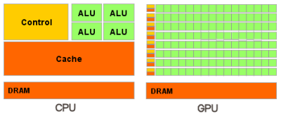
CPU and GPU
Processor | Intel Core 2 Extreme QX9650 | NVIDIA TESLA C1060 | NVIDIA FERMI
Transistors | 820 million | 1.4 billion | 3.0 billion
Processor clock | 3 GHz | 1.3 GHz | 1.15 GHz
Cores (Thread) | 4 | 240 | 512
Cache / Shared Memory | 6 MB x 2 | 16 KB x 30 | 16 or 48KB (configurable)
Threads executed per clock | 4 | 240 | 512
Hardware threads in flight | 4 | 30,720 | 24,576
Memory controllers | Off-die | 8 x 64-bit | 6 x 64 bit
Memory Bandwidth | 12.8 GBps | 102 GBps | 144 GBps

Slide 4
SIMD vs. SIMT
4
CPU
GPU
CPUs use SIMD (single instruction, multiple data) units for vector processing.
GPUs employ SIMT (single instruction multiple thread) for scalar thread processing. SIMT does not require the programmer to organize the data into vectors, and it permits arbitrary branching behavior for threads.
Mohammad Al-Turany, PANDA DAQT
16.04.2010

Slide 5
CUDA: Features
5
Standard C language for parallel application development on the GPU
Standard numerical libraries for FFT (Fast Fourier Transform) and BLAS (Basic Linear Algebra Subroutines)
Dedicated CUDA driver for computing with fast data transfer path between GPU and CPU

Slide 6
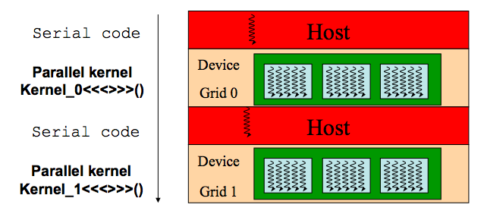
Why CUDA?
6
CUDA development tools work alongside the conventional C/C++ compiler, so one can mix GPU code with general-purpose code for the host CPU.
CUDA Automatically Manages Threads:
  It does NOT require explicit management for threads in the conventional sense, which greatly simplifies the programming model.
Stable, available (for free), documented and supported for windows, Linux and Mac OS
Low learning curve:
  Just a few extensions to C
  No knowledge of graphics is required

Slide 7
CUDA
7
ToolKit:
  NVCC C compiler
  CUDA FFT and BLAS libraries for the GPU
  CUDA-gdb hardware debugger
  CUDA Visual Profiler
  CUDA runtime driver (also available in the standard NVIDIA GPU driver)
  CUDA programming manual
CULA: GPU-accelerated LAPACK libraries
CUDA Fortran from PGI

Slide 8
CUDA in FairRoot
8
FindCuda.cmake (Abe Stephens SCI Institute)
  Integrate CUDA into FairRoot very smoothly
CMake create shared libraries for CUDA part
FairCuda is a class which wraps CUDA implemented functions so that they can be used directly from ROOT CINT or compiled code

Slide 9
FindCuda.cmake
Abe Stephens
(Scientific Computing and Imaging Institute, University of Utah)
Features:
Works on all CUDA platforms
Will generate visual studio project files
Parses an nvcc generated dependency file into CMake format.
Targets will be regenerated when dependencies change.
Displays kernel register usage during compilation.
Support for compilation to executable, shared library, or PTX.

Slide 10
CMakeList.txt
…..
set(CUDA_BUILD_TYPE "Device")
#set(CUDA_BUILD_TYPE "Emulation")
…..
Include(FindCuda.cmake)
…..
add_subdirectory (mcstack)
add_subdirectory (generators)
add_subdirectory (cuda)
…..

Slide 11
FairCuda
#ifndef _FAIRCUDA_H_
#define _FAIRCUDA_H_
…
#include "Rtypes.h"
#include "TObject.h”
extern "C" void IncrementArray(Int_t device);
extern "C" void DeviceInfo();
extern "C" void CHostFree(const float *a);
extern "C" void CHostAlloc(float *a, int n);
extern "C" void FieldArray(float *x, float *y, float *z, int nx, int ny, int nz);
extern "C" void ReadHadesField(float *tzfl,float *trfl,float *tpfl);
………

Slide 12
FairCuda
class FairCuda : public TObject {
public:
FairCuda();
virtual ~FairCuda();
void IncrementArray(Int_t device) {
return CudaIncrementArray(device); }
void DeviceInfo() {return CudaDeviceInfo(); }
………
ClassDef(FairCuda, 1)
};

Slide 13
Reconstruction chain (PANDA )
13
.......
Hits
Track Finder
Track candidates
Track Fitter
Tracks
Task
CPU
Task
GPU
.......

Slide 14
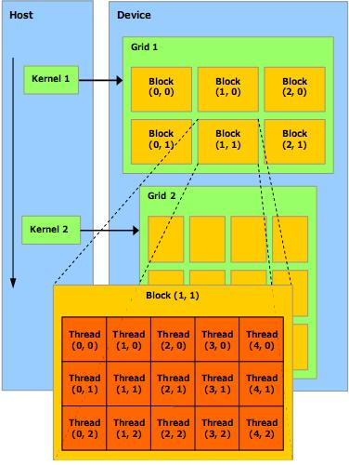
CUDA programming model
14
  Kernel:
    One kernel is executed at a time
    Kernel launches a grid of thread blocks
  Thread block:
    A batch of thread.
    Threads in a block cooperate together, efficiently share data.
    Thread/block have unique id
  Grid:
    A batch of thread blocks that execute the same kernel.
    Threads in different blocks in the same grid cannot directly communicate with each other

Slide 15
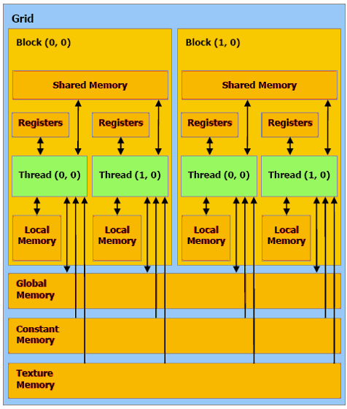
CUDA memory model
15
There is 6 different memory regions

Slide 16
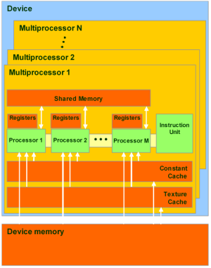
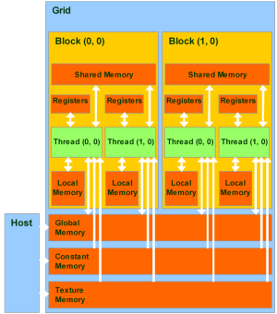
16
Global, local, texture, and constant memory are physically the same memory.
They differ only in caching algorithms and access models.
CPU can refresh and access only:
global, constant, and texture memory.

Slide 17
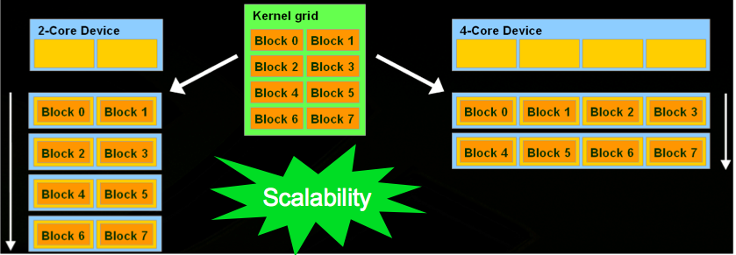
Scalability in CUDA
17

Slide 18
CUDA vs C program
CPU program
CUDA program
void inc_cpu(int *a, int N) {
int idx;
for (idx = 0; idx<N; idx++)
a[idx] = a[idx] + 1;}
int main() {
...
inc_cpu(a, N);
__global__
void inc_gpu(int *a, int N) {
int idx = blockIdx.x * blockDim.x +
threadIdx.x;if (idx < N)
a[idx] = a[idx] + 1;}
int main() {
...
dim3 dimBlock (blocksize);
dim3 dimGrid( ceil( N / (float)blocksize) );
inc_gpu<<<dimGrid, dimBlock>>>(a, N);

Slide 19
CPU vs GPU code (Runge-Kutta algorithm)
19
float h2, h4, f[4];
float xyzt[3], a, b, c, ph,ph2;
float secxs[4],secys[4],seczs[4],hxp[3];
float g1, g2, g3, g4, g5, g6, ang2, dxt, dyt, dzt;
float est, at, bt, ct, cba;
float f1, f2, f3, f4, rho, tet, hnorm, hp, rho1, sint, cost;
float x;
float y;
float z;
float xt;
float yt;
float zt;
float maxit = 10;
float maxcut = 11;
const float hmin = 1e-4;
const float kdlt = 1e-3;
…...
__shared__ float4 field;
float h2, h4, f[4];
float xyzt[3], a, b, c, ph,ph2;
float secxs[4],secys[4],seczs[4],hxp[3];
float g1, g2, g3, g4, g5, g6, ang2, dxt, dyt, dzt;
float est, at, bt, ct, cba;
float f1, f2, f3, f4, rho, tet, hnorm, hp, rho1, sint, cost;
float x;
float y;
float z;
float xt;
float yt;
float zt;
float maxit= 10;
float maxcut= 11;
__constant__ float hmin = 1e-4;
__constant__ float kdlt = 1e-3;
…..

Slide 20
CPU vs GPU code (Runge-Kutta algorithm)
20
do {
rest = step - tl;
if (TMath::Abs(h) > TMath::Abs(rest))
h = rest;
fMagField->GetFieldValue( vout, f);
f[0] = -f[0];
f[1] = -f[1];
f[2] = -f[2];
………..
if (step < 0.) rest = -rest;
if (rest < 1.e-5*TMath::Abs(step)) return;
} while(1);
do {
rest = step - tl;
if (fabs(h) > fabs(rest))
h = rest;
field=GetField(vout[0],vout[1],vout[2]);
f[0] = -field.x;
f[1] = -field.y;
f[2] = -field.z;
………..
if (step < 0.) rest = -rest;
if (rest < 1.e-5*fabs(step)) return;
} while(1);

Slide 21
Example (Texture Memory)
21
Using texture memory for field maps

Slide 22
Field Maps
22
Usually a three dimensional array (XYZ, Rθϕ, etc)
Used as a lockup table w ith some interpolation
For performance and multi-access issues, many people try to parameterize it.
Drawback:
  Specific for certain maps
  Hard to do with good accuracy
  Not possible for all maps

Slide 23
Texture Memory for field maps
23
Three dimensional arrays can be bind to texture directly
Accessible from all threads in a grid
Linear interpolation is done by dedicated hardware
Cashed and allow multiple random access
Ideal for field maps!

Slide 24
Runge-Kutta propagator
24
The Geant3 Runge-Kutta propagator was re-written inside a cuda kernel
  Runge-Kutta method for tracking a particle through a magnetic field. Uses Nystroem algorithm (See Handbook Nat. Bur. Of Standards, procedure 25.5.20)
The algorithm it self is hardly parallelizable, but one can propagate all tracks in an event in parallel
For each track, a block of 8 threads is created, the particle data is copied by all threads at once, then one thread do the propagation

Slide 25
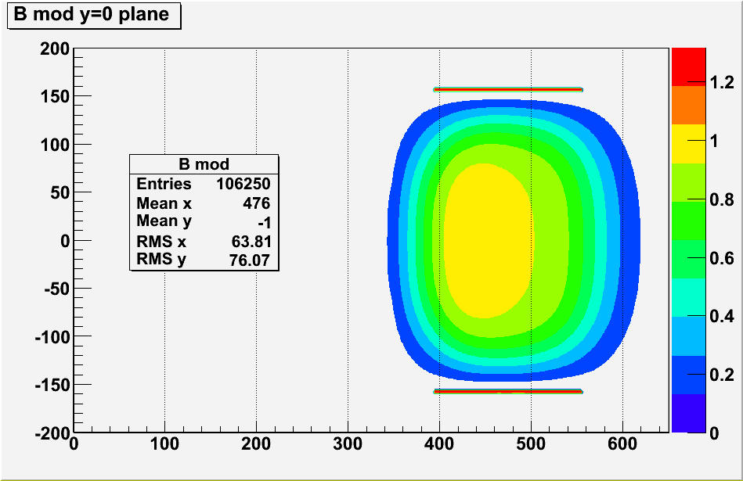
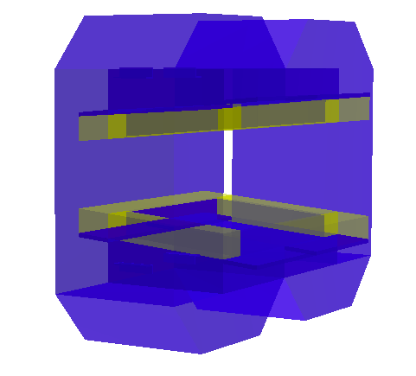
Magnet and Field
25

Slide 26
Cards used in this Test
26
 | Qaudro NVS 290 | GeForce 8400 GT | GeForce 8800 GT | Tesla C1060
CUDA cores | 16 (2 x 8) | 32 (4 x 8) | 112 (14 x 8) | 240 (30 x 8)
Memory (MB) | 256 | 128 | 512 | 4000
Frequency of processor cores (GHz) | 0.92 | 0.94 | 1.5 | 1.3
Compute capability | 1.1 | 1.1 | 1.1 | 1.3
Warps/Multiprocessor | 24 | 24 | 24 | 32
Max. No. of threads | 1536 | 3072 | 10752 | 30720
Max Power Consumption (W) | 21 | 71 | 105 | 200

Slide 27
Track Propagation (time per track)
27
Trk/Event | CPU | GPU emu | Quadro NVS 290 (16) | GeForce 8400GT (32) | GeForce 8800 GT (112) | Tesla C1060 (240)
10 | 240 | 190 | 90 | 80 | 70 | 40
50 | 220 | 140 | 50 | 36 | 20 | 8.0
100 | 210 | 160 | 44 | 29 | 17 | 5.0
200 | 210 | 125 | 45 | 28 | 15 | 4.3
500 | 208 | 172 | 46 | 26 | 11 | 2.6
1000 | 210 | 177 | 42 | 26 | 10 | 1.9
2000 | 206 | 178 | 41 | 26 | 10 | 1.5
5000 | 211 | 177 | 40 | 25 | 10 | 1.2
Time in μs needed to propagate one
track 1.5 m in a dipole field

Slide 28
Gain for different cards
Trk/Event | GPU emu | NVS 290 | 8400 GT | 8800 GT | Tesla
10 | 1.30 | 3 | 3 | 3.5 | 6
50 | 1.60 | 4.4 | 6 | 11 | 28
100 | 1.30 | 4.8 | 7.3 | 12.3 | 47
200 | 1.70 | 4.8 | 7.5 | 14.5 | 49
500 | 1.20 | 4.5 | 7.9 | 18.5 | 80
1000 | 1.20 | 5 | 8.1 | 21 | 111
2000 | 1.10 | 5 | 8 | 21 | 137
5000 | 1.20 | 5 | 8.4 | 21 | 175
CPU/GPU time
Track/Event

Slide 29
Resource usage in this Test
29
 | Qaudro NVS 290 | GeForce 8400 GT | GeForce 8800 GT | Tesla C1060
Warps/Multiprocessor | 24 | 24 | 24 | 32
Occupancy | 33% | 33% | 33% | 25%
Active Threads | 128 | 256 | 896 | 1920
Limited by Max Warps / Multiprocessor | 8 | 8 | 8 | 8
Active threads = Warps x 32 x multiprocessor x occupancy
Active threads in Tesla = 8x32x30x0.25 =
1920
Mohammad Al-Turany, PANDA DAQT
16.04.2010

Slide 30
Using GPUs in HADES
30
Field Map is converted to XYZ map
Event where generated with 0.2-.0.8 GeV protons
Tracks are propagated from the first layer in the MDC1 to the sixth layer in MDC4

Slide 31
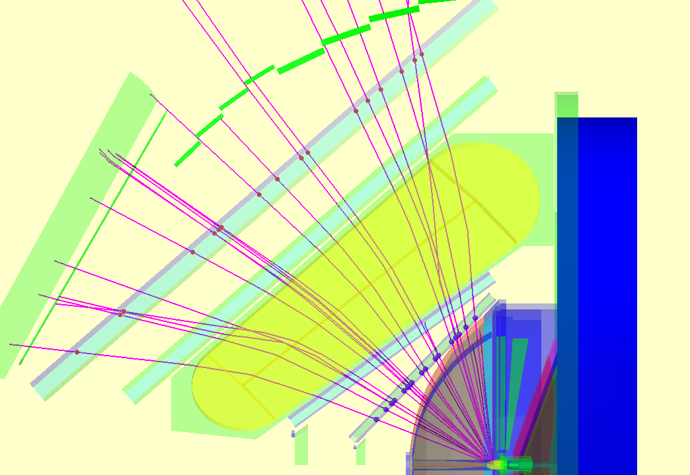
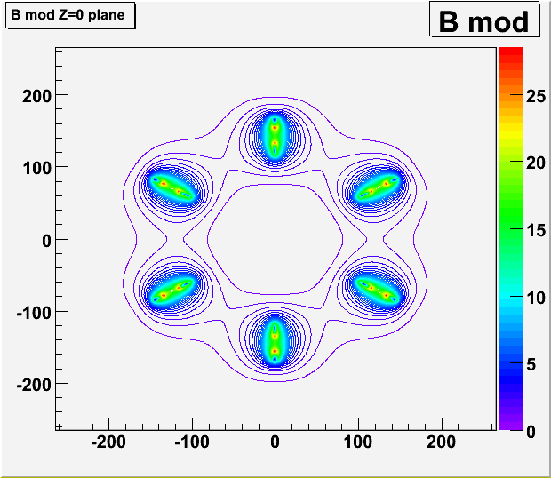
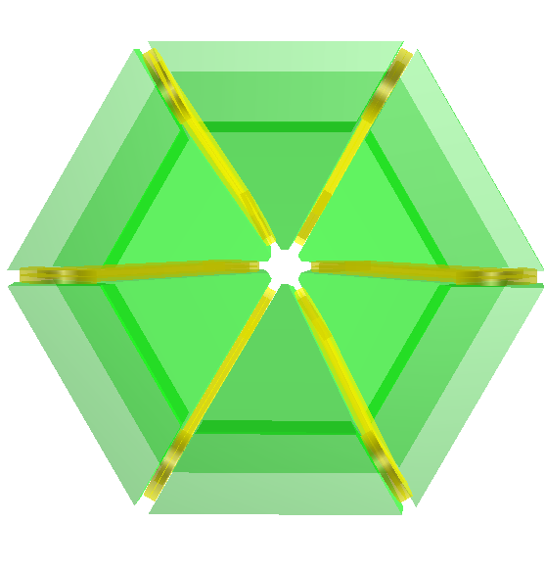
HADES

Slide 32
Track Propagation (Time per event)
32
Trk/Event | CPU | GPU emu | Tesla C1060 (240)
10 | 1.0 | 0.35 | 0.09
50 | 2.8 | 1.54 | 0.18
100 | 5.2 | 2.97 | 0.35
200 | 10.0 | 6.15 | 0.42
500 | 22.6 | 16.7 | 0.66
700 | 30.3 | 22.4 | 0.74
In HADES case the number of Tracks here should be taken as the number of propagations per events
(In HADES fitting each Track is propagated 6 times for each iteration in the fit)
Mohammad Al-Turany, PANDA DAQT
16.04.2010

Slide 33
Track Propagation ( μs/propagation)
Time in μs needed to propagate one
track from MDC1 layer1 to
MDC 4 layer 6
Speedup factors
Trk/Event | GPU emu | Tesla
10 | 2.9 | 11
50 | 1.9 | 15
100 | 1.8 | 15
200 | 1.6 | 24
500 | 1.4 | 34
700 | 1.4 | 41
Trk/Event | CPU | GPU emu | Tesla C1060 (240)
10 | 100 | 35 | 9.0
50 | 56 | 31 | 3.6
100 | 52 | 30 | 3.5
200 | 50 | 31 | 2.0
500 | 45 | 33 | 1.3
700 | 43 | 32 | 1.1

Slide 34
Example (Zero Copy)
34
Using the pinned (paged-locked) memory to make the data available to the GPU

Slide 35
Zero Copy
35
Zero copy was introduced in CUDA Toolkit 2.2
It enables GPU threads to directly access host memory, and it requires mapped pinned (non-pageable) memory
Zero copy can be used in place of streams because kernel-originated data transfers automatically overlap kernel execution without the overhead of setting up and determining the optimal number of streams

Slide 36
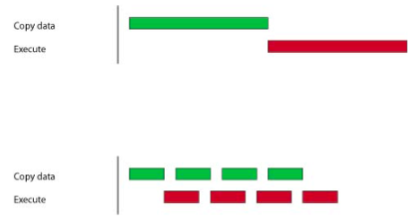
Track + vertex fitting on CPU and GPU
36
CPU Time/GPU Time
Track/Event | 50 | 100 | 1000 | 2000
GPU | 3.0 | 4.2 | 18 | 18
GPU (Zero Copy) | 15 | 13 | 22 | 20
Time needed per event (ms)
 | 50 | 100 | 1000 | 2000
CPU | 3.0 | 5.0 | 120 | 220
GPU | 1.0 | 1.2 | 6.5 | 12.5
GPU (Zero Copy) | 0.2 | 0.4 | 5.4 | 10.5

Slide 37

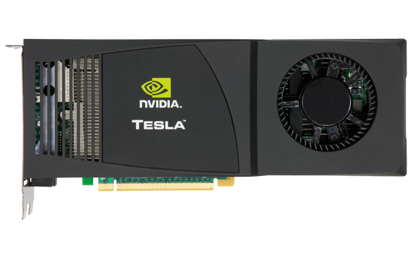
Parallelization on CPU/GPU
No. of Process | 50 Track/Event | 2000Track/Event
1 CPU | 1.7 E4 Track/s | 9.1 E2 Track/s
1 CPU + GPU (Tesla) | 5.0 E4 Track/s | 6.3 E5 Track/s
4 CPU + GPU (Tesla) | 1.2 E5 Track/s | 2.2 E6 Track/s

Slide 38
NVIDIA’s Next Generation CUDA Architecture
38
FERMI

Slide 39
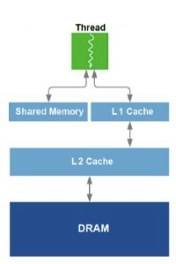
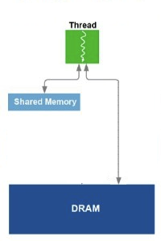
Features:
Support a true cache hierarchy in combination with on-chip shared memory
Improves bandwidth and reduces latency through L1 cache’s configurable shared memory
Fast, coherent data sharing across the GPU through unified L2 cache
Fermi
Tesla
http://www.behardware.com/art/imprimer/772/

Slide 40
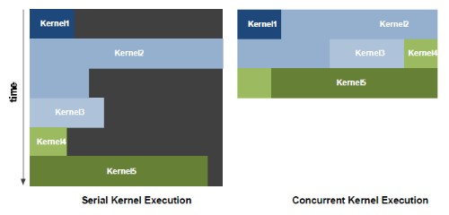
NVIDIA GigaThread™ Engine
Increased efficiency with concurrent kernel execution
Dedicated, bi-directional data transfer engines
Intelligently manage tens of thousands of threads
http://www.behardware.com/art/imprimer/772/

Slide 41
ECC Support
41
First GPU architecture to support ECC
Detects and corrects errors before system is affected
Protects register files, shared memories, L1 and L2 cache, and DRAM

Slide 42
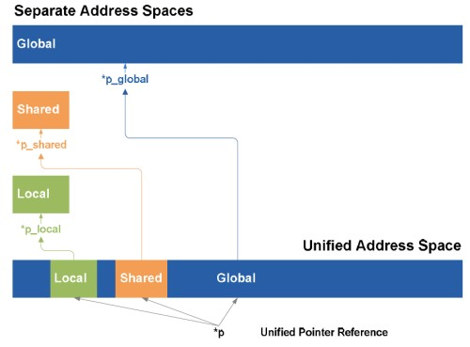
Unified address space
42
Groups local, shared and global memory in the same address space.
This unified address space means support for pointers and object references that are necessary for high-level languages such as C++.
http://www.behardware.com/art/imprimer/772/

Slide 43
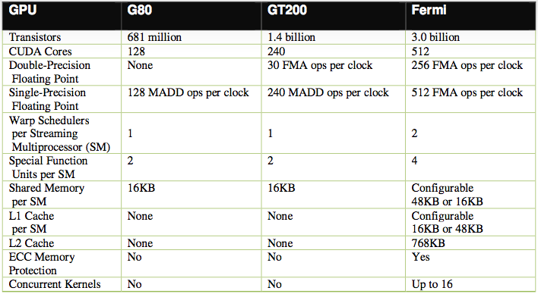
Comparison of NVIDIA’s three CUDA-capable GPU architectures
http://www.in-stat.com
Notes:
FMA or FMAC stands for Fused multiply add accumulate
MADD = multiply and Add

Slide 44
Next Steps related to Online
In collaboration with the GSI EE, build a proto type for an online system
  Use the PEXOR card to get data to PC
  PEXOR driver allocate a buffer in PC memory and write the data to it
  The GPU uses the Zero copy to access the Data, analyze it and write the results

Slide 45
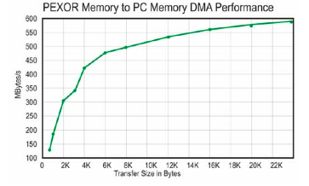
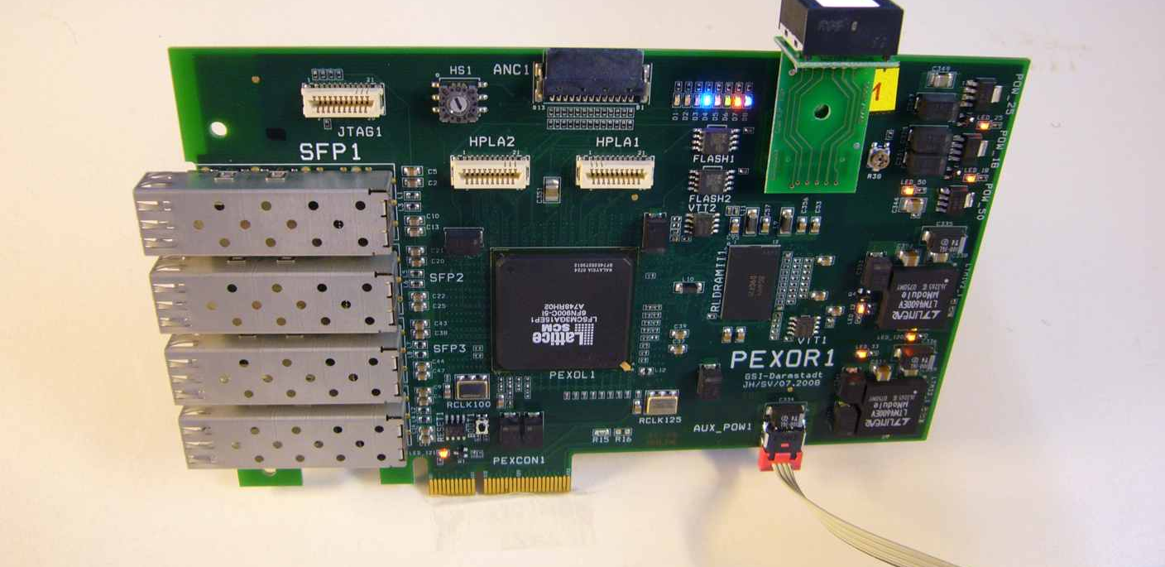
PEXOR
The GSI PEXOR is a PCI express card provides a complete development platform for designing and verifying applications based on the Lattice SCM FPGA family.
Serial gigabit transceiver interfaces (SERDES) provide connection to PCI Express x1 or x4 and four 2Gbit SFP optical transceivers

Slide 46
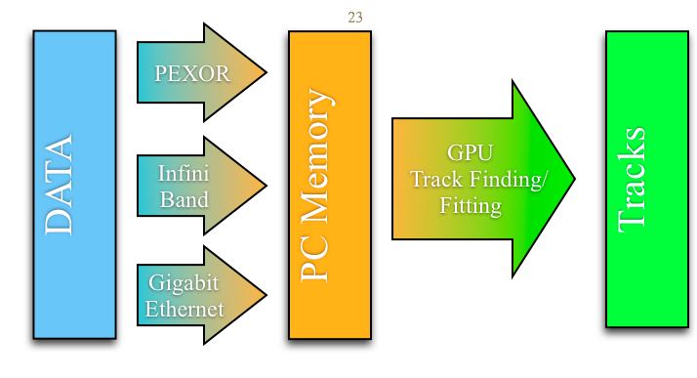
Configuration for test planned at the GSI
?

Slide 47

Summary
47
Cuda is an easy to learn and to use tool.
Cuda allows heterogeneous programming.
Depending on the use case one can win factors in performance compared to CPU
Texture memory can be used to solve problems that require lookup tables effectively
Pinned Memory simplify some problems, gives also better performance.
With Fermi we are getting towards the end of the distinction between CPUs and GPUs
  The GPU increasingly taking on the form of a massively parallel co-processor

