Slide 1

AliEn v2-18
S. Bagnasco, L. Betev, C. Grigoras, F. Furano, A. Grigoras, S. Lee, P. Mendez, A.Peters, P. Saiz, S. Schreiner, O. Vladimirovna, J.Zhu
ALICE - FAIR Offline Meeting
4 May 2010

Slide 2
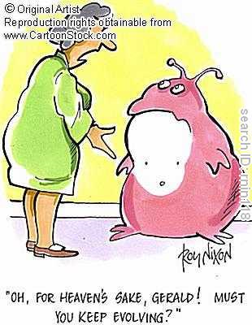
Why new AliEn?
AliEn evolves
  New requests
  New features
  Bigger scale
    More 20K jobs v2-17
    Can we do 200K with v2-18?
What is the next evolution?

Slide 3
What is new in AliEn v2-18
Solved quite a lot of ‘previous challenges’ http://indico.cern.ch/contributionDisplay.py?contribId=49&sessionId=4&materialId=slides&confId=69951
Job and File Quotas (Sehoon)
Improved SE discovery (Steffen, Costin)
Web interface to AliEn (Costin)
Site services under http (Jianlin)
Better package installation (Pablo)
Running AliEn jobs in your laptop (Pablo)
Optimized OCDB access (Chiara, Raffaele, Pablo)
New web server (Steffen)
Updated versions of external modules (Olga, Alina)
Bug fixes (everybody)
  And new bugs are born...

Slide 4
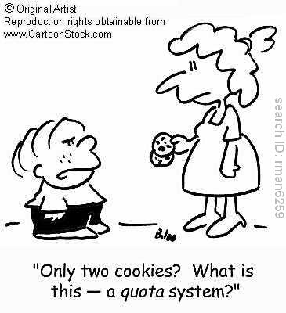
File and job quotas
Limit on the resources
Per user
Jobs:
  # jobs, cpuCost, running time
Files:
  # files , total size (including replicas!)
Still to define limits
fquota and jquota

Slide 5
SE discovery
Finding the closest working SEs of a QoS
  Taking into account MonALISA tests
  For reading and writing
Simplifying the selection of SE
  And giving more options in case of special needs
Reducing calls to central services

Slide 6
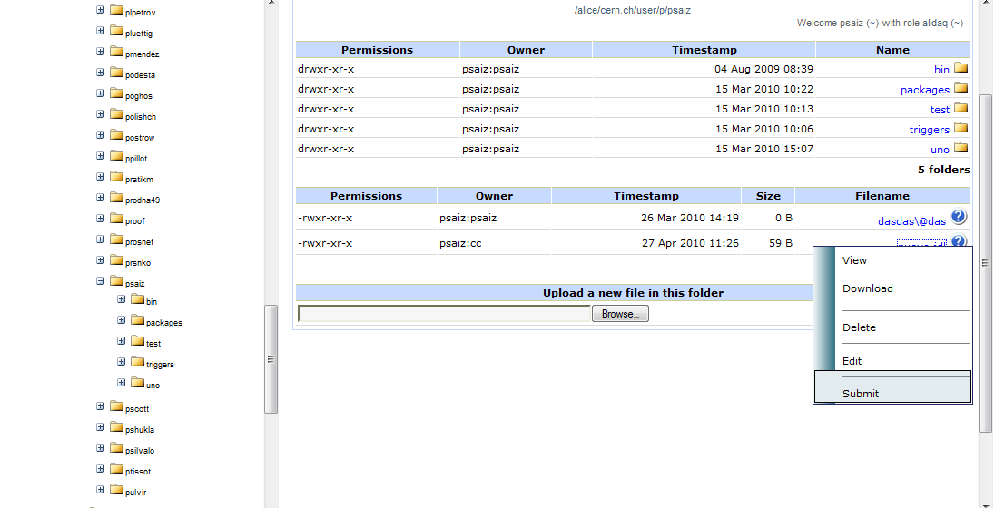
Web interface
https://alimonitor.cern.ch/catalogue/

Slide 7
Submit -n
Run your job before submitting it to the grid
Same JDL syntax (except for slitting)
Configuring same packages
Ideal case:
  User develops locally
  Tries code with ‘submit –n’
  Run in the full grid

Slide 8
New challenges
Perl 5.10 and multi-threaded processes (Alina,Olga)
Globus vs. Openssl (Alina, Artem)
Glexec (Steffen)
Database replication (Lola)
Using gridsite (Jianlin)
Relocation of jobs (Patricia)
AliEn in ORACLE (Almudena)
VO to VO submission (Szymon)
Simplify JobAgents
Improve logging mechanism
File deletion
xrd3cp
...

Slide 9
AliEn for ALICE and FAIR
Very good collaboration:
  AliEn and MonALISA setup and configured for FAIR
  ALICE profits from ‘small’ environments to test new changes
  FAIR profits from code developed by ALICE
  PANDA workshops very useful
At the beginning, FAIR had lot of support from CERN
Now, PANDA/CBM responsible for deployment/maintenance
  But not yet development...

Slide 10
Remote development
Two projects:
  VO to VO submission and AliEn on ORACLE
More difficult than in-site development
  ETA=π* local ETA (or even π²)
Possible reasons :
  Steep learning curve
  Lack of doc
  Difficult to ask for help
  Other priorities
How to improve it:
  (Short) Trips to CERN
  Improving documentation
  Any other ideas?

Slide 11
Summary
AliEn v2-18 deployed for ALICE
  With new and exciting features
  Easier to select SE
    Trust default values!
  File and job quotas
  Running jobs locally
  Improved package installation
AliEn evolution continues…
  Already planning next release
  If you want to collaborate, please let us know.

Slide 12
Backup

Slide 13
Site services on http
Changing one attribute in LDAP
Configuration created automatically
Httpd is
  Faster than SOAP::Lite server
  More reliable than SOAP::Lite server
  Same processes for multiple services
  Several services under same port
Easier to integrate with gridsite

Slide 14

How SE discovery works
Write:
I’m in ‘Madrid’
Give me SEs!
Authen
Client
Optimizer
Try: CCIN2P3, CNAF, Kosice
File Catalogue
SERank
Similar process for read (limited to SE having the file)
Can select number of SE, QoS, particular user, avoid SE...
DEFAULT ARGUMENTS SHOULD BE USED WHENEVER POSSIBLE

Slide 15
Package installation
Both for native PackMan and ‘torrent’ installations
Multi-client safe
  Including the dependencies
New command:
  Packman synchronize
    Installs all packages defined in AliEn
    Deletes packages not defined in AliEn
New option:
  -local

Slide 16
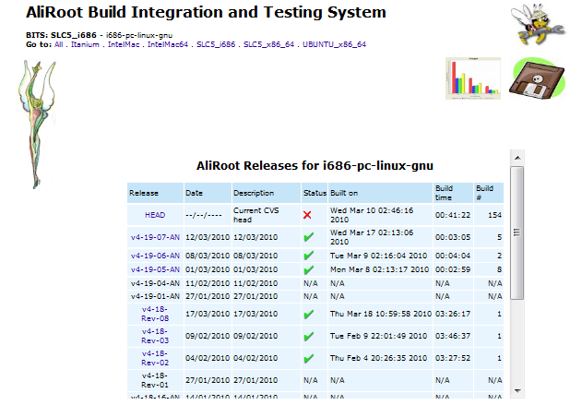
Pre-Installing all packages
Node1
Local Disk
Packman synch
Node2
Local Disk
BUILD SYSTEM
Packman synch
Node3
AliEn FC
Local Disk
Packman synch
...
Packman synch
Node n
Local Disk
Packages can still be installed automatically before running the job

Slide 17
masterSE
Command for site/vo administrators
Ease replicating, moving, deleting all the files in a particular SE
Identify broken links in the catalogue

