Slide 1
Begining of discussion of FRESCA measurement
Brunner Kristof

Slide 2
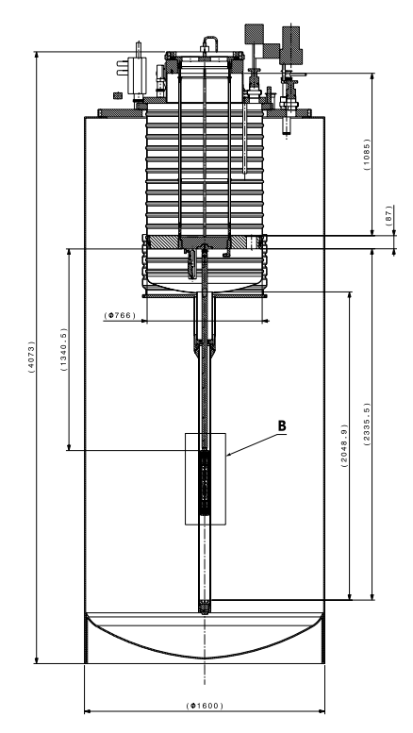
First week of the quarantine
FRESCA
Discussion with the design office
  Weekly meetings
  For now we are talking through what we
  want to achieve, and how would it be
  possible
  Preliminary drawings to discuss about
Work will progress slowly during the
quarantine due to 75% of the design
office not being able to work
  CERN staff designers are reallocated to
  work on the most important projects

Slide 3
Difficulties to rule out
Most important property of the setup is to set and keep a stable temperature during at least 30 min intervals
Two main suggestion
  Pumping cold He gas to the bottom of the setup, and heat it locally, then circulating it through the system
    The power input to the heater is controllable
  Pumping cold He gas to the bottom of the setup, and letting it circulate through the whole system, while heaters are heating the whole setup
    Needs heater system all around the setup
Next week Torsten Koetting from the cryolab will be included in the meeting, and we will discuss advantages of both solution

Slide 4
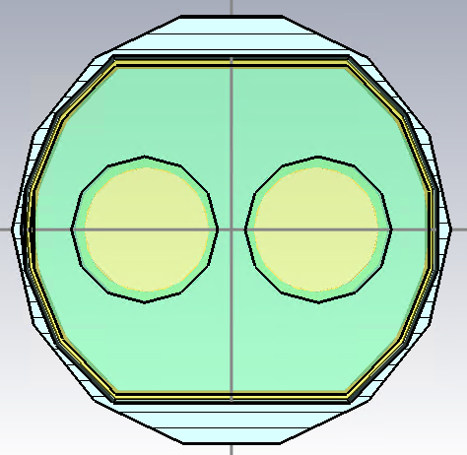
Difficulties to rule out
The space between the setup and the inner aperture of the FRESCA magnet is ~9mm radially
  sufficient for the cables coming from the bottom, but might be a bit too small for heaters
  One way to increase this is to have the tube outside the beam screen not cylindrical
  I am running simulation now to
  check how much would this
  influence the
vacuum pipe
beam screen

Slide 5
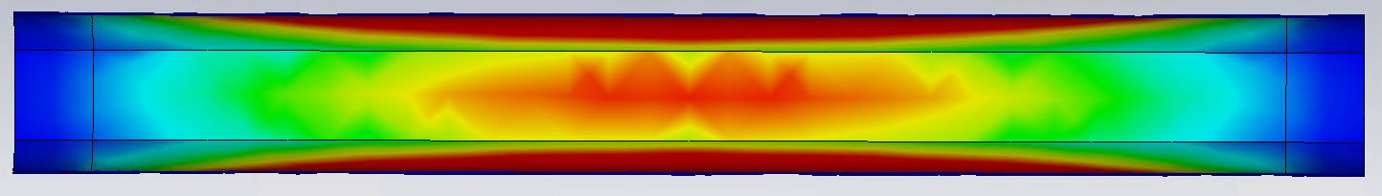
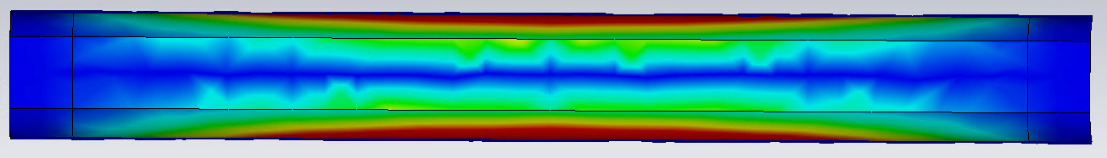
Simulation
How much do the pumping holes influence the measurement
If not too much (e.g. up to 5%), then it does not matter what is on the outside of the beam screen
Even mode surface currents on the beam screen
Pumping holes are here
Odd mode surface currents on the beam screen

Slide 6
University duties
In the current situation my courses both switched to remote lecturing
  This way I can attend one of my courses
No one really knows how will the rest of the semester go down
For now I don't see myself going for an unpaid leave in May and June (as planned originally)
  No exam will possibly be held in May
  To be decided as soon as I know more of the long term plans in CERN and at the university

