Slide 1
HEPDipo
Status of the design and developments
Baseline and 4 coils comparaison
MSC-MDT
April 1st, 2020

Slide 2
Status of models and design
Model | Baseline | 4 coils option
2D Ansys magnetic | ✓ | ✓
2D Opera magnetic | ✓ | ✓
2D Roxie magnetic | ✓ | ✓
2D Ansys mechanical | ✓ | ✓
3D Ansys magnetic | ✓ | ✓
3D Opera magnetic | ✓ | ✓
3D Ansys mechanical | ✓ | Updating for the new 4 coils solution
Magnet protection | ✓ | Updating for the new 4 coils solution
Status of design | Addressing issues: pre-load criterium Ti pole deformation Stress on the wedge Rod (Al / SS) | Addressing issues: pre-load criterium Stress on the end plate etc..

Slide 3
Status of cable trials
Magnet / option | Ramp angle (°) | Winding machine load 25 and 50 kg | Geometric measurements | Laser track
HEPDipo baseline | 10 | ✓ | ✓ | ✓
HEPDipo baseline | 17 (FRESCA2) | ✓ | ✓ | ✓
HEPDipo 4 coils Outer coil | 10 | ✓ | ✓ | ✓
HEPDipo 4 coils Outer coil | 17 (FRESCA2) | ✓ | ✓ | ✓
DEMO 16 T for FCC Inner layer | - | ✓ | ✓ | ✓
DEMO 16 T for FCC Outer layer | - | ✓ | ✓ | ✓
Status | finished | finished | finished | Data under analysis

Slide 4
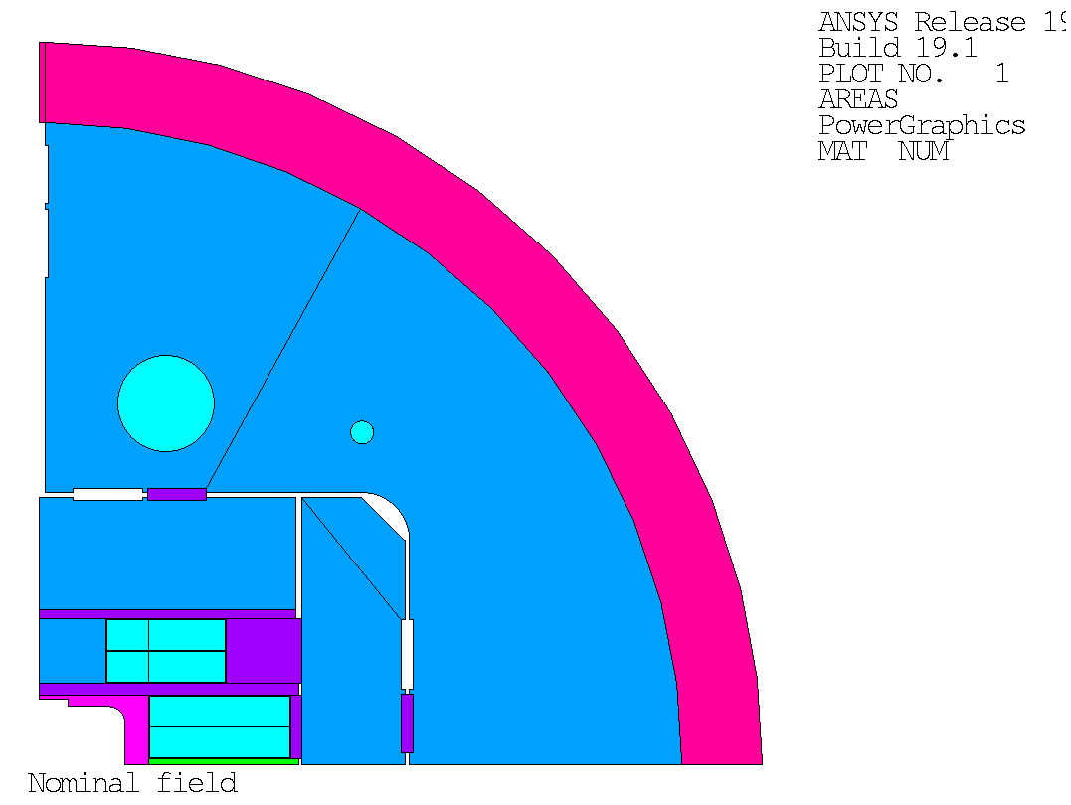

4 coils option vs 6 coils (baseline)
Aluminum Shell
vertical
pusher
Coil3
iron pole
Coil2
Yoke
Coil2
inter-coil
shim
Coil1
Coil1
titanium
pole
mid-plane
shim
horizontal pad

Slide 5
4 coils option vs 6 coils (baseline)
boat
32 turns
iron
pole
42 turns
32 turns
42 turns
32 turns
50 turns
32 turns
50 turns
32 turns
32 turns
titanium
pole
rails
mid-plane
shim
 | Turns (1/4)
4 coils | 92
6 coils | 96

Slide 6
Goal and cable data
 | Goal (SPC / LBNL)
B center | 15 / 16 T
% SS | 85% / 84%
temperature | 4.2 / 1.9 K
aperture | ‘rectangular’ 150x100
length | ~ 2 m
Cable data
number of strands | 44
thickness | 1.95 mm
width | 26.2 mm
turn insulation thickness | 0.20 mm
coil insulation thickness | 0.5 mm
Inter-layer insulation | 0.5 mm

Slide 7
Wire specification
Parameter | Value
Wire technology | RRP 108/127
Wire diameter in mm | 1.1
Cu:non-Cu ratio | 1
RRR | >150
Critical current density at 15 T, 4.2 K in A/mm2 | 1640
Parameter | Value
Critical current density at 12 T, 4.2 K in A/mm2 | 3000
C0 in AT/mm2 | 255230
α | 0.96
TC0 in K | 16
BC20 in T | 28.8

Slide 8
Magnetic results comparison (85 % of LL – 4.2 K)
Parameter | 4 Coils value | 6 Coils value
Bap - aperture field (T) | 14.84 | 14.82
Bpk - Coil peak field (T) | 15.17 | 15.31
Field quality b3, b5, b7, b9 (units) | - 5.86, - 4.01, 2.05, - 0.10 | 42.08, - 10.49, - 0.80, - 0.14
Energy per length (MJ/m) | 7.3 | 6.86
Horizontal Lorentz force (1/4) (MN/m) | 14.37 | 14.41
Vertical Lorentz force (1/4) (MN/m) | - 8.56 | - 7.11
Operational current (kA) | 14.67 | 14.28
(Bap/Bpk)/(SC_area) (1/mm²) | 8.09E-5 (+5.5%) | 7.68E-5

Slide 9
Stress on coils comparison
HF
region
Outer
coil
HF
region
Outer
coil
HF
region
Inter
coil
High field
region
Inner
coil
HF
region
Inner
coil
15 T operation | 4 Coils von Mises stress | 6 Coils von Mises stress
Inner / inter / outer coils | 145 / / 120 MPa | 158 / 115 / 110

Slide 10
Mechanical results comparison
Parameter | 4 Coils value (MPa) | 6 Coils value
 | Room temperature / cooling down / 15 T | Room temperature / cooling down / 15 T
Inner coil | 9 / 52 / 145 | 48 / 110 / 158
Inter coil | - | 74 / 154 / 145
Outer coil | 55 / 103 / 135 | 53 / 113 / 117
Iron pole (S1) | 1 / 13 / 280 | 1 / 15 / 246
Horizontal pad (S1) | 92 / 157 / 109 | 100 / 200 / 130
Vertical pad (S1) | 44 / 54 / 128 | 57 / 77 / 78
Yoke (S1) | 92 / 155 / 194 | 105 / 108 / 140
titanium pole (Von Mises) | 81 / 590 / 800 | 370 / 766 / 1225
Shell (Azimuthal) | 70 / 163 / 154 | 123 / 215 / 234

Slide 11
Parametric analysis: horizontal tolerance
Horizontal misalignment
Horizontal misalignment
Outer
coil
Outer
coil
Horizontal
misalignment
Inter
coil
Inner
coil
Inner
coil
Fixed position
for the inner coil
Fixed position
for the inner coil

Slide 12
Parametric analysis: horizontal tolerance
4 Coils
6 Coils
For a mm of displacement
the peak of stress of the 4 coils
option remains the same.
The peak is stress of the 6 coils
option goes from 157 to 186 MPa

Slide 13
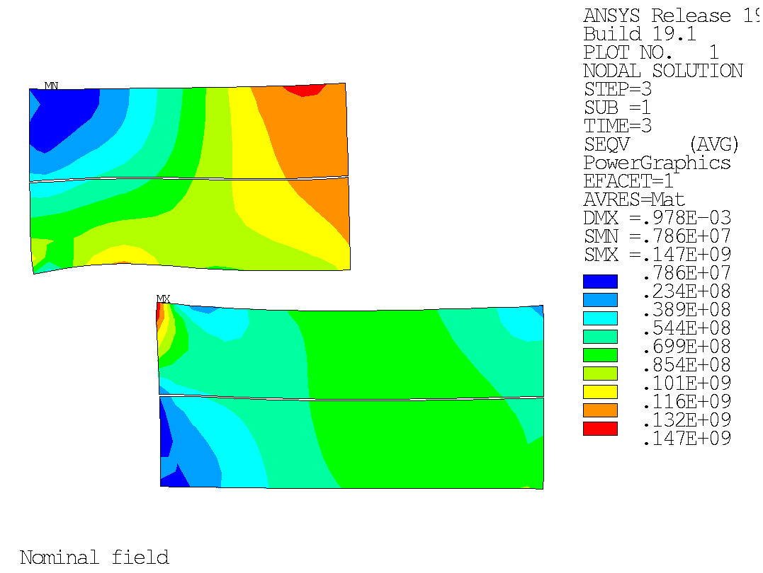
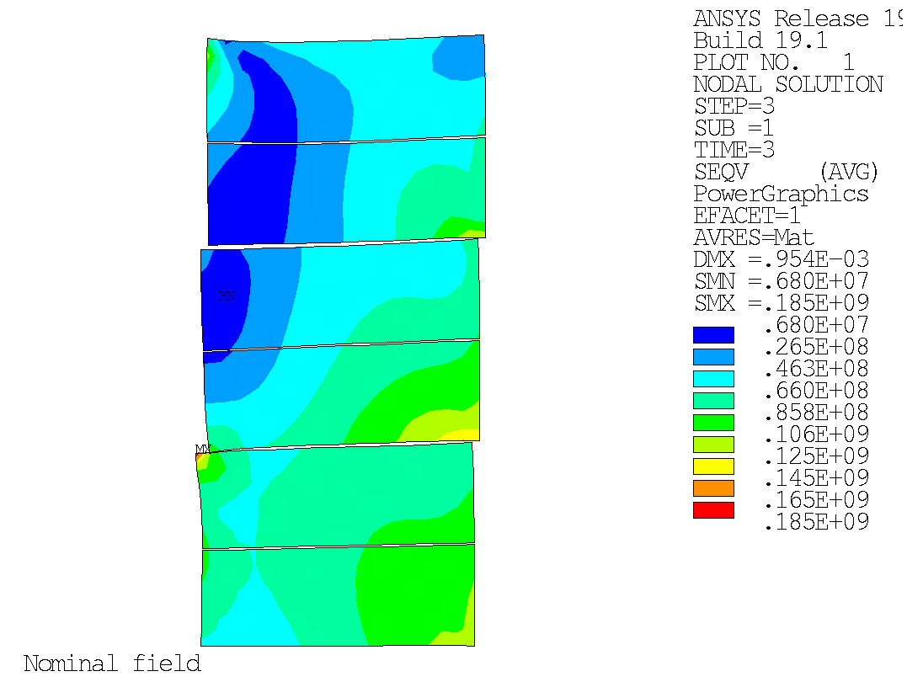
Parametric analysis: horizontal tolerance (1 mm)
4 Coils
6 Coils
147 MPa
185 MPa

Slide 14
Parametric analysis: vertical tolerance
Outer
coil
Outer
coil
Inter
coil
Inner
coil
Fixed position
for the inner
coil
Inner
coil
Fixed position
for the inner coil
The inner coil position is fixed. An interference, representing the dimension tolerance is introduced between coils ( )

Slide 15
Parametric analysis: vertical tolerance - coils
4 Coils
6 Coils
For a mm of interference between
Coils, the peak of stress of the
4 coils option goes from 145 to
187 MPa
The peak of stress of the 6 coils
option goes from 157 to 290 MPa

Slide 16
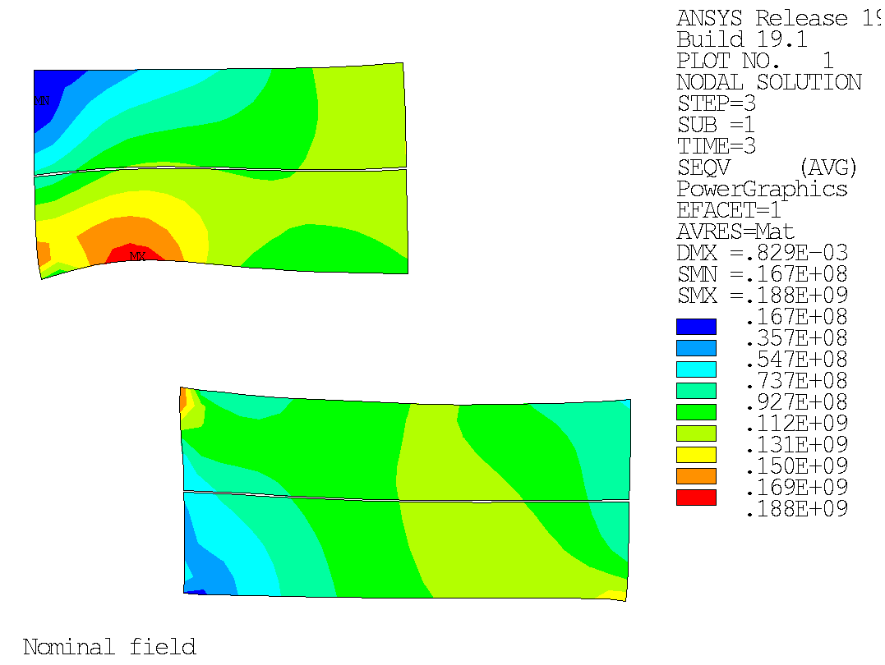
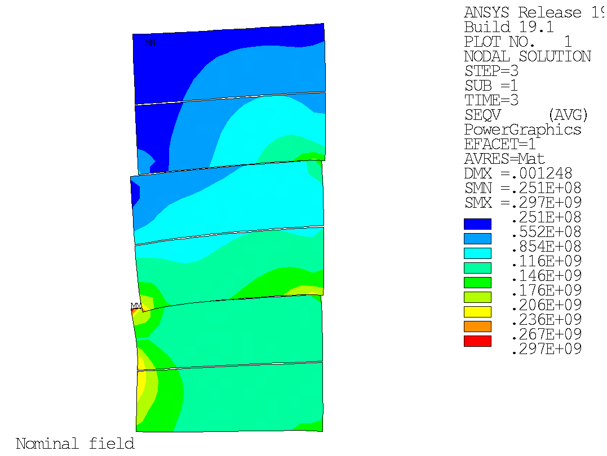
Parametric analysis: vertical tolerance (1 mm)
4 Coils
6 Coils
188 MPa
297 MPa
220 MPa

Slide 17
Parametric analysis: vertical tolerance – Ti pole
4 Coils
6 Coils
For a mm of interference between
coils the peak of stress on the Ti
Pole of the 4 coils option goes from
800 to 1438 MPa
The peak is stress on the Ti pole
of the 6 coils option goes from
1225 to 2262 MPa

Slide 18
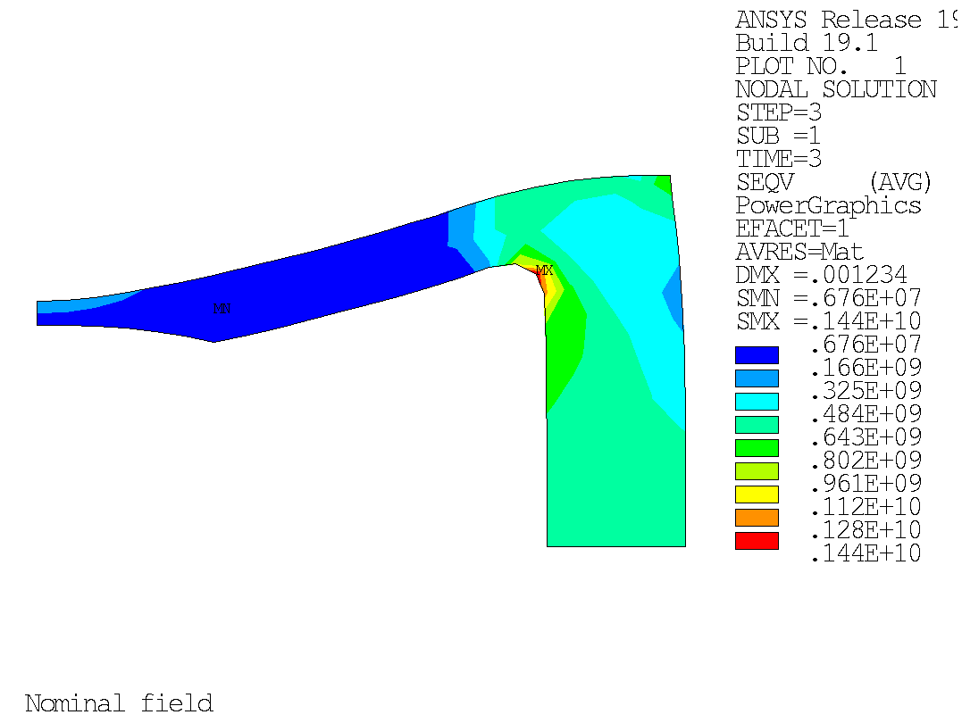
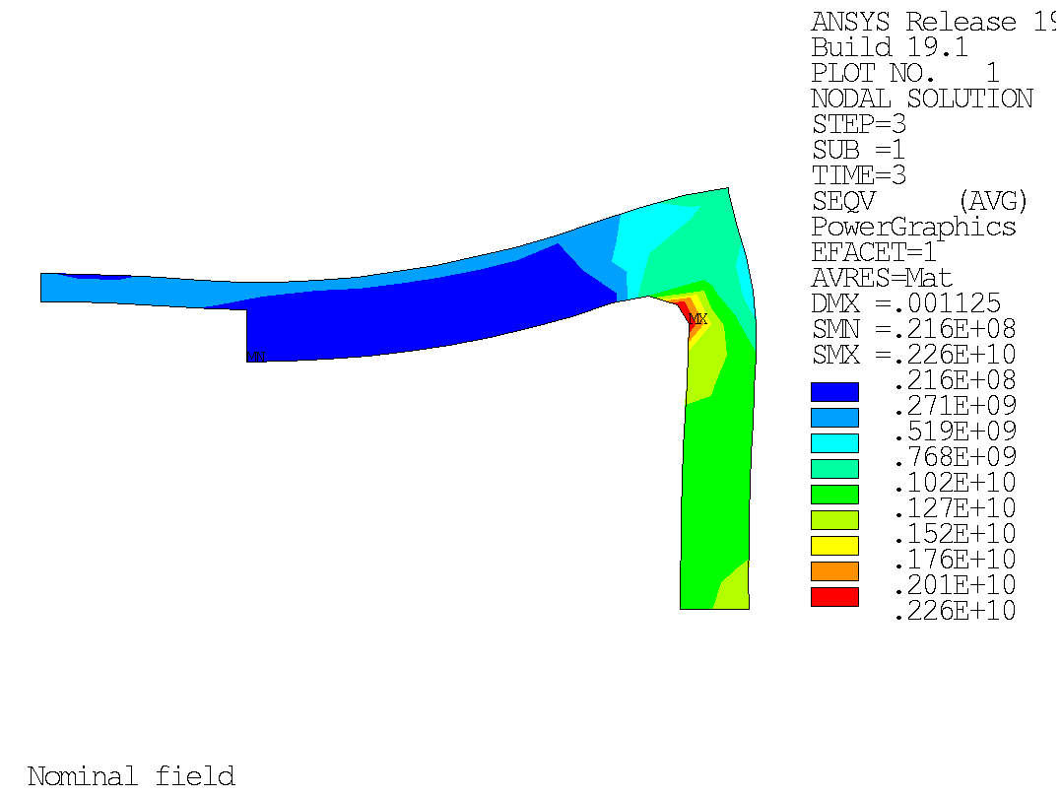
Parametric analysis: vertical tolerance (1 mm)
4 Coils
6 Coils
2260 MPa
1440 MPa
Titanium Yield point = 1650 MPa

Slide 19
Annex

Slide 20
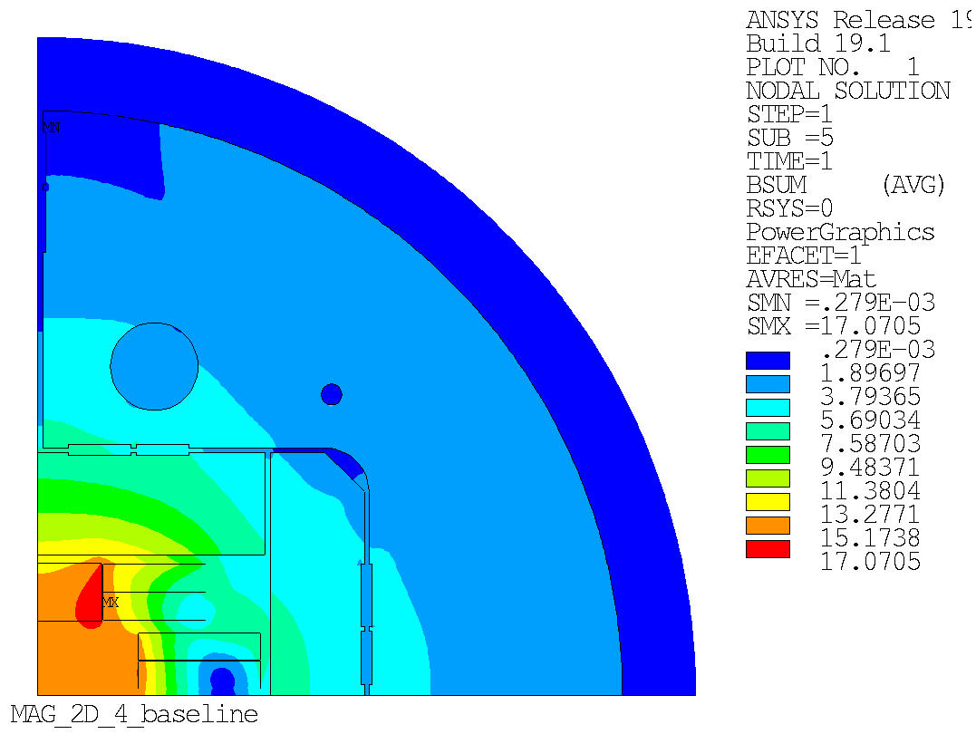
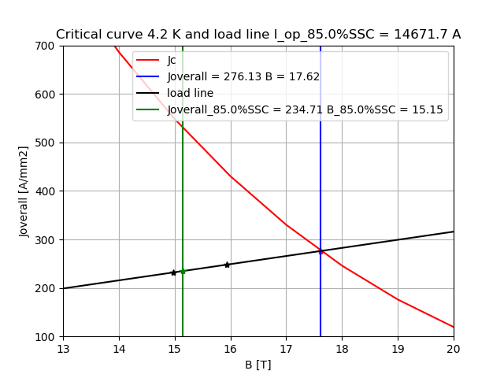
Magnetic 4.2 K - 85% of the load line
Bore field (B): 14.84 T
Max coil field (B): 15.17 T

Slide 21
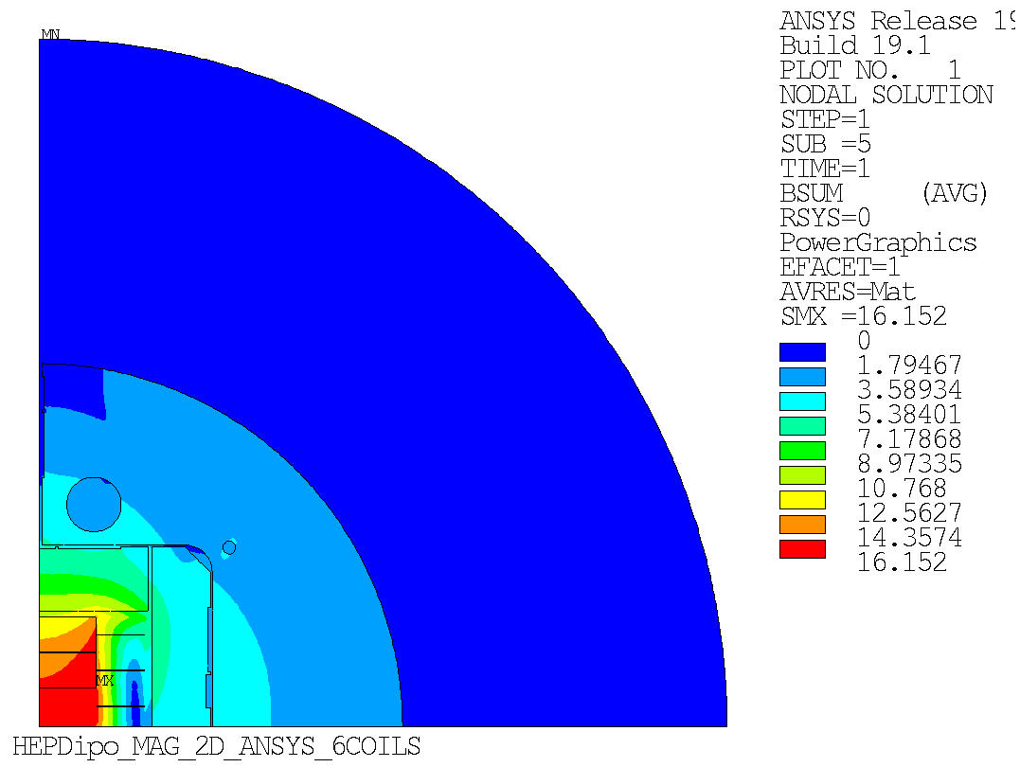
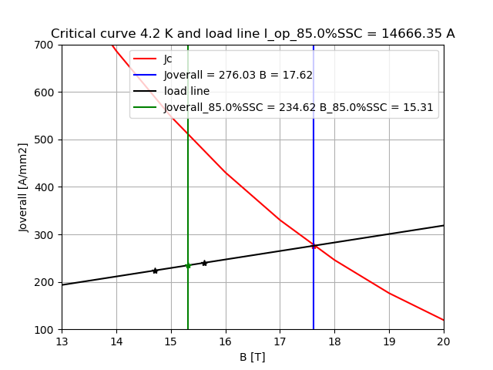
Magnetic 4.2 K - 85% of the load line
Bore field (B): 14.82 T
Max coil field (B): 15.31 T

