Slide 1
CCT FF quad for CEPC – how does it compare?
M. Koratzinos
Optics meeting
3 /4/2020

Slide 2
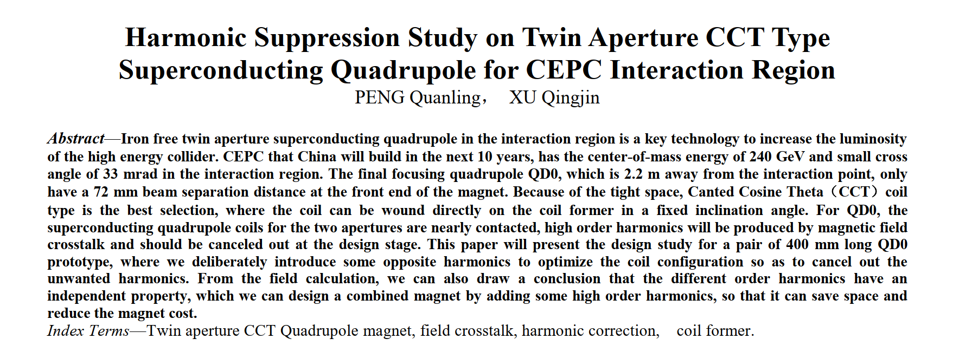
New preprint

Slide 3
Introduction
It seems that the CEPC is giving up the idea of an iron yoke FF quad and replaces it with a CCT design.
We did this first.
How close are the two designs?
I am comparing the CEPC pre-print with my published work:
A Method for Greatly Reduced Edge Effects and Crosstalk in CCT Magnets, by M. Koratzinos, G. Kirby, J. Van Nugteren, E.R. Bielert, arXiv:1709.08444 [physics.acc-ph] IEEE Trans. Appl. Supercond. 28 (2018) no.3, 4007305.

Slide 4
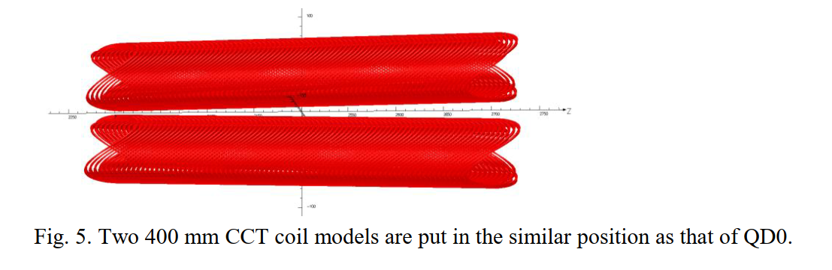
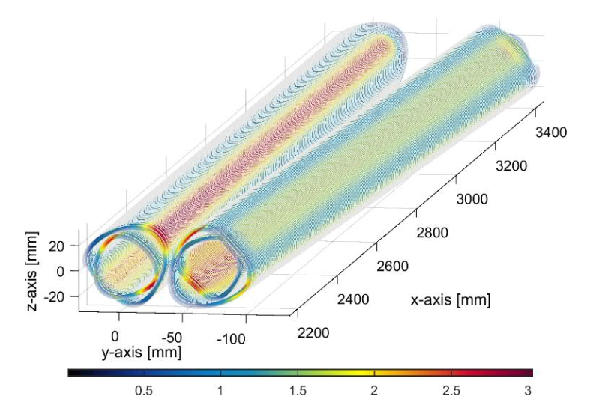
layout
CEPC
FCC-ee

Slide 5
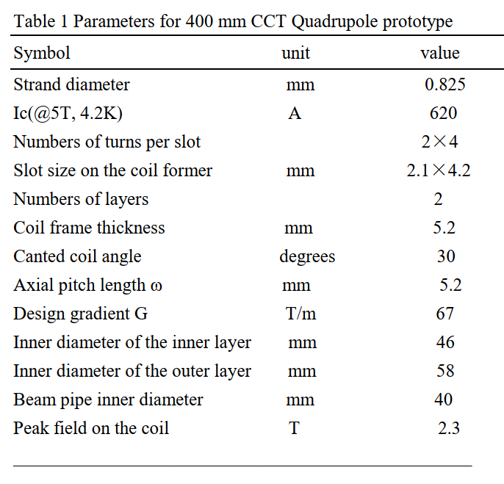
parameters
CEPC
FCC-ee
same
same
same
2.05 X 4.00
same
6.0mm
same
5.0mm
100T/m
44
50
30
3.0

Slide 6
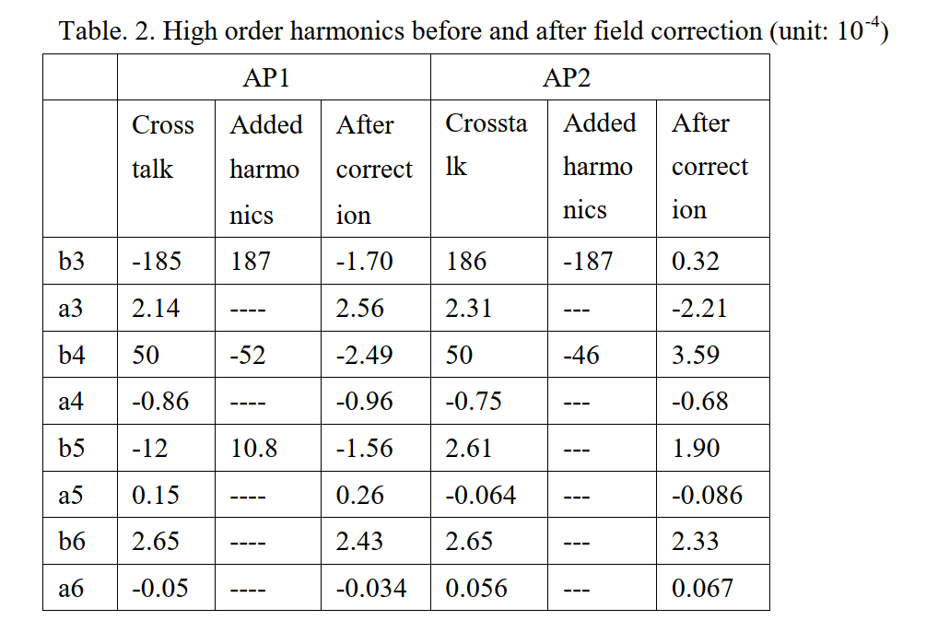
Cross talk – before correction
FCC-ee
-95
-1
+20
+0.2
-2
0
0
0
CEPC: harmonics at 13mm; FCC-ee: harmonics at 10mm

Slide 7
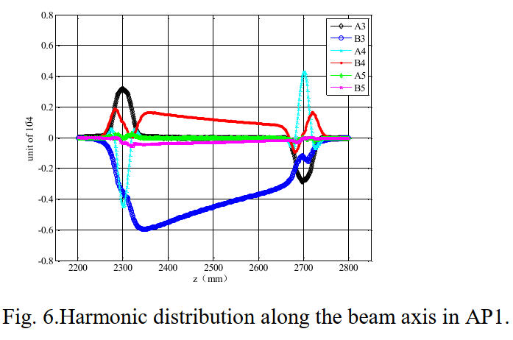
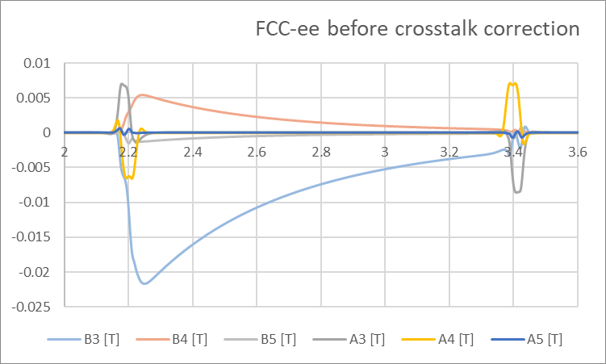
Cross-talk: before correction
CEPC
FCC-ee
Note: CEPC quad is only 40cm long; FCC-ee quad is full length (1.2m)
Note: vertical scales are different: on the right: field strength in T

Slide 8
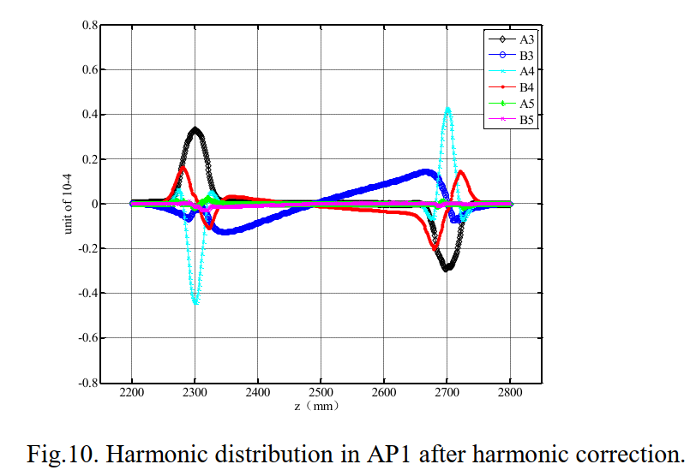
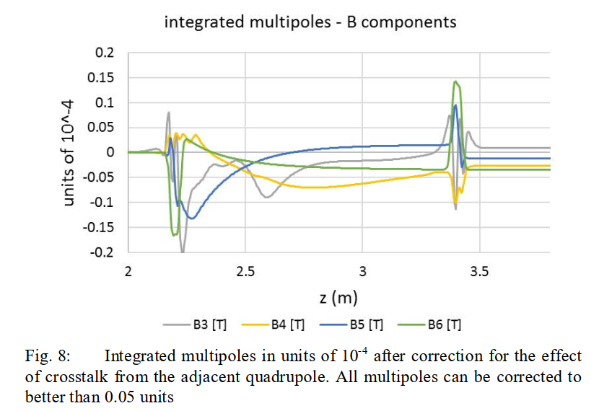
Cross talk – after correction
CEPC
FCC-ee
After correction, limit would be related to alignment and groove accuracy, the method itself can be arbitrarily accurate

Slide 9
Summary
…another point where our Chinese colleagues have converged to our design.
My paper is referenced, but the FCC project is not…

