Slide 1
thoughts on orbit tolerance with monochromatization*
Frank Zimmermann
115th FCC-ee Optics Design Meeting, 3 April 2020
*thanks to Jörg Wenninger for raising this issue
comments made during the meeting in green

Slide 2


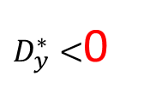


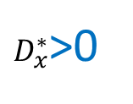







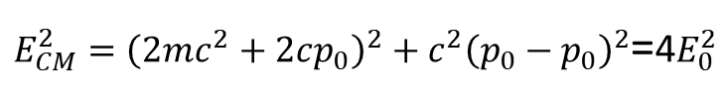
ideal monochromatization
$$\sqrt{β_{x}^{∗}ε_{x}} ≪\left|D_{x}^{∗}\right|σ_{δ}$$
& ignore second order dispersion
e⁻
e⁺
x
$$δ0+2Δδ$$
$$δ0−2Δδ$$
$$δ0+Δδ$$
$$δ0−Δδ$$
x=D_{x}*δ
$$δ0$$
$$δ0$$
$$δ0−Δδ$$
$$δ0+Δδ$$
$$δ0−2Δδ$$
$$δ0+2Δδ$$
$D_{x}^{∗}$>0
$D_{y}^{∗}<$0
s
$E_{CM}^{2}={\left(2mc^{2}+2cp_{0}\right)}^{2}+{c^{2}\left(p_{0}−p_{0}\right)}^{2}$=4$E_{0}^{2}$

Slide 3


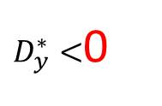


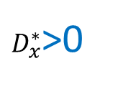



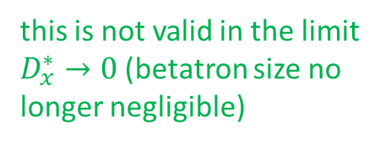



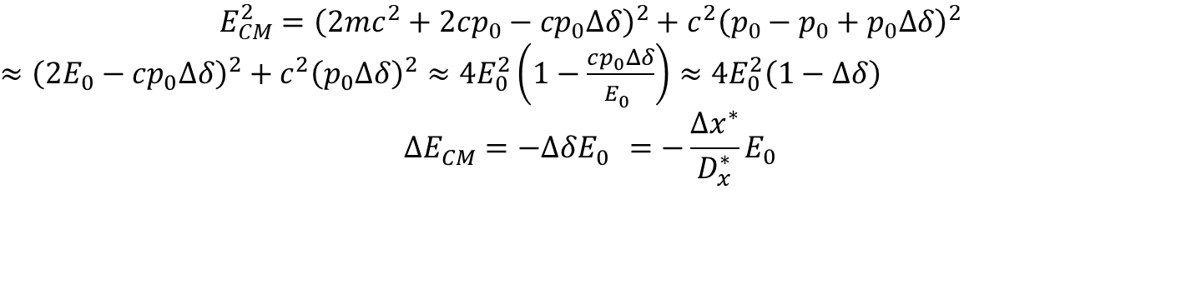
monochromatization with beam-beam offset
e⁻
$$δ0+2Δδ$$
e⁺
x
$$δ0+Δδ$$
$$δ0−2Δδ$$
$$δ0$$
$$δ0−Δδ$$
Δx*=D_{x}*Δδ
$$δ0−Δδ$$
$$δ0$$
$$δ0−2Δδ$$
$$δ0+Δδ$$
$$δ0+2Δδ$$
$D_{x}^{∗}$>0
$D_{y}^{∗}<$0
s
$$E_{CM}^{2}={\left(2mc^{2}+2cp_{0}−{cp}_{0}Δδ\right)}^{2}+{c^{2}\left(p_{0}−p_{0}+p_{0}Δδ\right)}^{2}$$
$≈{\left(2E_{0}−cp_{0}Δδ\right)}^{2}+{c^{2}\left(p_{0}Δδ\right)}^{2}≈4E_{0}^{2}\left(1−\frac{cp_{0}Δδ}{E_{0}^{}}\right)$ $≈4E_{0}^{2}\left(1−Δδ\right)$
$$ΔE_{CM}^{}=−ΔδE_{0}^{}=−\frac{Δx^{∗}}{D_{x}^{∗}}E_{0}$$
this is not valid in the limit
$D_{x}^{∗}→0$ (betatron size no
longer negligible)

Slide 4

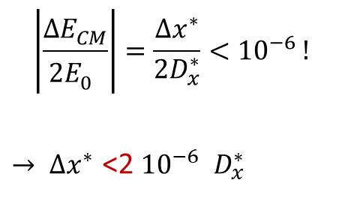
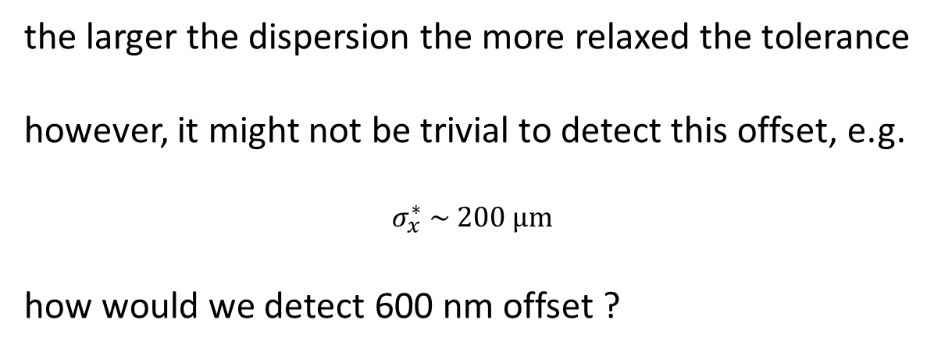
$$\left|\frac{ΔE_{CM}^{}}{{2E}_{0}^{}}\right|=\frac{Δx^{∗}}{{2D}_{x}^{∗}}<{10}^{−6 }!$$
$→ Δx^{∗}$ <2 ${10}^{−6 }$ $D_{x}^{∗}$
comment from
Alain Blondel:
10⁻⁵ would be OK
$with D_{x}^{∗} \sim 30 cm:Δx^{∗}\text{ < }\text{600 }\text{nm}$
6 μm
the larger the dispersion the more relaxed the tolerance
however, it might not be trivial to detect this offset, e.g.
$$σ_{x}^{∗} \sim 200 μm$$
how would we detect 600 nm offset ?
6 μm may be possible
with Vernier scan
(Mike Koratzinos,
Tatiana Pieloni)

Slide 5
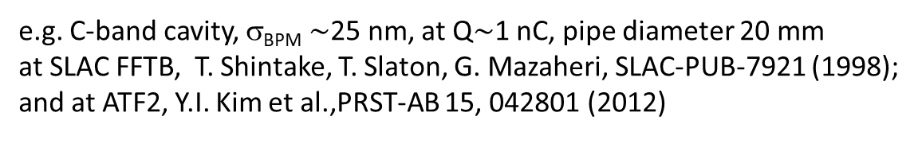
RF BPMs?
problem is the crossing angle
(if there is… )
e.g. C-band cavity, σ_{BPM} $\sim$25 nm, at Q$\sim$1 nC, pipe diameter 20 mm
at SLAC FFTB, T. Shintake, T. Slaton, G. Mazaheri, SLAC-PUB-7921 (1998);
and at ATF2, Y.I. Kim et al.,PRST-AB 15, 042801 (2012)
feasible in a storage ring?
(Katsunobu Oide)
RF BPMs ?
RF BPM?
IP
30 mrad
can we avoid the crossing angle
and use common RF BPMs?
or calibrate BPM readings with zero dispersion?

