Slide 2
Parameter Considerations for a 3 TeV PWFA Linear Collider
Ben Chen
CERN / University of Oslo

Slide 3
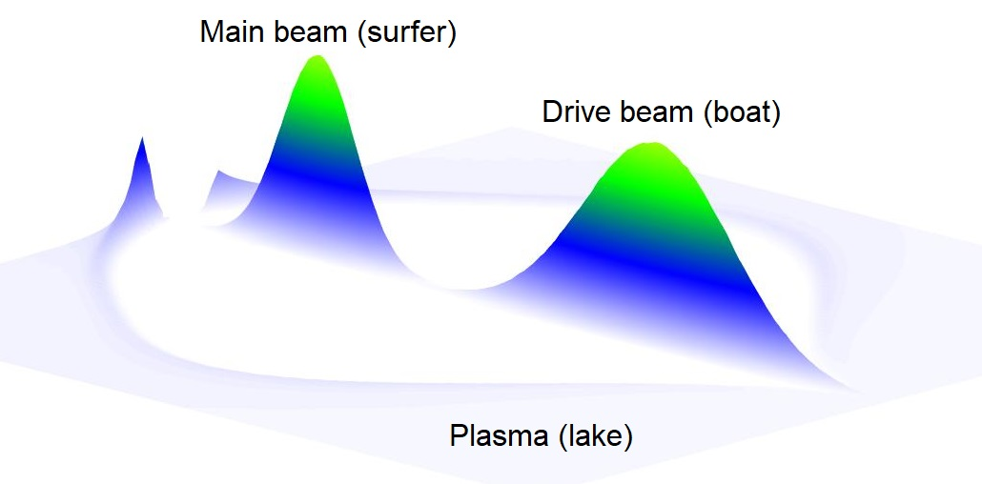
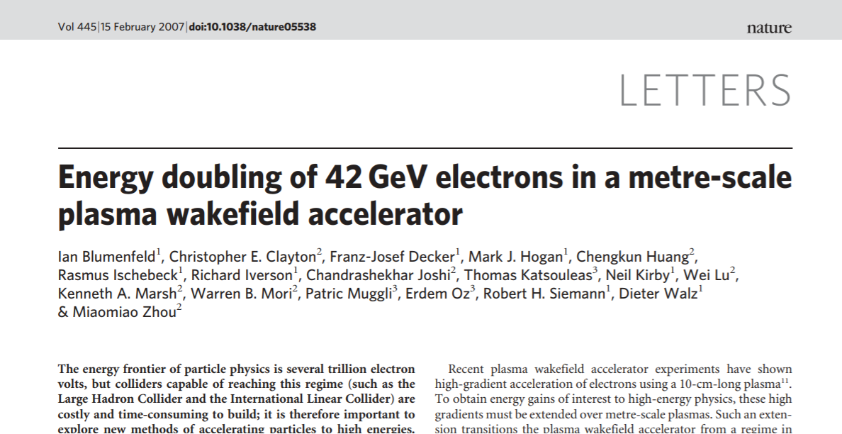

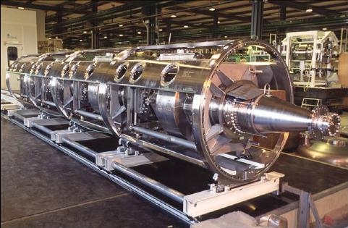
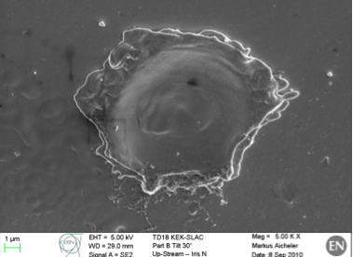
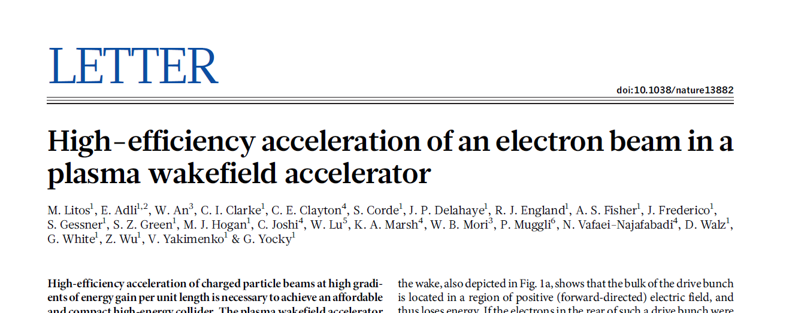
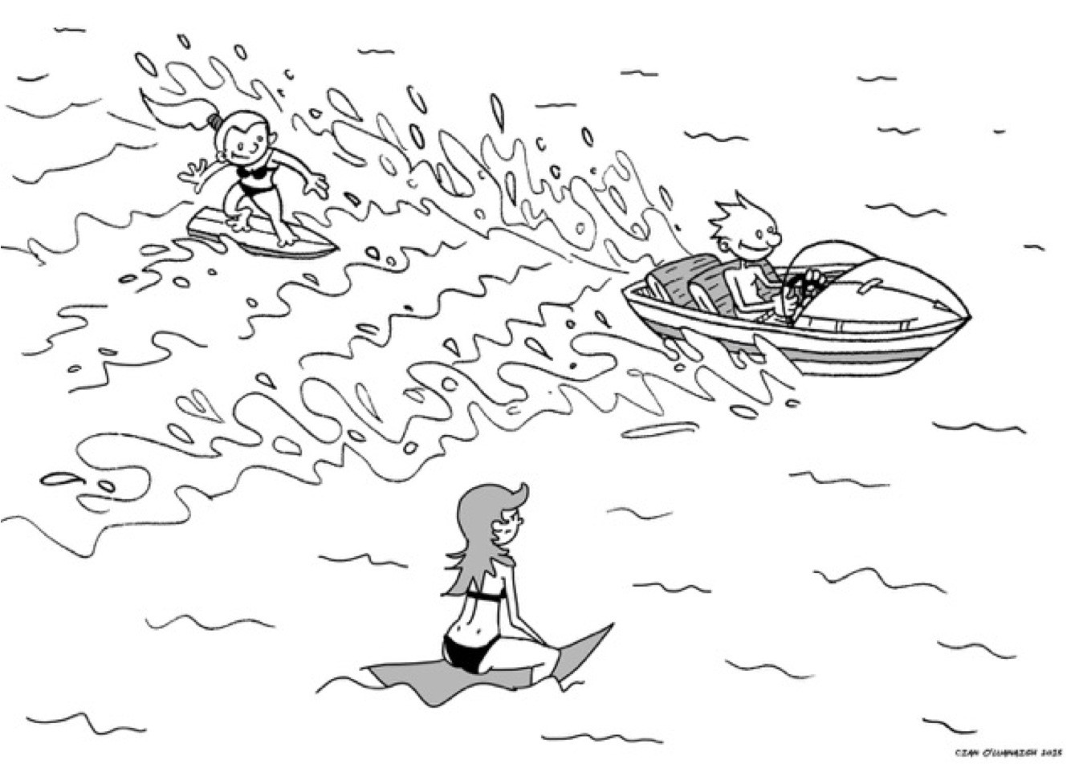
Plasma wakefield acceleration (PWFA)
PWFA is a very promising candidate (mainly envisioned to be used in a e⁺e⁻ collider).
Gradient of current technologies limited by electrical breakdown (state of the art: 100 MV/m).
Plasma (typically created by ionizing lithium vapor) known to sustain high fields.
Gradients tens of GV/m have been demonstrated in experiments along with high efficiency.
Let particles «surf» on a plasma wave generated by a driving beam.

Slide 4
Part I: Instability Studies

Slide 5
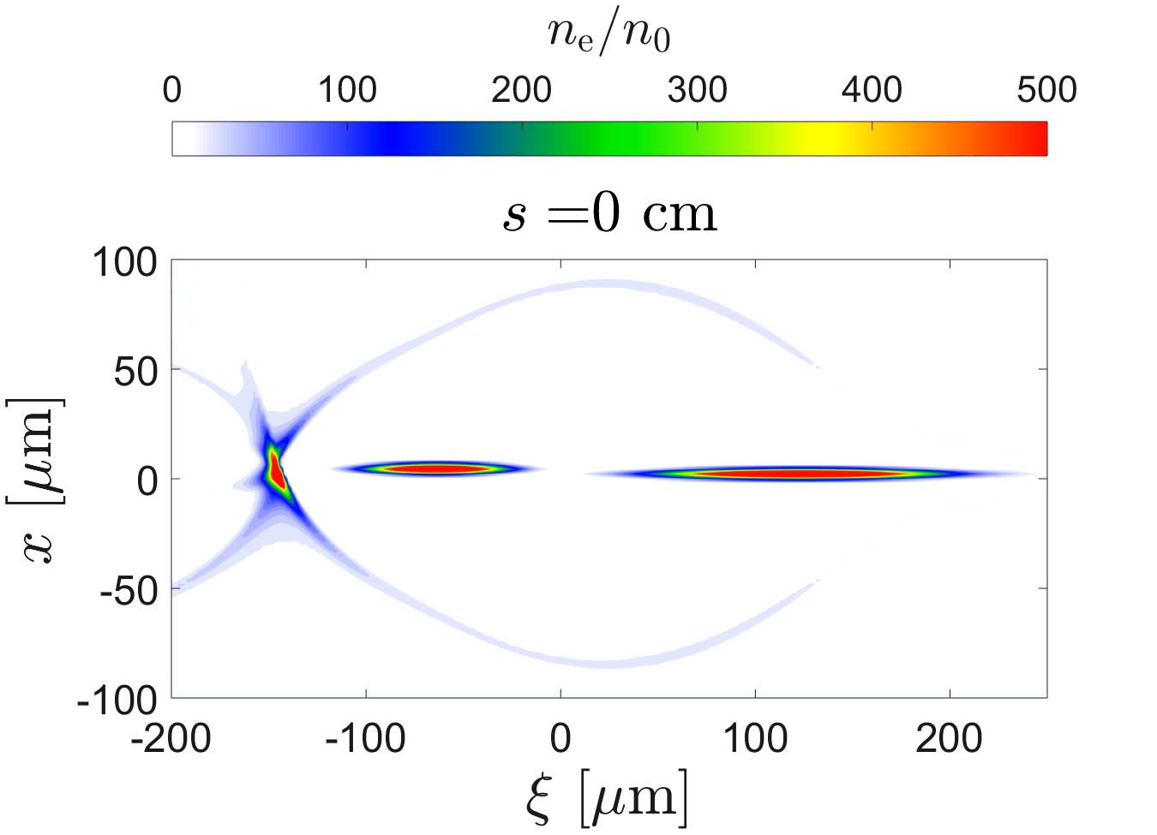
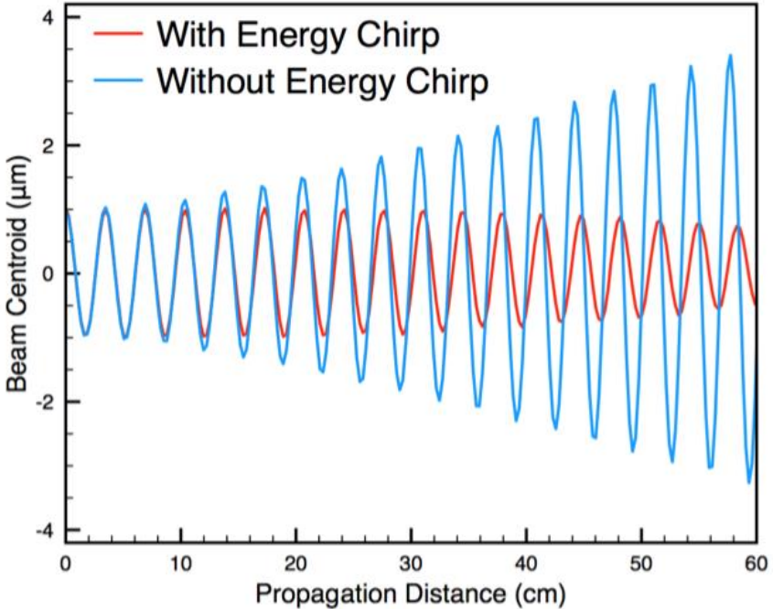
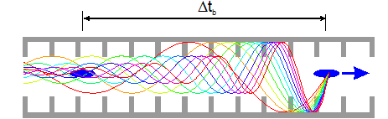
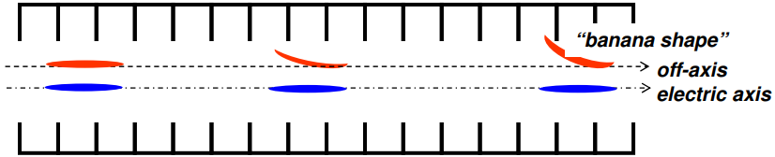
Transverse instabilities and wakefields
One of the main challenges.
Fields generated by a driving particle’s interaction with the acc. cavity due to misalignment.
Can be several o.m. larger than in metallic cavities.
Limits the beam charge.
Mitigation methods exist.
These effects have been taken into account in the design of CLIC.
PWFA-LC parameter studies have so far not considered the effect of transverse wakefields on efficiency.
QuickPIC Open Source
Need an improved understanding
of the transverse instabilities and their mitigation mechanisms in order to improve the estimate of the efficiency of a PWFA-LC.
D. Schulte
W. An

Slide 6
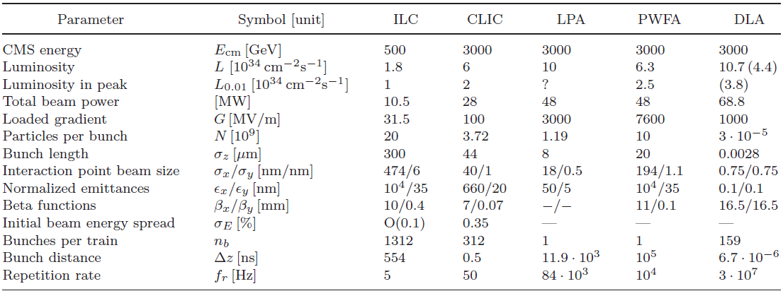
Parameter study
Conceptual parameter sets for a PWFA-LC have been proposed to identify the main challenges and base parameters.
Snowmass parameter set: US particle physics 2013 Community Summer Study by E. Adli et al.
Possible improvements of the main beam parameters taking transverse instability into account.
  Current simulation methods (PIC) computationally expensive.
  Express transverse forces as a wake function in order to simplify complex simulations.
  Allows for simple scaling laws and clearer parameter dependencies required for global optimisation.
Parameter comparison by D. Schulte

Slide 7
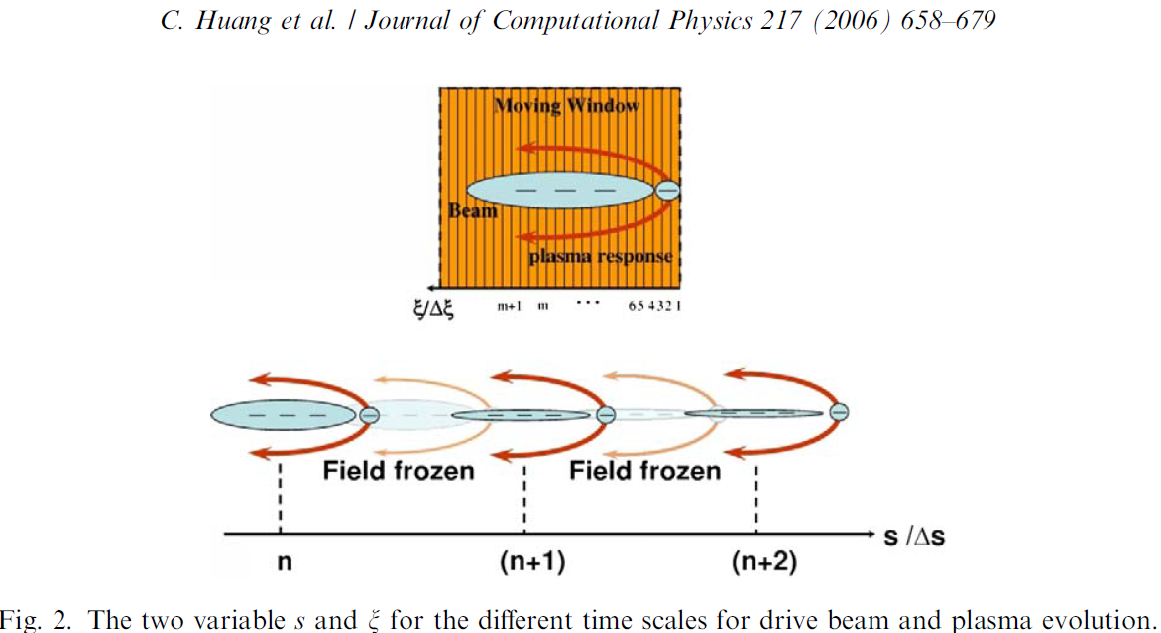
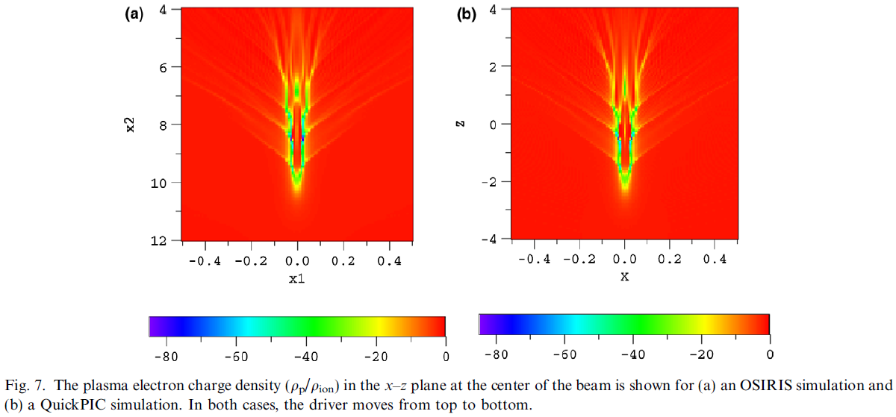
QuickPIC
Open source version developed by UCLA.
Fully parallelised, fully relativistic, three-dimensional quasi-static PIC code.
Quasi-static approximation.
Reduces computation time with 2-3 o.m compared to full PIC codes.
Agrees well with full PIC codes for problems of interest.

Slide 8
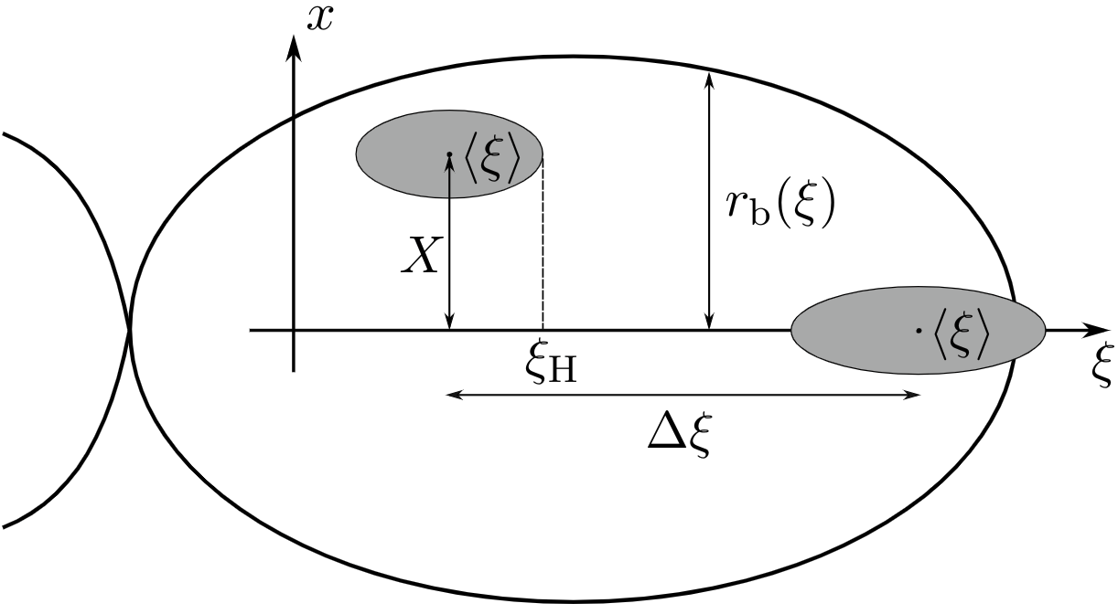
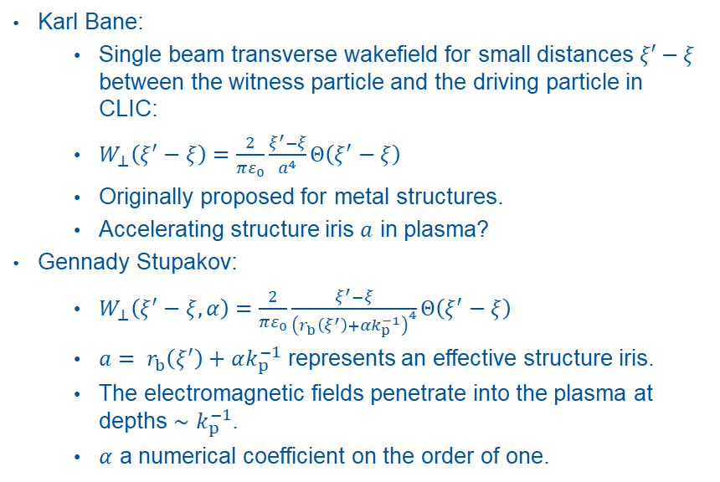
Transverse wakefunction
Karl Bane:
  Single beam transverse wakefield for small distances $ξ′−ξ$ between the witness particle and the driving particle in CLIC:
  $W_{⊥}\left(ξ^{′}−ξ\right)=\frac{2}{πε_{0}}\frac{ξ^{′}−ξ}{a^{4}}Θ\left(ξ^{′}−ξ\right)$
  Originally proposed for metal structures.
  Accelerating structure iris $a$ in plasma?
Gennady Stupakov:
  $W_{⊥}\left(ξ^{′}−ξ,α\right)=\frac{2}{πε_{0}}\frac{ξ^{′}−ξ}{{\left(r_{b}\left(ξ^{′}\right)+αk_{p}^{−1}\right)}^{4}}Θ\left(ξ^{′}−ξ\right)$
  $a= r_{b}\left(ξ^{′}\right)+αk_{p}^{−1}$ represents an effective structure iris.
  The electromagnetic fields penetrate into the plasma at depths $∼k_{p}^{−1}$.
  $α$ a numerical coefficient on the order of one.
G. Stupakov

Slide 9
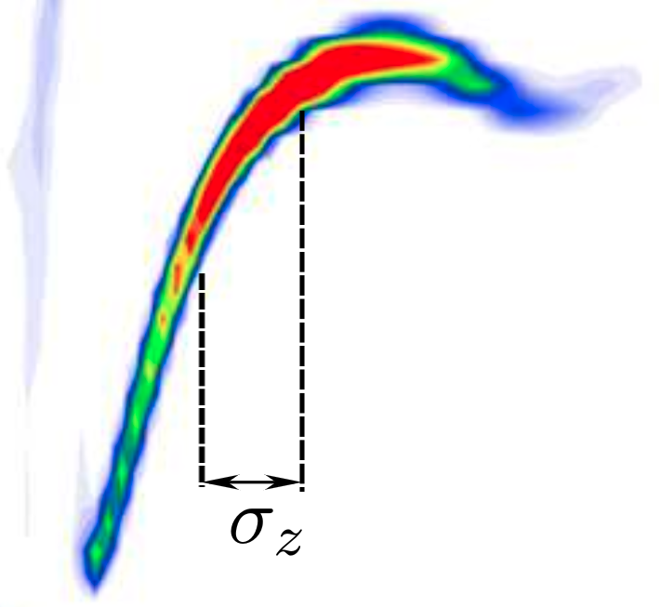
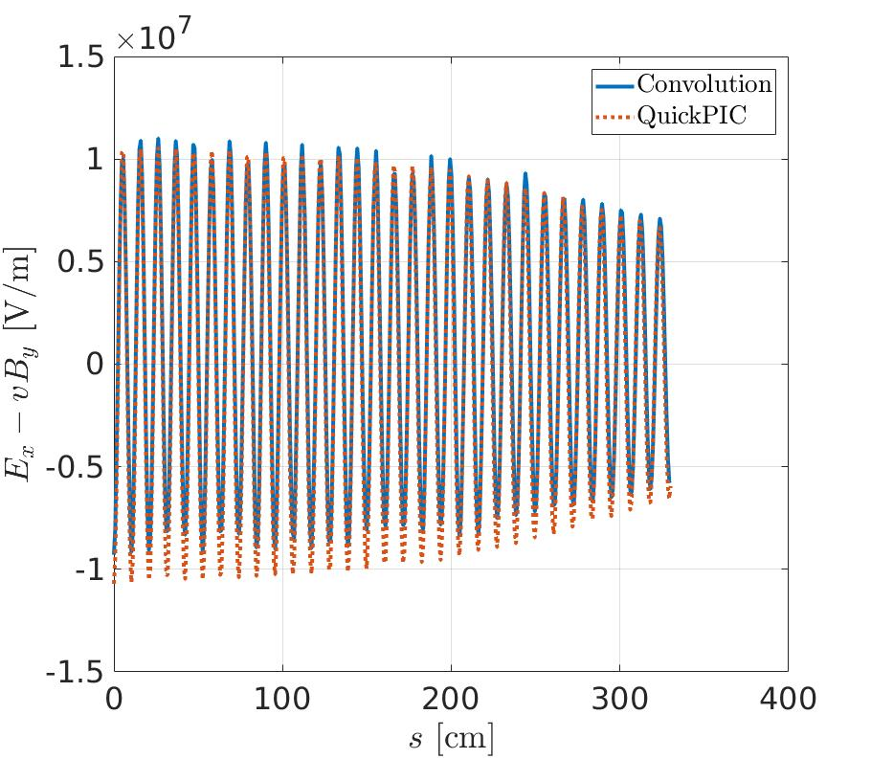
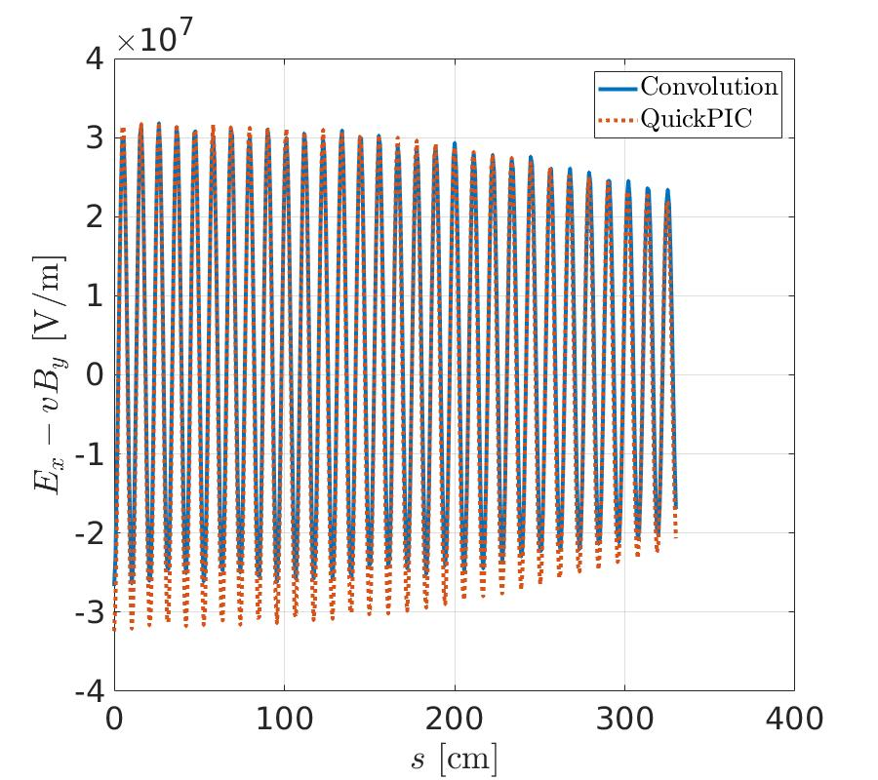
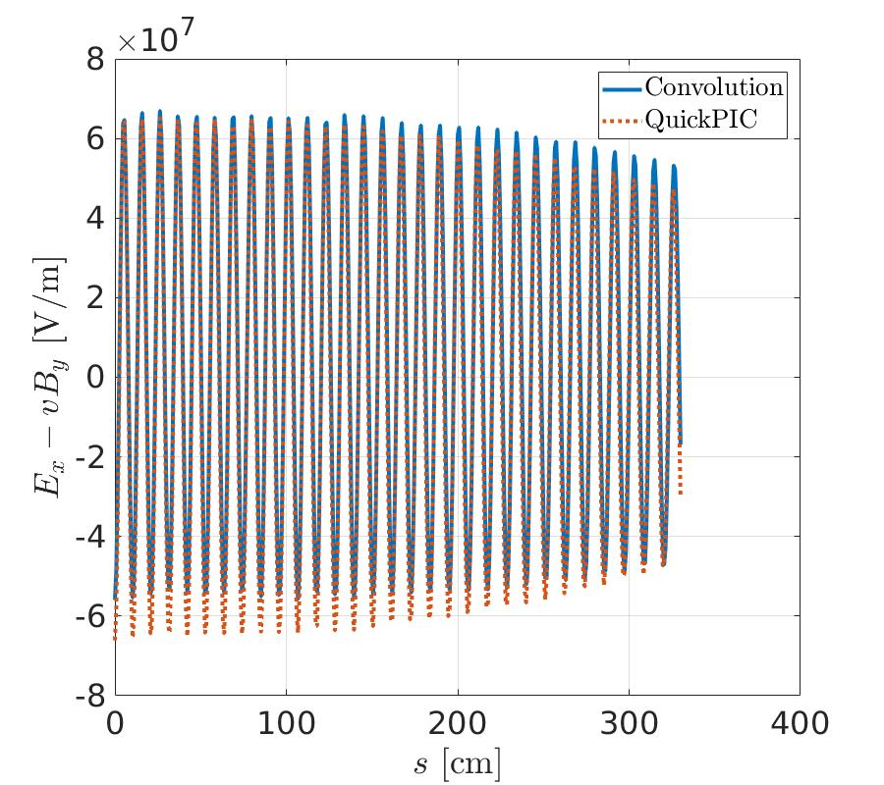

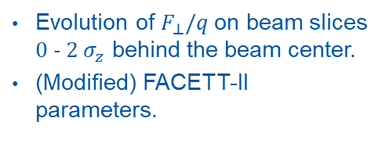
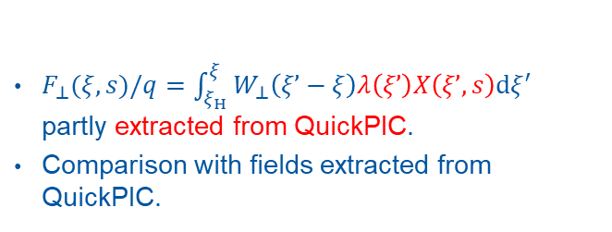

Benchmarking the transverse wakefunctions
Evolution of $F_{⊥}/q$on beam slices 0 - 2 $σ_{z}$ behind the beam center.
(Modified) FACETT-II parameters.
$F_{⊥}(ξ,s)/q=\int_{ξ_{H}}^{ξ}{W_{⊥}\left(ξ’−ξ\right)λ\left(ξ’\right)X\left(ξ’,s\right)dξ^{′}}$ partly extracted from QuickPIC.
Comparison with fields extracted from QuickPIC.
Beam center
$1σ_{z}$ behind center
$2σ_{z}$ behind center

Slide 10
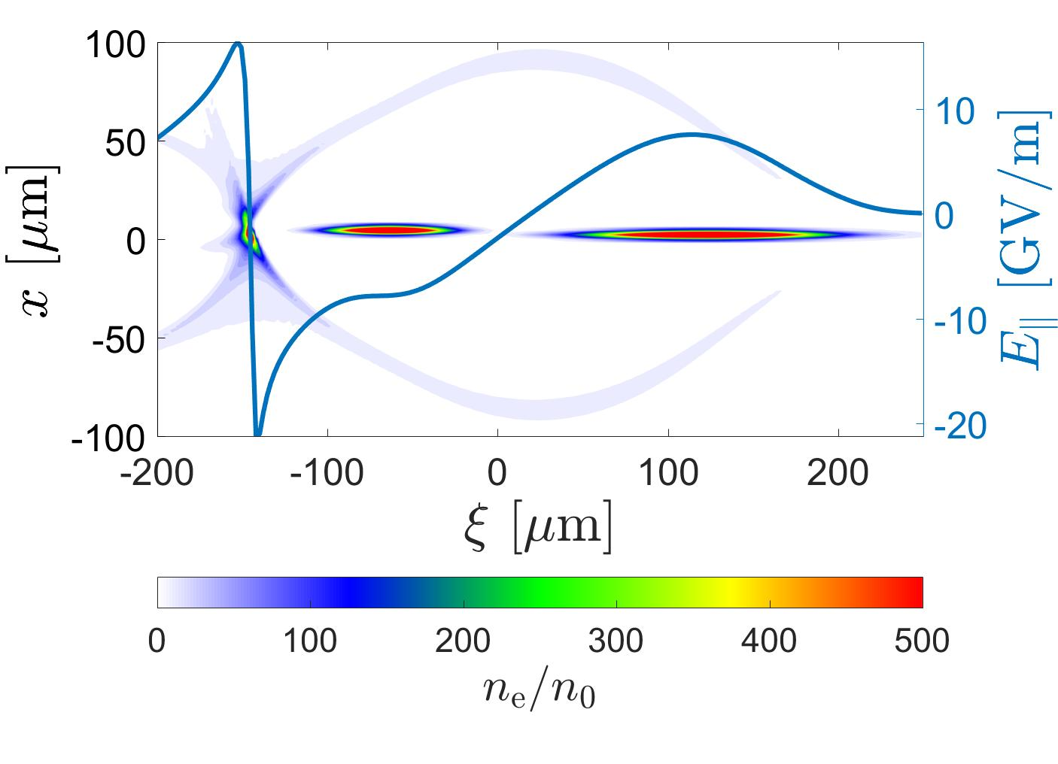
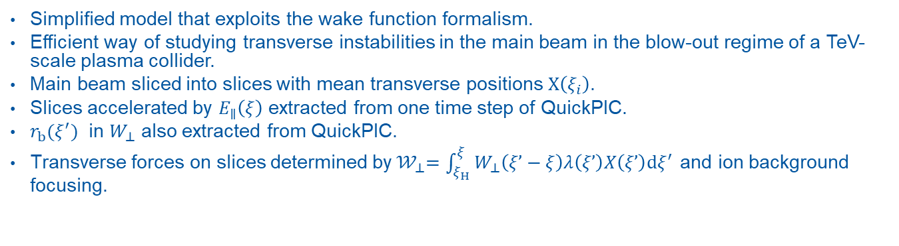
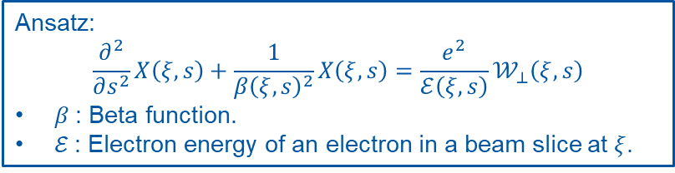
Simplified quasi-static model
Simplified model that exploits the wake function formalism.
Efficient way of studying transverse instabilities in the main beam in the blow-out regime of a TeV-scale plasma collider.
Main beam sliced into slices with mean transverse positions $X\left(ξ_{i}\right)$.
Slices accelerated by $E_{∥}\left(ξ\right)$ extracted from one time step of QuickPIC.
$r_{b}(ξ^{′})$ in $W_{⊥}$ also extracted from QuickPIC.
Transverse forces on slices determined by${ 𝒲}_{⊥}=\int_{ξ_{H}}^{ξ}{W_{⊥}\left(ξ’−ξ\right)λ\left(ξ’\right)X\left(ξ’\right)dξ^{′}}$ and ion background focusing.
Ansatz:
$$\frac{∂^{2}}{∂s^{2}}X\left(ξ,s\right)+\frac{1}{β{\left(ξ,s\right)}^{2}}X\left(ξ,s\right)=\frac{e^{2}}{ℰ\left(ξ,s\right)}𝒲_{⊥}\left(ξ,s\right)$$
$β$: Beta function.
$ℰ$: Electron energy of an electron in a beam slice at $ξ$.

Slide 11
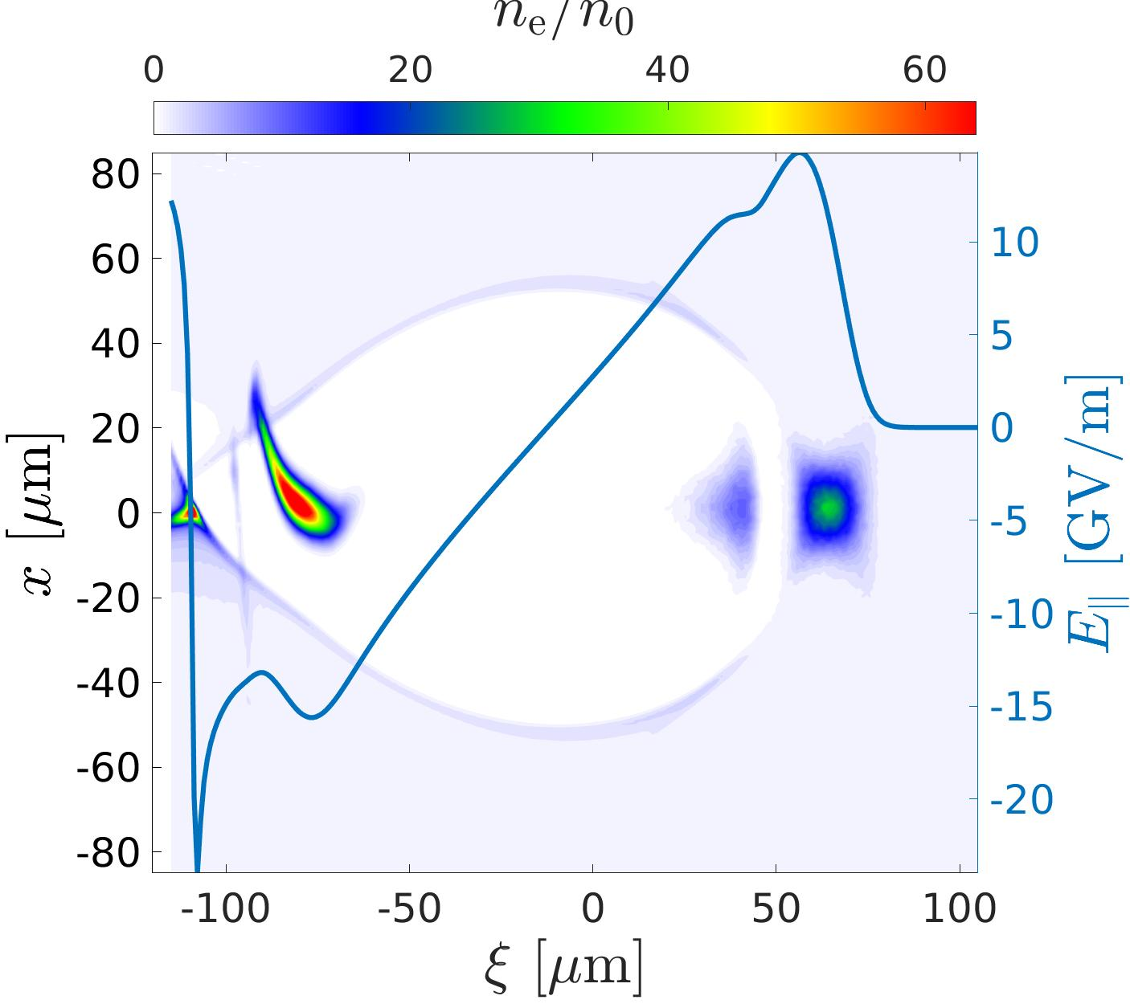
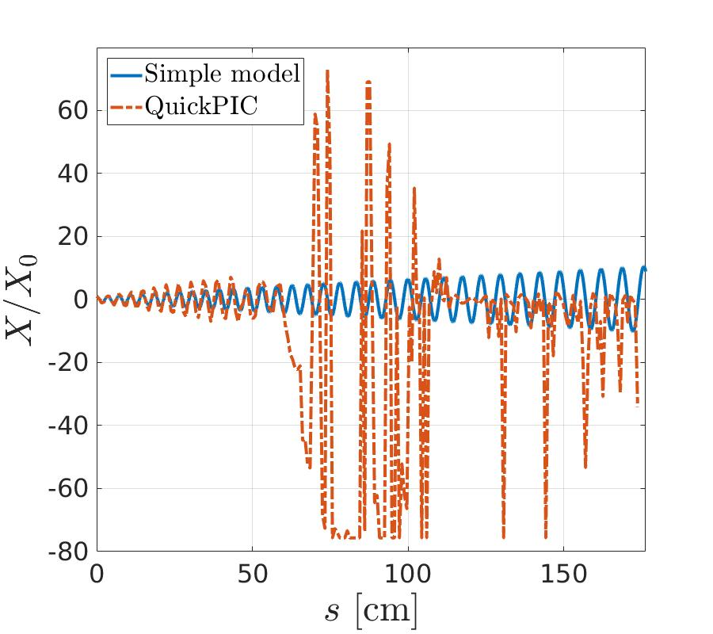
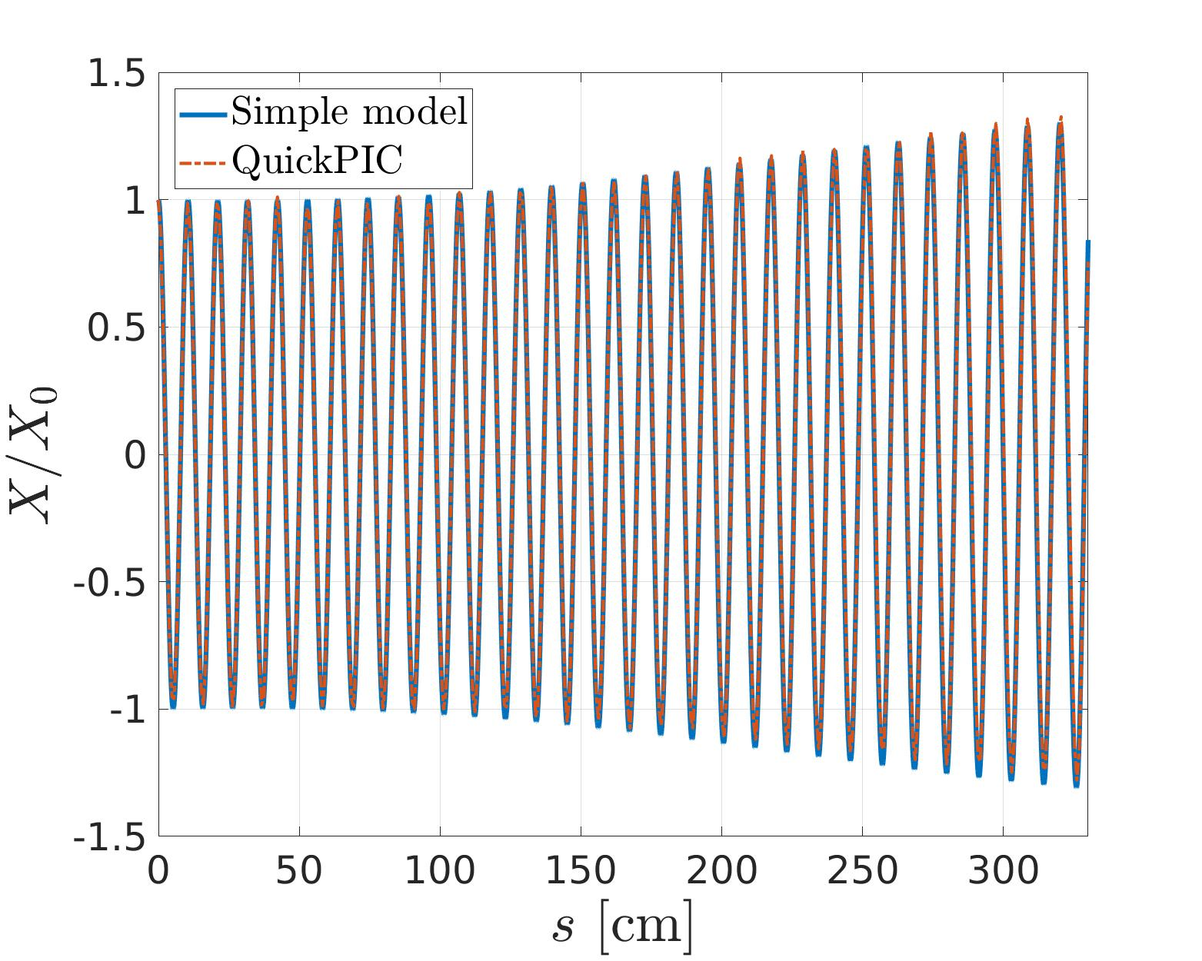
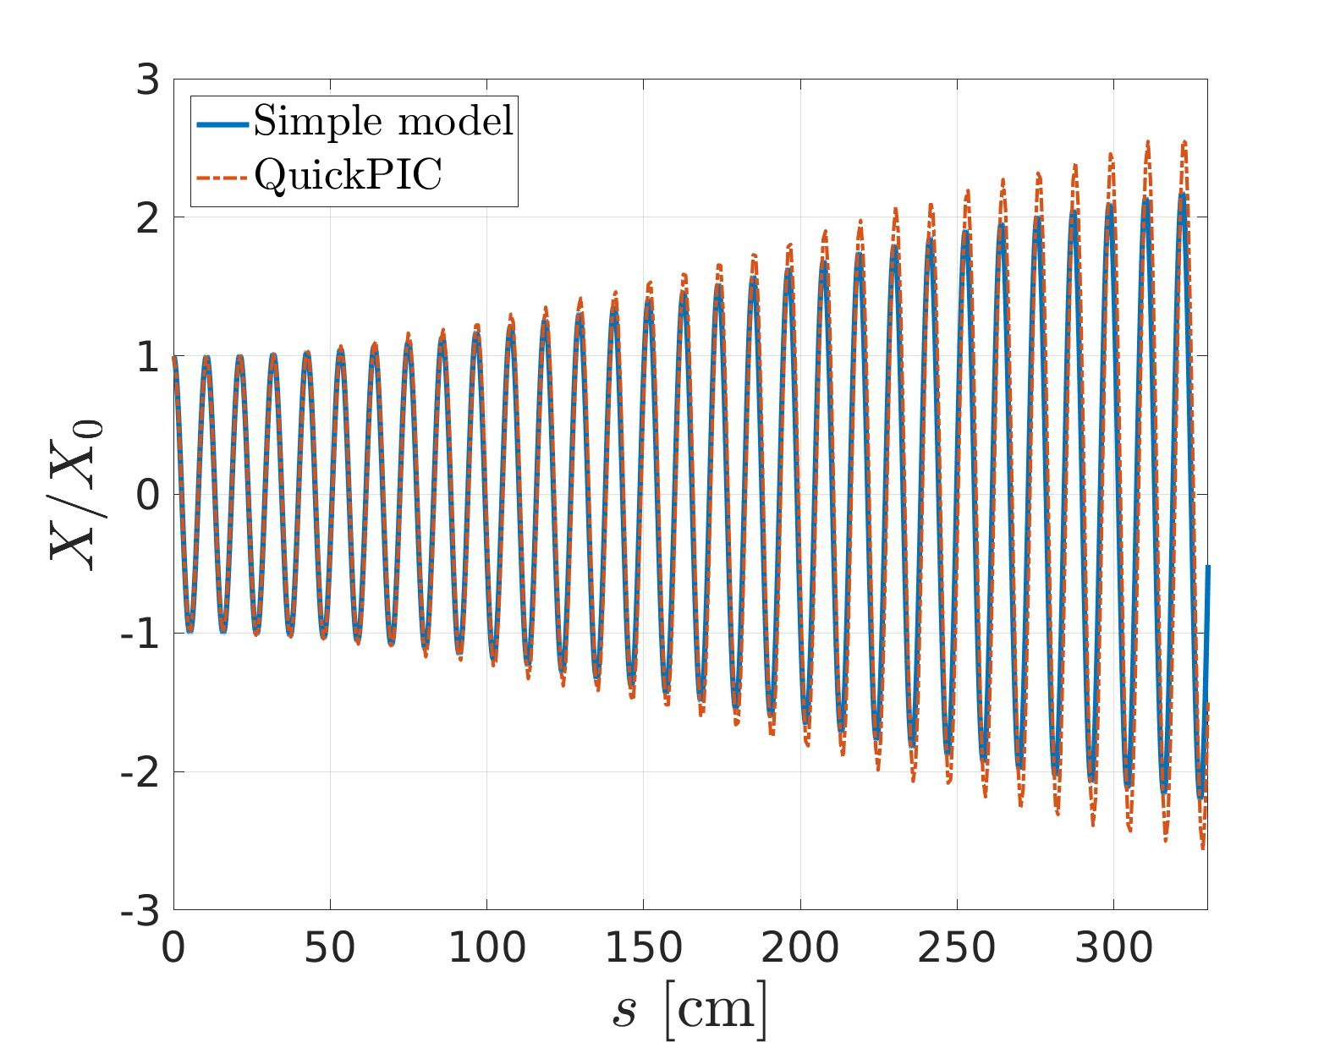
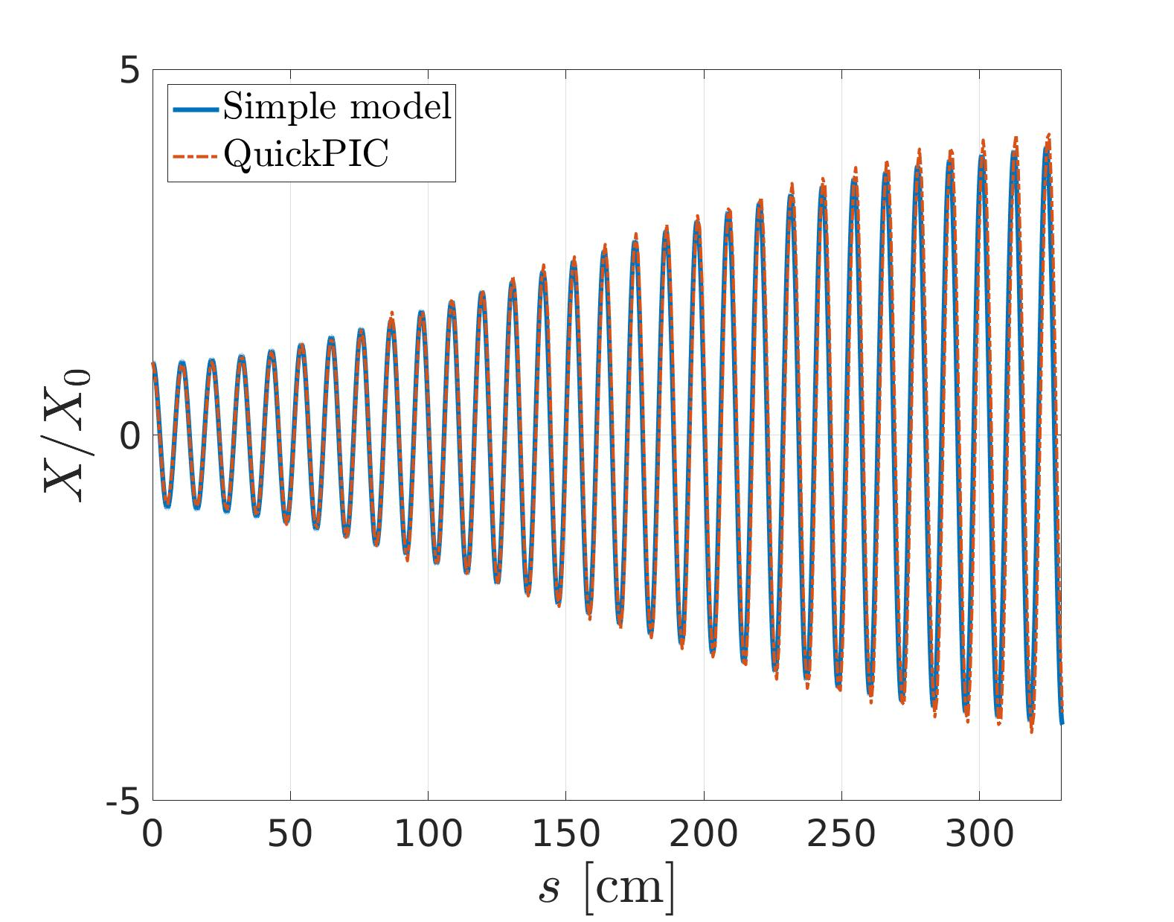
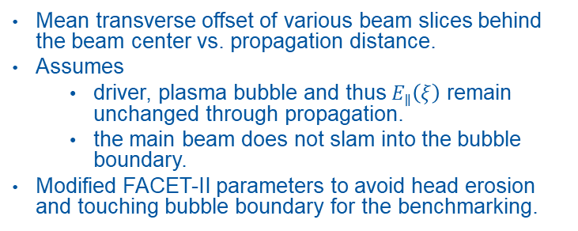

Benchmarking the simplified model
Mean transverse offset of various beam slices behind the beam center vs. propagation distance.
Assumes
  driver, plasma bubble and thus $E_{∥}\left(ξ\right)$ remain unchanged through propagation.
  the main beam does not slam into the bubble boundary.
Modified FACET-II parameters to avoid head erosion and touching bubble boundary for the benchmarking.
Beam center
$1σ_{z}$ behind center
$2σ_{z}$ behind center

Slide 12
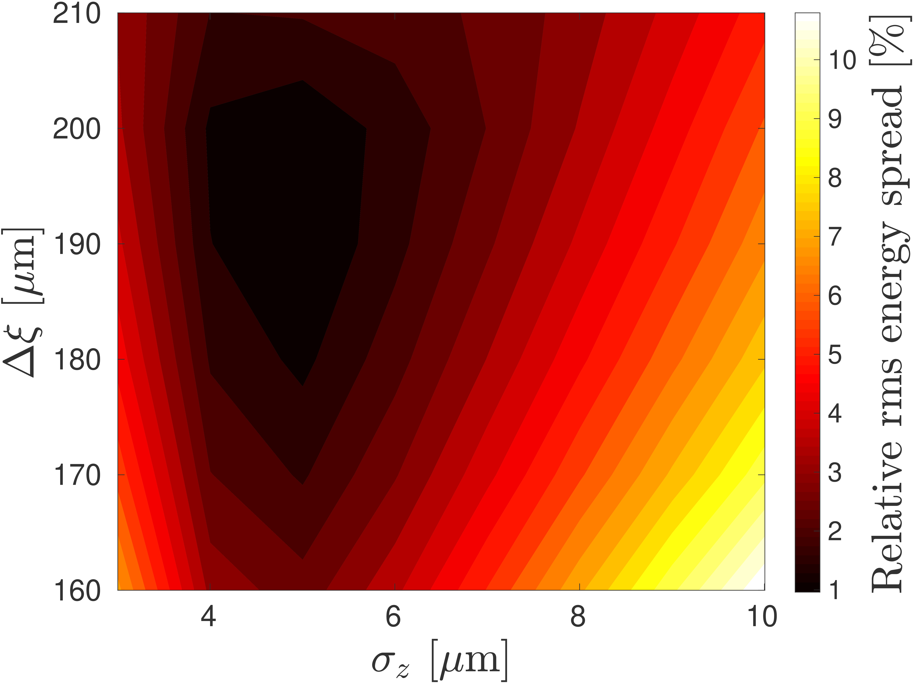
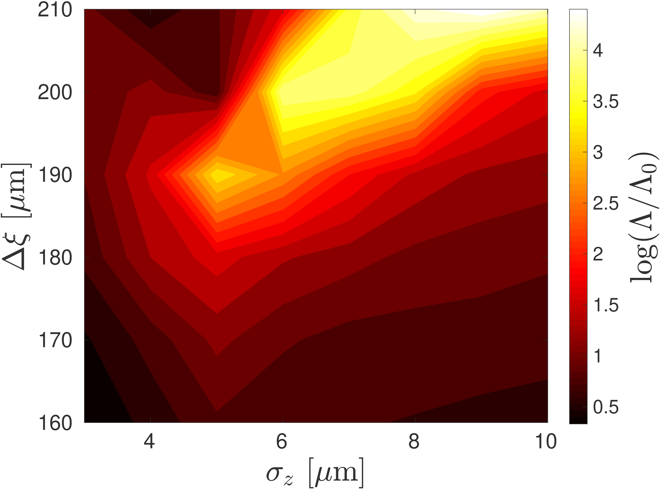
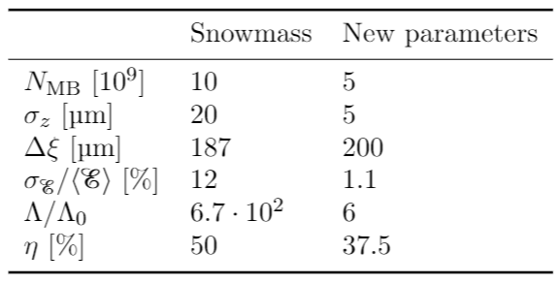
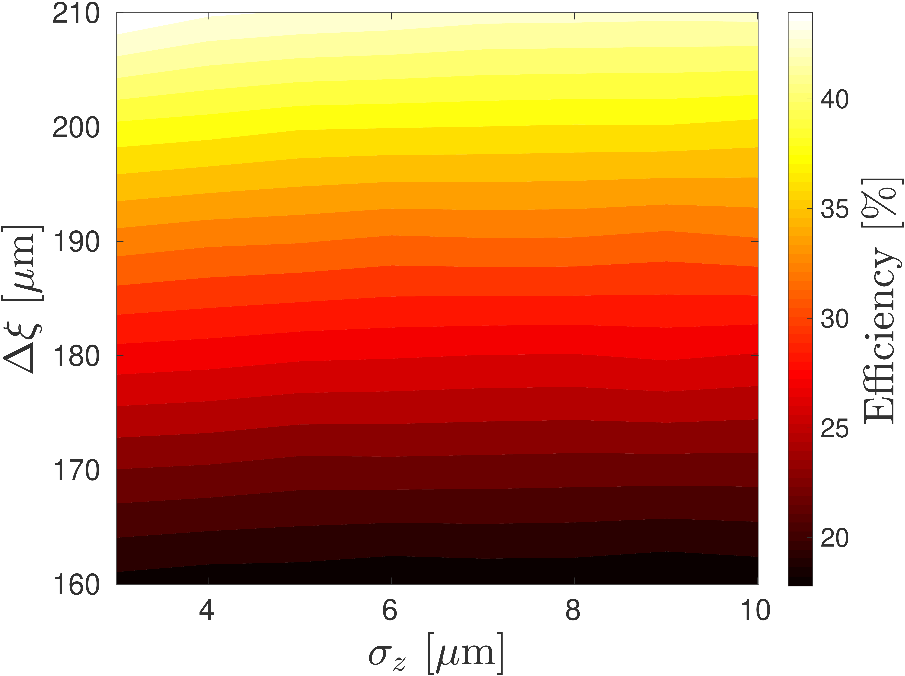
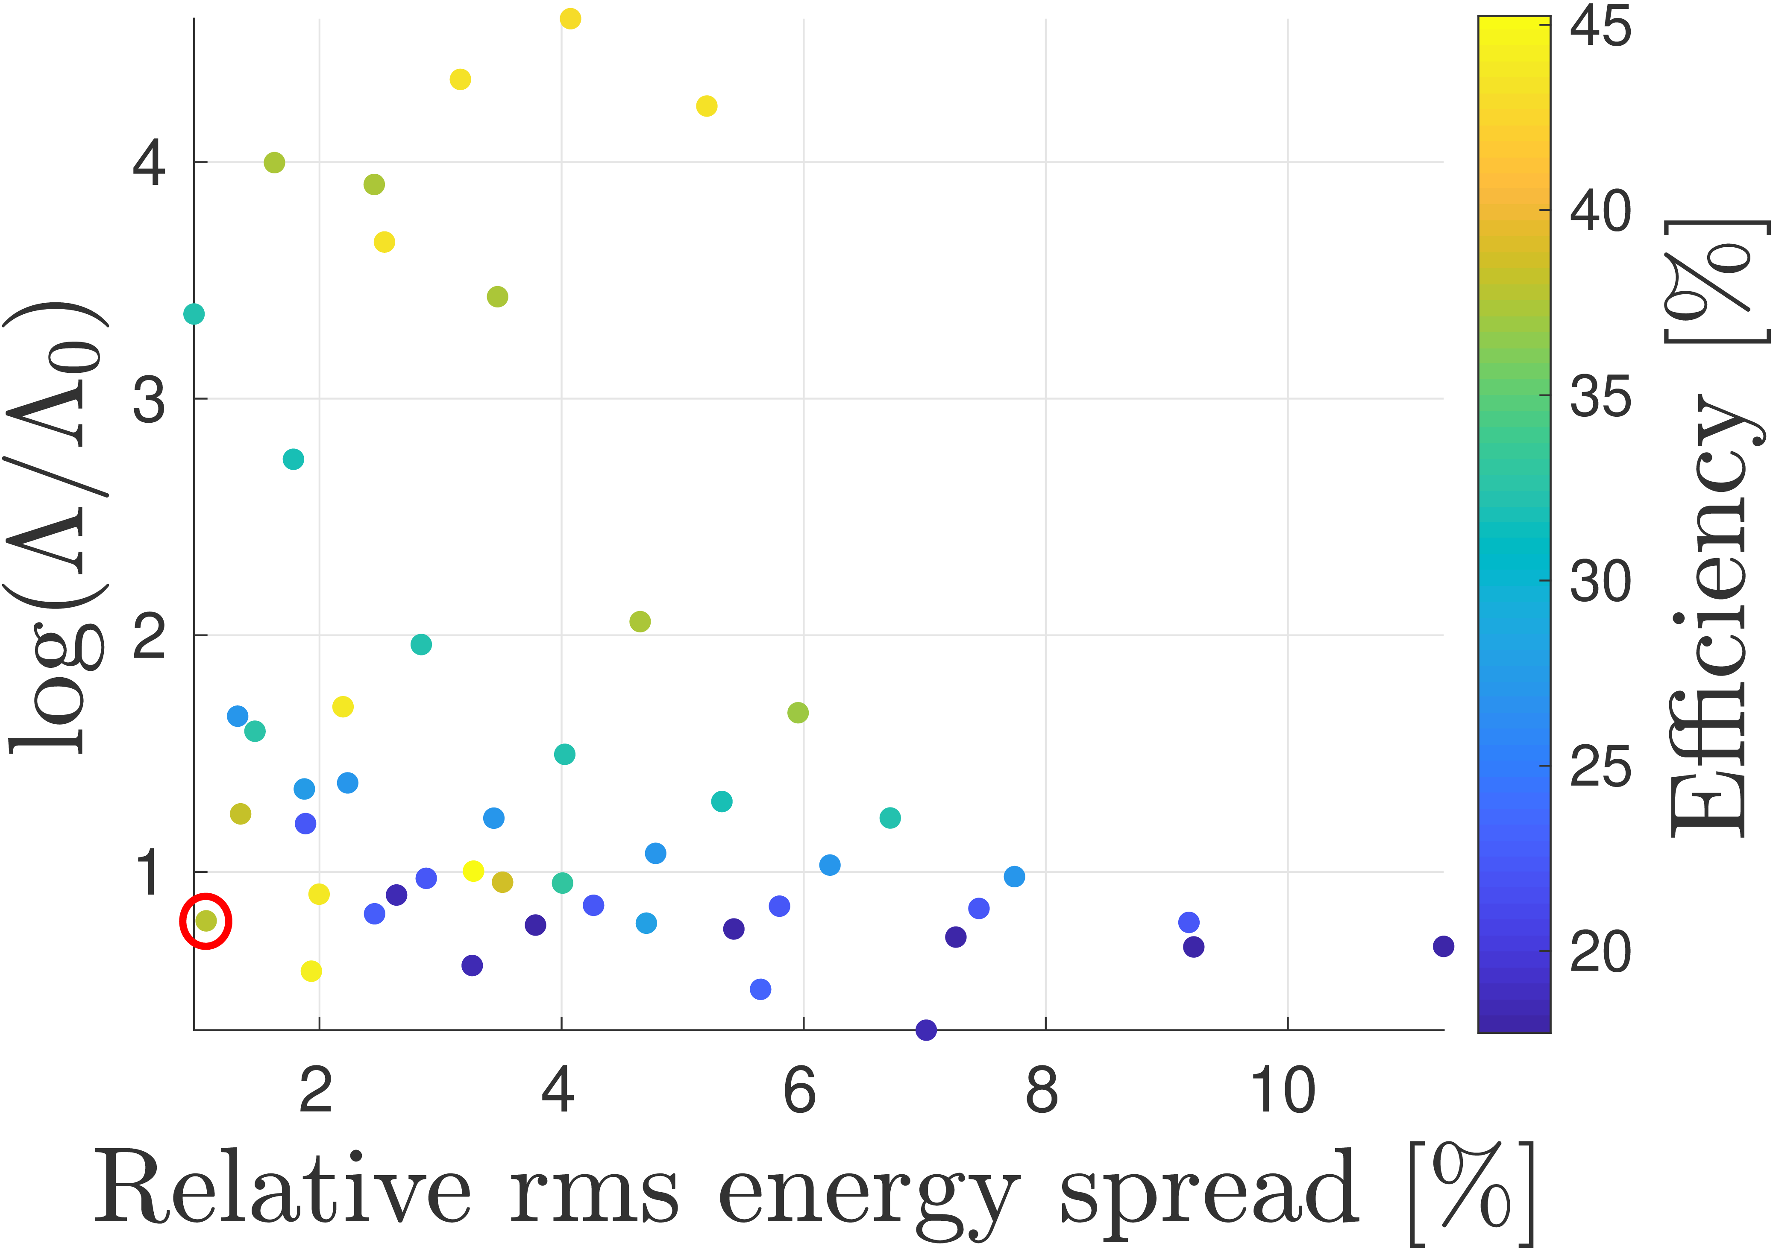
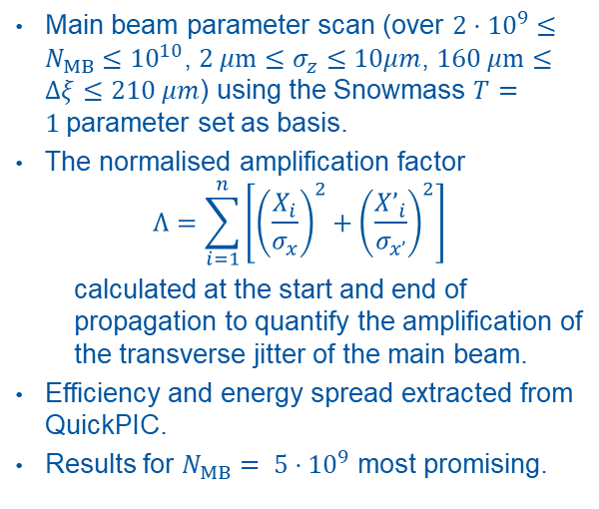
Instability studies parameter scan
Main beam parameter scan (over $2⋅{10}^{9}≤N_{MB}≤{10}^{10}$, $2 μm≤σ_{z}≤10μm$, $160 μm≤Δξ≤210 μm$) using the Snowmass $T=1$parameter set as basis.
The normalised amplification factor
$$Λ=\sum_{i=1}^{n}{\left[{\left(\frac{X_{i}}{σ_{x}}\right)}^{2}+{\left(\frac{X’_{i}}{σ_{x’}}\right)}^{2}\right]}$$
  calculated at the start and end of propagation to quantify the amplification of the transverse jitter of the main beam.
Efficiency and energy spread extracted from QuickPIC.
Results for $N_{MB}= 5⋅{10}^{9}$ most promising.
What about luminosity?

Slide 13
Part II: Beam-Beam Studies

Slide 14
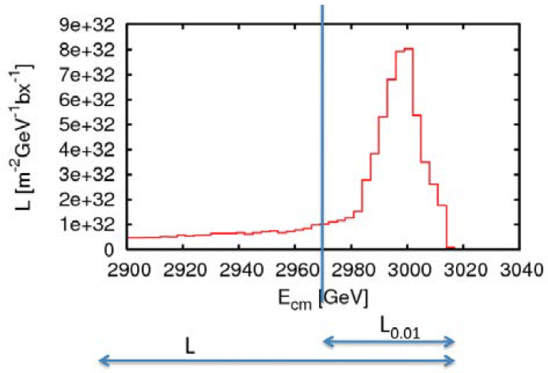
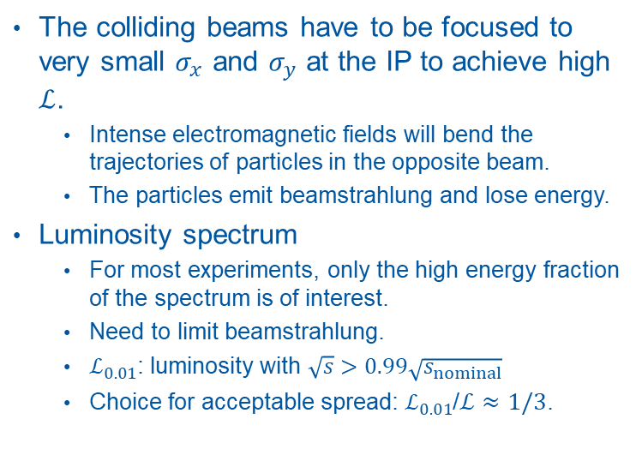
Beamstrahlung
The colliding beams have to be focused to very small $σ_{x}$ and $σ_{y}$ at the IP to achieve high $ℒ$.
  Intense electromagnetic fields will bend the trajectories of particles in the opposite beam.
  The particles emit beamstrahlung and lose energy.
Luminosity spectrum
  For most experiments, only the high energy fraction of the spectrum is of interest.
  Need to limit beamstrahlung.
  $ℒ_{0.01}$: luminosity with $\sqrt{s}>0.99\sqrt{s_{nominal}}$
  Choice for acceptable spread: $ℒ_{0.01}$/$ℒ≈1/3$.
D. Schulte

Slide 15
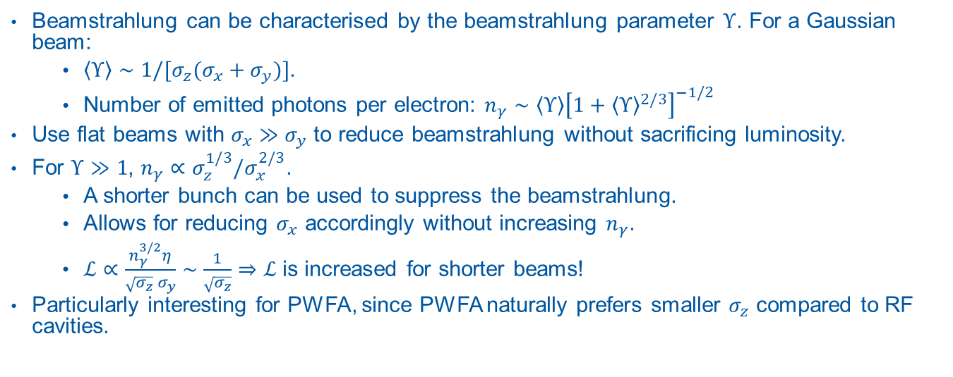
Why does PWFA have an advantage here?
Beamstrahlung can be characterised by the beamstrahlung parameter $Υ$. For a Gaussian beam:
  $\left\langle Υ\right\rangle ∼1/[σ_{z}(σ_{x}+σ_{y})]$.
  Number of emitted photons per electron: $n_{γ}∼\left\langle Υ\right\rangle {\left[1+{\left\langle Υ\right\rangle }^{2/3}\right]}^{−1/2}$
Use flat beams with $σ_{x}≫σ_{y}$ to reduce beamstrahlung without sacrificing luminosity.
For $Υ≫1$, $n_{γ}∝σ_{z}^{1/3}/σ_{x}^{2/3}$.
  A shorter bunch can be used to suppress the beamstrahlung.
  Allows for reducing $σ_{x}$ accordingly without increasing $n_{γ}$.
  $ℒ∝\frac{n_{γ}^{3/2}η}{\sqrt{σ_{z}} σ_{y}}∼\frac{1}{\sqrt{σ_{z}}}⇒$ $ℒ$ is increased for shorter beams!
Particularly interesting for PWFA, since PWFA naturally prefers smaller $σ_{z}$ compared to RF cavities.

Slide 16
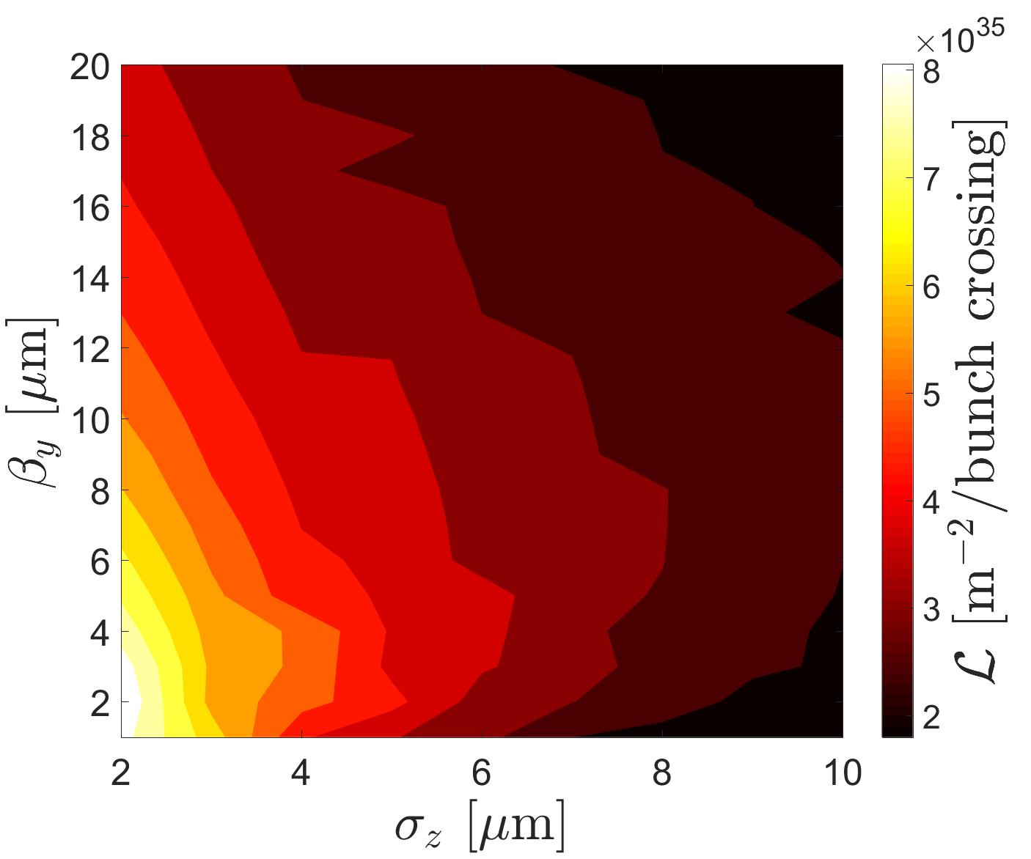
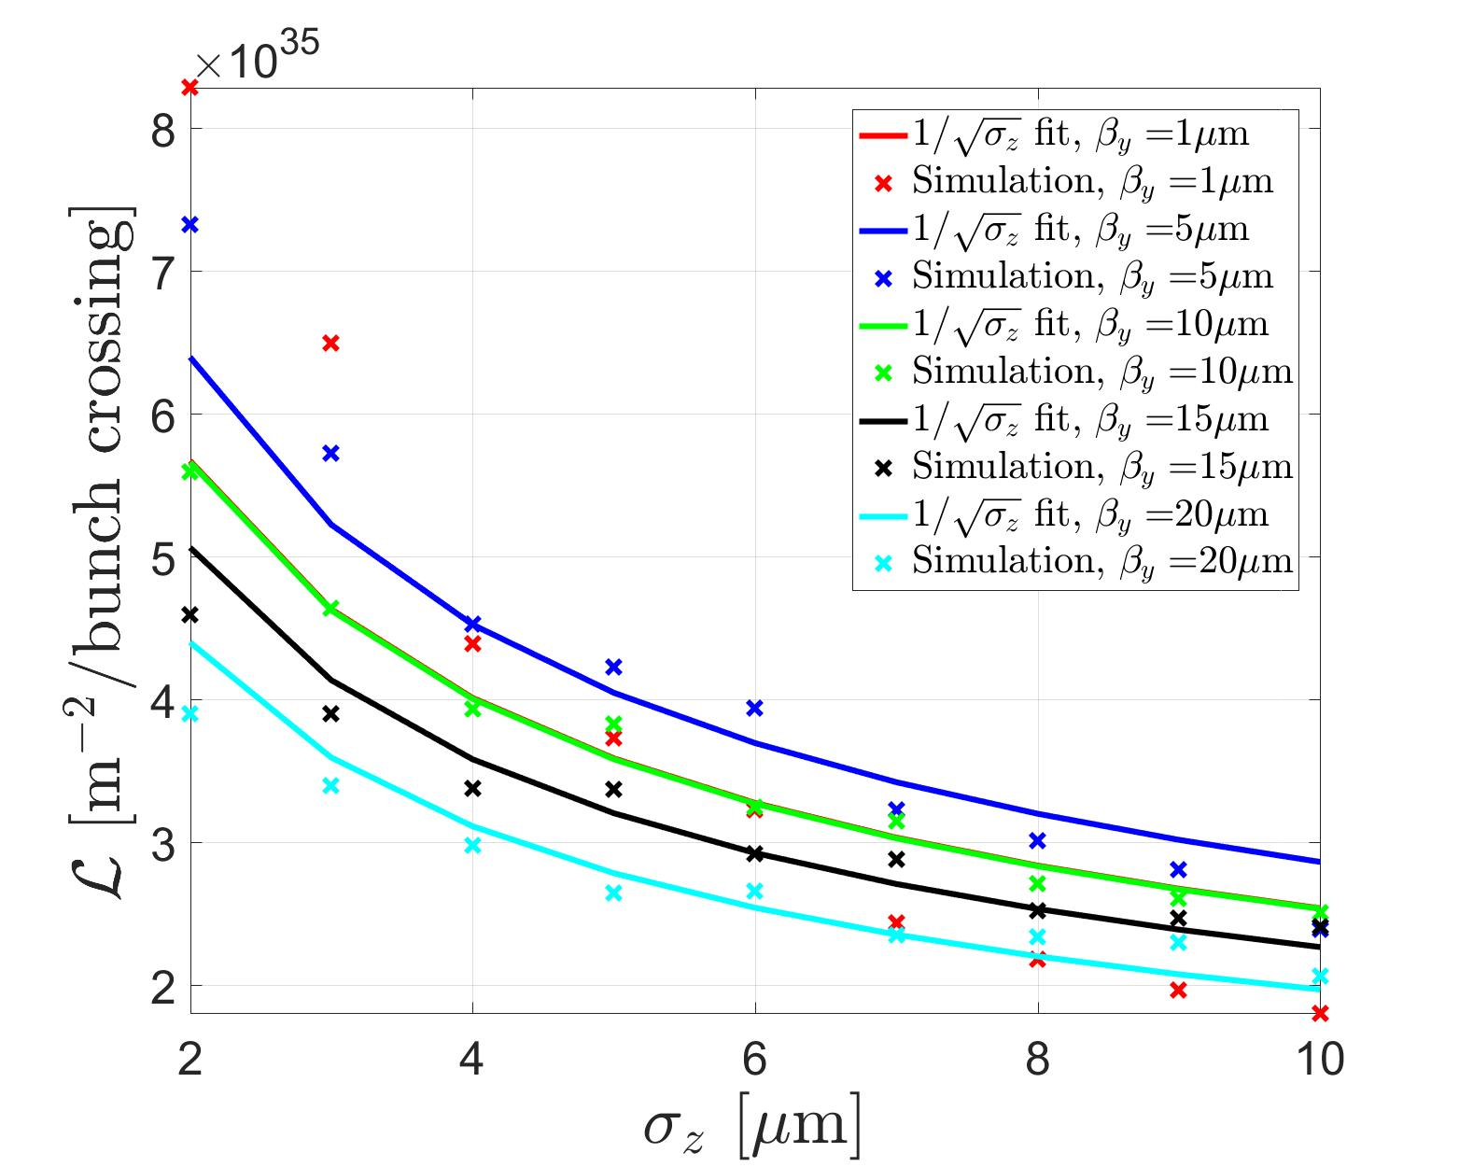
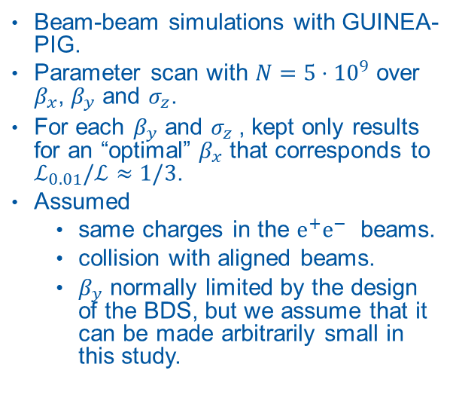
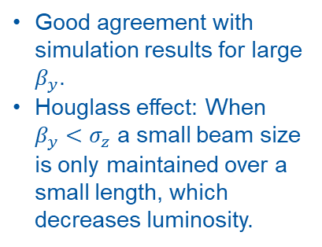
Beam-beam parameter scan
Beam-beam simulations with GUINEA-PIG.
Parameter scan with $N=5⋅{10}^{9}$ over $β_{x}$, $β_{y}$ and $σ_{z}$.
For each $β_{y}$ and $σ_{z}$, kept only results for an “optimal” $β_{x}$ that corresponds to $ℒ_{0.01}/ℒ≈1/3$.
Assumed
  same charges in the $e^{+}e^{−}$ beams.
  collision with aligned beams.
  $β_{y}$ normally limited by the design of the BDS, but we assume that it can be made arbitrarily small in this study.
Good agreement with simulation results for large $β_{y}$.
Houglass effect: When $β_{y}<σ_{z}$ a small beam size is only maintained over a small length, which decreases luminosity.

Slide 17
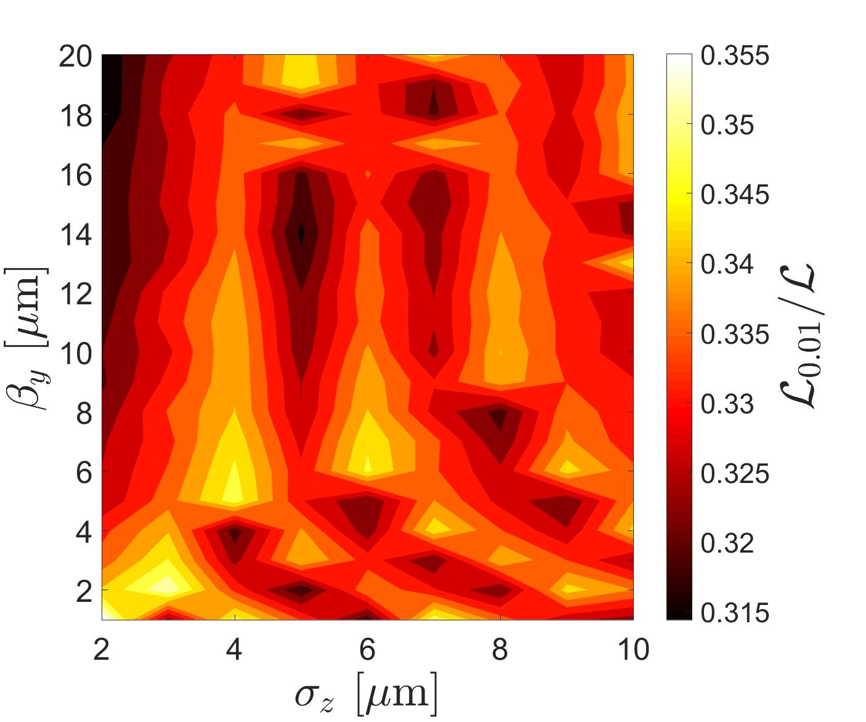

Slide 18
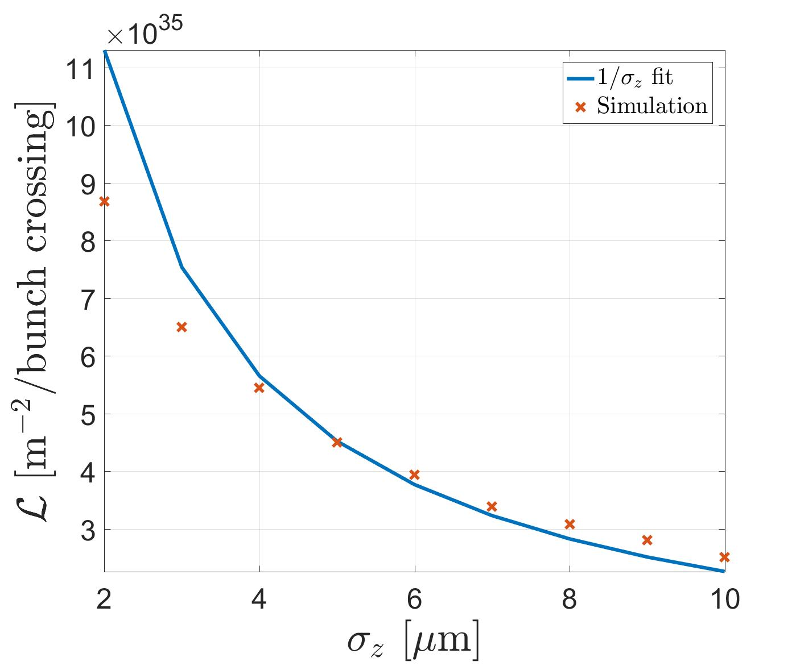

Need $β_{y}≥σ_{z}$ in order to mitigate the hourglas effect.
Choosing $β_{y}≈σ_{z}$ gives
  $ℒ∝\frac{n_{γ}^{3/2}η}{\sqrt{ε_{y}} σ_{z}}∼\frac{1}{σ_{z}}$.
Compared this to GP results by plotting the maximum $ℒ$ for each $σ_{z}$ against $σ_{z}$.

Slide 19
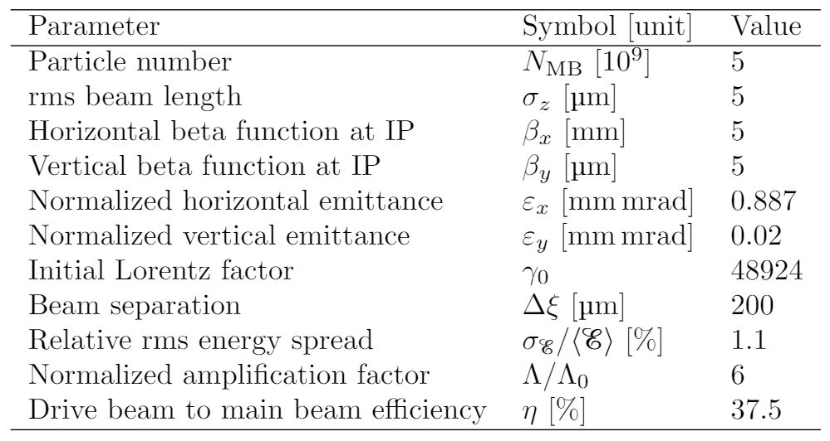
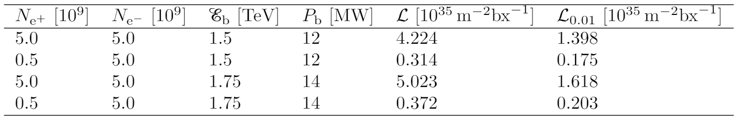

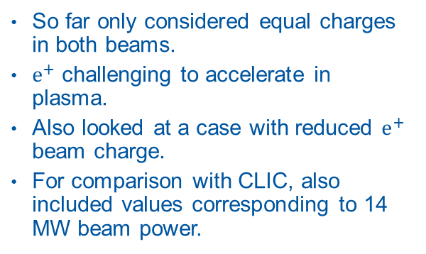
Some key figures
So far only considered equal charges in both beams.
$e^{+}$ challenging to accelerate in plasma.
Also looked at a case with reduced $e^{+}$ beam charge.
For comparison with CLIC, also included values corresponding to 14 MW beam power.
For $f_{r}=10 kHz$, $n_{b}=1$

Slide 20
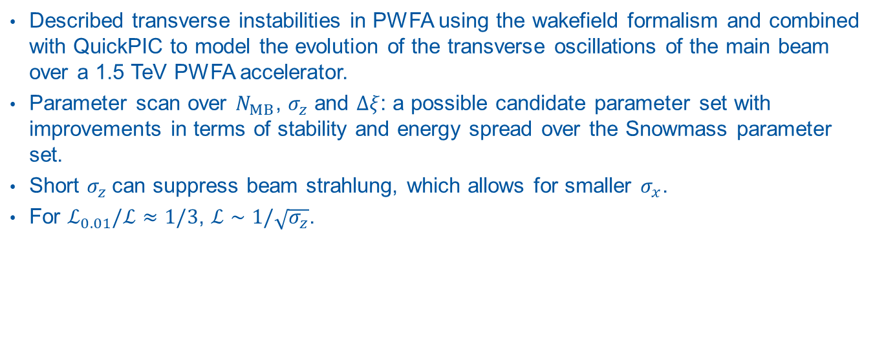
Summary
Described transverse instabilities in PWFA using the wakefield formalism and combined with QuickPIC to model the evolution of the transverse oscillations of the main beam over a 1.5 TeV PWFA accelerator.
Parameter scan over $N_{MB}$, $σ_{z}$ and $Δξ$: a possible candidate parameter set with improvements in terms of stability and energy spread over the Snowmass parameter set.
Short $σ_{z}$can suppress beam strahlung, which allows for smaller $σ_{x}$.
For $ℒ_{0.01}/ℒ≈1/3$, $ℒ∼1/\sqrt{σ_{z}}$.

Slide 22
Make accelerators small again!

