Slide 1

ESO update: AUL Testing - status
As TSO you are responsible for testing the AUL buttons inside your buildings.
Everyone has now received an email about this.
Thanks to all those who have responded already!

Slide 2
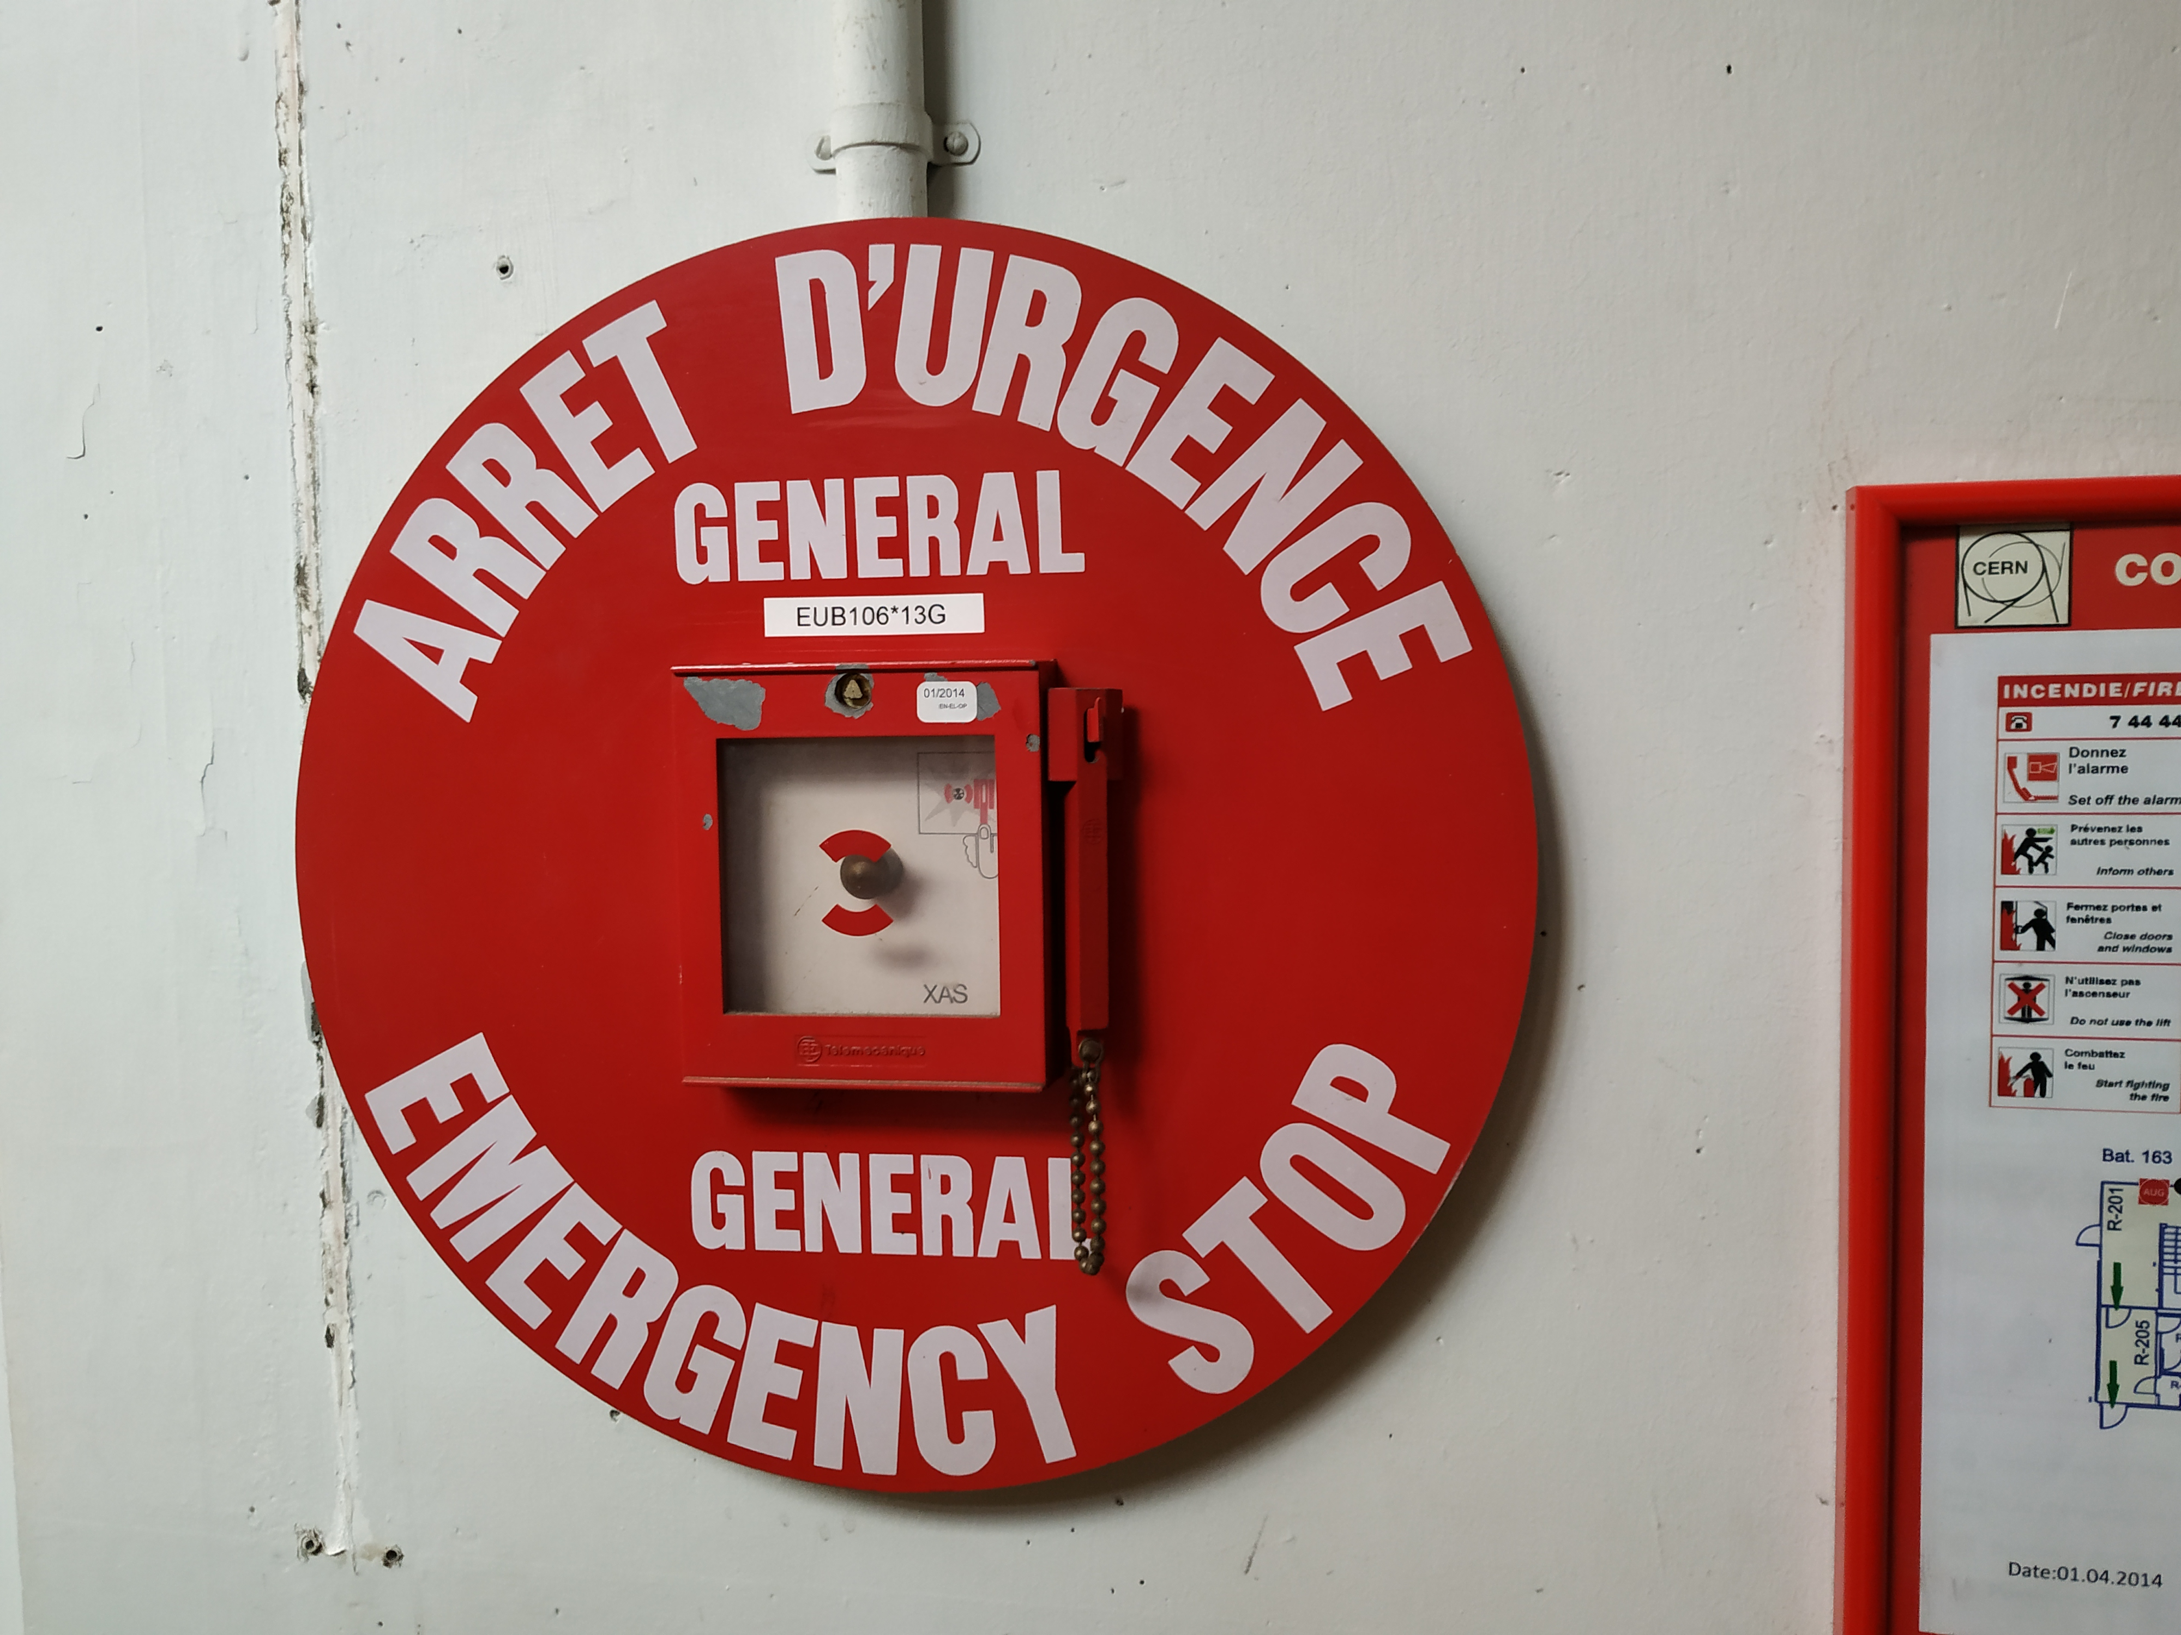
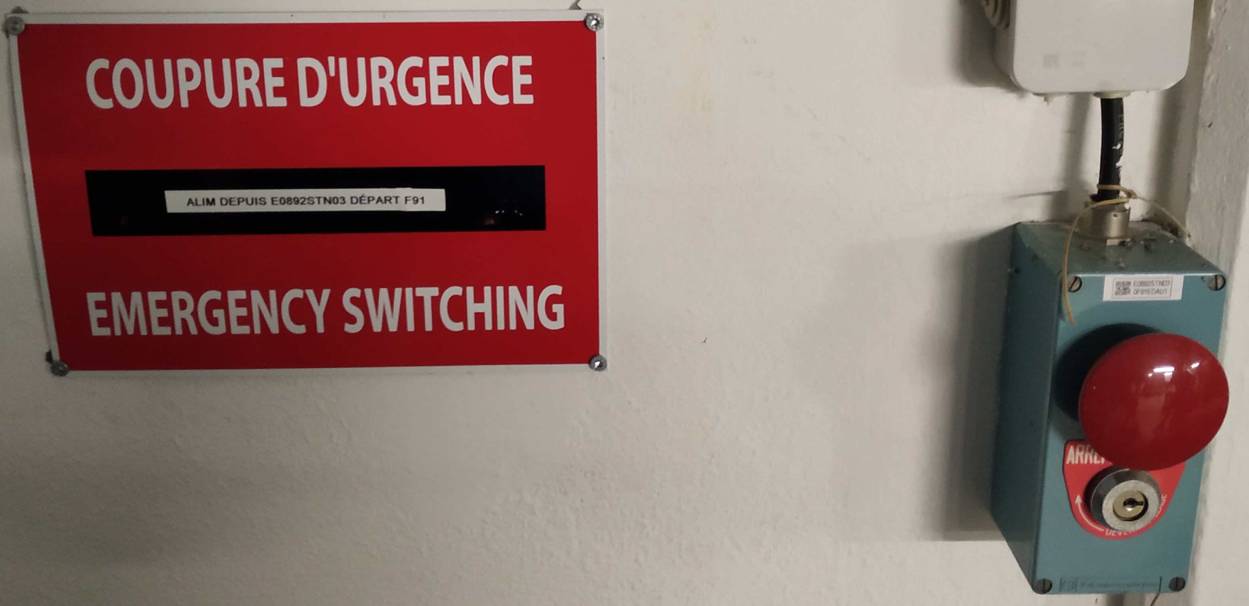
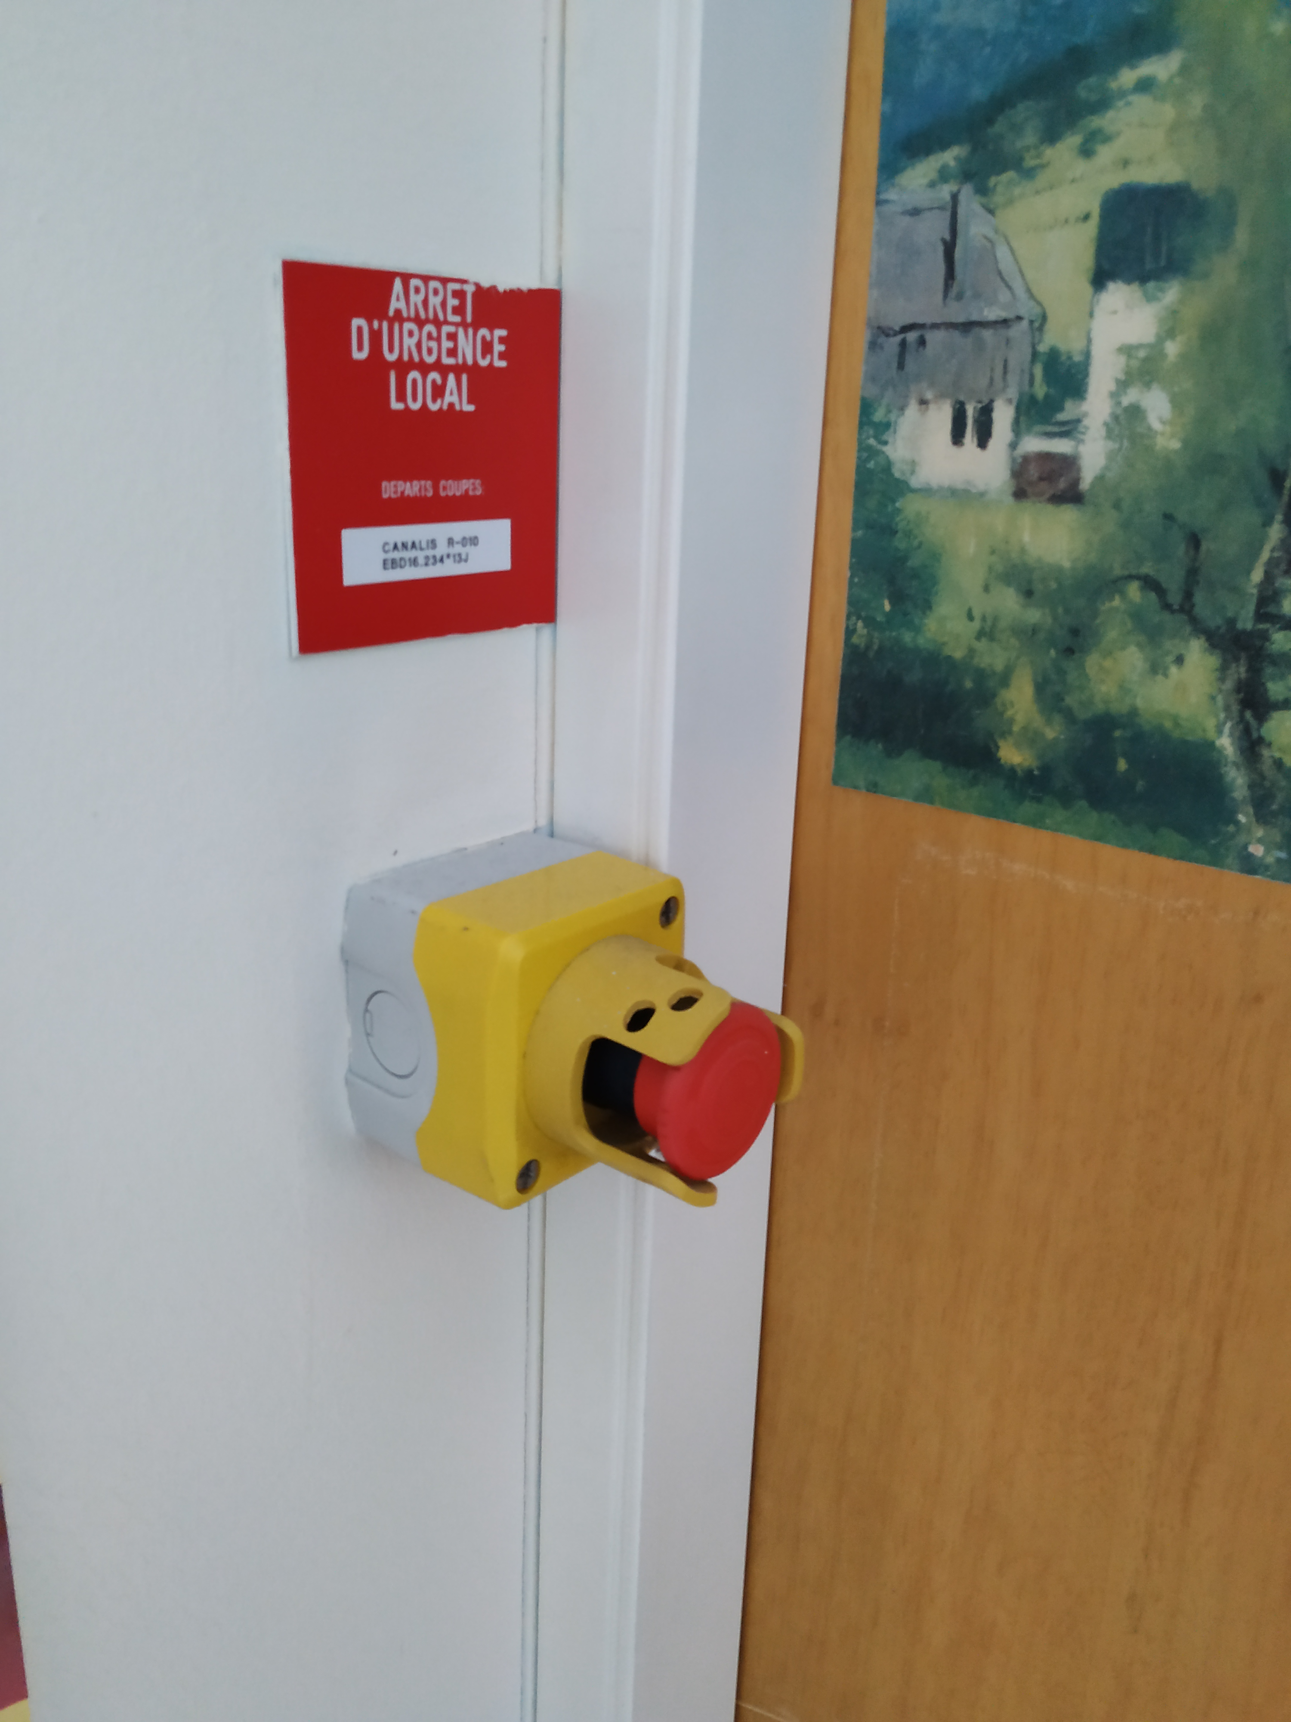
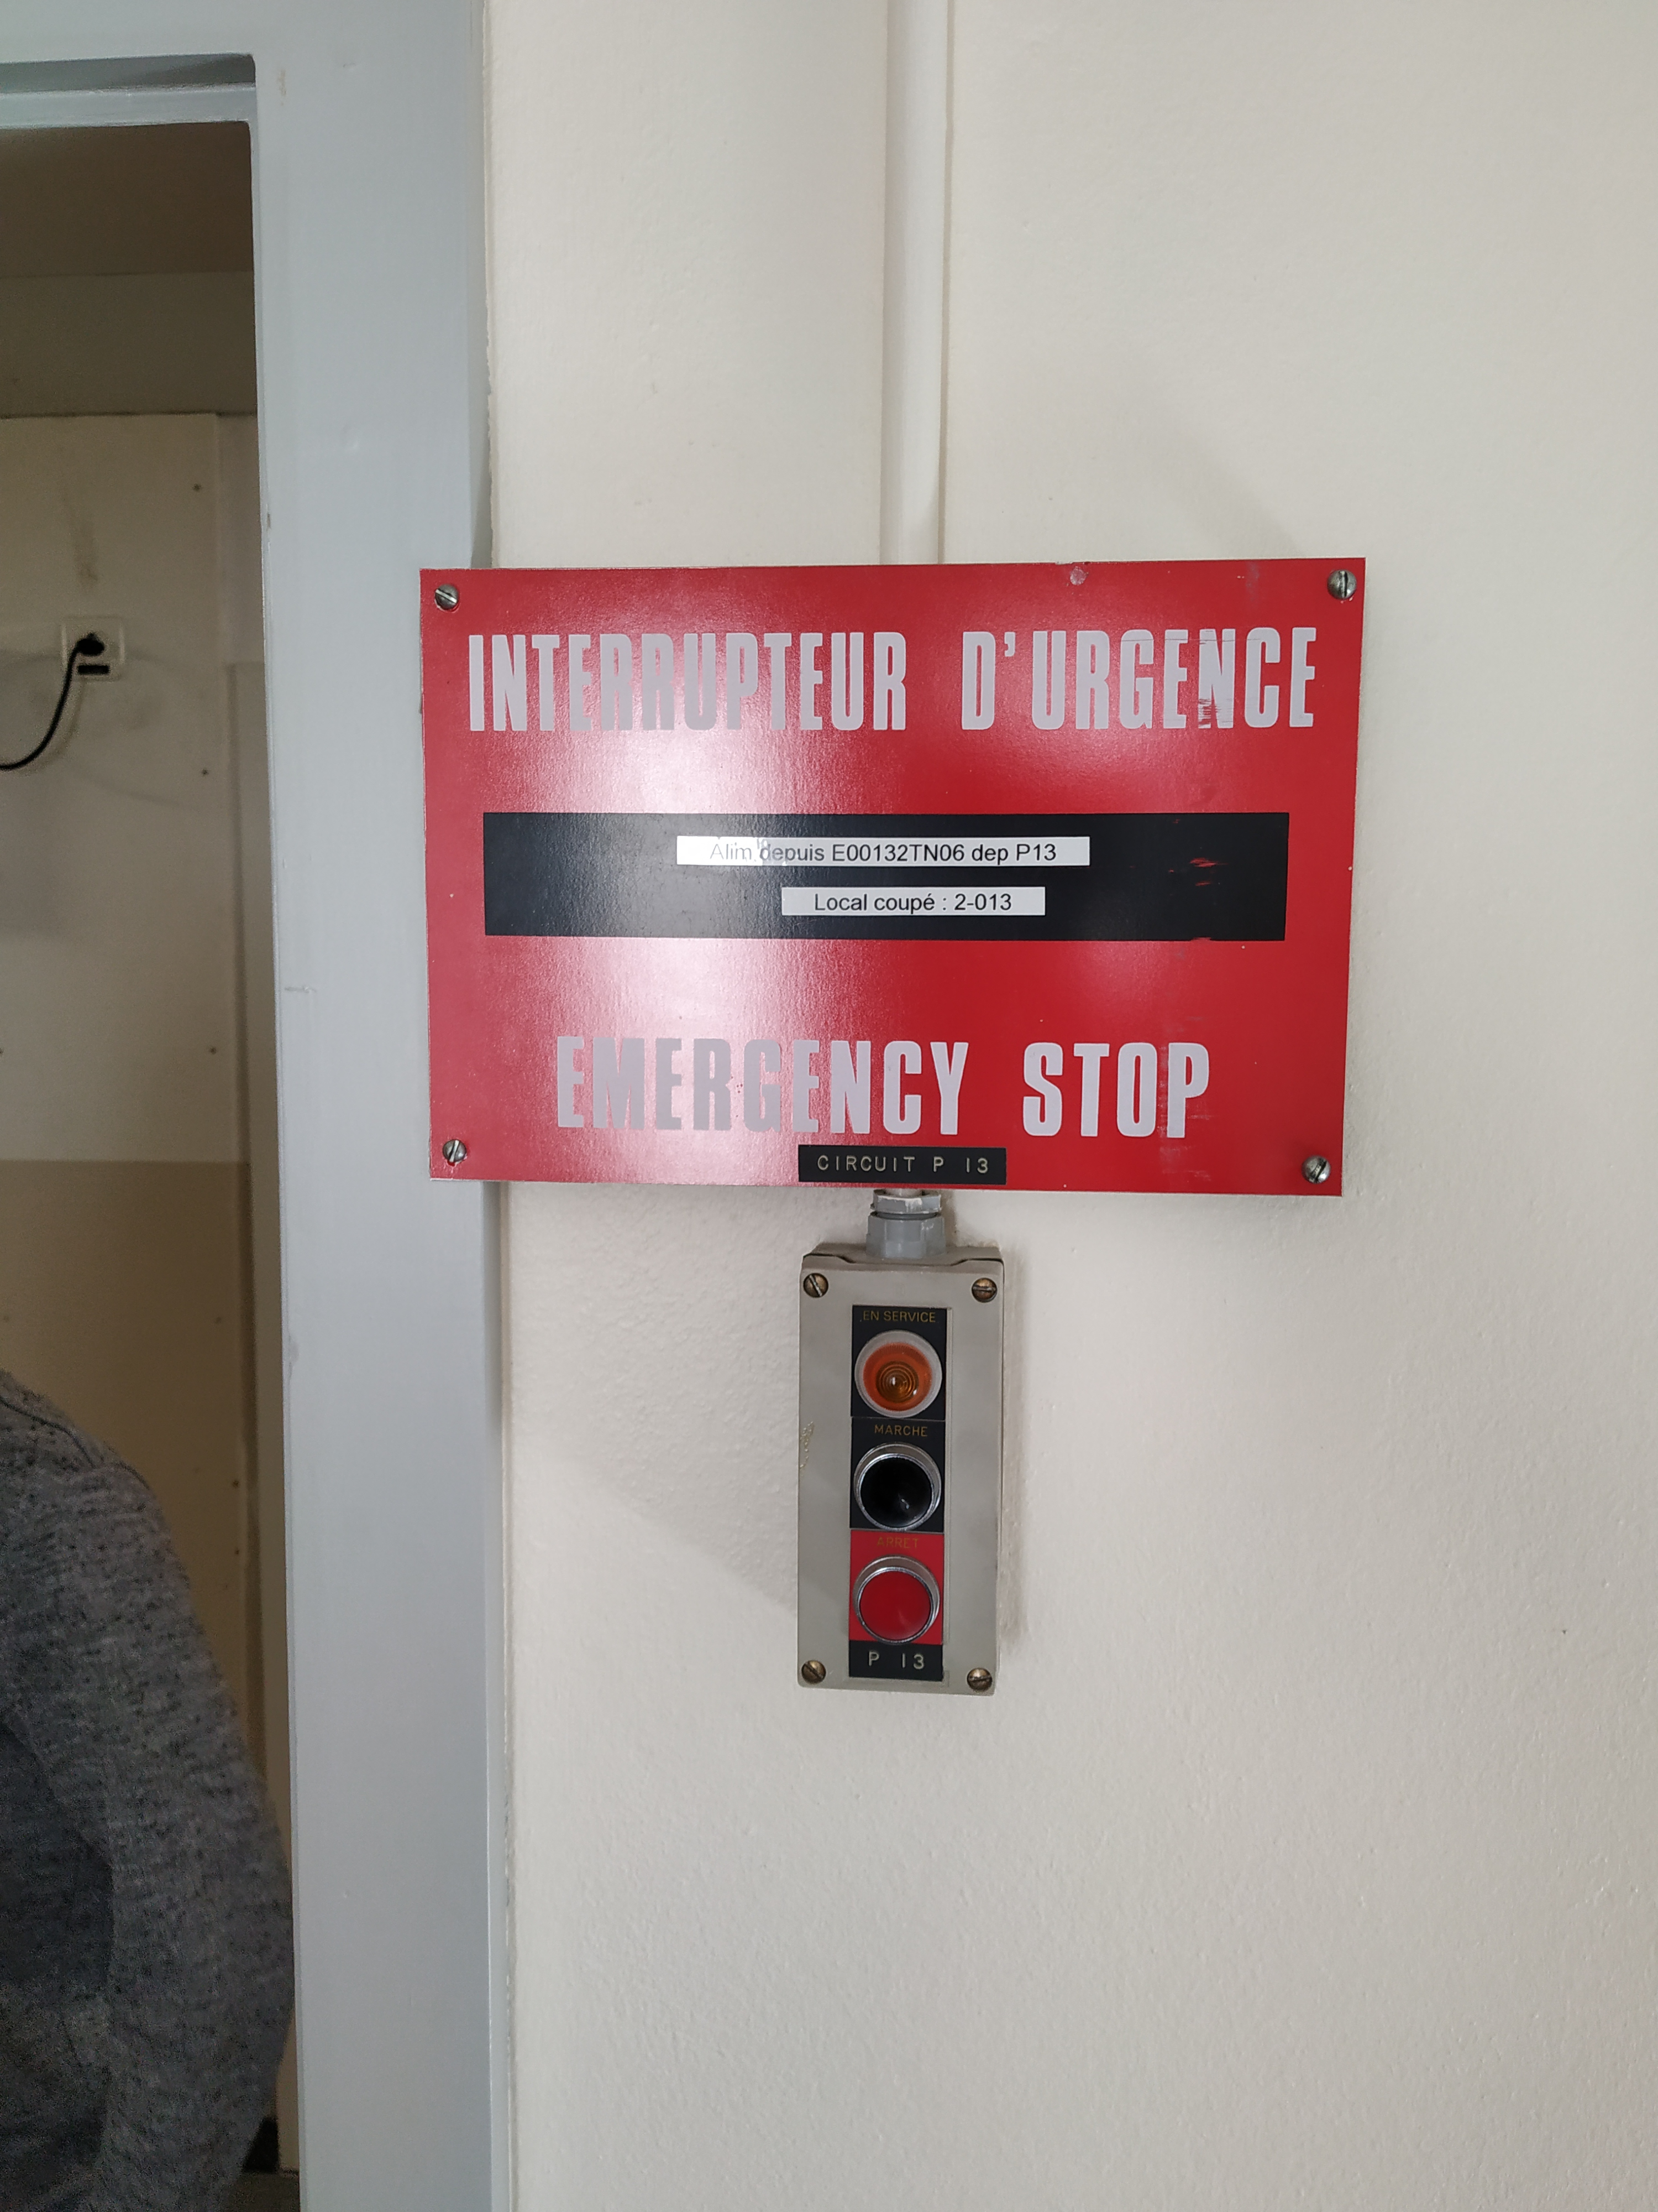
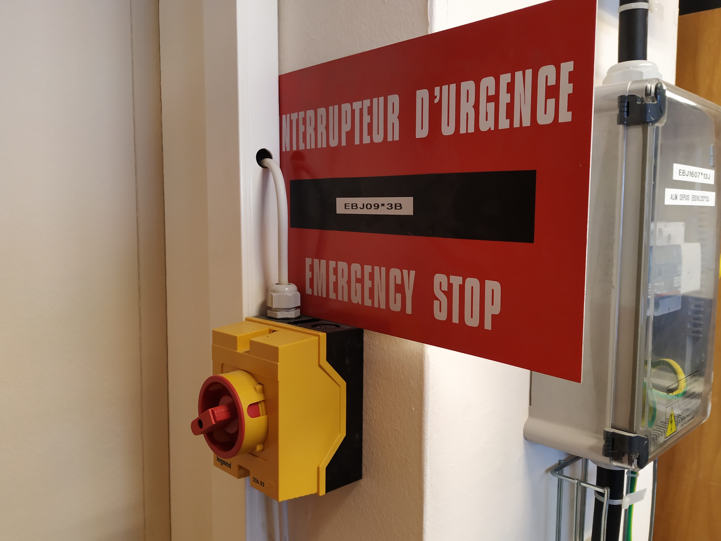
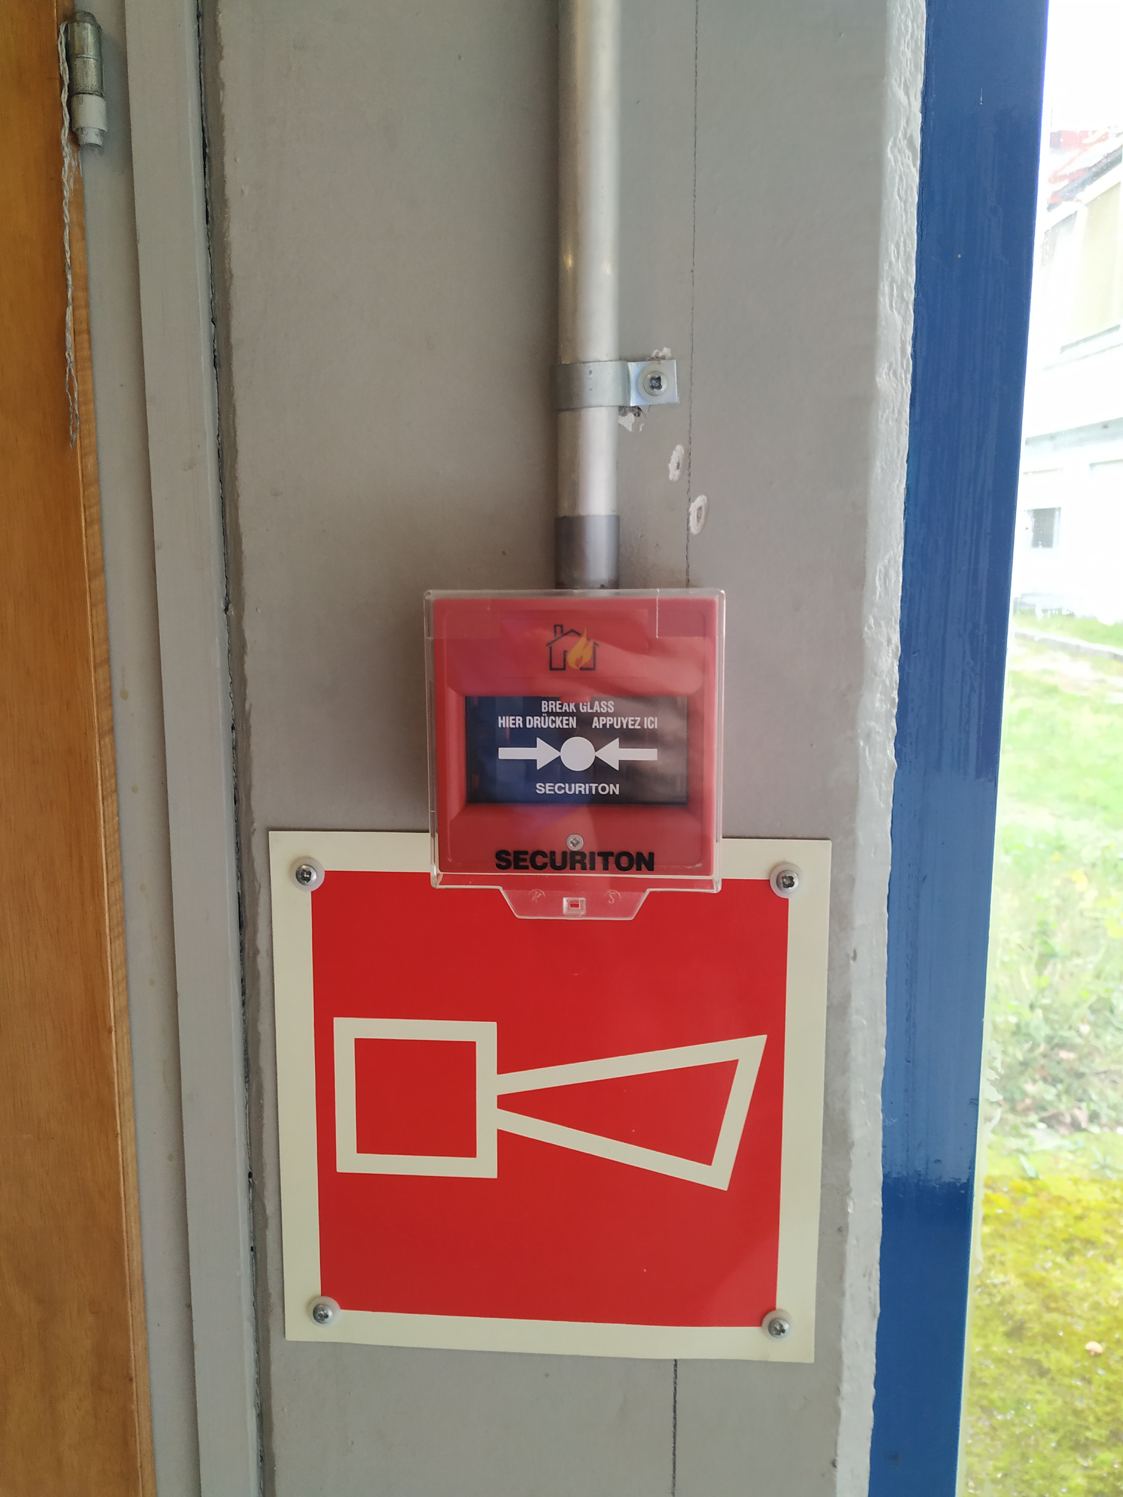
AUL Testing - Reminder
AUG EN-EL
Evacuation Alarm BE-ICS
AUL - TSO
If in doubt, ask!

Slide 3
AUL Testing - Databases
Some of our AULs are identified in EAM (for SMB and EN) but the list is not complete or updated:
Current AULs in the database
Obsolete AULs in buildings which are no longer required, not in the database
Current AULs in buildings which are not in the database
When testing, I will request database updates in EAM for you. You can see the current status of testing and links to test reports via EDMS 2323998.
An action plan is in discussion for the removal of old, unused AUL buttons with SMB.
✓
✗
✗

Slide 4
Verification of AUL installations
Work in progress!
Your help in checking each
building is very much appreciated! Don’t hesitate to ask if you have questions.

Slide 5
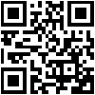
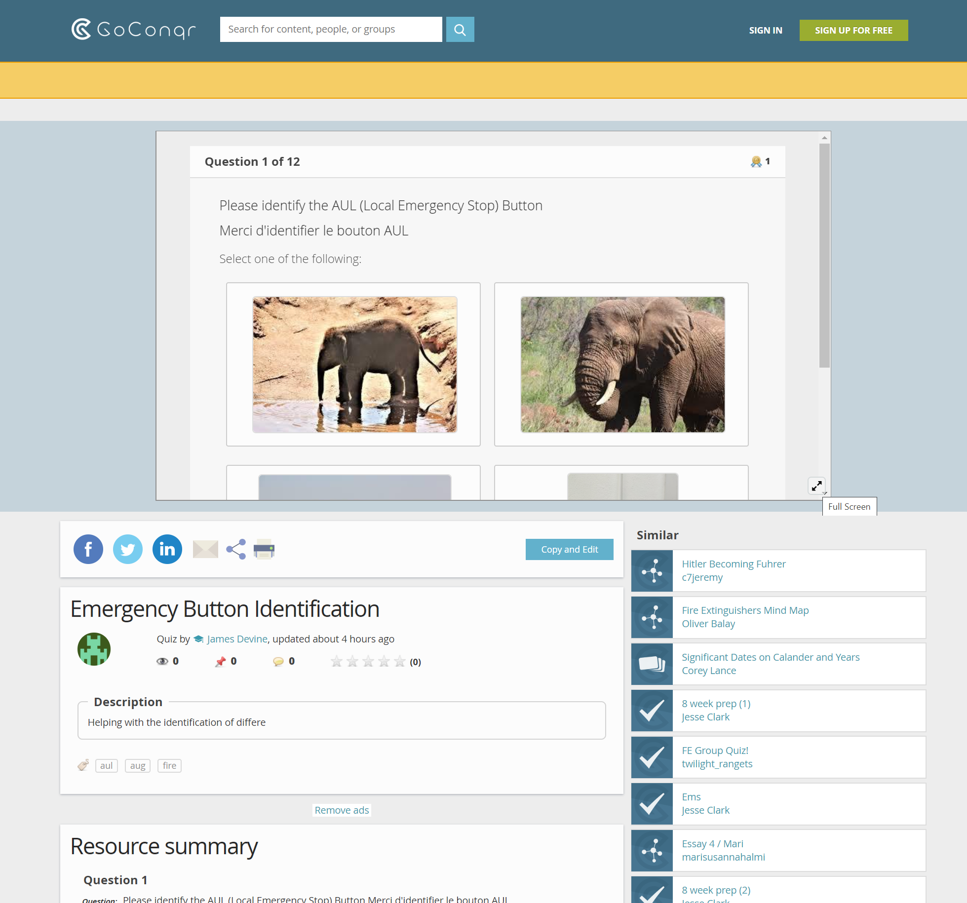
An online quiz to help with AUL, AUG and evacuation alarm button identification:
Browser: http://cern.ch/go/6Xmf
Mobile:
Click here for
fullscreen!

