Slide 1
14th WP15 meeting
Thin Film for Superconducting RF (TF-SRF)
Oleg Malyshev
WP15 coordinator

Slide 2
Agenda
Focus on 3 main activities:
Quadrupole resonator (QPR)
Development and characterising of new SC coatings on small samples
Delivery report and periodic report

Slide 3
Schedule of milestones and deliverables
 |  | Year 1 |  |  |  | Year 2 |  |  |  | Year 3 |  |  |  | Year 4
Task | Description | Q1 | Q2 | Q3 | Q4 | Q1 | Q2 | Q3 | Q4 | Q1 | Q2 | Q3 | Q4 | Q1 | Q2 | Q3 | Q4
1 | 1st WP meeting. | M1
2 | Evaluation of cleaning process for surface preparation for Cu and Nb substrate for Nb coating -(INFN). |  | M2 |  | D1
2-4 | Evaluation of system 1 & 2 (e.g. NbN and Nb₃Sn coating) - STFC |  |  |  |  | M3 |  |  | D2
2-4 | Evaluation of system 3 (e.g. MgB₂ and SIS multilayer coating) |  |  |  |  |  |  |  |  | M4 |  |  | D3
1-4 | Final report. |  |  |  |  |  |  |  |  |  |  |  |  |  |  |  | D4
now

Slide 4
List of milestones and deliverables
Type | Delivery date | Lead beneficiary | Related task/ responsible | Description | Status
M1 | m1 | STFC | Task 15.1 | 1st WP meeting. Analysing outcome from EuCARD2 and current state of the field, finalising a detailed plan for WP | Competed
M2 | m6 | INFN | Task 15.2 | First sample substrates cleaned at INFN for depositing at partners (Report to StCom) | Completed
D1 | m12 | INFN | Task 15.2 | Evaluation of cleaning process. Report defining an optimum cleaning and polishing procedure for surface preparation for Cu and Nb substrate for Nb coating minimising the substrate effect on the final film properties. | Completed
M3 | m14 | STFC | Task 15.3, 15.4 | First samples exchanged (system 1 and 2) and deposited at partners (Report to StCom) | Completed
D2 | m24 | STFC | Task 15.3, 15.4 | Evaluation of systems 1 and 2. Report on deposition, surface and structural analysis, DC and RF superconductivity evaluation of systems 1 and 2 (e.g. NbN and Nb₃Sn) and Superconductor-Insulator-Superconductor (SIS) multilayer coating | Completed
M4 | m26 | HZB | Task 15.3, 15.4 | First samples exchanged (system 3 and SIS) and deposited at partners (Report to StCom) | Completed
D3 | M36 31/03/2020 | HZB | Task 15.3, 15.4 | Evaluation of system 3. Report on deposition, surface and structural analysis, DC and RF superconductivity evaluation of system 3 (e.g. NbTiN or MgB₂) and SIS multilayer coating | Started Due by 31/04/2020
D4 | M46 31/01/2020 | STFC | Task 15.3, 15.4 | Final report on thin film technology [46] Report summarizing the results on the evaluation of cleaning and coating procedures for highest Q₀ and E_{a}

Slide 5
Preparation of the 2nd Periodic Report
Time to complete the 2nd Periodic Report covering M18 to M36 (November 2018 – April 2020).
Schedule:
31.3 : deadline for Task leaders to send their part to WP Coordinators
  Contributions received only from Cristian and Eugen, many thanks
  Contribution from others – urgently required, please
30.4 : deadline for WP Coordinators to send their chapter to CERN
30.5 : first complete draft ready.
15.6 : final draft sent to SC for comments.
30.6 : deadline for submission.

Slide 6
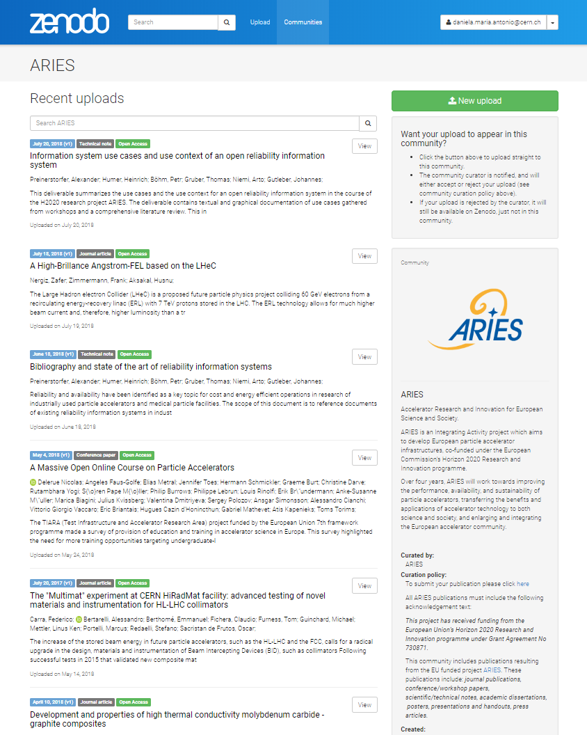
Publications
Please let me know a list of your publications for ARIES:
  Jornal Articles
  Reports
  Conference papers
  Technical notes
  Other
  Thesis
Acknowledgment of H2020 funding in your papers!

Slide 7
3rd ARIES Annual Meeting
20-24 April 2020 at IST Congress Center, Lisbon, Portugal
Cancelled
But a few sessions will take place on Wednesday 22nd April (CET) by Vydeo:
9:00-10:30 4th ARIES Governing Board Meeting (by invitation)
11:00-17:00 ARIES virtual Annual Meeting
  Open Session: https://indico.cern.ch/event/910102/
  I will give a 20-min talk on WP15 progress at 11:30
17:00 Steering Committee meeting (by invitation)

Slide 8
IFAST (ARIES-II)
Submitted on 17 March 2020
Result of EC evaluation: 17 August 2020
Consortium Agreement preparation: Oct. 2020 – Mar. 2021
Project start: 1 May 2021 (at end of ARIES)
Duration: 4 years (2021 – 2025)

