Slide 1




ARIES Update
Stewart Leith, Jiaokun Qiao, Michael Vogel
Authors would like to acknowledge the support provided by European Union’s ARIES collaboration H2020 Research and Innovation Programme under Grant Agreement no. 730871.

Slide 2
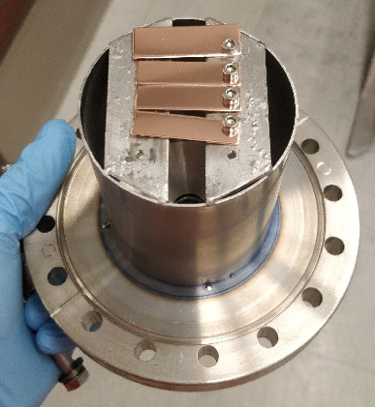
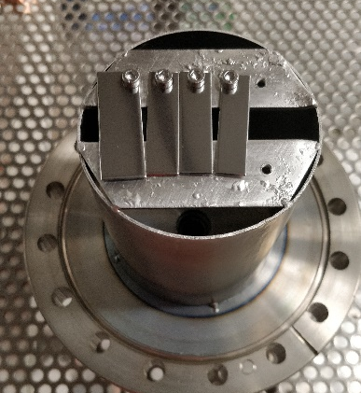
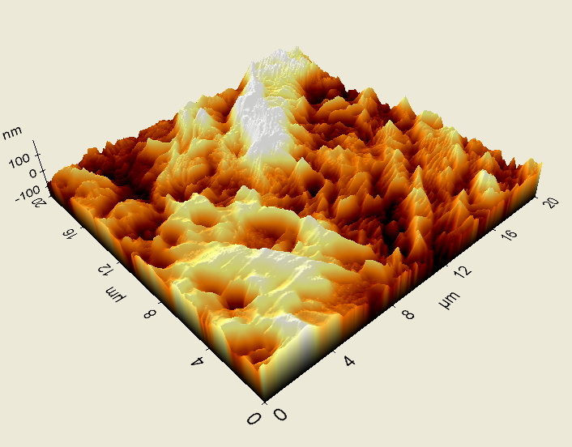
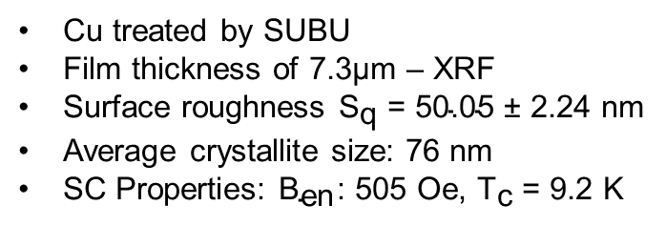
QPR B2 Small Samples
Cu treated by SUBU
Film thickness of 7.3$\text{μm}$ – XRF
Surface roughness ${\text{S}}_{\text{q}}\text{ = 50.05 }\text{±}\text{ 2.24 }\text{nm}$
Average crystallite size: 76 nm
SC Properties: ${\text{B}}_{\text{en}}$: 505 Oe, ${\text{T}}_{\text{c}}$ = 9.2 K

Slide 3
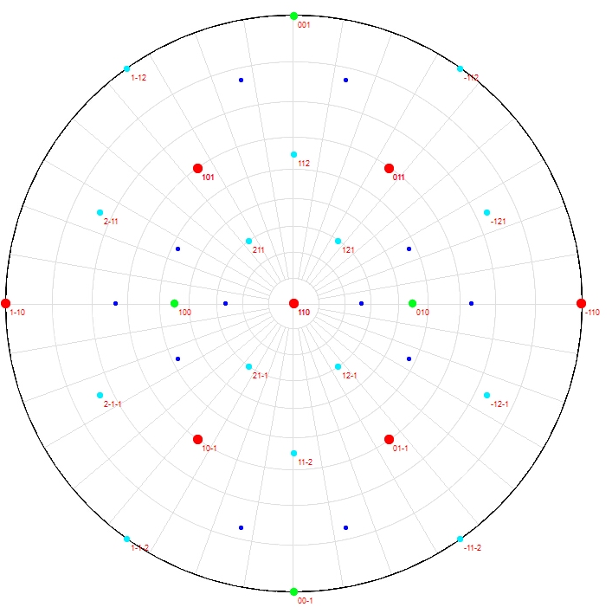
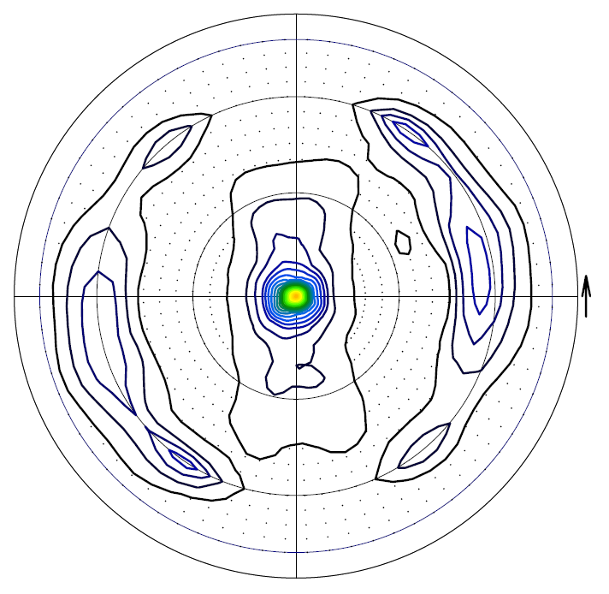
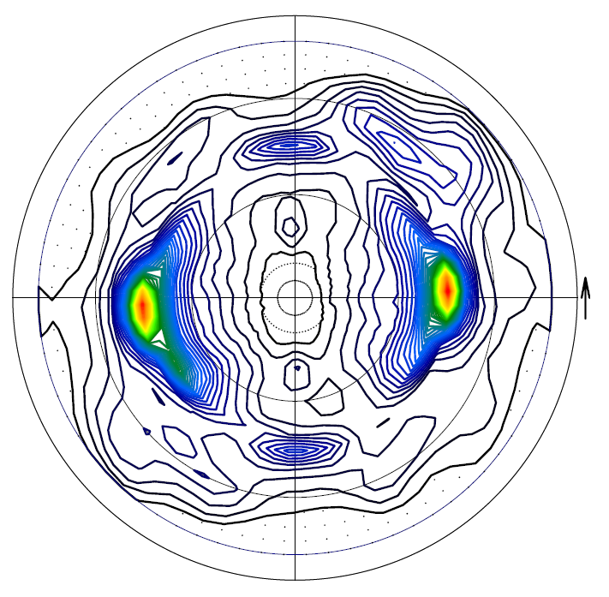
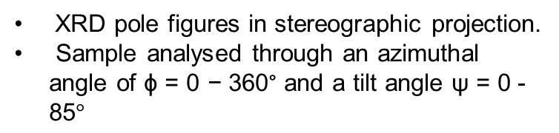
QPR B2 Small Samples
XRD pole figures in stereographic projection.
Sample analysed through an azimuthal angle of $\text{ϕ}\text{ = 0} \text{−}\text{ 3}\text{60}\text{°}$ and a tilt angle $\text{ψ}\text{ = 0 - 85}°$
Nb {110} theoretical layout
Nb (110)
Nb (200)

Slide 4
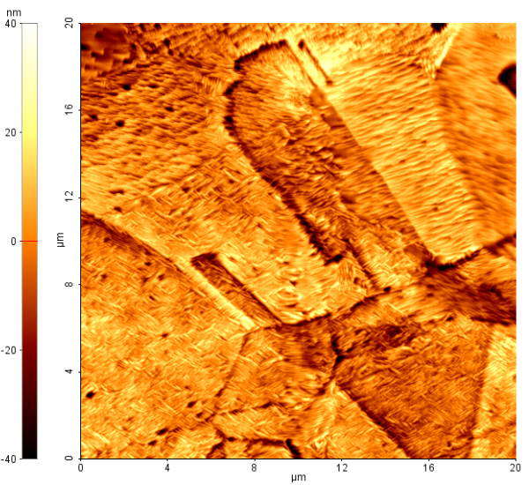
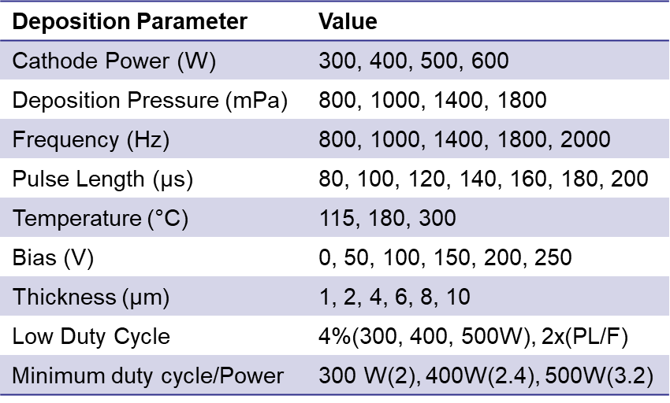
HiPIMS Nb Samples - HDC
Deposition Parameter | Value
Cathode Power (W) | 300, 400, 500, 600
Deposition Pressure (mPa) | 800, 1000, 1400, 1800
Frequency (Hz) | 800, 1000, 1400, 1800, 2000
Pulse Length (µs) | 80, 100, 120, 140, 160, 180, 200
Temperature (°C) | 115, 180, 300
Bias (V) | 0, 50, 100, 150, 200, 250
Thickness ($\text{μm}$) | 1, 2, 4, 6, 8, 10
Low Duty Cycle | 4%(300, 400, 500W), 2x(PL/F)
Minimum duty cycle/Power | 300 W(2), 400W(2.4), 500W(3.2)
Initial Results:
Multiple types of grains observed in all HiPIMS samples – Similar to DCMS
Reduced Roughness compared to DCMS: 5.89nm vs. 19.38nm
Oxygen content <5% in all samples
Significant changes in peak current!

Slide 5
Waveform Analysis - HDC
Cathode Power
Deposition Pressure
Frequency
Pulse Length

Slide 6
Waveform Analysis-LDC
400W
Duty Cycle (%) | Peak Current (A)
2.4 | 54.9
4 | 48.315
8 | 26.355
10 | 20.63
12 | 17.21
14 | 17.195
16 | 15.66
18 | 12.395
20 | 10.018

Slide 7
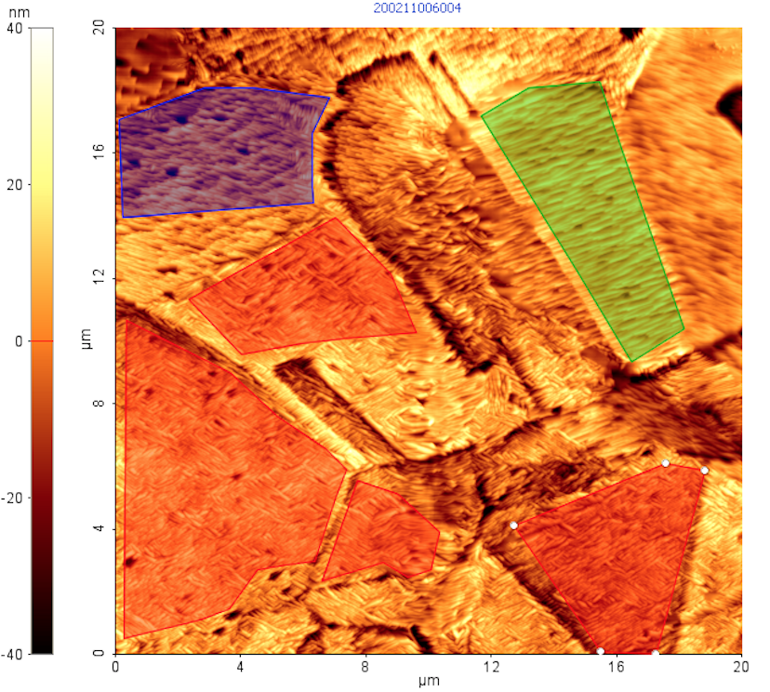
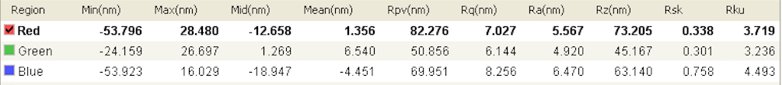
Surface Topography
Different grain structures analysed separately
Decreased effect of GB – focused on grain morphology
Single grain type identified in all samples
Parameter | Nett Effect (Increase)
Cathode power | Increase
Deposition pressure | Decrease
Substrate Bias | Increase
Temperature | Slight increase
Frequency | Mid-range increase
Pulse Length | No effect
Thickness | Increase

Slide 8
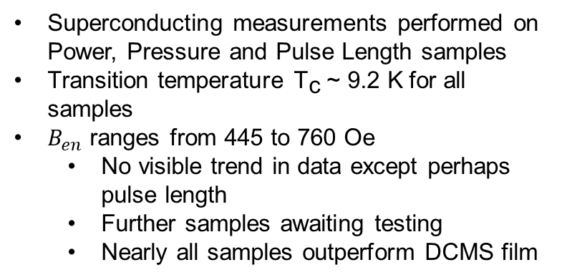
Superconducting Performance
Superconducting measurements performed on Power, Pressure and Pulse Length samples
Transition temperature ${\text{T}}_{\text{c}} \text{\sim }\text{ 9.2 }\text{K}$ for all samples
$B_{en}$ ranges from 445 to 760 Oe
  No visible trend in data except perhaps pulse length
  Further samples awaiting testing
  Nearly all samples outperform DCMS film

Slide 9
Superconducting analysis
NbN and ML samples
Nb samples only – DCMS vs. HiPIMS

Slide 10
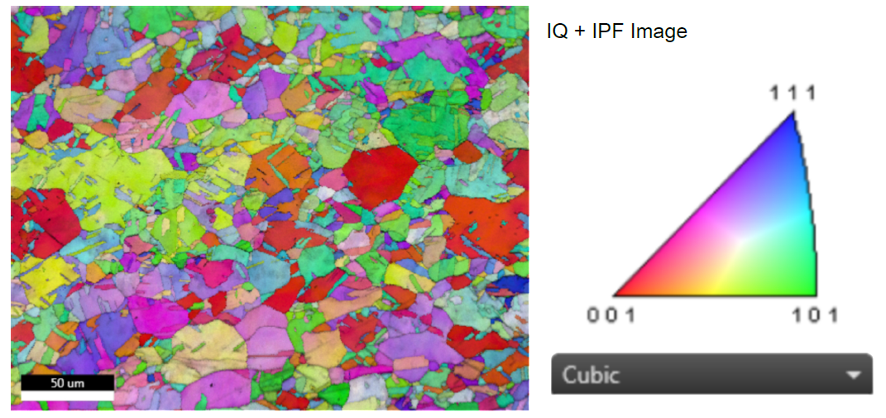
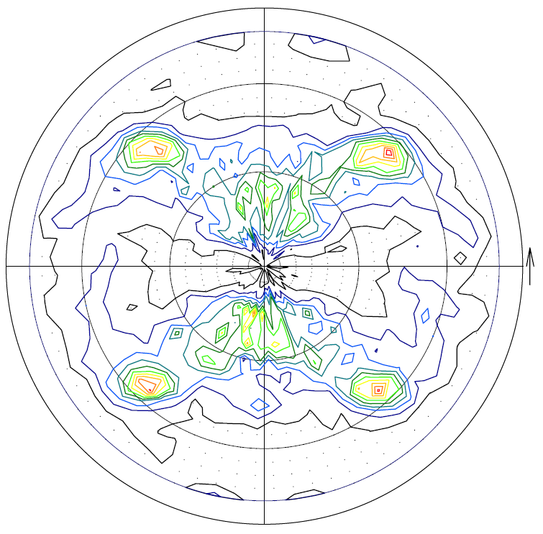
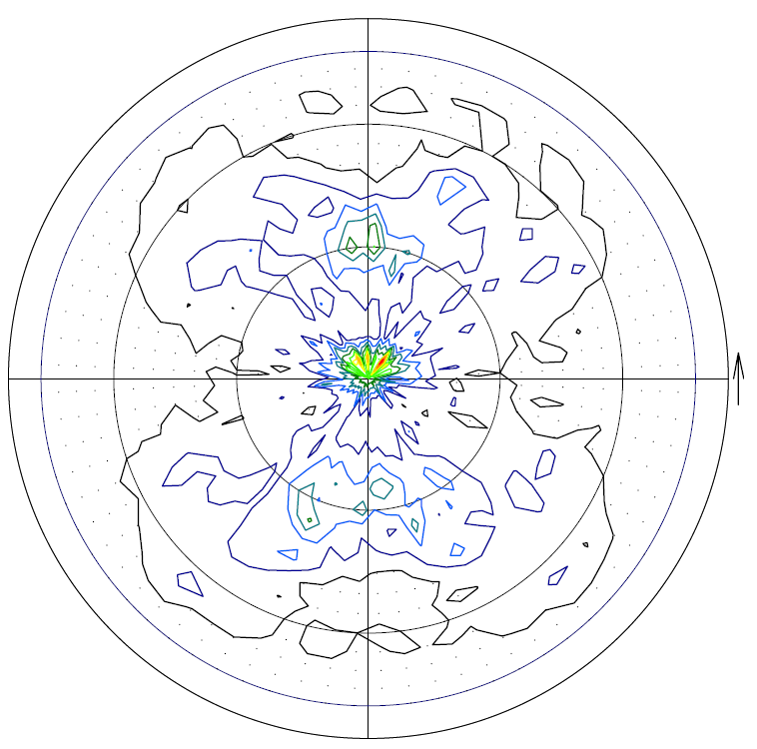
Texture Analysis - Cu
EBSD and Pole figure measurements indicate {100} oriented Cu substrate
Cu (111)
Cu (200)

Slide 11
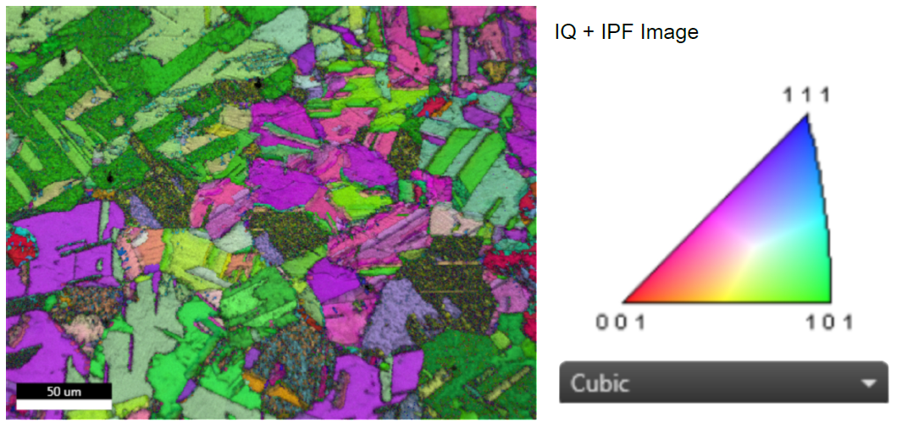
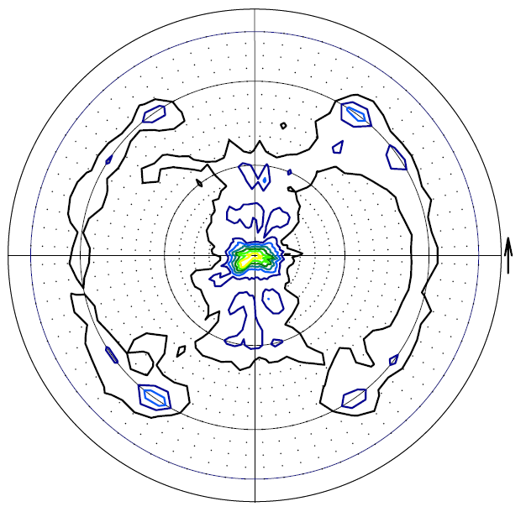
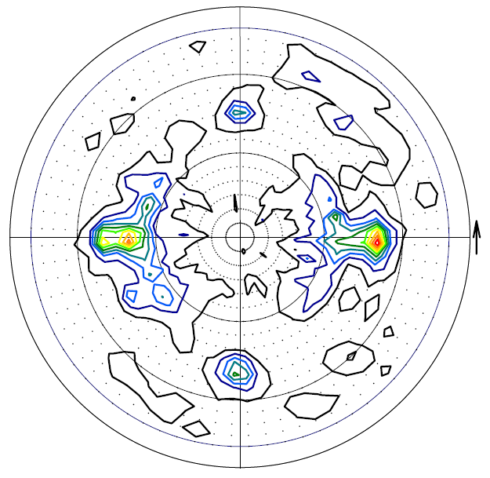
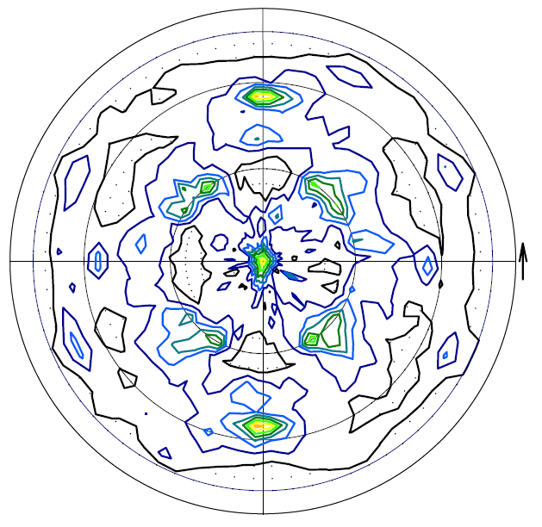
Texture Analysis - Nb
EBSD and Pole figure measurements indicate {110} oriented Nb film
Nb (110)
Nb (200)
Nb (112)

Slide 12
Thanks for your Attention!
Authors would like to acknowledge the support provided by European Union’s ARIES collaboration H2020 Research and Innovation Programme under Grant Agreement no. 730871.

