Slide 1


Status of laser polishing/treatment for QPR samples
Arturs Medvids, Pavels Onufrijevs, Aleksandrs Mychko, Liga Grase
21.04.2020.

Slide 2
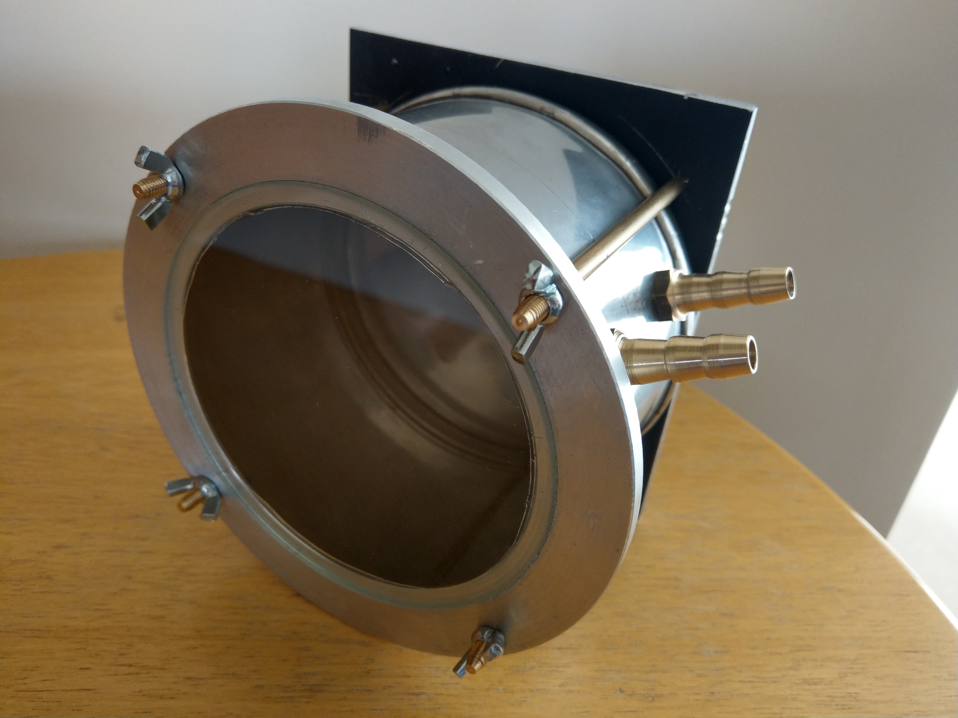

Slide 3
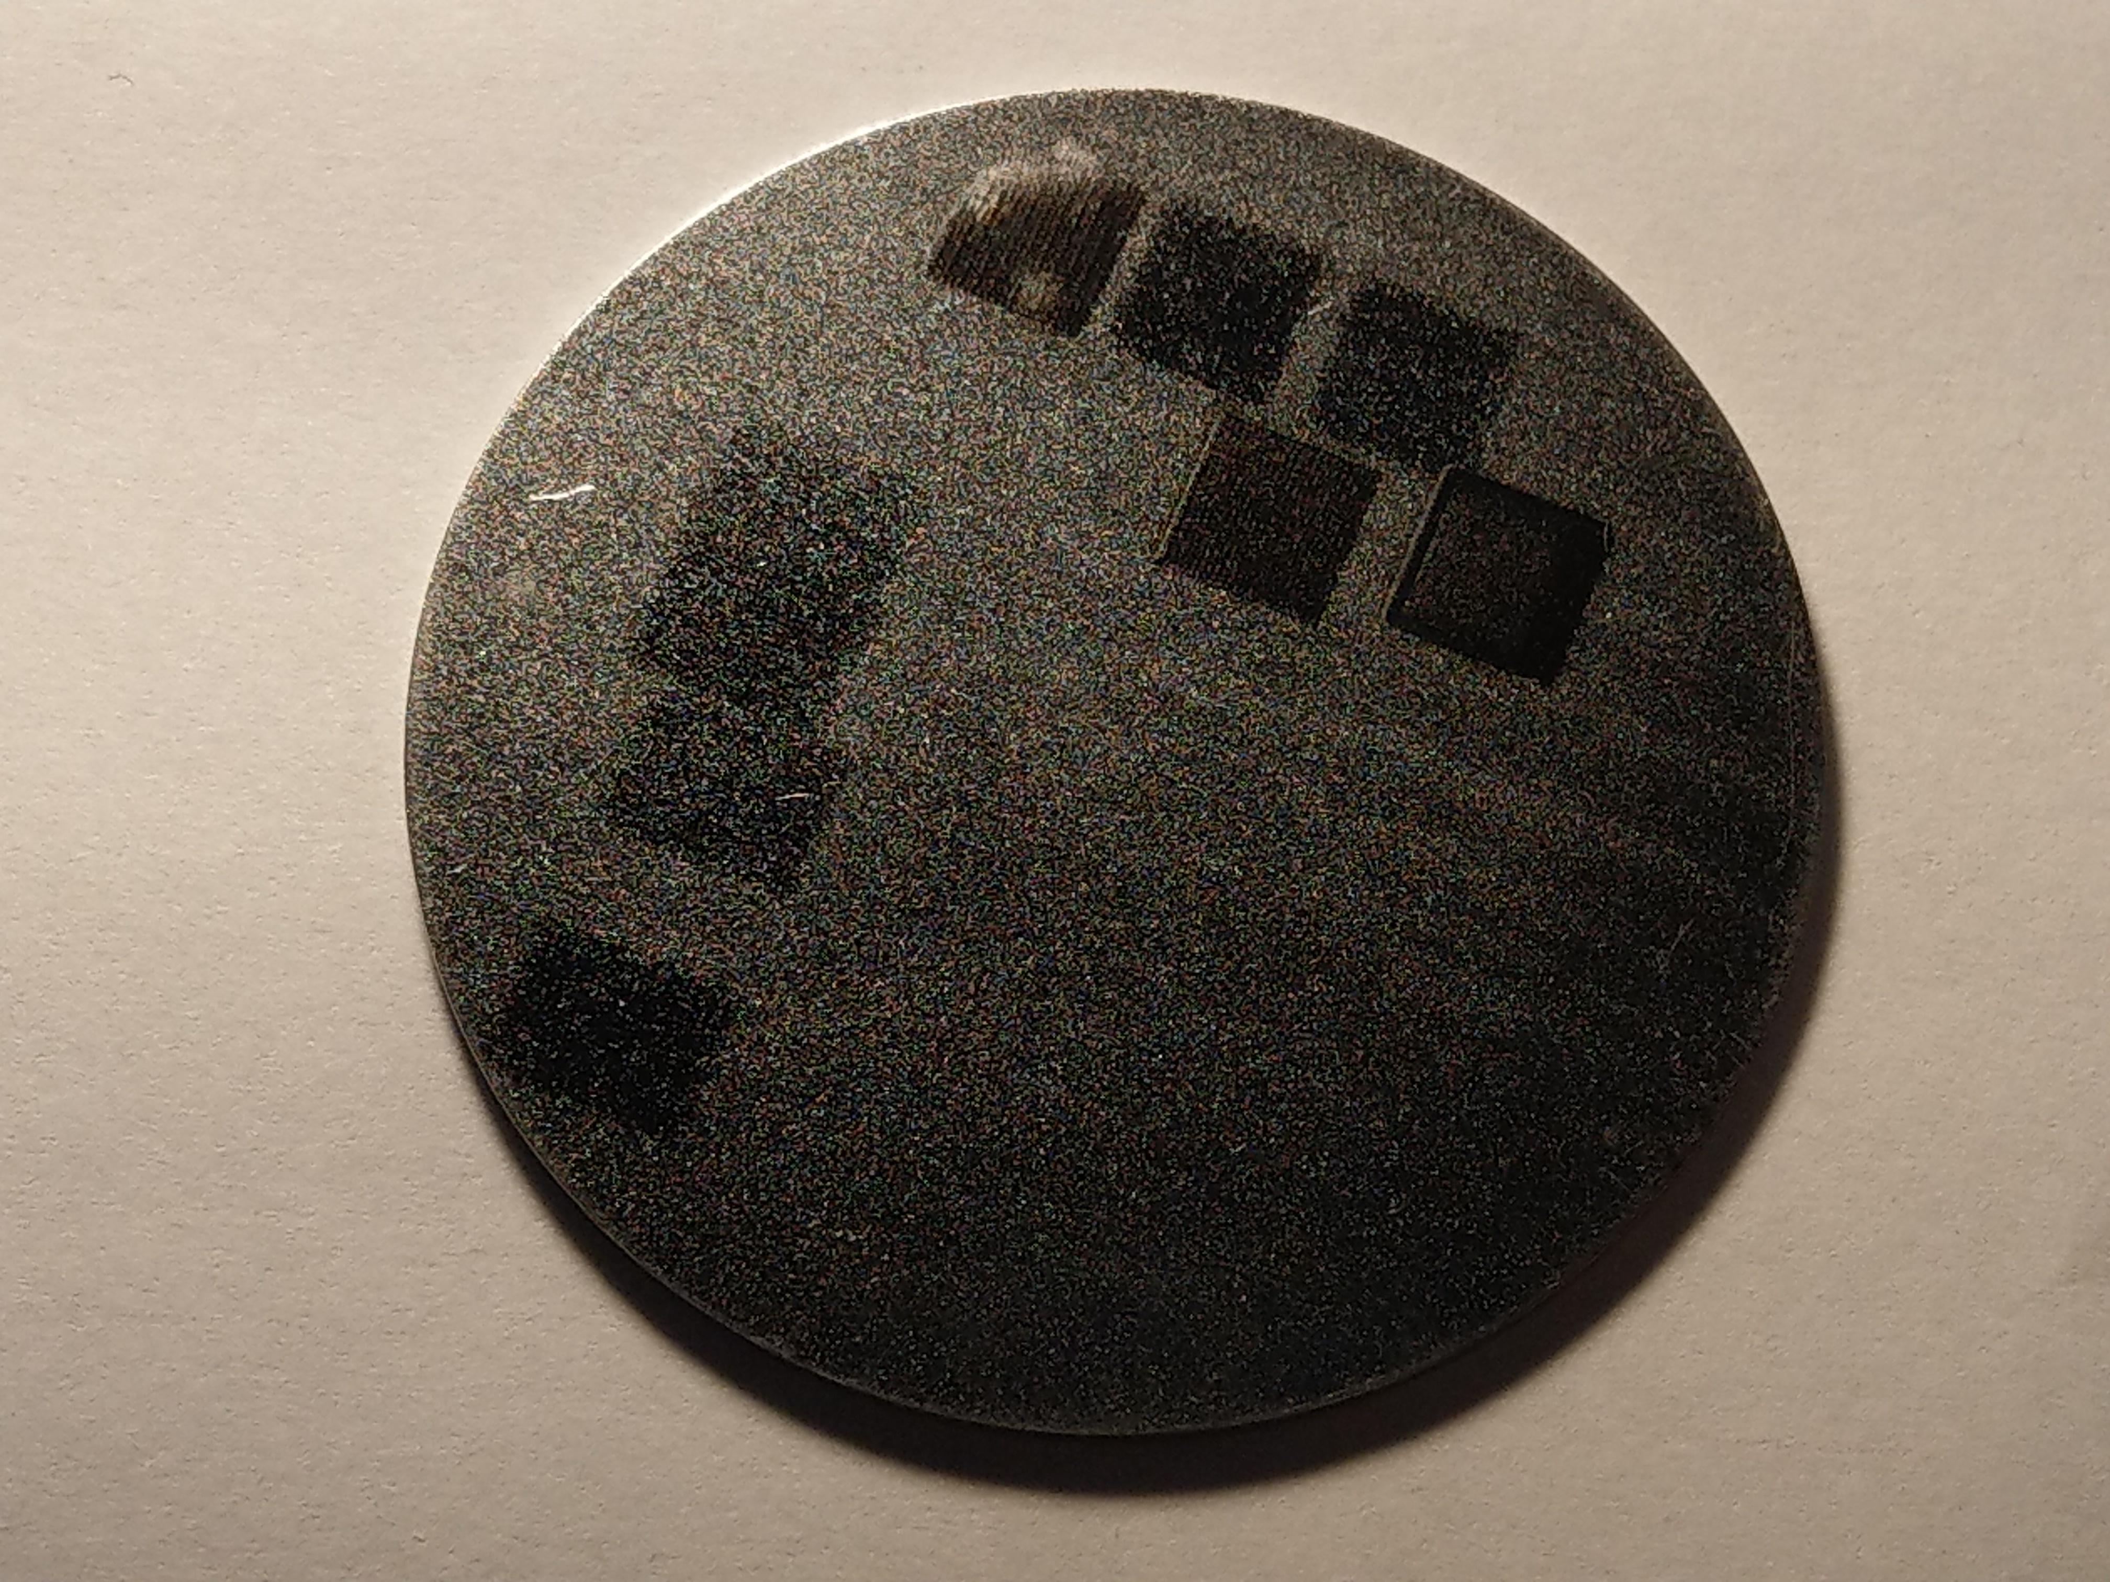
I _{min}
I_{max}
I _{mid}
Fig.1. Optical image of Bulk Nb sample. Irradiated places are dark.
Sample diameter is 50 mm, irradiated areas are of size 5x5 mm².

Slide 4
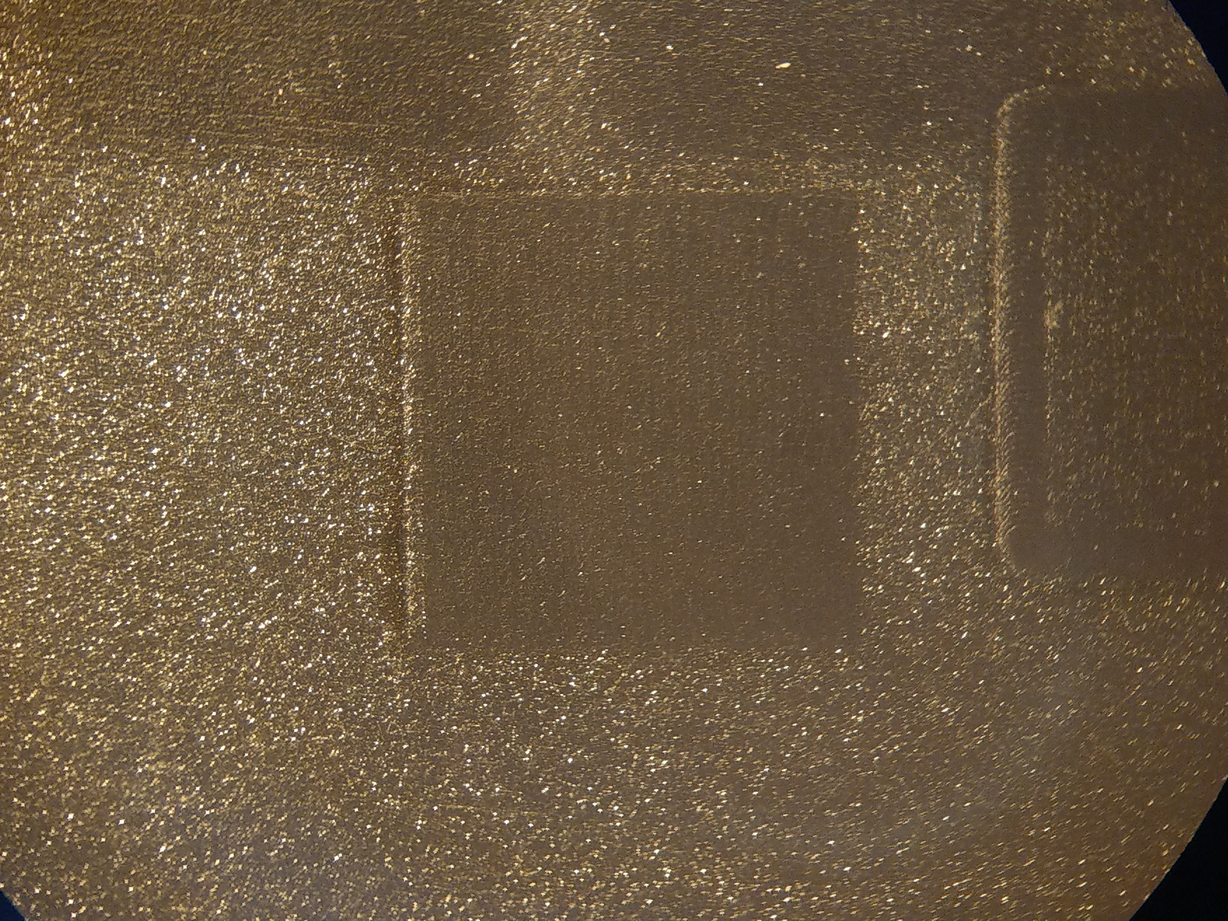
Fig. 2. Magnified image of the irradiated 5x5 mm² area of the sample. The irradiated area is smoother.

Slide 5
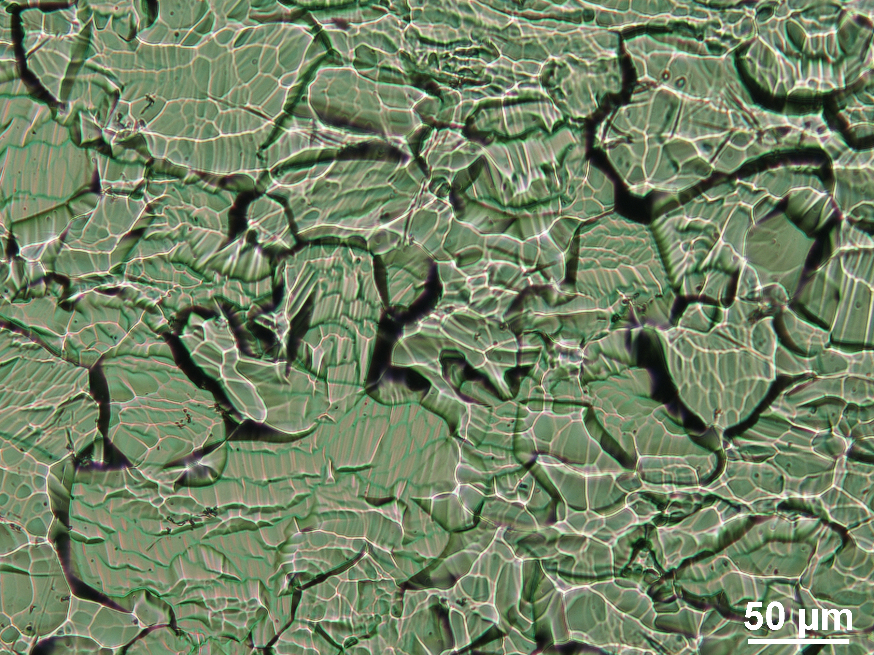
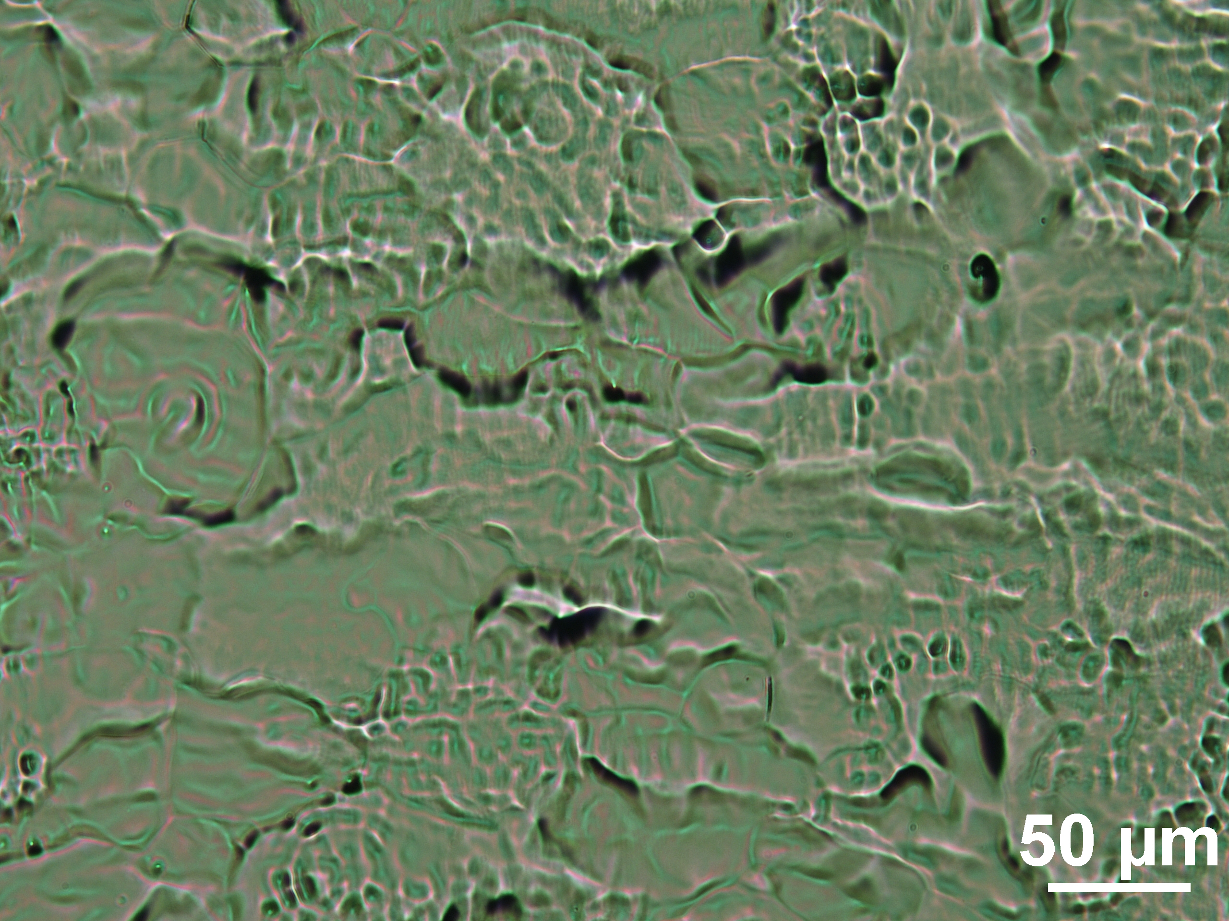
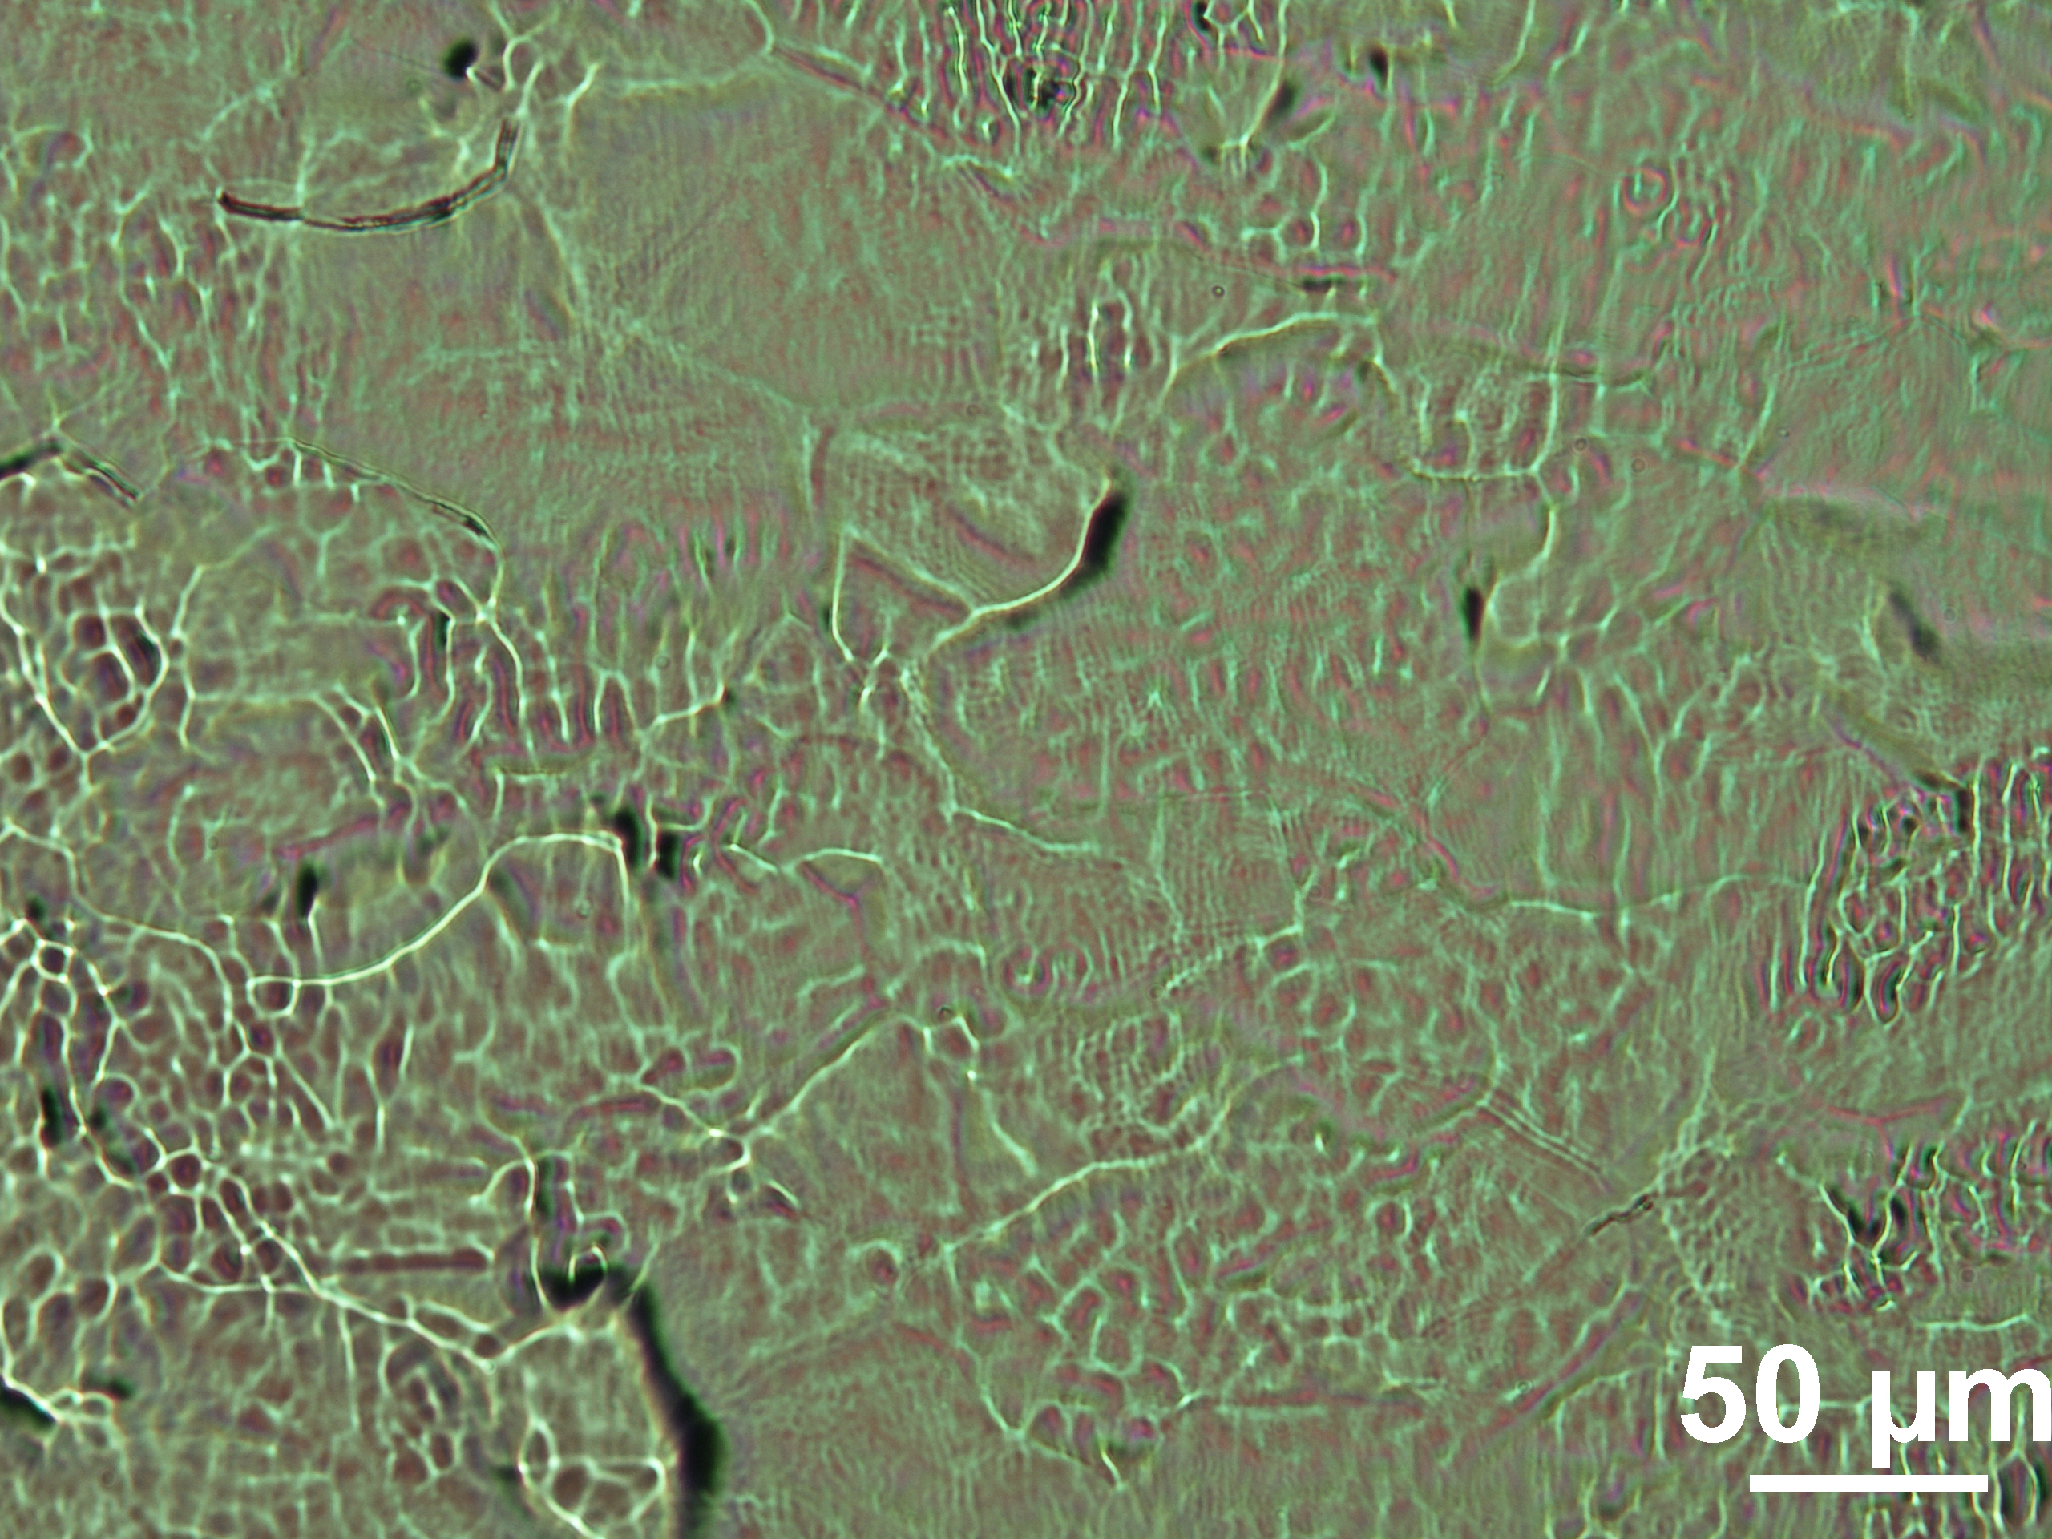
Fig. 3. Optical microscope images of the non-irradiated and irradiated with middle (irradiated 1) and maximal (irradiated 2) Nd:YAG laser intensity sample. The irradiated surface becomes smoother.
Optical Microscope
Non-irradiated
Laser: 1064 nm
Spot diameter: 1.5 mm
Scan speed: 1.0 mm/s
Span pitch: 0.3 mm
Irradiated 1
Energy: 34.1 ± 0.5 mJ
Filter: HC-1
Focus lens: 5.5 cm
Irradiated 2
Energy: 44.7 ± 0.6 mJ
Filter: Not used
Focus lens: 5.5 cm
Irradiated 1
Irradiated 2

Slide 6
Fig. 4. XRD pattern of the non-irradiated and irradiated areas with minimal, middle and maximal laser intensity.

Slide 7
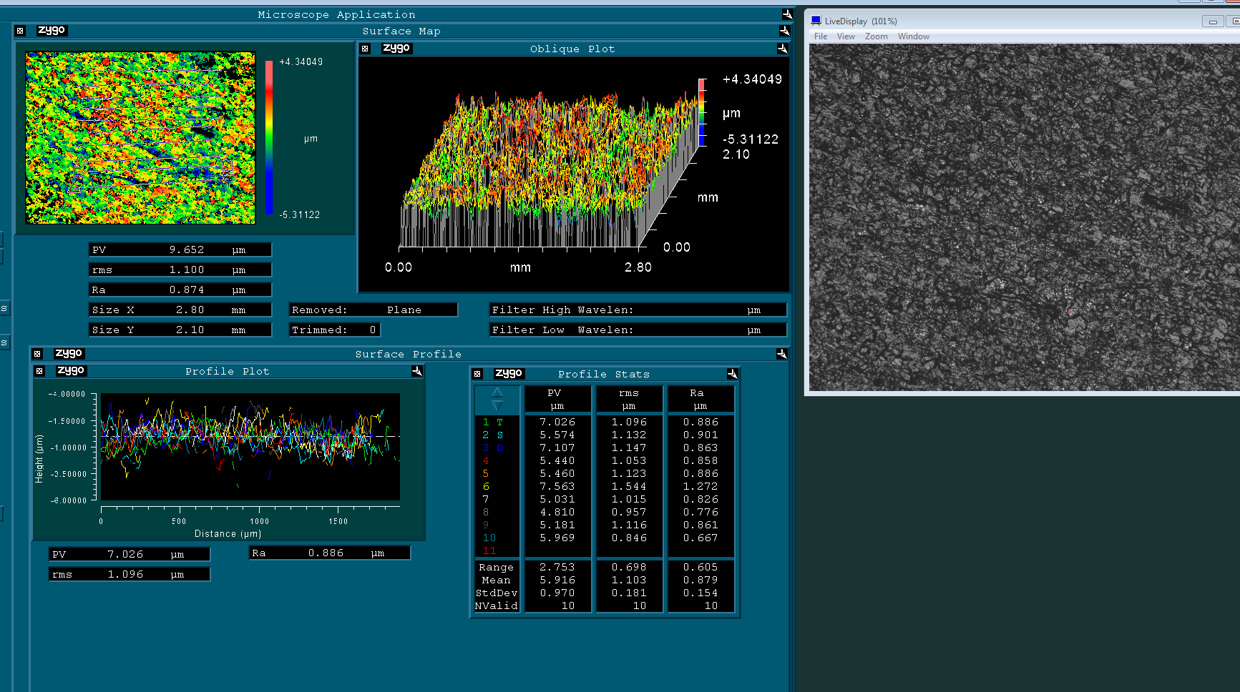
white light interferometry
Non-irradiated

Slide 8
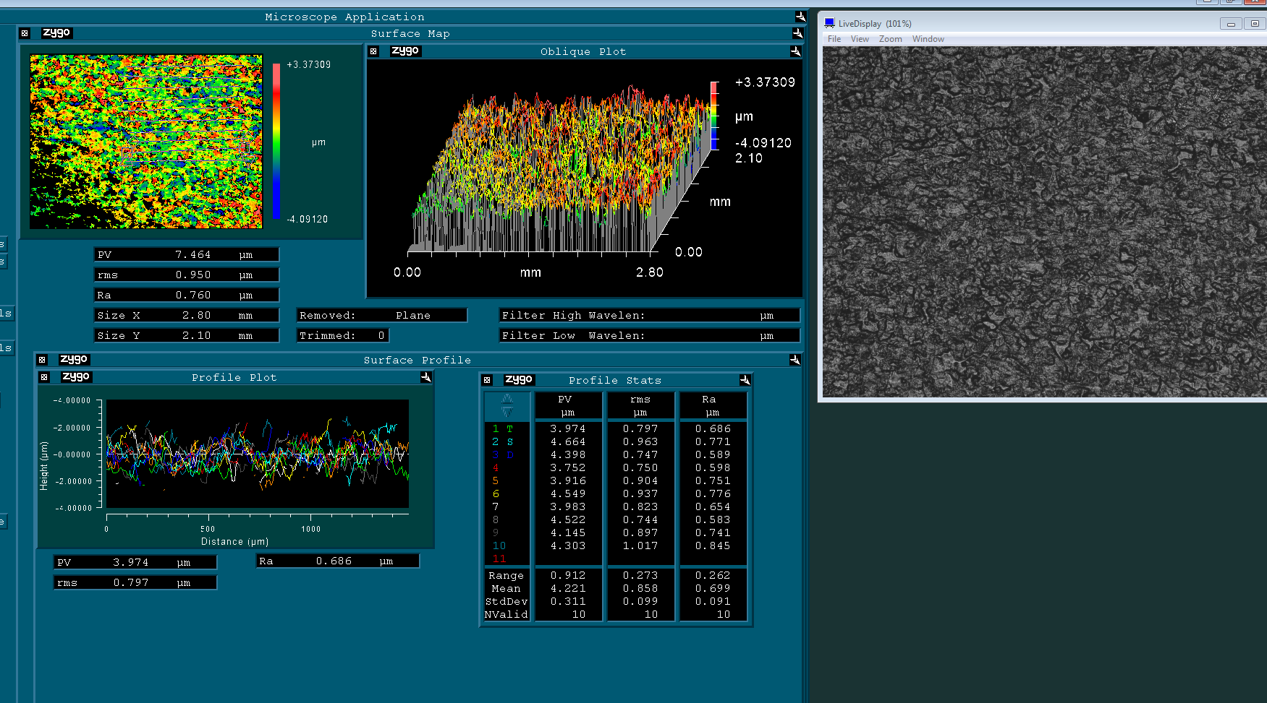
Irradiated-4

Slide 9
Thank you for your attention!

