Slide 1
Progress with AC/DC Characterisation facilities at STFC
Daniel Turner
Lancaster University
Daresbury Laboratory
Notes:
Working title

Slide 2
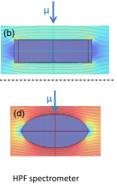
Commercial magnetometry - VSM/SQUID
Field is applied over the whole sample.
Field is applied by electromagnet, therefore the orientation of the sample is key.
Non-ellipsoidal/spherical samples will experience edge effects.
Capacitive reference detector
Oscillator
Sample Straw
Differential amplifier
Lock in Amplifier
Sample
Power supply
Pick up Coil
Electromagnet
Junginger, T., Abidi, S. H., Maffett, R. D., Buck, T., Dehn, M. H., Gheidi, S., Kiefl, R., Kolb, P., Storey, D., Thoeng, E., Wasserman, W., & Laxdal, R. E. (2018). Field of first magnetic flux entry and pinning strength of superconductors for rf application measured with muon spin rotation. Physical Review Accelerators and Beams, 21(3), 32002.
Notes:
Should I cite the paper which says less than 0.05 degrees for a thin film in a parallel field?
Tobis paper https://doi.org/10.1103/PhysRevAccelBeams.21.032002 - Junginger, T., Abidi, S. H., Maffett, R. D., Buck, T., Dehn, M. H., Gheidi, S., Kiefl, R., Kolb, P., Storey, D., Thoeng, E., Wasserman, W., & Laxdal, R. E. (2018). Field of first magnetic flux entry and pinning strength of superconductors for rf application measured with muon spin rotation. Physical Review Accelerators and Beams, 21(3), 32002.

Slide 3
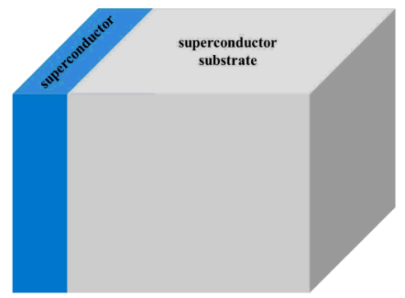
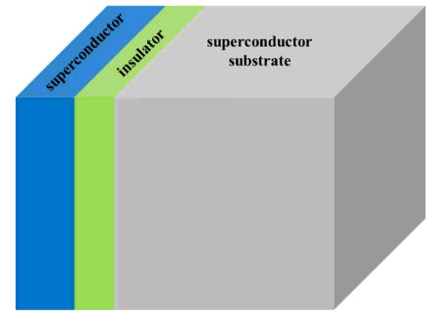
Multilayer approach
Bulk Nb cavities are reaching theoretical limits.
One theory to increase these limits is to use layered structures:
  Superconducting Superconducting bi layer – Consists of a ‘dirty’ SC layer with a larger λ_{L}, followed by SC bulk with smaller λ_{L}.
  Superconducting Insulating Superconducting structure – SC layers separated by a dielectric/insulating layer
Kubo, T. (2017). Multilayer coating for higher accelerating fields in superconducting radio-frequency cavities: a review of theoretical aspects. In Superconductor Science and Technology (Vol. 30, Issue 2). https://doi.org/10.1088/1361-6668/30/2/023001
Notes:
Kubo, T. (2017). Multilayer coating for higher accelerating fields in superconducting radio-frequency cavities: a review of theoretical aspects. In Superconductor Science and Technology (Vol. 30, Issue 2). https://doi.org/10.1088/1361-6668/30/2/023001

Slide 4
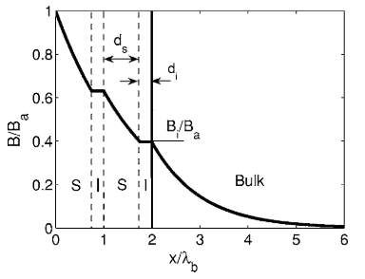
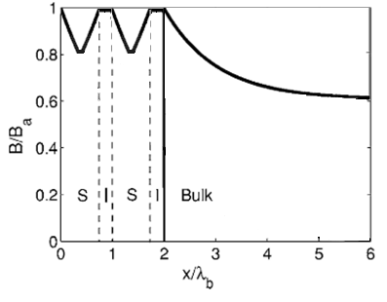
Multilayer testing with VSM/SQUID
Schematic
Gurevich, A. (2006). Enhancement of rf breakdown field of superconductors by multilayer coating. Applied Physics Letters, 88(1), 012511. https://doi.org/10.1063/1.2162264
Field applied from one side, as will be seen in an SRF cavity.
Field applied from a SQUID magnetometer
Field enters through insulating layer.
Possibilities for testing Multilayer structures:
  Deposit fully coated ellipsoids.
  New characterisation techniques.
Why do we need a local magnetometer?
To imitate cavity operation – Field applied from one side of the sample.
Applied field much smaller than the sample to eliminate edge effects.
Notes:
Talk about the difficulties depositing multilayer on 3D ellipsoid – why equipment must change to test planar samples

Slide 5
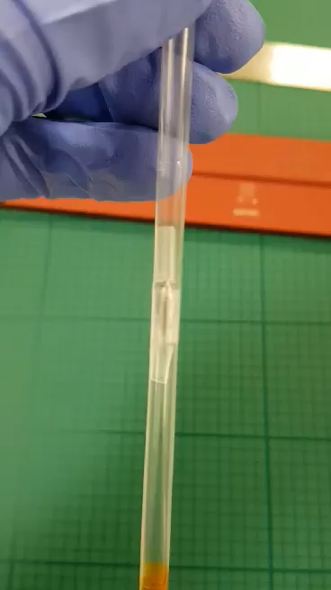
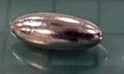
Nb Ellipsoids developed at TRIUMF
Ellipsoids have been machined at TRIUMF with consecutive treatments. One ellipsoid sample will be compared with a planar sample.
All tested in β-NMR, (presented at TTC by Edward Theong, https://indi.to/9v78M), then sent to Rutherford Appleton Laboratory to be tested via SQUID magnetometer.
4 mm
10 mm
Notes:
Make sure to mention the demagnetization factor of the ellipsoid is due to the flux lines becoming much more concentrated at the largest radius of the ellipsoid.
For baseline Hvp +/- 14 Oe ie 1.4 mT
Not Hc1 for the flat sample, but show that it correlates with the ellipsoid sample . Don’t know the geometry effects of the flat sample and pinning in the sample yet, difficult to determine hc1 for non elliptical and non annealed sample.

Slide 6
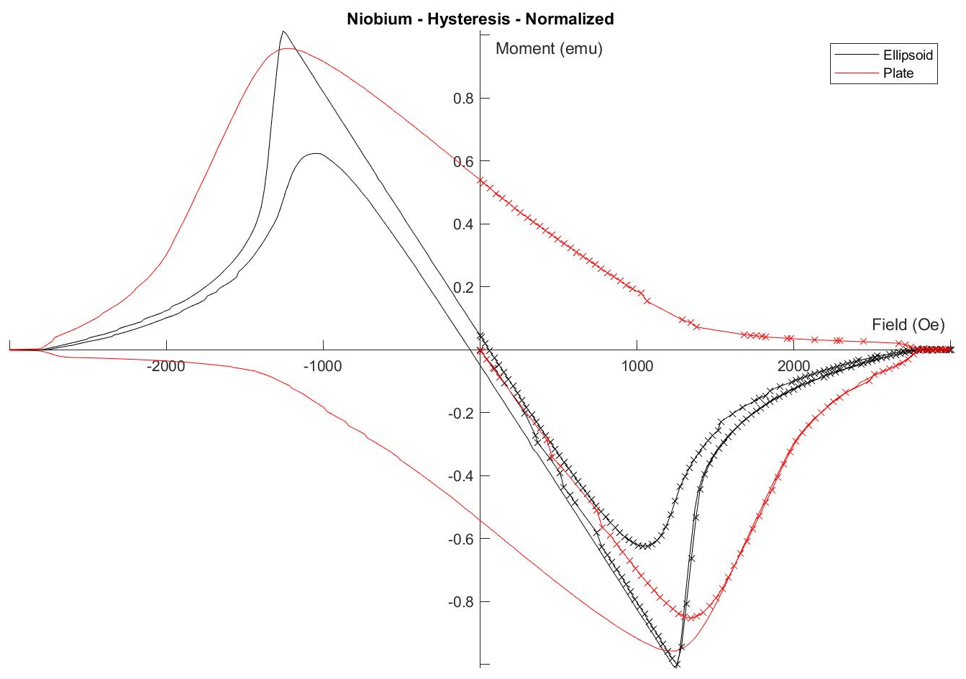
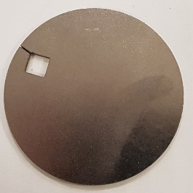
Comparison between Nb ellipse and planar sample
Notes:
Mention that the Nb ellipsoid is Eds talksamples are the same as those used in Beta NMR – Eds talk.
Ellipsoid has been 1400 degree annealed with weak pinning – no edge effects

Slide 7
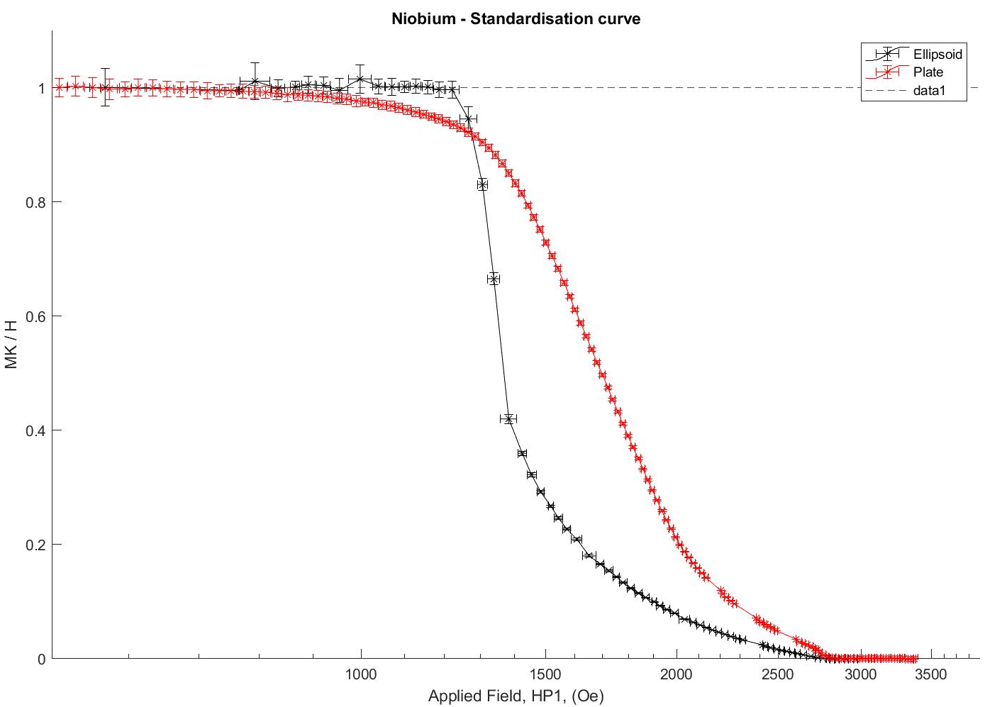
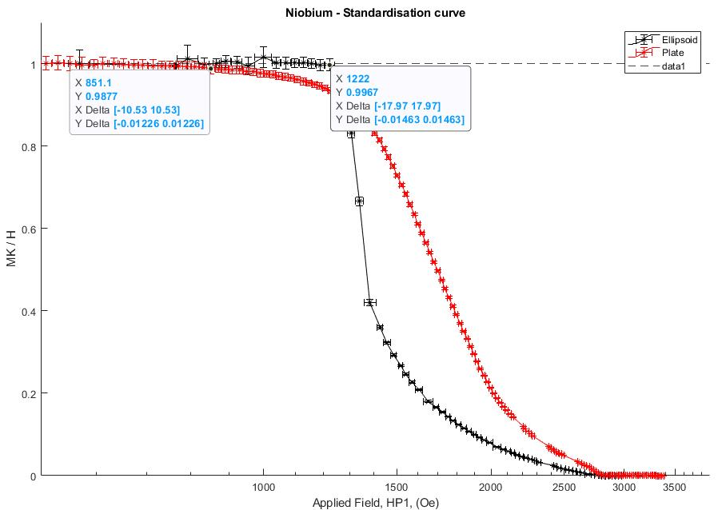
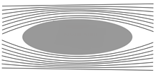
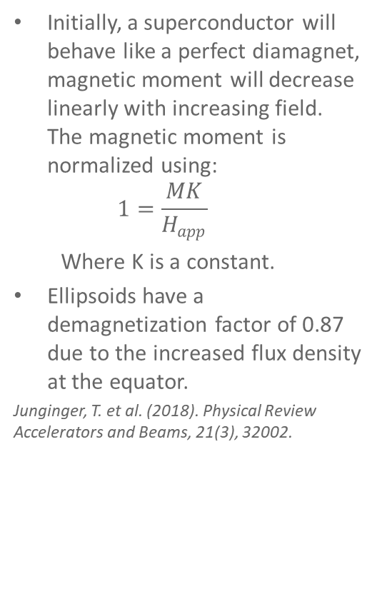
How to determine H_{vp}
Initially, a superconductor will behave like a perfect diamagnet, magnetic moment will decrease linearly with increasing field. The magnetic moment is normalized using:
  $$1=\frac{MK}{H_{app}}$$
  Where K is a constant.
Ellipsoids have a demagnetization factor of 0.87 due to the increased flux density at the equator.
Junginger, T. et al. (2018). Physical Review Accelerators and Beams, 21(3), 32002.
Notes:
Make sure to mention the demagnetization factor of the ellipsoid is due to the flux lines becoming much more concentrated at the largest radius of the ellipsoid.
For baseline Hvp +/- 14 Oe ie 1.4 mT
Not Hc1 for the flat sample, but show that it correlates with the ellipsoid sample . Don’t know the geometry effects of the flat sample and pinning in the sample yet, difficult to determine hc1 for non elliptical and non annealed sample.

Slide 8
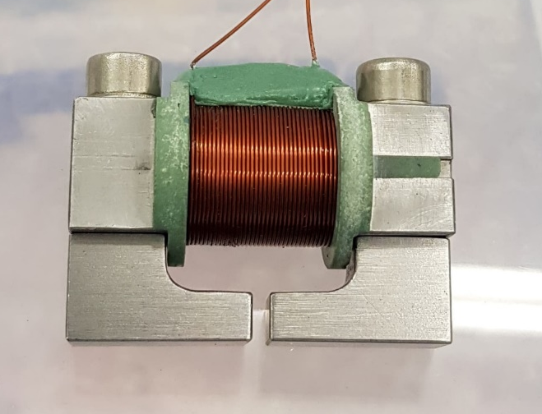
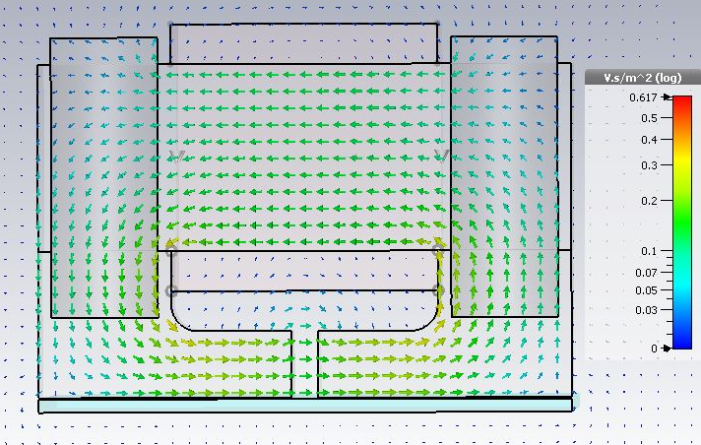
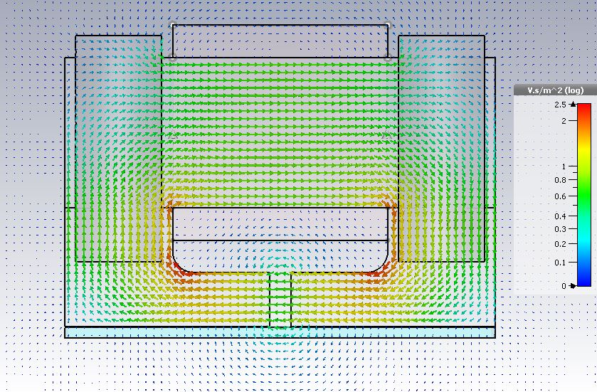
Field penetration experiment at Daresbury
Planned for cryogen free system, did not cool to a low enough temperature.
Moved to a LHe open cycle system to ensure suitable method.
HP1
Sample
HP2
Sample

Slide 9
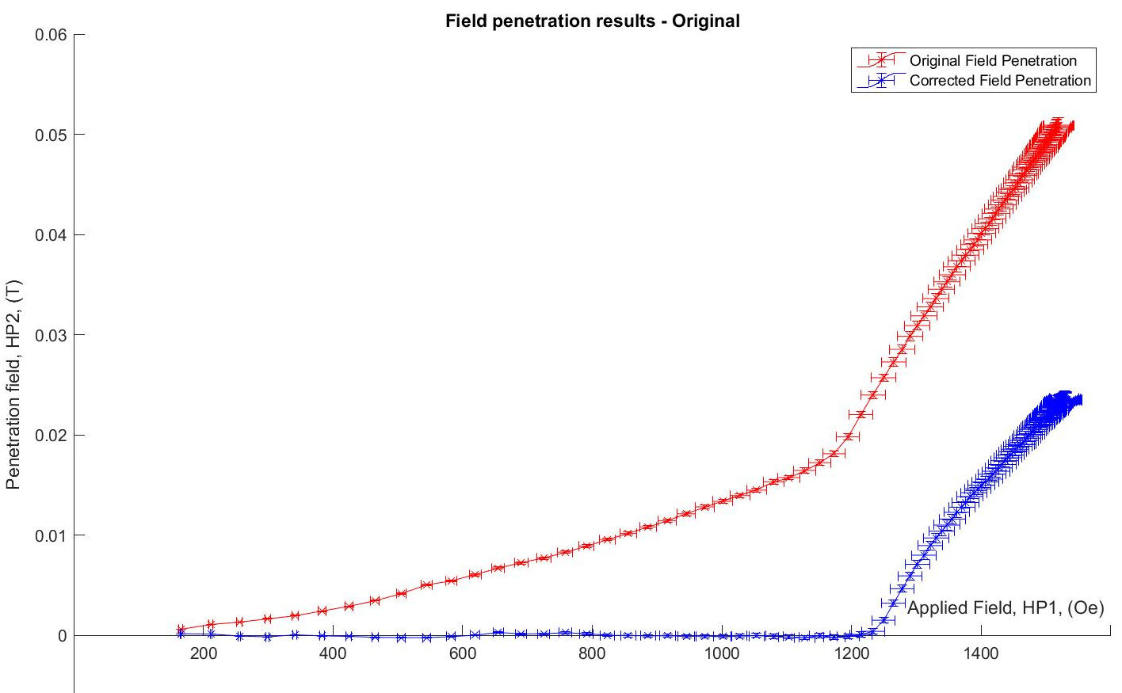
Original data shows there was some external magnetisation/flux leakage.
This data was removed to determine if the method works, however this means the data is unreliable. For the field of full flux penetration.

Slide 10
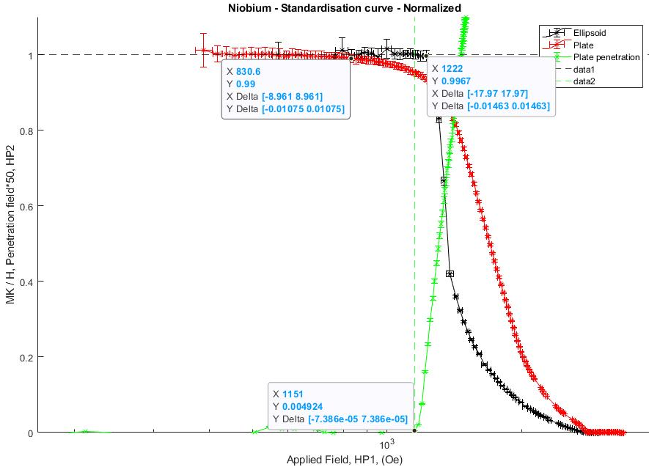
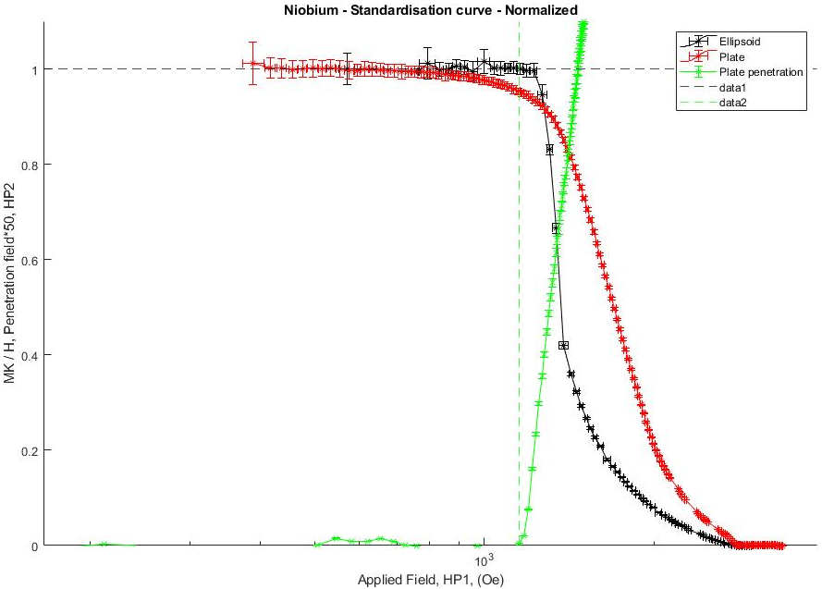
Results
HP1
Sample
HP2
Field penetration experiment, Daresbury Laboratory
  50 mm disk
  H_{fp} (4.2 K) = 115.1 mT ± 1.5 %
  H_{fp} (0 K) = 145.0 mT ± 1.5 %
VSM magnetometer
Ellipsoid: H_{vp}(4.2 K) = 122.2 mT
  Demagnetization factor, 0.87
  H_{c1}(4.2 K)= 140.5 mT
  H_{c1}(0 K)= 179.9 mT
VSM magnetometer
Plate: H_{vp}(4.2 K) = 83.6 mT
  H_{c1}(0 K)= 105.3 mT
Notes:
Cuboid: H_{vp} (4.2 K) = 115.1 mT
H_{vp}(0 K)= 147.0 mT
OUR METHOD WORKS! Error in the SQUID is +/- 0.8 mT.
Hall probe error is given by Arepoc, which states less than 1.5 % error at 4.2 K from 0 – 5 T.

Slide 11
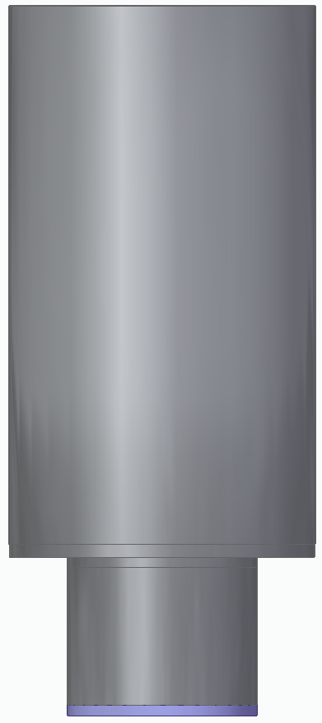
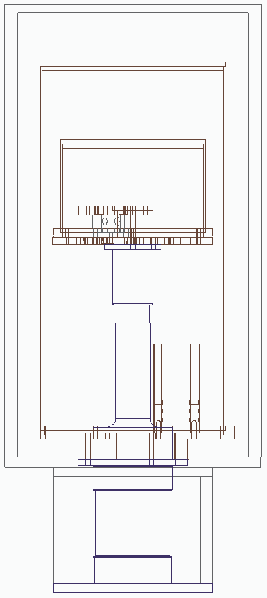
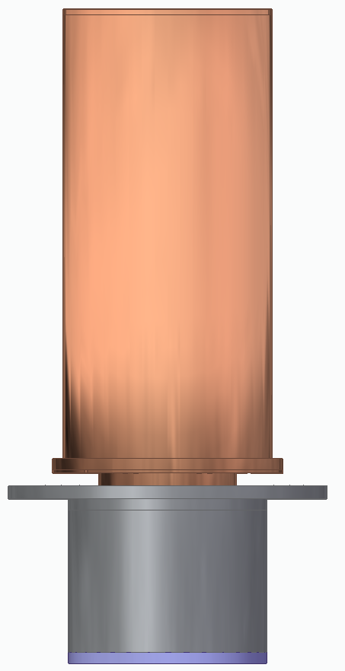
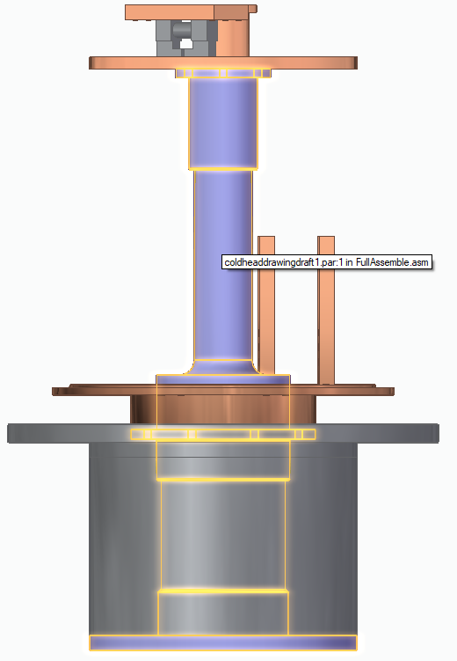
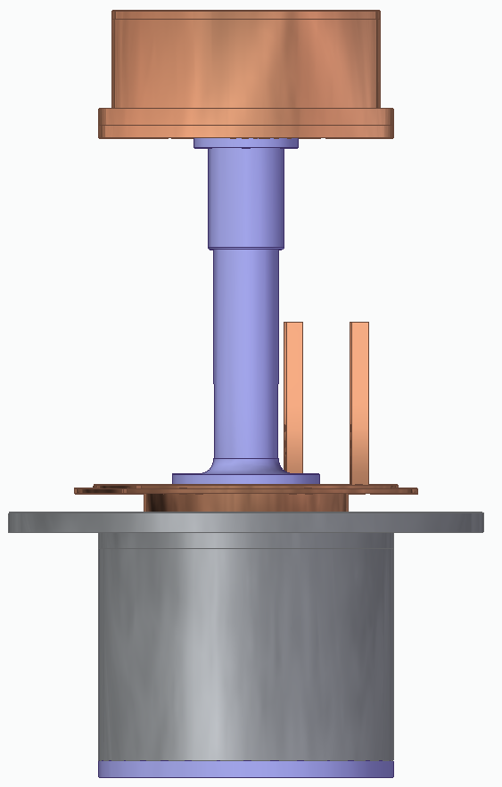
Field penetration experiment - Dry
Thermal radiation shield
Large Cu bobbin
Stage 2 plate
Stage 1 plate
Normal conducting to superconducting joins
Vacuum can
Cold head
Thermal radiation shield

Slide 12
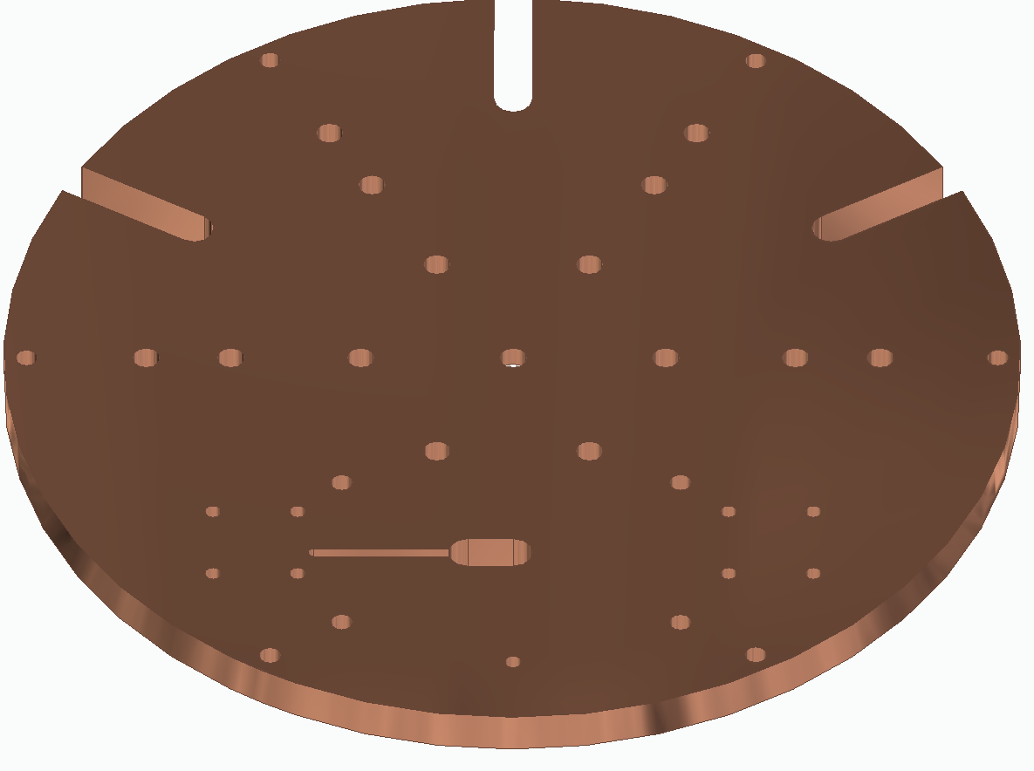
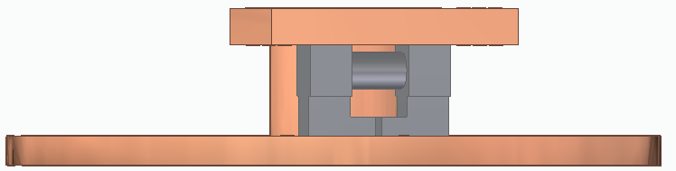
Field penetration experiment - Dry
Resistors – Heaters
G10 posts to hold the magnet in position
Sample area
Hall Probes – One in between dipoles of the yoke, 1 under the sample
Thermometer
2
1
4
1
3
5
4
Notes:
Magnet was very anisotropic – 155 mT in one direct, 354 mT in the other. Sent back to team at RAL for extension, they removed the diodes and re-tested
With Diodes: 36 mT both directions
Diodes removed: 136 & 144 mT (2.9 V, 1A)
SO… no diodes in the new system
Simulations in CST with this permeability creates 1.34 T @ 20 A

Slide 13
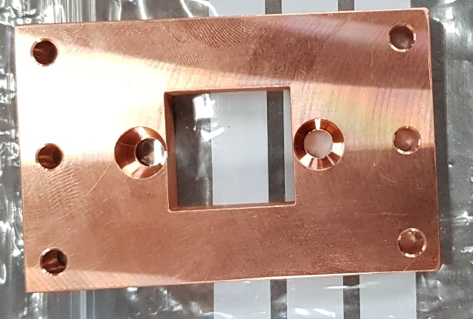
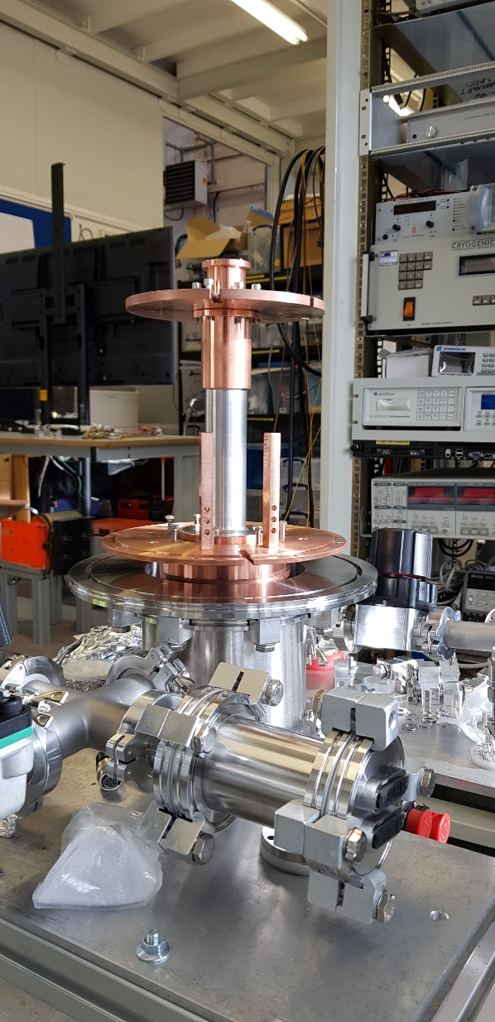
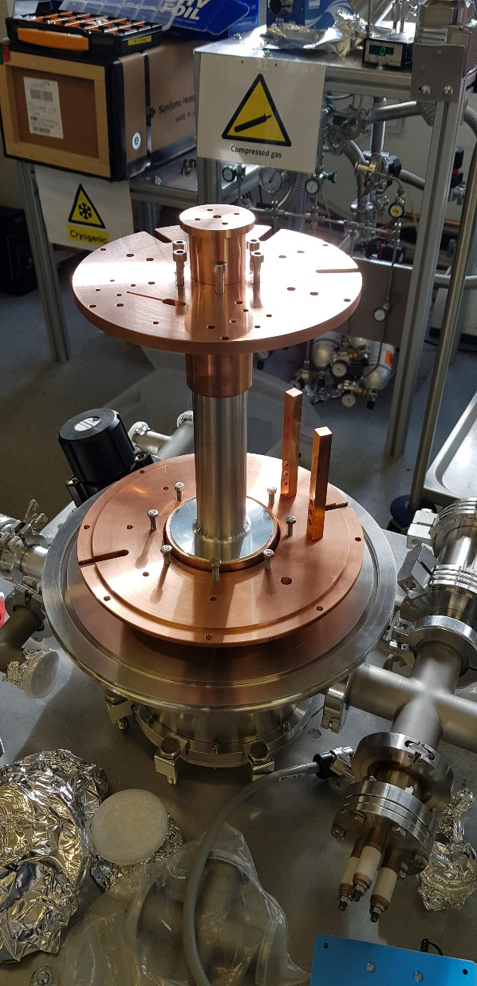
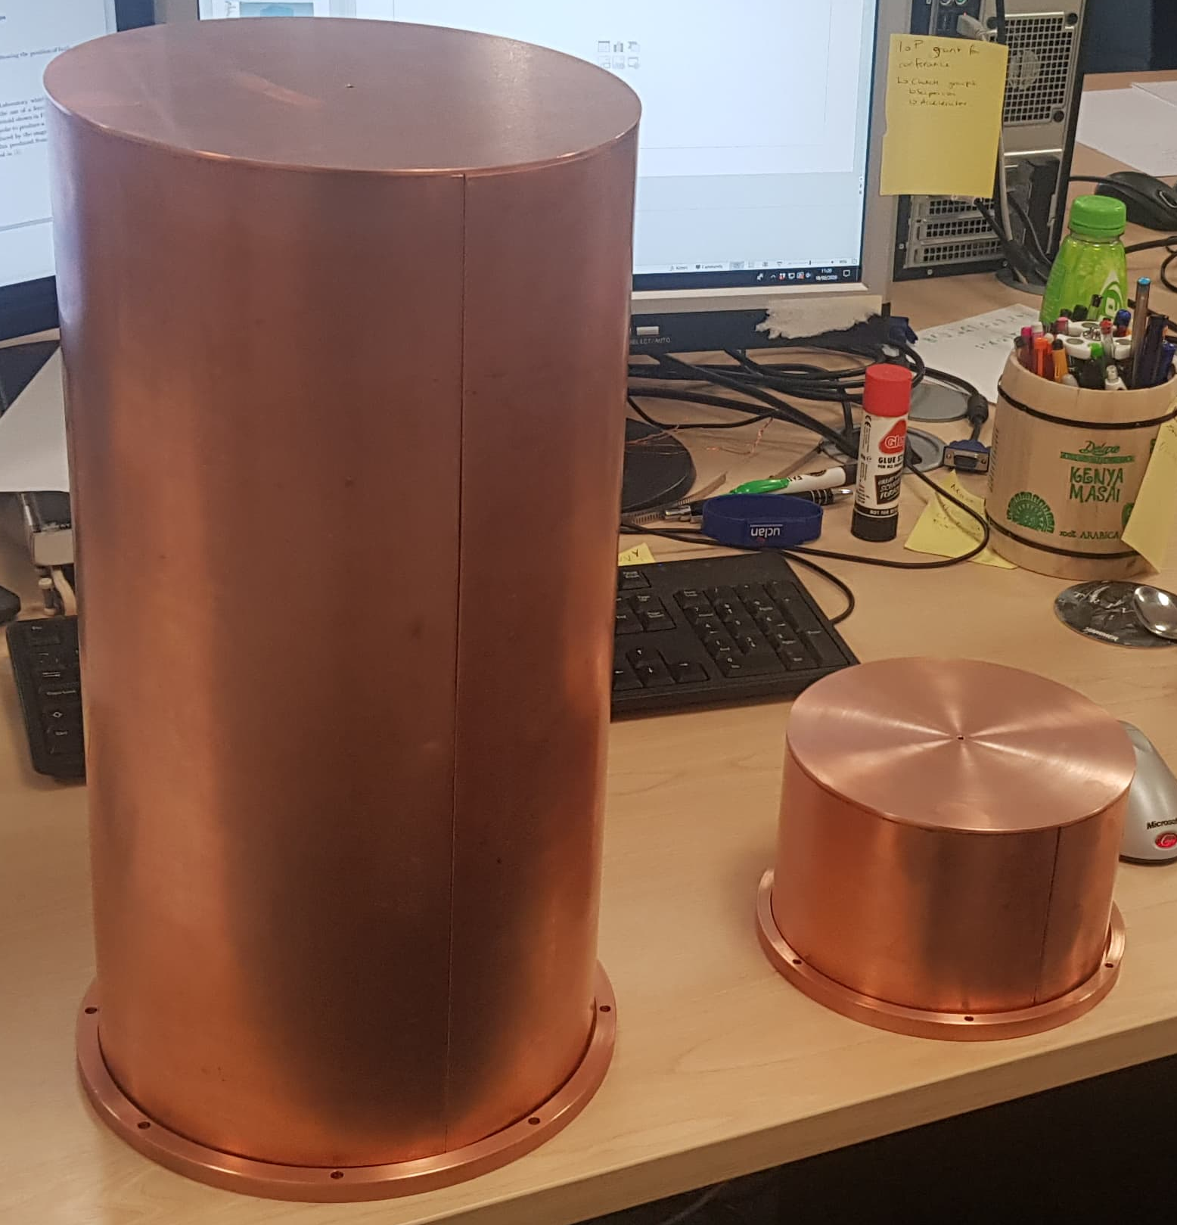
Current status

Slide 14
Thanks for listening, any questions?
21st April 2020
daniel.turner@cockcroft.ac.uk

Slide 15
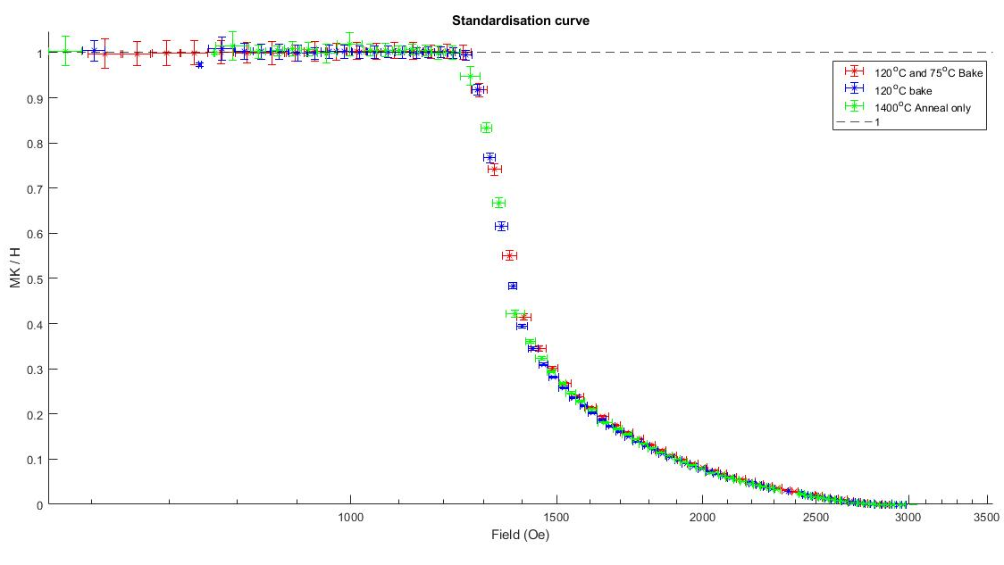

Slide 17
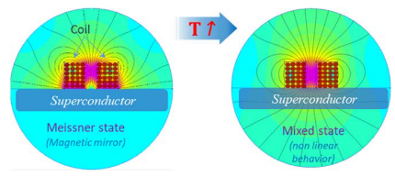
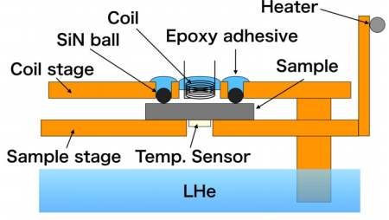
3rd Harmonic Systems
Designed to act close to cavity conditions – as low as 2 K, parallel B > 200 mT, applied from one side of the sample to the other.
A parallel field applied by solenoid, reflected initially by the sample, acting as a magnetic mirror.
1
2
¹Antoine CZ, Aburas M, Four A, Weiss F, Iwashita Y, Hayano H, et al. Optimization of tailored multilayer superconductors for RF application and protection against premature vortex penetration. Supercond Sci Technol. 2019;32(8).
²Ito H, Hayano H, Kubo T, Saeki T. Lower Critical Field Measurement System based on Third-Harmonic Method for Superconducting RF Materials. Nucl Instruments Methods Phys Res Sect A Accel Spectrometers, Detect Assoc Equip 955. 2020;955.
Notes:
System developed to measure field penetration close to actual cavity operation conditions.
Want a set up based on 3rd harmonic where edge effects do not influence the results.
AC reference current generates a field on the sample through the use of a coil, screening current on SC produces = and opposite moment – perfect magnetic mirror.
Temperature is increased until the sample crosses the transition between Meissner and mixed state.
If in KHz, vortices become trapped, which in turn change the coil impedance, changing the voltage of the coil.
Nonlinearity independent of of I polarity, distortion has only odd components with the 3rd harmonic being most intense.
V3 (third harmonic) appears at the transition and then fades out once the vortices become mobile.
Wanted to work close to cavitiy operating conditions ie >200 mT ~2 K.
Area underneath the curve represents how many vortices

Slide 18
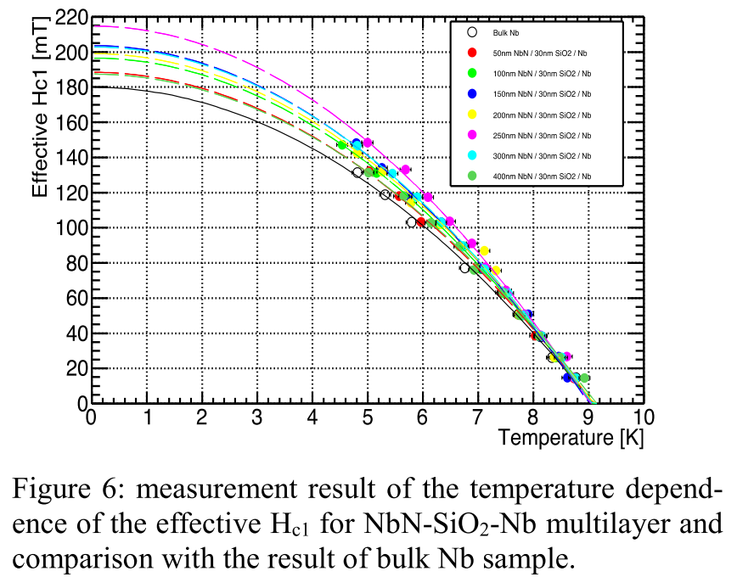
3rd Harmonic - KEK Results
Ito H, Hayano H, Kubo T, Saeki T, Katayama R, Iwashita Y, et al. Lower Critical Field Measurement of NbN Multilayer Thin Film Superconductor at KEK. Proc SRF2019. 2019;0–4.

