Slide 1

Low Power Facility for Thin Film RF Measurements at DL
Taaj Sian, Daniel Seal, Phillippe Goudket, Graeme Burt and Oleg Malyshev
Notes:
LANCASTER UNIVERSITY POWERPOINT TEMPLATES
These PowerPoint templates are for use by all Lancaster University staff. Please see below for further information regarding the use of these templates. Should you have any further queries, please contact the marketing team via marketing-services@lancaster.ac.uk
Template slide 3: Insert a new slide
If you need to insert a new slide, from the ‘home’ toolbar, click on ‘new slide’ and select from the templates the style you require from the dropdown box.
Template slide 4: Typing new text and copying text from another document
New text should be typed over the text in the appropriate template. Copy and pasting text from another document will result in changing the style of the typography and layout. This is unavoidable as it is part of the Microsoft software. We appreciate that in sometimes you will need to copy text from another document into this template. Once you have pasted the existing text into the template, you will need to change the formatting so that they typefaces, sizes, colour, line spacing and alignment are consistent with the rest of the template.
Template slide 5: Inserting images
There are three choices of templates with images already inserted. Please use the template with the relevant image size and positioning. To insert an image, please go to ‘insert’ then ‘picture’ and find your image, highlight it and ‘insert’. Resize the image and position as per the example template.
Template slide 6: Text boxes
If a text box is deleted, either insert a new slide (using the appropriate template) or go to another slide and copy a text box. To select a text box for copying, please click on the outer edge of the text box so that the line goes solid (not dashed). Right click your mouse and select ‘copy’, then go back and ‘paste’ it into the slide where the text box is missing which should paste into the correct position on the slide.
Template slide 7: Other information
Typefaces, sizes and colours
All copy is Calibri.
Slide title copy throughout:
Size: 36 point
Colour Lancaster University red: (RGB) R: 181 G: 18 B: 27 (recent colours on PowerPoint)
Small copy on first and last slide:
Size: 16 point
Colour grey: (RGB) R: 102 G: 102 B: 102 (recent colours on PowerPoint)
Sub-headings:
Size: 24 point – italics
Colour grey: (RGB) R: 102 G: 102 B: 102 (recent colours on PowerPoint)
Bullets copy and body copy:
Size: 24 point (see below for a further option)
Colour grey: (RGB) R: 102 G: 102 B: 102 (recent colours on PowerPoint)
It isn’t advisable to have too much text on a slide, however on rare occasions it may be necessary, therefore there is a slide using 20 point bullet pointed text.
Line spacing and alignment
Single line spacing (apart from the main headings which is ‘exactly 35 point’)
All text is aligned left
Slide title options
There are two options for titles on the slides – one line or two lines for longer titles. Ideally, the one line title should be used, however on rare occasions a two line title maybe needed.

Slide 2
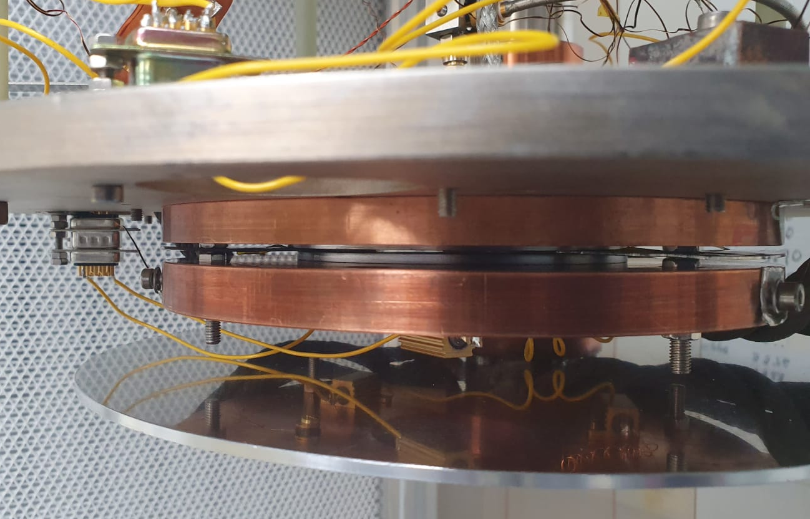
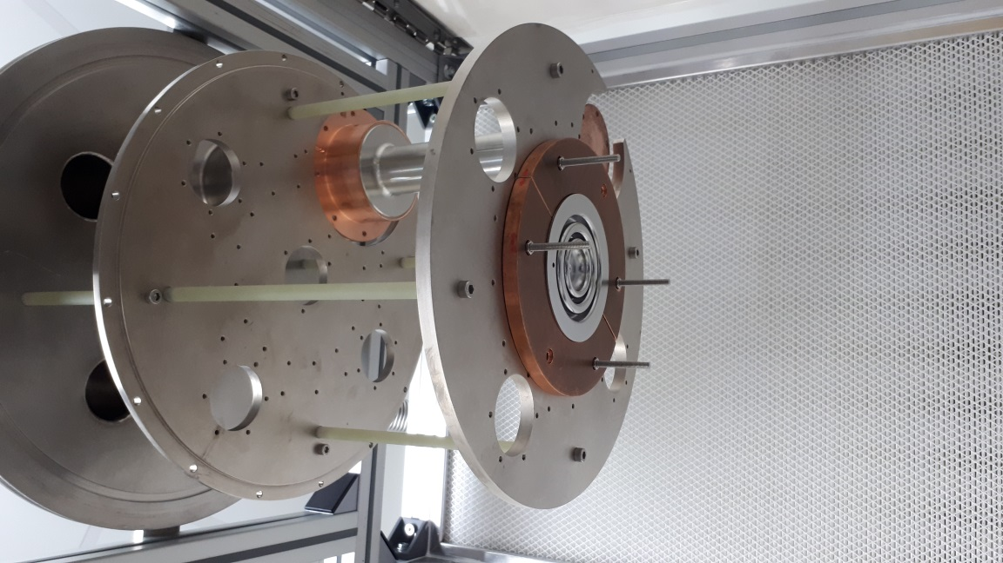
Introduction
Cavity Plate
Stage 1
Sample Plate
2 Choke Cavity
Stage 2

Slide 3
Reasons for a dry system
Cold head used as we want a dry system to avoid contact between the sample and cavity and so
  Samples do not need to be welded to a holder
  It is insensitive to field leakage
  It provides fast sample changeover
We have both 2 and 3 choke designs for the F=7.8 GHz cavity
Stage 1
2 Choke Cavity
Stage 2

Slide 4
Reasons for another probe
We have trouble getting a good measurement using a single probe due to microphonics
We want to add another probe
  We can add in a self exited loop (SEL)
  Provides a simple measurement of energy stored with smaller errors
We have aluminium versions of both cavities to determine the best place to put the probe
Stage 1
2 Choke Cavity
Stage 2

Slide 5
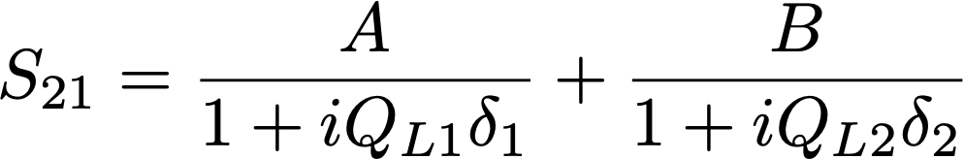
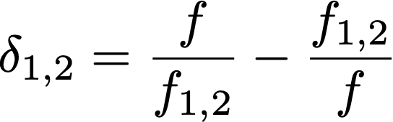
Adding an additional probe
3 choke aluminium cavity has 4 new holes, 1 in each choke and 1 between the 1st and 2nd choke
The problem with having chokes is that they may resonate at other frequencies producing Fano resonances
We fit to these resonances to try to separate out the signal from the cavity mode this will help to:
  Get an accurate stored energy measurement
  To understand the resonances so we can avoid them
4
3
1
2

Slide 6
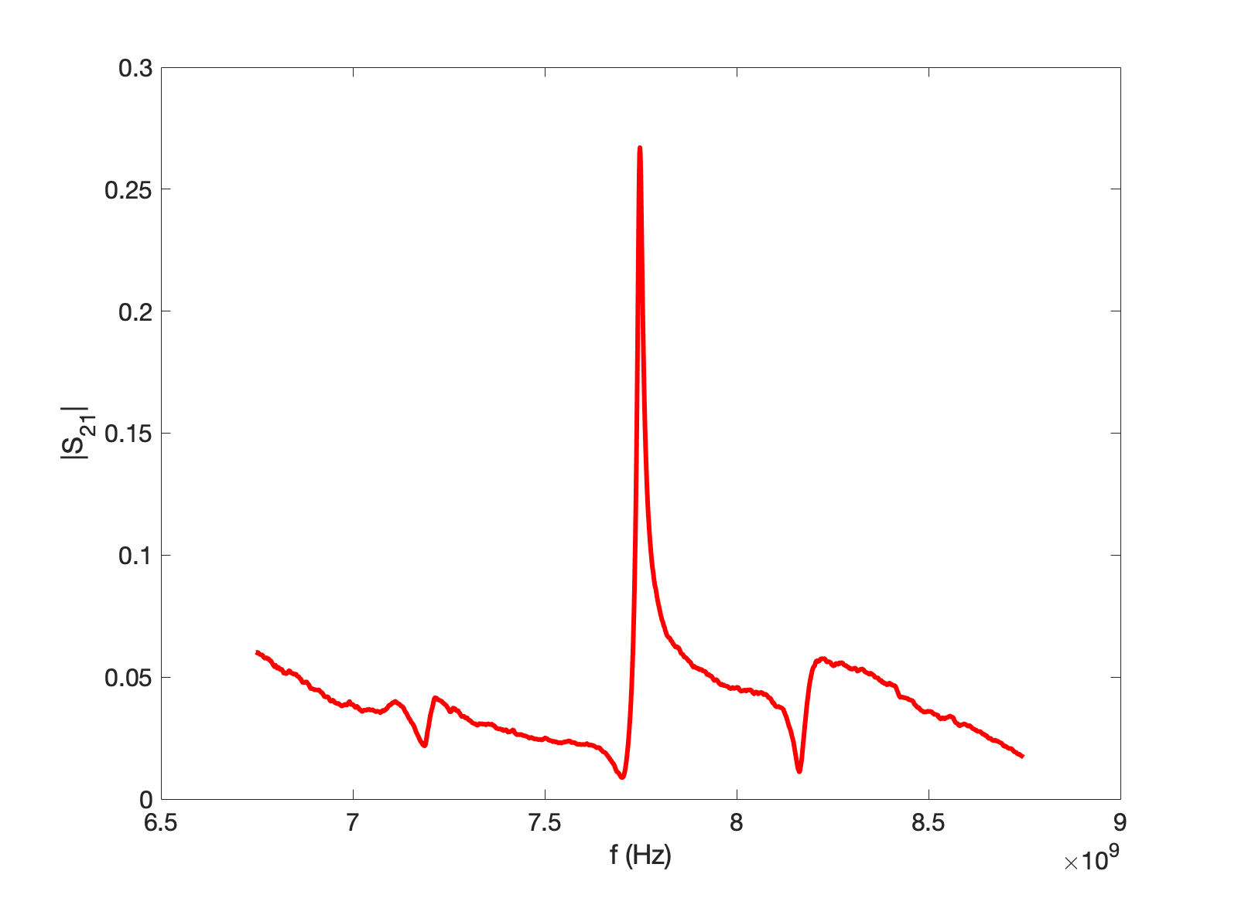
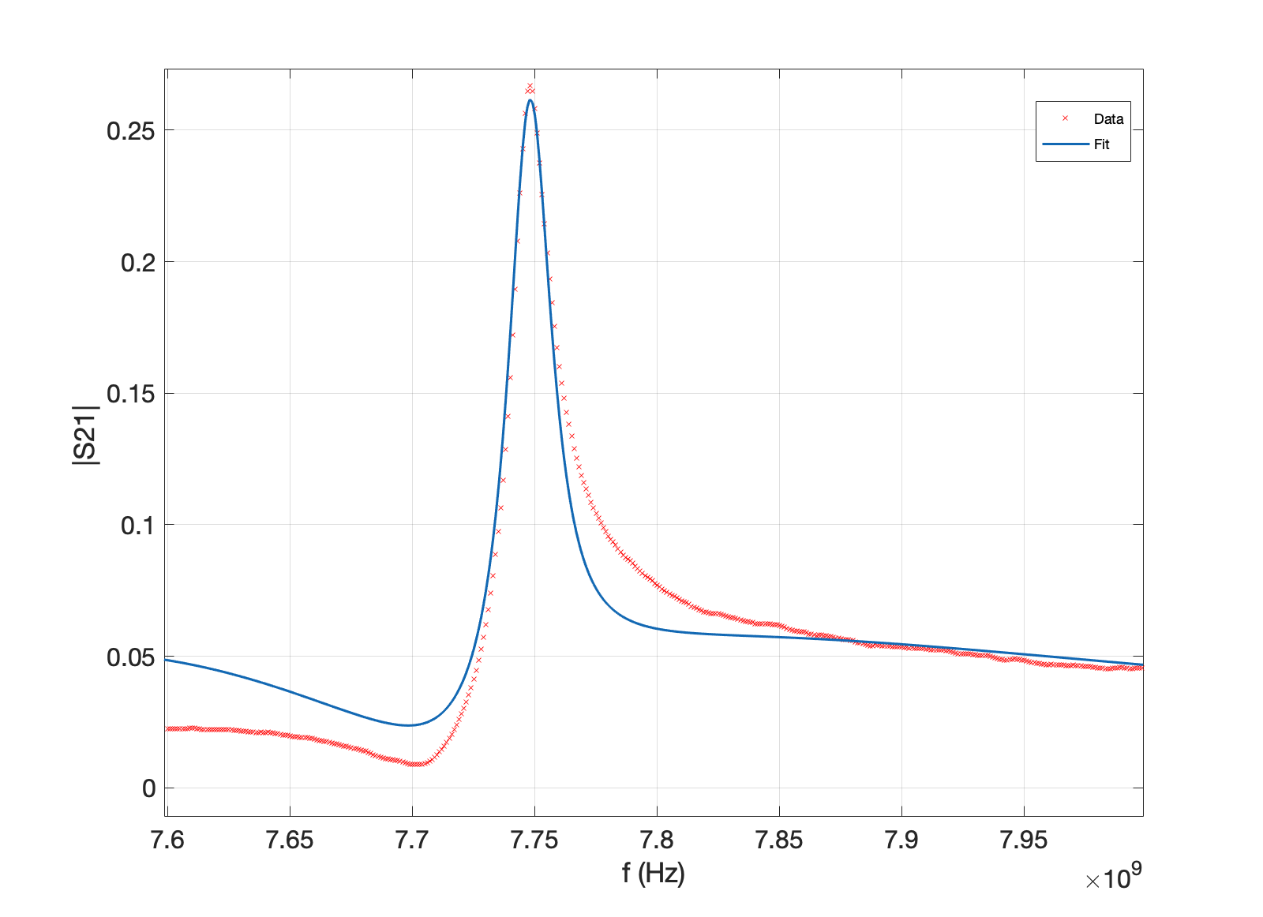
Fano Resonances from Choke 1
f₁ | 7.70 GHz
f₂ | 7.75 GHz
A | 0.06
B | -2.8
Q_{L1} | 21.7
Q_{L2} | 344.1
a | 0.10
3 Fano resonances from this choke, the strongest is:
  f₁ at 7.70 GHz, f₂ at 7.75 GHz

Slide 7
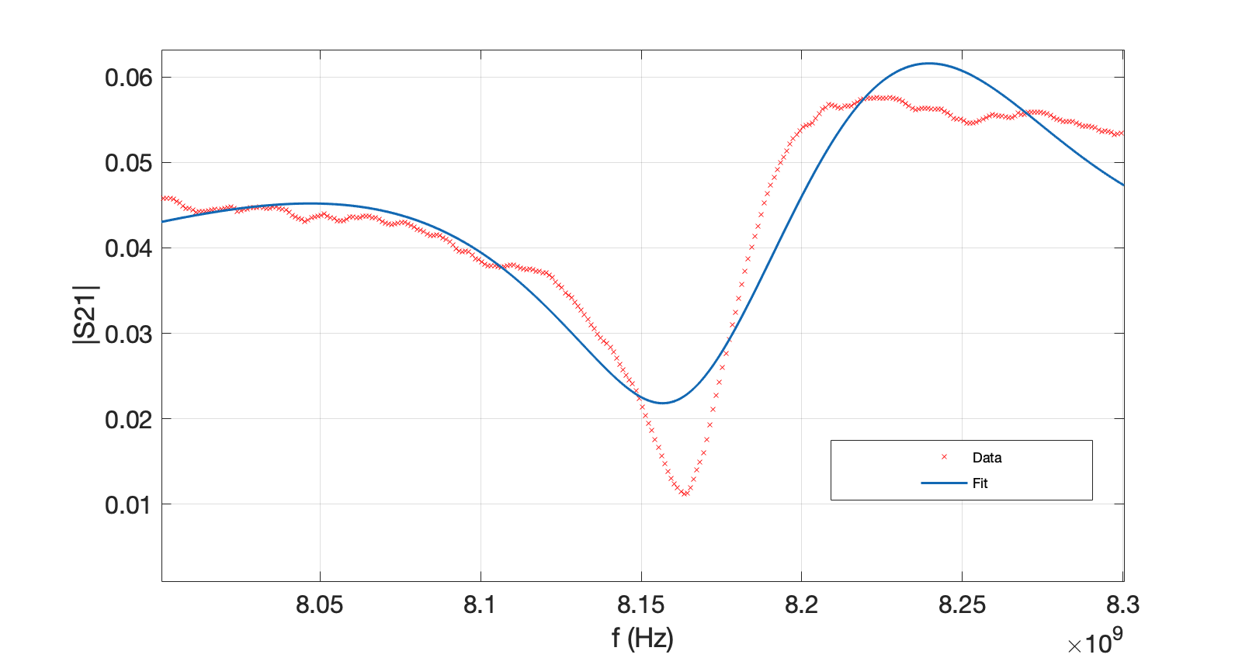
Fano Resonances from Choke 1
f₁ | 8.16x10^9
f₂ | 8.22x10^9
A | 1.98
B | -3.23
Q_{L1} | 21.7
Q_{L2} | 42.9
a | 0.04
3 Fano resonances from this choke, the second strongest is:
  f₁ at 8.16 GHz, f₂ at 8.22 GHz
We do not have data from the weakest resonance yet.

Slide 8
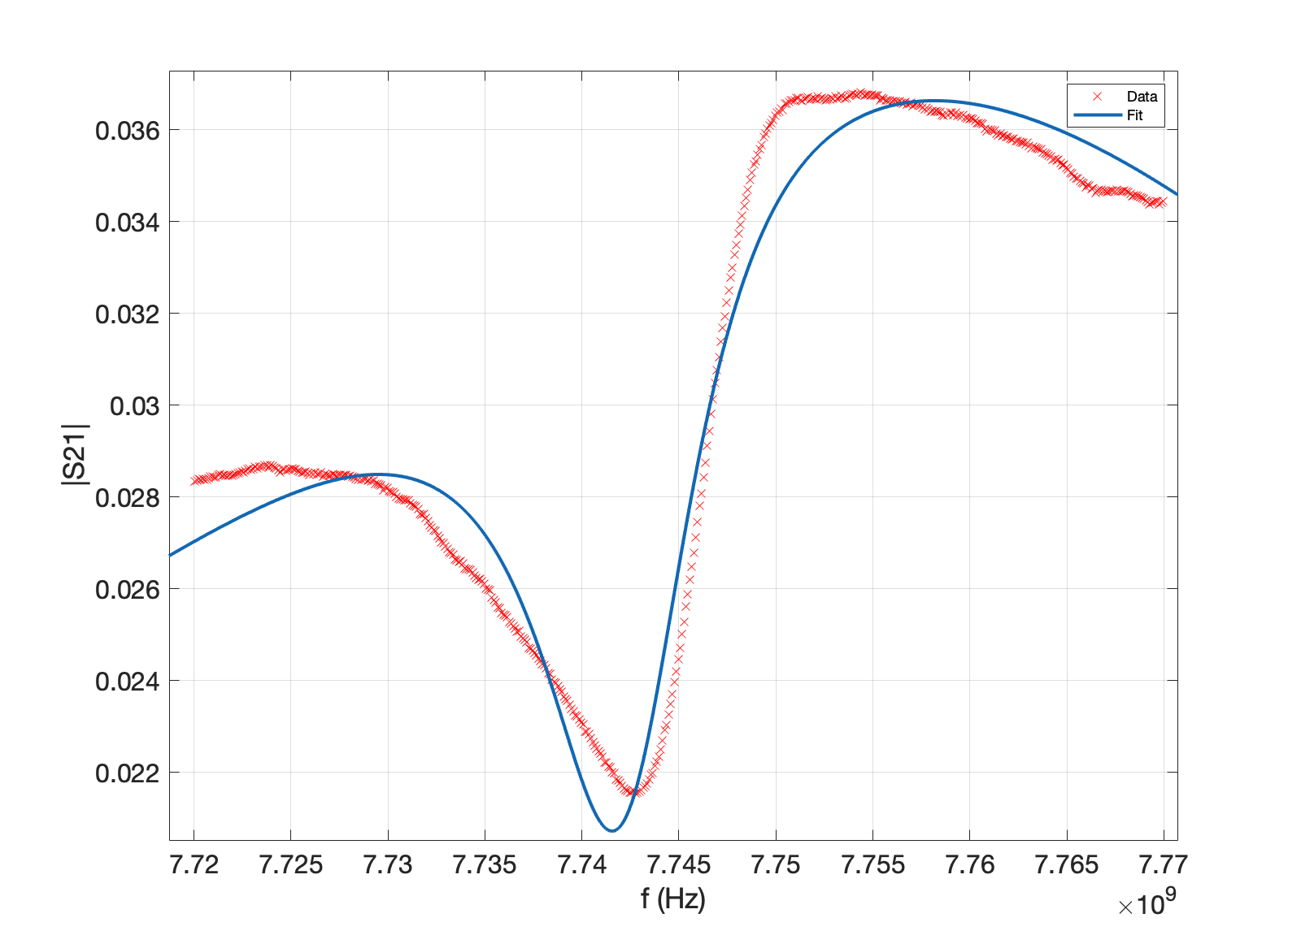
Fano Resonance from Choke 2
f₁ | 7.74 GHz
f₂ | 7.75 GHz
A | -0.421
B | 0.964
Q_{L1} | 694.1
Q_{L2} | 91.7
a | 0.0403
Only measurement from this choke, a wider scan will be taken after lockdown
  f₁ at 7.74 GHz, f₂ at 7.75 GHz

Slide 9
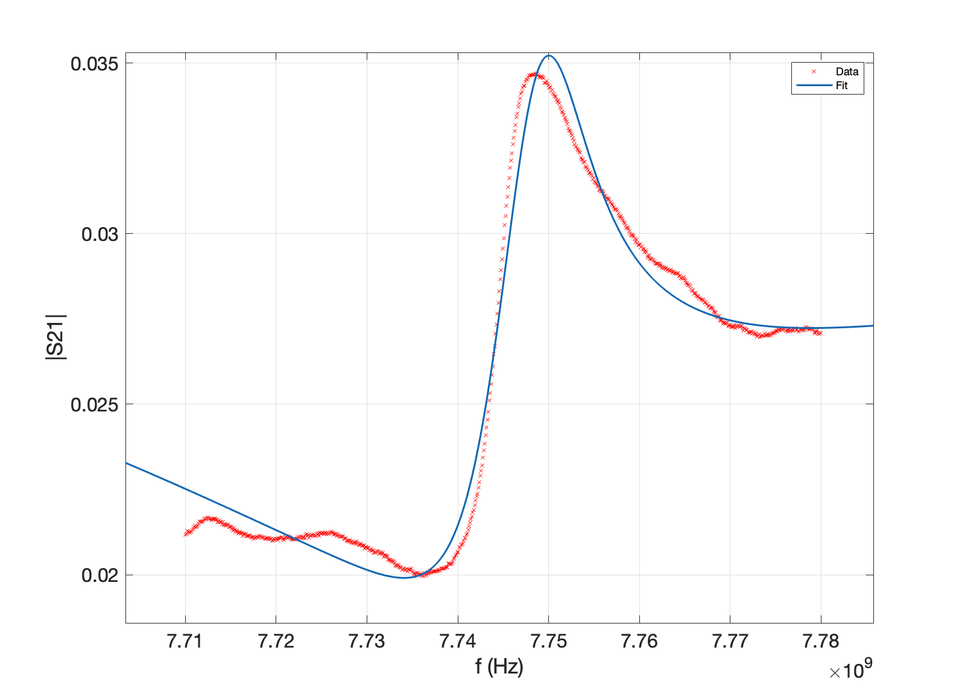
Fano Resonances from Choke 3
f₁ | 7.74 GHz
f₂ | 7.75 GHz
A | -0.371
B | 1.137
Q_{L1} | 32.0
Q_{L2} | 509
a | 0.0447
Only measurement from this choke, a wider scan will be taken after lockdown
  f₁ at 7.74 GHz, f₂ at 7.75 GHz

Slide 10
Summary
We have found Fano resonances from each of the 3 chokes
Initial CST simulations didn’t show these resonances
We are doing CST simulations to find the source to see if the resonances could be due to manufacturing
Fano resonances could also be from other modes in the cables

Slide 11
Thank you
Questions?
Notes:
LANCASTER UNIVERSITY POWERPOINT TEMPLATES
These PowerPoint templates are for use by all Lancaster University staff. Please see below for further information regarding the use of these templates. Should you have any further queries, please contact the marketing team via marketing-services@lancaster.ac.uk
Template slide 3: Insert a new slide
If you need to insert a new slide, from the ‘home’ toolbar, click on ‘new slide’ and select from the templates the style you require from the dropdown box.
Template slide 4: Typing new text and copying text from another document
New text should be typed over the text in the appropriate template. Copy and pasting text from another document will result in changing the style of the typography and layout. This is unavoidable as it is part of the Microsoft software. We appreciate that in sometimes you will need to copy text from another document into this template. Once you have pasted the existing text into the template, you will need to change the formatting so that they typefaces, sizes, colour, line spacing and alignment are consistent with the rest of the template.
Template slide 5: Inserting images
There are three choices of templates with images already inserted. Please use the template with the relevant image size and positioning. To insert an image, please go to ‘insert’ then ‘picture’ and find your image, highlight it and ‘insert’. Resize the image and position as per the example template.
Template slide 6: Text boxes
If a text box is deleted, either insert a new slide (using the appropriate template) or go to another slide and copy a text box. To select a text box for copying, please click on the outer edge of the text box so that the line goes solid (not dashed). Right click your mouse and select ‘copy’, then go back and ‘paste’ it into the slide where the text box is missing which should paste into the correct position on the slide.
Template slide 7: Other information
Typefaces, sizes and colours
All copy is Calibri.
Slide title copy throughout:
Size: 36 point
Colour Lancaster University red: (RGB) R: 181 G: 18 B: 27 (recent colours on PowerPoint)
Small copy on first and last slide:
Size: 16 point
Colour grey: (RGB) R: 102 G: 102 B: 102 (recent colours on PowerPoint)
Sub-headings:
Size: 24 point – italics
Colour grey: (RGB) R: 102 G: 102 B: 102 (recent colours on PowerPoint)
Bullets copy and body copy:
Size: 24 point (see below for a further option)
Colour grey: (RGB) R: 102 G: 102 B: 102 (recent colours on PowerPoint)
It isn’t advisable to have too much text on a slide, however on rare occasions it may be necessary, therefore there is a slide using 20 point bullet pointed text.
Line spacing and alignment
Single line spacing (apart from the main headings which is ‘exactly 35 point’)
All text is aligned left
Slide title options
There are two options for titles on the slides – one line or two lines for longer titles. Ideally, the one line title should be used, however on rare occasions a two line title maybe needed.

