Slide 1
Traceless
contact tracing using an anonymous, encrypted, trustless architecture

Slide 2
Features
Set Bluetooth name to a randomized string
  Name gets changed every few hours
Use Bluetooth to detect nearby devices
  Medium to high signal strength as proxy for distance
  Read only the Bluetooth name
  Generate uniquely secure cryptographic hash with both names
  Save on each device for 21 days
Utilize only publicly broadcast info
  Friendly name
  No pairing

Slide 3
Secure hash
Symmetric hash(a,b) = hash(b,a)
  First step, sort first, then hash
Utilize bcrypt, scrypt, argon2
  sufficiently long and slow unique hash
Effectively encodes unique interaction in a window of time
Meaningless to anyone else

Slide 4
Reporting
Opt-in to report positive
Shares 21 day storage of recent hashes
Other users publicly see these hashes
Server deletes data after 21 days

Slide 5
Features
Minimal data footprint
A single hash is only meaningful to the two users
Carries no other info

Slide 6
German App
Very similar – is source code available?
How do they share ID?
PushToken – digital address of phone

Slide 7
TraceTogether - Singapore
Government server with phone numbers
Authority involved
Phones use Bluetooth to exchange a Temporary ID (refreshed at regular intervals, generated by encrypting User ID with a private key held by MOH)
If infected, user has the option to give MOH access to TraceTogether data
Pairing?

Slide 8
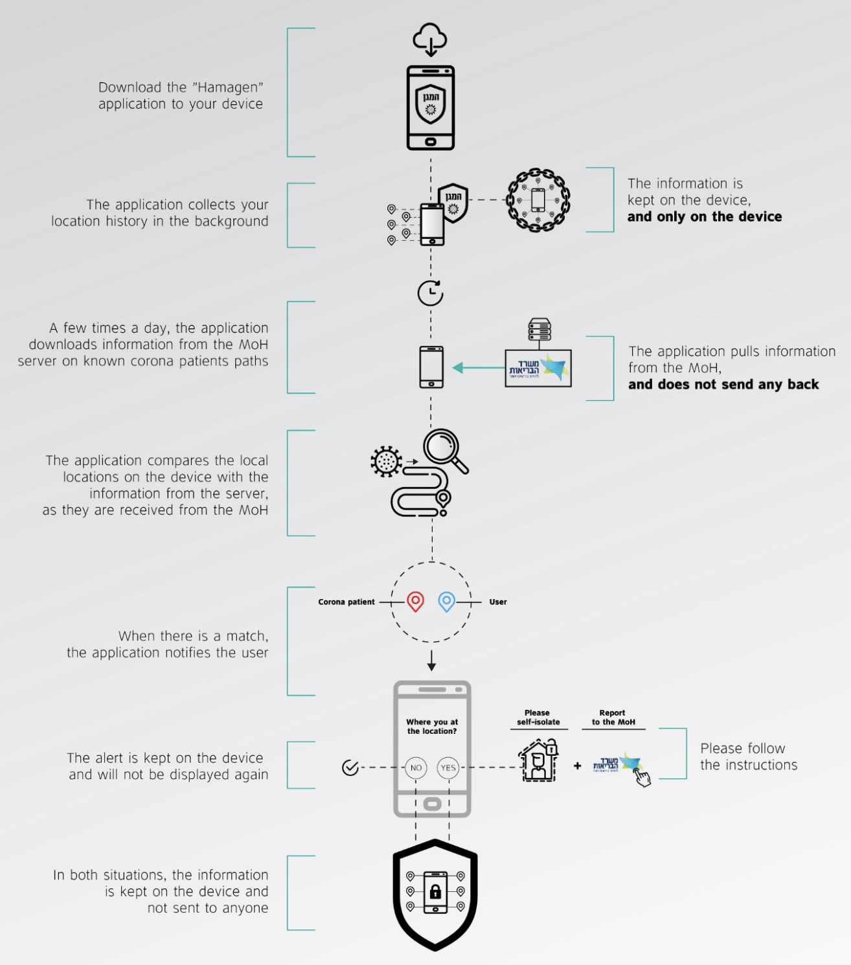
Hamagen - Israel

Slide 9
Stopp Corona – Austria
Phone number
Digital handshake – pairing?

