Slide 1
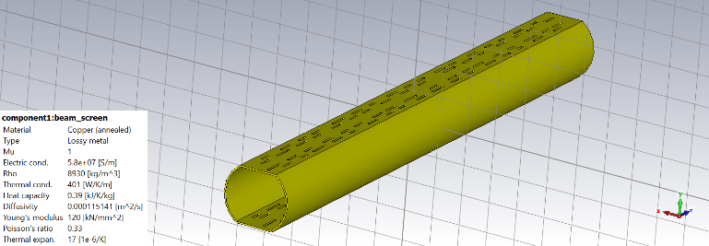
Follow-up on pumping slot simulations
After the last meeting, frequency domain simulation was run with the pumping slots implemented

Slide 2
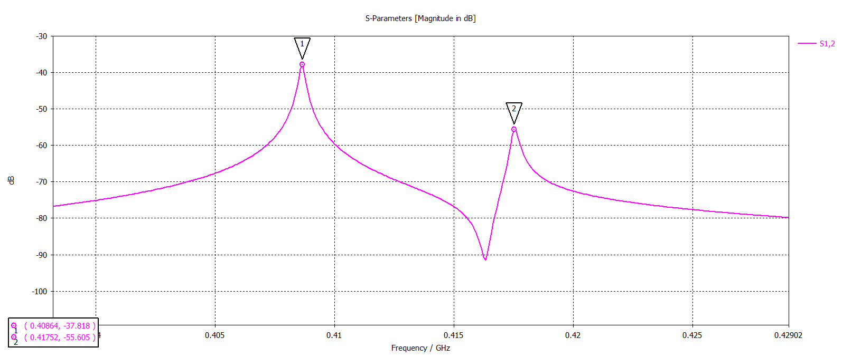
Follow-up on pumping slot simulations
After the last meeting, frequency domain simulation was run with the pumping slots implemented
Results are consistent with eigenmode simulation
Even mode
Odd mode

Slide 3
Follow-up on pumping slot simulations
Separation between the modes ~10 MHz (hopefully sufficient, but measurement will decide)
No unwanted modes appear (as expected)
Even mode
Odd mode

Slide 4
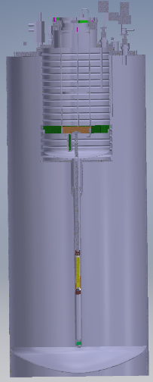
Cooling of the FRESCA insert
Insulating vacuum inside
Primary candidate:
  Cryocooler
    Has a room temperature
    side
    And a cold head sticking into the cryostat (<300 mm)
Outside
~1100 mm
Lambda plate
~1250 mm
Insert

Slide 5
Cooling of the FRESCA insert
Insulating vacuum inside
Primary candidate:
  Cryocooler
    Has a room temperature
    side
    And a cold head sticking into the cryostat (<300 mm)
    Because of this the head is
    really high up and is experiencing 300 K radiation
    How does heat get from the insert to the cold head? (helium gas is the most straightforward but then needs a helium circulation system)
  Helium vaporization?
Outside
~1100 mm
Lambda plate
~1250 mm
Insert

Slide 6
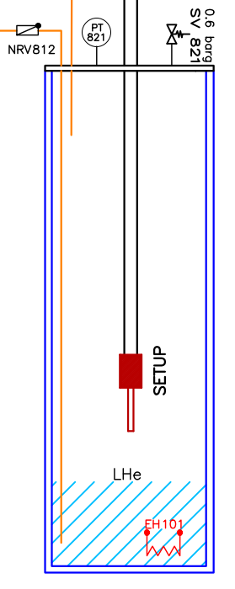
Cooling of the FRESCA insert
Insulating vacuum inside
Primary candidate:
  Helium vaporization
    Currently being used in the cryolab for setting the temperature of a smaller sample (~10 cm)
    2 large concerns:
      To set temperature at 50 K might be really challenging with this setup (cold helium gas comes from the bottom goes through heater system and is then passing through the setup)
      Volume at the bottom of the cryostat is really small (~ 40,000 mm^3 = 40 ml)
      For comparison in the setup on the left they are using 3 l of liquid helium for one cycle (2-3 temperature steps)
Outside
~1100 mm
Lambda plate
~1250 mm
Insert

Slide 7
Heat load on the FRESCA insert
There is no significant heat load coming from the measurement itself
Only heat conduction in the stainless steel and heat radiation is playing a role
I am now working on estimating the power of this
  Required for the design of the cooling setup
Outside
~1100 mm
Lambda plate
~1250 mm
Insert

