Slide 1
Requirements, emerging technologies and challenges
for detectors at future colliders
LHCP, 09/06/2021
D. Contardo, IN2P3/IP2I

Slide 2
Upgrades and new collider projects timeline
< 2030
2030-2035
2035-2040
2040-2045
> 2045
EIC
ATLAS & CMS – LS4
LHCb – LS4
ALICE 3 – LS4
CLIC
ILC
ATLAS & CMS – LS5
BELLE-2
ALICE ITS3 – LS3
FCC-ee
FCC- hh
Muon Collider
Walk through new experimental paradigms and a (limited) selection of R&D topics
  Representative of other program needs, QCD, rare decays/phenomena, Neutrino, Dark Matter…
  Main resource:
    ECFA R&D roadmap process: https://indico.cern.ch/event/957057/
    Input from future facilities: https://indico.cern.ch/event/957057/page/21634-input-from-future-facilities
    Task force’s symposia: https://indico.cern.ch/event/957057/program
Note: glossary of acronyms at the end of the presentation

Slide 3
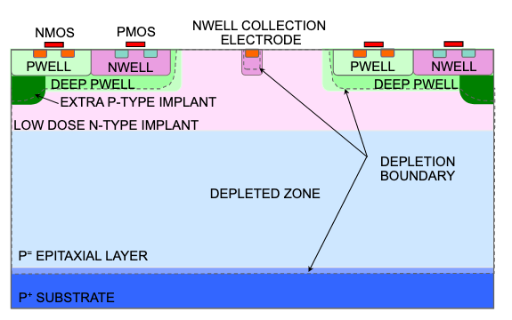
Ultimate position precision for Vertex Detectors (σ_{IP})
ALICE ITS3 in LS3 (2025) target σ_{hit} ≃ 3 µm, X/X₀* ≃ 0.05% / layer
  MAPS 65 nm node (10-20 µm pitch), 12” wafer with stitching (no PCB), ultra low power ≃ 20 mW/cm² (gas flow cooling), thickness down to 20 µm (bending) and ultra-light mechanics
Further project needs
  Up to O(100) MHz/cm², CLIC up to 6 GHz/cm², FCC-hh up to 30 GHz/cm²
  Also benefit with BC identification O(ns) time stamp for BIB rejection, possibly ultrafast timing
  Step(s) to ≲ 28 nm and/or 3D integration while maintaining ultralow power and X/X₀
A recent design optimized for rad. tol. and timing
ALICE ITS3 upgrade proposal
* X/X₀ could become the limiting factor to precision - low X/X₀ beam pipe, layers inside, also for low radius benefit, being considered

Slide 4
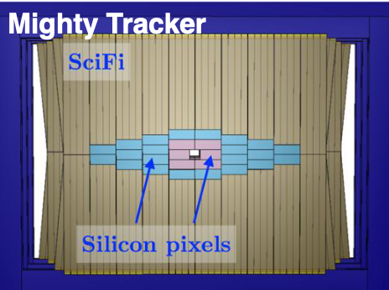
Ultimate position precision for Tracking (σ_{Pt})
FCC-ee at Z-peak is the most demanding, BES limit is σ(p_{T})/p_{T} ≃10⁻³*
  MAPS with granularity tuning, possibly larger size or grouped pixels for power optimization**
    X/X₀ in tracker typically larger due to detector area O(x20) VD
First occurrence in LHCb & ALICE-3 LS4, EIC (2031)
LHCb post LS4: first large scale application 30 m²
Alice-3 (LS4) – MAPS 20 µm pitch - BC timing 25 ns - 10¹³ neq/cm²
UT upstream magnet 6 m²
MT at low r within SciFi 20 m²
50 x 150 – 100 x 300 pitch
≲ 5 x 10¹⁴ neq/cm²
* Requirements are usually less demanding but still targeting unprecedented σ_{hit} ≃ 7 µm at low X/X₀ ≲ 1% / layer
** TPC and DCs are low X/X₀ alternative at relatively low rates e-e colliders - see slide 11

Slide 5
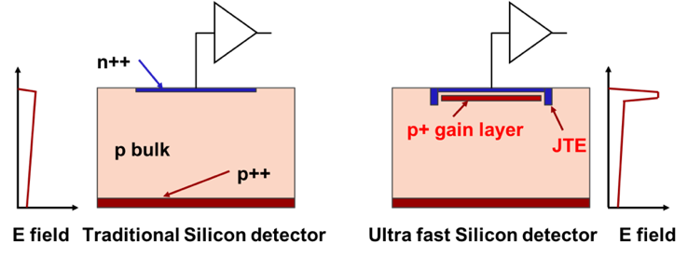
4D tracking with ultrafast timing (σ_{t})
Hit & track-vertex time association provides ultimate BIB/PU rejection at e-e/hh colliders, could enable correction of time-dependent parameters within BCs*
  MAPS, planar/3D/passive CMOS exploiting timing capabilities w/o amplification
    Targeting σ_{t} O(≲100) ps with specific designs – by geometry 3D should be best
  LGADs w/ amplification, at 100 % fill factor, VD pitch, large area, monolithic design
    Targeting σ_{t} O(≲10) ps **
  Ultrafast FE, rise time ≃ to signal O(100’s) ps, @ low power consumption
  Detector configuration optimized for X/X₀, eg all/dedicated layers, preferably tracking than VD…
3D design
LGAD initial pad design toward pixelated sensors
Trench Isolated Design
i-LGAD
Resistive Sharing Design
* ex. BES within BC correction at FCC-ee would ideally require O(5) ps precision
** Also relevant for ToF PID layers, see slide 10

Slide 6
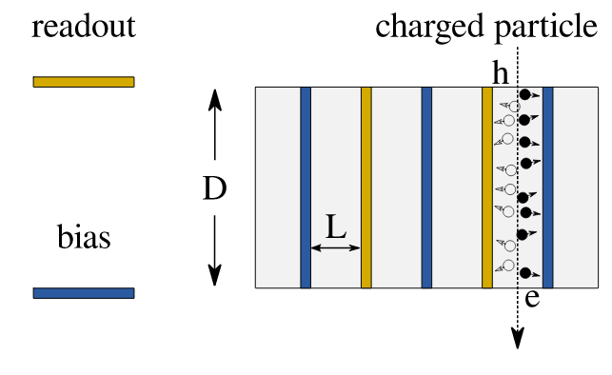
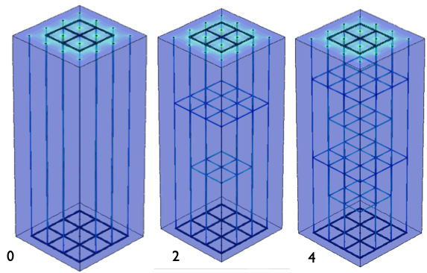
Extreme radiation tolerance
Major challenge for FCC-hh no current technologies can survive below 30 cm*
  Both sensors and ASICs
Behavior beyond neq 10¹⁷/cm² not really known, models may be too pessimistic
  3D, thin & planar … may approach needs Diamond is a good candidate
  Other WBG semiconductors GaInP, GaAs, GaN, SiC WBG now commercially used to be evaluated
  New materials 2D graphene and metamaterials are also options to consider
Qualification at NIEL ≳ 10¹⁷ neq/cm² is an issue in itself
ex. CVD-diamond semiconductor pixel sensors
  New 3D design with laser graphitization process for thin low ρ electrodes
  In depth field optimization readout structures
  Need scaling for production of large areas
ex. ASICs
  Deeper nodes in 3D do not guaranty rad. tol.
  Higher dielectric thick oxide (multiple) gates
  Carbon based process beyond CMOS, nanotube, graphene
ex. FinFET technology
* But also several current technologies would not fulfill needs at relatively large radii, limits already hit at HL-LHC for: ASICs, Si, Scint., SiPMs…
increased rad. tol. highly desirable for LHCb upgrade-2 VD, replacement of ATLAS/CMS VD and Timing LGADs

Slide 7
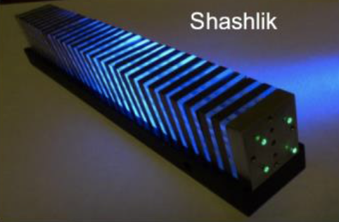
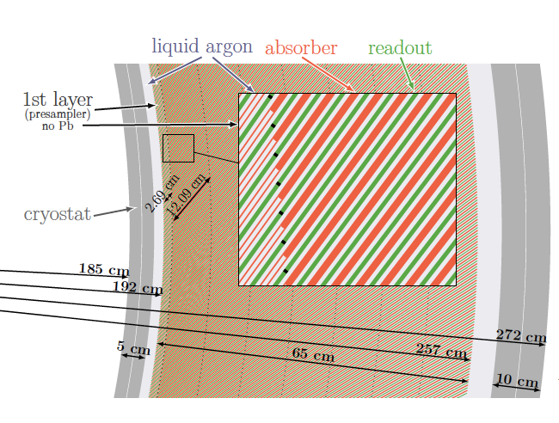
Calorimetry Particle Flow & Dual EM/Had. in all concepts
PFlow to profit of det. with best precision (eg. tracker for charged particles)
  Mostly driven by ⊥ & // granularity or shower containment
Dual EM & Had. shower component measurements for e/γ – π ID and energy compensation
  Mostly driven by // segmentation or physical dual signal readout (Cerenkov/Scintillating light)
High ⊥ & // granularity
Si-pads/Scint tiles
Shashlik EM concept with
fine ⊥ granularity
Spaghetti concept
fine ⊥ granularity
Homogenous DR EM + DR Hadronic
LAr multilayer electrode design for // segmentation
Shashlik EM concept
extended to DR
Homogenous DR EM with
fine ⊥ granularity
Homogenous hadronic
⊥ & // granularity

Slide 8
Calorimetry Particle Flow & Dual EM/Had. in all concepts
Different sampling concept are reaching similar ballpark performance, while homogenous design can provide ultimate energy resolution, especially for γs
Novel designs, heterogenous, can drive experimental choices toward specific environment (background, PU) & physics focus e/γ, jets, momentum range…
High ⊥ & // granularity
Si-pads/Scint tiles
Shashlik EM concept with
fine ⊥ granularity
Spaghetti concept
fine ⊥ granularity
Homogenous DR EM + DR Hadronic
LAr multilayer electrode design for // segmentation
Shashlik EM concept
extended to DR
Homogenous DR EM with
fine ⊥ granularity
Homogenous hadronic
⊥ & // granularity

Slide 9
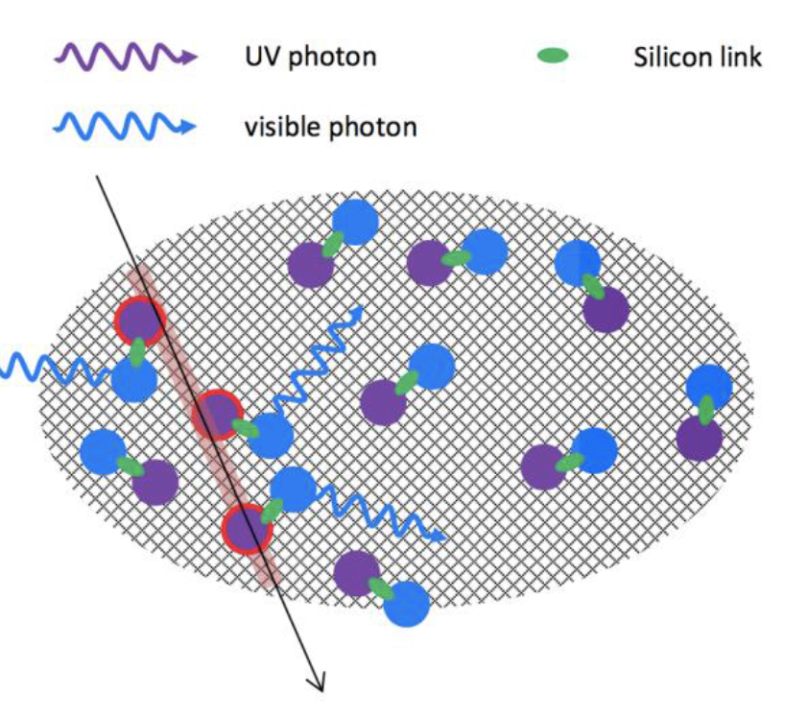
5D calorimetry with ultrafast timing*
Several use cases, PU mitigation, 2γ-vertexing, shower origin (DR), separation of Ceren./Scint. in single material (O(10) GHz sampling) – shower reconstruction precision with ML techniques
  Silicon option, see slides 5 (LAPPD could be an option, see slide 15)
  Scintillating/Cerenkov light devices**
    New materials and doping: ex. SiO₂:Ce₃ provide both Cerenkov and Scintillation light
    Nano materials: luminophore higher light yield, faster, more rad. tol. - quantum dots embedded in solution, polymer or on passive material surface, faster, possible tuning of λ-emission with dot size
    Heterogenous materials, exploiting 3D printing for unconventional shapes
  Ultrafast analog or digital photoconverters SiPM(SPAD) adapted to new materials, see slide 15
Nano materials luminophore
Quantum dot ex. perovskite embedded in polymer
YAG 3D printing in ≃ 30 nm layers
* First implementation @ σ_{t} ≃ 50 ps per cell in CMS HGC – overall precision depends on # cells (energy), 80 MHz sampling in CMS Crystal ECAL
Next step LHCb Upgrade-2 SPACAL, Shashlik design with σ_{t} O(10) ps
** Also relevant for ToF PID layers, see slide 10, ex. CMS LYSO crystal layer MTD

Slide 10
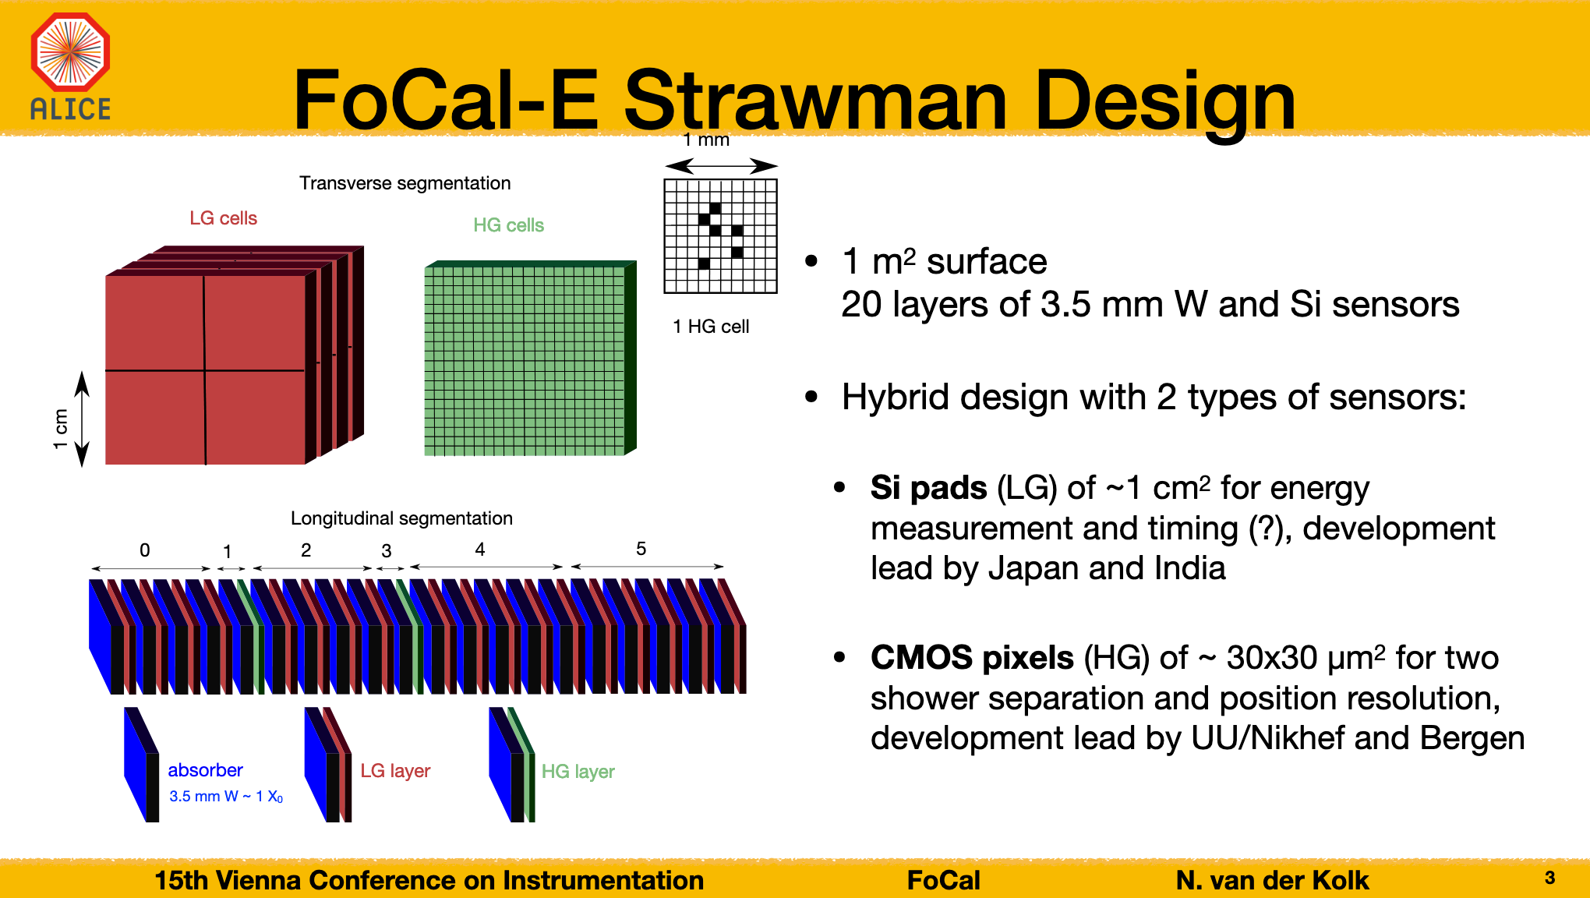
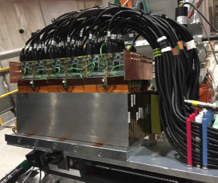
Digital high granularity calorimetry
Measure energy by hit counting
  MAPS for EM section**
    Granularity versus performance & power dissipation, compactness - sampling fraction
  Scintillating tiles, RPCs, MPGDs for Had. section
    Granularity versus performance & power dissipation, compactness - sampling fraction
    New resistive designs for MPGDs RPWell – MicroMegas (see slide 12 and 16)
ALICE LS3 2025 FOrwardCALorimeter heterogenous design and prototype
RPC & MicroMegas 2 bits (3 thresh.) semi-digital
in 1m³ prototype (GEM layers in preparation)
* Monolithic and/or 3D integration CMOS sensors with pads can also be considered for analog calorimetry for compactness

Slide 11
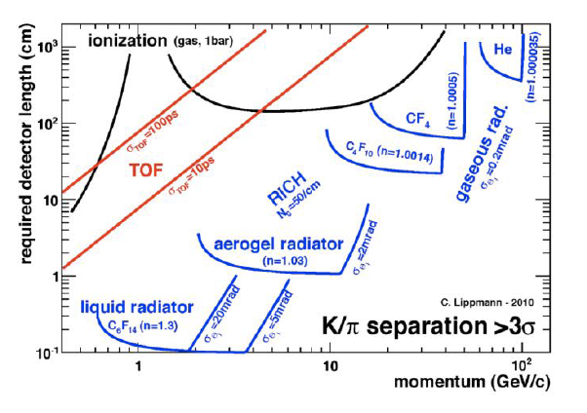
Particle Identification, extending p_{T} coverage
TPC or Drift Chambers (DC), dE/dx and/or dN_{cl}/dx
  Crossing at 1 -2 GeV requires another measurement – well adapted to barrel also provides tracking
RICH, β through Cerenkov angle
  Different refractive index and expansion volumes needed to cover p-range - adapted to forward regions
DIRC, combining Cerenkov angle (reflection) and ToP - ToF
  Thin quartz radiators w/ or w/o expansion for intermediate p-range both in barrel and forward regions
ToF, direct β measurement
  Si/Scint./MPGD thin layer(s) adapted to cover low-intermediate p-range both in barrel & forward regions
IDEA DC PID simulation dE/dx dN_{cl}/dx
RICH radiators
3σ π/K separation with typical ToF (@2m), Torch (DIRC) & Rich

Slide 12
TPC – DC with dE/dx and dN_{cl}/dx
dE/dx, typical resolution 5% for 1 m.bar
  High pressure can improve PID (and p-range)
dN_{cl}/dx, ≳ x2 better resolution at same depth
  In x-y space in TPCs (diffusion may be a limiting factor)
    High granularity MPGD RO, possibly 3D with σ_{t} O(1) ns
  In time in DC
    Signal sampling @ ≳ 1 GHz
Combination could be optimal at p relativistic rise
For tracking TPC & DC provide O(100) x σ_{hit} ≃ 100 µm & low X/X₀
  ex. IDEA DC @ FCC-ee 1.6 (5%) X/X₀ barrel(endcap), σ(p_{T}) / p_{T} ≃ 3 x10⁻³*
    Carbon wires - new assembly techniques
  ex. TPC GEM and MicroMegas RO
    Pixel pitch O(50) µm, resistive DLC layer (AC coupling) to tune ρ, monolithic design
ILC TPC simulation
ILC TPC simulation
GEM and MicroMegas new RO designs
MEG-2 He Drift Chamber
High granularity resistive AC designs RPWELL (left) & MM middle, InGrid CMOS on timepix monolithic (right) - eco-friendly gas Ar:CO2 - high rate sparkles capability for muon detection
* With a Si wrapping layer at outer radius

Slide 13
RICH with new designs and radiator materials
ex. LHCb (gas) up to p ≃ 100 GeV, σ_{Θ} ≃ 0.2 mrad
  Light optical elements in acceptance - higher granularity with
  longer lever arm and/or smaller pixel size, photosensors with
  high QE in green to enhance signal for timing
    Light mirrors, high reflection coating
    MPPC with 5 mm pitch, high rad. tol.
ex. EIC (gas) up to p ≃ 50 GeV
  Option for High Pressure RICH with Ar at 3.5(2) bar (≃ C₄F₁₀/CF₄ 1 bar)
ex. ALICE-3 & EIC (aerogel) down to p ≃ 10 MeV/c
  Multiple-refractive index (left) or lens focusing (right) radiators
  Tunable refractive index within new materials
    Photonic crystals in 1D/2D/3D very thin layers O(100) nm
    Metamaterials metallic wire or nanomaterials with layer
    thickness < λ creating an effective medium
Ultrafast timing σ_{t} O(≲ 50) ps to exploit same γ-Cerenkov arrival time for bgk rejection
  SiPM/LAPPD see slide 15
LHCb current and LS4 upgrades
n₁
n₂
…

Slide 14
DIRC with focusing and ultrafast timing for 3D (x-y-t)
Fused Silica Quartz radiator O(1) cm thick, up to p ≃ 10 GeV
  σ_{Θ} down to 0.5 mrad, with high granularity MCP-PMTs and/or expansion lever arm
  σ_{t} ≃ 10-15 ps with MCP-PMT (SiPM) O(≲50) ps SPTR (30 γ / track in LHCb TORCH)
Lens focusing designs, ex. Panda, IEC new hybrid bars & expansion design (right)
SuperB
LHCb Upgrade-2
Reflection focusing designs, ex. SuperB, LHCb upgrade-2
  In LHCb ToF alone at 10 m & σ_{t} ≃ 10 ps cover up to p ≃ 10 GeV

Slide 15
Photo Detectors high QE, ultrafast for single-γ, rad. tol.
MCPM-PMT
  2 “ square, 64 x 64 pixels LHCb TORCH
  LAPPD* large area 20 cm²
    Cheaper materials ex. borosilicate glass, 20 µm pores
  SPTR (HPK) down to σ_{t} ≃ 34 ps
ALD coating to improve CE and rad. tol.
Al layer to protect photocathode for improved rad. tol.
Hybrid design with pixel ASIC integration in vacuum tube, σ_{hit} ≃ 10 µm, σ_{t} ≃ 10 ps, 2.5 Ghit/s LHCb-2
SiPM
  Analog design, integrating charge on pixels
  SPAD digital, counting pixel hits, in CMOS process / 3D integ. design
    Improved σ_{hit} and σ_{t}*, but higher DCR & lower fill factor
    Micro-lens array design to compensate fill factor effect
New materials (WBG), ex. GaInP, GaAs, SiC, GaN - smaller pixels
  Improve rad. tol. (low DCR)
  Improve QE , particularly in UV for noble liq./ultrafast devices (Cerenkov)*
* SPAD 50 µm pitch σ_{t} ≃ 20 ps compared to ≃ 30(80) ps with 1(3x3) mm² SiPMs
** Also relevant to TPC/Cerenkov vessels for neutrino & DM experiments
Micro-lens SPAD

Slide 16
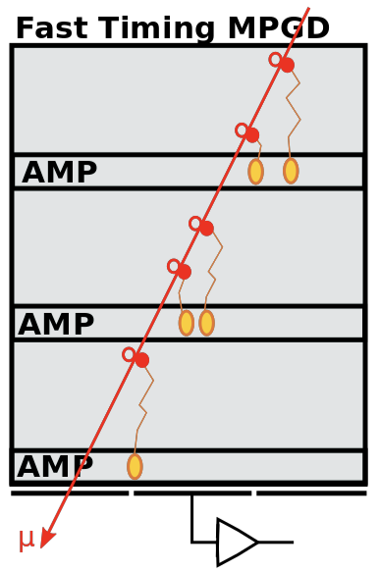
Gas detectors for photo-detection and ultrafast ToF
Multi-GEM, MM, or hybrid with recent RO (see slide 12)
  Minimize IBF ≲ 3%
  Improve photocathode QE and rad. tol.
    ex. Hydrogenated diamond films in spray techniques
    Nano-diamond (gold) grains (UV-sensitive)
Compass RICH
Ultrafast timing layers
  Multigap RPCs, 24 x 160 µm gaps for σ_{t} ≃ 10-20 ps in O(5) mm
    Materials for low ρ, mechanical challenges
  Fast Timing MPGD
    Multiple thin amplification gaps
  MM with Cerenkov radiator and photocathode
    New materials for photocathode, ex DLC coating for rad. tol.
Intrinsic multilayer concept
FTM with µ–rwell readout
Picosec MM 24 ps for 10 pe (≃ 1 mip)

Slide 17
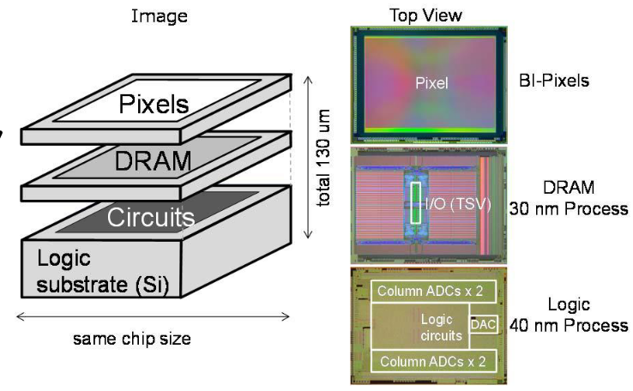
3D integration and deep node technologies
Sensitive layer + ASICs + Silicon photonics transceiver (for ≳100 Gbps)
  Optimize layer technologies to functionalities
Stacking with high density bonding
  Flip chip bumps, liq. phase, metal-metal diffusion, nano-porous
  gold bumps ≲ 10 µm pitch, anisotropic conductive films…
Stacking with Trough Silicon Via
  Enable ultralow pixel pitch*, more RO functions, lower dead areas & X/X₀ with thinning
  ex. CMOS image sensor 3D integration exist at Samsung and Sony in deep nodes
Samsung: 1.4 µm pixels in 65 nm & 14 nm FIN-FET (3D transistors) readout , wafer level stacking
3D layer thinned to 3 µm design for 960 fps Sony(left) layers thinned to 3 µm
Samsung (right) 1.2 µm pixel pitch, 2.5 TSV 6.3 µm in 28 nm logic 20 nm DRAM
* Ultralow pitch could have interest for inclined tracks

Slide 18
Outlook
Tremendous technology opportunities and new ideas exist to prepare unprecedented performance for next generation of detectors, keys to this new era:
  3D nano-scale new materials & process
  4th dimension, time measurement
  Heterogenous designs
  ML reconstruction techniques
System, production, operation aspects and costs need to be considered
Collaborative effort and joint budgets are more than ever crucial to access expensive technologies and allow efficient top-up of developments addressing several project needs

Slide 19
Glossary of acronyms
ALD – Atomic Layer Deposition
BC – bunch crossing
BES - Beam Energy Spread
BIB – Beam Induced Background
Bgd – Background
DIRC – Detection of Internal Reflected Cerenkov light
DLC - Diamond Like Carbon
DR – Dual Readout
LGADS – Low Gain Avalanche Photodiodes
MAPS – Monolithic Active Pixel Sensors
MPPC- Micro Pixels Photo Converters (SipMs, MCP-PMT)
PU – Pile-Up
RO readout
SPTR – Single Photon Time Resolution
ToP – Time of Propagation
ToF time of Flight
WBG Wide Band Gap

