Slide 1
FCC-ee compensation scheme: consolidation
M. Koratzinos
Optics meeting
17 /4/2020

Slide 2
Introduction
What I did was to revisit and clean up the compensation scheme (as presented in our CDR)
I needed to find an extra 5mm of space for the cryostat. That means that the compensating solenoid needs to be made 5% smaller…
…increasing the emittance blow-up…
So, I then tried to re-optimise to gain what was lost (or even a bit more)
Many thanks to Katsunobu for patiently helping me in my debugging sessions, for checking my results and providing valuable feedback

Slide 3
Role of compensation
According to our CDR, the role of the compensation scheme is to satisfy (amongst others) the following conditions:
  Total integral of Bdl seen by the beam should be close to zero (*)
  Field in the vicinity of QC1L1 < ±50mT (**)
  Emittance blow up should be as small as possible
  (*) tunable: I stop iterations if better than 10⁻³ Tm. CDR states that emittance blows up by 0.1pm for a 10⁻³ Tm mismatch in compensation
  (**) this is not investigated at depth. Could be too stringent
Emittance blow-up only important for the Z running

Slide 4
Improvements over CDR
The outer radius of the coils has been reduced so as to leave 5mm for the cryostat
the compensating solenoid starts 5mm further downstream
The screening solenoid and compensating solenoid are 5mm apart
Now both coils have variable pitch ➔ great for optimising
The exact coil is now exported from the magnet optimization program. Before, the coil was a cylindrical envelope.
Reminder: CDR number for the emittance blow-up for 2IPs at the Z: 0.4pm

Slide 5
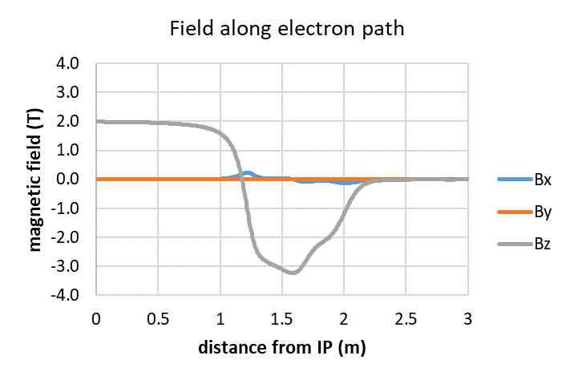
field

Slide 6
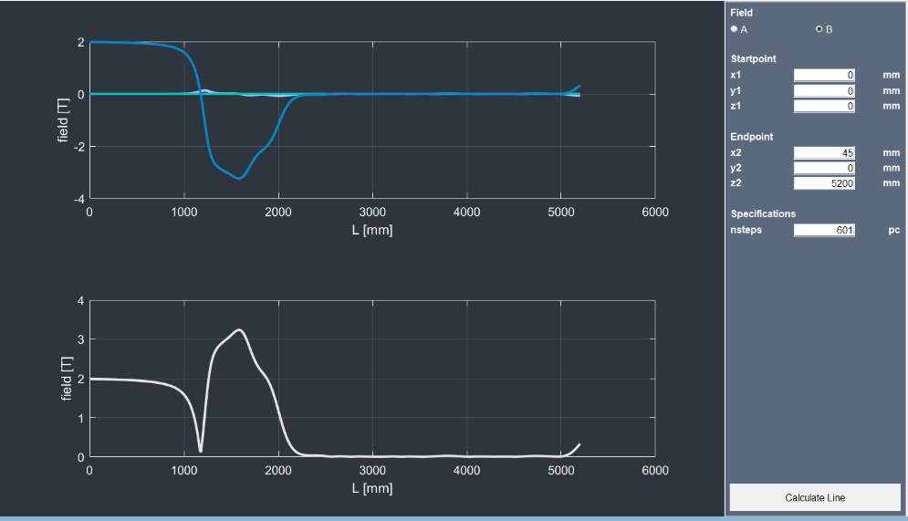
Field all the way to the endcaps – no return yoke

Slide 7
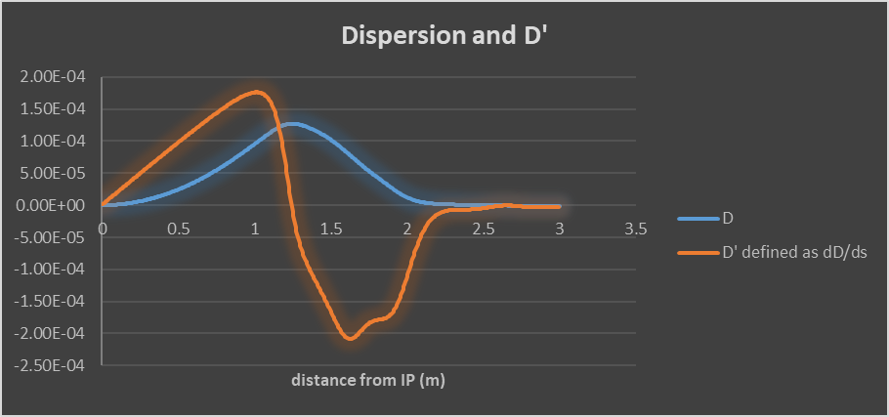
Dispersion – closes locally

Slide 8
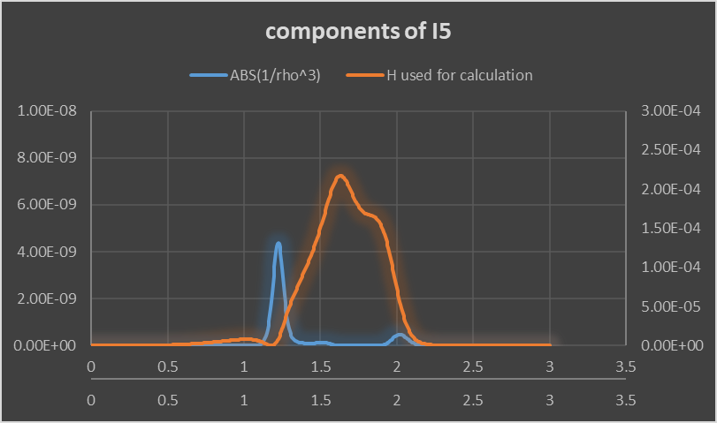
Emittance blow up depends on I5 which is the product of the blue and red curves

Slide 9
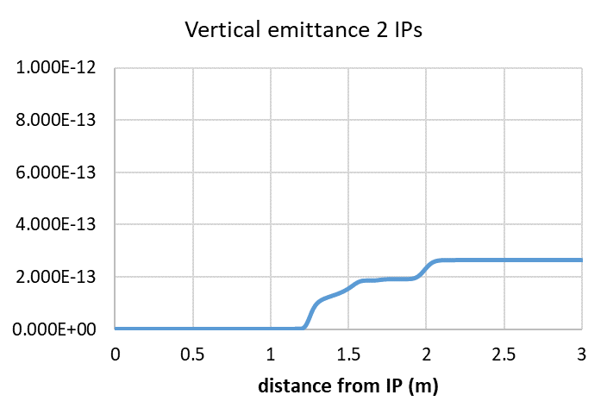
Vertical emittance blow up – 0.175pm for 2IPs
Katsunobu’s SAD full optics analysis: 0.175 pm for 2 IPs
My simple analysis gets 0.26 pm for 2 IPs

Slide 10
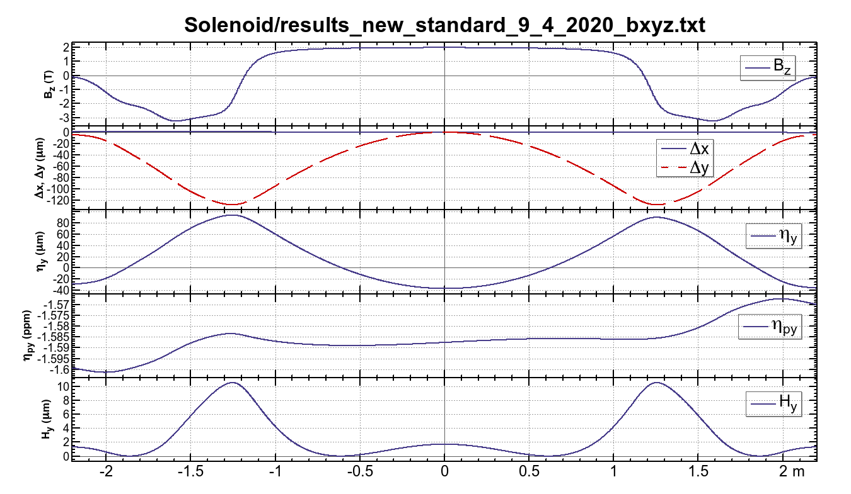
Results of SAD

Slide 11
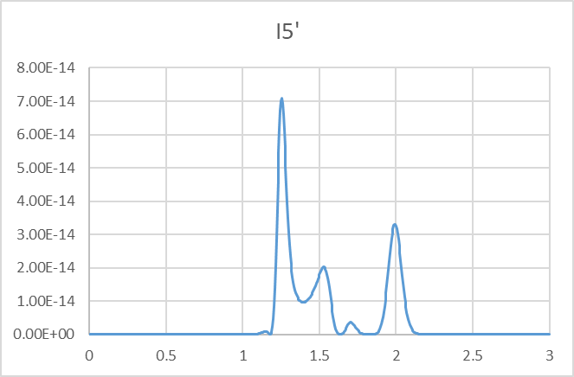
where emittance grows

Slide 12
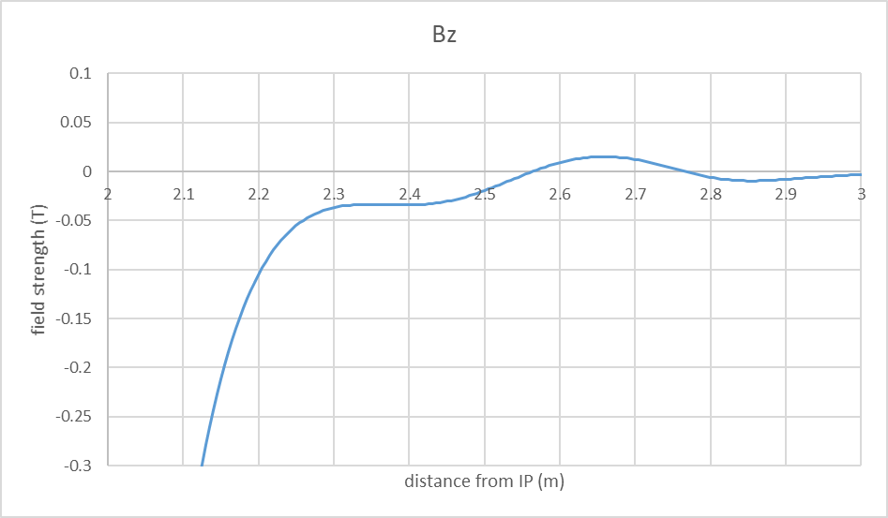
Field in the vicinity of QC1L1
QC1L1

Slide 13
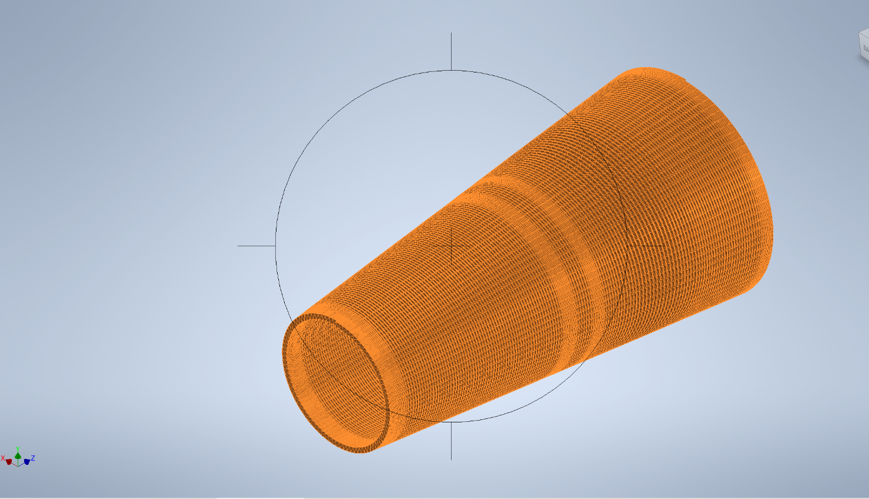
Export to CAD – compensating solenoid wire

Slide 14
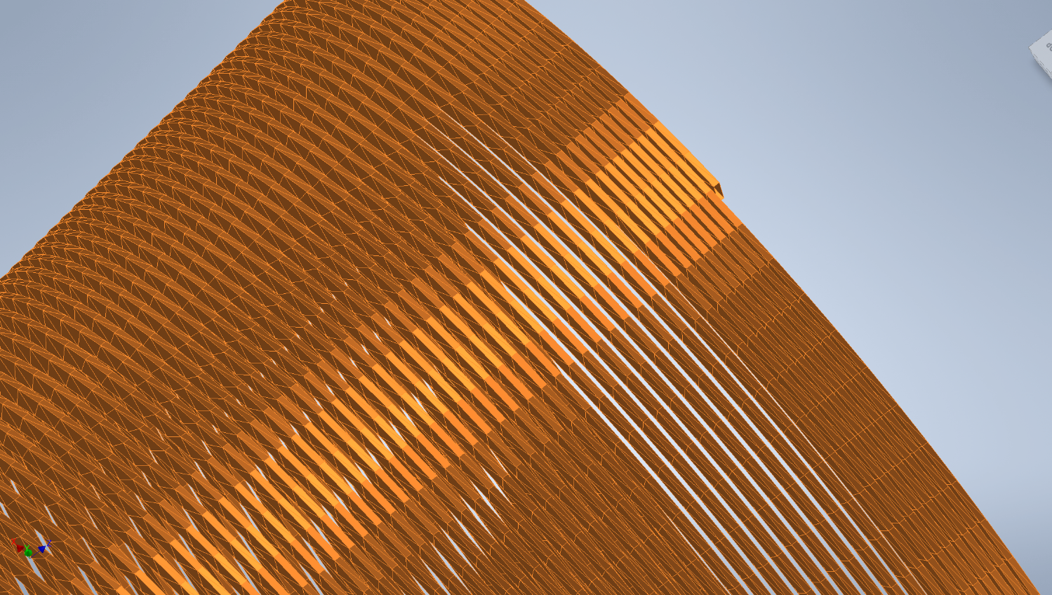
Individual wire is exported

Slide 15
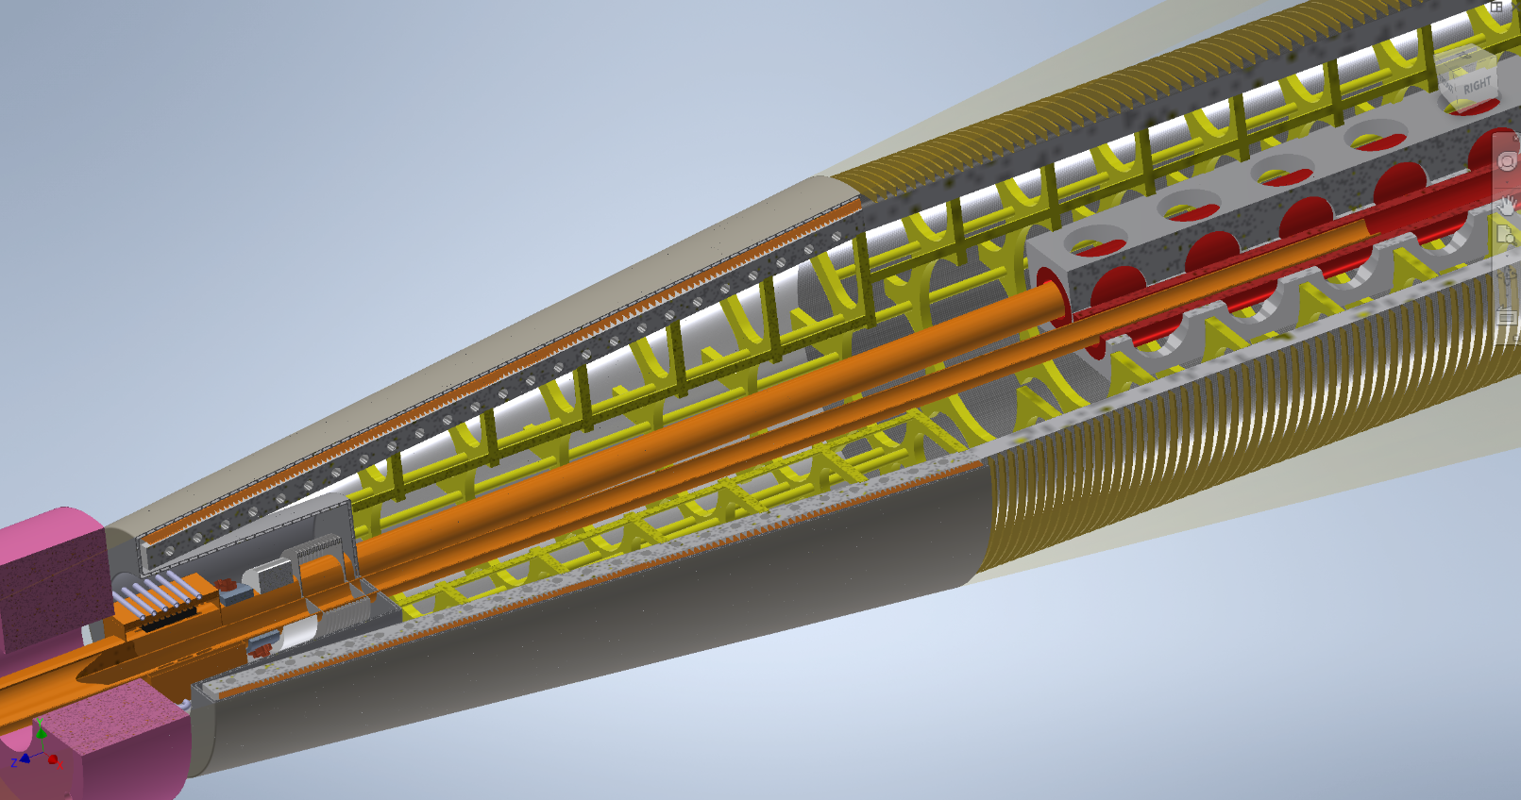
The full assembly

Slide 16
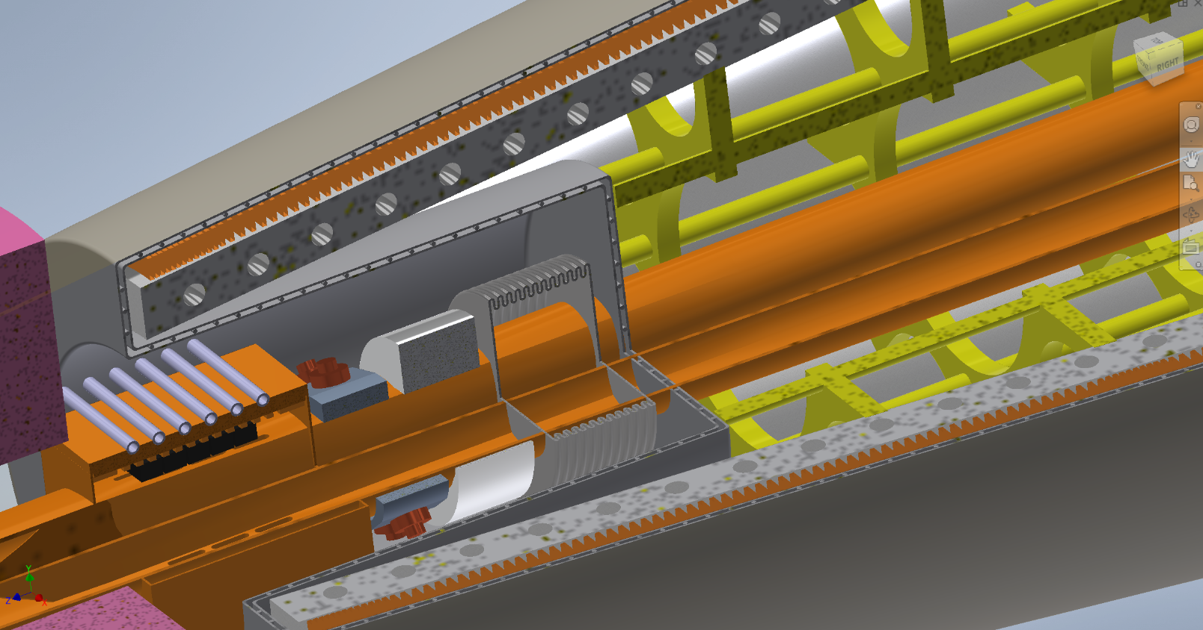
Front of the compensating solenoid

Slide 17
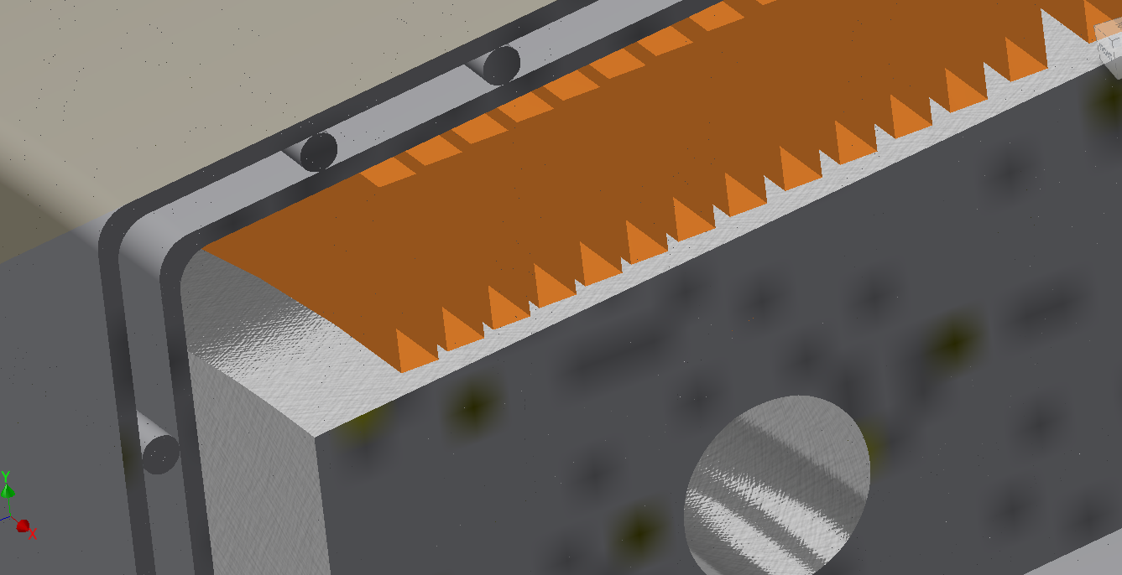
Front of the compensating solenoid
Coil windings
Cryostat
Coil support
He cooling duct

Slide 18
Summary
A new optimization of the compensation scheme has been performed
Now everything fits inside the 100mrad cone, including the cryostat
Emittance blow up from two IPs according to the optics analysis: 0.175pm at the Z (compared to 0.4pm quoted in our CDR) ** this will not be a bottleneck if we need to go to 4IPs! **
Realistic representation of the solenoids, down to the individual cable
This is a complex analysis, I probably could not have done it if not for COVID19…

