Slide 1

Testing the effect of quadrupolar impedance
with Vlasov approach developed for e-cloud
G. Iadarola
Many thanks to:
N.. Biancacci, L. Mether, E. Métral, N. Mounet, G. Rumolo, L. Sabato, C. Zannini

Slide 2
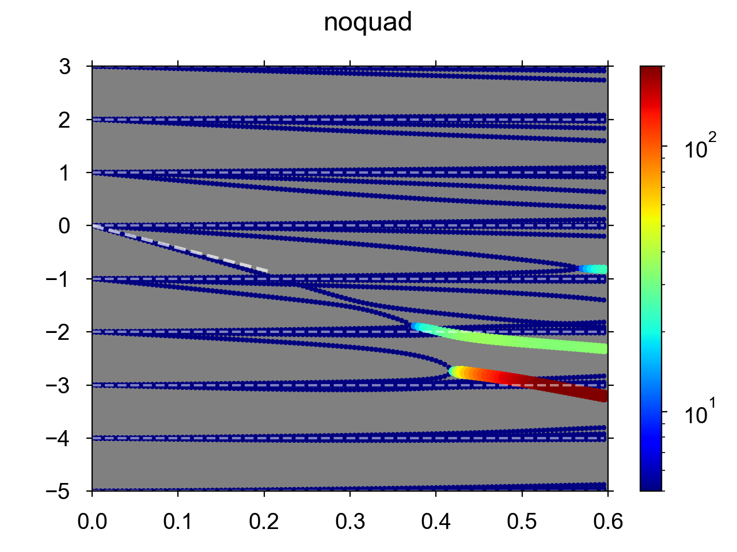
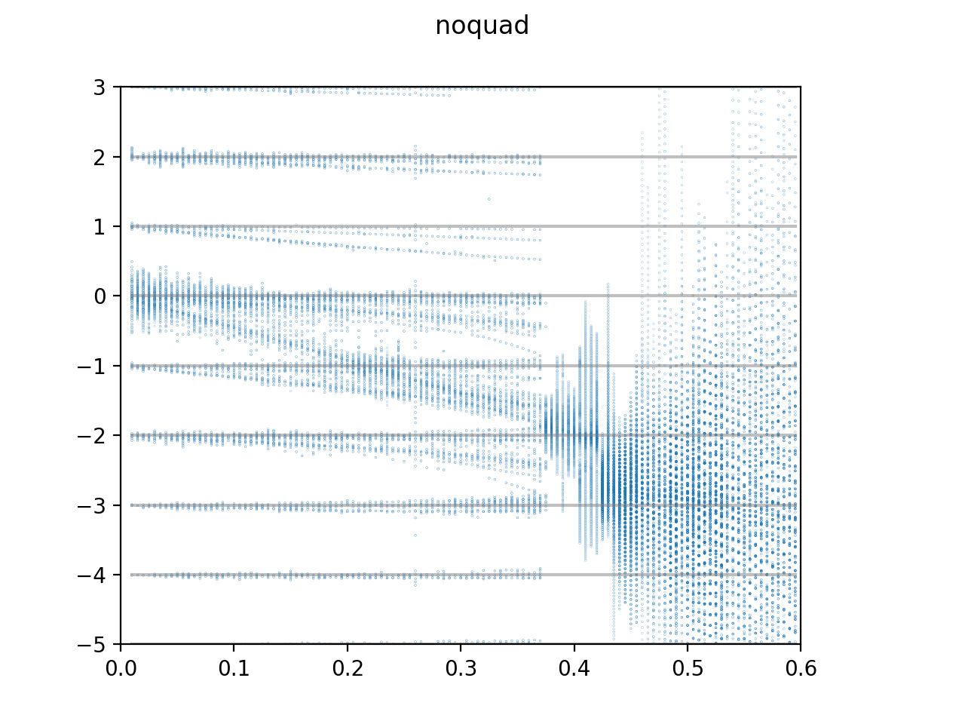

Dipolar impedance alone
Studied case:
4 σ_{t} = 1.3 ns, reference intensity 1.2 x 10¹¹ p/b
BB resonator (f_{r} = 2 GHz, R_{s}=75 MΩ)
Synchrotron tune Q_{s} = 4.9 x 10⁻³
Vlasov
PyHEADTAIL
(Q-Q₀)/Q_{s}
(Q-Q₀)/Q_{s}
Factor on bunch intensity
Factor on bunch intensity
The dashed line is the expected rigid-bunch tune shift estimated as:

Slide 3
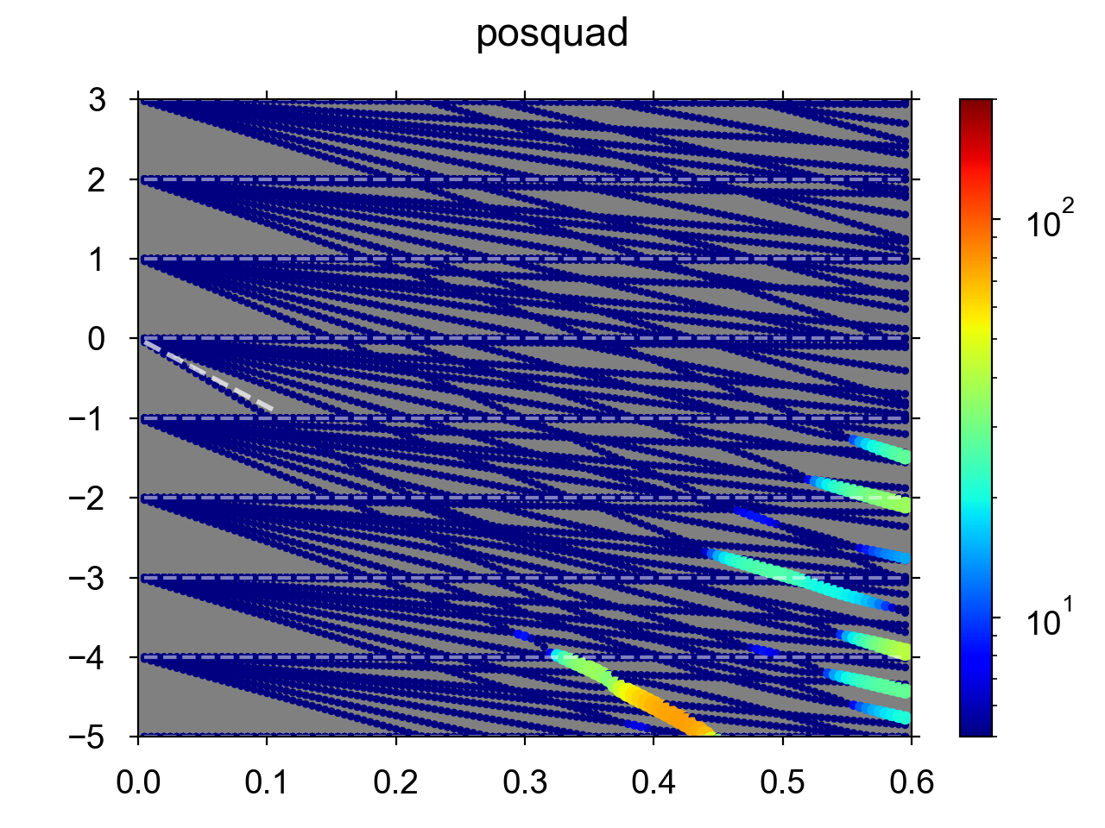
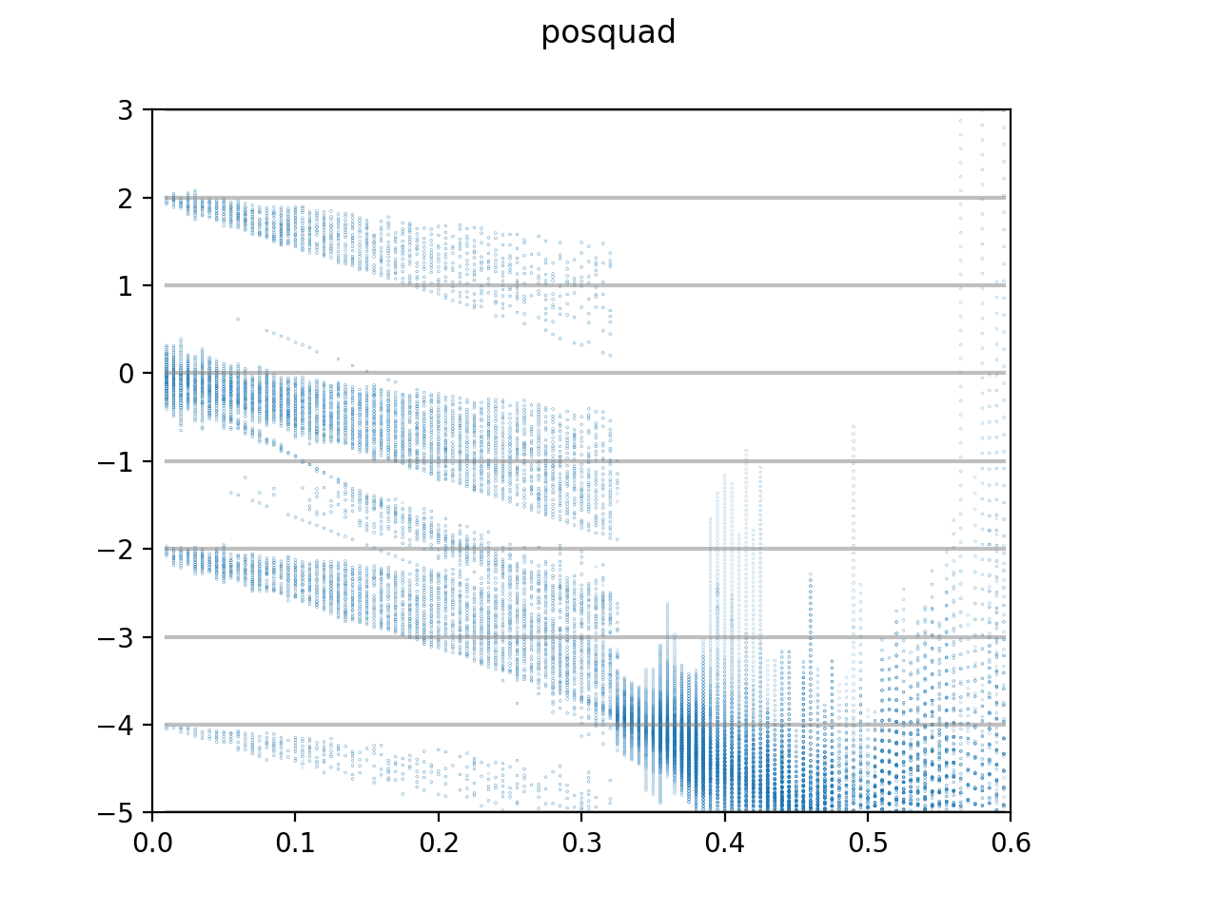
Dipolar + positive quadrupolar
Studied case:
4 σ_{t} = 1.3 ns, reference intensity 1.2 x 10¹¹ p/b
BB resonator (f_{r} = 2 GHz, R_{s}=75 MΩ)
Synchrotron tune Q_{s} = 4.9 x 10⁻³
Vlasov
PyHEADTAIL
(Q-Q₀)/Q_{s}
(Q-Q₀)/Q_{s}
Factor on bunch intensity
Factor on bunch intensity
The dashed line is the expected rigid-bunch tune shift estimated as:

Slide 4
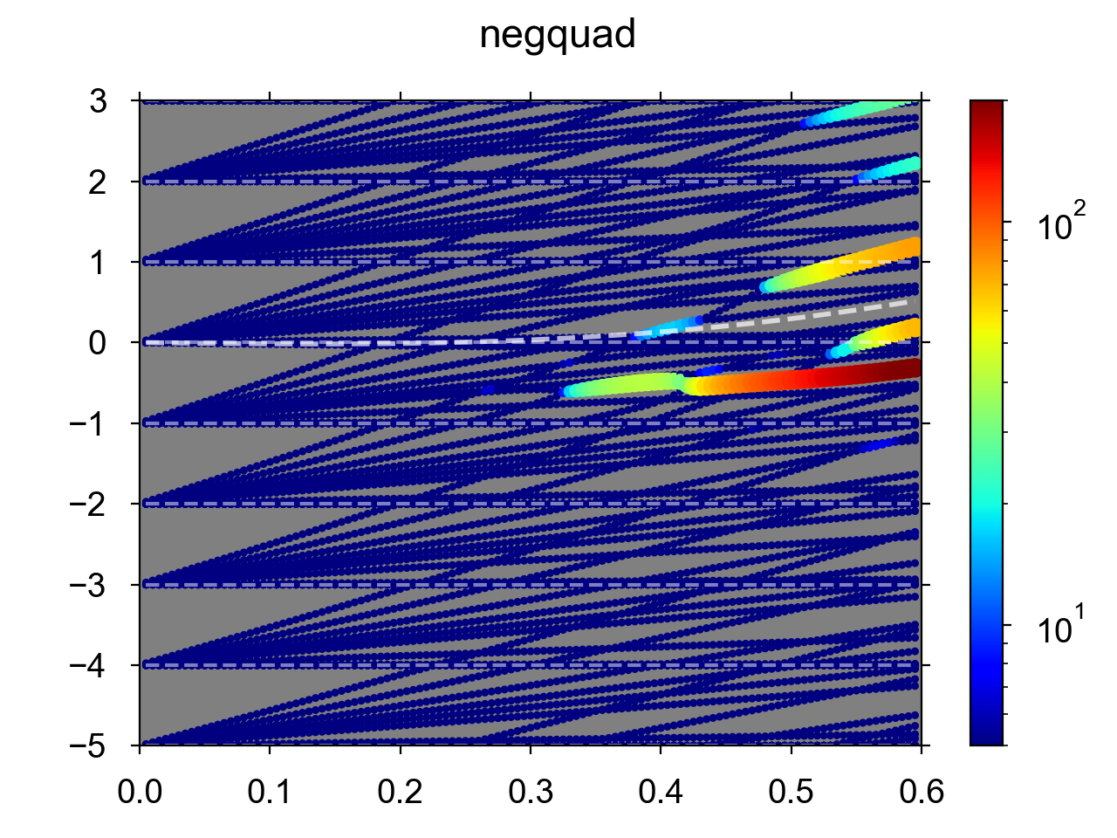
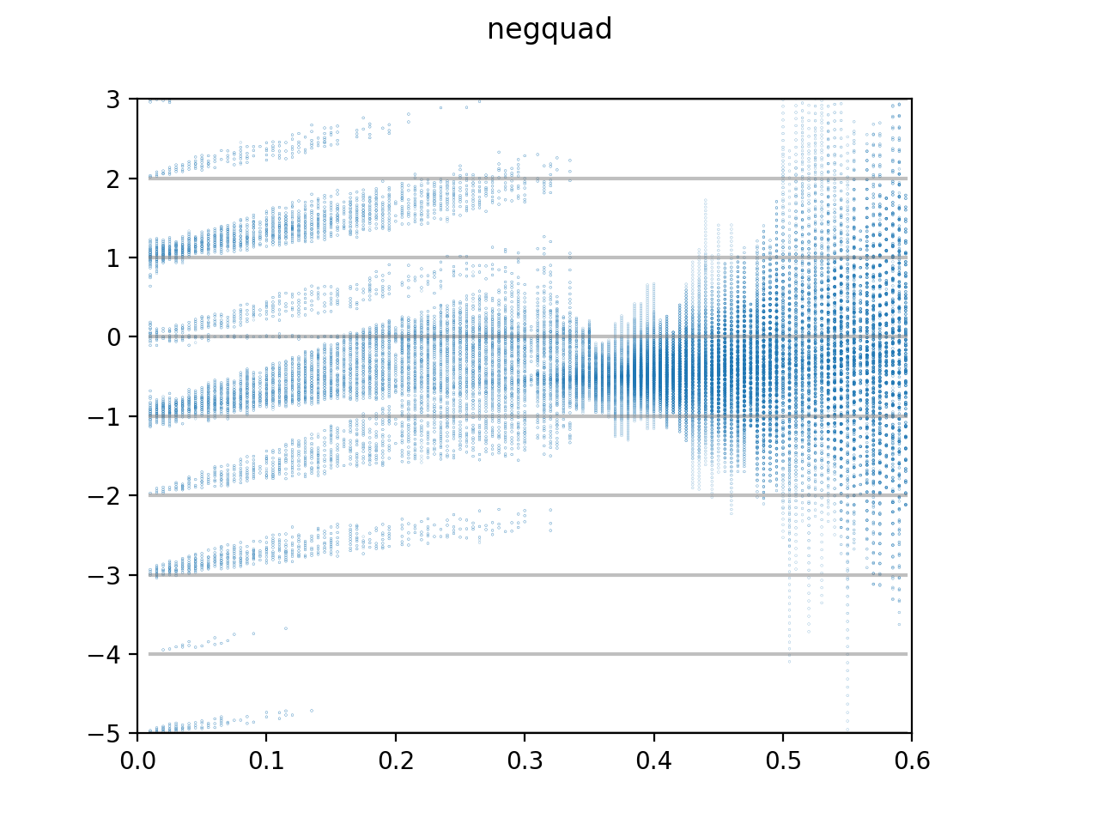
Dipolar + negative quadrupolar
Studied case:
4 σ_{t} = 1.3 ns, reference intensity 1.2 x 10¹¹ p/b
BB resonator (f_{r} = 2 GHz, R_{s}=75 MΩ)
Synchrotron tune Q_{s} = 4.9 x 10⁻³
Vlasov
PyHEADTAIL
(Q-Q₀)/Q_{s}
(Q-Q₀)/Q_{s}
Factor on bunch intensity
Factor on bunch intensity
The dashed line is the expected rigid-bunch tune shift estimated as:

Slide 5
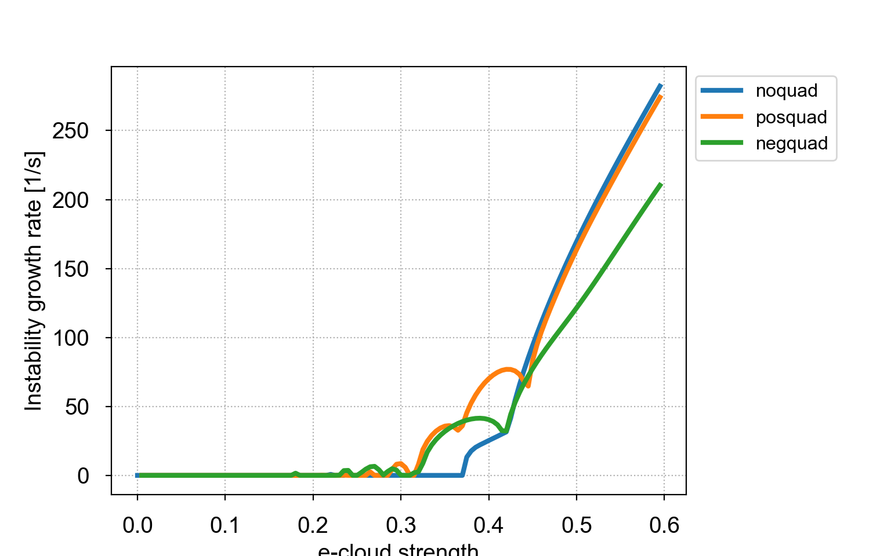
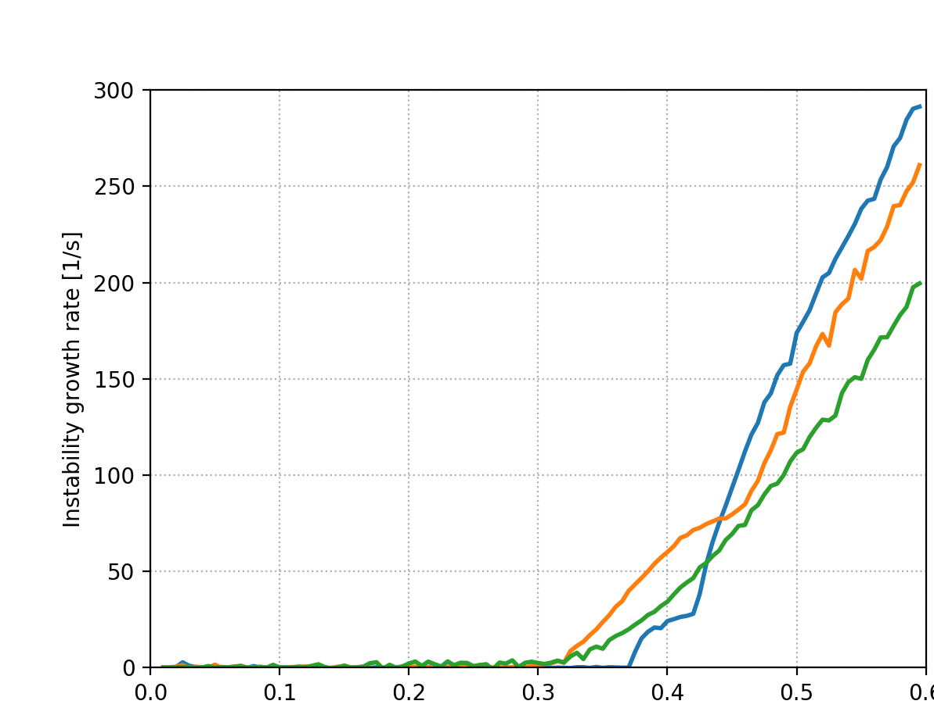
Instability risetimes
Vlasov
PyHEADTAIL
Destabilizing effect
Destabilizing effect
Factor on bunch intensity
Factor on bunch intensity

Slide 6
Comparison
Dipolar alone
The behavior of the modes changes significantly (it is not simply a rigid shift)
This is the effect of the changing detuning along the bunch acting differently on different radial modes
Dipolar + positive quadrupolar
Dipolar + negative quadrupolar

Slide 7
Conclusion
The new Vlasov solver agrees well with PyHEADTAIL for the case of dipolar and quadrupolar impedances
The quadrupolar impedance introduces complex changes in the behavior of the modes: different shifts for different radial modes as result of the detuning along the bunch
This can affect the instability threshold and have a destabilizing effect in a certain range of intensity
Thanks for your attention!

