Slide 1
Tune shift simulations for the PSB: lessons learned
E. Koukovini Platia, G. Rumolo, C. Zannini
Acknowledgements
N. Mounet, M. Schenk, P. Zisopoulos
215th HSC section meeting, 27/4/20

Slide 2
Outline
Introduction
Frequency analysis: Issues and solutions
  FFT and Sussix
  Multi-BPM
First comparisons between PyHEADTAIL, DELPHI, and theory
Wake sampling issue in PyHEADTAIL
Pre-LS2 results at 160 MeV and 1.4 GeV
Conclusions

Slide 3
Outline
Introduction
Frequency analysis: Issues and solutions
  FFT and Sussix
  Multi-BPM
First comparisons between PyHEADTAIL, DELPHI, and theory
Wake sampling issue in PyHEADTAIL
Pre-LS2 results at 160 MeV and 1.4 GeV
Conclusions

Slide 4
Introduction
Action to discuss impedance-induced observables pre- and post- LS2 in May
Tune shift with intensity simulations for the PSB at several energies
  160 MeV, 1 GeV, 1.4 GeV, and 2 GeV
Tune shift vs. intensity measurements and/or simulations are one of the
most common observables in accelerators worldwide
Did such studies already for the CLIC DRs, ALBA, Diamond, PS and it was a straightforward and quick analysis
But the PSB puts macroparticle codes such as PyHEADTAIL to the challenge (low beta machine, multiturn wake effects, indirect space charge etc.)

Slide 5
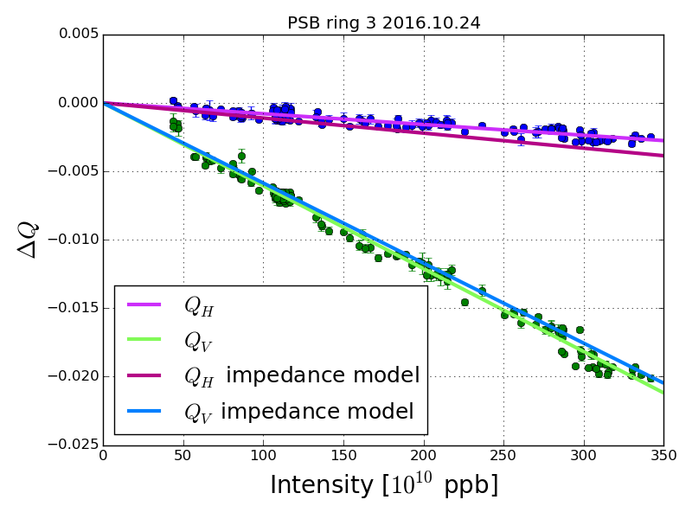
Tune shift measurements at 160 MeV (pre-LS2)
Comparison of measurements with theory (analytical
formula from Chao adjusted by Carlo to account for low beta)
T. Rijoff Presented in the
145th HSC meeting
PSB tune shift measurements realized in the past by B. Jones, K. Li, N. Mounet, D. Quatraro, T. Rijoff, G. Rumolo, C. Zannini

Slide 6
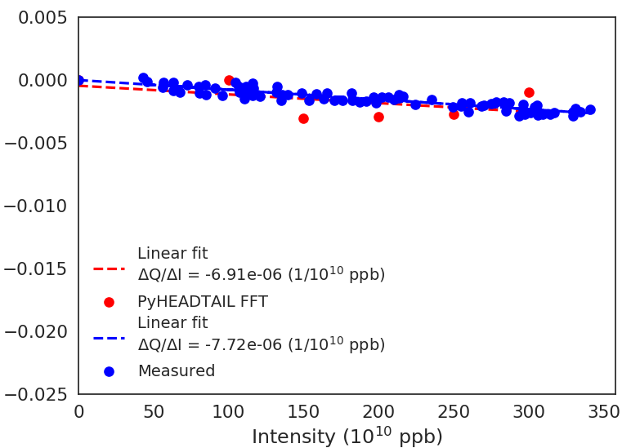
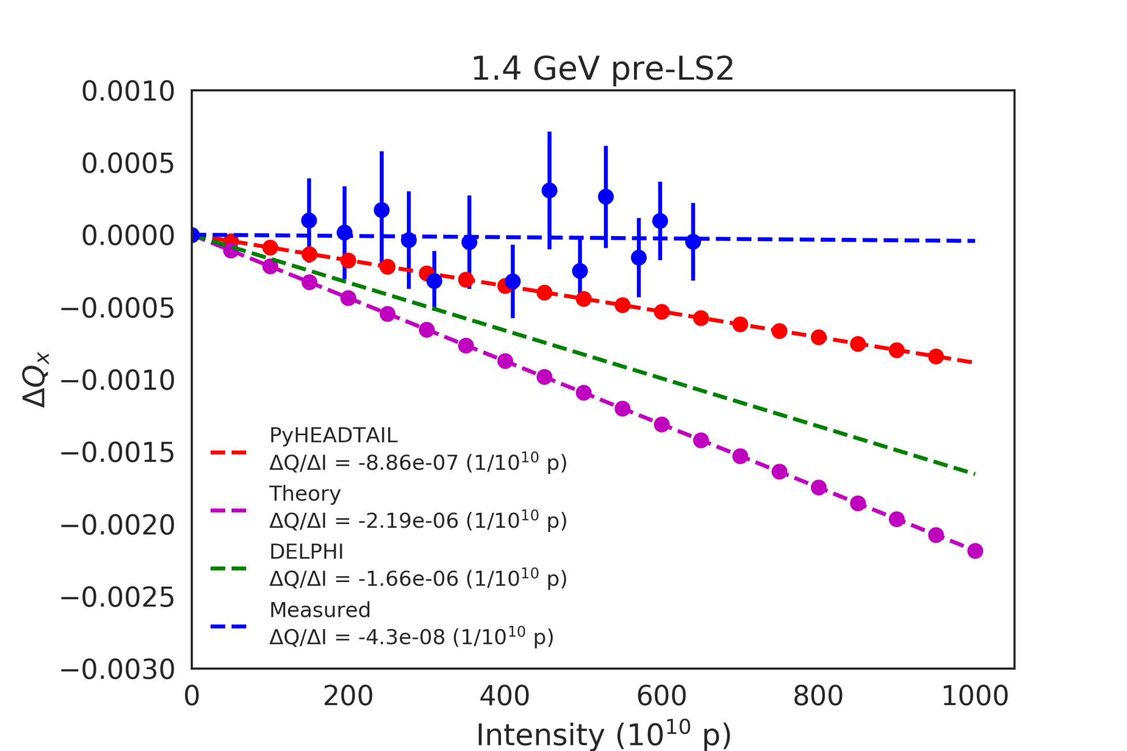
Horizontal tune shift at 160 MeV (pre-LS2)
Extensive macroparticle simulations with PyHEADTAIL
were done for the horizontal instability studies
Presented in the 182nd
HSC meeting
Simulation with full impedance model (dipolar & quadrupolar)
33000 turns, non-linear motion, parabolic bunch, no kick, 150 turns multiturn wakes, 4 x 10⁶ macroparticles (mp), 3000 slices, ±3σ
~11% difference in the slopes
Focus was put on the horizontal plane due to the instability
Notes:
11% difference in the slopes

Slide 7
Outline
Introduction
Frequency analysis: Issues and solutions
  FFT and Sussix
  Multi-BPM
First comparisons between PyHEADTAIL, DELPHI, and theory
Wake sampling issue in PyHEADTAIL
Pre-LS2 results at 160 MeV and 1.4 GeV
Conclusions

Slide 8
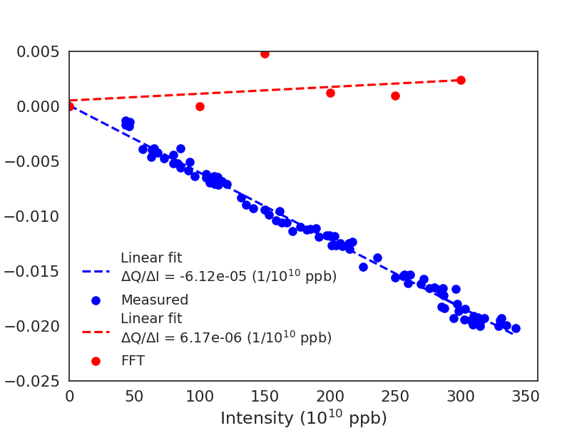
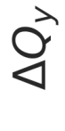
Vertical tune shift at 160 MeV (pre-LS2)
PyHEADTAIL simulation with full impedance model (dipolar & quadrupolar)
33000 turns, non-linear motion, parabolic bunch, no kick, 150 turns multiturn wakes, 4 x 10⁶ macroparticles (mp), 3000 slices, ±3σ
For the vertical plane, doing FFT for 33000 turns without kick did not yield
good agreement → Next step: apply initial kick

Slide 9
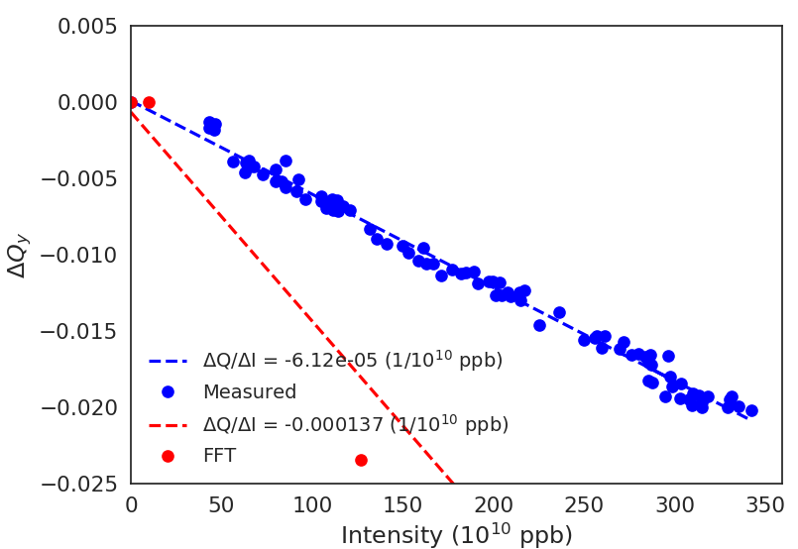
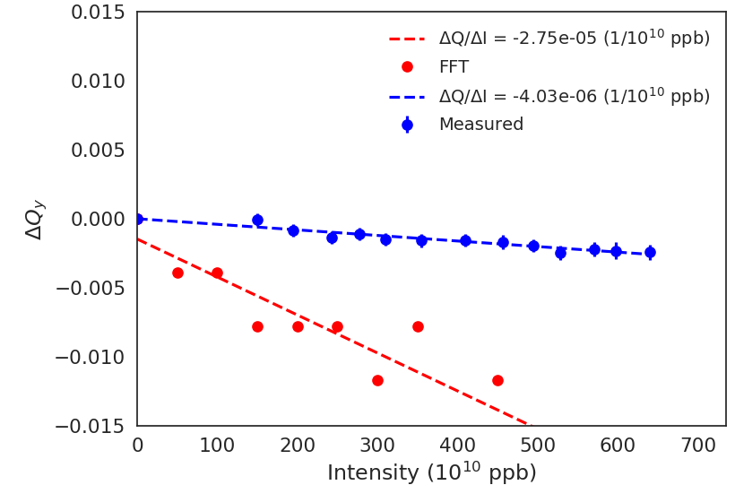
Vertical tune shift with kick (pre-LS2)
Initial kick, track for T = 256 turns
160 MeV
1.4 GeV
FFT analysis on the PyHEADTAIL data does not give the expected slope
Same issue at higher energy

Slide 10
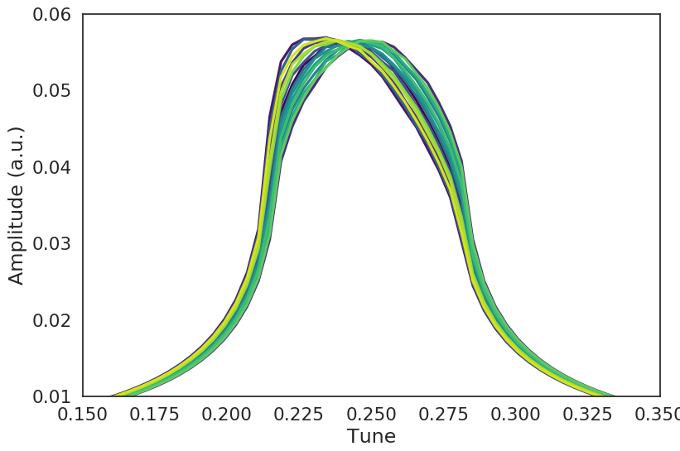
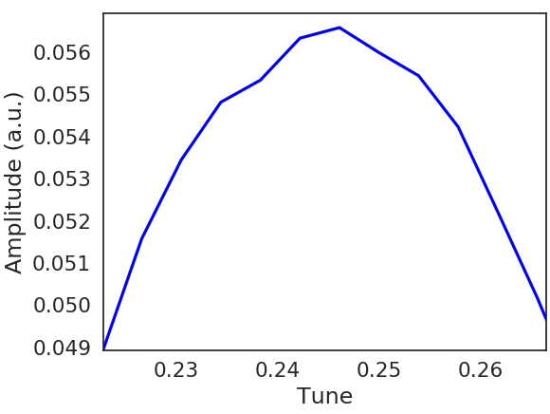
1.4 GeV: FFT spectra
Plot for all scanned intensities
Poor resolution, cannot
resolve better than 1/T ≈ 4 x 10⁻³
Bad resolution from T = 256 turns
→ Can we use more turns?
I = 50 x 10¹⁰ p →
expected tune shift x ~2 x 10⁻⁴

Slide 11
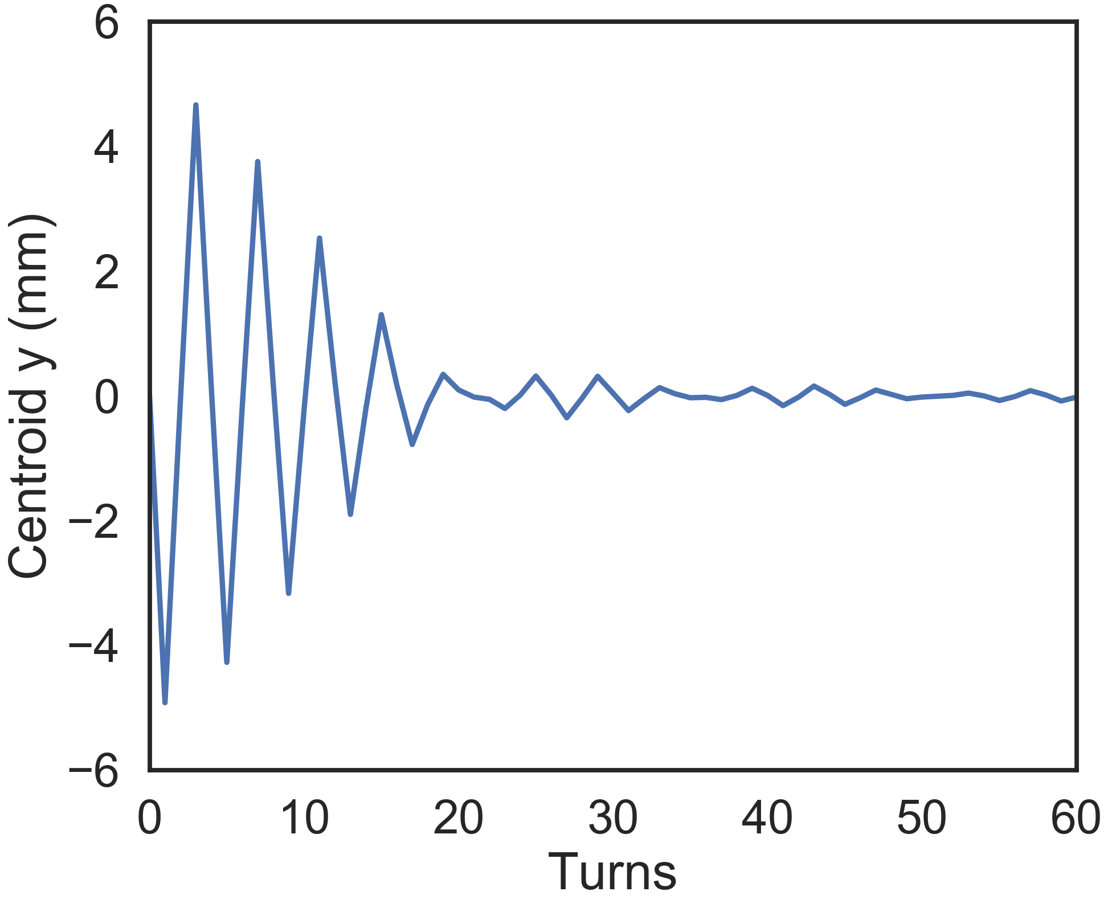
Centroid signal at 1.4 GeV
Fast decoherence due to high chromaticity (Q’_{y} = -1.6)
Can use at most T ≈ 30 turns to calculate the betatron tunes
Try Sussix

Slide 12
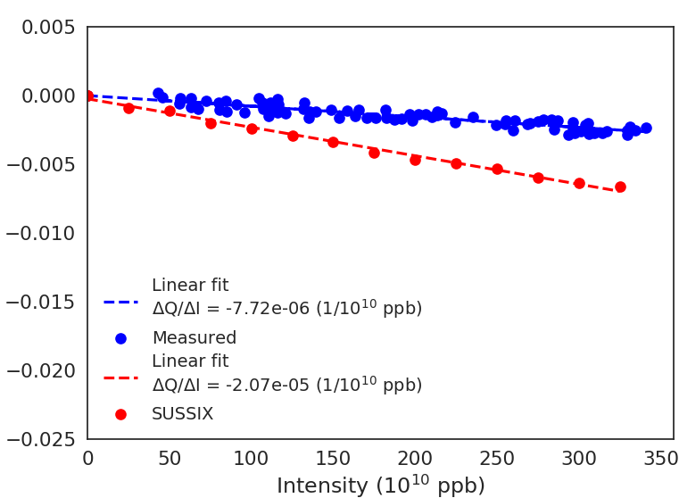
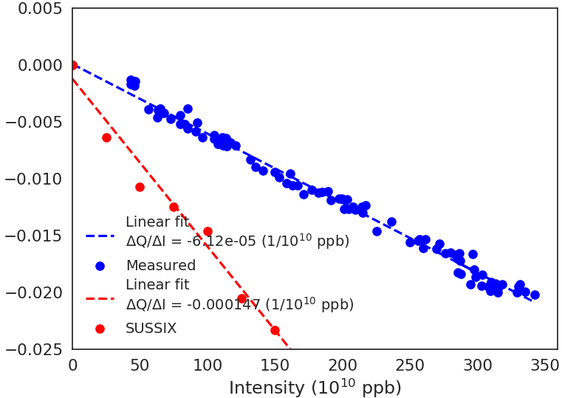
Sussix analysis
30 turns
30 turns
Sussix analysis on the PyHEADTAIL data does not give the expected slope
either

Slide 13
Outline
Introduction
Frequency analysis: Issues and solutions
  FFT and Sussix
  Multi-BPM
First comparisons between PyHEADTAIL, DELPHI, and theory
Wake sampling issue in PyHEADTAIL
Pre-LS2 results at 160 MeV and 1.4 GeV
Conclusions

Slide 14
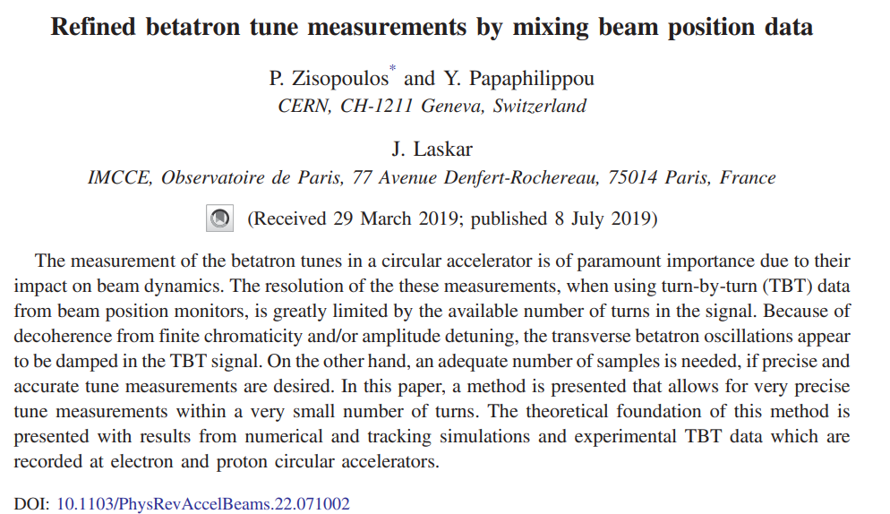
How to get adequate number of samples?
Idea to record the centroid in PyHEADTAIL at multiple segments/turn instead of once/turn
Divided the ring in 16 equidistant segments in PyHEADTAIL to simulate the 16 BPMs of the PSB
Need to scale down the wake and apply the kick after every segment
P. Zisopoulos had proposed the mixed BPM method

Slide 15
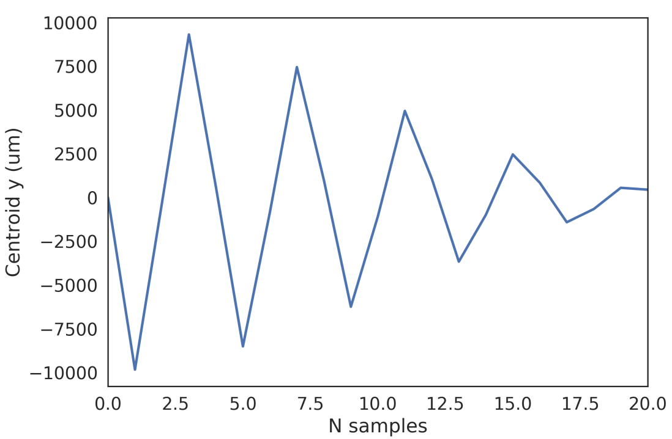
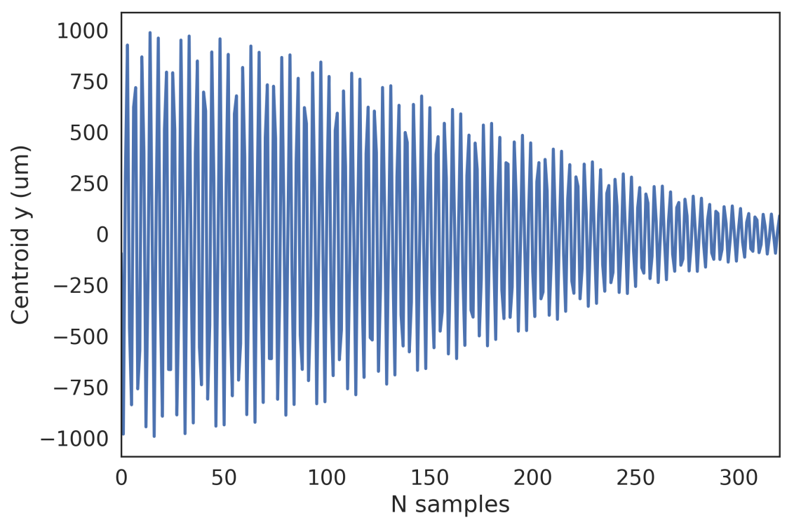
Centroid signal at 1.4 GeV with PyHEADTAIL
1 segment per turn
16 segments per turn
The number of samples has significantly increased
Originally, in 20 turns there were 20 samples
In 20 turns now, there are 320 samples

Slide 16
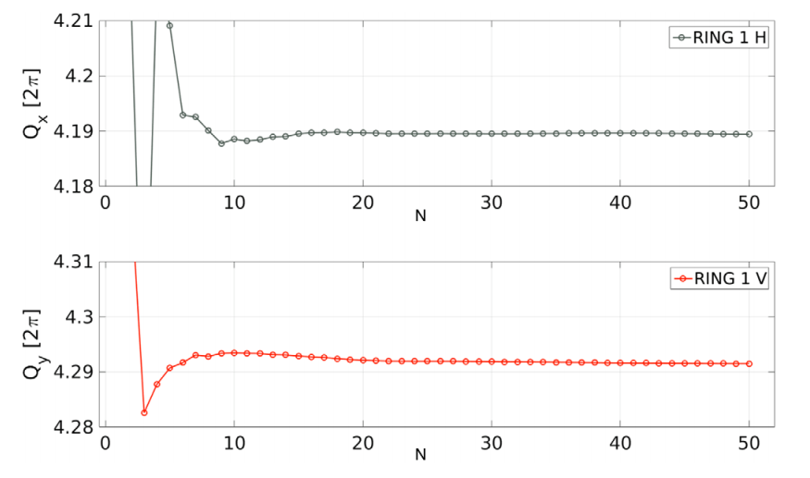
PSB measurements in P. Zisopoulos’ PRAB paper
Panos finds convergence of the betatron tune value after ~20 turns
(i.e. 320 samples)

Slide 17
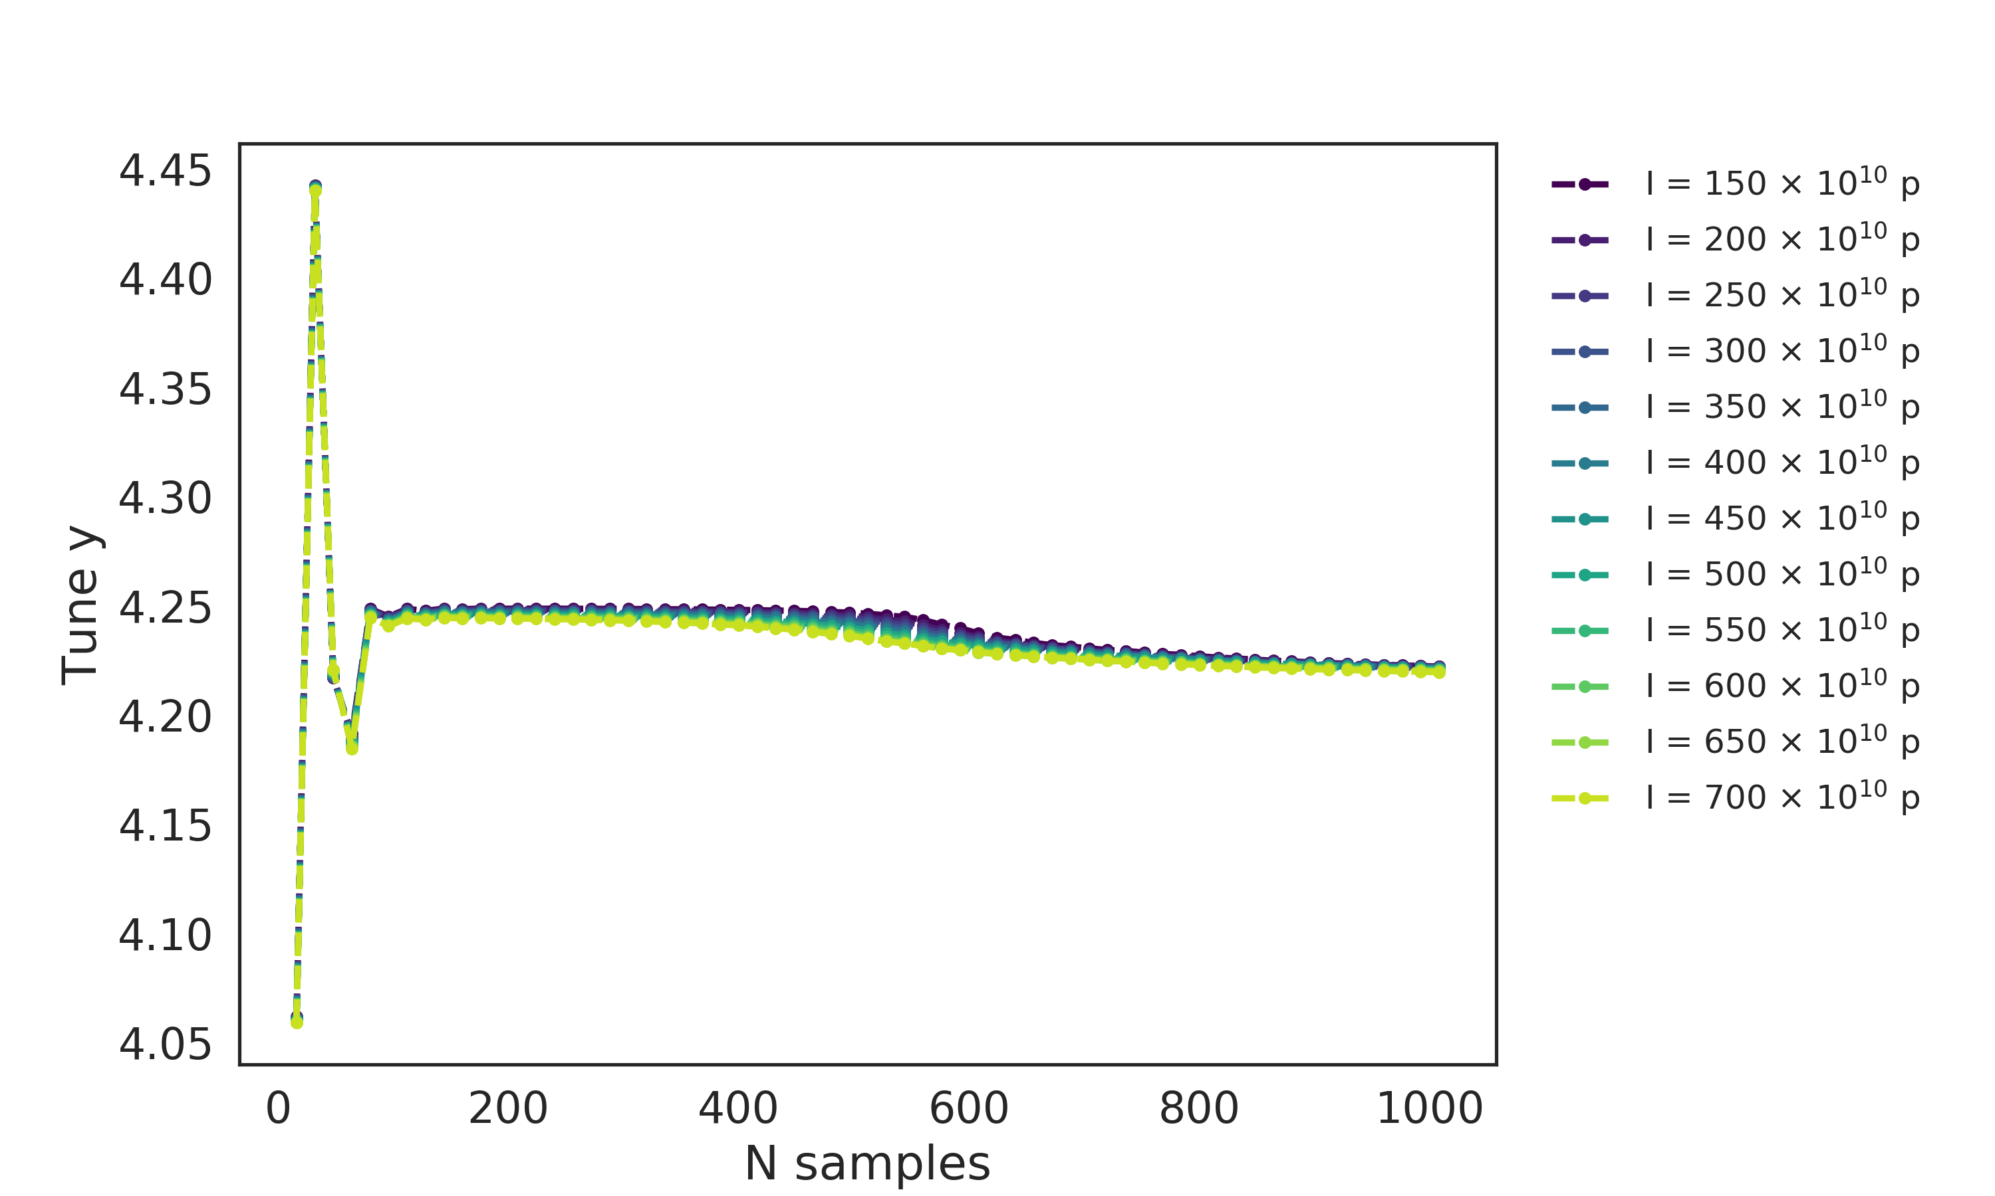
Tune variation with number of samples in PyHEADTAIL
Bare tune in y = 4.25

Slide 18
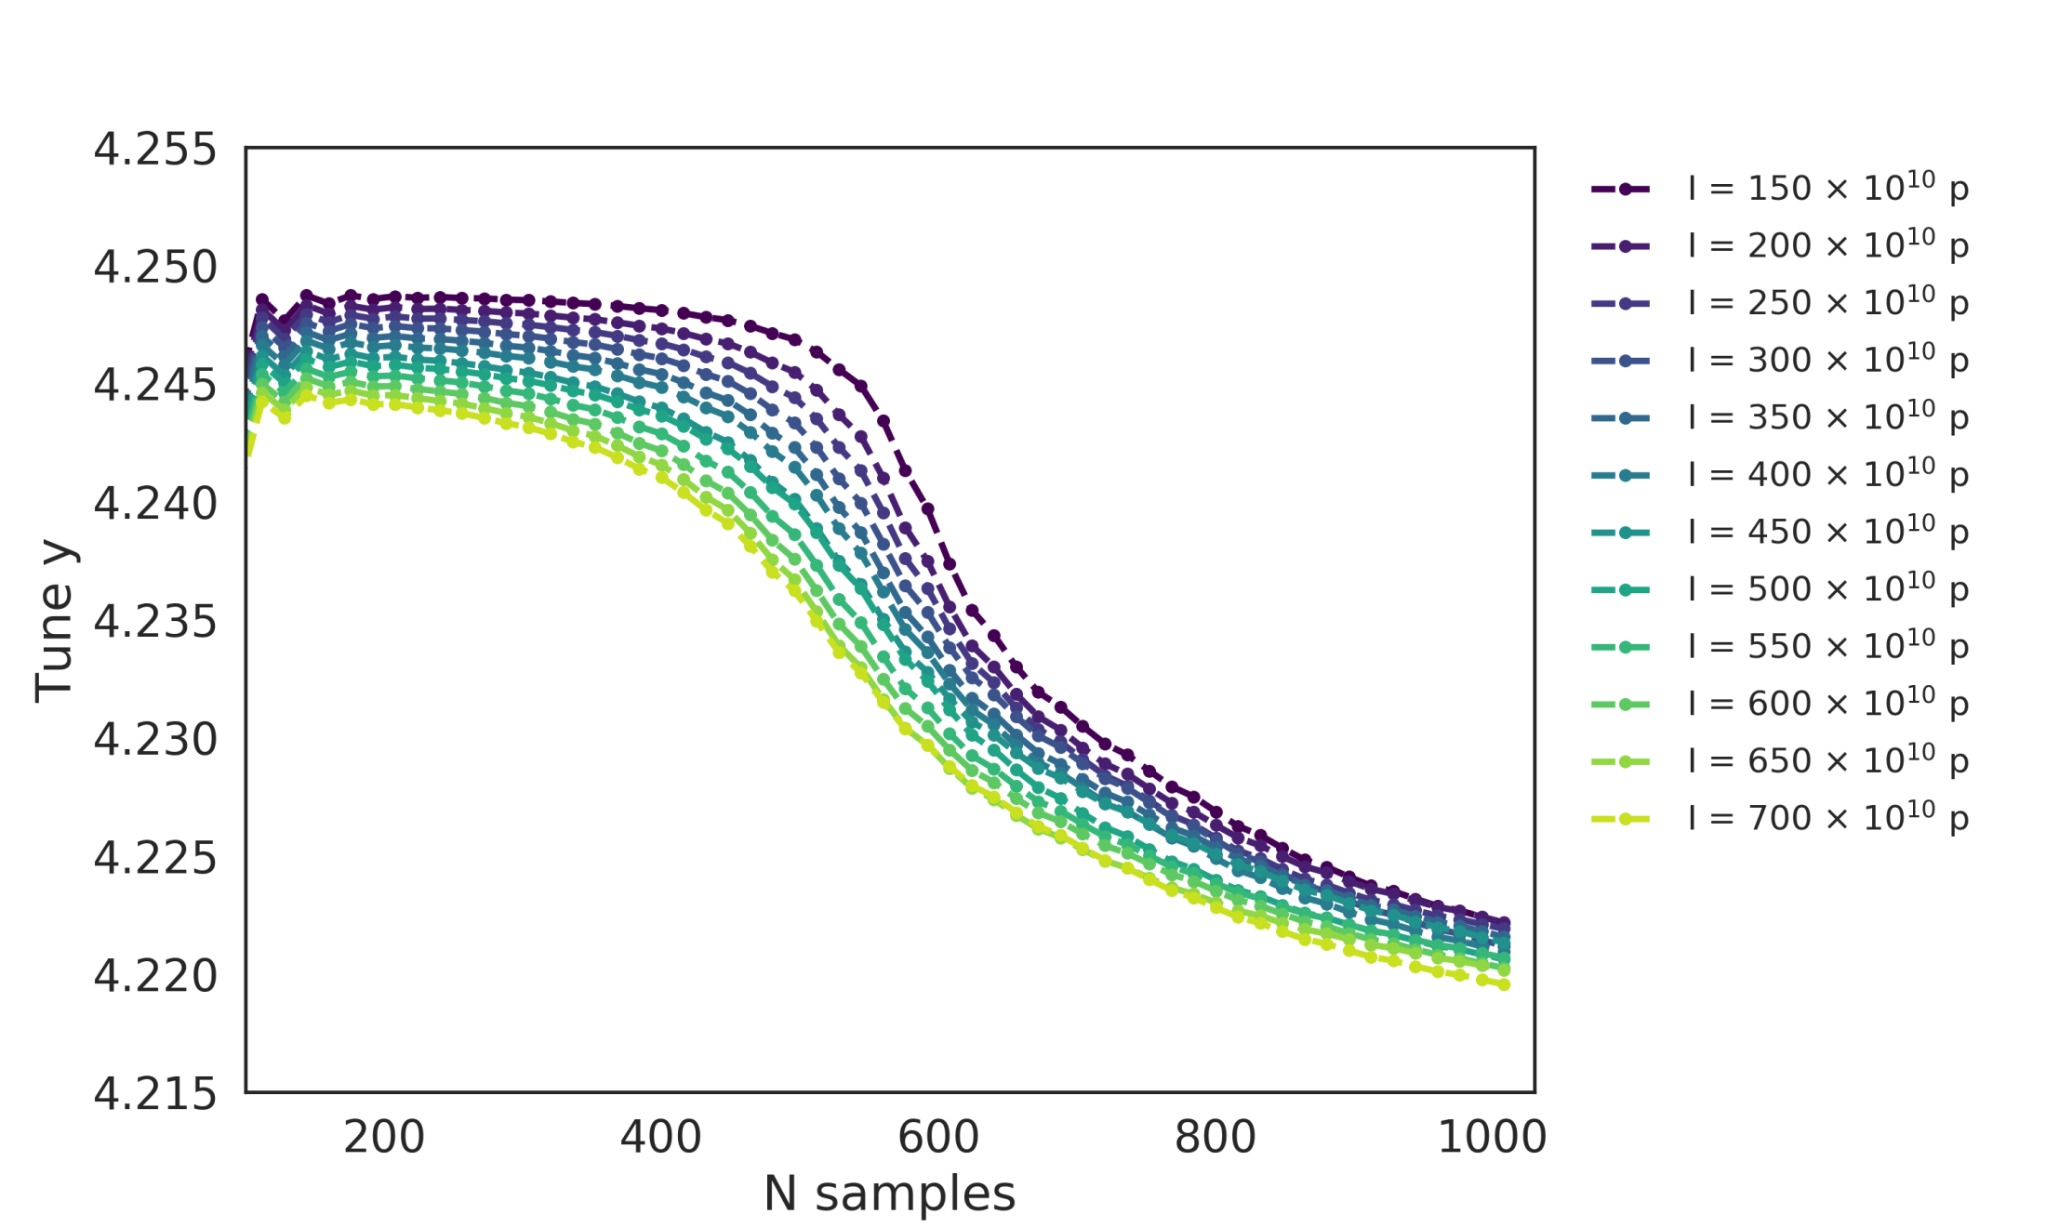
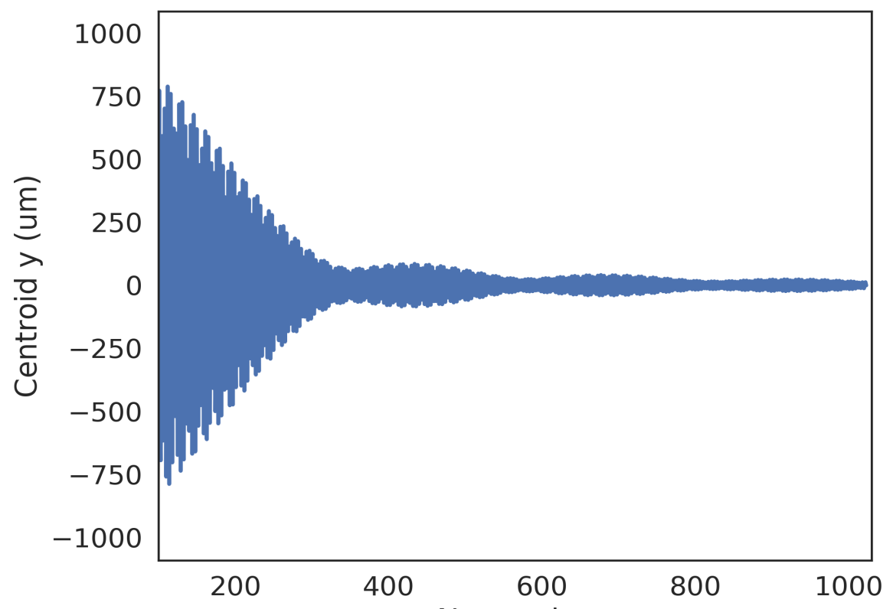
Tune variation with number of samples in PyHEADTAIL
Zoom in
Suspicion that chromaticity in combination with the PSB wake are responsible for this behavior (signal becomes smaller due to decoherence)

Slide 19
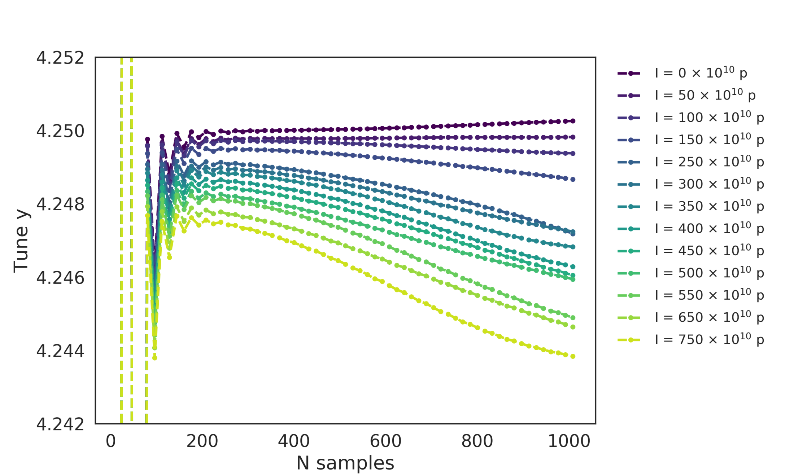
Simpler impedance model: Broadband Resonator
R_{s} = 4 MΩ/m, f_{r} = 1.72 MHz, Q = 1, nturns_wake = 1
The tune still changes with the number of samples also for simpler impedance models (no effect of multiturn wake)

Slide 20
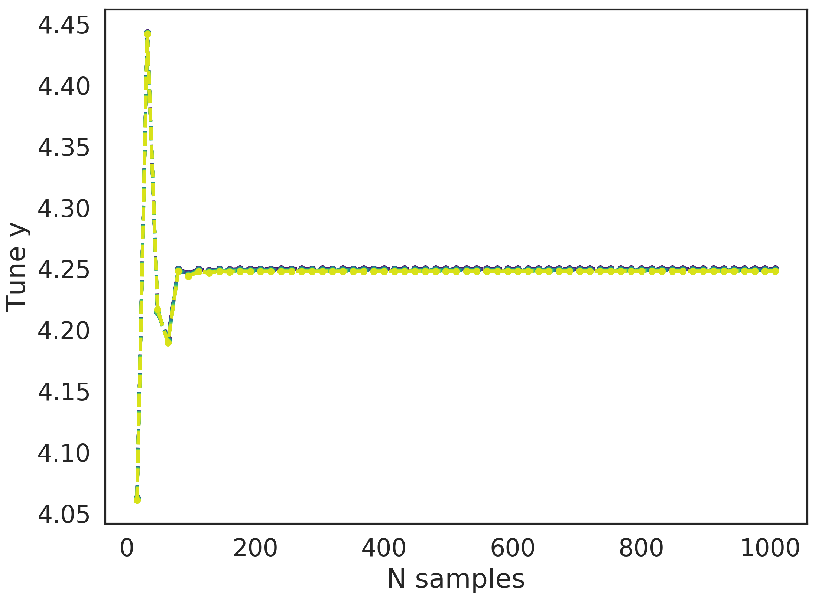
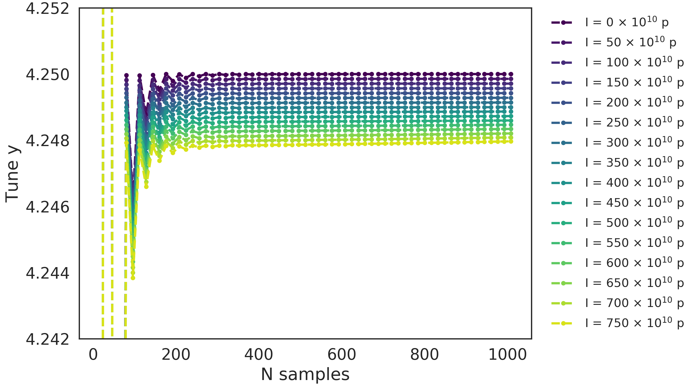
Simpler impedance model: Broadband Resonator
R_{s} = 4 MΩ/m, f_{r} = 1.72 MHz, Q = 1, nturns_wake = 1
Zero chromaticity
Zoomed in
With 0 chromaticity, the tune reaches convergence with the number of samples
Did some first comparisons with 0 chromaticity and the full PSB model

Slide 21
Outline
Introduction
Frequency analysis: Issues and solutions
  FFT and Sussix
  Multi-BPM
First comparisons between PyHEADTAIL, DELPHI, and theory with 0 chromaticity
Wake sampling issue in PyHEADTAIL
Pre-LS2 results at 160 MeV and 1.4 GeV
Conclusions

Slide 22
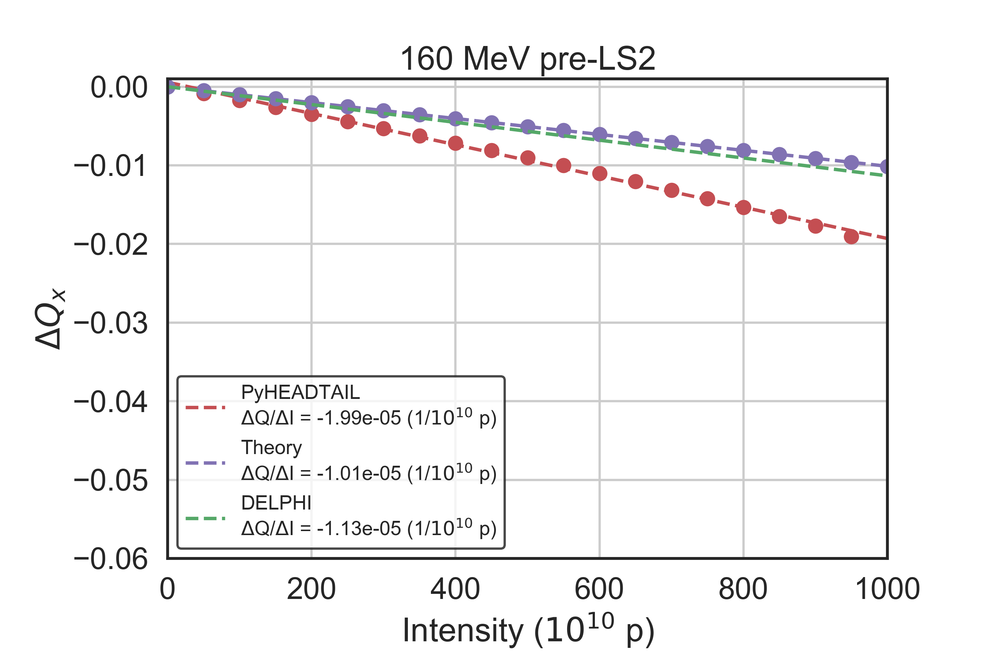
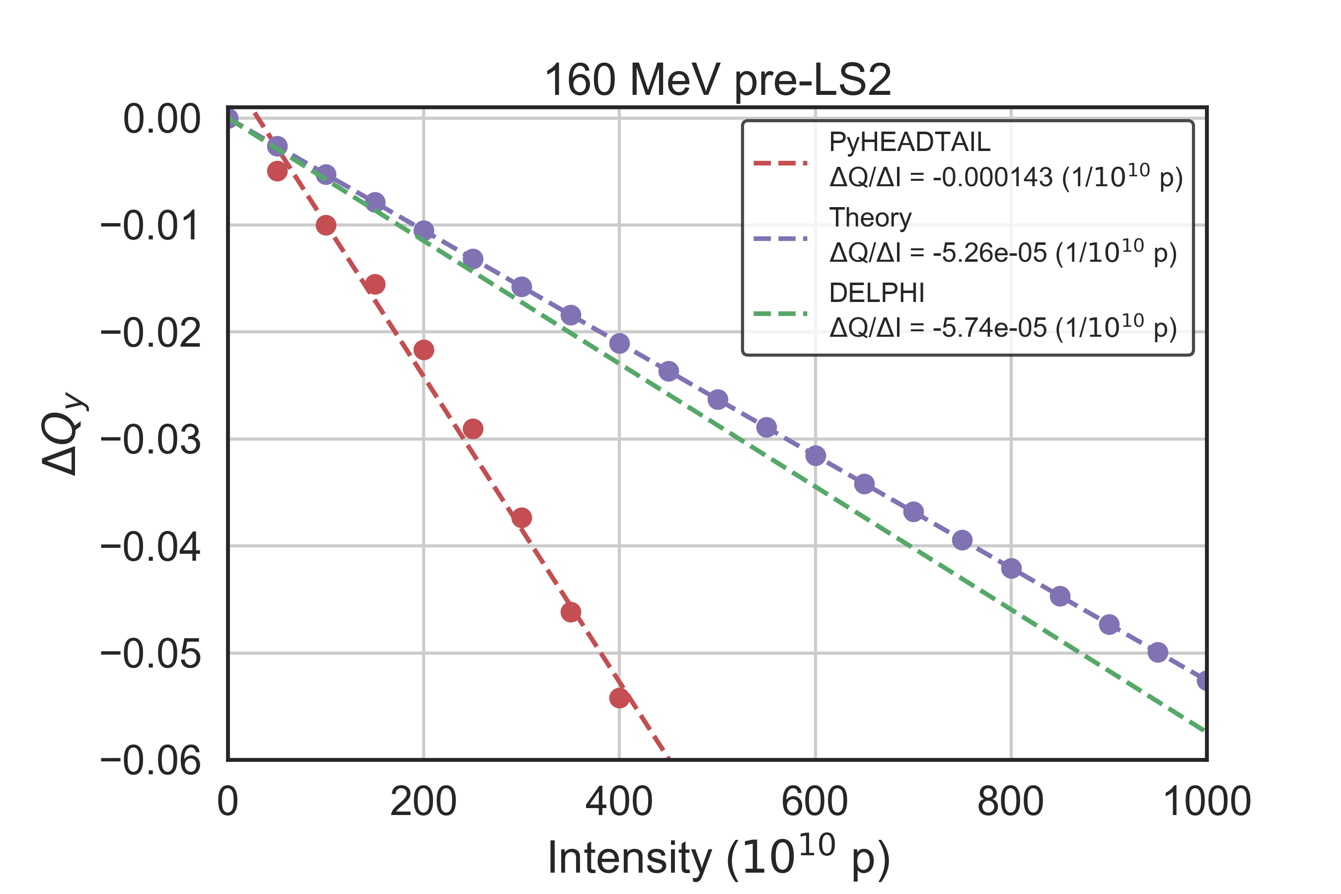
Tune shift at 160 MeV pre-LS2
Full wake model, 0 chromaticity, 3000 slices for the wake, Gaussian profile, 4𝝈_{t} = 600 ns
Good agreement between theory and DELPHI (within 10%)
Results are more robust thanks to the increased segments/turns and thus the adequate samples for the analysis
But PyHEADTAIL overestimates the slope significantly
Notes:
Bare tunes 4.16/4.25

Slide 23
Outline
Introduction
Frequency analysis: Issues and solutions
  FFT and Sussix
  Multi-BPM
First comparisons between PyHEADTAIL, DELPHI, and theory with 0 chromaticity
Wake sampling issue in PyHEADTAIL
Pre-LS2 results at 160 MeV and 1.4 GeV
Conclusions

Slide 24
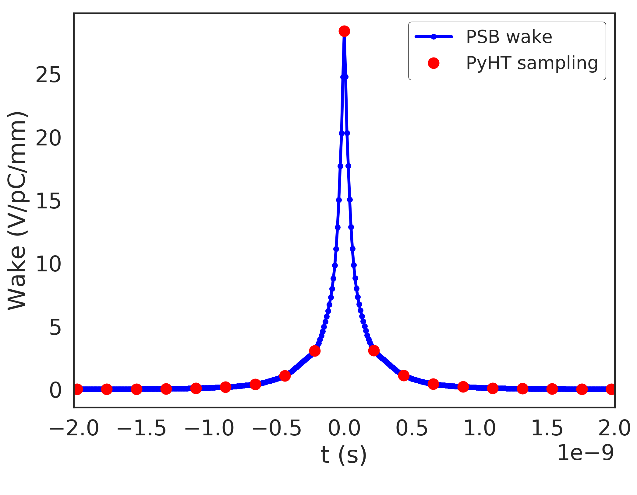
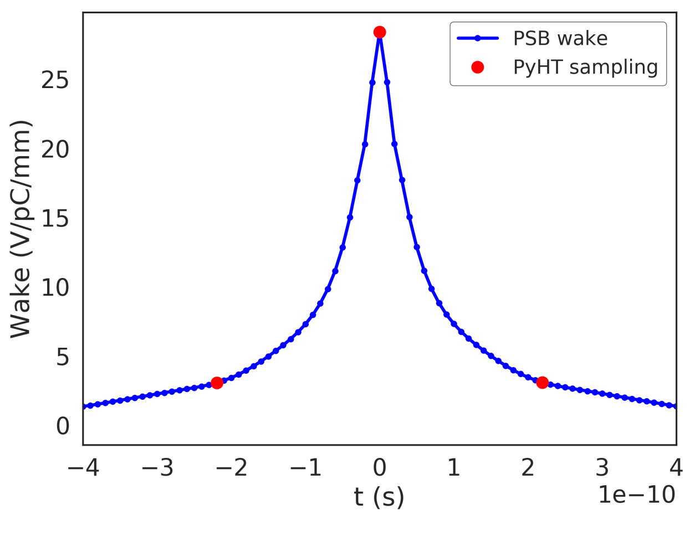
Wake (dipolar x) at 160 MeV pre-LS2
* The red dots represent the distances between source and target slices (3000 slices, ± 3σ, 4 x 10⁶ N_{mp}, 1333 mp/slice)
t
t < 0
t > 0
t = 0
Zoomed in
Around t=0, all particles in the slice are being kicked equally with the full peak → overestimating the effect of the wake

Slide 25
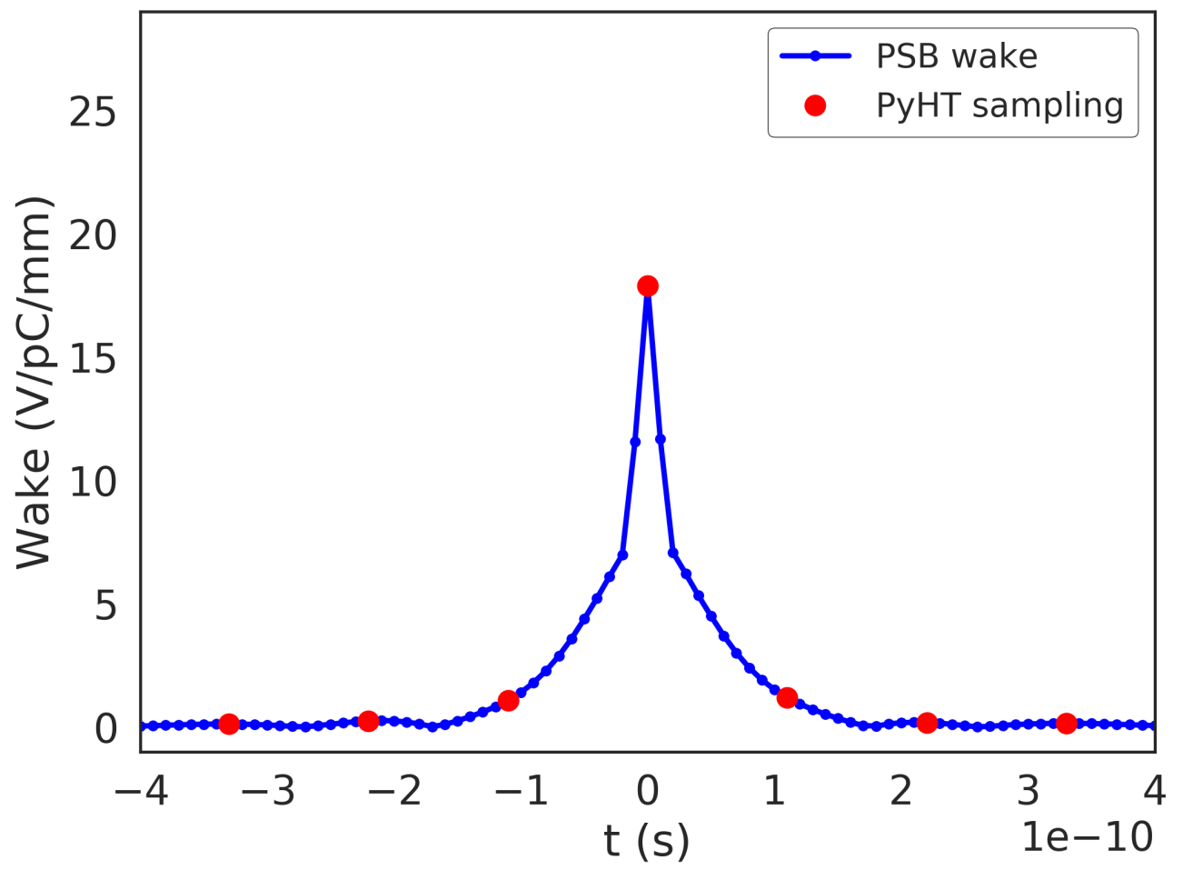
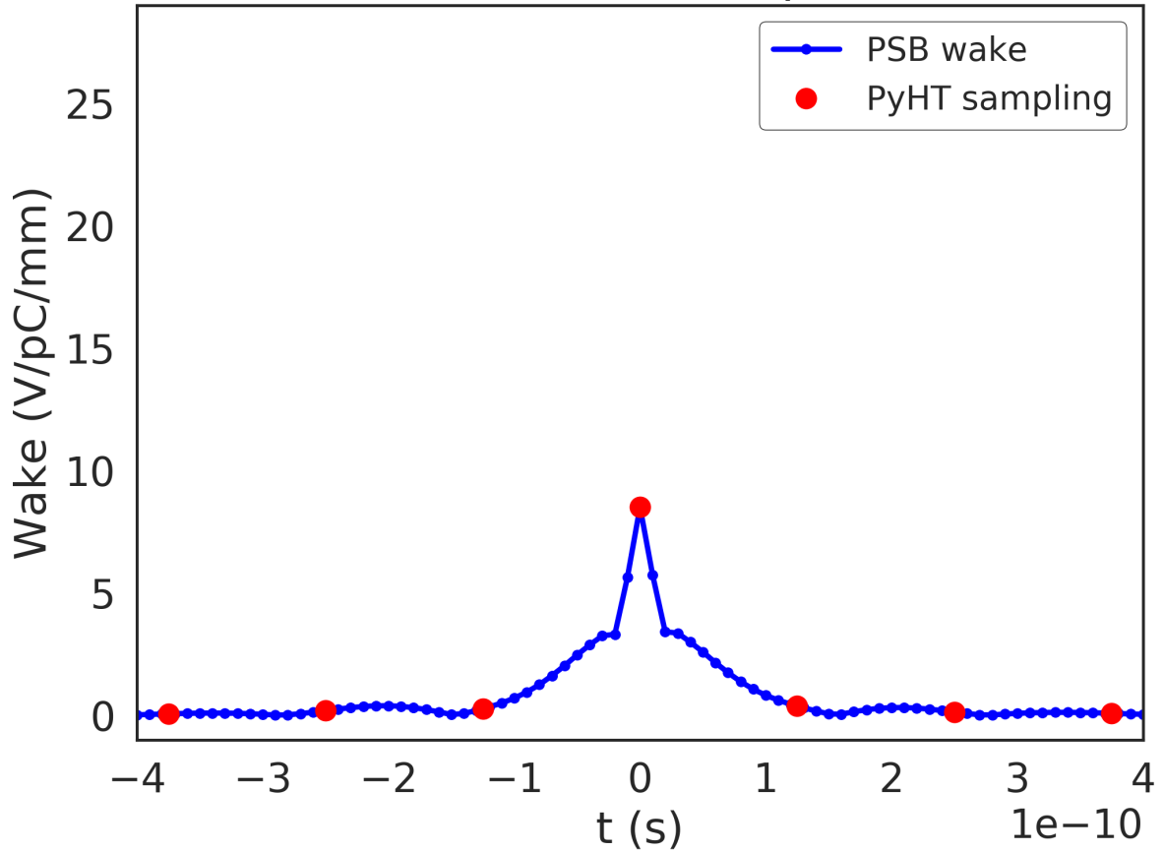
Wake (dipolar x) at 1.4 GeV pre-LS2
Same issue at higher energies
Is it a problem of the indirect space (ISC) charge alone?
Without ISC
Still overestimating the effect of the wake
Notes:
Step transitions

Slide 26
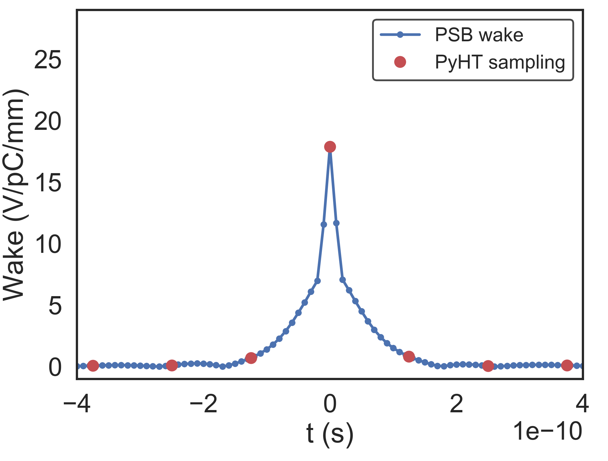
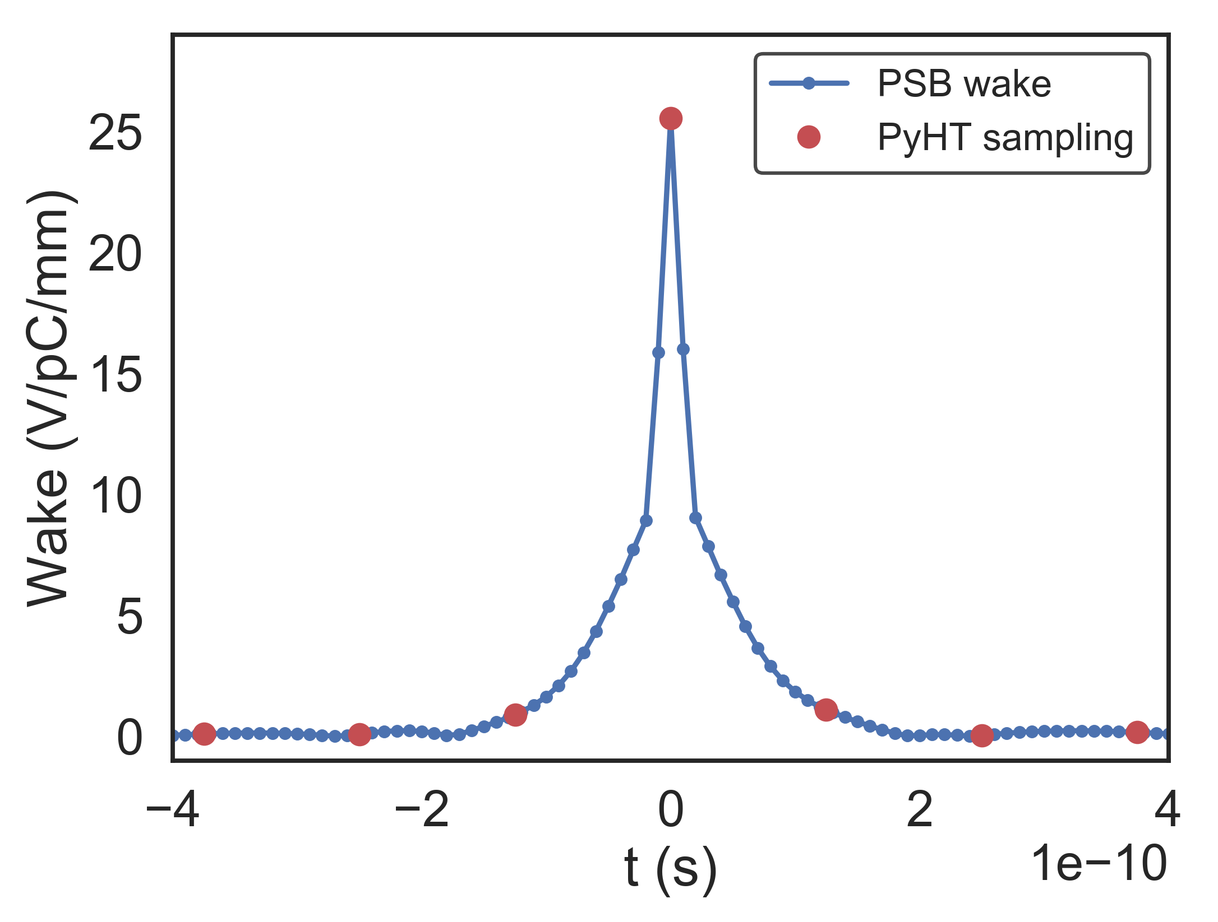
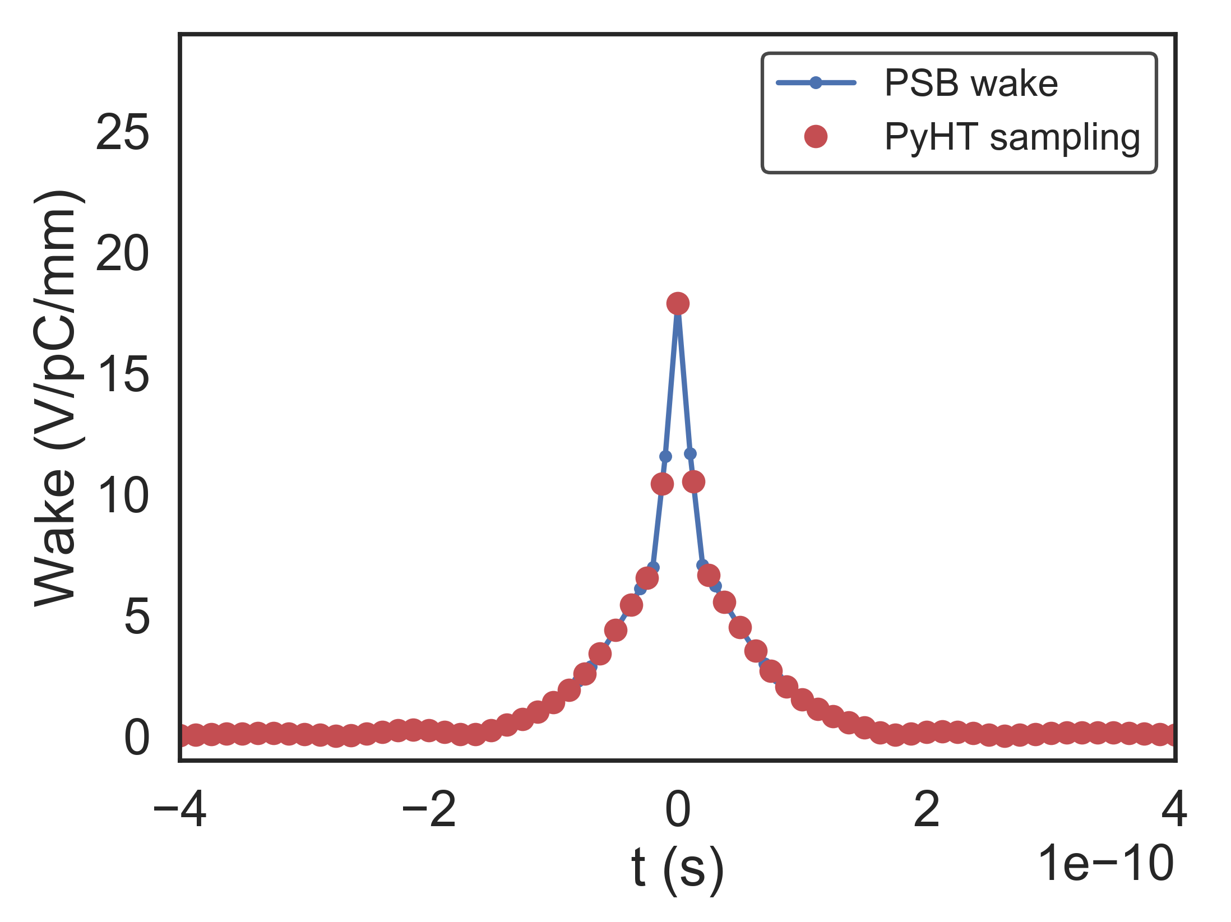
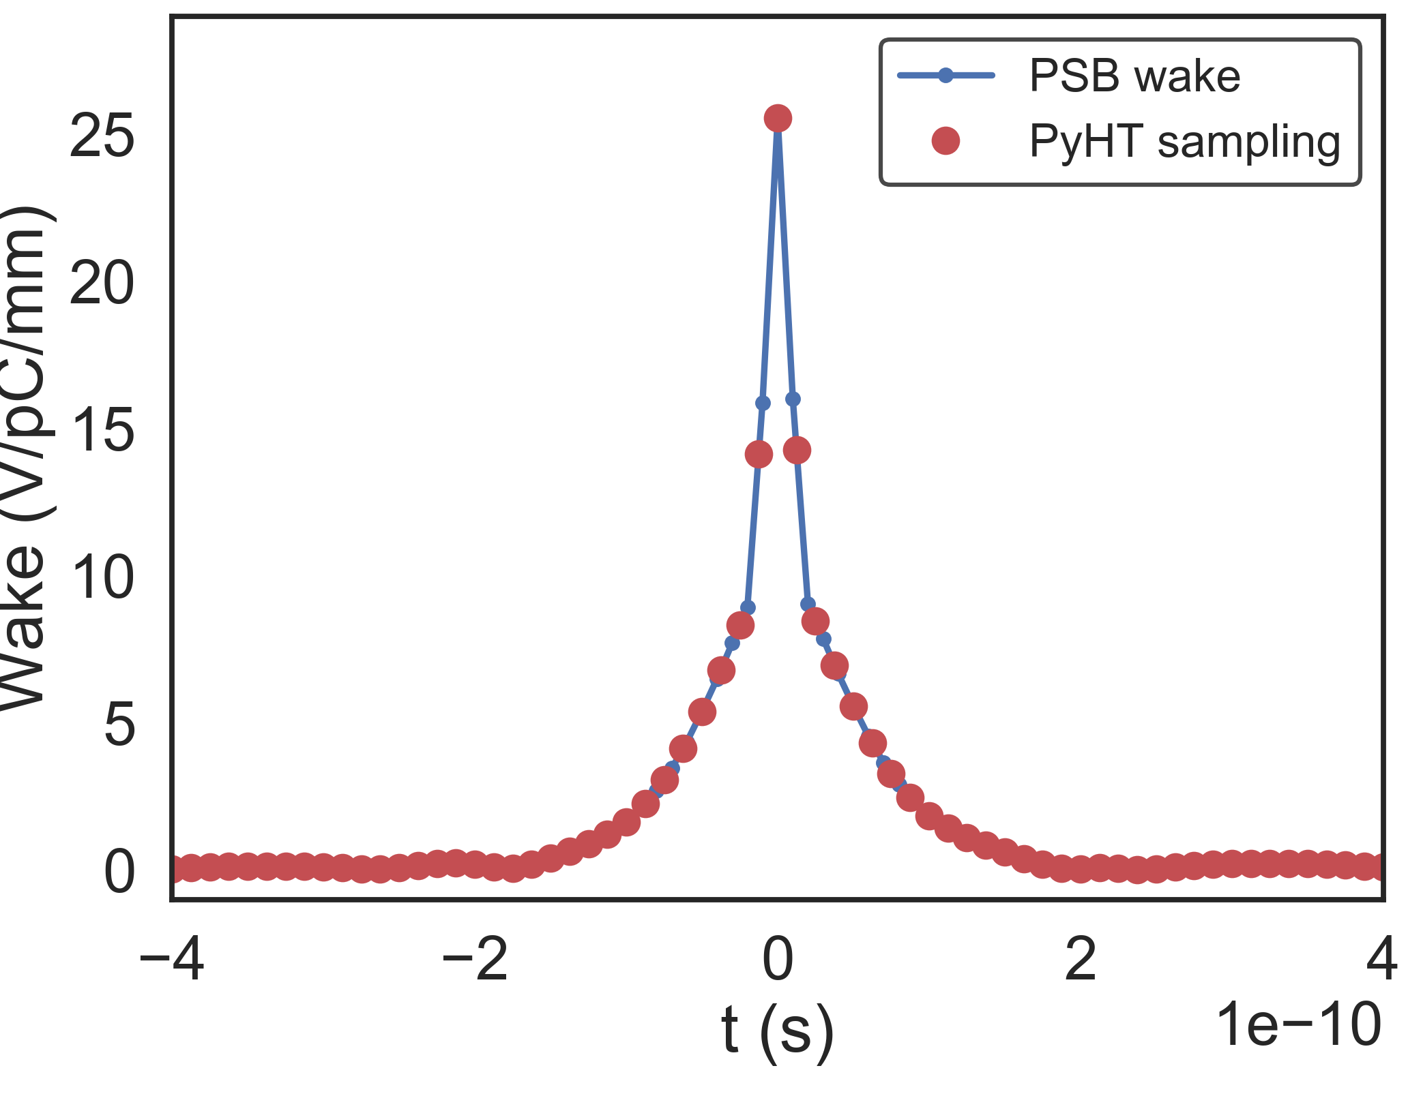
Wake (dipolar x) at 1.4 GeV
Horizontal
Vertical
3000 slices, ±3σ
20000 slices, ±2σ

Slide 27
Outline
Introduction
Frequency analysis: Issues and solutions
  FFT and Sussix
  Multi-BPM
First comparisons between PyHEADTAIL, DELPHI, and theory with 0 chromaticity
Wake sampling issue in PyHEADTAIL
Pre-LS2 results at 160 MeV and 1.4 GeV
Conclusions

Slide 28
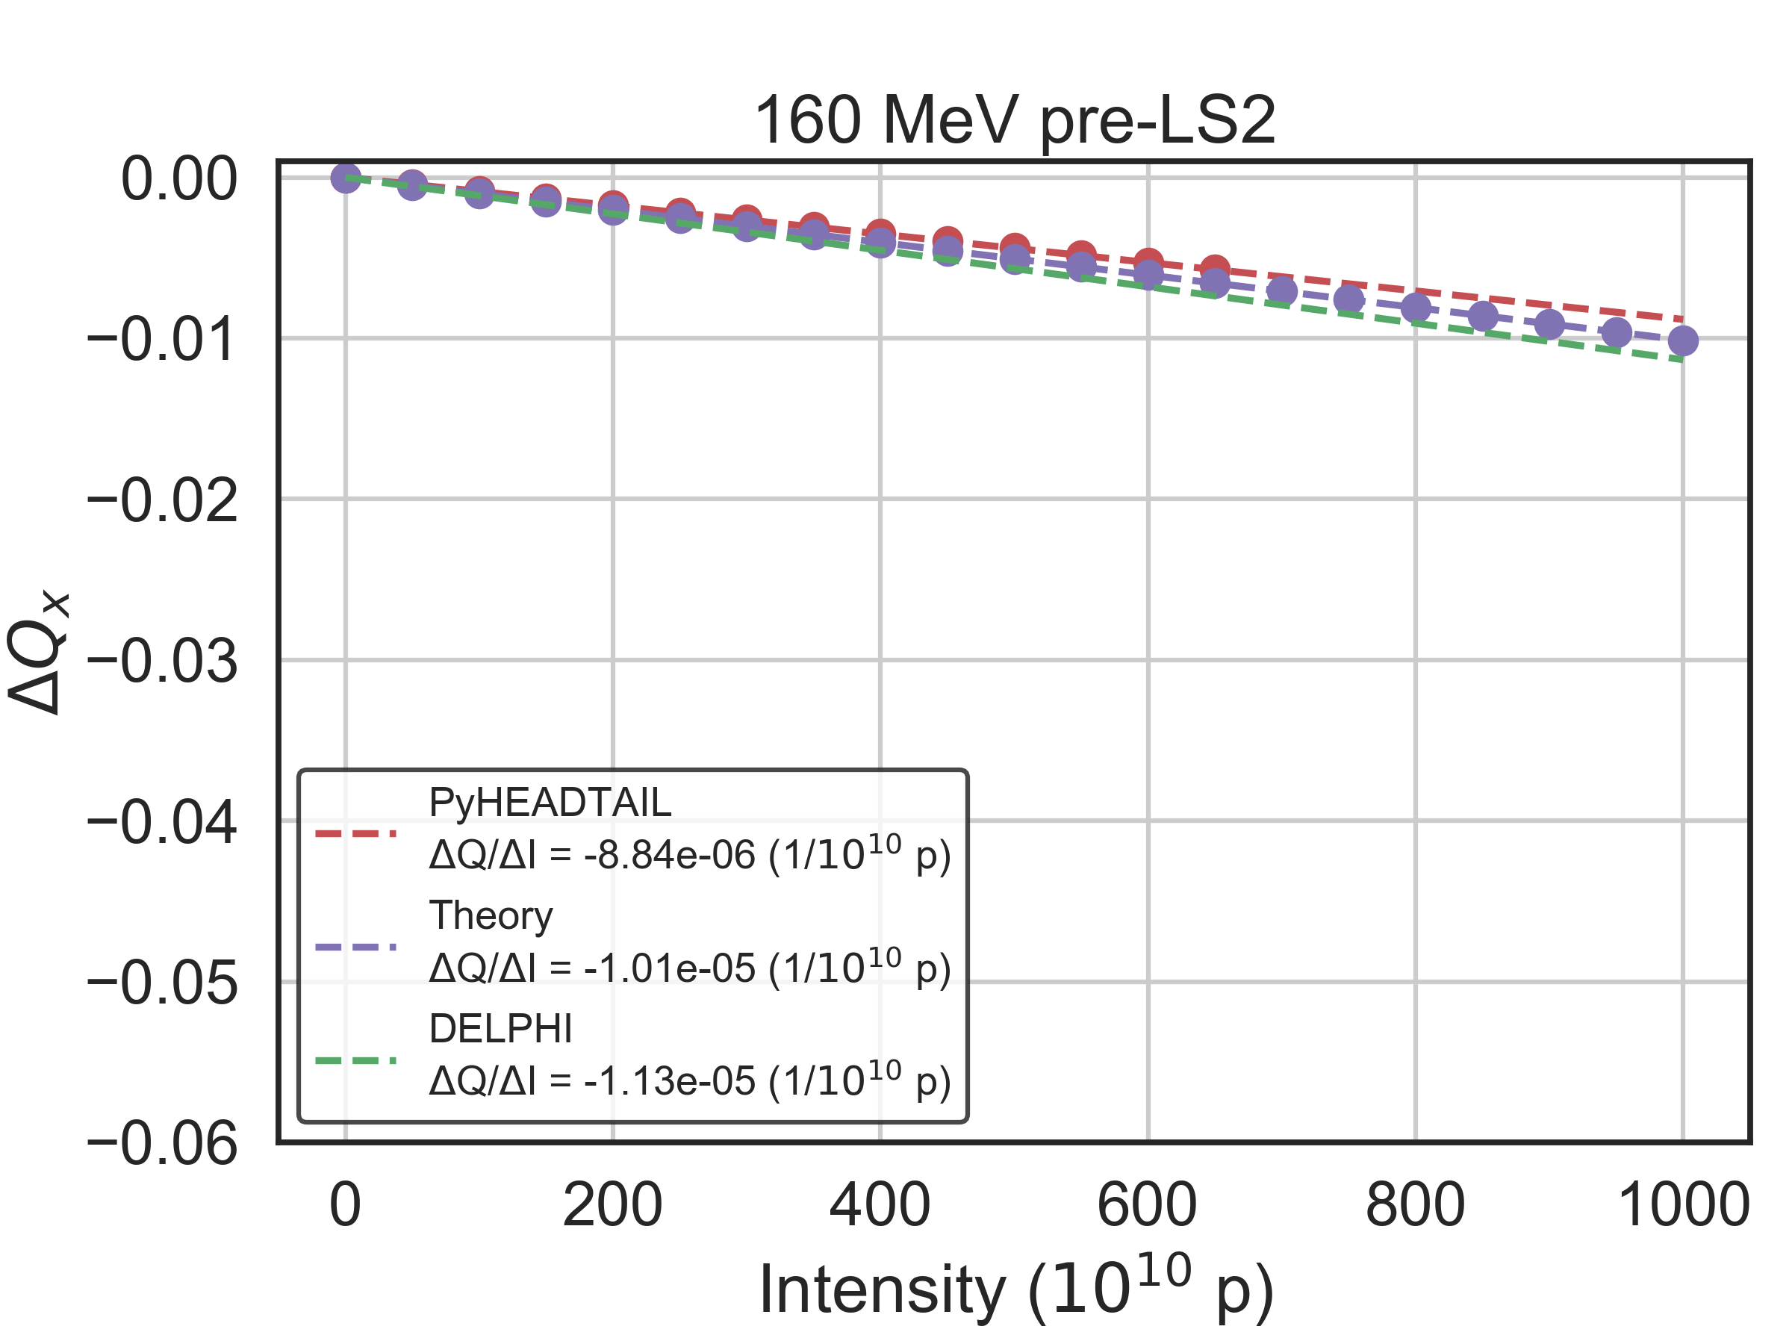
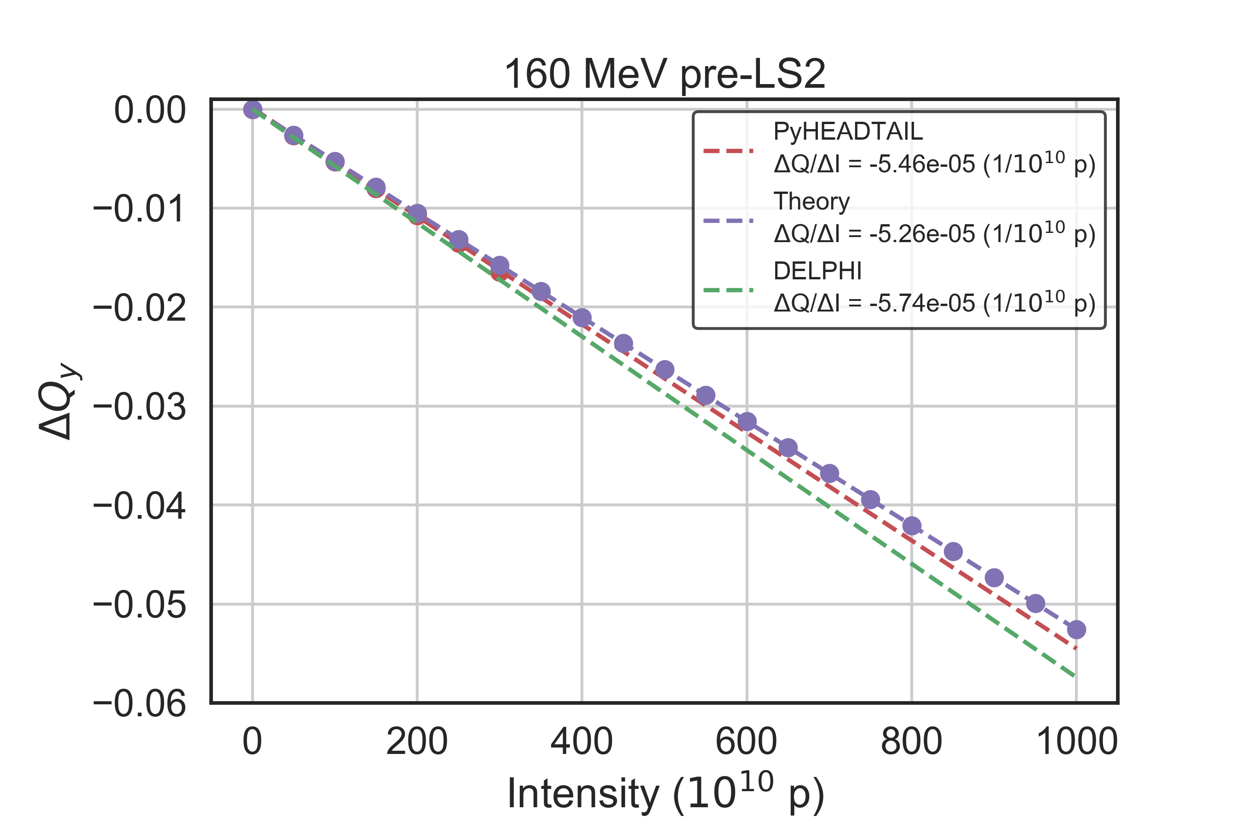
Tune shift at 160 MeV pre-LS2
Full model, 0 chromaticity, 20000 slices for the wake (200 mp/slice), Gaussian profile, 4𝝈_{t} = 600 ns
Agreement of PyHEADTAIL, DELPHI and theory within 13%

Slide 29
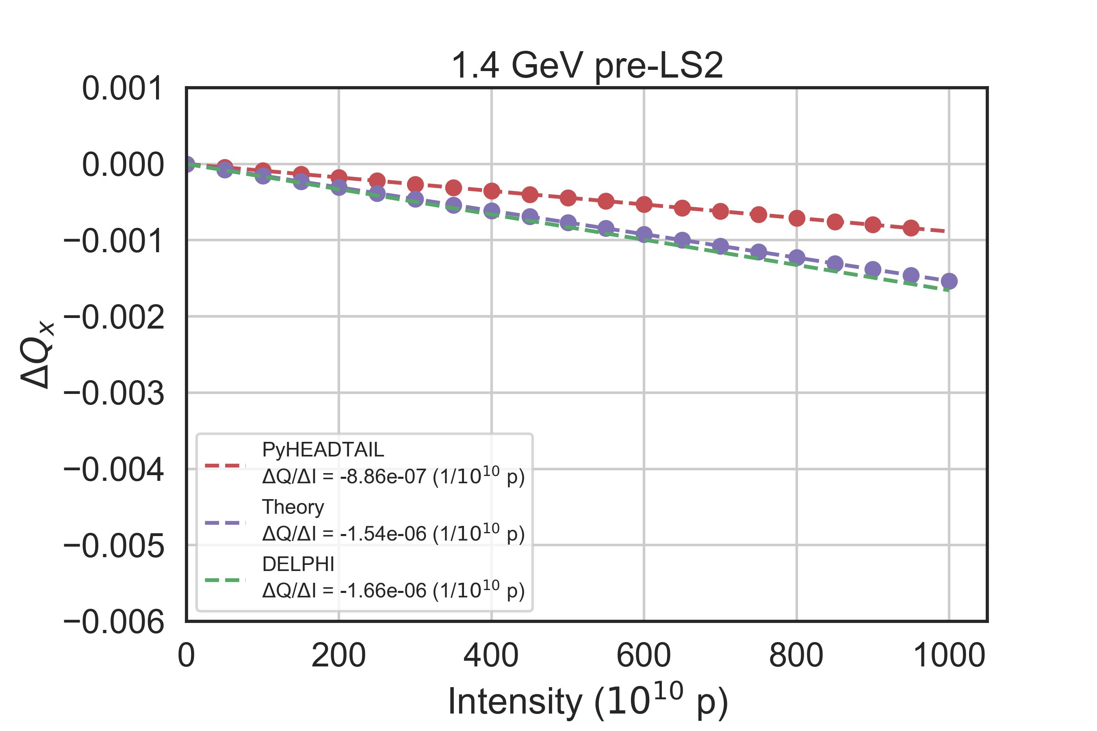
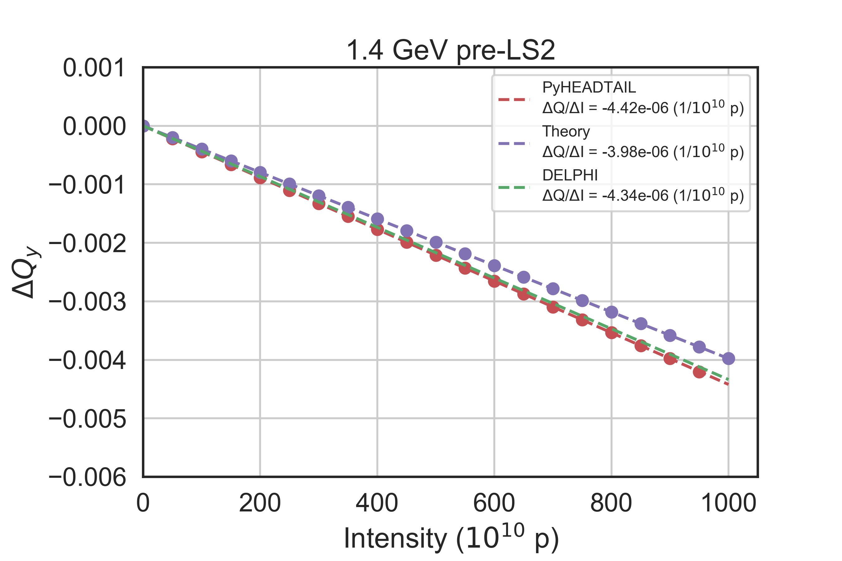
Tune shift at 1.4 GeV pre-LS2
0 chromaticity, 20000 slices for the wake, Gaussian profile, 4𝝈_{t} = 250 ns
Agreement of PyHEADTAIL, DELPHI and theory within 10% in y but
50% in x
Possibility of numerical issues due to the low number of macroparticles per slice (200 mp)

Slide 30
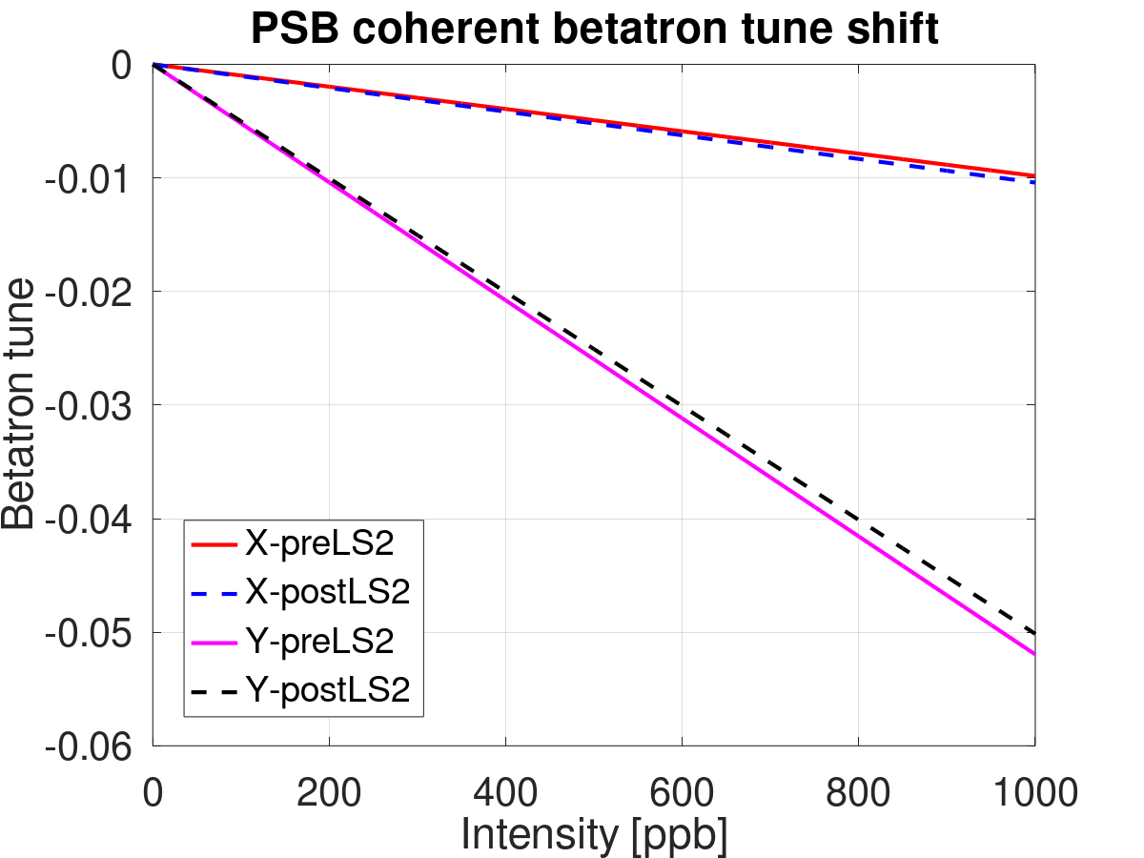
Prediction with theory at 160 MeV with natural chromaticity
Courtesy C. Zannini
6% larger tune shift in x post-LS2
4% smaller tune shift in y post-LS2
The predicted change by theory is smaller than the best agreement between PyHEADTAIL, DELPHI, and theory

Slide 31
Outline
Introduction
Frequency analysis: Issues and solutions
  FFT and Sussix
  Multi-BPM
First comparisons between PyHEADTAIL, DELPHI, and theory with 0 chromaticity
Wake sampling issue in PyHEADTAIL
Pre-LS2 results at 160 MeV and 1.4 GeV
Conclusions

Slide 32
Conclusions
Resolution of FFT is not good enough for the PSB due to fast decoherence (combination of wake and high natural chromaticity)
Sussix/NAFF can get good enough resolution by using the multi-BPM method
PyHEADTAIL was overestimating the tune shift slopes due to insufficient wake resolution around t = 0s
  Significant improvement by increasing the slice number to 20000
  However, the number of macroparticles/slice is very low
  This might lead to numerical issues in some cases
First comparisons between PyHEADTAIL, DELPHI, and theory for 0 chromaticity. DELPHI and theory agree within 10%
PyHEADTAIL agrees within 13% at 160 MeV and 50% at 1.4 GeV (pre-LS2)
The predicted theoretical slopes post-LS2 vary only by ~4 - 6%

