Slide 1
A short introduction to the
2010
Summer
Student
Hardware
Labs
Niko Neufeld & Carmelo d’Ambrosio, CERN-PH / 7 July 2010
special thanks to Olav Ullaland

Slide 2



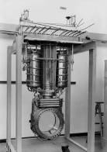
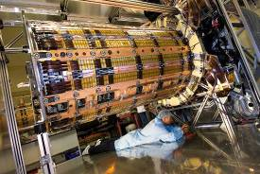
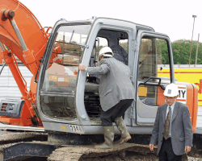
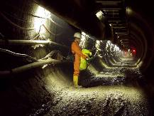
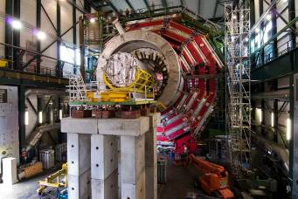
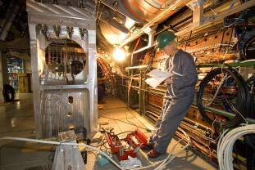
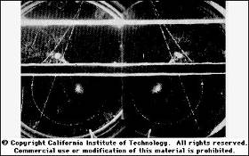
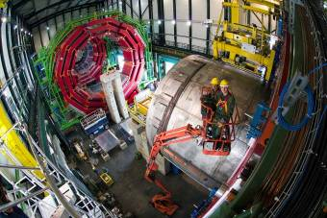
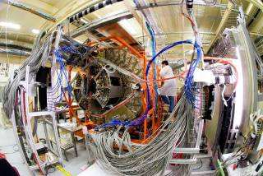
The Summer Student Hardware Labs
(even in software and physics!)
With the size of the experimental tools in high energy physics getting larger and more complicated, it is very hard in some short summer months to get a feeling of the different aspects of an experiment.

Slide 3
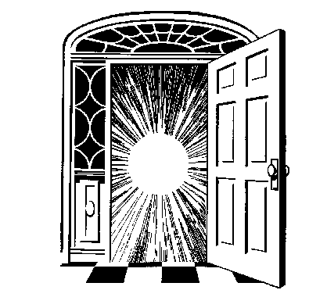











We would therefore like to invite you into some of our labs and try to show you in a few hours what we are doing there and why we are doing it.
Who are "we" :
Johan
Andre
Carmelo
Irena
Ilias
Lau
Edda
Sune
Christian
Beat
Alwall
Braem
D’Ambrosio
Dolenc
Efthimiopoulos
Gatignon
Gschwendtner
Jakobsen
Joram
Jost
Simon
Michael
Niko
Nicola
Thomas
Tim
Mataguez
Moll
Neufeld
Pacifico
Schneider
Stelzer
Welcome!

Slide 4
As a Menu*, we can offer:
Accelerator Technology
Inorganic Scintillator Detectors
Organic Scintillator Detectors
Silicon Detectors
Data Acquisition
High Energy Physics Monte-Carlo Techniques
* Coffee is included!

Slide 5
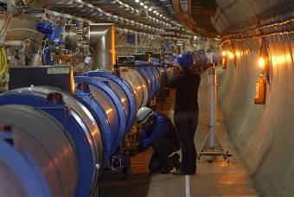
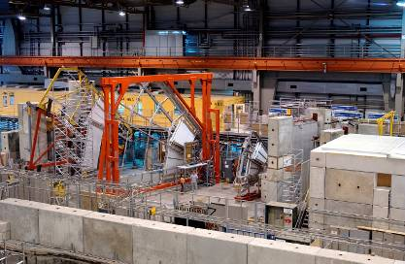
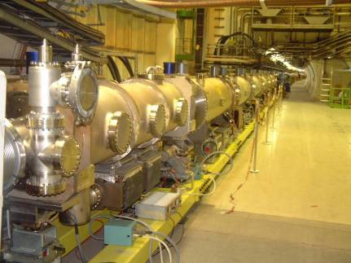
Beam Lines
4 afternoons with optimisation of a beam line by using collimators, bending magnets and targets. Particle identification with Cherenkov counters and absorbers.
Contact persons : Simon Mataguez,
Ilias Efthymiopoulos, Lau Gatignon and
Edda Gschwendtner
4 groups of 5 students
When: 17, 18, 19, 20 Aug
Where: H6
+ Introduction to beam lines: 16 August

Slide 6
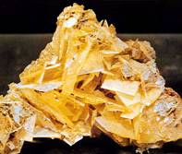
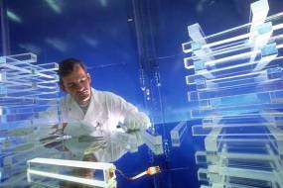
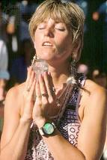
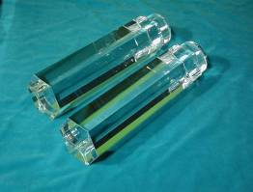
X- and Gamma- rays detection with a Hybrid Photon Detector
Contact person: Carmelo D’Ambrosio
Requirements: a film badge
Time : one afternoon, 14:00 – 17:30
3 groups of 3 students
Dates : 4, 6 and 9 August
Place : 29-1-021
Please note that gamma sources and
high voltages are present on the set-up.
New Scintillating Crystals are being developed for bio-medical applications, which were first developed for high energy physics or material science. With a new generation of photodetectors being made available for the same applications (HPDs, APDs, SDCs, etc.), these gamma detectors (crystal + photodetector) represent an important contribution in the evolution of instrumentation for physics and non-physics applications.
BaF₂

Slide 7
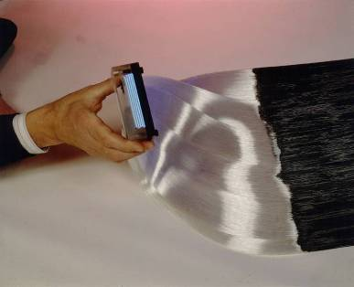
Measurements with scintillating fibres.
Contact Persons :
Andre Braem, Sune Jakobsen, Christian Joram and Thomas Schneider
3 afternoons with 3 students.
When: 2, 4, 6 August 14:00 to 18:00
Where: Meeting room: 3-R-020.
What: Scintillation emission spectrum, light absorption
length, reflective coating, photodetectors.
CERN photo CERN-EX-9201043
End part of the scintillating fibre detector of the CHORUS experiment. There are 1 million fibres and each fibre has a diameter of 500 .micron.m.

Slide 8
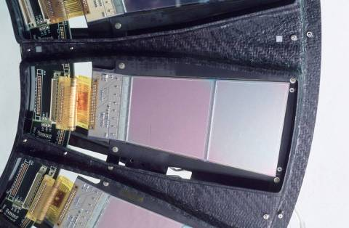
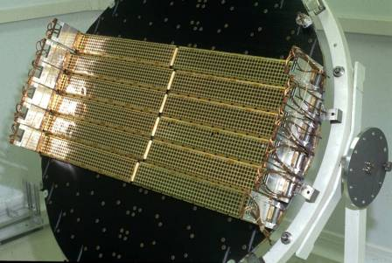
Characterization of irradiated silicon sensors.
Contacts: Irena Dolenc, Michael Moll and Nicola Pacifico
3 afternoons with 3 students.
When: 15, 19 and 26 July at 14:00
+ common visit to the Si facility, after the 3 workshops
Where: Meeting room: 28-2-015
What: We will investigate how radiation damage is influencing the silicon tracking detectors in the LHC experiments. The following properties of irradiated and non-irradiated silicon detectors will be measured: Reverse current, detector capacitance, depletion voltage and charge collection efficiency. This will give you an impression on how much detectors in the LHC will suffer from radiation damage. In a concluding discussion we will look at some possibilities on how to make detectors radiation harder.

Slide 9
Data Acquisition (and fun with bits lost and found).
Contact persons:
Niko Neufeld and Guoming Liu
Requirements: Some basic programming experiences
would be good - but that should not deter anyone.
4 sessions with 4 students
Time : one afternoon, 14:00 – 17:00
Dates : 12, 13, 14 and 16 July
Place : Point 8
(transport arranged via email)
Real data acquisition at 1 MHz.
Follow the data through LHCb and try not to lose a single bit!
From the front-end electronics, through the readout boards, the network, the farm to tape - and not back.

Slide 10

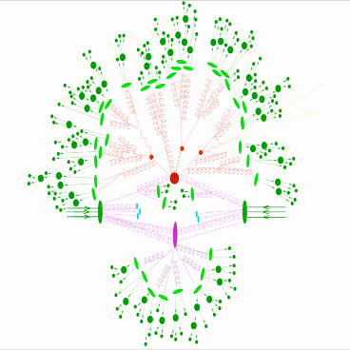
MadGraph
http://madgraph.hep.uiuc.edu/
Contact Persons: Tim Stelzer
Johan Alwall
3 afternoons with up to 18 students each time.
Training Centre (bgs. 572), rooms 23 and 24 at 14:00.
3, 4 and 5 August.
1. High-Q2 Scattering 2. Parton Shower
3. Hadronization 4. Underlying Event
In this workshop we will
Discuss the various aspects of a hard-hadronic collision using a FLASH simulation.
Develop cutting edge Monte Carlo techniques necessary for simulating these collisions.
Use MadEvent’s new web-based capabilities to produce event simulations for processes important to LHC physics.

Slide 11
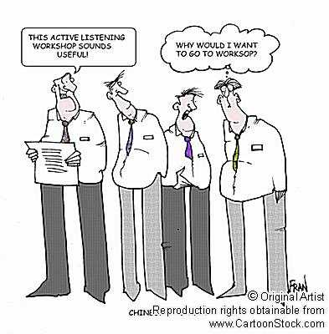
What you have to do :
①
Do what Sharon and Laura will tell you to do by e-mail
③
②
Have fun!
Try not to forget
your rendez-vous…,

