Slide 1
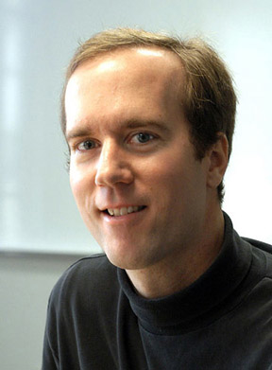
CERN Student Summer School 2010
James Wells
July 7, 2010
James Wells

Slide 2
Summer Programme Team
Sharon Hobson (HR)
Laura Saulnier (HR)
Laila S’Hien (HR Administrative student)
James Purvis (HR)
Andreas Hoecker (Experiment)
Luca Malgeri (Experiment)
Dirk Duellmann (IT-DM)
Werner Herr (BE-ABP)
Christophe Grojean (Theory)
James Wells (Theory, Chair)

Slide 3
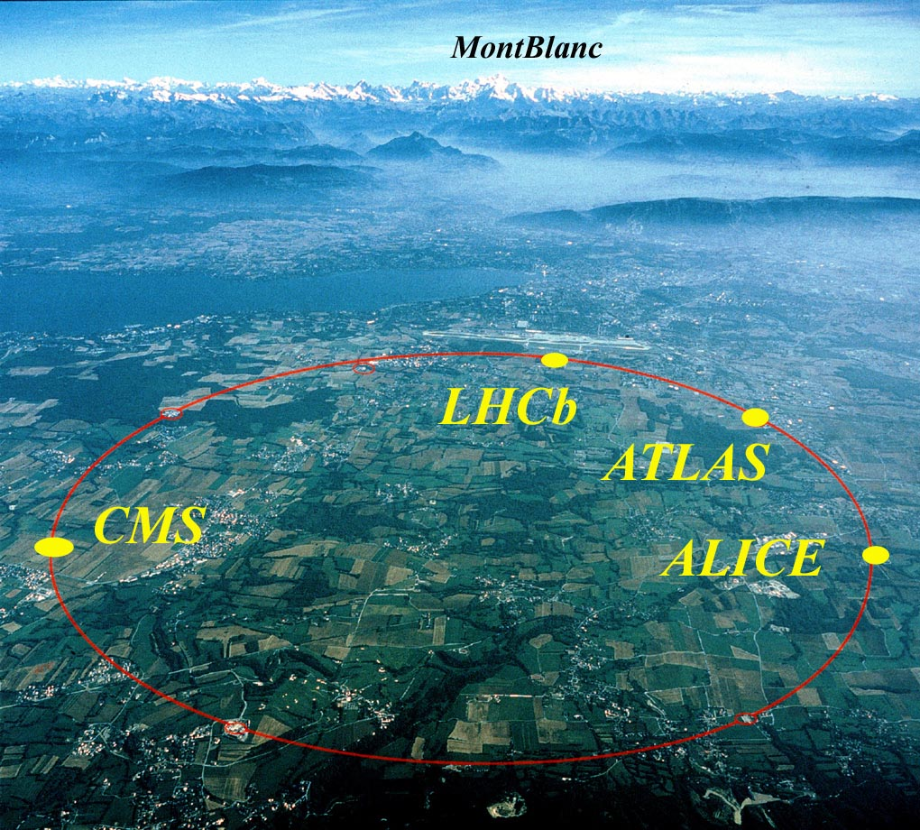
CERN is an exciting place
SSLP
Theory

Slide 4
Advantages and Opportunities of working at CERN
Opportunity to work at most advanced experimental facility.
Large community of leading theorists, experimentalists, computing experts, accelerator physicists, engineers, etc.
Exemplifies international cooperation.
This is where discoveries are made.

Slide 5
Some Major Discoveries at CERN
Neutral Currents (1972)
W and Z bosons (SPS) 1983
Number of light neutrino families (LEP) 1991
Precision tests and constraints on Higgs (LEP) 1991-2000
Evidence for quark gluon plasma (Heavy Ions)
Creation of anti-hydrogen in the laboratory 2002
We expect many more discoveries in the near future, perhaps some by you!

Slide 6
CERN Student Summer School
Goals: Expose students to forefront research, aid in their development as scientists, teach them knowledge and skills for future work.
These goals are achieved through a series of lectures on theoretical and experimental physics, and through individual work within a group at CERN.
Your engagement is crucial! Get involved, ask questions, go to group meetings, discuss with fellow students, work hard, ….

Slide 7
Lectures
Lectures have been planned on the most important topics you need to learn to better your career now.
Lecturers have been selected because they are one of the top individuals in their fields, and have experience presenting material pedagogically.
Nevertheless, it will not be easy! But that is good….
There is a discussion period set aside at the end of each day’s lectures for you to ask lecturers questions.

Slide 8
The 2010 Lecture Programme
Lecture Programme can be found at:
http://indico.cern.ch/scripts/SSLPdisplay.py?stdate=2010-07-05&nbweeks=7
Many categories of research represented.
Experimental Physics (Accelerators, Detectors, Hadron colliders, Neutrino physics, CP violation, First results from the LHC experiments, Astrophysics, Antimatter, Nuclear physics, Heavy ions, etc.)
Theoretical Physics (Quantum field theory, Standard Model, Beyond the Standard Model, Cosmology and Astroparticle physics, etc.)
Other (Statistics, Electronics, DAQ systems, Medical physics, ROOT, etc.)

Slide 9
2010 SSLP Activities
Lectures everyday from 9:15 –12:00, and discussion session from 12:00 –12:30.
We will host several workshops -- see next presentation by Niko Neufeld.
Student Poster Session will take place afternoon of Wed Aug 11th. Student Presentations mornings of Aug 17-19.
… Do not forget the welcome drink today at 17:00.

Slide 10
And finally ….
For administrative and scheduling questions, please contact Sharon or Laura.
Feel free to contact me with questions or comments you might have: james.wells@cern.ch
Opportunity to give helpful feedback with the student questionnaire.
Enjoy CERN, Geneva, your research group, and the lecture series!

