Slide 1
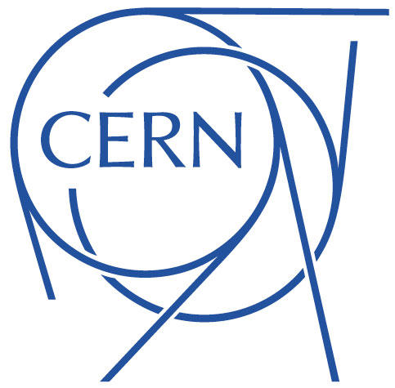
Field quality in MCBRD
E. Todesco, L. Fiscarelli, A. Musso, G. Kirby
19 May 2020 – CERN

Slide 2
MCBRD1
First prototype built at CERN (MCBRD1 and MCBRD1b)
  Three apertures built, since one had some training
Magnetic measurements of MCBRD1b
  With apertures assembled in the yoke, we have -10 units of b₃ and +8.0 units of a₃
  With apertures without iron yoke, we have all multipoles below 2.5 units
  Data presented by L. Fiscarelli 11 dec 2019

Slide 3
MCBRD1
Data with iron (room temperature)
 | AP1 RED |  |  | AP2 VIOLET
 | Central | Integral |  | Central | Integral
 | b_{n}
2 | 0.66 | 0.10 |  | -0.96 | -2.31 | Units at 35 mm
3 | -10.50 | -8.56 |  | 0.14 | 1.02
4 | 0.34 | -0.22 |  | -0.36 | -0.53
5 | 1.94 | 2.64 |  | 0.15 | 0.07
6 | 0.04 | -0.25 |  | 0.06 | -0.04
7 | -0.95 | -0.80 |  | 0.04 | -0.02
8 | 0.01 | -0.06 |  | 0.00 | 0.00
9 | 0.13 | 0.18 |  | -0.01 | -0.01
10 | 0.01 | -0.02 |  | 0.00 | 0.00
 | a_{n}
2 | -6.10 | -6.00 |  | -1.68 | -0.89
3 | -0.72 | 1.18 |  | 8.79 | 8.25
4 | -0.03 | -0.03 |  | -0.10 | -0.11
5 | 0.31 | 0.23 |  | 2.17 | 2.29
6 | -0.13 | -0.18 |  | 0.01 | 0.03
7 | 0.00 | 0.02 |  | 0.71 | 0.75
8 | 0.02 | 0.00 |  | -0.01 | -0.01
9 | -0.02 | -0.03 |  | 0.13 | 0.11
10 | 0.00 | -0.01 |  | 0.00 | -0.01

Slide 4
MCBRD1
Data without iron (room temperature)
  Very good field quality (within 2.5 units)

Slide 5
MCBRD2
Room temperature measurements in WST
  Only one sign of the current, data are indicative but not valid up to the unit
  New measurement to be done in IMP at room temperature in these days – then at 4.2 K during powering
n | bn | n | an
2 | -10.928 | 2 | 6.466
3 | -4.503 | 3 | 0.735
4 | 2.384 | 4 | -4.424
5 | 2.770 | 5 | 2.372
6 | 4.142 | 6 | -1.104
7 | -0.307 | 7 | -0.989
8 | 1.142 | 8 | 1.215
9 | 1.205 | 9 | 0.127
10 | 0.251 | 10 | 0.006
Very preliminary

Slide 6
MCBRD2
A review of Roxie model is anyway ongoing to see how correct the 10 units of b₃/a₃
  One hypothesis is that the source is the shape of the iron yoke in contact to the coil, in particular the slits to lock the aperture in the yoke
  We will explore the possibility of adding more slits at other ablges (not to be used for alignment) to compensate the asymmetry)
An update on the situation at the end of June, with both Roxie simulations and measurements from IMP

