Slide 1

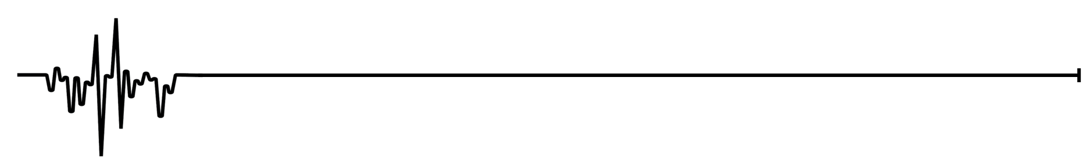
Summary of power supply ripple observations in the LHC and impact on the HL-LHC
S. Kostoglou, G. Sterbini, Y. Papaphilippou
With the valuable help of:
G. Arduini, C. Baccigalupi, H. Bartosik, M. C. Bastos, X. Buffat,
J. P. Burnet, R. De Maria, D. Gamba, L. Intelisano, T. Levens,
M. Martino, V. Montabonnet, N. Mounet, D. Nisbet, M. Soderen,
H. Thiesen, Y. Thurel, N. Triantafyllou, D. Valuch, J. Wenninger
63rd TCC 13/12/2018:
https://indico.cern.ch/event/779650/contributions/3244747/attachments/1770859/2877607/TCC_noise_131218.pdf
WP2, 19/05/2020

Slide 2
Motivation
LHC performance during Run I & II: proton losses and emittance growth ↑ than anticipated → mechanism that enhances diffusion → Noise effects
Power supply ripple in dipoles and quadrupoles:
  Observed in LHC & expected in HL-LHC
  50 Hz harmonics
    What is the source? Summary of 2018 observations.
    What is the impact on lifetime?
    How can we mitigate?
  Expected in HL-LHC
  Inner Triplet
    Do we expect an impact on the HL-LHC beam performance?
  Open questions and next steps.

Slide 3
Motivation
LHC performance during Run I & II: proton losses and emittance growth ↑ than anticipated → mechanism that enhances diffusion → Noise effects
Power supply ripple in dipoles and quadrupoles:
  Observed in LHC & expected in HL-LHC
  50 Hz harmonics
    What is the source? Summary of 2018 observations.
    What is the impact on lifetime?
    How can we mitigate?
  Expected in HL-LHC
  Inner Triplet
    Do we expect an impact on the HL-LHC beam performance?
  Open questions and next steps.

Slide 4
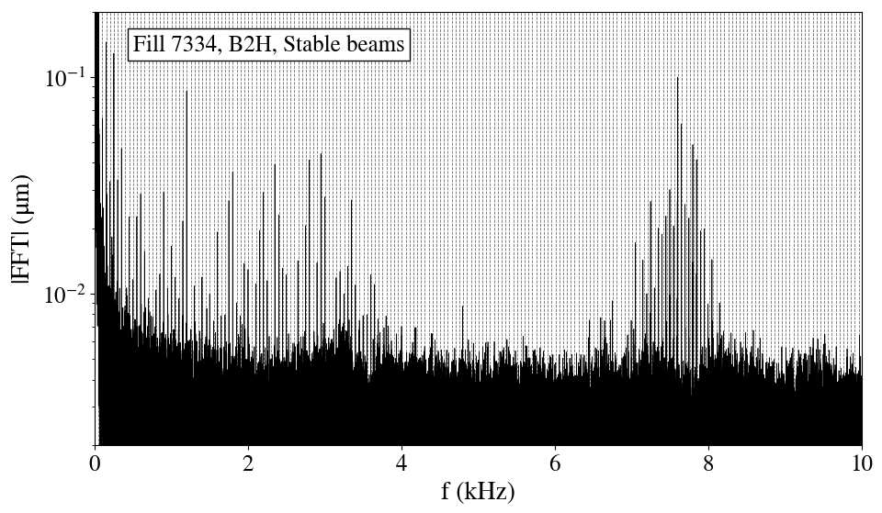
Beam spectrum at SB
“Low frequency cluster”
“High frequency cluster”
50 Hz harmonics
50 Hz harmonics
ADTObsBox
Low-f cluster up to 3.6 kHz.
High-f cluster ~7-8 kHz, in the regime f_{rev}-f_{x}
Not aliases due to sampling error.
Not an artifact of the instrumentation system.
The effect is dipolar.
Status of noise studies in the LHC and expected impact for the HL-LHC, WP2 26/11/2019

Slide 5
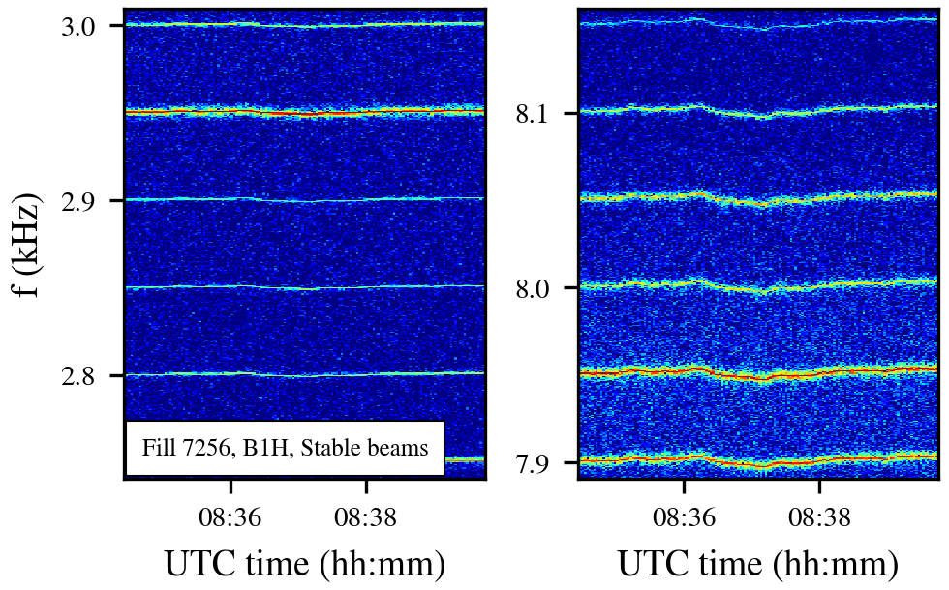
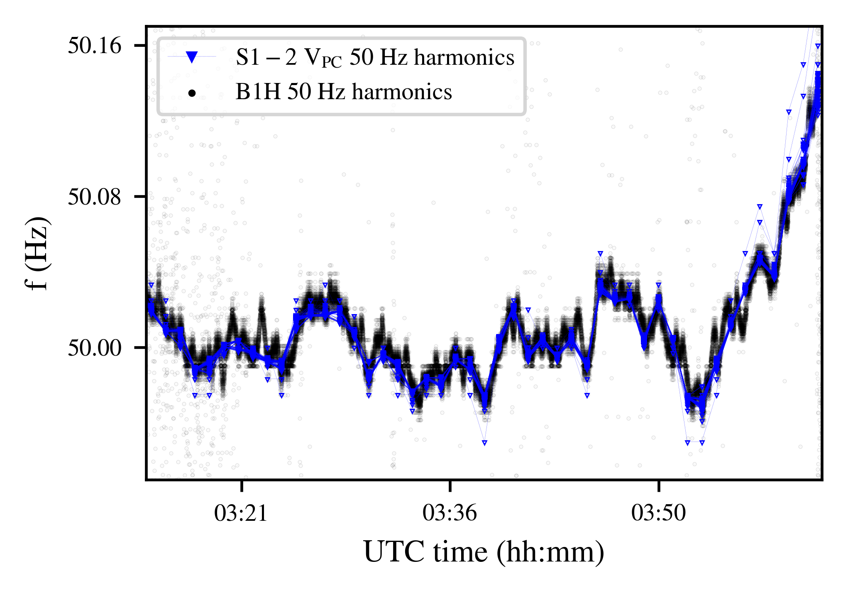
Beam spectrum at SB
Low-f cluster + High-f cluster:
Multiple 50 Hz harmonics.
Similar phase modulation from the mains, with an amplitude proportional to the order of the harmonic.
“Low frequency cluster”
“High frequency cluster”
Frequency evolution of all harmonics normalized with the order of the harmonic.

Slide 6
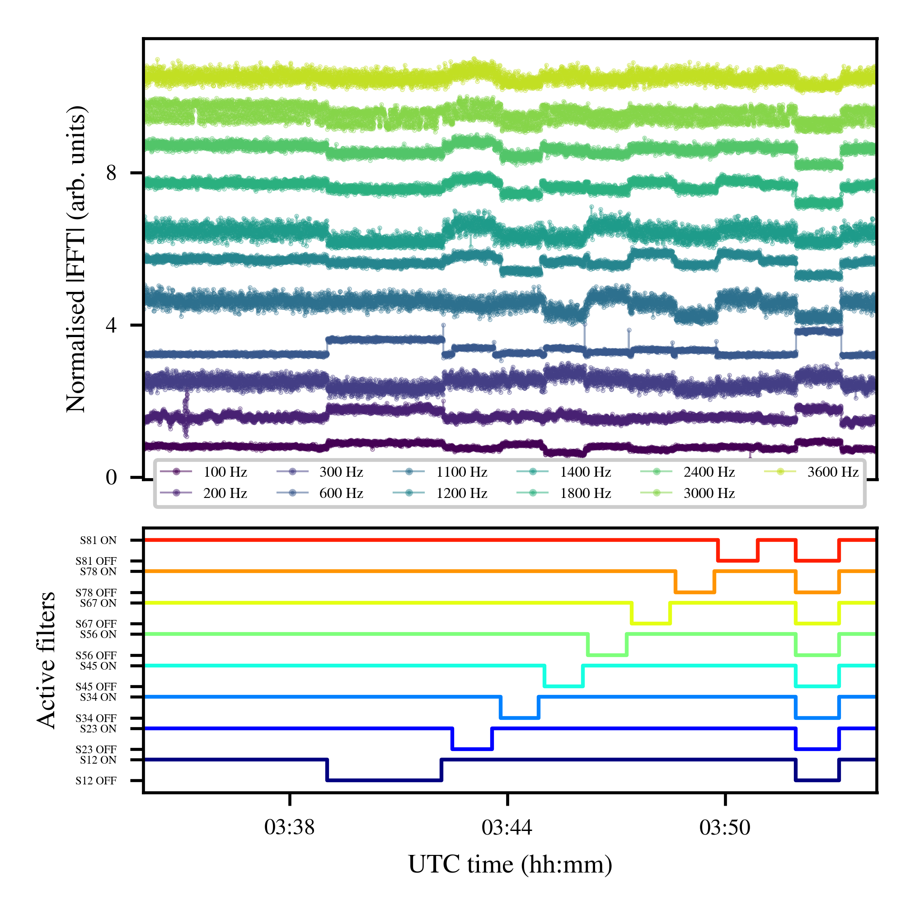
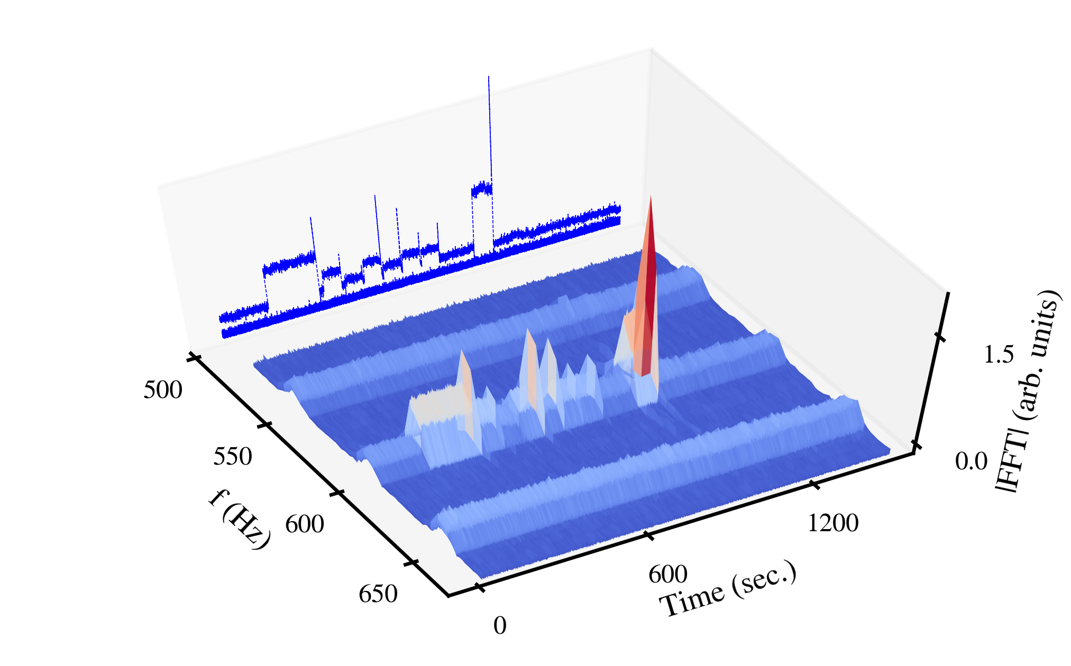
Experiments with active filters
ON/OFF active filters MB PC: impact on the harmonics of the low-f cluster.
All eight sectors contribute to this effect.
Amplitude evolution of beam harmonics up to 3.6 kHz (h=72)
Projections
3.6 kHz is clearly passing to the beam, although way beyond the cutoff beam screen frequency [1,2].
[1] R. De Maria et al, Field fluctuation and beam screen vibration measurements in the LHC magnets
[2] M. Morrone M. Martino, et al, Magnetic frequency response of High-Luminosity Large Hadron Collider beam screens., Phys. Rev. ST Accel. Beams

Slide 7
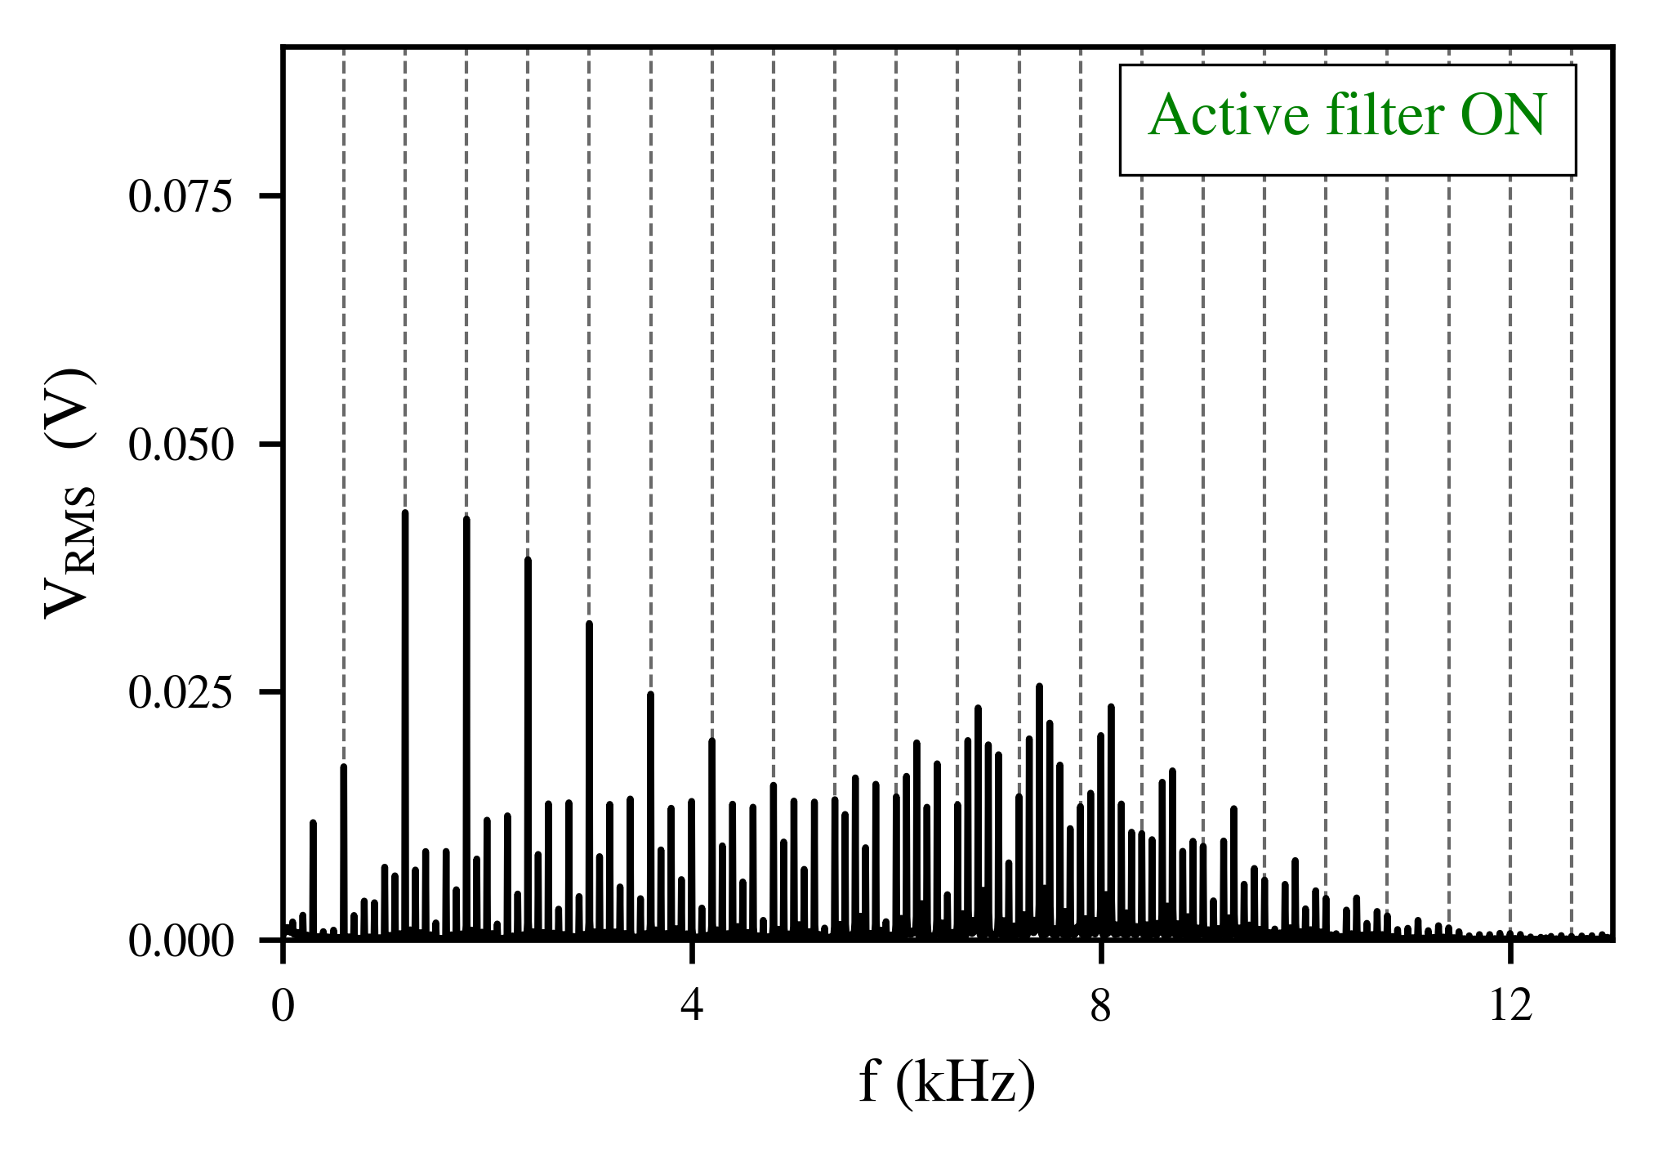
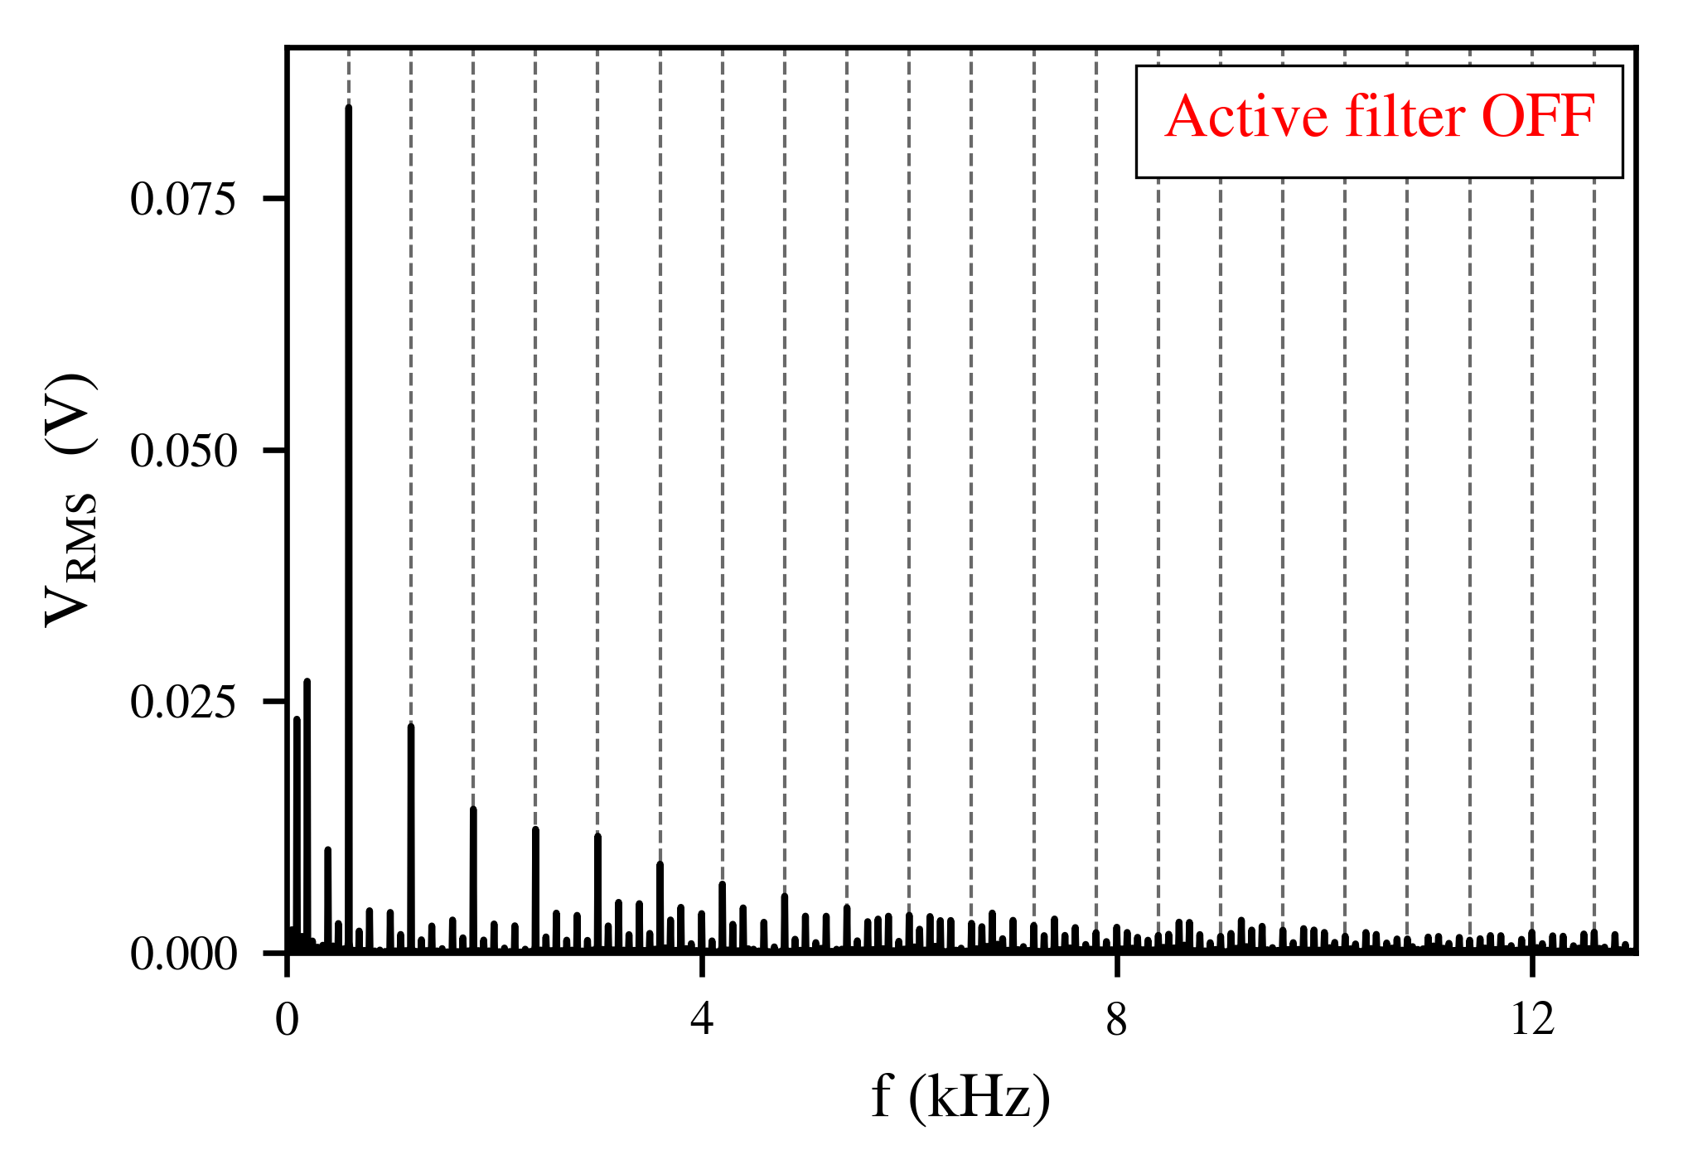
Experiments with active filters
Active filters enhance the high-order harmonics [1].
Amplitudes of the high-f cluster still lower than low-f cluster.
There is also the shielding from beam screen, vacuum chamber.
No impact on the high-f cluster in the beam was observed during AF tests but strong mitigation from ADT, see next slides.
Multiples of 600 Hz
Voltage spectrum from PC in sector 1-2
[1] J.P Burnet, Test results of RPTE LHC thyristor rectifier with active filter.

Slide 8
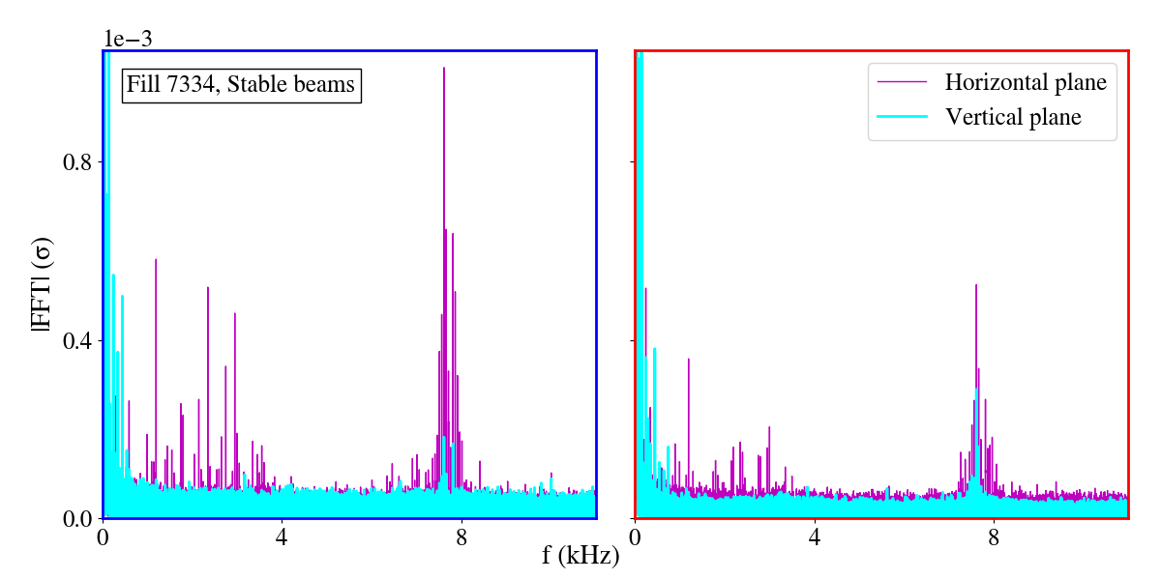
Comparison between beams & planes
B1
B2
ADTObsBox
The horizontal plane of B1 is mainly affected.
Asymmetry between low & high f-cluster.
maximum beam offset, equal to ~0.1 μm or 10⁻³ σ → Equivalent kick 0.09 nrad from single dipole at β=105 m, 1e-3 distance from tune (in the absence of a damper), corresponds to stability of 2e-9 for a single main bend.

Slide 9
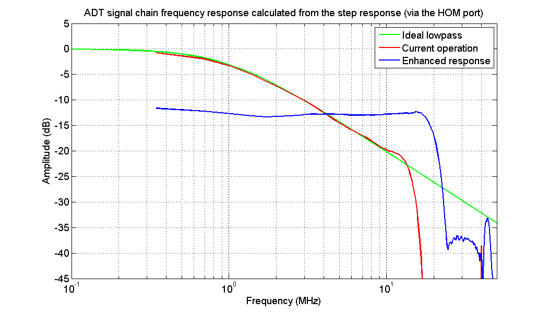
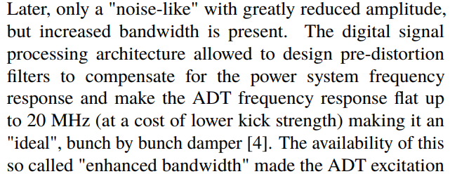
Impact of ADT BW on 50 Hz
Impact of high-f cluster when the ADT BW is changed from extended to standard.
Change in the ADT BW during Adjust, reduction of high-f cluster.
Fill 7035 no change of ADT BW in Adjust. SB with extended BW.
Standard BW
Extended BW
Evian 2019, M. Soderen et al
LBOC, 30/10/2012, D. Valuch

Slide 10
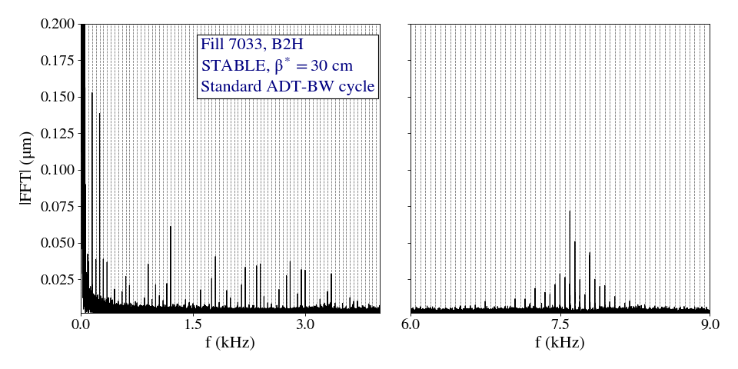
Impact of ADT BW on 50 Hz
Fill 7033, Stable beams
B2H
Standard setting
regular-BW cycle

Slide 11
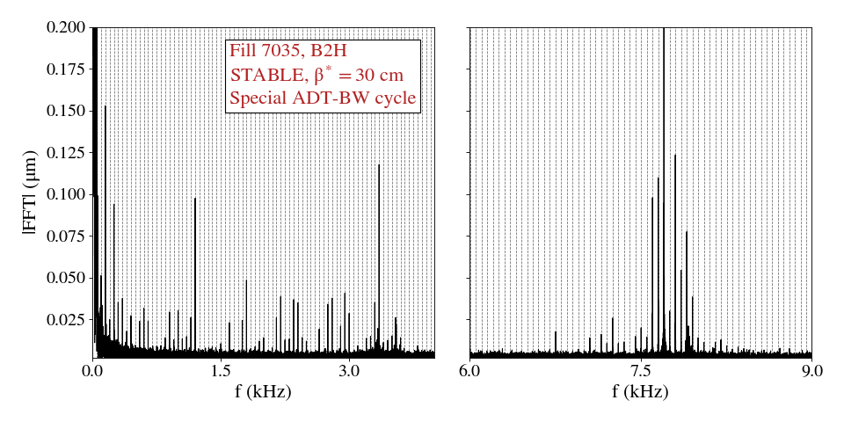
Impact of ADT BW on 50 Hz
Fill 7035, Stable beams
Special settings
Special cycle ADT extended-BW

Slide 12
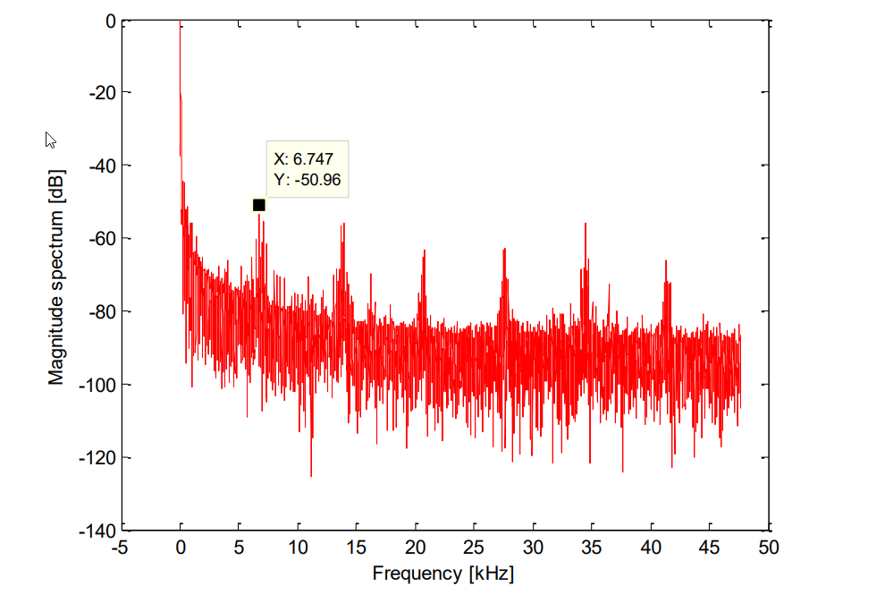
Impact of ADT BW on 50 Hz
Open question
Source of the high-f cluster:
Similar signature between low and high-f cluster.
Contrary to what was expected, larger amplitude of the high-f cluster.
Higher sensitivity of the beam’s response to f_{rev}-f_{x} compared to f_{x}?
UPS?
Fill 7035, Stable beams
Special settings
Special cycle ADT extended-BW
V. Chareyre, Assessment of the High Frequency Noise Produced by the UPS Systems in the LHC Machine

Slide 13
Motivation
LHC performance during Run I & II: proton losses and emittance growth ↑ than anticipated → mechanism that enhances diffusion → Noise effects
Power supply ripple in dipoles and quadrupoles:
  Observed in LHC and expected in HL-LHC
  50 Hz harmonics
    What is the source? Summary of 2018 observations.
    What is the impact on lifetime?
    How can we mitigate?
  Expected
  Inner Triplet
    Do we expect an impact on the HL-LHC beam performance?
  Open questions and next steps.
Based on the source and that no modification is foreseen for the MB PC for HL-LHC, the 50 Hz harmonics will be present in the future.

Slide 14
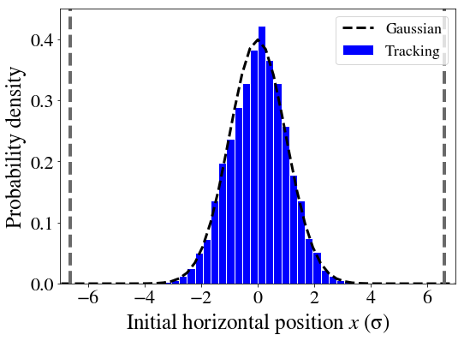
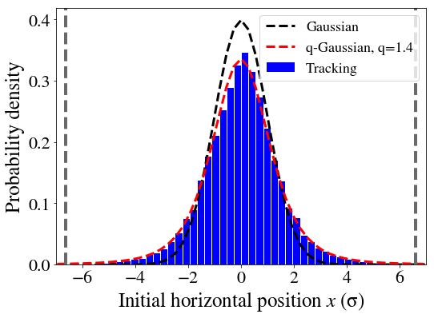
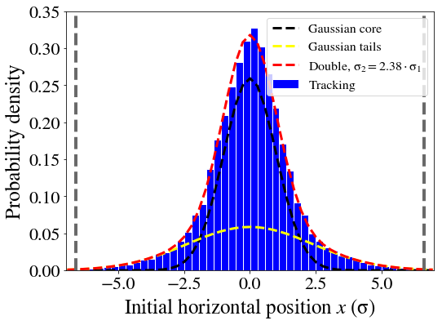
A note on tracking distributions
Aperture at 5σ_{coll} (3.5 μm) → 6.7σ (2 μm)
Gaussian
q-Gaussian
Double Gaussian

Slide 15
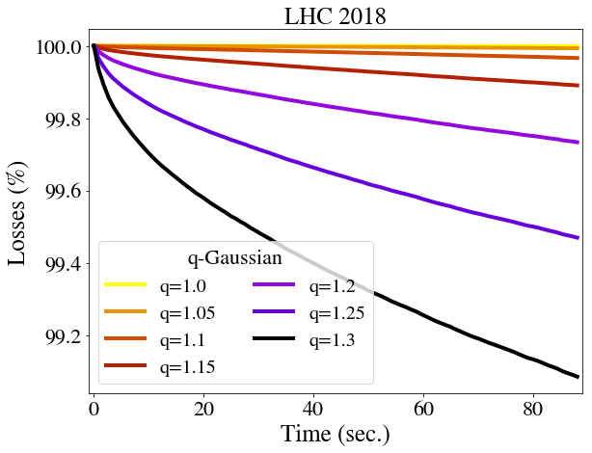
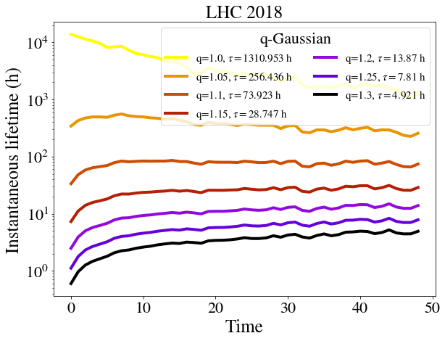
A note on tracking distributions
Aperture at 5σ_{coll} (3.5 μm) → 6.7σ (2 μm)
Gaussian
q-Gaussian
Double Gaussian
q-Gaussian

Slide 16
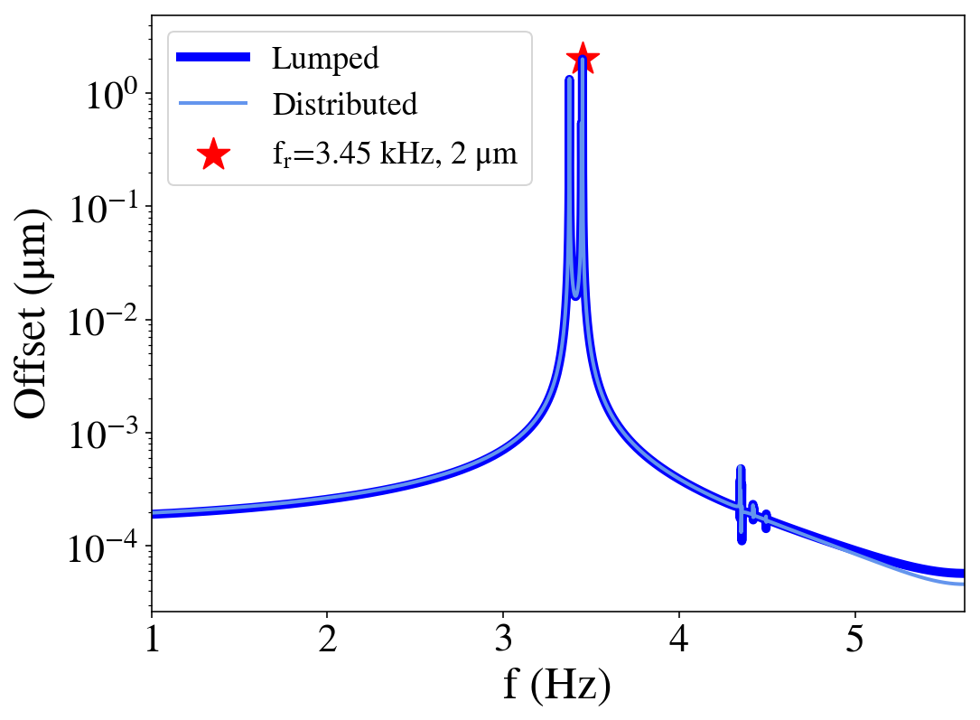
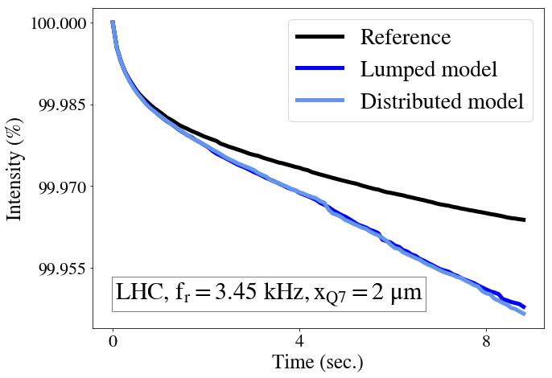
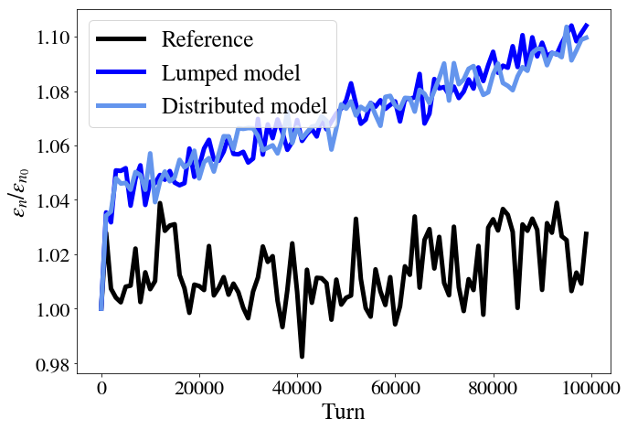
Lumped vs distributed model
Comparison of a dipolar excitation at 3.45 kHz and offset of 2 μm (larger than experimental observations) in Q7 PU with 2 models:
Lumped model: a single modulated kick at Q7.
Distributed model: modulated kick (same phase and amplitude) in 1232 LHC dipoles.
FFT
Sixtracklib
Losses, q=1.15
Emittance, q=1
Preliminary

Slide 17
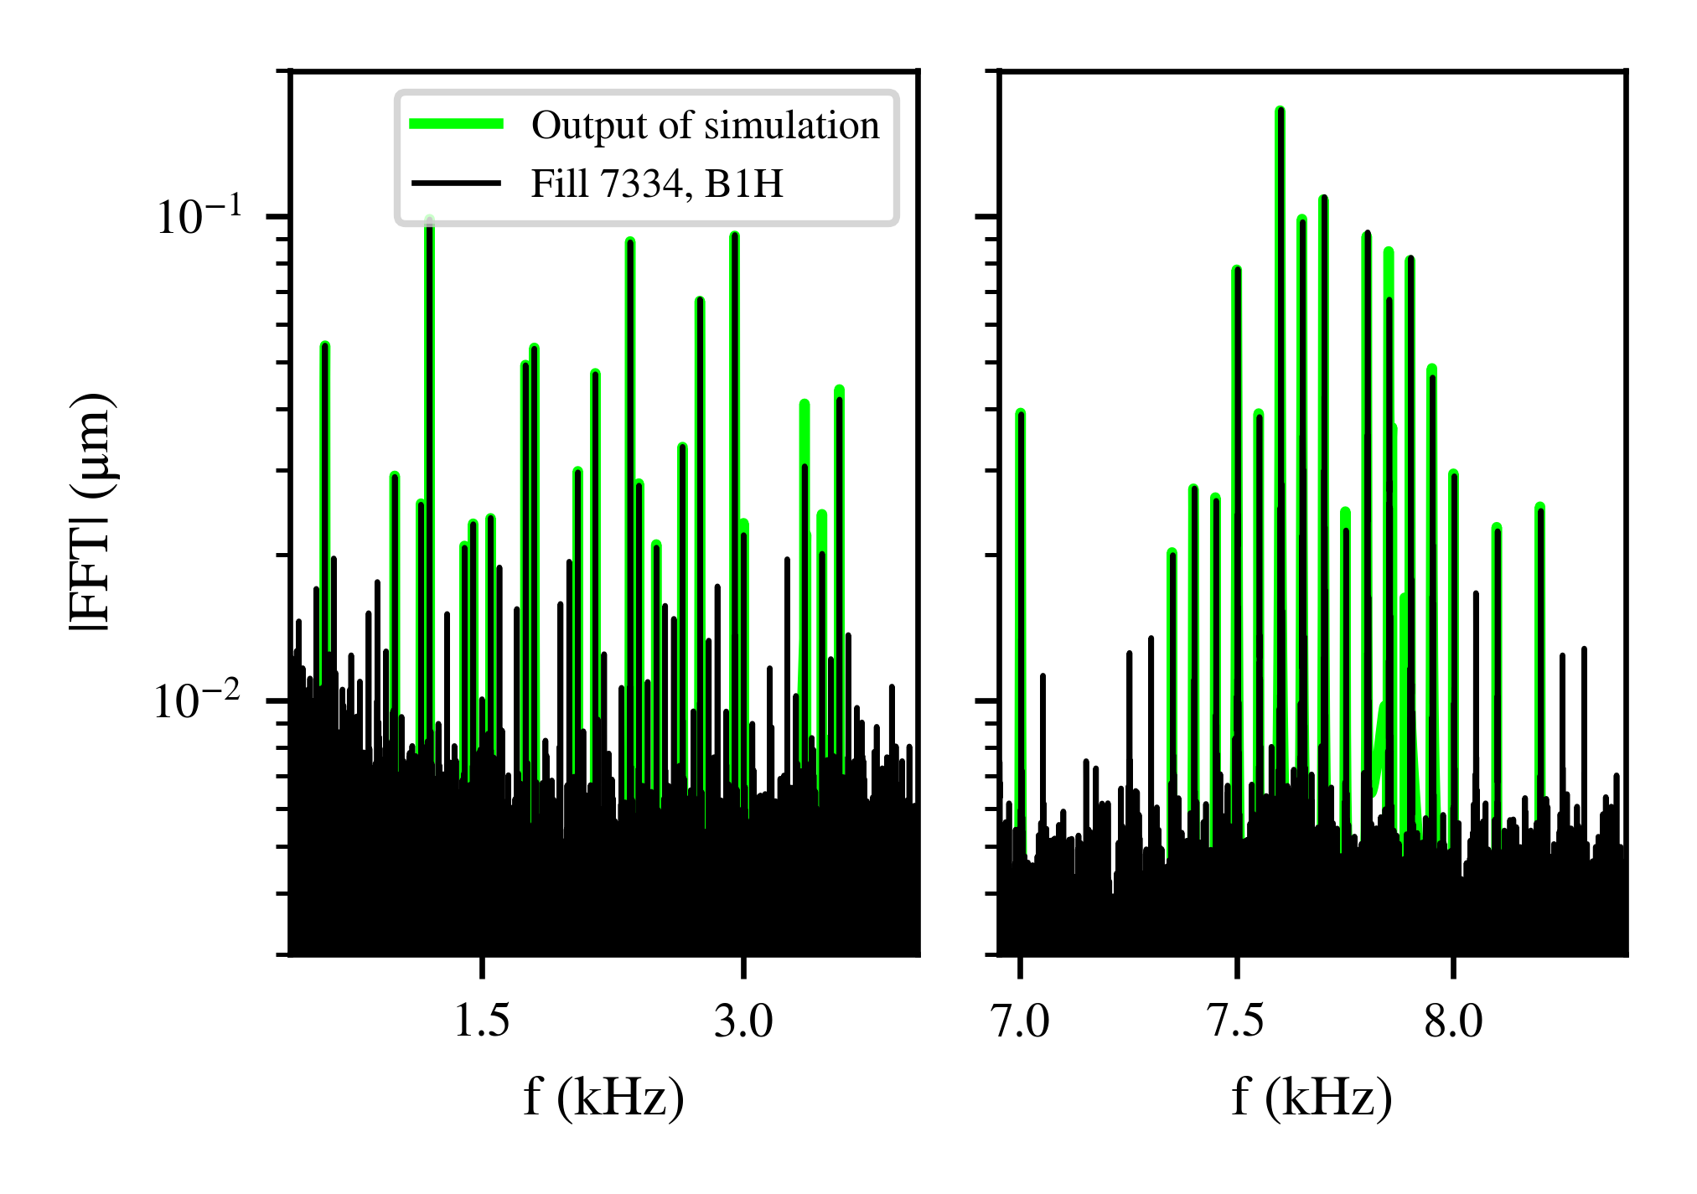
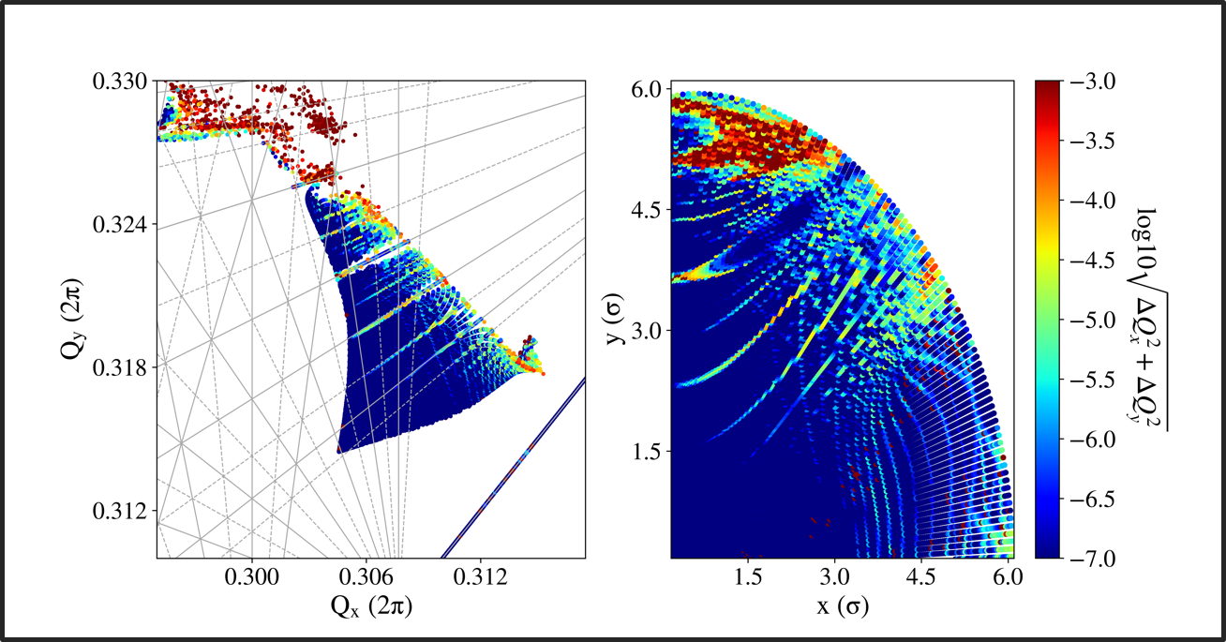
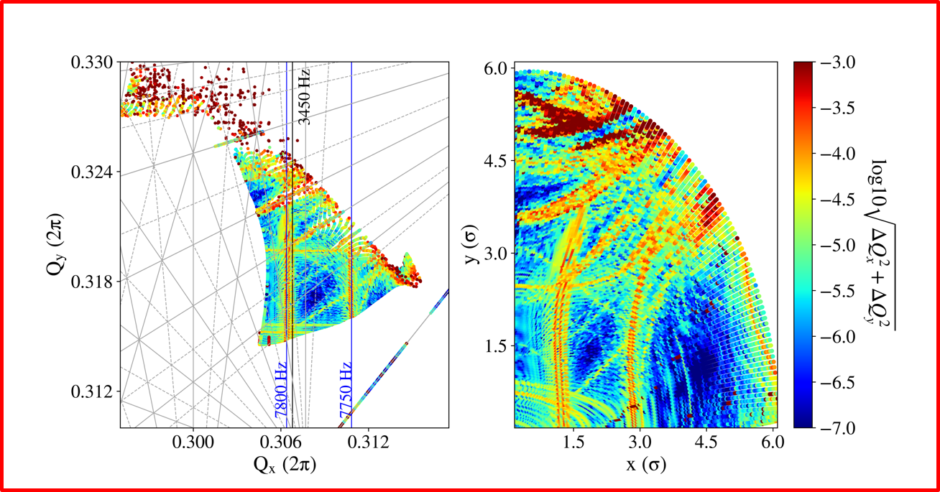
Intensity evolution with a realistic spectrum
“Low frequency cluster”
“High frequency cluster”
Spectrum in SB (considering the LHC spectrum).
Spectrum in simulations
LHC
Baseline
Realistic spectrum

Slide 18
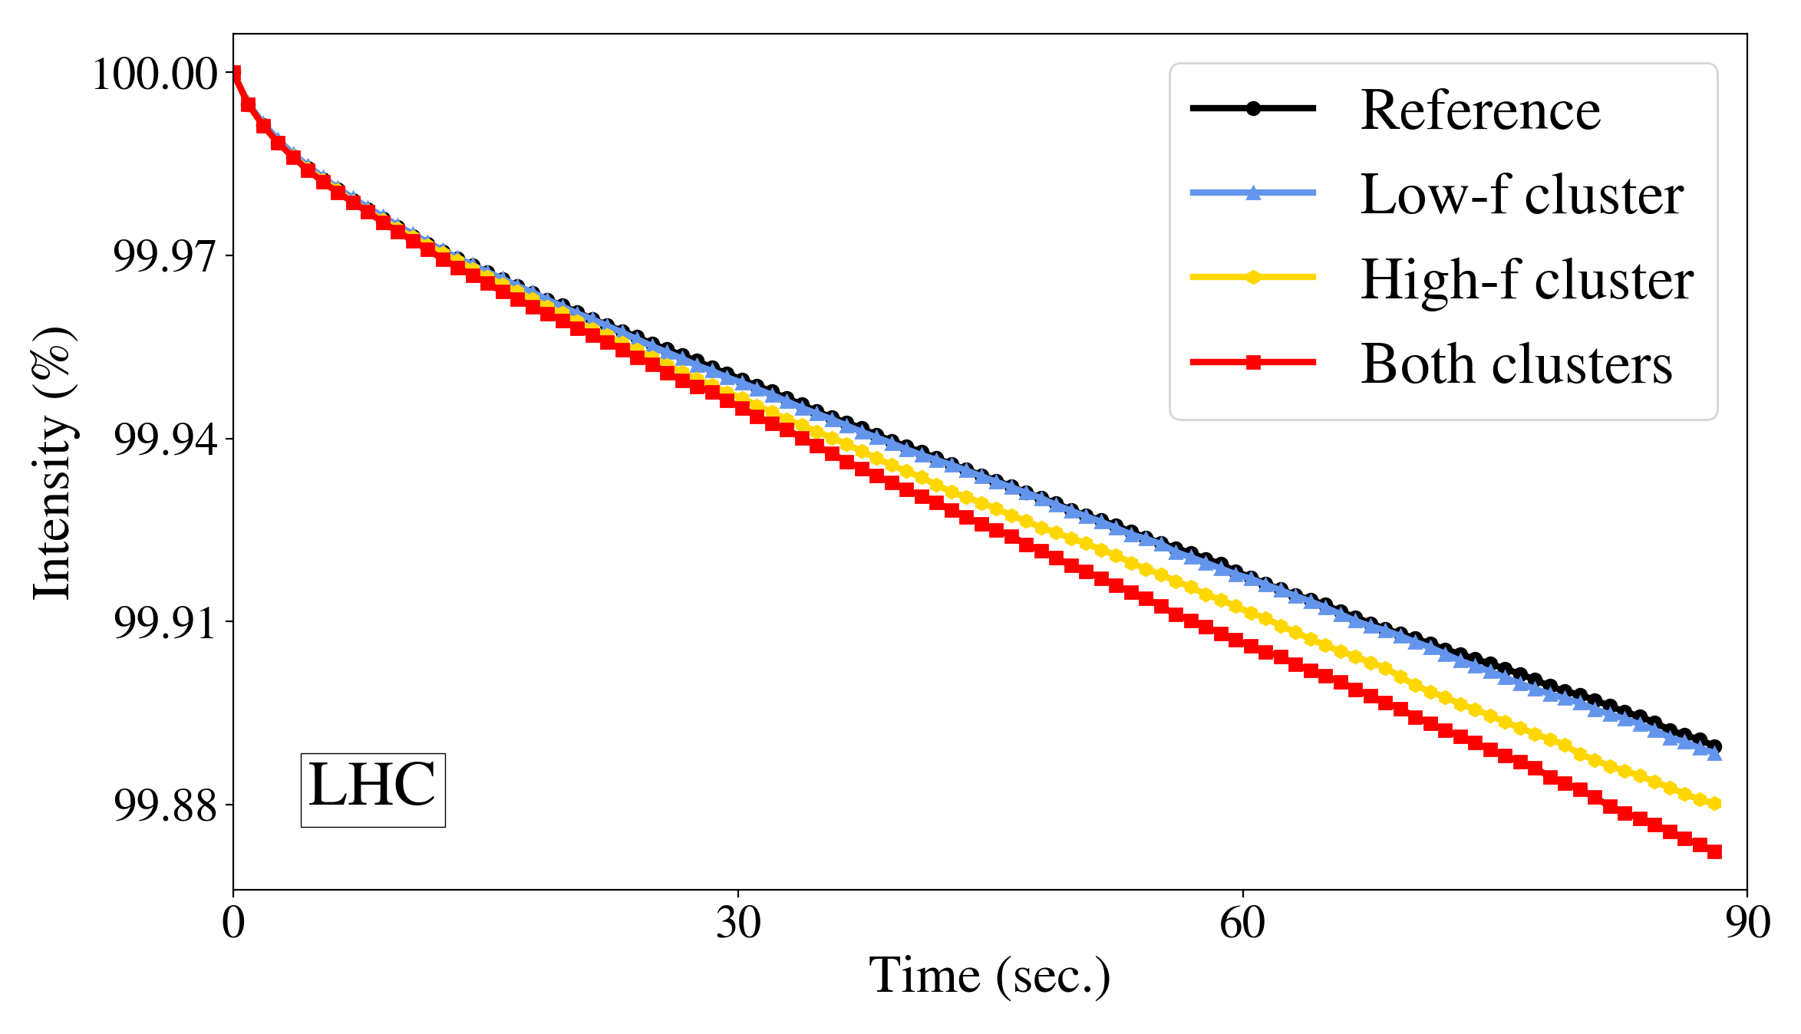
Intensity evolution with a realistic spectrum
“Low frequency cluster”
“High frequency cluster”
Transverse*: q=1.15 , σ_{q-gauss}/σ_{gauss} = 1.05
Longitudinal: q=0.88, σ_{q-gauss}/σ_{gauss} = 0.95
LHC
Baseline
Including the low-f cluster
Including the high-f cluster
Including both
*S. Papadopoulou: HSI lumi meeting 18/5/2018 BSRT calibration Fill 6699

Slide 19
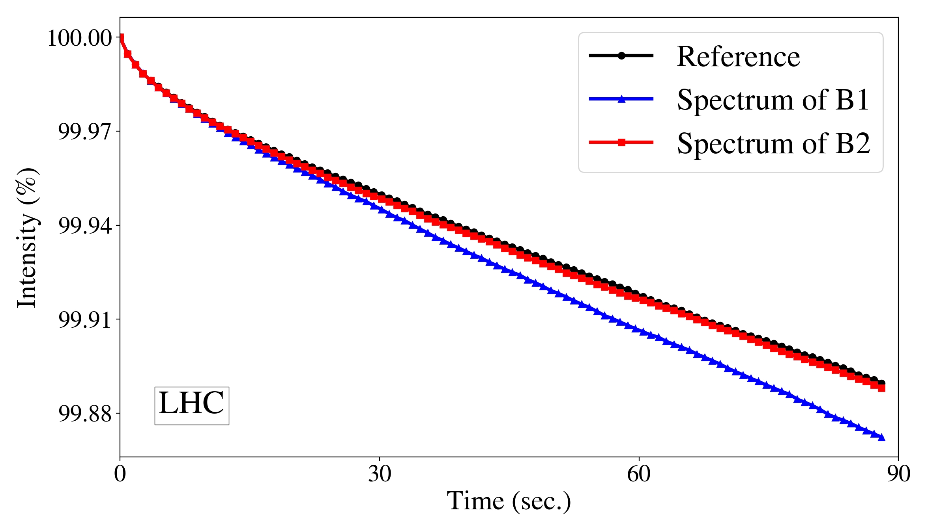
Intensity evolution of B1 & B2
LHC
Reference
Spectrum of B2
Spectrum of B1
Considering the spectrum of B1 or B2 in simulations leads to an asymmetry in the intensity evolution for the two beams.

Slide 20
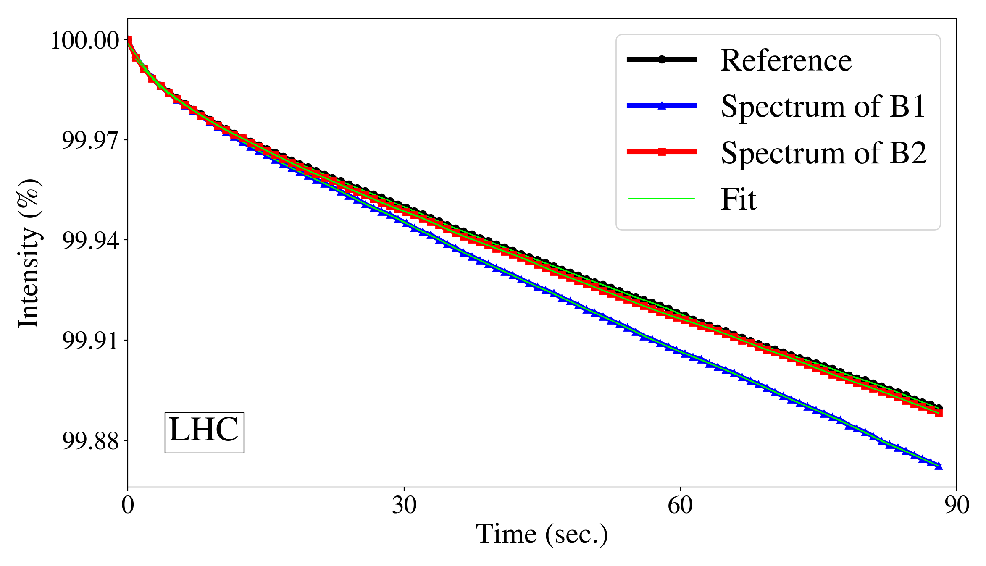
Intensity evolution of B1 & B2
LHC
Instantaneous lifetime from fit + moving average
Considering the spectrum of B1 or B2 in simulations leads to an asymmetry in the intensity evolution for the two beams.

Slide 21
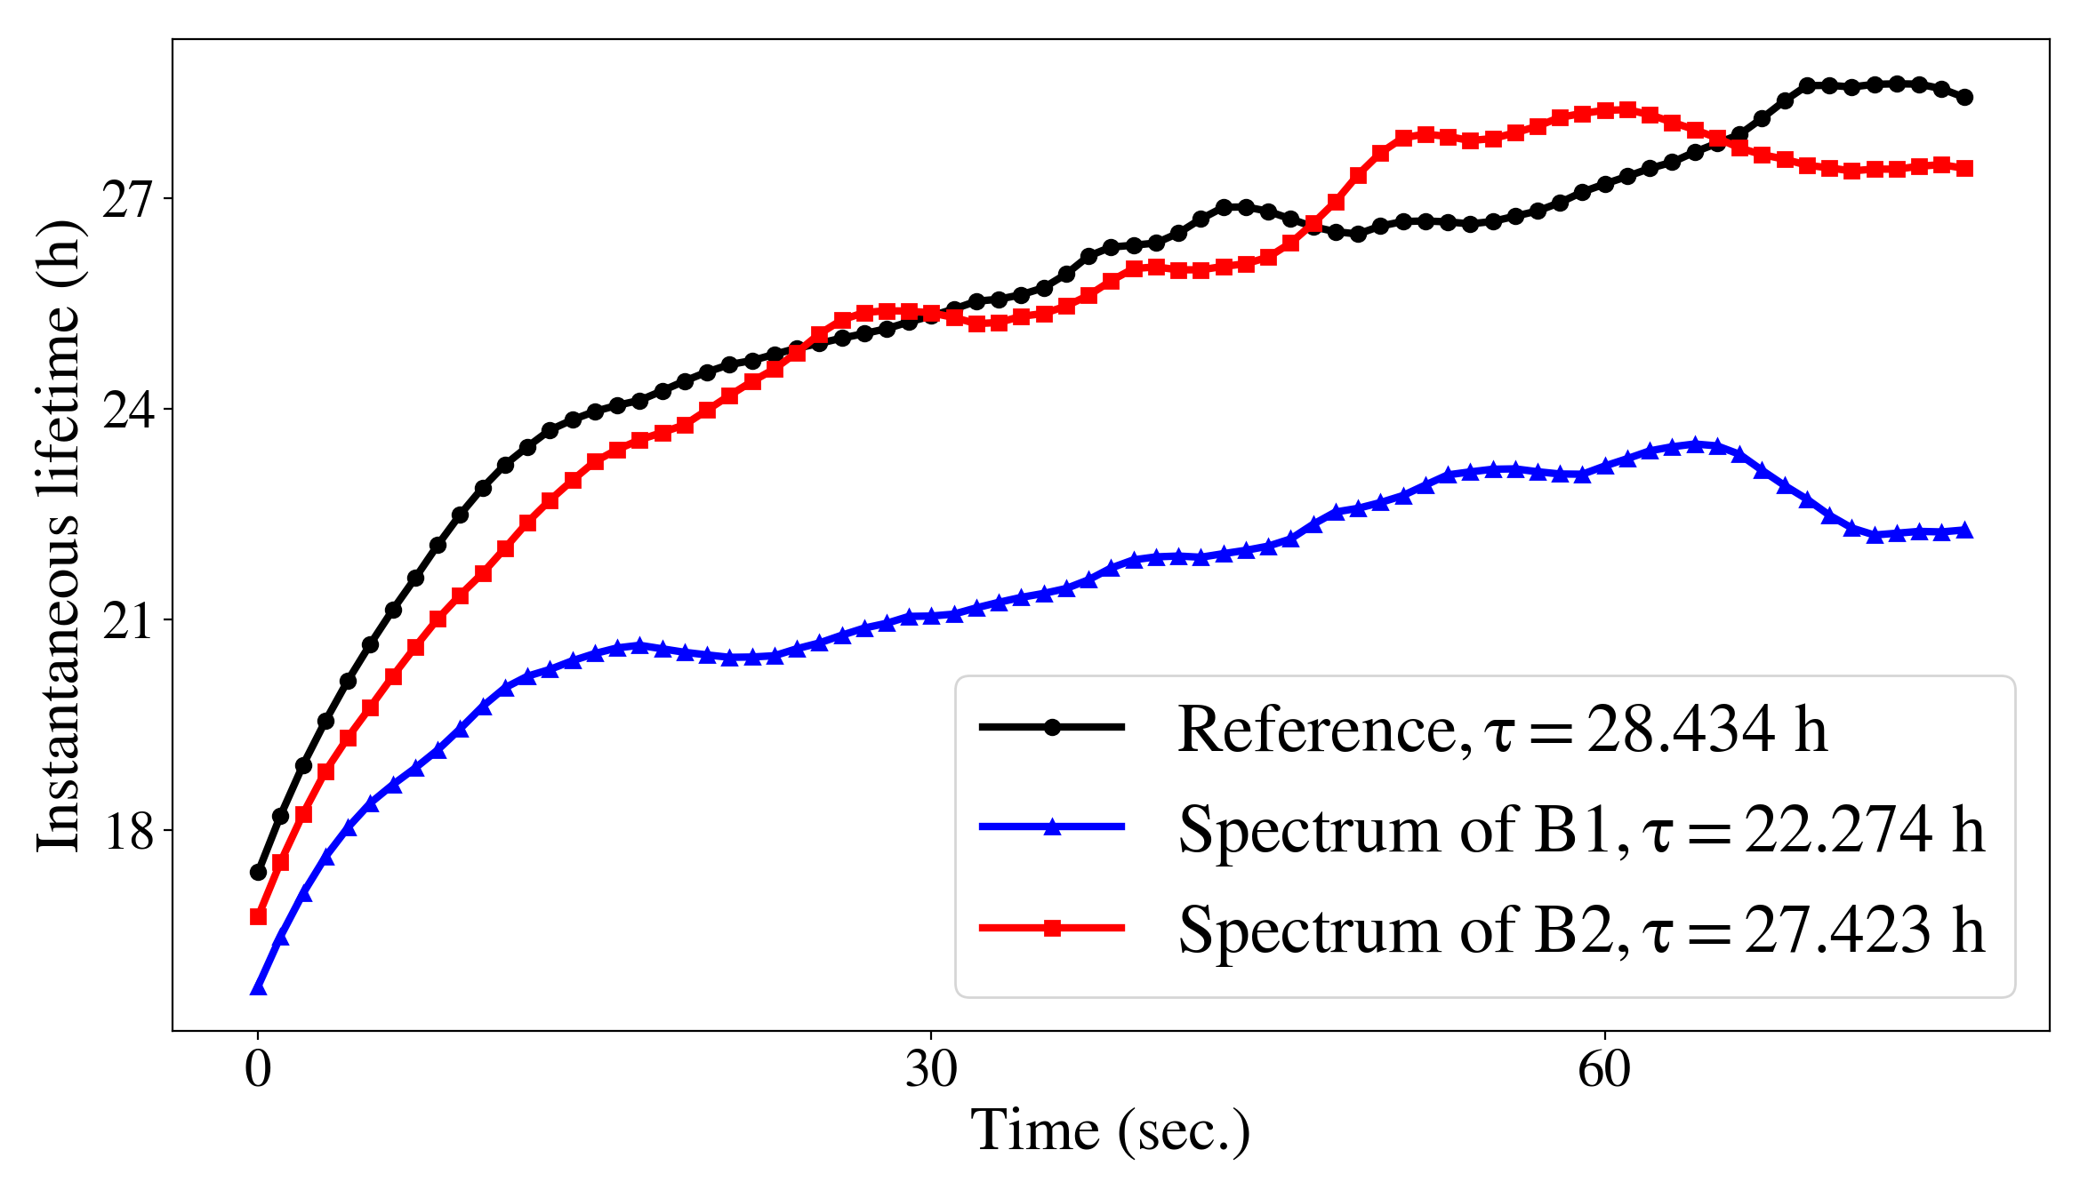
Intensity evolution of B1 & B2
LHC
Instantaneous lifetime at 90 s.
Considering the spectrum of B1 or B2 in simulations leads to an asymmetry in the intensity evolution for the two beams.

Slide 22
Motivation
LHC performance during Run I & II: proton losses and emittance growth ↑ than anticipated → mechanism that enhances diffusion → Noise effects
Power supply ripple in dipoles and quadrupoles:
  Observed
  50 Hz harmonics
    What is the source? Summary of 2018 observations.
    What is the impact on lifetime?
    How can we mitigate?
  Expected
  Inner Triplet
    Do we expect an impact on the HL-LHC beam performance?
  Open questions and next steps.

Slide 23
Mitigation
Attenuation of 50 Hz harmonics is expected due to upgrade of ADT system for Run 3.
ADT comb filter to increase the gain only around the most important 50 Hz harmonics instead of whole BW.
Main objectives for Run 3:
Better understanding of the source of the high-f cluster in Run 3 (Inject noise in a warm dipole?, impact of ADT gain, impedance related?UPS?..)

Slide 24
Motivation
LHC performance during Run I & II: proton losses and emittance growth ↑ than anticipated → mechanism that enhances diffusion → Noise effects
Power supply ripple in dipoles and quadrupoles:
  Observed in LHC and expected in HL-LHC
  50 Hz harmonics
    What is the source? Summary of 2018 observations.
    What is the impact on lifetime?
    How can we mitigate?
  Expected in HL-LHC
  Inner Triplet
    Do we expect an impact on the HL-LHC beam performance?
  Open questions and next steps.

Slide 25
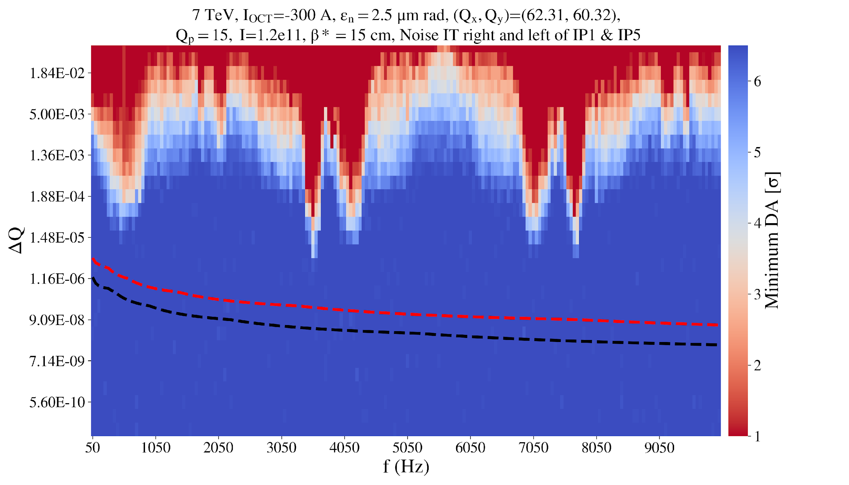
Noise thresholds with DA scans
Modulation frequency as a function of modulation depth, color-coded with minimum DA
HL-LHC
6D
DA reduction
Sum in phase all triplets circuits
RMS sum
all triplets circuits
No impact even when considering multiple voltage tones simultaneously with amplitudes as derived by PC specifications

Slide 26
Open questions & next steps
50 Hz
What is the source?
                Source of the low-f cluster are rectifier MB PC. Although the source and signature is the same, the mechanism driving the high-f cluster’s amplitude to be clearly identified with dedicated experiments in Run 3.
                Measurements needed to check if related to UPS noise.
Is there an impact on lifetime?
Impact on losses especially due to high-f cluster. LHC simulations show that the factor of 2 between the spectra of B1 and B2 can lead to a different intensity evolution of the two beams.
How can we mitigate?
    Expecting amplitude reduction of harmonics due to higher sensitivity ADT pickups.
    If not the case, more refined ADT filter configuration.
    Inject noise in a warm dipole.
    MB PC instrumentation in sector 1-2 very important to these studies. If possible, deploy in all sectors or to be cycled around the sectors after technical stops.
    Shielding not as effective as expected: Study voltage vs magnetic field transfer function in the 0-10 kHz regime for LHC MB and its vacuum chamber in SM18?

Slide 27
Open questions & next steps
Inner triplet
Do we expect an impact on the HL-LHC?
The threshold of DA reduction (ΔQ = 1e-5, depending on the frequency) orders of magnitude above PC specifications → no impact is expected (including both tune modulation due to power supply ripple and operation with high-chromaticity).
However, important non-linearities not included in the simulations → test limits by injecting noise in a single warm quadrupole e.g. Q4/Q5.
50 Hz & Inner triplet
Studies mainly focused on impact on lifetime → Emittance growth studies and comparison with analytical models.

Slide 28
Backup

Slide 29
Motivation
LHC performance during Run I & II: proton losses and emittance growth ↑ than anticipated [1-4] → mechanism that enhances diffusion → Noise effects
[1] F. Antoniou, et al. Can we predict luminosity? 7th Evian Workshop on LHC beam operation 2016
[2] S. Papadopoulou, et al. Emittance, intensity and luminosity modeling and evolution, 8th Evian Workshop on LHC beam operation 2017
[3] S. Papadopoulou S, et al. What do we understand on the emittance growth? 9th Evian Workshop on LHC beam operation 2019
[4] S. Kostoglou, et al. Luminosity and lifetime modeling and optimization, 9th Evian Workshop on LHC beam operation 2019

Slide 30
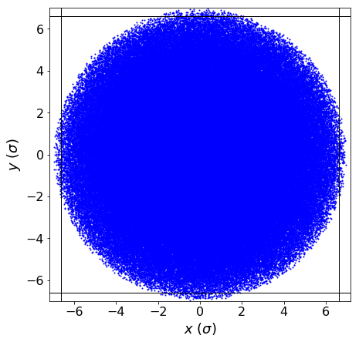

A note on tracking distributions
Initial distribution:
Transverse:
sampling from a uniform distribution up to 7σ.
Aperture at 5σ_{coll} (3.5 μm) → 6.7σ (2 μm)
Assign weights depending on PDF of simulated distribution.
Longitudinal:
δp/p extending in the whole bucket height.

Slide 31
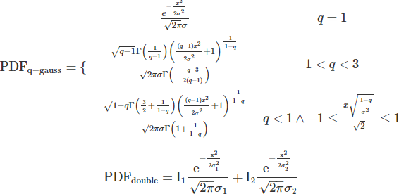
A note on tracking distributions
Initial distribution:
Transverse:
sampling from a uniform distribution up to 7σ.
Aperture at 5σ_{coll} (3.5 μm) → 6.7σ (2 μm)
Assign weights depending on PDF of simulated distribution.
Longitudinal:
δp/p extending in the whole bucket height.
Gaussian
q-Gaussian
Weights
Double Gaussian
Collimator
Double Gaussian: 5% population for > 3.5 σ₁ →σ₂=2.38 σ₁

Slide 32
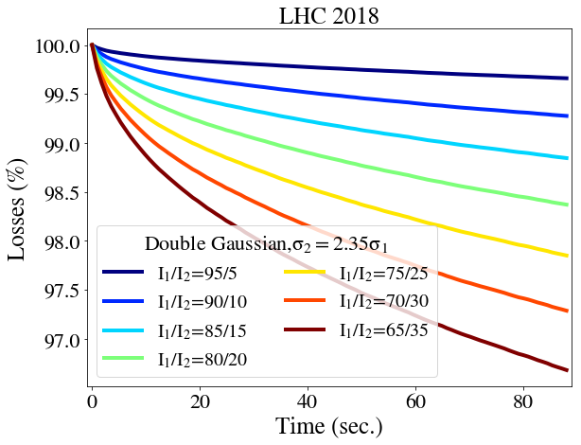
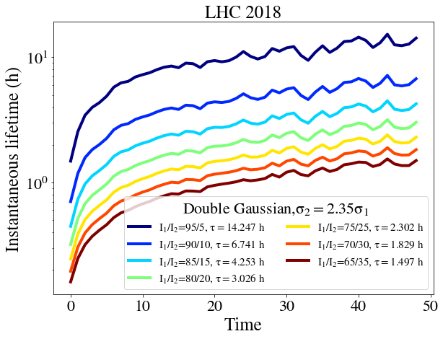
A note on tracking distributions
q-Gaussian
Double Gaussian

Slide 33
Intensity evolution of B1 & B2
 | Instantaneous lifetime at 90 s (h)
Transverse | q=1 | q=1.05 | q=1.1 | q=1.15
Reference | 1560.242 | 279.463 | 75.677 | 28.434
Spectrum of B1 | 889.798 | 188.705 | 56.24 | 22.274
Spectrum of B2 | 1433.508 | 264.628 | 72.584 | 27.423
21.66%
25.68%
22.31%
18.77%
*Transverse: σ_{q-gauss}/σ_{gauss} = 1.05
Longitudinal: q=0.88, σ_{q-gauss}/σ_{gauss} = 0.95
*S. Papadopoulou: HSI lumi meeting 18/5/2018 BSRT calibration Fill 6699

