Slide 1
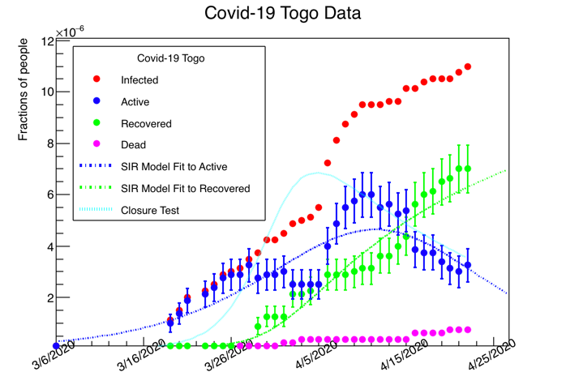
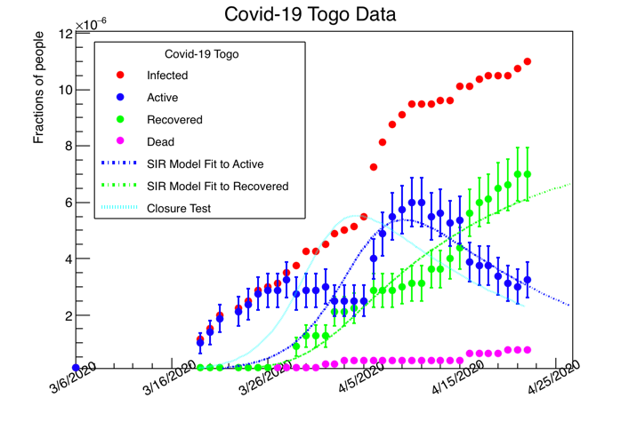
As expected the SIR Model does not fit the data
Features in the data (Active)
are not well modeled by the SIR

Slide 2
Modified SIR Fit parameters and closure
root [0] .x Covid19_Togo_April23.C
FCN=166.955 FROM MINOS STATUS=SUCCESSFUL 167 CALLS 699 TOTAL
EDM=1.0436e-08 STRATEGY= 2 ERROR MATRIX ACCURATE
EXT PARAMETER STEP FIRST
NO. NAME VALUE ERROR SIZE DERIVATIVE
1 p0 (b) 4.19903e-01 6.85252e-03 -1.09896e-04 1.05176e-03
2 p1 (b/k) 7.00000e+00 1.14430e+00 -1.20710e-02** at limit **
3 p2 (i[0]) 1.15310e-04 6.06027e-06 1.21361e-06** at limit **
4 p3 8.89763e-06 3.21024e-07 3.21024e-07 -9.10879e-04
FCN=28.8971 FROM MINOS STATUS=SUCCESSFUL 375 CALLS 1031 TOTAL
EDM=2.18591e-09 STRATEGY= 2 ERROR MATRIX ACCURATE
EXT PARAMETER STEP FIRST
NO. NAME VALUE ERROR SIZE DERIVATIVE
1 p0 (b) 4.85022e-01 1.64470e-02 6.69232e-03 -2.60320e-04
2 p1 (b/k) 8.40000e+00 1.91434e+00 6.06100e-04** at limit **
3 p2 (i[0]) 1.38372e-04 4.55988e-05 1.81352e-03** at limit **
4 p3 8.40959e-06 6.55329e-07 6.55329e-07 5.51759e-03
I had to introduce p3 as a global scaling parameter to make progress in the fit. P3 suggests that the number of susceptibles is not the entire population; further, quarantine measures alter the dynamics significantly away from the SIR model. We need to go beyond the SIR

Slide 3
Take a look at this paper
Title: Why differential equation based models fail to describe the dynamics of epidemics
Preprint arXiv:2004.07208
https://arxiv.org/pdf/2004.07208.pdf
I would like to study this one with the people that are interested to go further
The possibility for grant application
  https://www.icgeb.org/activities/grants/
However, as we get more details, keep fitting to the SIR as a reference to go further

