Slide 1
Situation of covid 19 in Togo

Slide 2
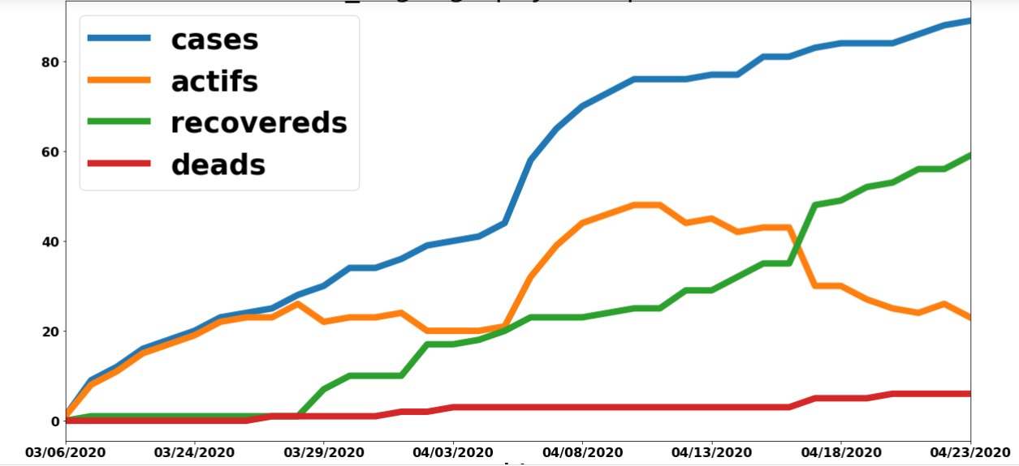
Graphycal representation

Slide 3
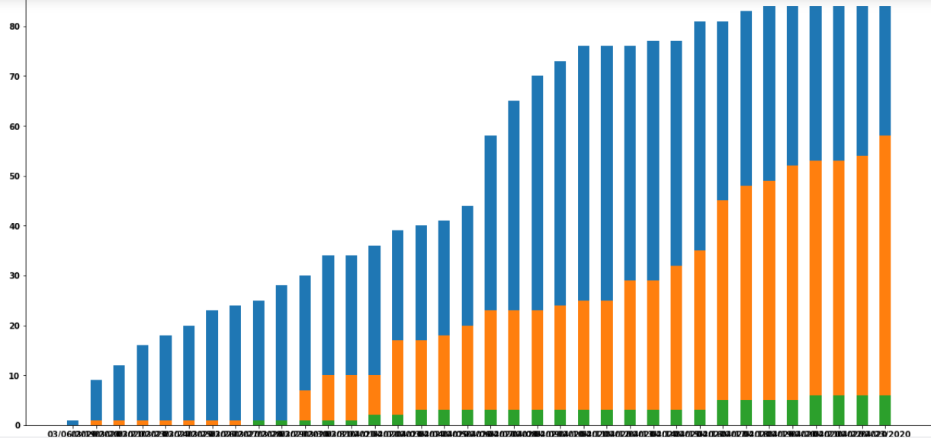
Daily Variation

Slide 4
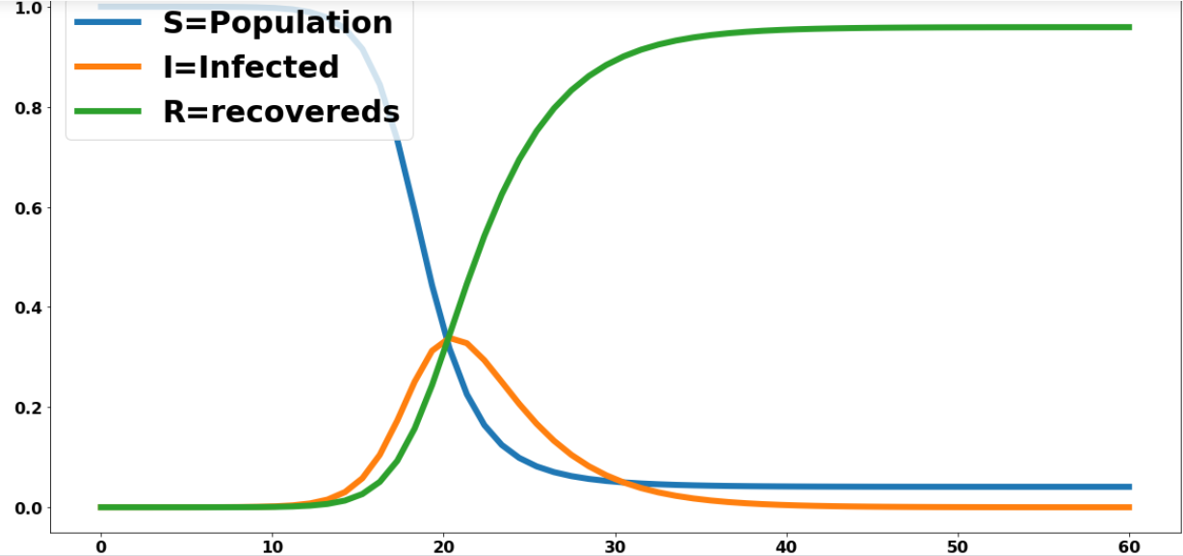
SIR model

Slide 5
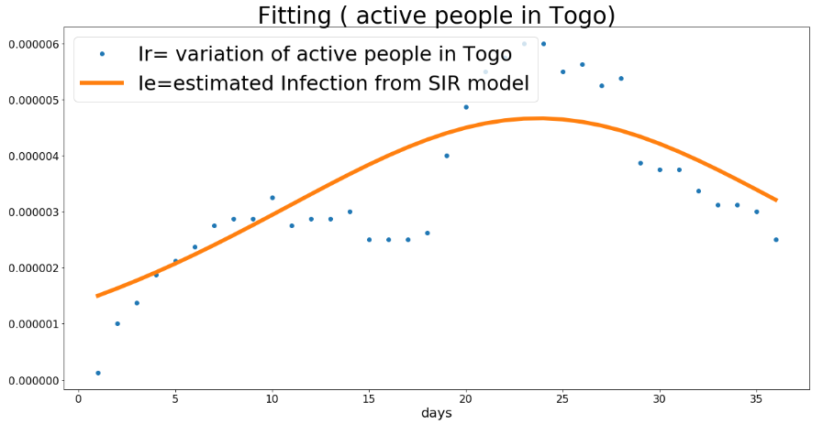
Fitting

