Slide 1
A research cloud in a box
Jason Anderson
CASE, University of Chicago
Mathematics and CS Division, Argonne National Laboratory
jasonanderson@uchicago.edu
IRIS-HEP SSL telecom
April 24, 2020

Slide 2
Chameleon: Experiments and users
Balance: large-scale and diverse hardware
  Large-scale: ~large homogenous partition (~15,000 cores), 5 PB of storage distributed over 2 sites (now +1!) connected with 100G network…
  …and diverse: ARMs, Atoms, FPGAs, GPUs, Corsa switches, etc.
We like to change: testbed that adapts itself to your experimental needs
  Deep reconfigurability (bare metal), isolation (CHI), expressiveness
  CHI: boot from custom kernel, serial console access, stitching, Bring Your Own Controller
Cloud++: leveraging and influencing mainstream cloud technologies
  Powered by OpenStack with bare metal reconfiguration (Ironic) + “special sauce”
  Chameleon team contribution (Blazar) recognized as top level OpenStack component
We live to serve: open, production testbed for Computer Science Research
  Currently 3,500+ users, 500+ projects, 100+ institutions
  100s of publications in OSDI, NSDI, SC, IPDPS, HPDC, SoCC, BDCloud, IEEE Cloud, IEEE BigData, HotEdge, EuroPar, CloudNet, SoSE, IEEE ICMLA, CCGrid, ICPP, and others

Slide 3

Chameleon hardware
Core Services
0.5 PB Storage System
Chameleon Associate Site
Northwestern
Haswell
Standard Cloud Unit
42 compute
4 storage
x2
SkyLake
Standard Cloud Unit
32 compute
Corsa Switch
x2
GENI
and other partners
Chameleon Core Network
100Gbps uplink public network
(each site)
Chicago
Austin
Haswell
Standard Cloud Unit
42 compute
4 storage
x10
SkyLake
Standard Cloud Unit
32 compute
Corsa Switch
x1
Core Services
3.5PB Storage System
Heterogeneous Cloud Units
GPUs (K80, M40, P100),
FPGAs, NVMe, SSDs, IB,
ARM, Atom, low-power Xeon

Slide 4
Chameleon hardware (details)
“Start with large-scale homogenous partition”
  12 Haswell Standard Cloud Units (48 node racks), each with 42 Dell R630 compute servers with dual-socket Intel Haswell processors (24 cores) and 128GB RAM and 4 Dell FX2 storage servers with 16 2TB drives each; Force10 s6000 OpenFlow-enabled switches 10Gb to hosts, 40Gb uplinks to Chameleon core network
  3 SkyLake Standard Cloud Units (32 node racks); Corsa (DP2400 & DP2200) switches, 100Gb ulpinks to Chameleon core network
  Allocations can be an entire rack, multiple racks, nodes within a single rack or across racks (e.g., storage servers across racks forming a Hadoop cluster)
Shared infrastructure
  3.6 + 0.5 PB global storage, 100Gb Internet connection between sites
“Graft on heterogeneous features”
  Infiniband with SR-IOV support, High-mem, NVMe, SSDs, GPUs (22 nodes), FPGAs (4 nodes)
  ARM microservers (24) and Atom microservers (8), low-power Xeons (8)
Coming soon: more nodes (CascadeLake), and more accelerators/GPUs

Slide 5
Operational Challenges FOR CS testbeds
Continuous Adaptation
Emphasis on development/adding new features, closer collaboration with user community
Chasing the Research Frontier
Even more flexibility
Access to L2 for all, complexity/automation, integration with commercial offerings
Configurable networking
Taking it up a notch
Security, fewer layers of abstraction, even less mature
Bare-metal clouds
Complex systems for complex problems
Interfaces, networking, security, relative immaturity of paradigm
Clouds

Slide 6
Operational goals for CS testbeds
Reliable: the testbed should have reliable performance and stability for operators and users. Efforts should be made to reduce both the chance and impact of failure as much as possible.
Secure: the testbed should not impose undue security risk to operations; though there are inherent risks due to the extraordinary nature of the testbed, we should reduce the chance and impact of compromise.
Cheap: we should reduce the amount of effort/intervention required to operate the testbed. There are variable maintenance costs with the amount of inventoried hardware; we should avoid similar variable software costs. This means streamlining operations, heavily automating, and reducing triage time.

Slide 7
Why containers?
Software isolation
OpenStack (and thus Chameleon) is built on pip packages, which use a flat dependency tree. Virtual environments are possible, but difficult to wrangle and not well-supported.
  OpenStack has significant internal automation built just around their global requirements list staying sane across all services.
Chameleon’s control plane is very lean, as we prioritize funds for user-reservable hardware.
File system isolation
Containers cannot access the root file system except via explicit mounts
Simpler sharing model
Containers are less complex to build than e.g., RPM or Debian packages, and do not require expressing runtime software dependencies.
Notes:
For more context on OpenStack requirements, see https://docs.openstack.org/project-team-guide/dependency-management.html

Slide 8
Containerizing an OpenStack Cloud
What we used
Kolla: builds OpenStack services as individual Docker container images
Kolla-Ansible: Ansible playbooks for deploying/configuring Kolla containers
  N.B.: Kayobe (Kolla-Ansible++) also includes playbooks/tools for provisioning physical network layer, as well as support for common use-cases like data processing and containerized workloads, but we do not use it presently.
What we added
Build pipelines to suit Chameleon’s need to iterate on code forks
Additional automation for building/deploying custom CHI services
Tooling to allow cascading of configurations (ship default config suitable for 90%, allow individual sites to tweak/override to get the last 10%).

Slide 9
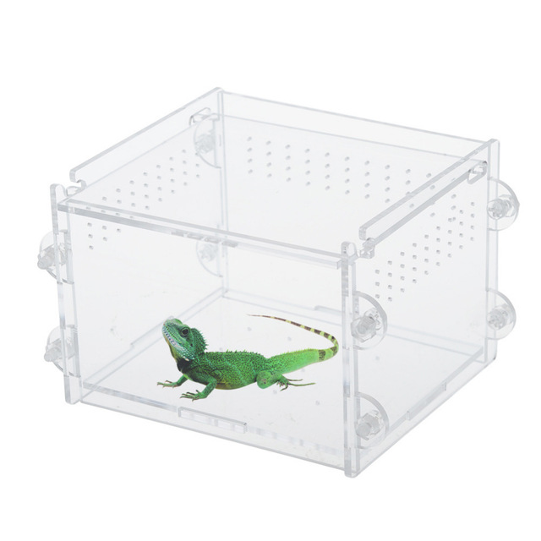
Synthesis: Chi-in-a-box
CHI-in-a-box: packaging a commodity-based testbed
  First released in summer 2018, continuously improving
  Packaging systems as well as operations model
CHI-in-a-box scenarios
  Independent testbed: package assumes independent account/project management, portal, and support
  Chameleon extension: join the Chameleon testbed (currently serving only selected users), and includes both user and operations support Part-time extension: define and implement contribution models
  Part-time Chameleon extension: like Chameleon extension but with the option to take the testbed offline for certain time periods (support is limited)
Adoption
  New Chameleon Associate Site at Northwestern since fall 2018
  Pilot organizations working on independent testbed configuration
Notes:
New testbed: you even get base images – ultimately also Prometheus and Swift

Slide 10

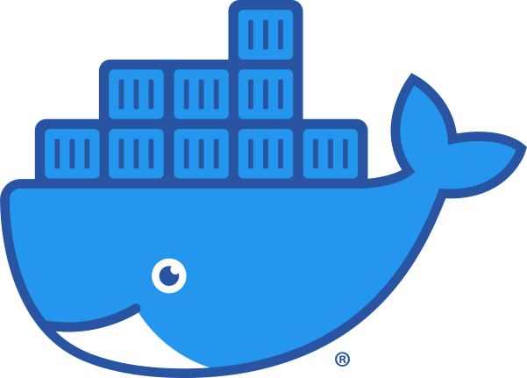
What’s in A box?
Physical switches
Hostnames
IPv4 addresses
TLS certificates
Docker containers:
OpenStack services
Chameleon services
Monitoring infra
Published by Chameleon
Single repository with:
Provisioning code
Installation guide
Runbooks
Published by Chameleon
Site-specific adjustments
Maintained by site operators

Slide 11
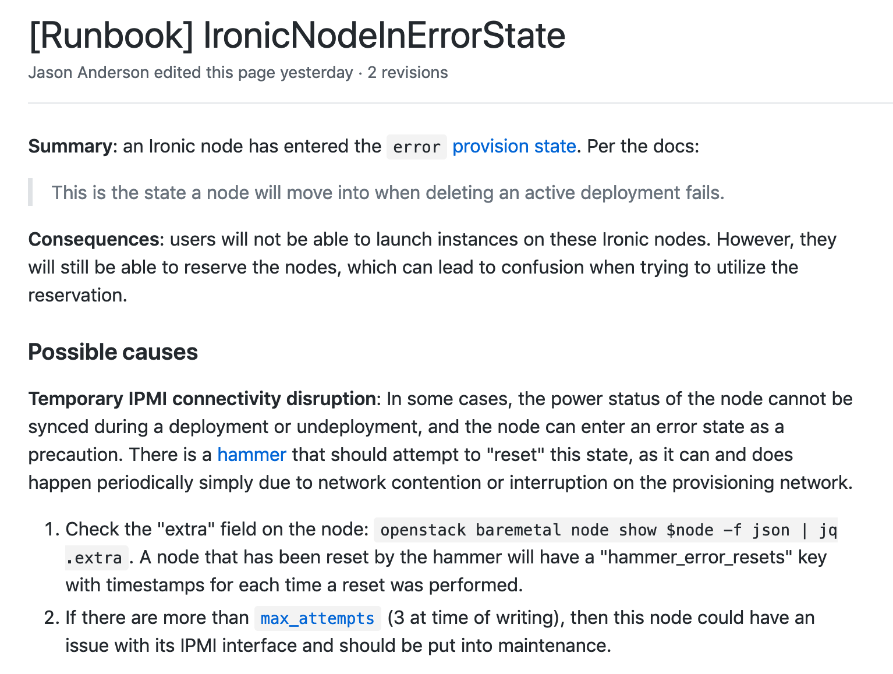
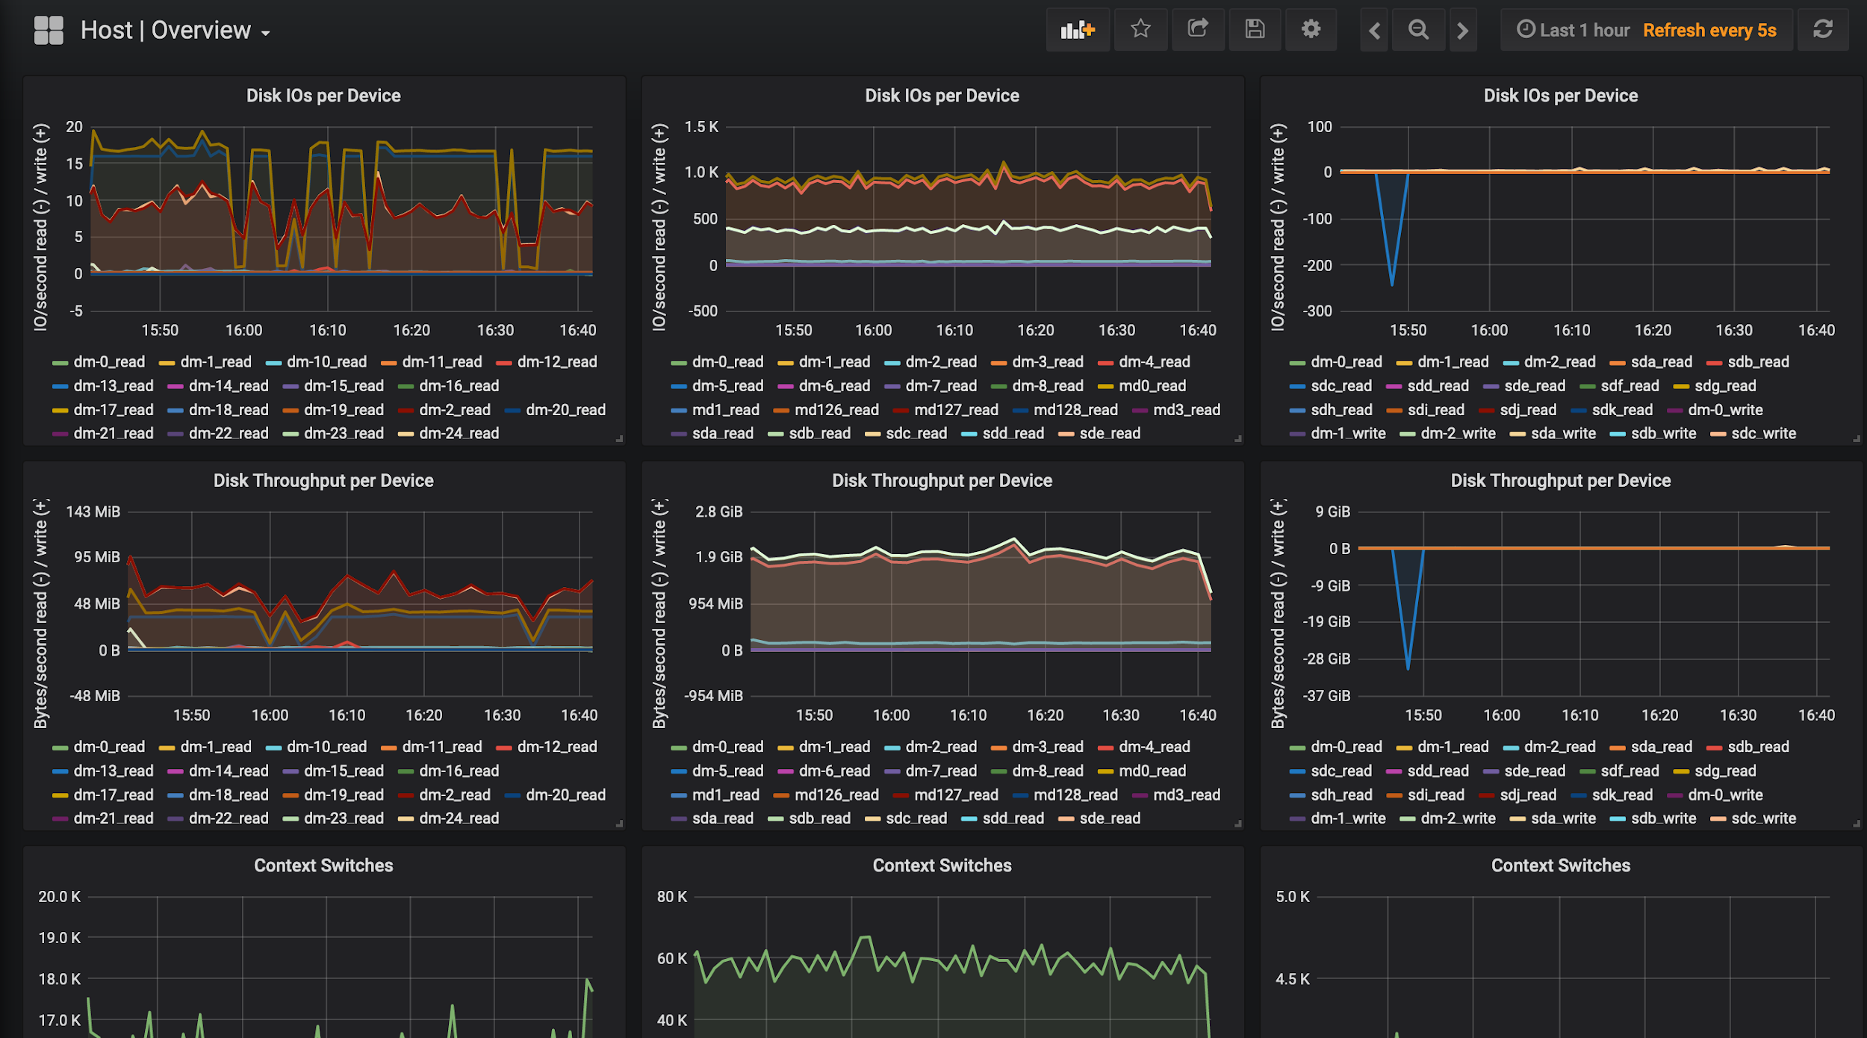
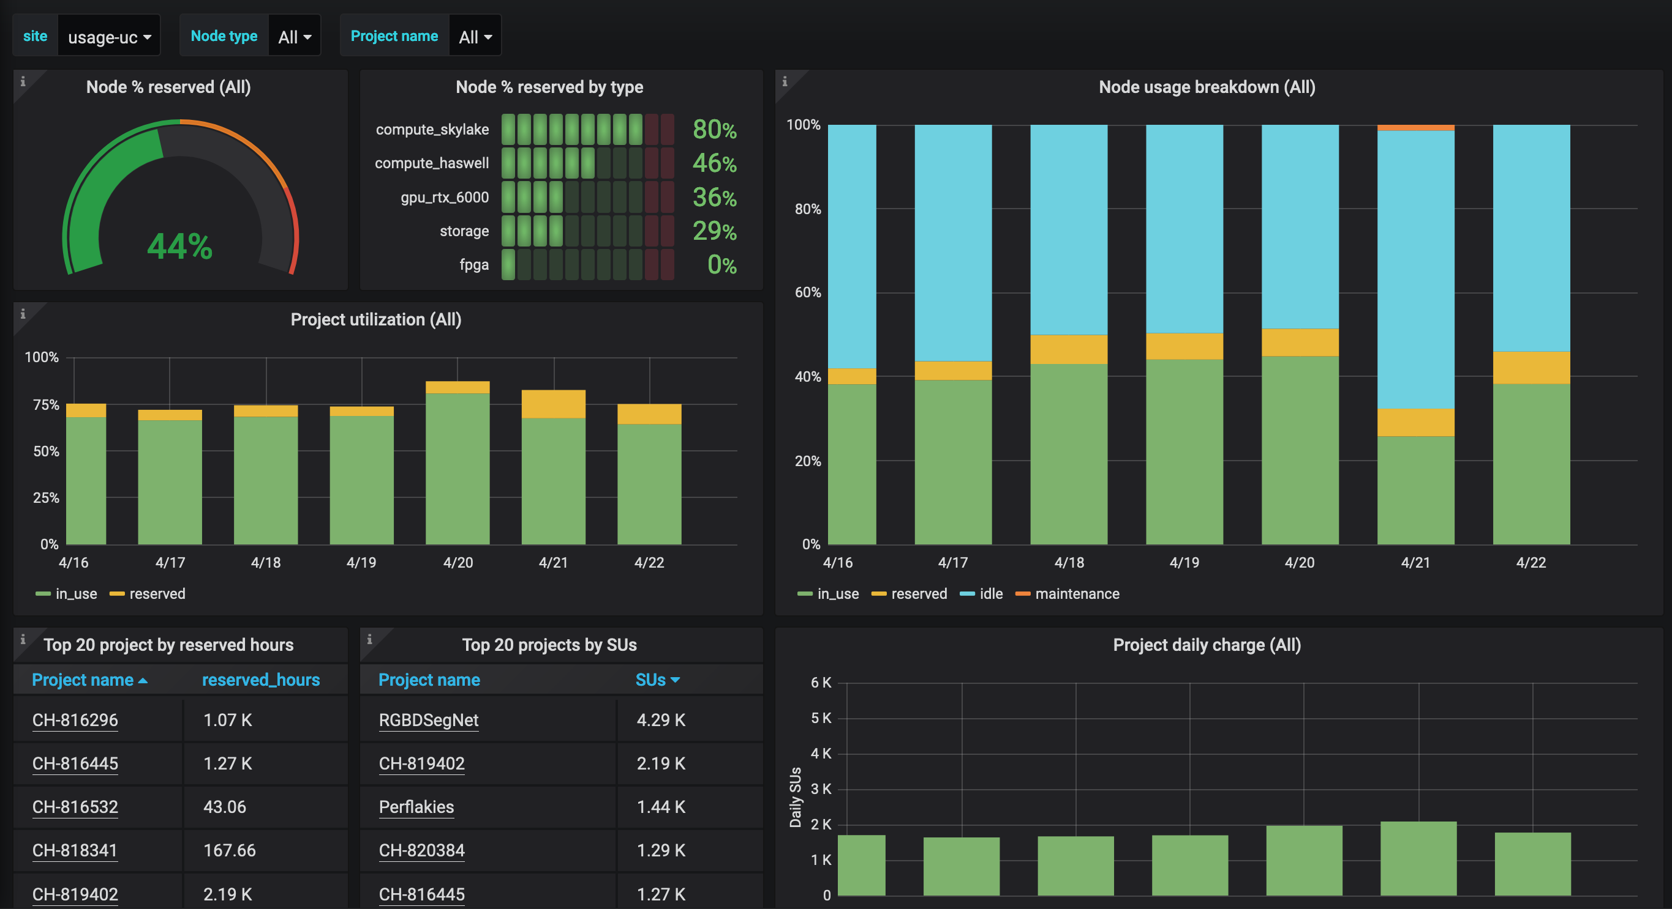


Slide 12
CHI-in-a-box: Reliability aspects
Detect issues quickly
  Automated daily/hourly “smoke tests” test user scenarios e.g., make a lease and launch an instance
  Monitoring and alert infrastructure detects anomalies
  Centralized logging facilitates pinpointing problems quickly
Create a process around maintenance
  Problematic nodes can be swapped out of user reservations (if possible)
  Nodes are put in maintenance and taken out of the reservable pool until fixed
  Automated scripts ensure the process is followed uniformly
Automatically fix some things and document others
  “Hammers”: automated repair, solve known idiosyncrasies with OpenStack system states
  Runbooks document a process for dealing with common issues
Notes:
Hammers: https://github.com/chameleoncloud/hammers

Slide 13
CHI-in-a-box: Security aspects
Threats
  Outsider threats: crimes of opportunity (crypto miners, DDoS botnet), simple entry methods (weakened host security, dated exploits)
  Insider threats: malicious activity from Chameleon servers, users intentionally shirking best practices for convenience
Mitigations
  Technical: require SSH key pairs for authentication, provide base images curated by Chameleon with sane security defaults, provide default firewall allowing only basic ports (SSH, HTTP(s)), separate management network from tenant networks, use central authentication / authorization, IDS alerts across entire deployment
  Process: allocation requests require project description and approval, users must agree to an acceptable use policy (AUP), log and categorize all security incidents, have a documented process for dealing with security incidents promptly

Slide 14
CHI-in-a-box: Cost aspects
Extensions, packaging, and upgrades
  Cost of upgrades and containerized packaging
  From the “Mother of All Upgrades” (~7 months) to manageable investment (~1 month)
Streamlining operations
  Goals: amplify the effort of a single operator, allow less experienced operators to contribute, minimize time spent on operations activities
  Easy to use monitoring and alerting infrastructure with good coverage: management node stats (load, disk partition space, memory usage, network traffic), network switch bandwidth utilization, Ceph storage cluster health, node reservation + instance launch activity, cluster utilization by hardware type, project
  Documentation where and when you need it, automate wherever possible
Moving towards an operator’s co-op model

Slide 15
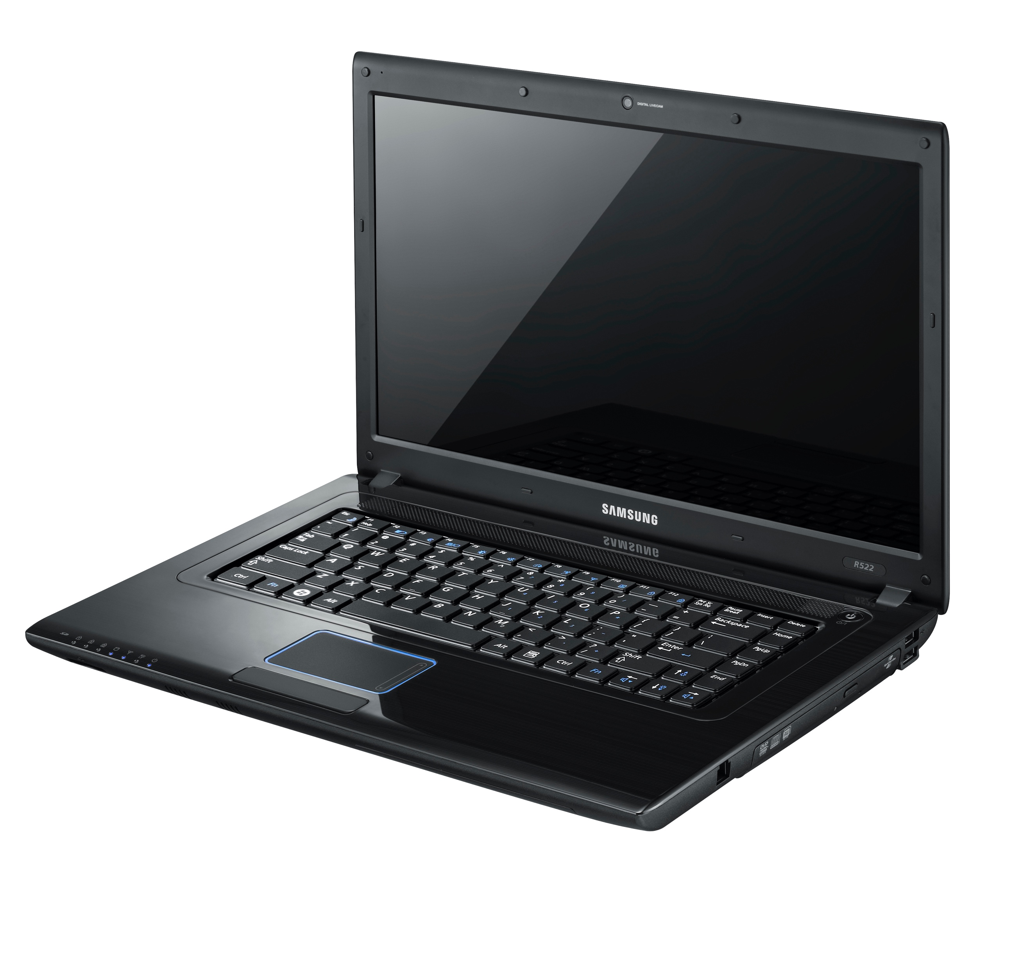
The build pipeline
User-triggered
base
openstack-base
neutron-base
prometheus
elasticsearch
neutron-api
neutron-dhcp-agent
ironic-base
ironic-api
ironic-conductor
grafana
Kolla’s primary workflow involves building all images for all services as part of a single batch, starting from the base image.
Images form a dependency tree, with parent images serving as the base for their children (via Docker layers, “FROM” statements).

Slide 16

On-demand build
base
openstack-base
neutron-base
prometheus
elasticsearch
neutron-api
neutron-dhcp-agent
ironic-base
ironic-api
ironic-conductor
grafana
To avoid extra work when applying changes to a single service, we automatically build a target service directly when its source is updated.

Slide 17
Triggering SCHEDULE
Once a month (or manually)
base
openstack-base
neutron-base
prometheus
elasticsearch
neutron-api
neutron-dhcp-agent
ironic-base
ironic-api
ironic-conductor
grafana
But, we periodically do trigger a full rebuild in order to pick up security updates to the base image(s).

Slide 18
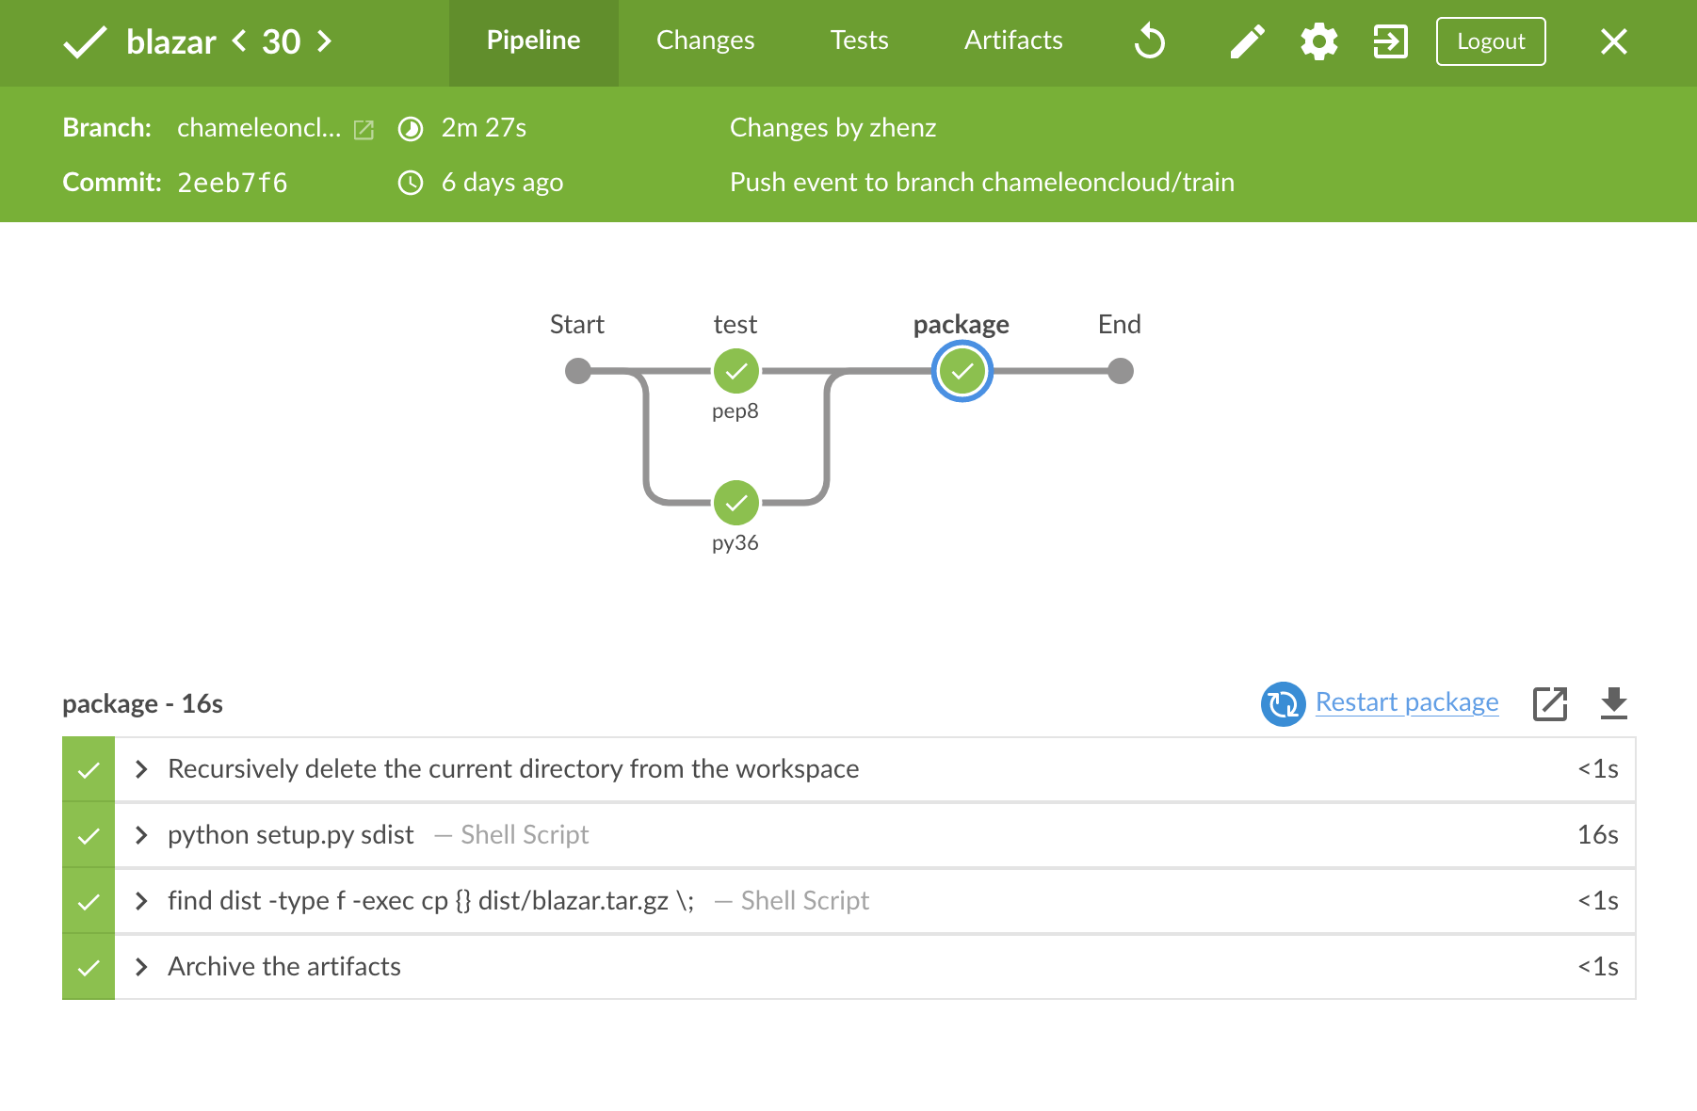
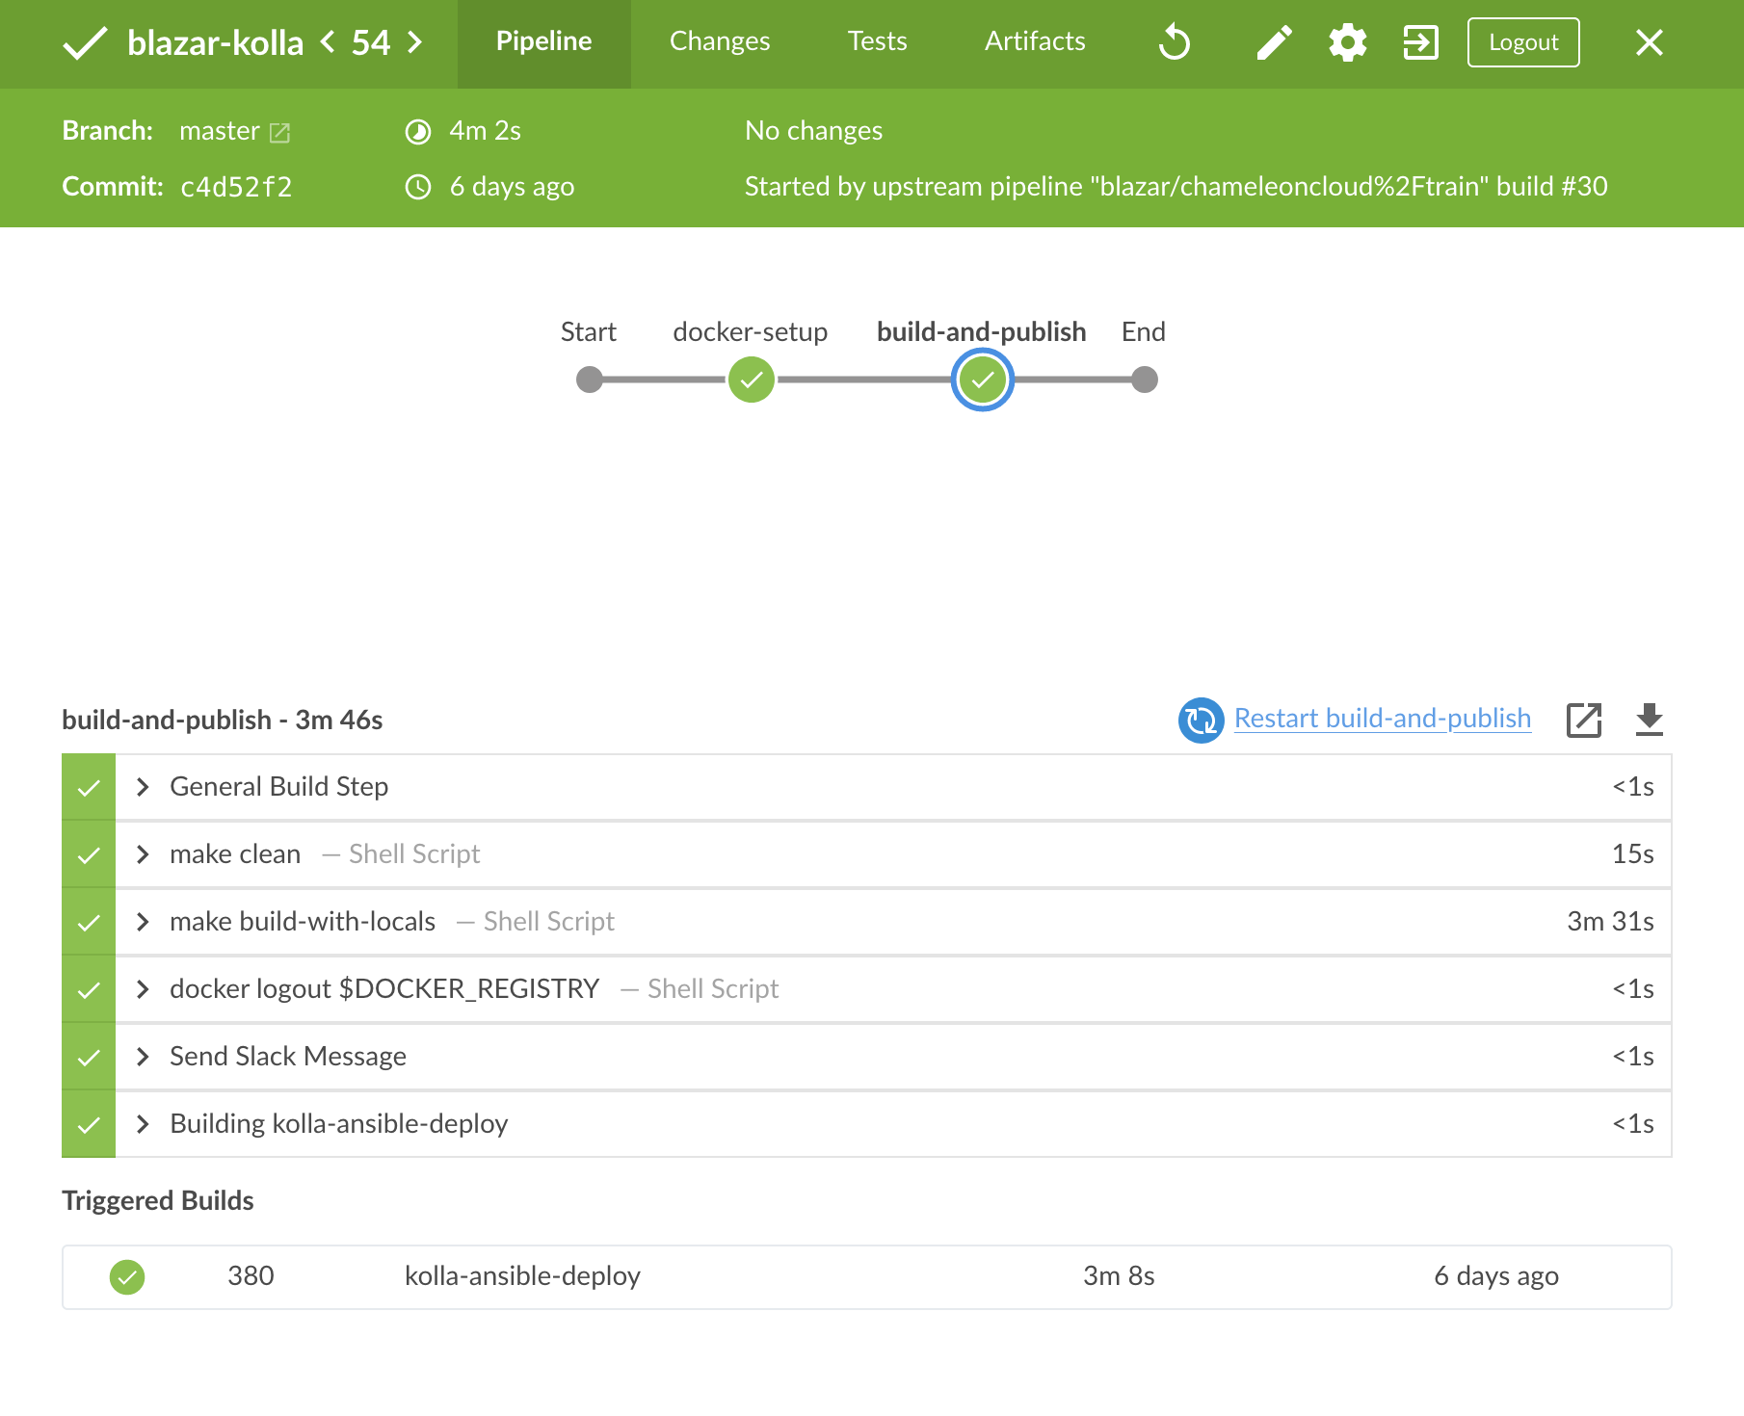
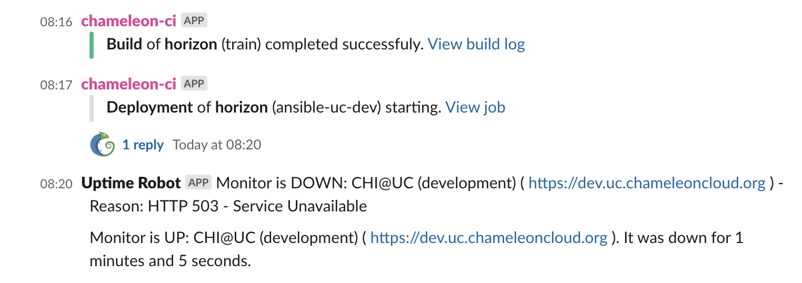

Slide 19
Supply chain security
Chameleon is looking to expand to more host institutions, to create a wider federated cloud testbed for CISE.
  Each site is designed to operate independently, with its own control plane. No one site can impact another’s availability.
  User accounts and allocations are centrally managed and vetted by Chameleon.
  We have control of the Docker images we publish. Docker Content Trust (DCT) can improve confidence consumers have right image.
  We have a thin set of guidance around Chameleon’s distinct security posture and what mitigations are recommended at the host institution.
Do we give operators sole control (and responsibility) of applying upgrades? Or do we allow the Chameleon team to trigger upgrades to infrastructure remotely?
  If the latter, how do we ensure this is done securely, with audit trails, revocation, etc.

Slide 20

We’re here to change!
chameleoncloud.org

