Slide 1
CMSUK Interests in
Triggering and Reconstruction
Claire Shepherd-Themistocleous (RAL)
for CMSUK

Slide 2
ECHEP Triggering - CMS interests
CMSUK extensive involvement in trigger; in current trigger and for Phase II upgrade.
Interests relevant to ECHEP on using FPGAs and GPUs to execute algorithms.
Phase II upgrade work on Tracker, HGCAL, ECAL and L1 trigger. Work on algorithms in FPGAs in all cases
Headline areas of interest: Real time data processing and accelerated computing using heterogeneous systems.

Slide 3
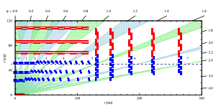
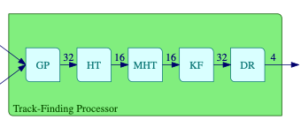
Track reconstruction example
Upgraded Si tracker will enable track reconstruction for use in the L1 trigger.
Tracks reconstructed from stubs in backend FPGAs
Algorithm sequence implemented in
one VU9P.

Slide 4
Track reconstruction
Track reconstruction algorithm uses Hough Transform and Kalman Filter
Implemented in firmware (VHDL)
Components implemented in HLS
New algorithm largely implemented in HLS
Growing experience of HLS.
  Works well for algorithms that progress linearly
  Does not work well for data routing
  C++ has to be carefully written
  Various C++ technical elements not available (yet?)
Comparisons of KF only part in FPGAs and GPUs
Tracking a significant CMS interest

Slide 5
Algorithms
Variety of algorithms developed to perform vertex finding, jet reconstruction at L1. Includes some neural net implementations
Use of HLS to evaluate individual algorithm deployment in FPGAs.
Exploration of more complex event selection in FPGAs
Extensive experience of real time algorithms and deployment in FPGAs
Develop this experience to explore accelerated computing possibilities using FGPAs.
Interest in abstraction layers that allow straightforward deployment for users in heterogenous systems.

Slide 6
CMS UK interests
How can complex event processing in real time reduce offline and possibly HLT computing requirements?
How can different computing architectures be exploited to provide required computing capability?
Comparison of algorithm performance in CPUs, FPGAs and GPUs.
Exploitation of FPGAs for real time processing applications.
Development of use of heterogenous computing systems.
Interfaces to enable straightforward exploitation of accelerated computing options.

