Slide 1
MTF studies
A.G. 29.04.2020
Topics:
MTF with standard methods in comparision with the theory
MTF with speckles in comparision with the theory
Based on Stefanos studies:
  Theoretical MTF of a defocused system
  YAG thickness optimisation

Slide 2

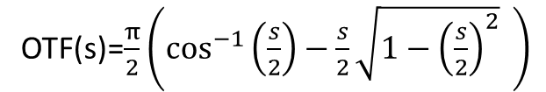

The frequency response function of a perfectly focused system
$$s=\frac{λq}{NA}$$
OTF(s)=$\frac{π}{2}\left(\cos^{−1}\left(\frac{s}{2}\right)−\frac{s}{2}\sqrt{1−{\left(\frac{s}{2}\right)}^{2}} \right)$
cutoff frequency
$$q_{cutoff}=\frac{2NA}{λ}$$

Slide 3
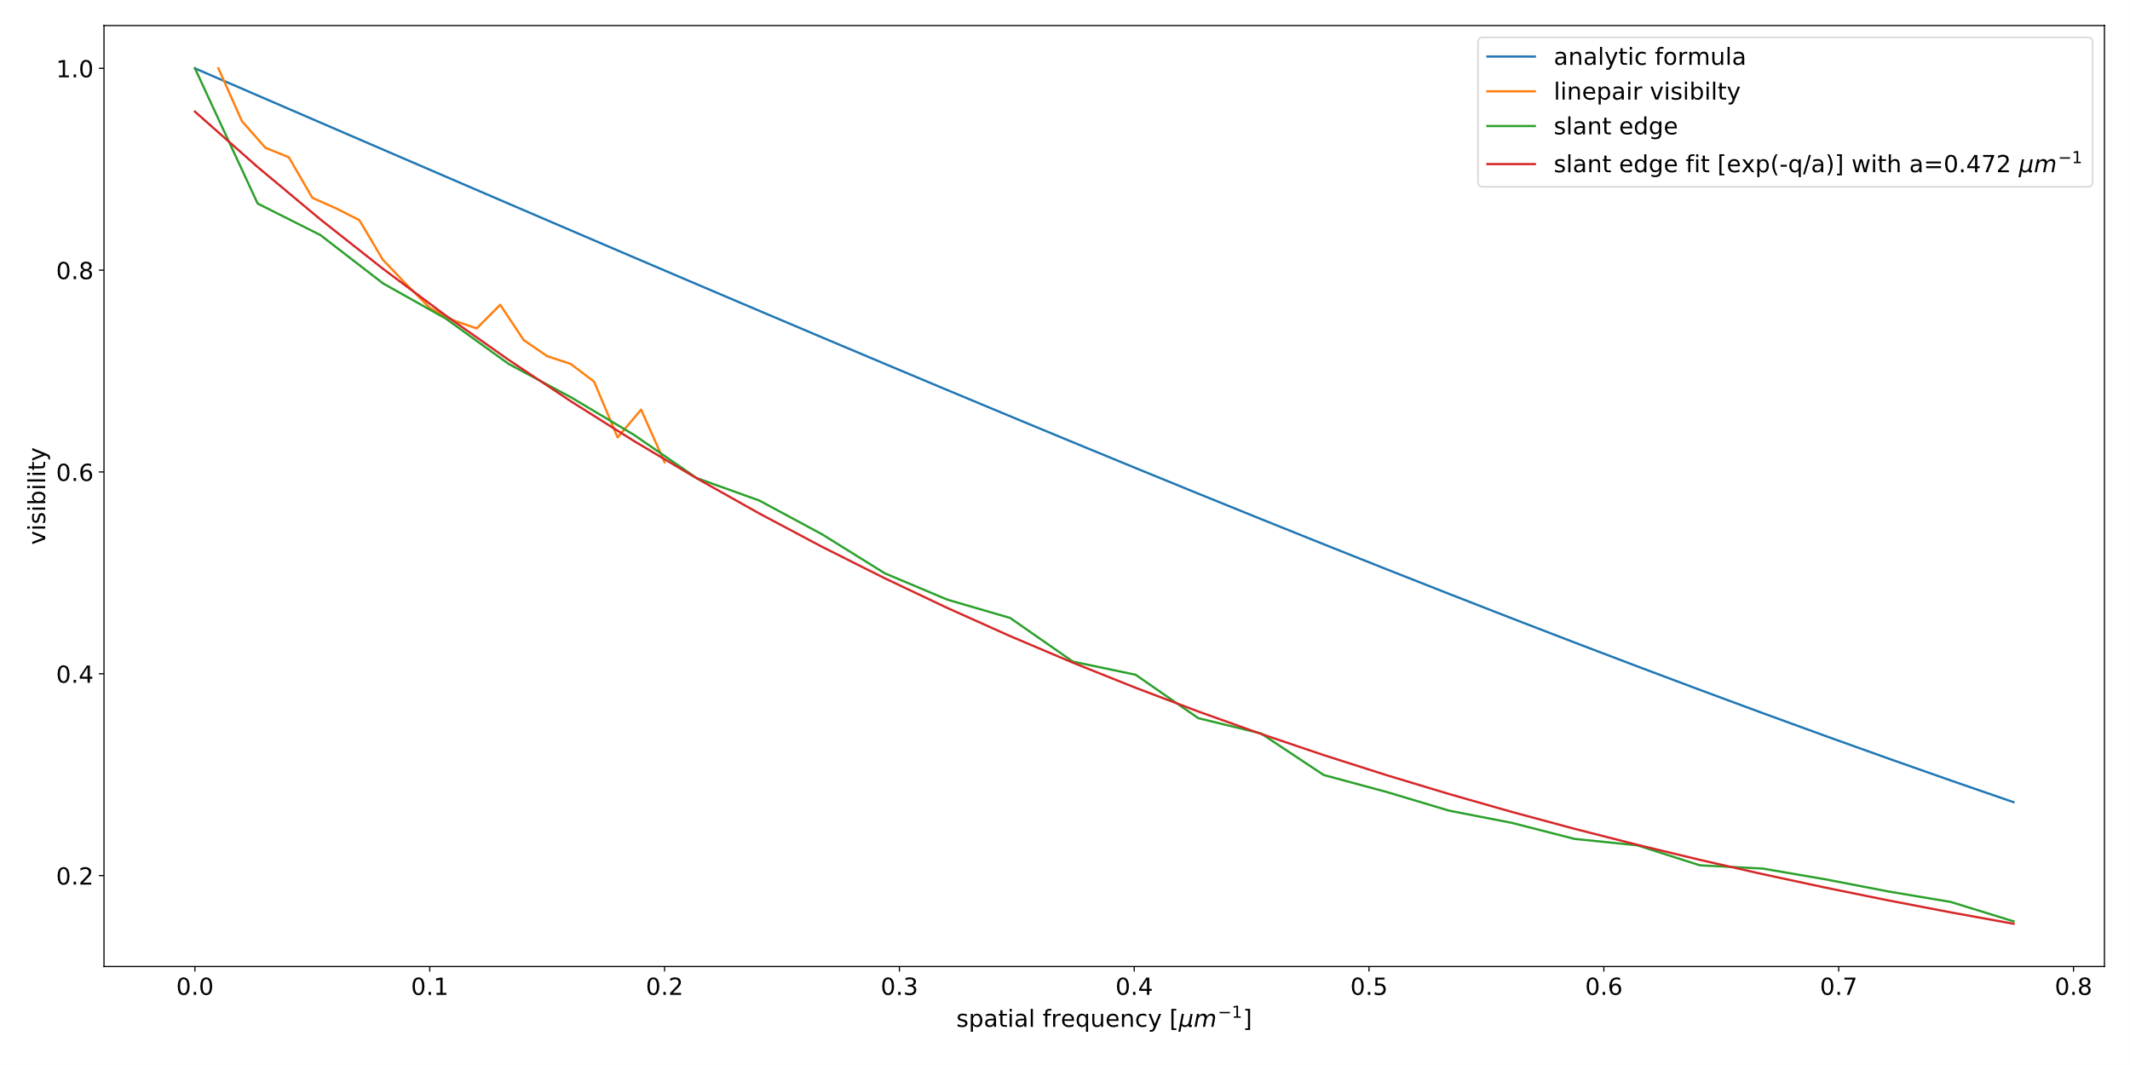
Comparison of standard tests of the MTF with the analytic approach
For a 20x, NA=0.4 objective on a 1236x1626 pixels with 5.4mmx7.2mm at wavelength of 632nm
cutoff at q=1.26 µm^-1

Slide 4
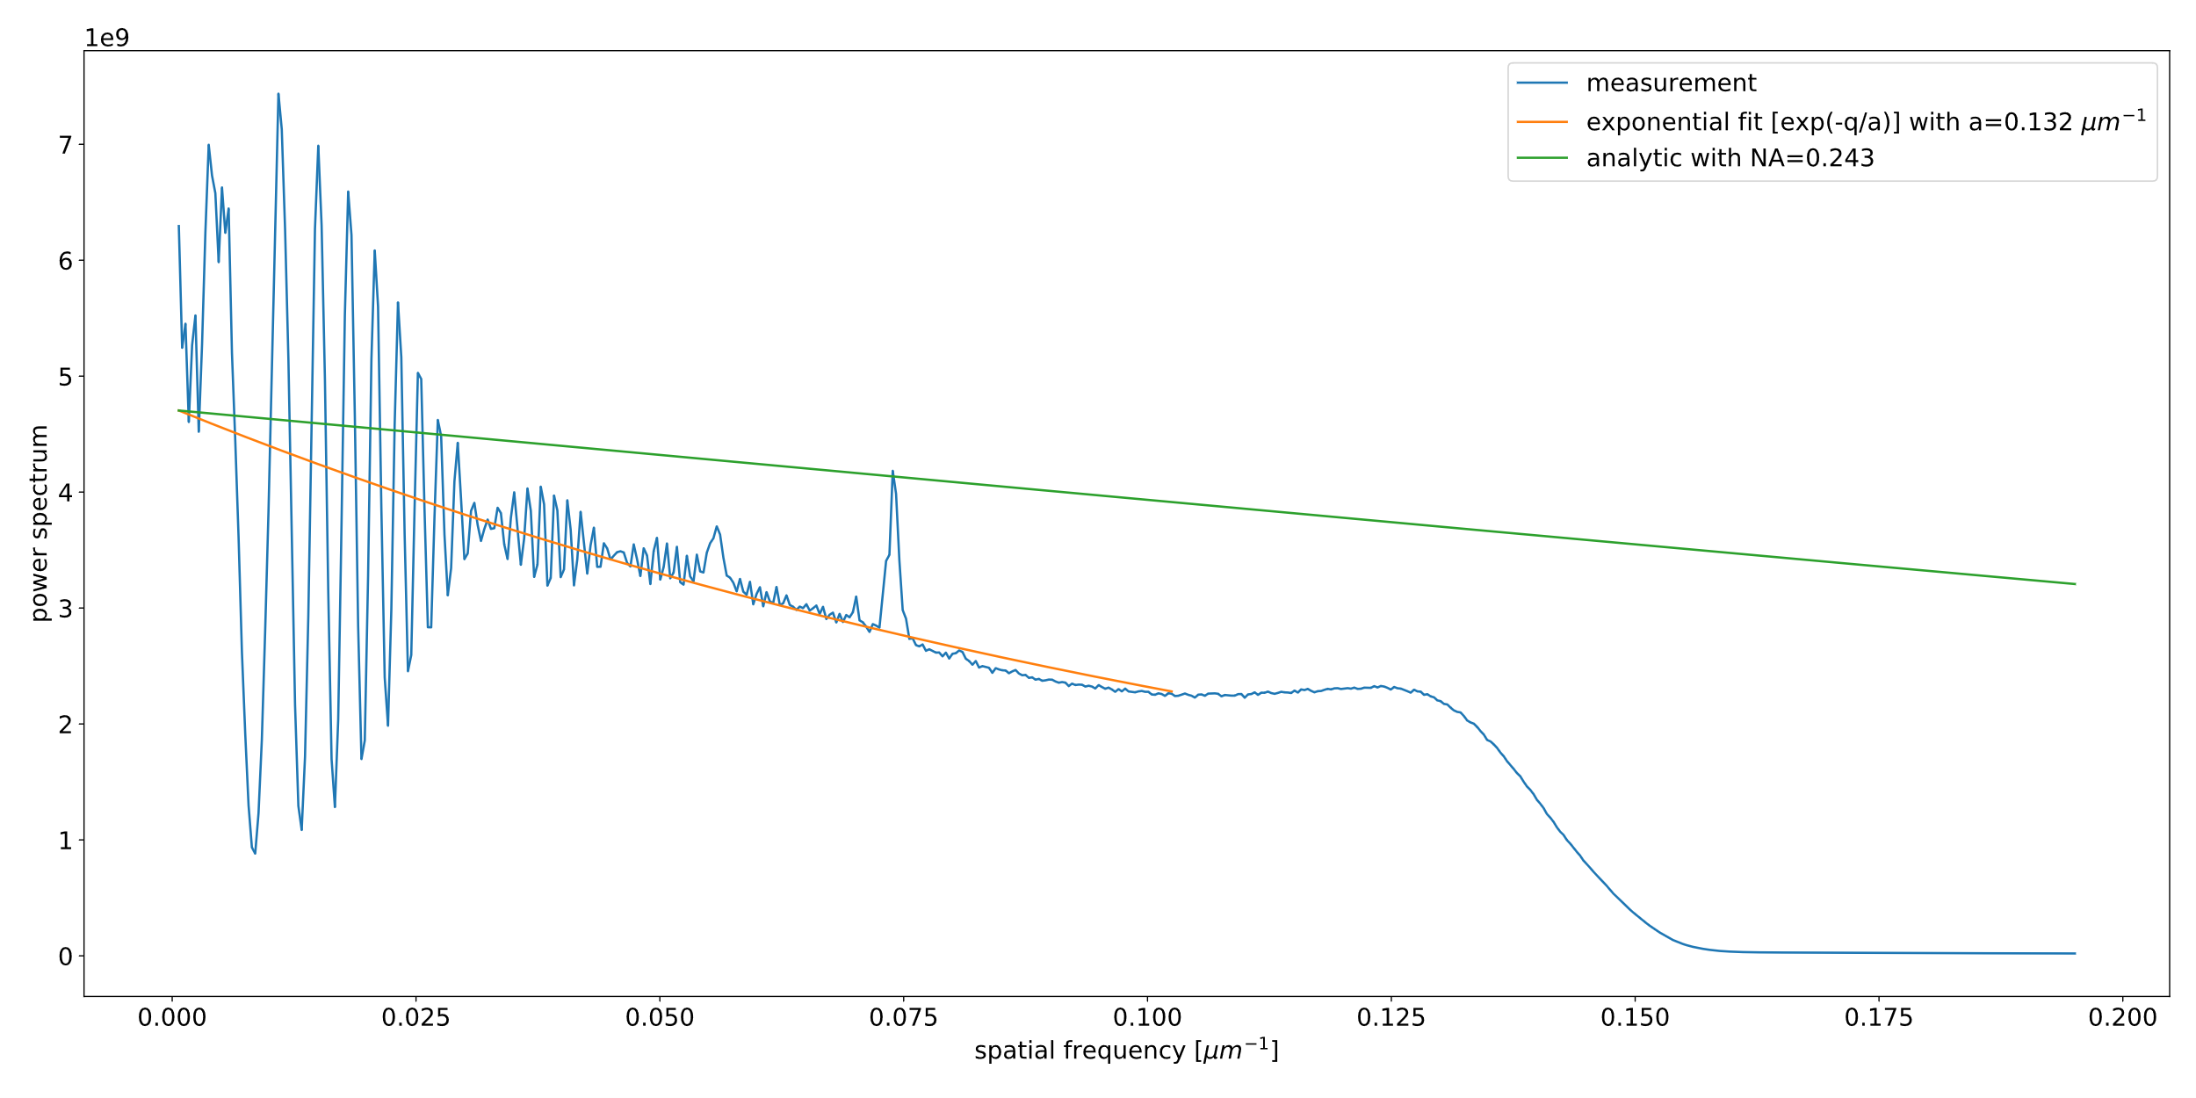
Comparison of the speckles MTF with the analytic approach
For a 2.6x, NA=0.236 lens on a 1236x1626 pixels with 5.4mmx7.2mm at wavelength of 632nm
Colloids diameter=1µm, distance 10mm

Slide 5




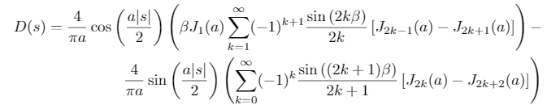

The response of a defocused aberration-free optical system
H.H Hopkins (1955)
https://doi.org/10.1098/rspa.1955.0158
ζ … defect of focus
δz … thickness of YAG
NA … numerical aperture
n … refractive index
λ … working wavelength
q … spatial frequency

Slide 6
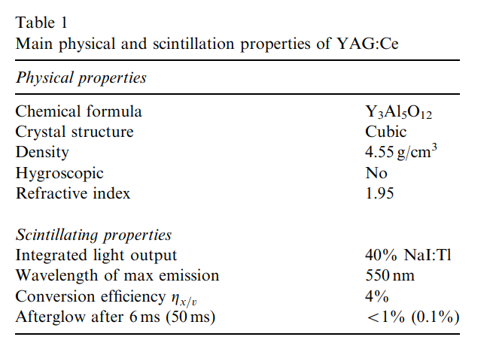
Main physical and scintillation properties of YAG:Ce
M. Stampanoni et al. (2002)
https://doi.org/10.1016/S0168-9002(02)01167-1

Slide 7
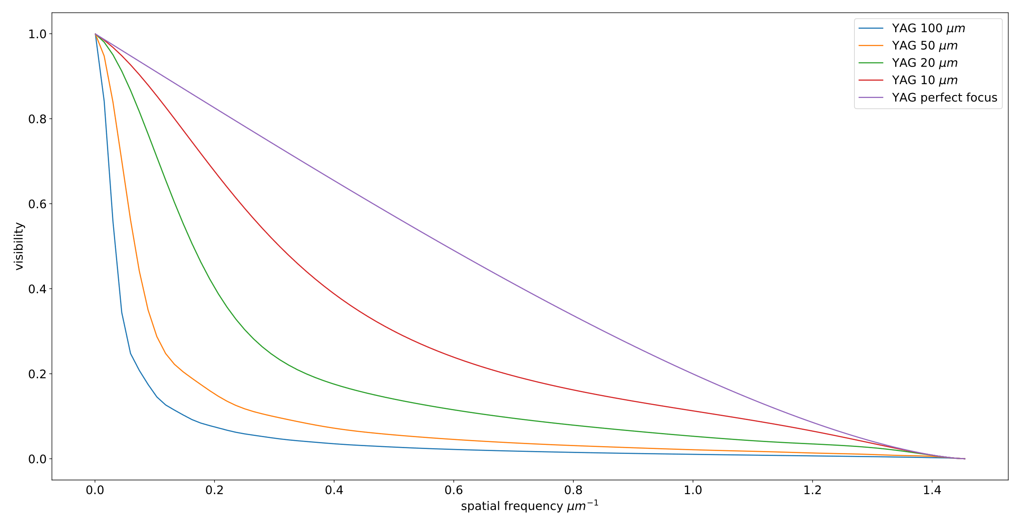
OTF for NA=0.4, λ=550nm, n=1.95, different δz

Slide 8
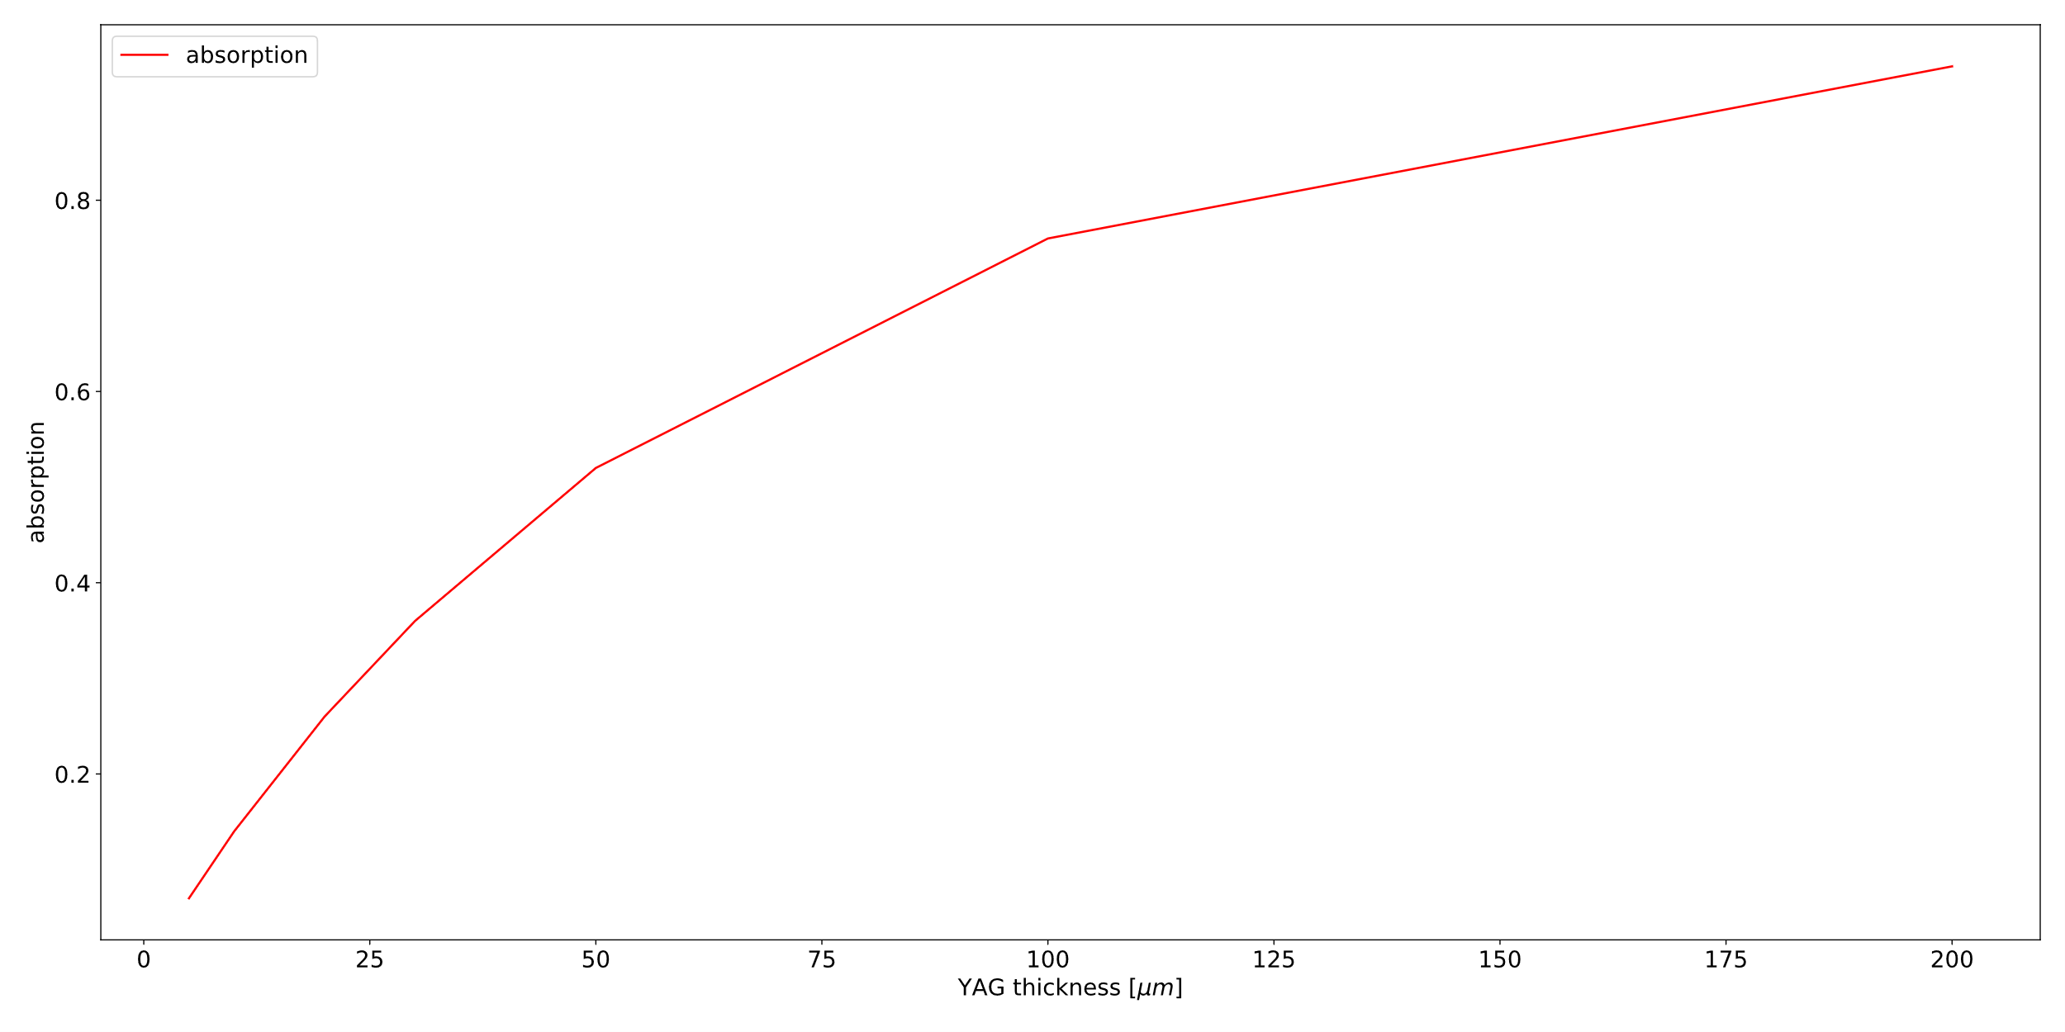
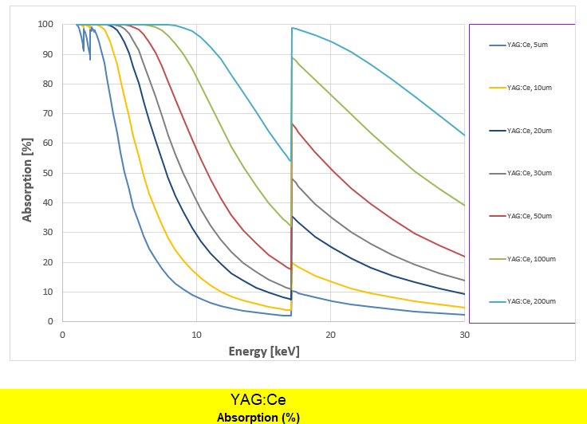
Absorption (conversion) of the YAG:Ce
Absorption depending on the energy for different YAG thicknesses
Absorption depending on the thickness of the YAG for 20keV

Slide 9
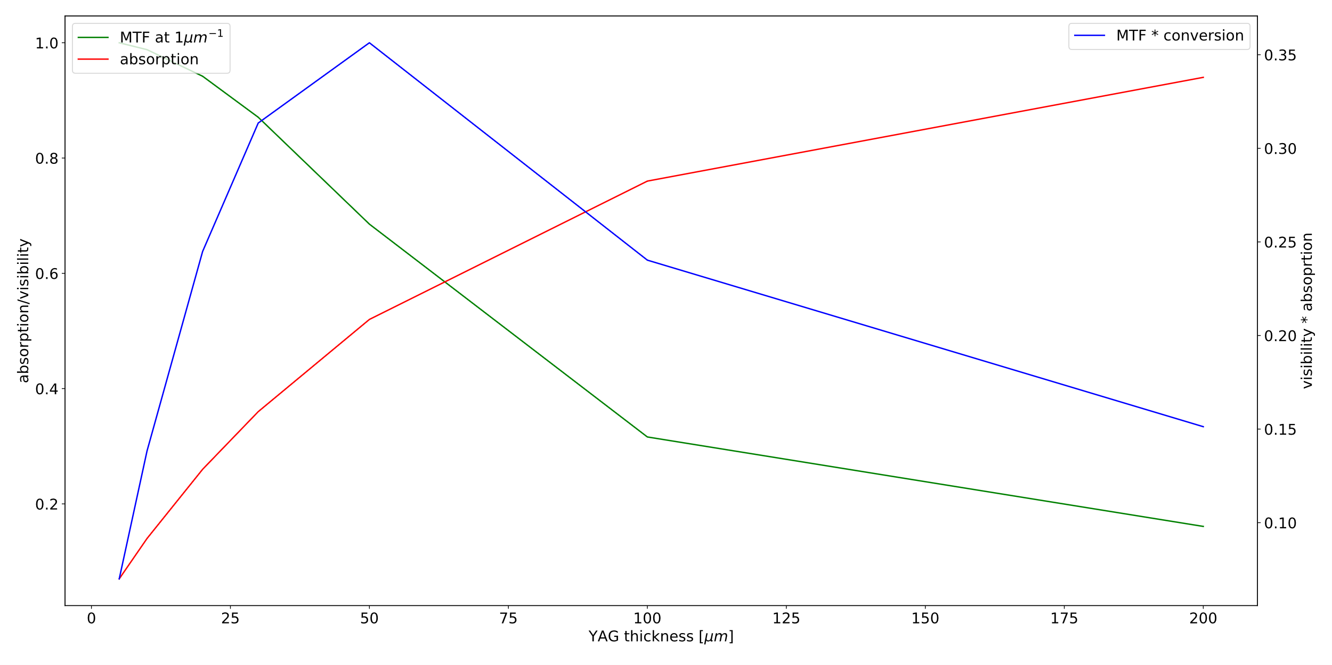
Relation between the advantages of a thicker YAG because of more conversion versus the advantages of a thinner YAG because of a better OTF
Best tradeoff for q=1µm^-1 is a 50µm YAG

